Slide 1

The United States of America
Ryan Safner
Country Profile ECON 317

Slide 2
Historical Overview
A former British Colony
Independence July 4, 1776 – American Revolutionary War
Established a constitutional presidential federal republic
U.S. Constitution 1789
Civil War 1861-1865 between Union and Confederate States of America
Key roles in WWI and WWII
Cold War vs Soviet Union
Dominant power in latter 20th Century

Slide 3
Demographics¹
Population (2018): 327,167,434 (0.619% growth)
HDI (2017)²: 0.924 (13th)
Life Expectancy (2018): 78 years
Happiness³: 6.9/10
Poverty (% less than $1.90/day): 1.2% (2018)
Gini (2016): 41.5
1 All data (except as otherwise noted) from World Bank Development Indicators
^{2 U.N. HDI}
^{3 U.N. World Happiness Report}

Slide 4
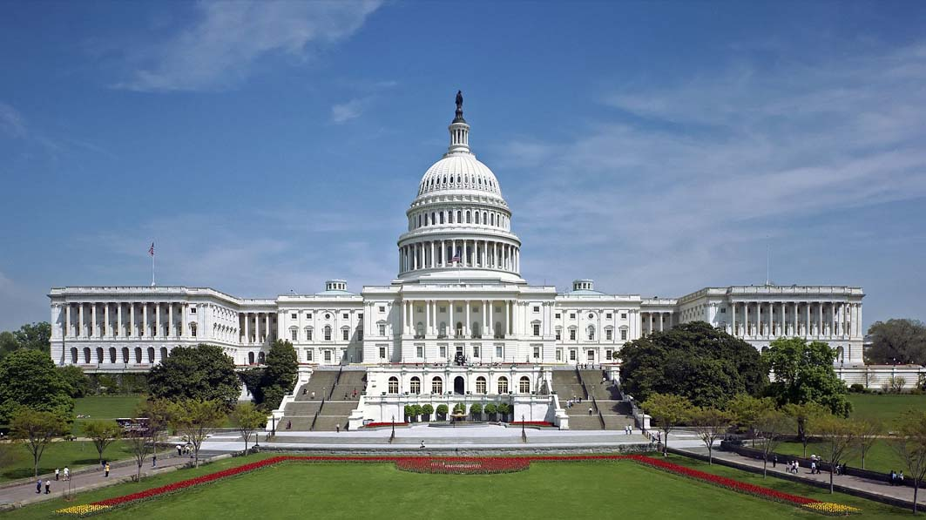
Institutions & Culture
Religions¹:
No official religion
73% Christian, 21.3% Unaffiliated, 2.1% Jewish, 0.8% Muslim, 2.9% Other
Languages
No official language (at Federal level)
English
Common Law legal system
Polity IV²: 10/10
Political Freedom (Freedom House)³: 86/100 – Free
Economic Freedom (Fraser, 2017)⁴: 8.19/10 (5th)
Corruption (2018)⁵: 71/100 (22nd)
Rule of Law Score⁶: 0.71/1.00 (20th)
^{1 Gallup}
^{2 Polity IV} ^{3 Freedom House}
^{4 Fraser Institute}
5 Transparency International: CPI
^{6 World Justice Project}

Slide 5
Economy¹
Macroeconomy
GDP per capita: $62,641 (2018) (2.22% growth)
Inflation: 2.44% (2018)
Debt % of GDP: 99% (2016)
Unemployment: 3.87% (2019)
Trade
Trade % of GDP: 27% (2017)
Top Trade: Refined Petroleum ($74.5B), Cars ($56B), Aircraft ($54B)²
Top Trading partners: Mexico, Canada, China, Japan, Germany³
Ease of Doing Business (2020)⁴: 85/100
1 All data (except as otherwise noted) from World Bank Development Indicators 2 Observatory of Economic Complexity
^{3 US Census}
4 World Bank: Ease of Doing Business Score

Slide 6
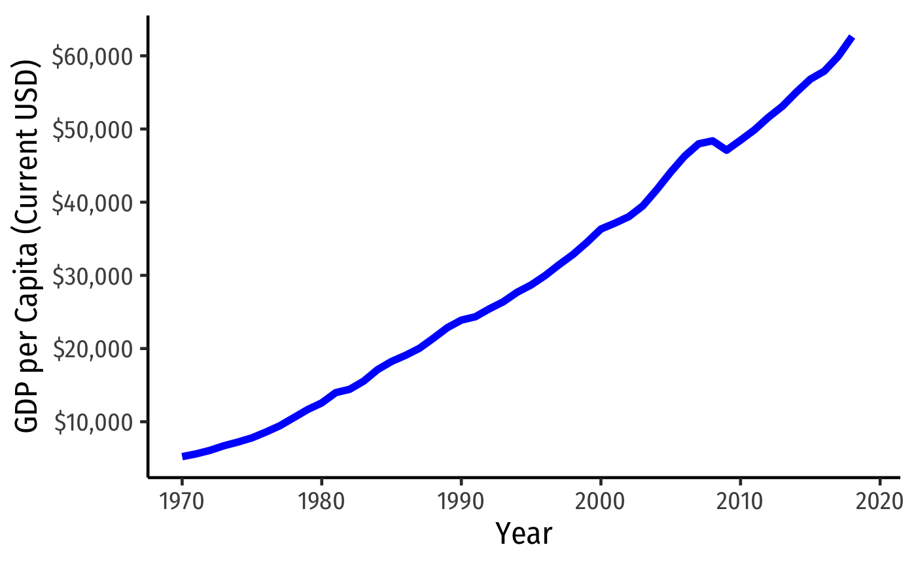

Slide 7
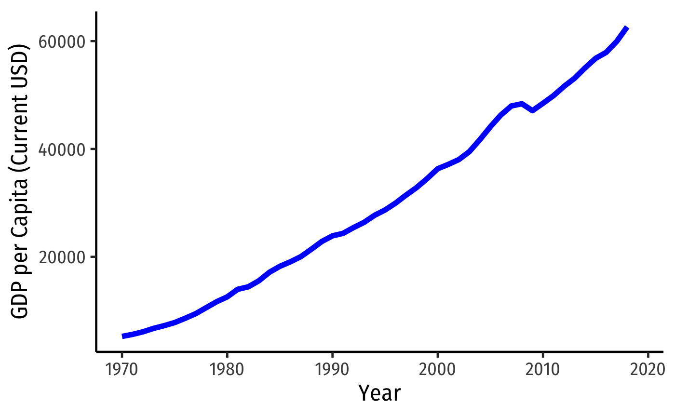
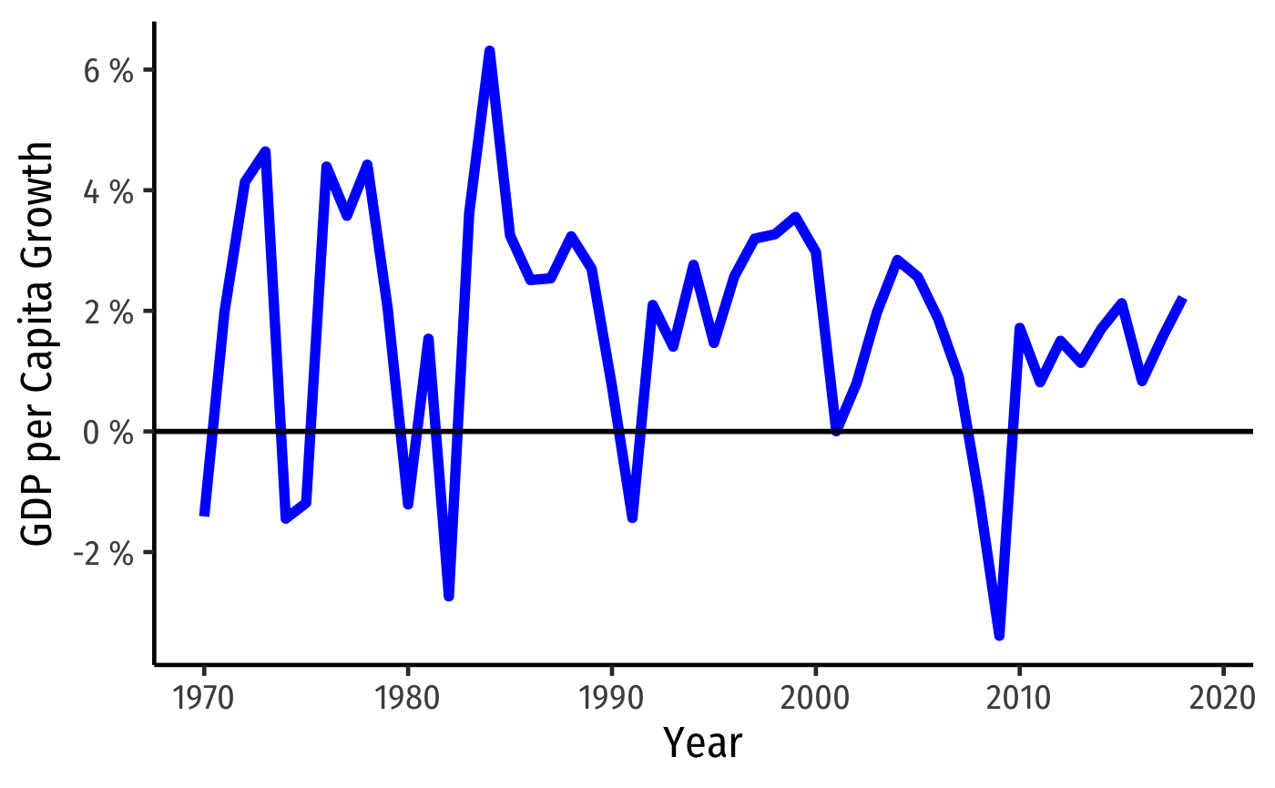

Slide 8
