Slide 1
Egyptian Country Overview
Chase Whitworth
11/17/2020

Slide 2
Essentials
Population: Close to 105 million (14th world)*
Rate of 2.28% (2020)*
Unemployment: 12.2%*
Labor Participation 30 million or 71%*
Impoverish population: 27.8%*
Life Expectancy: 73.7 yrs (140th world)*
Infant Mortality Rate: 17.1 deaths /1000 births (87th World)*
Human Development Index: .7 (116/189 countries) (2018)”
Gini Coefficient: 31.5 (2017)”
Happiness Index: 4.166 (2019)^

Slide 3
Economic Essentials (2017 Data)
Real GDP/ Growth Rate: $236.5 Billion/ 4.2% (2017)*
Real GDP per Capita/ Growth Rate: $12,700/ -1% (2017)*
Inflation: 23.5% (217th World)*
Budget in GDP % : -8.6%*
Debt in GDP % : 103%*
Exchange Rate: 18.05 EGP (Egyptian pounds)/ 1 US Dollar*

Slide 4
Trade Essentials(~)
Top 5 exports by Value
Crude Petroleum ($4.93 Billion)
Refined Petroleum ($1.99 Billion)
Gold ($1.86 Billion)
Nitrogenous Fertilizers ($1.39 Billion)
Petroleum Gas ($1.17 Billion)
Top 5 Trading Partners
Italy
UAE
USA
China
Germany

Slide 5
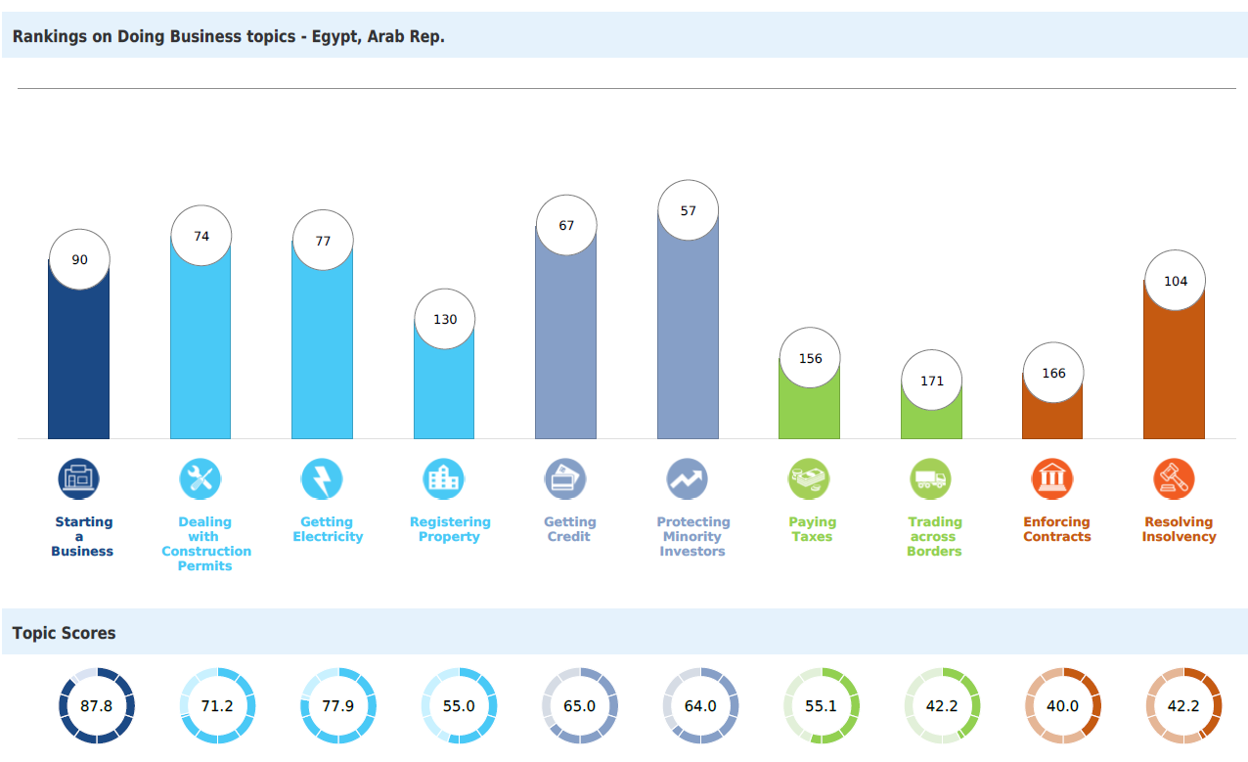
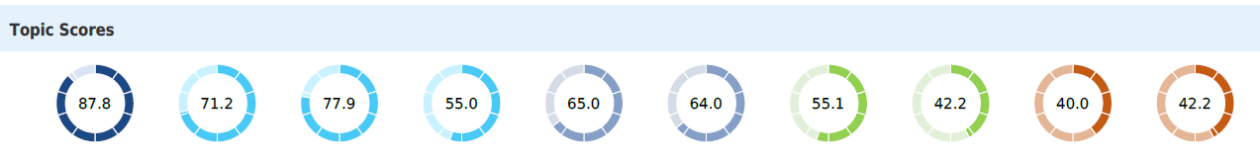
Government Essentials
Trade as % of GDP: 47% or roughly $120 Billion
Doing Business Index: 60.1(“)
Amount of US Aid received: $1.43 Billion(`)
$1.31 Billion or 94% designated as “Peace and Security”

Slide 6
Living Essentials
Polity IV Score: -4 (2015)
Freedom Score: 21 (out of 100)
- Political Rights: 7 (out of 40)
Civil Liberties: 14 (out of 60)
Economic Freedom Score: 5.38 (out of 10)
152nd in the World
Corruption Score: 35 (out of 100)
106th in the World
Rule of Law Score: .36 (out of 1)
125 out of 128 countries measured

Slide 7
References
Egypt (EGY) Exports, Imports, and Trade Partners. (n.d.). Retrieved from https://oec.world/en/profile/country/egy?depthSelector1=HS4Depth&tradeScaleSelector1=tradeScale0 (~)
Egypt - World Happiness Index 2019. (n.d.). Retrieved from https://countryeconomy.com/demography/world-happiness-index/egypt (^)
Explore Economies. (n.d.). Retrieved from https://www.doingbusiness.org/en/data/exploreeconomies/egypt (“)
ForeignAssistance.gov. (n.d.). Retrieved from https://foreignassistance.gov/explore/country/Egypt (`)
The World Factbook: Egypt. (2018, February 01). Retrieved from https://www.cia.gov/library/publications/the-world-factbook/geos/eg.html (*)

