Slide 1
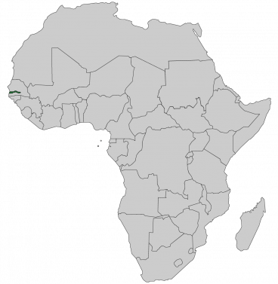
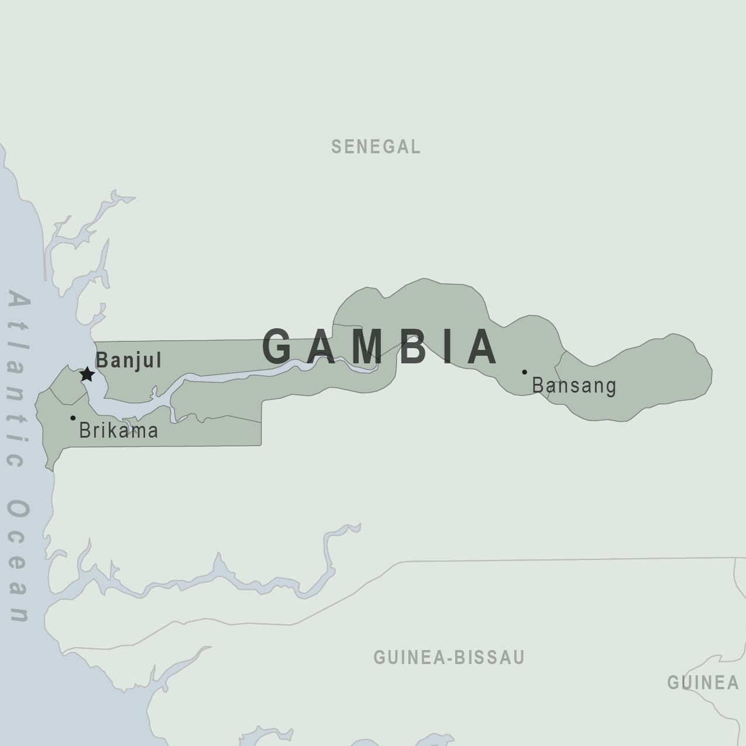
COUNTRY PROFILE:
THE GAMBIA
Sainabou Jallow
ECON 324: International Trade
Hood College, Fall 2020

Slide 2
Table of Contents
Background
Demographics
Equality
Health Data
Institutions
Macroeconomic Data
Trade and Economy

Slide 3
BACKGROUND
Smallest country on mainland Africa
Surrounded on three sides by Senegal and on one by the Atlantic ocean
Colonized by the British until gaining independence in 1964
Led by President Jawarah from 1965 to 1994
Jawarah was overthrown by a military coup in 1994 led by Jammeh
Jammeh president from 1994 to 2016
Increasingly authoritarian
Jammeh loses free and fair election in 2016 to Barrow
Barrow is current president
Potential for democratic backsliding
Country relies on agriculture and tourism and remittances
1

Slide 4
DEMOGRAPHICS
Population (July 2020 est.) | Population Growth (2020 est.) | Median Age (2020 est.)
2,173,999 | 1.87% | 21.8
2
Source: CIA World Factbook

Slide 5
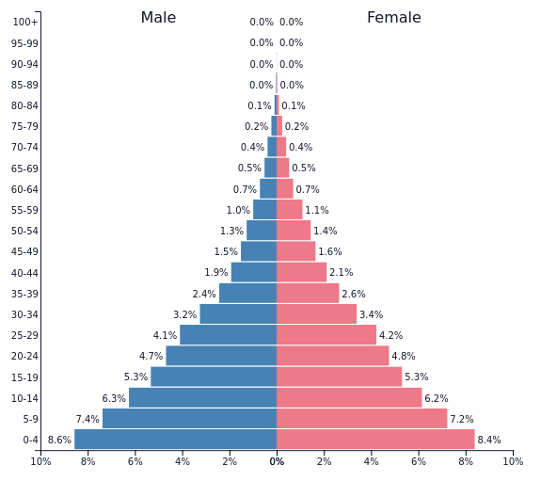
DEMOGRAPHICS
2
Source: Population Pyramids

Slide 6
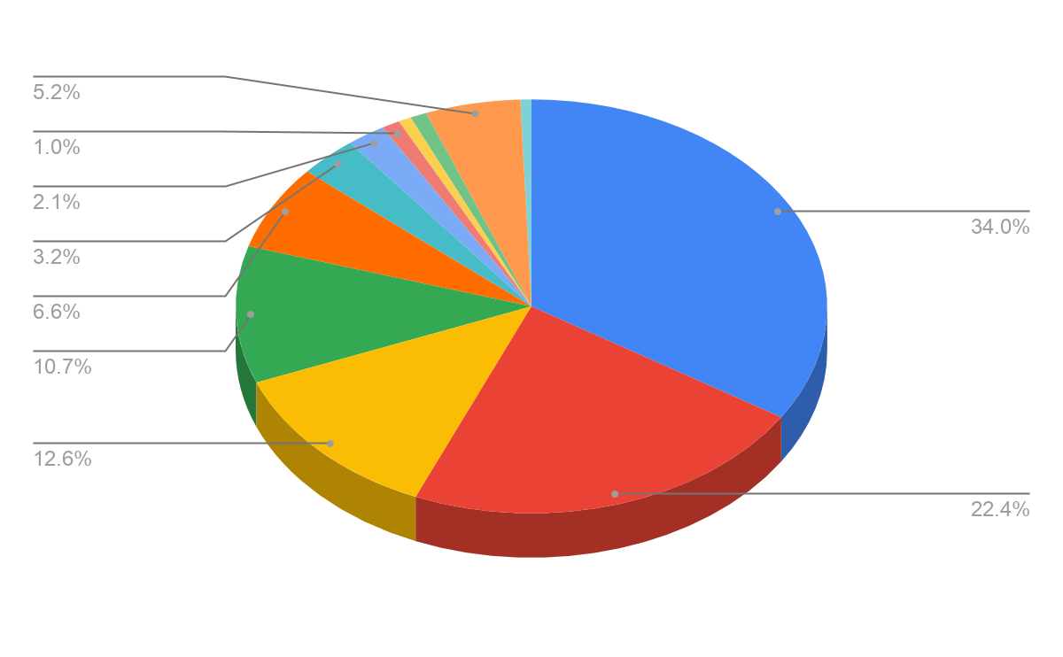
DEMOGRAPHICS
ETHNICITY
2
Source: CIA World Factbook

Slide 7
EQUALITY
% Population Below International Poverty Line ($1.90/day) (2015) | % Population Living in Urban Areas (2020) | Literacy Rate (2015)
10.1% | 62.6% | 50.8% *61.8% male *46.1% female
3
Source: CIA World Factbook

Slide 8
EQUALITY
Human Development Index Value (2018) | Gini Coefficient (2015) | Happiness Index Score (2020)
0.466 Low human dev. 174th/189 | 35.9 | 4.751 or 113/153
3
Sources: Human Development Index, Gini Coefficient, Happiness Index Score

Slide 9
HEALTH DATA
Life Expectancy at Birth | Infant Mortality Rate | Leading Causes of Death
65.8 years | 54.9/1,000 | Acute Respiratory Infection (13.7%) Malaria (12.9%) Pulmonary Tuberculosis (10.2%)
4
Source: CIA World Factbook,

Slide 10
INSTITUTIONS
Polity IV Score (2018) | Freedom House Score (2020) | Economic Freedom Score (2018) | Corruption Perceptions Index (2019) | Rule of Law Index Score (2020)
4 (Open Anocracy) | 46 (Partly Free) | 7.14 (2nd Quartile) | 37/100 or 93rd/198 | 0.50 or 74/128
5
Sources: Polity IV Score, Freedom House Score, Economic Freedom Score, Corruption Perceptions Index, Rule of Law Index Score

Slide 11
MACROECONOMIC DATA
Real GDP and Growth Rate (2019) | Real GDP/capita and Growth Rate (2019) | Unemployment Rate (2019) | Labor Force Participation Rate (2019) | Inflation Rate (2019)
$1.764 B 2.475% | $2,298.38 2.924% | 8.9% | 59.4% | 7.12%
6
Source: CIA World Factbook,

Slide 12
MACROECONOMIC DATA
Budget Deficit as % GDP | Debt as % GDP | Currency Exchange Rate for 1 USD
-1.7% | 86.57% | 51.75 Gambian Dalasis
6
Source: CIA World Factbook,

Slide 13
TRADE AND ECONOMY
Top 5 Exports by Value | Top 5 Trading Partners
Coconuts, Brazil Nuts, and Cashews ($36.5M) Rough Wood ($15M) Non-fillet Frozen Fish ($9.74M) Scrap Iron ($4.94M) Sawn Wood ($4.45M) | India ($44.3M) China ($19.9M) South Korea ($9.87M) Senegal ($8.17M) Belgium-Luxembourg ($5.32M).
7
Source: OEC

Slide 14
TRADE AND ECONOMY
Top 5 Imports by Value | Top 5 Trading Partners
Refined Petroleum ($271M) Light Pure Woven Cotton ($186M) Rice ($77M) Palm Oil ($56M) Raw Sugar ($54.9M). | China ($440M) Cote d'Ivoire ($277M) India ($150M) Senegal ($100M) Brazil ($89.8M).
7
Source: OEC

Slide 15
TRADE AND ECONOMY
Trade as % of GDP | Doing Business Index Score | US Foreign Aid Received
Exports: 21.85% Imports: 41.51% | 50.3 | $2,154,550
7
Source: OEC, US Foreign Assistance

Slide 16
COUNTRY PROFILE:
THE GAMBIA
Sainabou Jallow
ECON 324: International Trade
Hood College, Fall 2020

