Slide 1
Current Research
How can deep learning optimize
procedural content generation (PCG)?
Exploration of generative deep learning

Slide 2
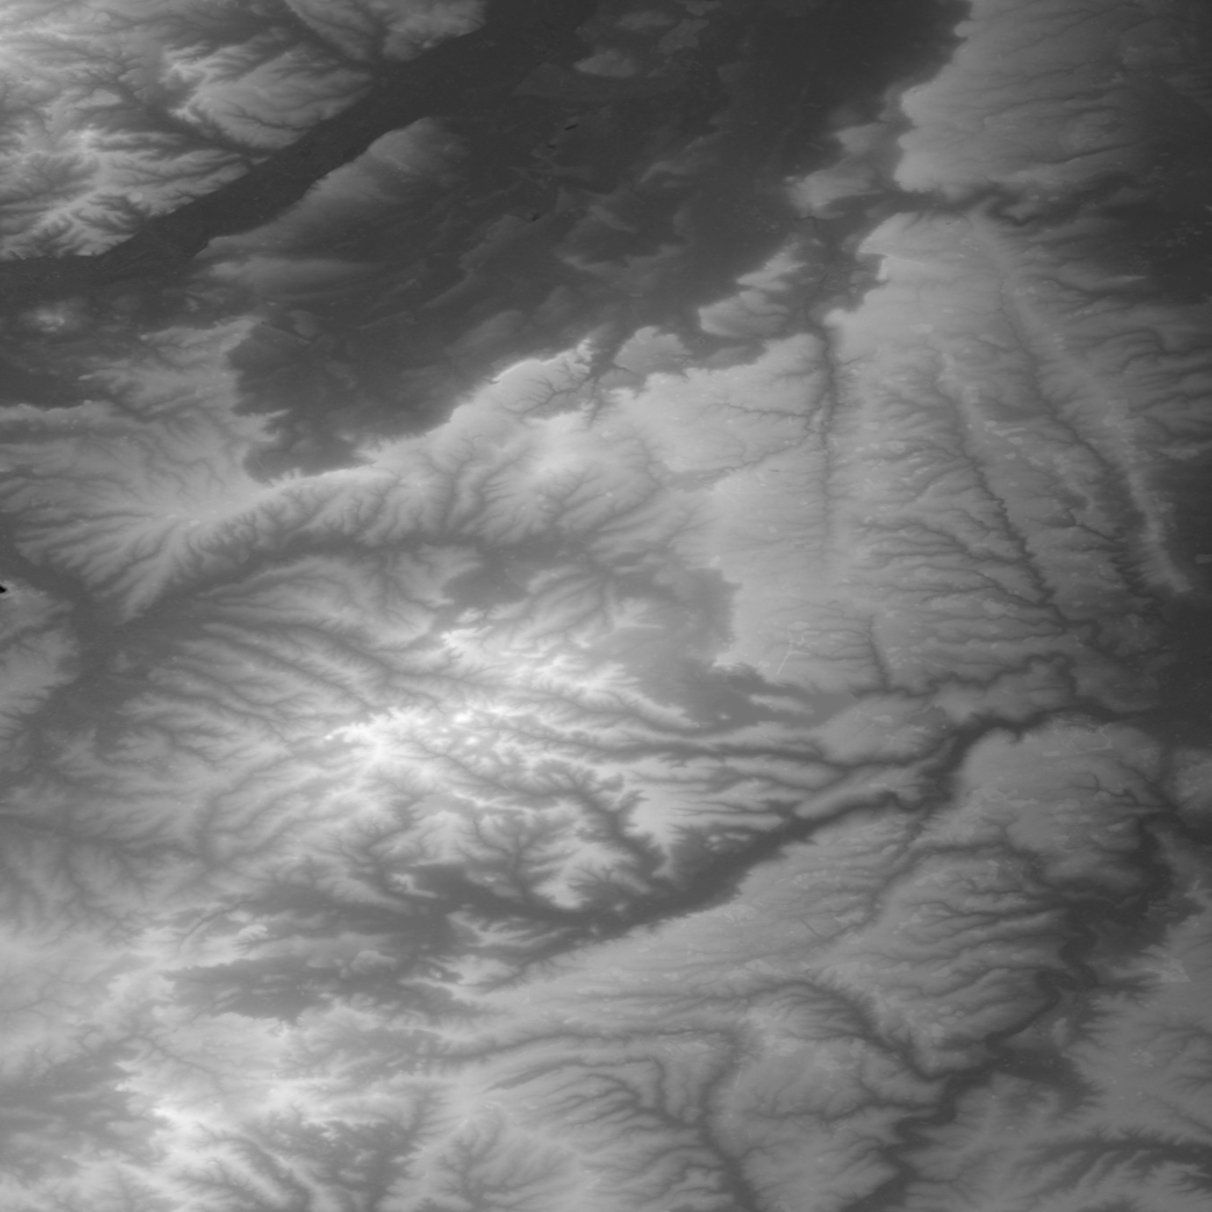
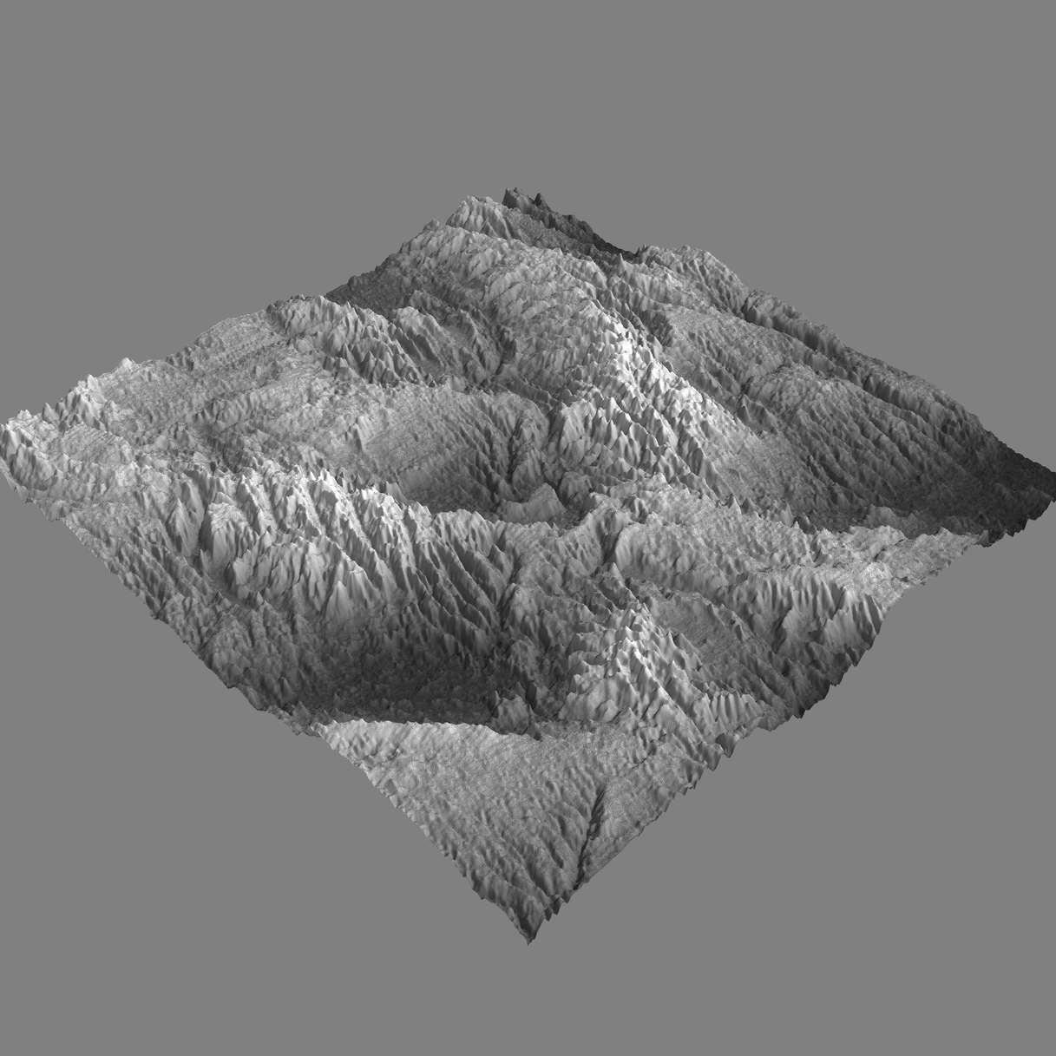
Elevation data
Novel game terrain generation
Learns features of real-world terrain elevation
Results published in COG

Slide 3
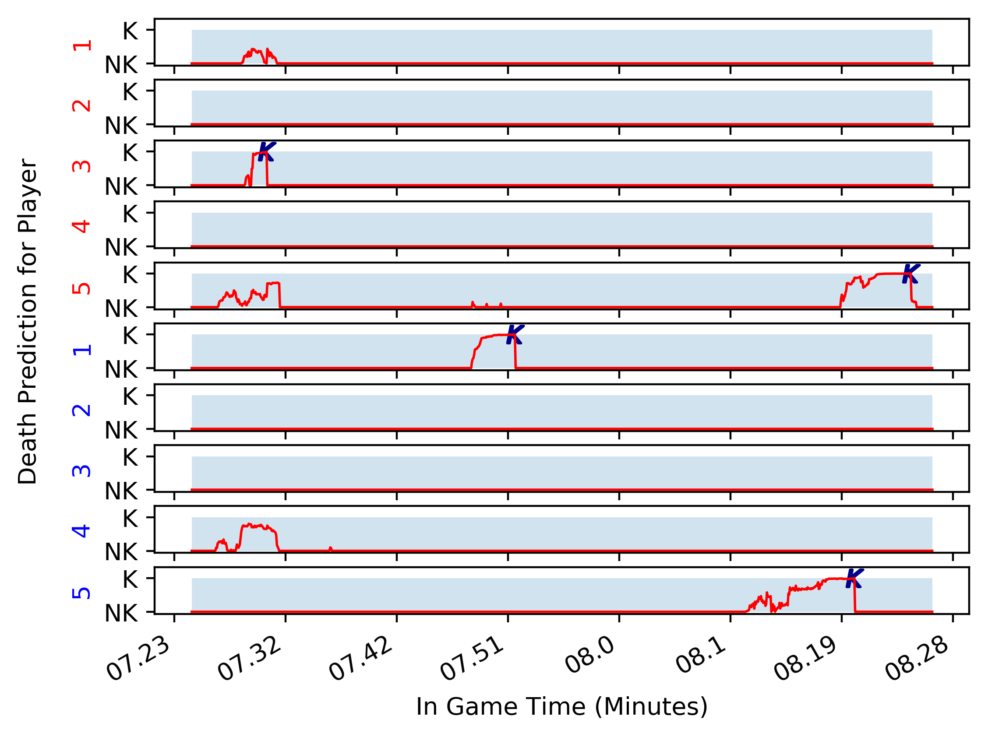
DOTA 2 Death Prediction
Side project with Adam Katona
Huge data set
Prediction of who dies next
Results published in COG

Slide 4
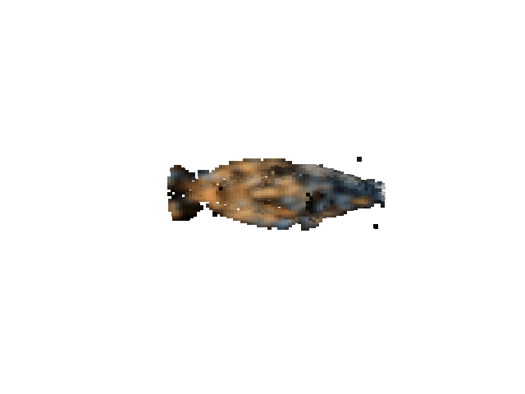
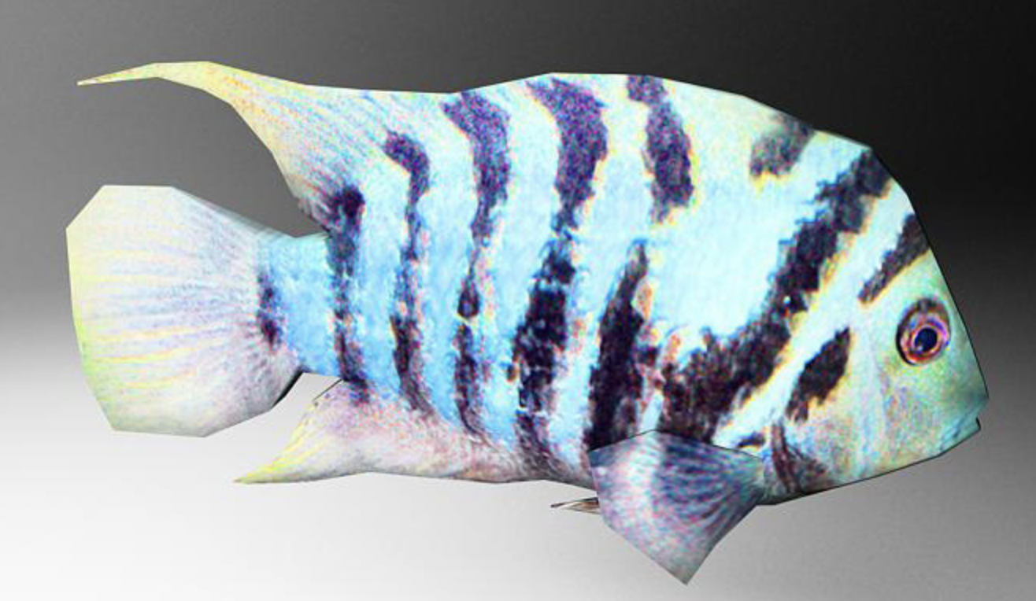
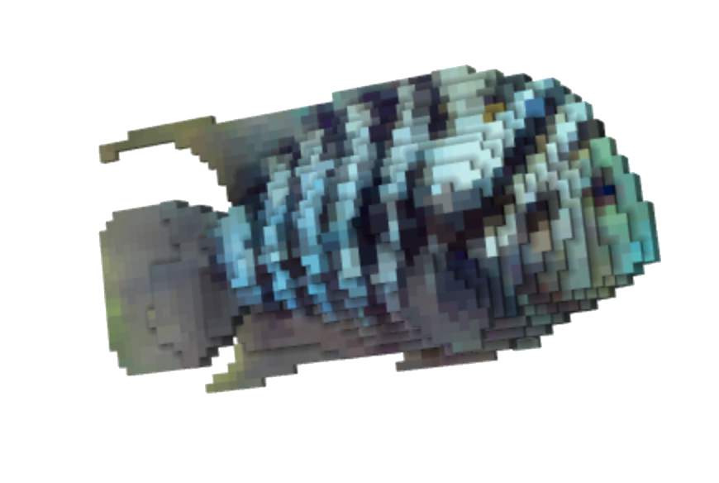
3D Models
Model (.Obj) -> Voxel -> GAN -> Voxel -> (Back to Model?)\
Current project/exploration
Automate design process

