Slide 1

Commissioner Scenario 3.3
Commissioning: Access to Quality Standards
Stuart is leading the commissioning of adult care within a CCG. He is interested in outcomes that could be specified for local diabetes care and guidance on how to monitor the quality of commissioned services.
Stuart has looked at national benchmarking statistics for diabetes .
He has reviewed his area’s performance compared to his neighbouring areas and to others with a similar demographic.
He notes that some areas are doing better than his.
He looks at internal documents to review what services are currently being commissioned for diabetes in his area
He turns to NICE for guidance.

Slide 2
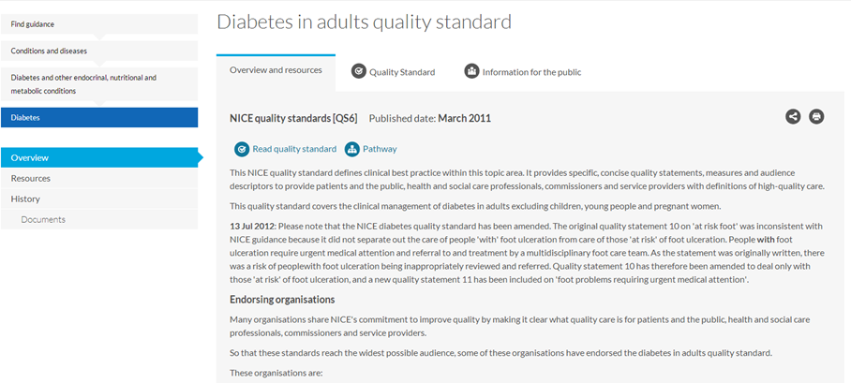
Question: what are the key areas we need to focus on to improve outcomes for diabetes in our area? The home page for the Quality Standard starts with an overview
Overview is shown initially
Notes:
It says that quality standards provide specific, concise quality statements, measures and audience descriptors to provide – amongst others – commissioners with definitions of high-quality care – in other words “ what does good look like”. Good this shouldn’t take long.

Slide 3
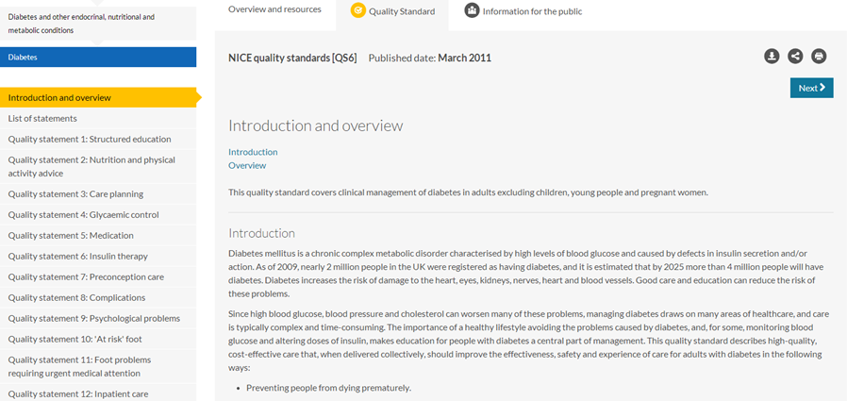
Question: which are the key areas? He follows the link to the main quality standard
Introduction and overview of diabetes
Individual Quality statements listed in side menu
Notes:
This is an overview. I know all about diabetes and what a problem it is. I want to get to the key areas. These must be them on the left. I can see at a glance that there are 14 of them. Lets look at the first one

Slide 4
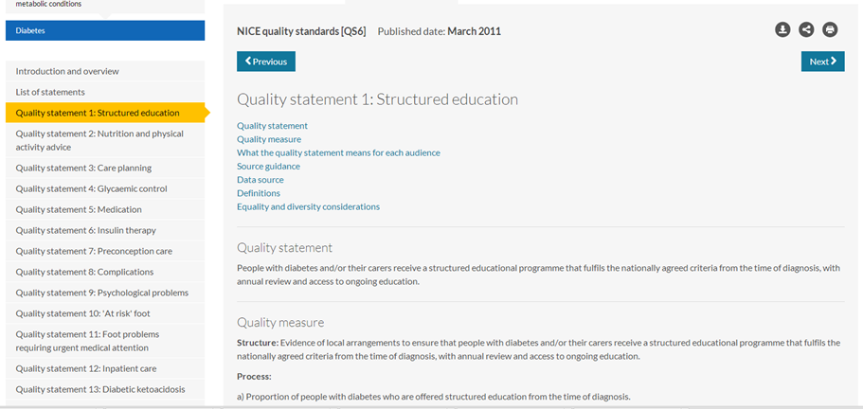
Question: What specifically should we be doing in each key area?
Link to audience relevance
Quality Statement
Notes:
OK, I can see the basic quality statement. It is very generic. What am I supposed to do about it? I see that there is a link for what it means for each audience.

Slide 5
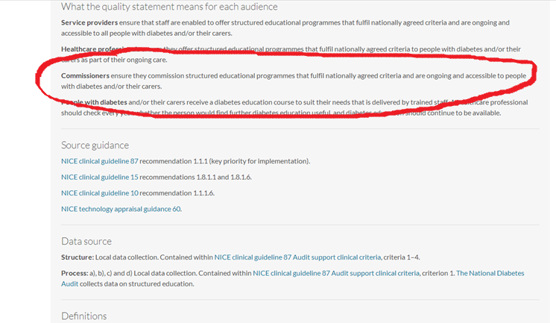
Question: What should I as a commissioner specifically be doing to address this quality statement?
Commissioners ensure they commission structured educational programmes that fulfil nationally agreed criteria and are ongoing and accessible to people with diabetes and/or their carers.
Notes:
Nationally agreed criteria? We have some education programmes but how do I find out what these criteria are and if our programme fulfils them? Perhaps it says in the source guidance they list below. I’ll start with the top one. Clinical Guideline 87 recommendation 1.1.1

Slide 6
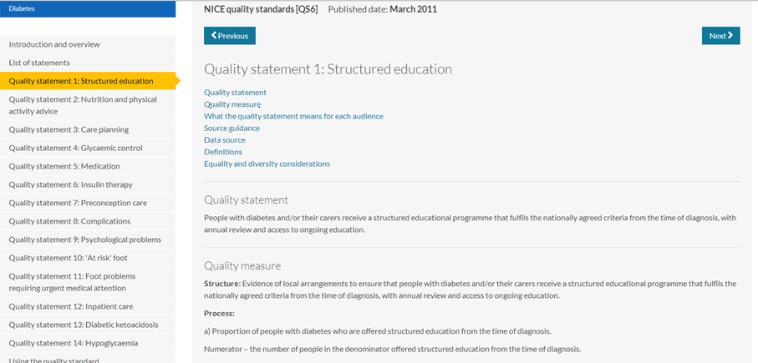
Question: Where is the detail that will help me with understand this? He scrolls back up to the list of links at the top of the page
Definitions
Notes:
OK, scrolling back up to the top, there is a link that says definitions. Perhaps that will help

Slide 7
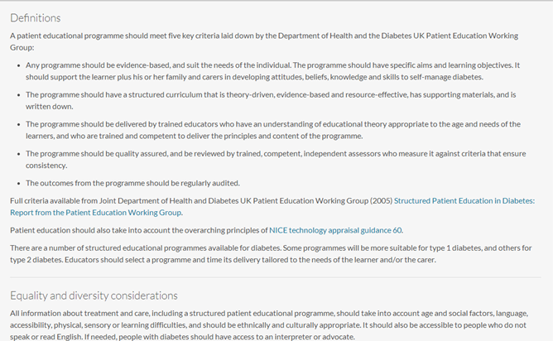
List of key criteria
External link to full criteria
Notes:
Oh, the criteria were down at the bottom of the page all the time. So I can copy and paste these when I need to. But perhaps I may need to look at the external link they provide which lists the full criteria. I will do that later. In the meantime….

Slide 8
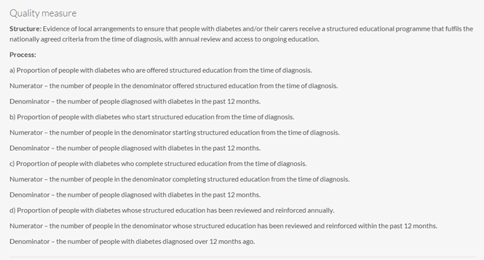
Question: How can I measure our baseline for this quality statement
Structure Measure
Process Measures
Notes:
I wonder how we are doing right now on this one. need to establish how we can measure our baseline. There are a lot of measures here. Where should we get the data from?

Slide 9
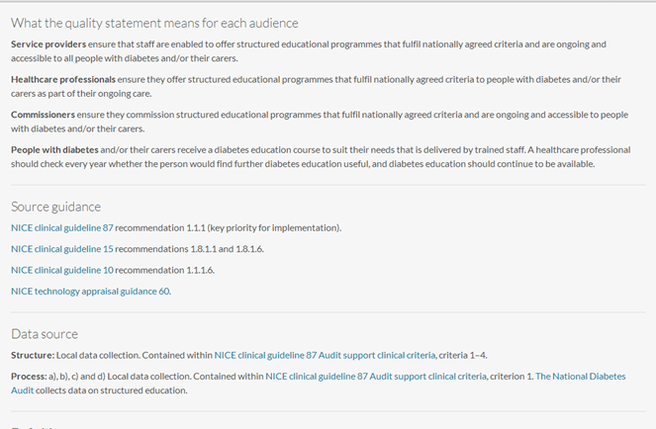
Question: Where should we get the data for these measures? He follows the link to data source
What quality statement means for each audience and Source Guidance presented between measures and the data source required to provide them
Data sources listed further down page and separate from measures
Notes:
Oh there it is right down the page. Local data collection contained within another document. I suppose I had better look and see.

Slide 10
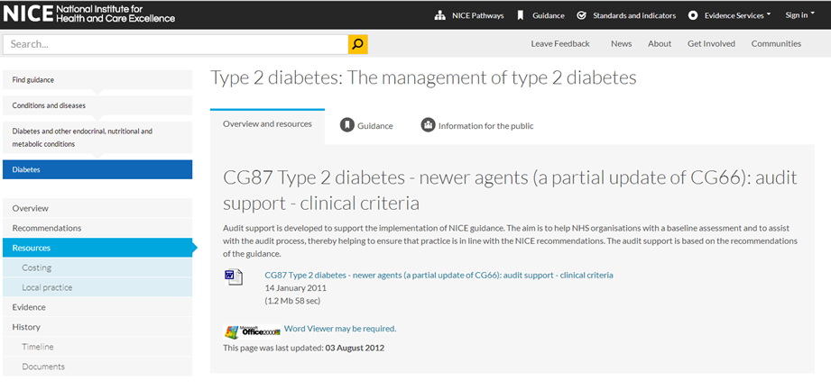
Question: How difficult will it be to collect this information? He downloads the word document
Word document
Notes:
Oh, it is in a word document.

Slide 11
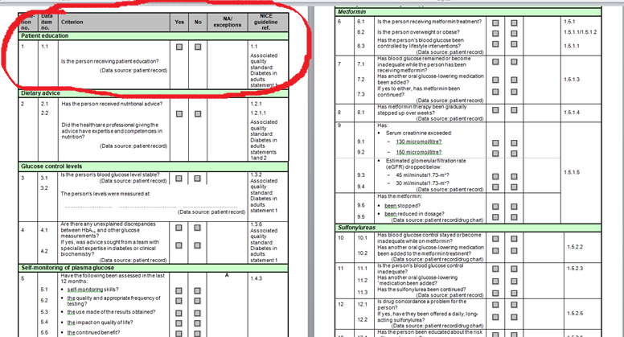
Links this to QS 6 statement 1
… and scrolls through it
Begins on p17
Notes:
Ah – page 17 in the word document shows the question to ask and where the provider will need to get the information from. The previous 16 pages were repeating what the quality statements were. I will have to send this document along with the measures to our business information peoples so they can get the ball rolling.

Slide 12
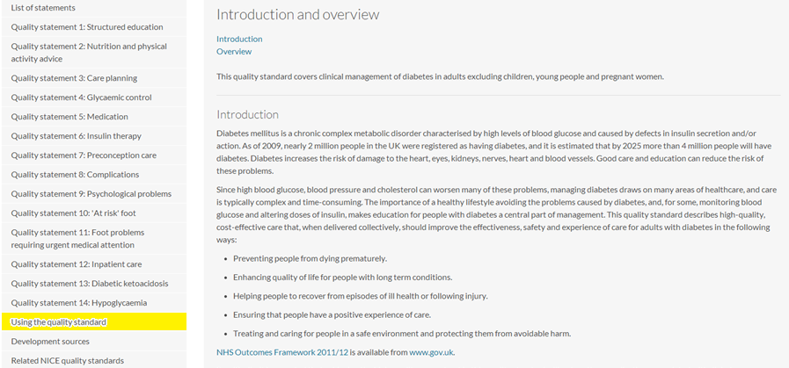
Question: How can we implement this in real life? He chooses the tab “using the quality standard”
Notes:
So if we wanted to implement this, how would we go about it. I am worried about the cost.The most hopeful tab there looks like “using the quality standard”

Slide 13
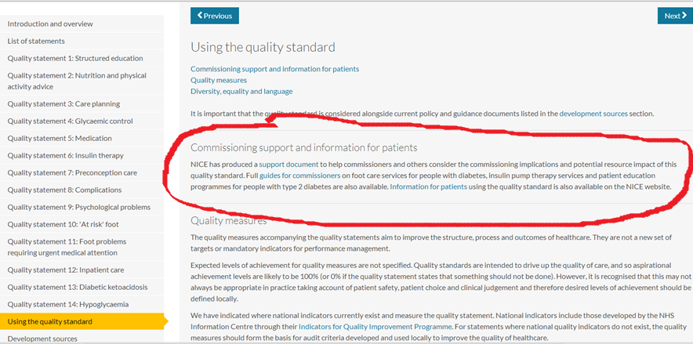
Question: How much is this likely to cost to implement? Are there any tools to help me establish this? He clicks on the “support document” link
Commissioning support and information for patients
NICE has produced a support document to help commissioners and others consider the commissioning implications and potential resource impact of this quality standard. Full guides for commissioners on foot care services for people with diabetes, insulin pump therapy services and patient education programmes for people with type 2 diabetes are also available. Information for patients using the quality standard is also available on the NICE website.
Notes:
OK Maybe the support document has what I need

Slide 14
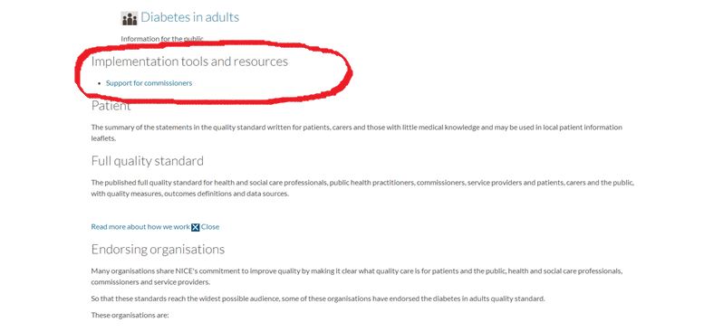

… and opens the pdf document
 | QS6 Diabetes in adults: cost impact and commissioning assessment 01 April 2011 (400.25 Kb 56 sec)
QS6 Diabetes in adults: cost impact and commissioning assessment
This assessment reviews the potential cost impact and implications for commissioners and service providers of the NICE quality standard for diabetes in adults.
It has been developed in conjunction with clinicians and reviewed by the Topic Expert Group for the quality standard.
Because each NHS community will have differing levels of compliance with the standard, the precise cost impact of each standard cannot be estimated at a national level. Cost impact should be assessed locally using the following commentary as a guide to areas that may need to be considered.
Notes:
This sounds promising – cost impact and commissioning assessment. Another document to search through though.

Slide 15
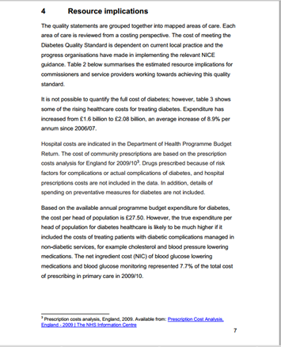
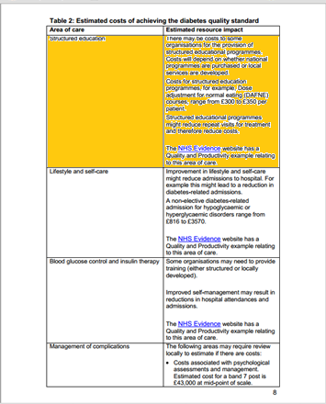
Here is cost estimation for achieving quality statement 1
… and searches through……..
Text on how cost estimates were arrived at
Information on resource implications does not start until p 7
Notes:
Wow – 27 pages. Ok, there is the cost estimate for QS 1. What is this based on? Ah there is some explanation in the text under “ resource implications”.

Slide 16
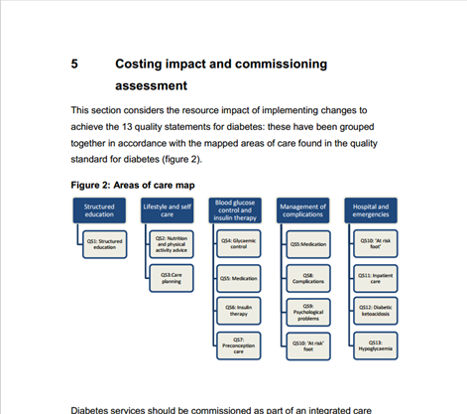
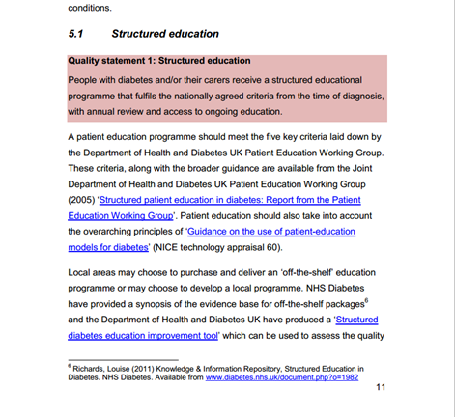
Repetition of need to comply with five key criteria
Local areas may choose to purchase and deliver an ‘off-the-shelf’ education programme or may choose to develop a local programme. NHS Diabetes have provided a synopsis of the evidence base for off-the-shelf packages and the Department of Health and Diabetes UK have produced a ‘Structured diabetes education improvement tool’ which can be used to assess the quality of structured education programmes For further information on commissioning a diabetes structured education service refer to the NICE ‘Patient education programme for people with type 2 diabetes commissioning guide’ (incorporating a benchmarking tool).
Useful information for costing
Notes:
Hold on, there is more starting on page 11 with links to some tools. I will try the NICE one first. Ok that is a broken link. The external one is a 50 page document. I will look at it later. There a few more paragraphs further down which have some examples of costing information on DAFNE courses and pointing me to more external sources. I will come back to those. The costing information seems to be in several places. Maybe before I go chasing it all I can see some examples of where this has been actually implemented. I see there is a reference here to a QUIPP example on the NHS evidence web site. The link is broken here too, but I know where the NHS Evidence site is and will have a quick look.

Slide 17
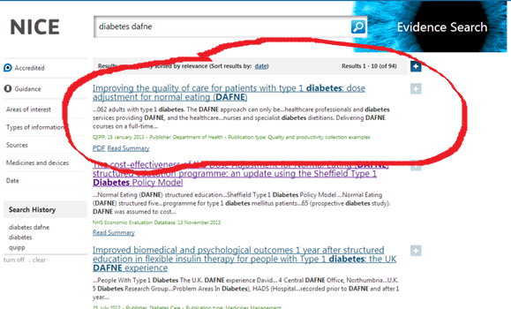
Question: show me some real life examples where this quality statement has been addressed successfully in an area like mine? He finds the QUIPP example on the Evidence web site
Notes:
This is the one they meant, and there seem to be a few more in the search results which may be relevant. I will see what this document says first, and then if I have time, go back and look at the others.

Slide 18
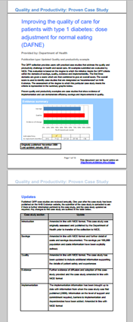
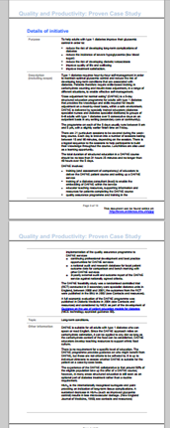
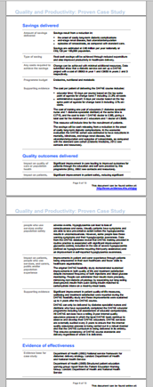
Question: Where are the outcomes and savings data? He looks through the document to locate the data that interest him.
Savings information
Outcome Information
Notes:
I just want a quick skim of this to find out briefly where it was done, what they did, what the outcomes were, the cost savings if any to see if it would be likely we could or should do something similar. I know what QUIPP is, not really bothered about reading what updates have been made right now I just want to get to the meat of the case study. There are no hyperlinks so I will just have to scroll down. OK, skimming over the update data, the detail begins on p3, the savings and outcomes information on p 5 and the location information on p7. Ah, there is no specific location information. I see it is nationwide. I am surprised that there are no more case studies/local collection resources listed under resources for the quality standard, but I need a coffee now and then I will look at those other links on the Evidence site if I have the energy. I am aware I have another 13 quality statements to repeat this exercise for. ….

Slide 19
Sources of Information used by Commissioner
https://www.nice.org.uk/Guidance/QS6
https://www.nice.org.uk/guidance/qs6/chapter/introduction-and-overview
https://www.nice.org.uk/guidance/qs6/chapter/Quality-statement-1-Structured-education
https://www.nice.org.uk/guidance/qs6/chapter/Quality-statement-1-Structured-education#what-the-quality-statement-means-for-each-audience
https://www.nice.org.uk/guidance/qs6/chapter/Quality-statement-1-Structured-education#definitions
https://www.nice.org.uk/guidance/cg87/resources/cg87-type-2-diabetes-newer-agents-a-partial-update-of-cg66-audit-support-clinical-criteria
https://www.nice.org.uk/guidance/cg87/resources/cg87-type-2-diabetes-newer-agents-a-partial-update-of-cg66-audit-support-clinical-criteria2
https://www.nice.org.uk/guidance/QS6/chapter/Using-the-quality-standard
https://www.nice.org.uk/guidance/QS6/chapter/Using-the-quality-standard#commissioning-support-and-information-for-patients
https://www.nice.org.uk/proxy/?sourceUrl=http%3a%2f%2fguidance.nice.org.uk%2fQS6%2fCommissionerSupport
https://www.nice.org.uk/resource/QS6/html/p/qs6-diabetes-in-adults-cost-impact-and-commissioning-assessment?id=lxio74xw4a3ofvbkj4g2kcfyru
https://www.nice.org.uk/guidance/qs6/resources/qs6-diabetes-in-adults-cost-impact-and-commissioning-assessment2
https://www.evidence.nhs.uk/
http://arms.evidence.nhs.uk/resources/qipp/899091/attachment

