Slide 1

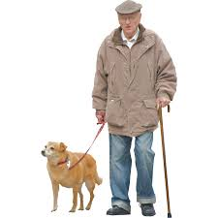
GP Scenario 3.1
Consultation with 65 year old patient
Presenting Symptoms
Vomiting
Bloating

Slide 2

GP consults patient history
Diagnosed conditions
Type 2 diabetes
Ischaemic heart disease
Tests performed
Endoscopy
Negative result. No malignancy detected
Drugs prescribed
Drug Simvastatin to lower cholesterol to manage ischaemic heart disease
Patient profile
65 years old
Presenting Symptoms
Vomiting
Bloating

Slide 3
Differential Diagnosis
Diagnosed conditions
Type 2 diabetes
Ischaemic heart disease
Tests performed
Endoscopy
Negative result. No malignancy detected
Drugs prescribed
Drug Simvastatin to lower cholesterol to manage ischaemic heart disease
Presenting Symptoms
Vomiting
Bloating
Patient profile
65 years old
Possible neuropathic complications of Type 2 diabetes (Gastroparesis)
Notes:
I would like to check and see I have got this right. I know the bloating is not due to malignancy but just want to check the latest guidance on diagnosing gastroparesis

Slide 4
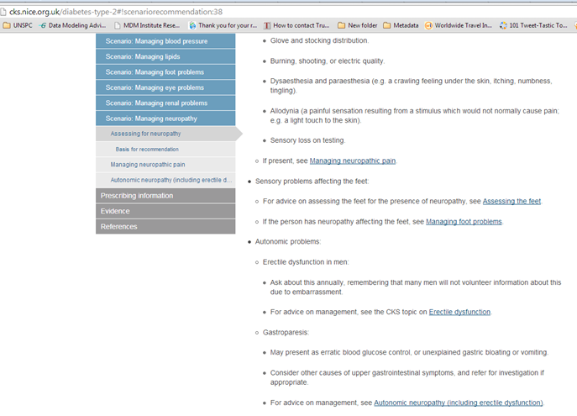
Question: what are the symptoms of gastroparesis? What other conditions present these symptoms? Consult CKS on type 2 Diabetes for guidance on diagnosing gastroparesis
Assessing for neuropathy
How to identify gastroparesis
Link to advice on managing autonomic neuropathy
Notes:
Here we are CKS on Type 2 Diabetes. They have a section on assessing for neuropathy. Excellent Here it says gastroparesis may present as erratic glucose control or unexplained bloating or vomiting, but to consider other causes and refer for investigation. Well the recent endoscopy came back negative, so I am fairly certain it must be gastroparesis

Slide 5
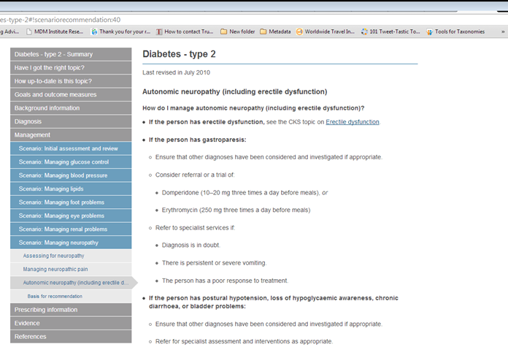
Question: What is recommended treatment for managing gastroparesis? GP seeks up to date guidance in CKS
Recommended trial of drugs: Domperidone or Erythromycin
Link to basis for recommendation
Notes:
What is the recommended treatment for a patient with gastroparesis? CKS suggests using either drug domperidone or erythromycin. I wonder what they base that on? There is no option for non-pharmacalogical treatment mentioned

Slide 6
Question: What is the evidence basis for this recommendation? Are there any other non-pharmacological treatment recommendations? GP investigates NICE guidelines on which the CKS recommendations are based following link in reference list on CKS
Gives guideline title and year but no number
Basis for recommendation
These recommendations are based on the National Institute for Health and Care Excellence guideline Type 2 diabetes: the management of type 2 diabetes (update) [National Collaborating Centre for Chronic Conditions, 2008; NICE, 2008a].
Links to guideline rather than recommendation
Notes:
Ah, ok. It comes from a NICE guideline. Good. I would like to see how strong a recommendation this is and if there are any non-pharmacological options. I will follow their link.

Slide 7
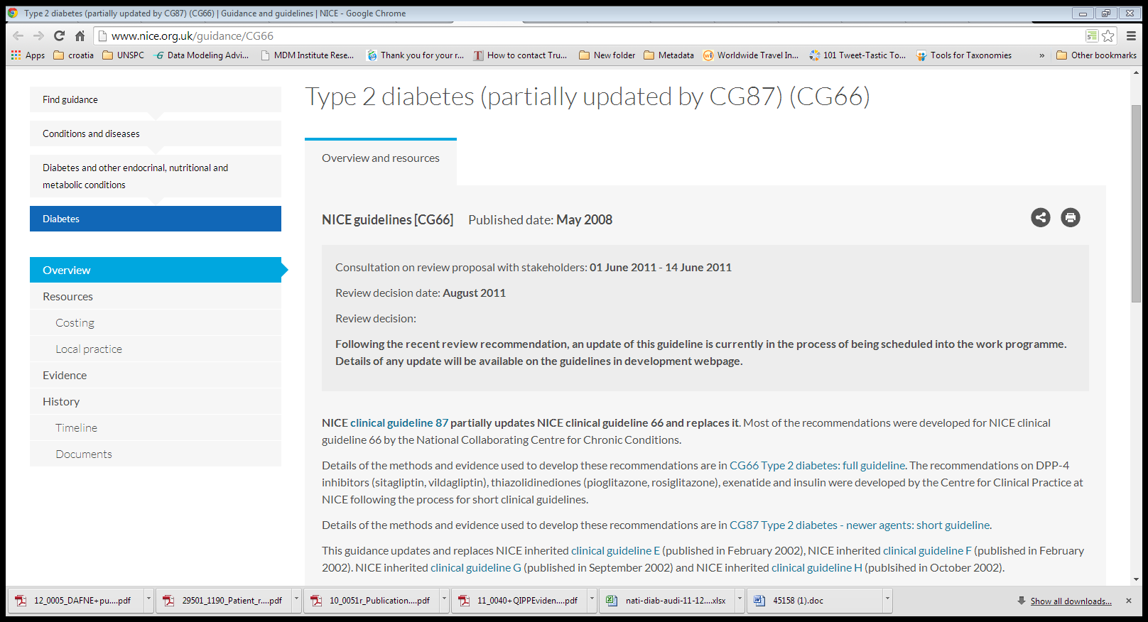
Question: Where can I find the original recommendations and underlying evidence? GP follows link to CG66 page on NICE web site
Type 2 diabetes (partially updated by CG87) (CG66)
Which guideline to look at? CG87 or CG66? Has it been completely replaced by CG87 or not?
NICE clinical guideline 87 partially updates NICE clinical guideline 66 and replaces it. Most of the recommendations were developed for NICE clinical guideline 66 by the National Collaborating Centre for Chronic Conditions.
Details of the methods and evidence used to develop these recommendations are in CG66 Type 2 diabetes: full guideline. The recommendations on DPP-4 inhibitors (sitagliptin, vildagliptin), thiazolidinediones (pioglitazone, rosiglitazone), exenatide and insulin were developed by the Centre for Clinical Practice at NICE following the process for short clinical guidelines.
Details of the methods and evidence used to develop these recommendations are in CG87 Type 2 diabetes - newer agents: short guideline.
Notes:
Goodness, this is confusing. I just want to get to the original guidance and see the underlying evidence for it. Do I go to 87 or 66? They say 87 partially updates and replaces 66 but there is all sorts of stuff on evidence on 66 too, so I really don’t know. I will start at 87 as it is the most up to date and take it from there.

Slide 8
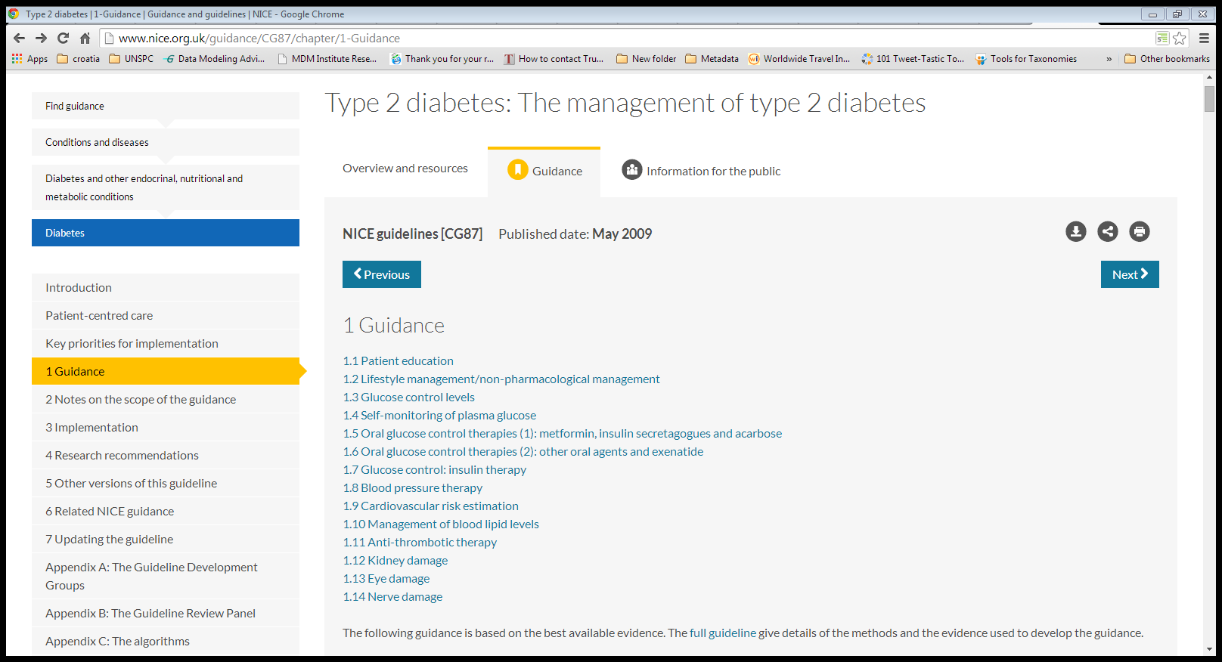
Question (cont): Where can I find the original guidance and underlying evidence on gastroparesis? GP consults CG87 (as most recent NICE guideline)
Consults section on nerve damage (neuropathy)
Notes the link to full guideline for methods and evidence
Notes:
I want to see the recommendations on gastroparesis. Ah yes. I expect the recommendations will come under nerve damage.

Slide 9
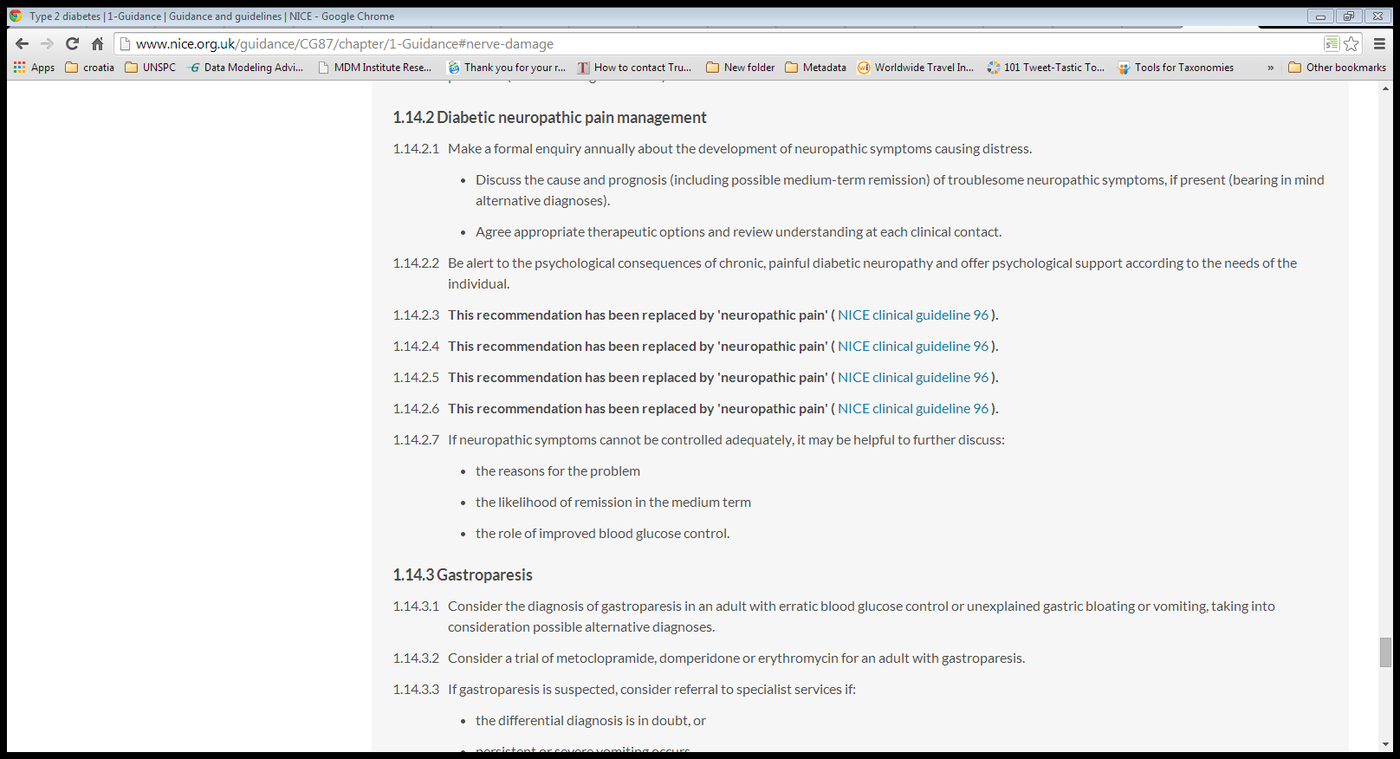
Question: I have found the original recommendations. What is the underlying evidence?
GP consults original NICE recommendations on treating gastroparesis to review underlying evidence
Notes there is another guideline on neuropathic pain
Recommendation suggests 3 possible drugs to treat gastroparesis metoclopramide, domperidone and erythromycin CKS did not recommend metoclopramide
Notes:
Here we are – gastroparesis. Interesting – the recommendation suggests 3 possible drugs, not just the two mentioned in the CKS. I really would like to find out in the evidence how effective these drugs are and which one is most effective as it is not clear from this. I also see the recommendations are for management through prokinetic drugs. Now how do I get back to the evidence? I think it said to look in the full guideline. I will note down the recommendation numbers so I can refer to them to find the related evidence. Let me go back

Slide 10
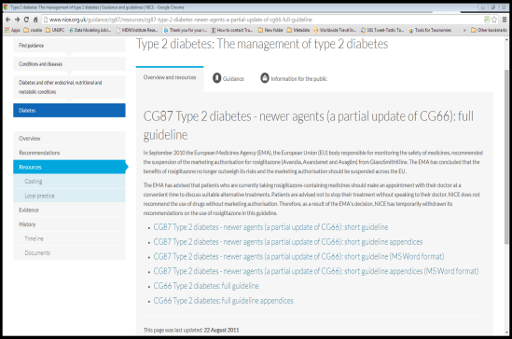
GP looks for underlying evidence on efficacy of recommended drugs. This is contained within full guideline CG66
5.1 Full guidelines
The full guideline, 'Type 2 diabetes (update): national clinical guideline for management in primary and secondary care' contains details of the methods and evidence used to develop the guideline. It is published by the National Collaborating Centre for Chronic Conditions. The short clinical guideline 'Type 2 diabetes: newer agents for blood glucose control in type 2 diabetes' contains details of the methods and evidence used to develop the recommendations in 1.6 and 1.7.2.
CG87 Type 2 diabetes - newer agents (a partial update of CG66): short guideline
CG87 Type 2 diabetes - newer agents (a partial update of CG66): short guideline appendices
CG87 Type 2 diabetes - newer agents (a partial update of CG66): short guideline (MS Word format)
CG87 Type 2 diabetes - newer agents (a partial update of CG66): short guideline appendices (MS Word format)
CG66 Type 2 diabetes: full guideline
CG66 Type 2 diabetes: full guideline appendices
Which one?
CG66 full guideline
Notes:
OK, I need to look in the full guideline. Which one was that again? It says to look in the full guideline Type 2 diabetes update for the methods and evidence. CG87 is called a partial update – do they mean that? No, that is called a short guideline. CG66 is a full guideline, but didn’t they say that been replaced? It doesn’t say update . This is so confusing. Shall I try the guideline or the appendices? I will try the guideline. If it is not there I will call NICE.

Slide 11
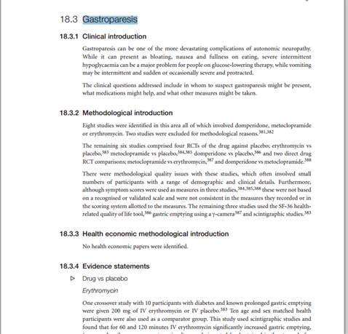
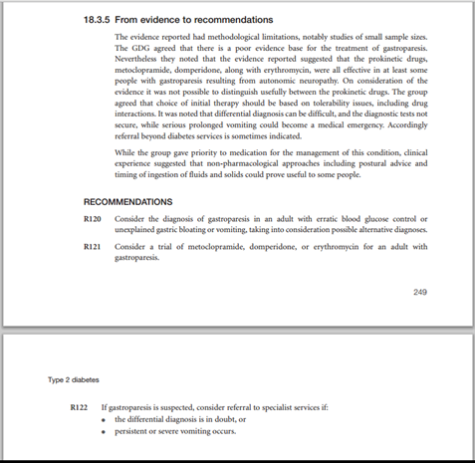
Question: How effective are the drugs? Which is the most effective drug? Do any of the studies have a population that matches my patient? What kind of studies have been included in the evidence review? GP searches full guideline CG66 pdf document for underlying evidence
GP reads discussion, which concludes that the evidence is poor and there is little to choose between the 3 prokinetic drugs recommended, all of which could be effective in some people in treating gastroparesis
Discussion included non-pharmacological management, but this did not make it to recommendations
Recommendation numbers different in full guideline from NICE guideline
GP reviews evidence statements on drug options for treating gastroparesis
Notes:
OK, I’ll just do a quick search and find the stuff on gastroparesis. My recommendations should be there. Interesting, the recommendation numbers are completely different but the recommendations are identical. I note in the discussion, there is talk of non-pharmaceutical management, but this has not made it into the recommendations. So now I can see the recommendations are based on reviewing just 6 studies. They are all RCTs. The discussion states that the evidence is poor and looking at the evidence statements and discussion, there is little to choose between the recommended drugs. It seems to be that any of the drugs have shown some effectiveness in some people. I wonder what populations were involved in these studies? I had better look at the reference numbers they provide.

Slide 12
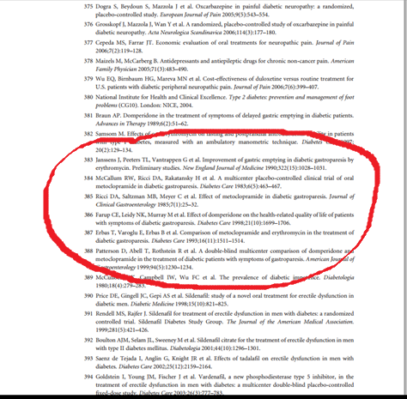
Question: where can I get details of the populations used in the studies? GP finds the list of studies in the reference list of pdf document but no more details
Notes:
OK, so that information is not provided. Hmm. These are all quite old studies. I wonder if there is any more up to date guidance come out on this since then?

Slide 13
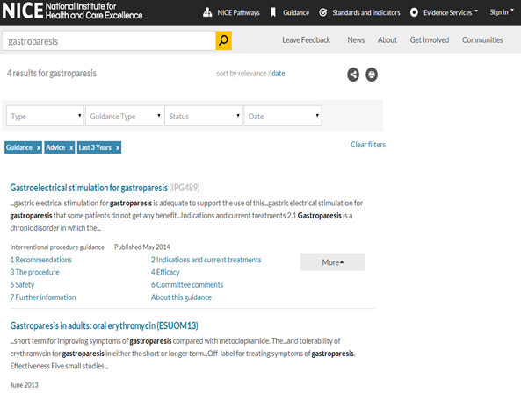
Question: What other guidance has NICE produced on gastroparesis since publication of CG87? GP searches for any further specific recent guidance on gastroparesis on NICE web site since guideline was produced
IPG recommends gastroelectrical stimulation for chronic, intractable nausea and vomiting secondary to gastroparesis. Prokinetics/diet should be first line treatment
Evidence update from systematic review suggests no significant benefit of using erythromycin over metoclopramide
Notes:
Anything specifically on gastroparesis? I see that gastroelectrical stimulation – not mentioned in previous guidance – might be an option but prokinetic drugs should be a first line option and an evidence update still shows no clear winner between erythromycin and metoclopramide. Ok

Slide 14
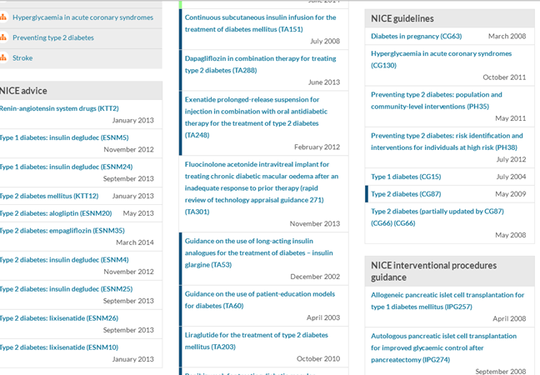
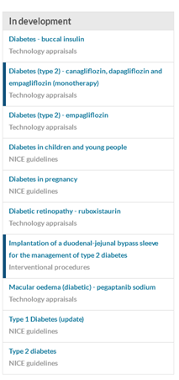
Question: What other more recent guidance has been written on Type 2 Diabetes? GP looks for further NICE guidance on diabetes on NICE web site to make sure nothing has been missed
GP has reviewed CG87 and CG66
Notes there is a new Type 2 Diabetes guideline in development
Notes:
Maybe I have missed something. Has there been anything more recent published or anything in development on T2 Diabetes in general? Ah I see there is a new guideline in development.

Slide 15
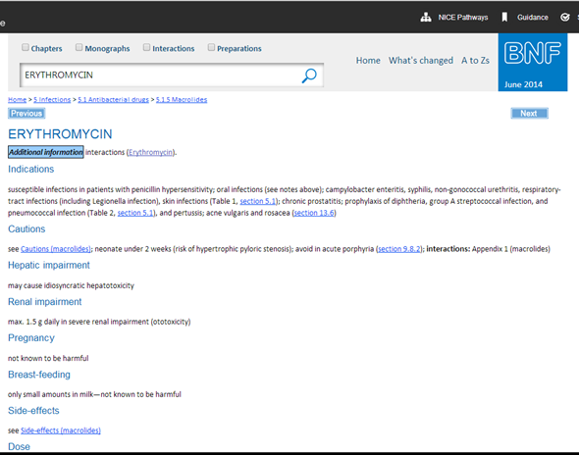
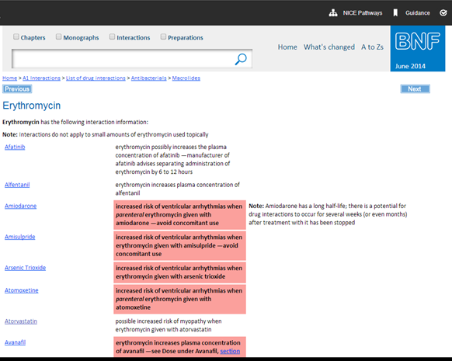
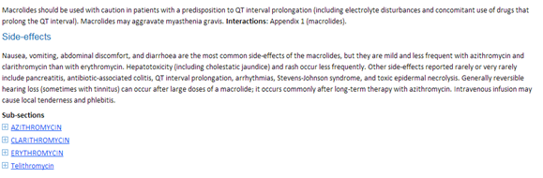
Question: Which is the most suitable drug for my patient to take as first line management of gastroparesis?
Given no clear lead from evidence of increased clinical effectiveness of one drug over another, and NICE evidence to recommendations discussion suggesting drug choice based on on tolerability, including drug interactions, GP consults BNF via Evidence web site for side effects, interactions information.
Contraindications, side effects, dose and drug interactions information spread over 2/3 web pages per drug
Notes:
If none of these drugs is more effective than the other, I need to know which is the safest for my patient to take as first line management of gastroparesis. The BNF should list all the side effects, contraindications and interactions.

Slide 16
Variables for GP to consider
Patient is 65 years old
Question: Which drug has a contraindication/caution for patients over 60?
Patient has Type 2 Diabetes:
Do any of the drugs have contraindication for those with Type 2 Diabetes?
Do any of the drugs have side effects which will exacerbate symptoms of type 2 Diabetes?
Patient has Ischaemic Heart Disease:
Do any of the drugs have contraindication for those with Ischaemic Heart Disease?
Do any of the drugs have side effects that will exacerbate symptoms of Ischaemic Heart Disease?
Patient is taking drug Simvastatin to lower cholesterol for IHD.
Do any of the drugs interact with simvastatin or similar statins?
Do any of the drugs interact with drugs patient taking to manage diabetes?
Drug side effects: What are the other side effects of these drugs?
Recommended drug for discussion with patient = ?
Notes:
Problem is, my patient also has Ischaemic heart disease and is taking statins to lower his cholesterol. This may take some time.

Slide 17
Sources of information used by GP to confirm diagnosis and suitable treatment options (1)
Diagnosed conditions
Type 2 diabetes
Ischaemic heart disease
Tests performed
Endoscopy
Negative result. No malignancy detected
Drugs prescribed
Drug? For ischaemic heart disease
Patient profile
65 years old
Presenting Symptoms
Gastric vomiting
Bloating

Slide 18
Sources of information used by GP (2)
Clinical Knowledge Summaries
http://cks.nice.org.uk/diabetes-type-2 introduction to Type 2 diabetes CKS
http://cks.nice.org.uk/diabetes-type-2#!scenario:7 Scenario: Managing neuropathy
http://cks.nice.org.uk/diabetes-type-2#!scenariorecommendation:38 Assessing for neuropathy – suggests Gastroparesis as a presenting sign
http://cks.nice.org.uk/diabetes-type-2#!scenariorecommendation:40
Automatic neuropathy – how to manage it, including drug treatments for gastroparesis
http://cks.nice.org.uk/diabetes-type-2#!scenariobasis:33
Basis of recommendation. Quotes NICE guidance but also EMA advice which counteracts one of NICE drug recommendations
http://cks.nice.org.uk/diabetes-type-2#!references/A39054 link on reference page to relevant NICE guidance.

Slide 19
Sources of information used by GP (3)
CG66 NICE Guideline
http://www.nice.org.uk/guidance/CG66 Home page Type 2 diabetes (partially updated by CG87) (CG66)
CG87 NICE Guideline
http://www.nice.org.uk/Guidance/CG87
http://www.nice.org.uk/guidance/CG87/chapter/introduction trying to find actual recommendations
http://www.nice.org.uk/guidance/CG87/chapter/1-Guidance List of recommendation subsections. Section 1.14 Nerve Damage is relevant
http://www.nice.org.uk/guidance/CG87/chapter/1-Guidance#nerve-damage Nerve Damage includes recommendations 1.14.3.1 -3 on gastroparesis
http://www.nice.org.uk/guidance/CG87/chapter/5-Other-versions-of-this-guideline looking for full guideline with links to methods and evidence
http://www.nice.org.uk/guidance/cg87/resources/cg87-type-2-diabetes-newer-agents-a-partial-update-of-cg66-full-guideline list of links to 6 versions of guideline 66/87 in various versions and appendices. Relevant one is CG66 full guideline
CG66 Full Guideline (pdf )
http://www.nice.org.uk/guidance/cg87/resources/cg66-type-2-diabetes-full-guideline2 p247-250 section on gastroparesis, introduction, evidence statements and evidence to recommendations discussion

Slide 20
Sources of information used by GP (4)
NICE website
http://www.nice.org.uk/Guidance/Conditions-and-diseases/Diabetes-and-other-endocrinal--nutritional-and-metabolic-conditions/Diabetes list of published and draft guidance for Type 2 diabetes
http://www.nice.org.uk/Search?area=NICE.Search&q=gastroparesis search for guidance specific to gastroparesis
http://www.nice.org.uk/Advice/ESUOM13 evidence update on use of erythromycin for gastroparesis

Slide 21
Sources of information used by GP (5)
Evidence web site (BNF)
http://evidence.nhs.uk/formulary/bnf/current?utm_source=evidence&utm_medium=homepage&utm_content=BNF&utm_campaign=BNF+Homepage BNF home page
http://evidence.nhs.uk/formulary/bnf/current/5-infections/51-antibacterial-drugs/515-macrolides/erythromycin?q=ERYTHROMYCIN erythromycin main page including indications, caution, dose
http://evidence.nhs.uk/formulary/bnf/current/a1-interactions/list-of-drug-interactions/antibacterials/macrolides/erythromycin erythromycin interactions
http://evidence.nhs.uk/formulary/bnf/current/5-infections/51-antibacterial-drugs/515-macrolides#PHP3501 erythromycin side effects
http://evidence.nhs.uk/formulary/bnf/current/4-central-nervous-system/46-drugs-used-in-nausea-and-vertigo/domperidone-and-metoclopramide/metoclopramide-hydrochloride?q=METOCLOPRAMIDE%20HYDROCHLORIDE metoclopramide main page – indications, cautions, contraindications, side effects, dose
http://evidence.nhs.uk/formulary/bnf/current/a1-interactions/list-of-drug-interactions/metoclopramide metoclopramide interactions
http://evidence.nhs.uk/formulary/bnf/current/4-central-nervous-system/46-drugs-used-in-nausea-and-vertigo/domperidone-and-metoclopramide/domperidone?q=DOMPERIDONE domperidone main page – indications, cautions, contraindications, side effects, dose
http://evidence.nhs.uk/formulary/bnf/current/a1-interactions/list-of-drug-interactions/domperidone domperidone side effects

