Slide 1
Services
When to use services
Creating a service
Using a service

Slide 2
Web API Example
It is common for apps to access data by communicating with web servers
The web server will provide a Web API which generally consists of routes which take parameters and return results
When we access the Web API we need to specify the URL, the parameters, and decode the resulting data, which may be in JSON format
For example, we might have a Web API which returns a list of books, which is used on multiple pages, hence we would need to reimplement the code on multiple pages.

Slide 3
Why use Services
In the previous book list example we would need to write the same getBooks() function in every component that wants to get the books
Duplicating code is almost always a bad idea
We should have one instance of the getBooks() function which can be called by all components

Slide 4
Service
A Service, is generally designed to be used as a Singleton
i.e. the Service class only ever has one instance
Angular doesn’t enforce this behavior of services, however it is common to use Singleton Services
Singleton Services are classes where an instance is created once at the start of the application, and there is only ever one instance (i.e. object) of the service class for the life of the application
All other components and services utilise the one instance of the service
Component
Component
Service
Component
Component

Slide 5
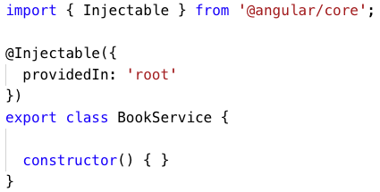
Default Service
Below is the default service code generated after using the Angular CLI to create a service:
ng generate service book
You can structure you files by creating
services within a services directory.
Eg. ng generate service services/book

Slide 6
providedIn
The providedIn property is important as it indicates which module the service is declared within
By default the value is ‘root’ which indicates that the service is available throughout the entire application and provided by the AppModule

Slide 7
Use the service
To use a service we inject it into the component which is using it, e.g.:
import { BookService } from ‘../book.service’;
class BookComponent {
constructor(private bookService: BookService) {}
}
Note the import is required

Slide 8
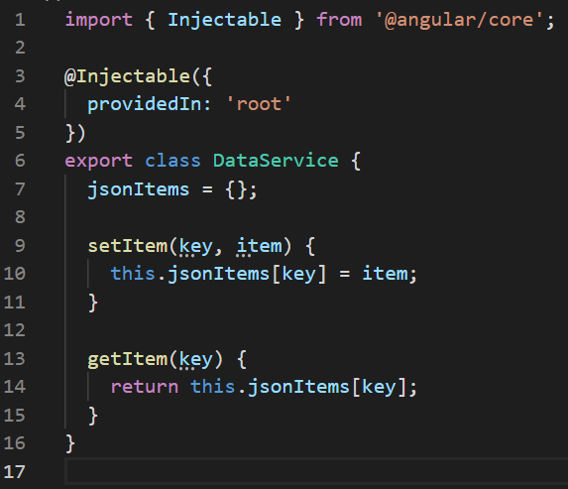
A Service for Data Managing
We may define a service to managing data. The data object jsonItems and its methods can be accessed and modified by multiple components conveniently.

Slide 9
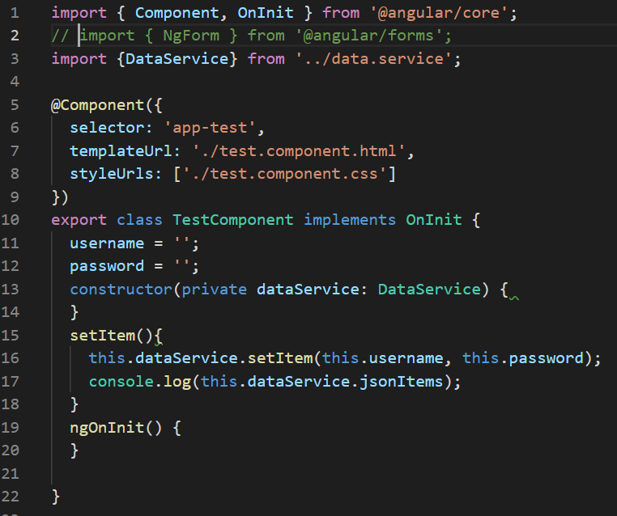
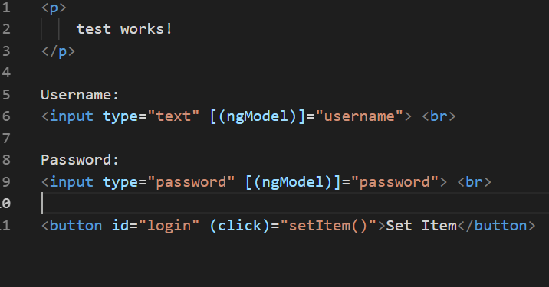
Use the service
The test component can set pairs of username and password in the JSON object jsonItems, which can be retrieved in other page components

Slide 10
Summary
Any common code used throughout the application should be stored in a service
Code for reading and writing to storage and communicating with web APIs commonly goes into a service
You should have different services for different responsibilities
For example, you should have one service handling storage and another service for communicating with web APIs

