Slide 1
Using Express and JQuery

Slide 2
JQuery
jQuery is a lightweight, "write less, do more", JavaScript library.
The purpose of jQuery is to make it much easier to use JavaScript on your website.
jQuery takes a lot of common tasks that require many lines of JavaScript code to accomplish, and wraps them into methods that you can call with a single line of code.
jQuery also simplifies a lot of the complicated things from JavaScript, like AJAX calls and DOM manipulation.

Slide 3
HTML
jQuery is used in a html file. But what is HTML?
​HTML stands for Hyper Text Markup Language.
HTML is the standard markup language for creating Web pages.
HTML describes the structure of Web pages using markup. HTML elements are the building blocks of HTML pages, which are represented by tags.
CSS defines the presentation (look, feel and position ) of the tags within a web page.

Slide 4
Adding jQuery to a WebPage
By linking the jQuery javascript file to your webpage.
The jquery.js file can be downloaded from http://jquery.com/download/ and stored in the same directory as your HTML file. You may also install jQuery via "npm install jquery –save" and then copy the jqery.js file from "\node_modules\jquery\dist\jquery.js" in your project folder.
You can also just link to the jQuery.js file via a CDN link.
Any javascript files contianing jQuery code or any other client side javascript can also located in the same directory as your HTML file.

Slide 5
Express, jQuery Example
We have a lot of moving parts for this example. We not only have to create the webpage but also the nodejs server that will serve it and any other endpoints required of the page..
Web Client
(http://localhost:3000)
Request 1 for http://localhost:3000
NodeJS Webserver
(server.js)
express.js
Request 2 (AJAX request) for credential check
http://localhost:3000/api/login
Body parser
Response 1
(form.html)
endpoint "/"
Maps to www/form.html
/www
jquery.js
form.html
Response 2
JSON data
script.js
endpoint "/api/login"
Maps to test login credentials function

Slide 6
Express, jQuery Example
A subdirectory on the server will hold the webpage (form.html) and any of its dependant files (jquery.js, script.js and style.css)
Web Client
(http://localhost:3000)
Request 1 for http://localhost:3000
NodeJS Webserver
(server.js)
express.js
Request 2 (AJAX request) for credential check
http://localhost:3000/api/login
Body parser
Response 1
(form.html)
endpoint "/"
Maps to www/form.html
/www
jquery.js
form.html
script.js
Response 2
JSON data
endpoint "/api/login"
Maps to test login credentials function
style.css

Slide 7
Express, jQuery Example
Server side endpoint have been defined in the server.js file that map to the root of the website "/" and a path "/api/login". Only requests to these two endpoints will get a valid response.
Web Client
(http://localhost:3000)
Request 1 for http://localhost:3000
NodeJS Webserver
(server.js)
express.js
Request 2 (AJAX request) for credential check
http://localhost:3000/api/login
Body parser
Response 1
(form.html)
endpoint "/"
Maps to www/form.html
/www
jquery.js
form.html
script.js
Response 2
JSON data
endpoint "/api/login"
Maps to test login credentials function
style.css

Slide 8
Express, jQuery Example
The webserver uses a number of packages (express, body-parser) to provide the functionality to create a webserver that will respond to any defined endpoints
Web Client
(http://localhost:3000)
Request 1 for http://localhost:3000
NodeJS Webserver
(server.js)
Express.js module
Request 2 (AJAX request) for credential check
http://localhost:3000/api/login
Body-parser module
Response 1
(form.html)
endpoint "/"
Maps to www/form.html
/www
jquery.js
form.html
script.js
Response 2
JSON data
endpoint "/api/login"
Maps to test login credentials function
style.css

Slide 9
Express, jQuery Example
The user requests (request 1) a page from http://localhost:3000. The response (response 1) to this reust is the form.html page.
Entering form data and clicking on the submit button triggers the jQuery ajax request (request 2). The response (response 2) to that request is displayed in a div on the page. The background colour of the form elements is changed depending on the result.
Web Client
(http://localhost:3000)
Request 1 for http://localhost:3000
NodeJS Webserver
(server.js)
Express.js module
Request 2 (AJAX request) for credential check
http://localhost:3000/api/login
Body-parser module
Response 1
(form.html)
endpoint "/"
Maps to www/form.html
/www
jquery.js
form.html
script.js
Response 2
JSON data
endpoint "/api/login"
Maps to test login credentials function
style.css

Slide 10
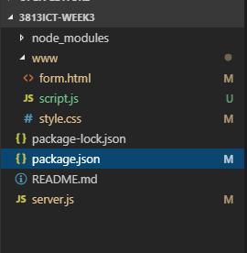
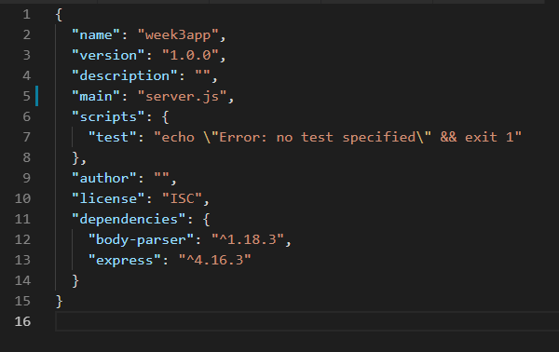
Package.json file
Below show the files that will make up this project.
The node_modules directory will be automatically created by npm.
A package.json file is created when you run the command npm int in a console in the directory you would like your project to be.
This project will need two npm packages installed. These are both added using NPM in the console by:
npm install express –save
npm install body-parser --save

Slide 11
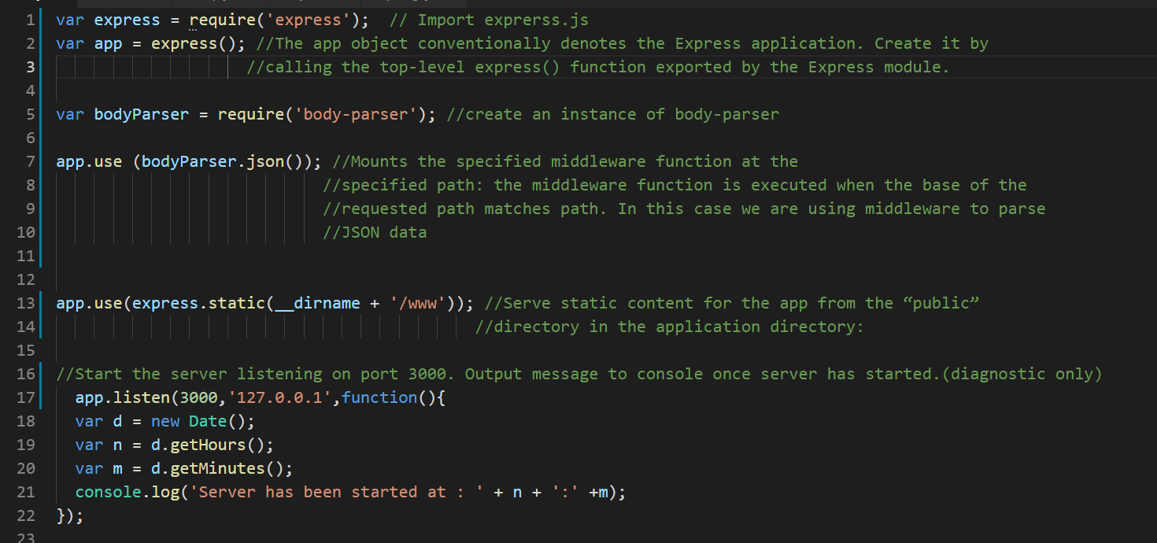
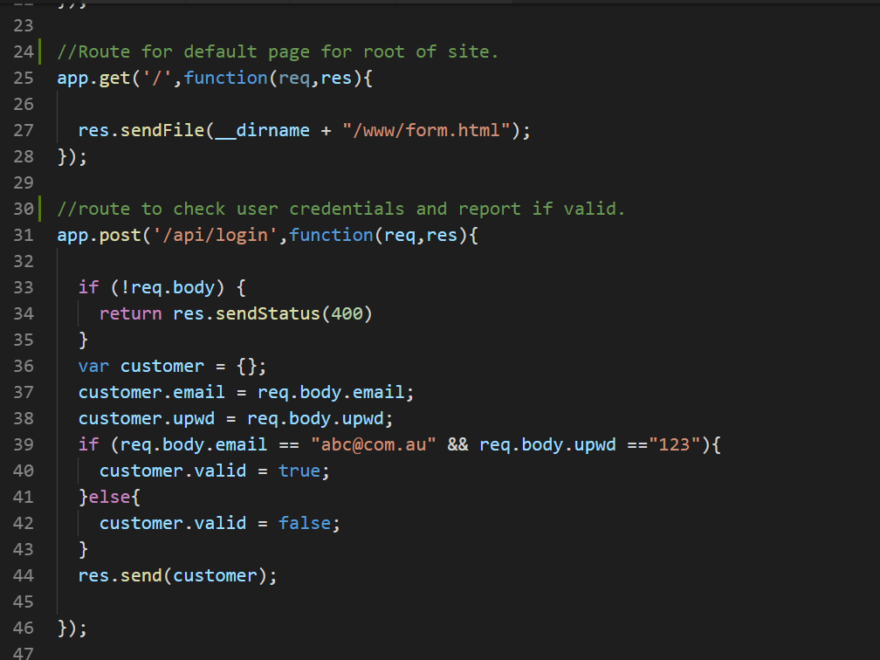
Code server.js
This is the code that makes up the server. We have "required" (imported) the express and body-parser modules and started the server listening on port 3000.
This part of the server.js file shows the two endpoints. The first being a default page for the site. The other being and endpoint that checks the user name and password and returns a JSON object. The values passed via the post method are extracted from req.body (body-parser) and the return object is sent back.

Slide 12
Retrieve Data in the req (request)
With node we access values passed to the server differently if it was passed as a get request or a post.In the previous, $.ajax call the post method is used to send data to the server. To retrieve the data at the server side, we need to install "body-parser" NPM package ( npm install body-parser) and require it in server.js file.
We will add the following lines of code in server.js to be able to access the req.body object that will contain the body of the request being sent to the server.
var bodyParser = require('body-parser');
app.use(bodyParser.json()) // parse application/json

Slide 13
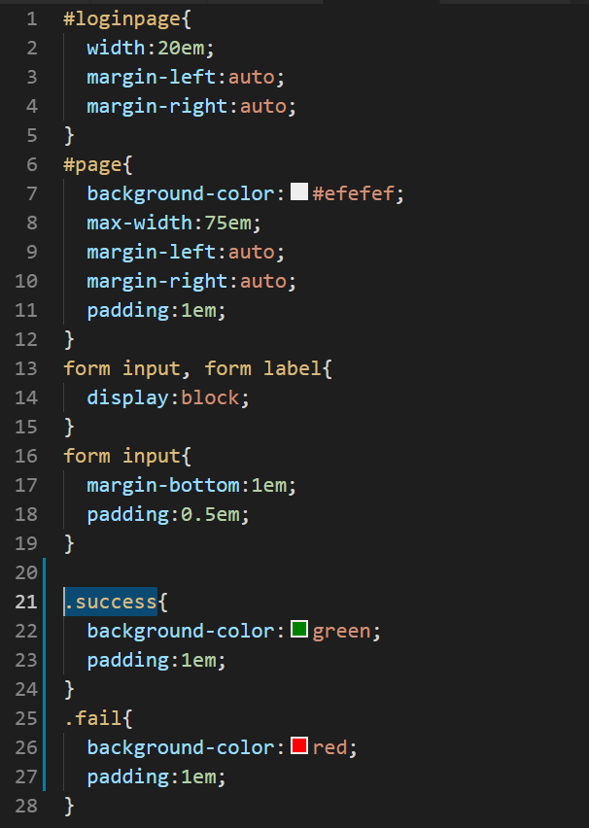
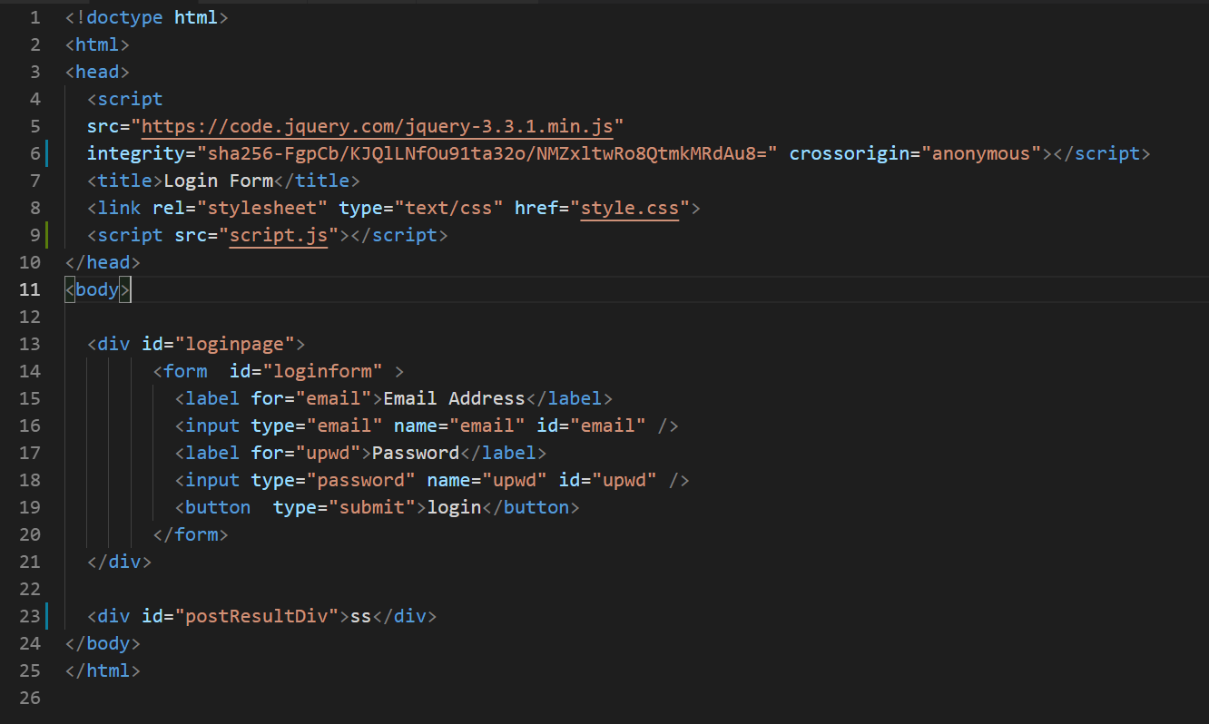
Code index.html and CSS
This is a standard web page containing a form. jQuery is linked via a CDN path.
Another javascript file called script.js contains the code to manage the interactivity of the pages (respond to a button click). A div called postResultDiv is available as a location to write a value to the screen. The CSS used for this page is also shown to the side.

Slide 14
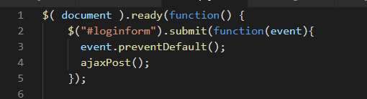
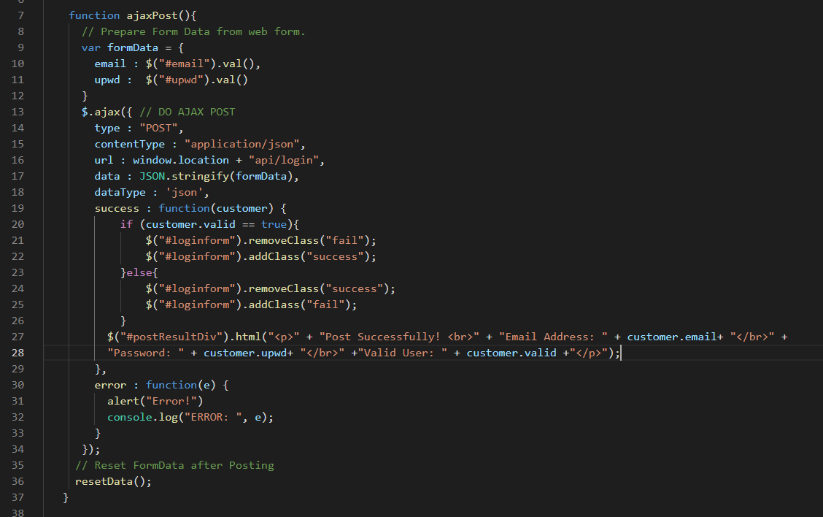
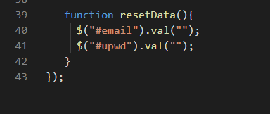
Code script.js
Pseudo Code
Once the page is fully loaded wait for the loginform to be submitted.
Prevent propagation of the submission event (stop actual submission) and send an ajax post request to the request url "/api/login".
If on success the "valid" property of the returned object is true then change the background colour of the form to green else change the background colour to red.
Write the value of each of the returned objects properties to the screen.
If on error then alert me a message to say "Error"
Reset the form values back to empty ready for another submission.

Slide 15
Example of jQuery Code
In your script.js file, you may add the following lines of code:
$( document ).ready(function() {
console.log( "ready!" );
});
The ready() method needs a callabck function as a parameter. When the page is fully rendered in the browser the ready callback function will be accessed
and the word "ready" will be written to the javascript console.
You can access the console but right clicking on the webpage in your browser and selecting "inspect". Select the console tab to see the output.

