Slide 1
Data Persistence

Slide 2
What is Data Persistence
Data persistence allows us, in the scope of a web app, to remember the state of the application between uses of the application.
Angular allows us to develop single page (html based) applications.
HTML 5 provides a range of client side Web Storage options that will allow us to store the state of a page between uses. These include
Local Storage
Session Storage
Cookies
IndexedDB

Slide 3
What is Data Persistence
These HTML web storage options are client side based ( in the web browser). Other server side options for data persistence are available (ie databases) and we will look at these in future weeks.

Slide 4
Local Storage
Each of the client side data persistence options allow us to store name(key) -> value pairs of strings.
The difference between each option is the amount of storage, time frame of existence and server interaction.
Local Storage stores data on the clients computer.
There is no expiration date of that data.

Slide 5
Local Storage
The data can only be accessed via JavaScript and HTML 5 in the browser.
The user has the ability to remove all local Storage.
There is no guarantee that the data will persist forever.
There is a capacity of around 5Mb per origin (Domain and Protocol). This value varies between browsers as the standard does not define an exact limit.
LocalStorage is not for storing sensitive user information it is quite insecure.
LocalStorage is synchronous. Each operation is only called after the other has completed.

Slide 6
localStorage methods
Add item to storage
localStorage.setitem(“key”,”value”);
Read an item from storage
let myvar = localStorage.getitem(“key”);
Edit item in storage
localStorage.setitem(“key”,”value”);
Remove an item from storage
localStorage.removeitem(“key”);
Clear all items from storage
localStorage.clear();

Slide 7
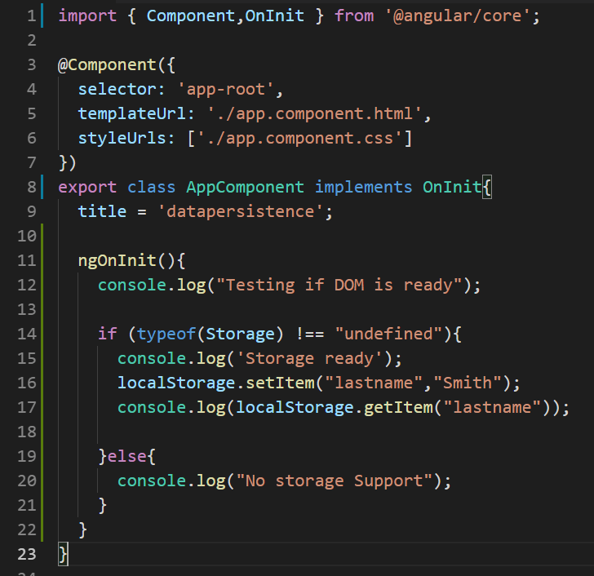
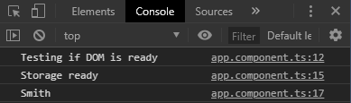
Local Storage Example
ngOnInit() is the same doing the same thing as the jQuery $(document).ready(function()). It waits for the DOM to be ready (ie your page is fully loaded and rendered)
Add an item to storage by passing a key and value to the localStorage.setItem() method. The key and value must be strings.
typeof(Storage) !== “undefined” tests is both localStorage and sessionStorage is available. Some older browsers may not support these methods.
Console output (Google Chrome)
Read an item from storage by passing a key to the localStorage.getItem() method.

Slide 8
Session Storage
SessionStorage is similar to localStorage. The only difference is that localStorage has no time limit (expiration date) while sessionStorage gets cleared when the page session ends.
A page session lasts for as long as the browser is open and survives over page reloads and restores. Opening a page in a new tab or window will cause a new session to be initiated. Closing a tab will clear the session.

Slide 9
sessionStorage methods
Add item to storage
sessionStrorage.setitem(“key”,”value”);
Read an item from storage
let myvar = sessionStrorage.getitem(“key”);
Edit item in storage
sessionStrorage.setitem(“key”,”value”);
Remove an item from storage
sessionStrorage.removeitem(“key”);
Clear all items from storage
sessionStorage.clear();

Slide 10
Cookies
Cookies are data sent by the server and stored in small text files (~2Kb), on your computer. The browser may store the cookie and send it back to the server with the next request.
When a web server has sent a web page to a browser via http, the connection is shut down, and the server forgets everything about the user. HTTP is not a stateful protocol.

Slide 11
Cookies - statefulness
Cookies were invented to solve the problem of statefulness "how to remember information about the user":
When a user visits a web page, data can be stored in a cookie on the client side
Next time the user visits the page, the cookie "remembers" that data.
Cookies were once used for general client side storage. It is now preferred to use the web storage API (localStorage and sessionStorage) and IndexedDB

Slide 12
Cookies
Cookies like local and session storage save data as name-value pairs but can also include cookie attributes following the name value pair preceded by a semicolon.
Cookies can be used for:
Session Management
Personalisation
Tracking

Slide 13
Cookie Attributes
A range of cookie attributes can be set on a cookie. These include
Secure
Domain
Path
HTTPOnly
Expires
Each attribute helps to limit the scope of the cookie and help improve its security.

Slide 14
Cookie Attributes
A cookie without an expiry date is a session cookie. It will be removed at the end of the current session (until the browser tab/window is closed)
Cookies with an expiry date is a permanent cookie
Cookies using the secure attribute is termed a secure cookie as it can only be transported using HTTPS

Slide 15
Cookies - How they work
After receiving a client request a server can send a Set-Cookie header with the response. The cookie is then stored by the browser. The cookie is then sent in subsequent client requests inside a Cookie HTTP header.
The Scope of the cookie (when it will be sent ) can be defined using the Domain and Path cookie attributes
Domain specifies hosts that are allowed to receive the cookie. If unspecified the host of the current documents location excluding subdomains is used.
Path indicated a URL path that must exist in the requested URL in order to send the cookie.

Slide 16
Javascript Cookie Examples
Session Cookie
document.cookie = “best_fruit=banana”;
Permanent Cookie
document.cookie=“best_fruit=banana; expires=Fri, 31 Dec 2020 23:59:59 GMT”
Expired Cookie
document.cookie=“best_fruit=banana; expires=Thu, 01 Jan 1970 00:00:00 GMT”
Secure Cookie
document.cookie=“best_fruit=banana; expires=Thu, 01 Jan 1970 00:00:00 GMT; Secure”
Visit https://developer.mozilla.org/en-US/docs/Web/HTTP/Cookies for more information on cookies

Slide 17
IndexedDB
IndexedDB is a low level API for client-side storage of significant amounts of structured data
IndexedDB is a Javascript based object-oriented NoSQL storage system.
Objects can be stored and retrieved with a key
Each IndexedDB database is unique to an origin (typically, this is the site domain or subdomain), meaning it cannot access or be accessed by any other origin.
We are not going into detail with IndexedDB but you should know it exists.

Slide 18
Web Storage and Cookie security
It’s important that you don’t store large amounts of sensitive information locally on clients browsers.
Cookies and web storage have a number of exploits which mean that data stored in them can be used or stolen by other sites people visit.
It is never a good idea to store passwords, sensitive user data or sensitive database data in cookies or web storage .

