Slide 1
SOCKET.IO / NODE / ANGULAR – Chat Application
npm packages required for the server
socket.io
express
cors
Node JS Server
Scenario
Client 1 initiates a socket connection with the server as do Client 2 and Client 3.
When Client 1 send data via that socket connection to the server it will be re transmitted to any other client that has a connection with that socket.
This will provide the mechanism for a basic real time chat application.
Client 1
Client 2
Client 3
npm packages required for the client
socket.io
bootstrap

Slide 2
Server Setup
npm init (set entry point as server.js)
npm install express cors body-parser socket.io –save
Create three files:
Server.js
Socket.js
Listen.js
This could all be done is a single file if required but lets try and modularize this project to make it more maintainable.
Server.js is our main file and we will require() all the necessary modules in this file
We can set up any express middleware that is needed (CORS)
Next we setup the sockets to handle requests from a client and then start the server listening for requests on port 3000.

Slide 3
Server Setup
On receiving a connection event the socket will start responding to message events and broadcasting the data to all other connected clients using io.emit method.
listen.js
server.js
socket.js

Slide 4
Client Side setup
Index.html
App component
Welcome to ….
Router Outlet
Node Server
Chat Component
Socket Service
New Message
Chat
Chat Messages
Message 1
Message 2

Slide 5
Client Setup
ng new chat
npm install socket.io bootstrap –save
Setup Bootstrap - "./node_modules/bootstrap/dist/css/bootstrap.min.css“ to the styles array of the angular.json file
Create a chat component - ng generate component chat
Create a service to manage the socket - ng generate service services/socket
Set up a form on chat.component.html (Use some bootstrap styling to make it look good/not crap)
Link the class property of “messagecontent” to the form input using two way binding [(ngModel)]
Create a click event listener that will be called when the button is clicked.

Slide 6
Client Setup
Import the FormsModule and add it to the imports array in the app.module.ts file. This will give us access to use the [(ngModel)] two way binding of the data in the form.
Import the CommonModule and add it to the imports array in the app.modules.ts file. This will allow access some Angular Structural directives. (*ngFor)
Import the Socket Service and add it to the providers array
Set up form on chat.component.ts
Add in the messagecontent property which will represent the value of the input element in the form.
app.module.ts
chat.component.ts

Slide 7
Client Setup
Run your app: ng serve –open
(it will need some work yet)
Edit the app.component.html file and remove all except for
<h1> Welcome to {{title}}</h1>
<router-outlet></router-outlet>
We will display the chat session as a series of bullet points on the page.
Edit the chat.component.html page to add in this ability
Define a property of the chat component called messages that is an array of strings This property will hold all of the chat messages as they come in and be displayed on the page in the unorderd list.
chat.component.html
chat.component.ts

Slide 8
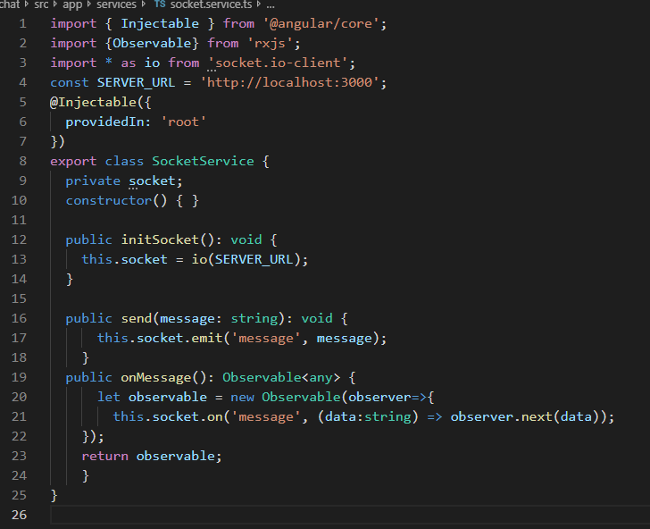
Client Setup
We now have all of the visual components in place. Now we need to add the sockets code to make it all work.
We are going to split our code for the sockets into a service rather than do it all in the component. We may want to use the socket features on other components and we do not want to duplicate code.
In the socket.service.ts file:
Import Observable module from rxjs
Import io module from socket.io-client
Our service will require three methods
Initialise a socket
Send a message
Receive messages
socket.service.ts

Slide 9
Client Setup
Lastly we need to initialise a socket and send and receive messages in our chat component
Import the socket service into our component and inject it via the constructor so we can use it within the class.
Call the socket service initSocket method once the component has loaded and subscribe to a stream of messages that might come from the server.
chat.component.ts

Slide 10
All done
With your server running at http://localhost:3000 , and client running from http://localhost:4200 you should be able to enter text and have it appear on each client.

