Slide 1
Automatic Door Lock
Phase 3
CSE 321 - Real-Time Embedded Systems
Ryan Antcliff

Slide 2
Project Overview
Automatic, safety-aware lock for my apartment door
Unlocks for an authorized user outside and for someone approaching from inside
Combines presence, RFID identity, door status, and a servo
Two microcontroller units linked over Bluetooth (inside + outside)

Slide 3
System Architecture
Outside unit: presence sensing + RFID authentication
Inside unit: servo control, door-closed sensing, presence sensing, and status LEDs
HC-05 master/slave Bluetooth link between boards
Outside decides what should happen; inside enforces safety rules

Slide 4
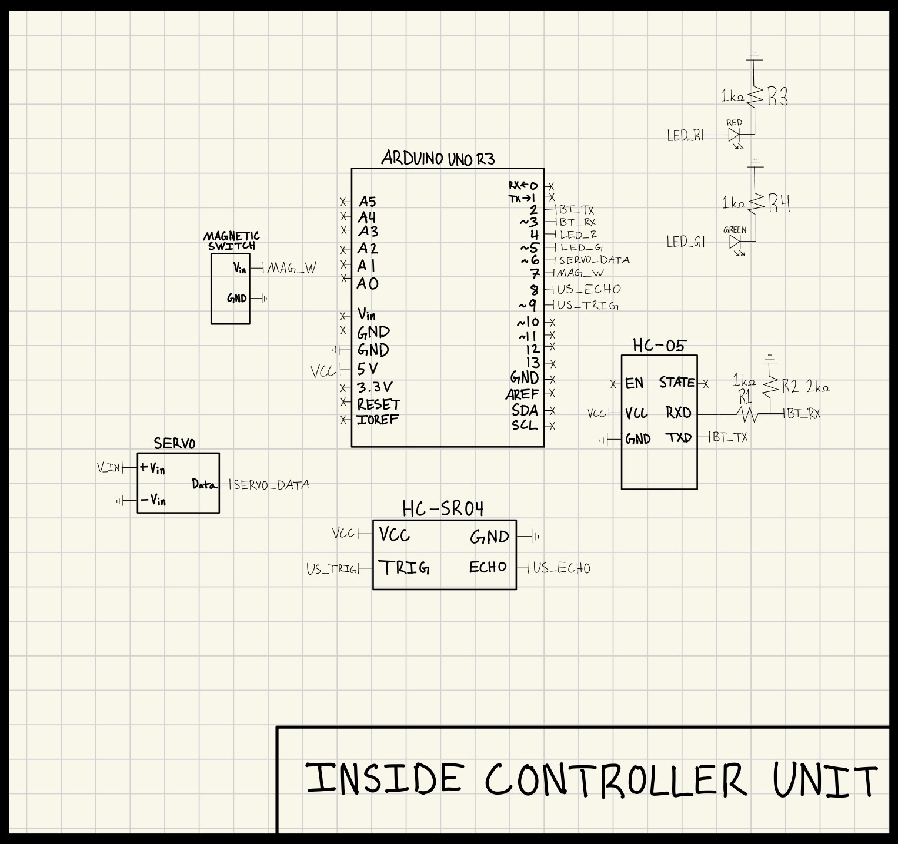
Inside Controller Wiring

Slide 5
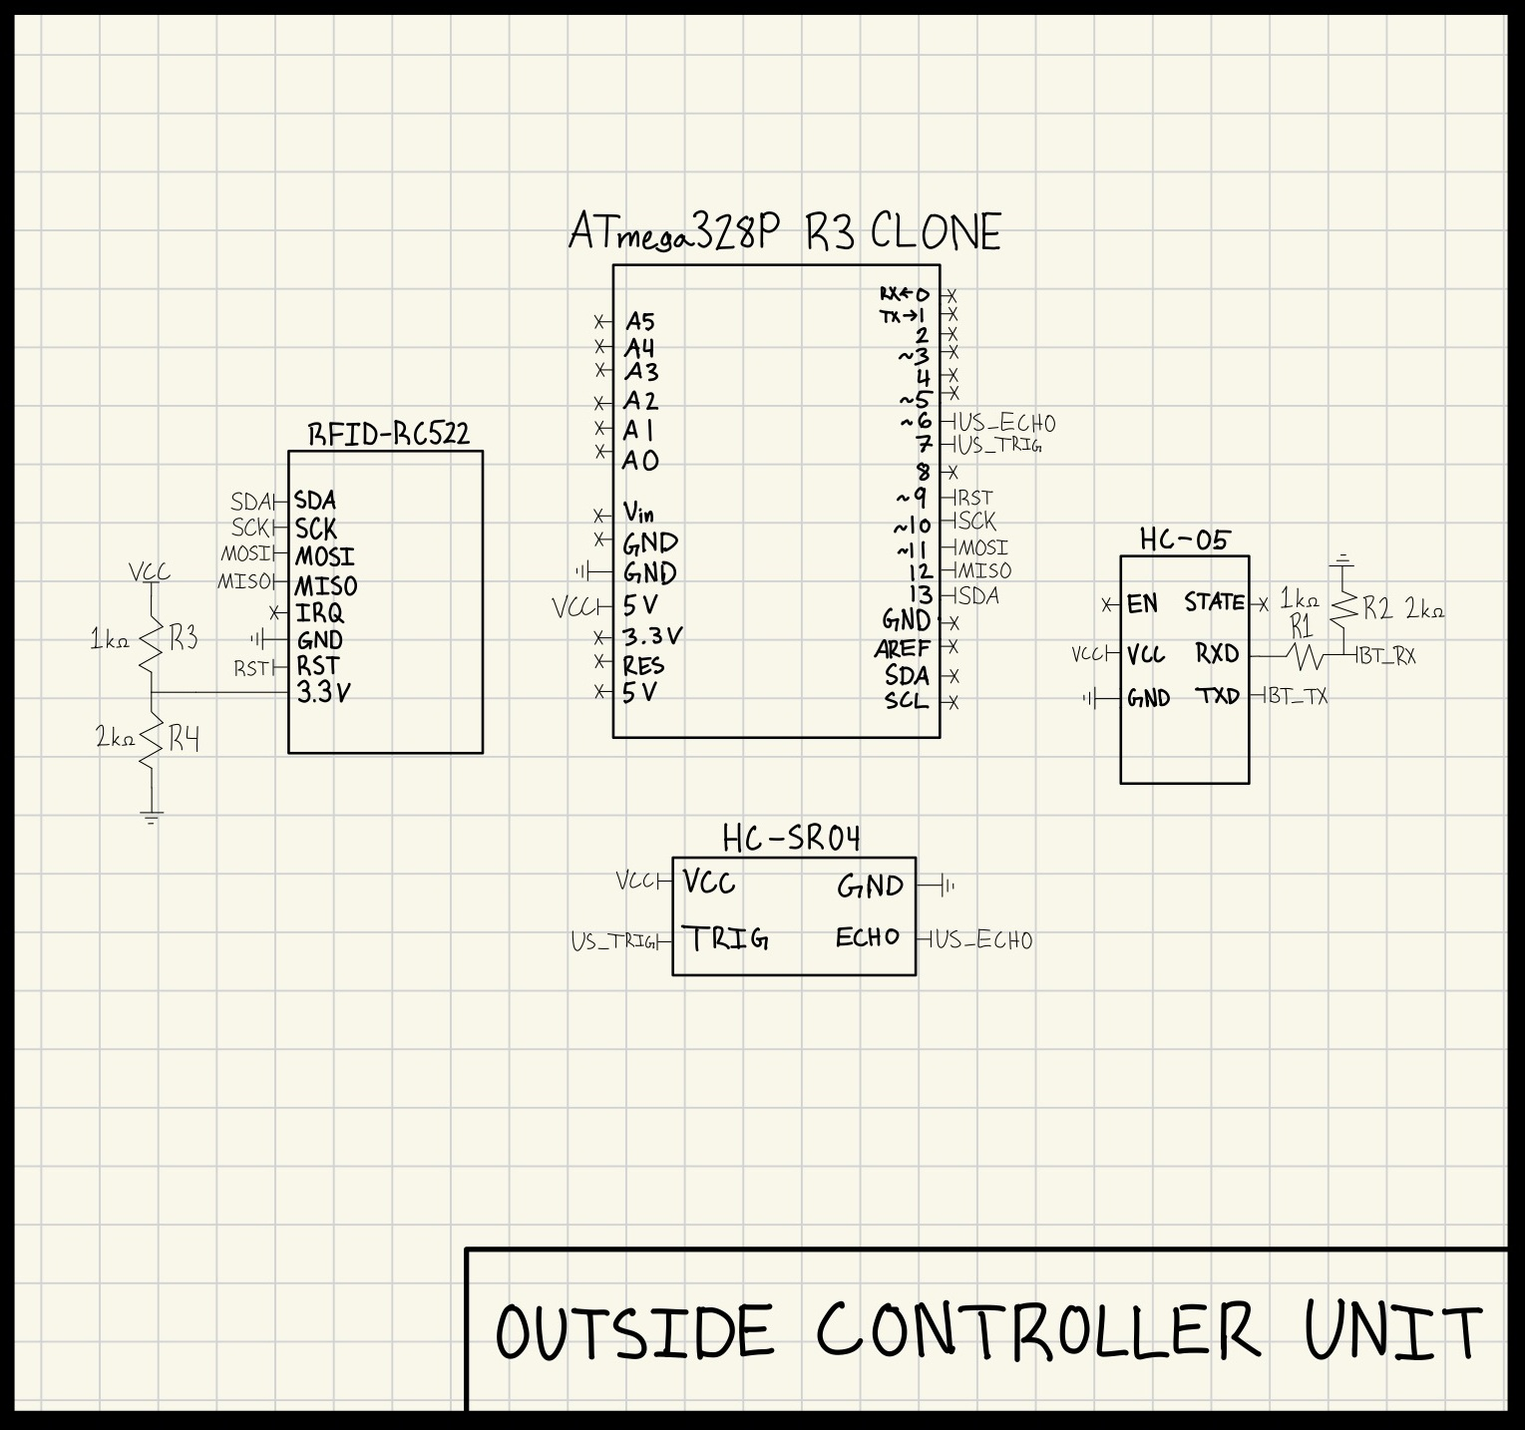
Outside Controller Wiring

Slide 6
HC-05 Bluetooth Protocol & Behavior
Outside unit sends single-character commands over Bluetooth
'0' → request UNLOCK (valid RFID + presence detected)
'1' → request LOCK / keep locked (access denied or relock)
Inside unit continuously listens and feeds commands into its state machine

Slide 7
Real-Time Behavior (Loop-Based Design)
No FreeRTOS in the final build (UNO clone memory is tight)
Both controllers use structured loop() logic with millis() timers
Frequent, non-blocking sensor checks keep the system responsive
Timeout-based automatic relock after a successful unlock
Notes:
I experimented with FreeRTOS earlier but never ran it in a stable way on the hardware because of memory limits. Instead, I now use a straightforward loop-based design: periodic checks of ultrasonic sensors and Bluetooth, and a state machine driven by millis()-based timeouts. This exhibits soft real-time behavior: the system reacts quickly enough for a human user and avoids long blocking delays.

Slide 8
How Phase 3 Differs from Phases 1 & 2
Phase 1: paper design with camera + facial recognition and many future modules
Phase 2: downscaled to realistic RFID-based prototype with two Arduino units
Phase 3: cleaned up final code into two .ino files and removed unused FreeRTOS attempts
Tightened presence + door-closed safety logic and created finished schematics and repository
Notes:
- Phase 1 was mostly on paper: UML, CRC cards, and diagrams describing a much bigger system with a camera, face recognition, database manager, scheduler, safety manager, etc.
- In Phase 2 I scoped it down into something I could actually build in a semester: two Arduino-based units using RFID instead of camera/face recognition, but still keeping the same core idea of presence + identity + door status.
- Phase 3 is about polishing that prototype. I cleaned up the code into final inside/outside sketches, removed FreeRTOS from the running build, tightened the logic for presence and the magnetic switch, and produced real schematics and an organized GitHub repo that matches what is on the bench.

Slide 9
Documentation & GitHub Repository
README with wiring, HC-05 AT commands, and RFID UID helper sketch
AutomaticDoorLock_Inside.ino and AutomaticDoorLock_Outside.ino in separate folders
Phase1.pdf, Phase2.pdf, and Phase3.pdf kept in a Phases/ directory
ProjectPictures/ folder with build and hardware photos
Repo link: https://github.com/ryantcliff/AutomaticDoorLock

Slide 10
Challenges and How I Overcame Them
Unassembled RFID module → learning to solder
Unpaired HC-05 Bluetooth Modules → learned AT commands and communication through SoftwareSerial
Sensor noise → tuned ultrasonic thresholds and debounced the magnetic switch
FreeRTOS memory usage → transitioned to simple loop() design

Slide 11
Future Work
Add authentication/encryption on top of the HC-05 link
Provide a way to manage RFID cards without reflashing code
Add a small backup battery and defined power-failure behavior
Explore more robust sensing than just ultrasonic distance

