Slide 1
Arctic Lake Sediment
Stanwell-Fletcher Lake

Slide 2
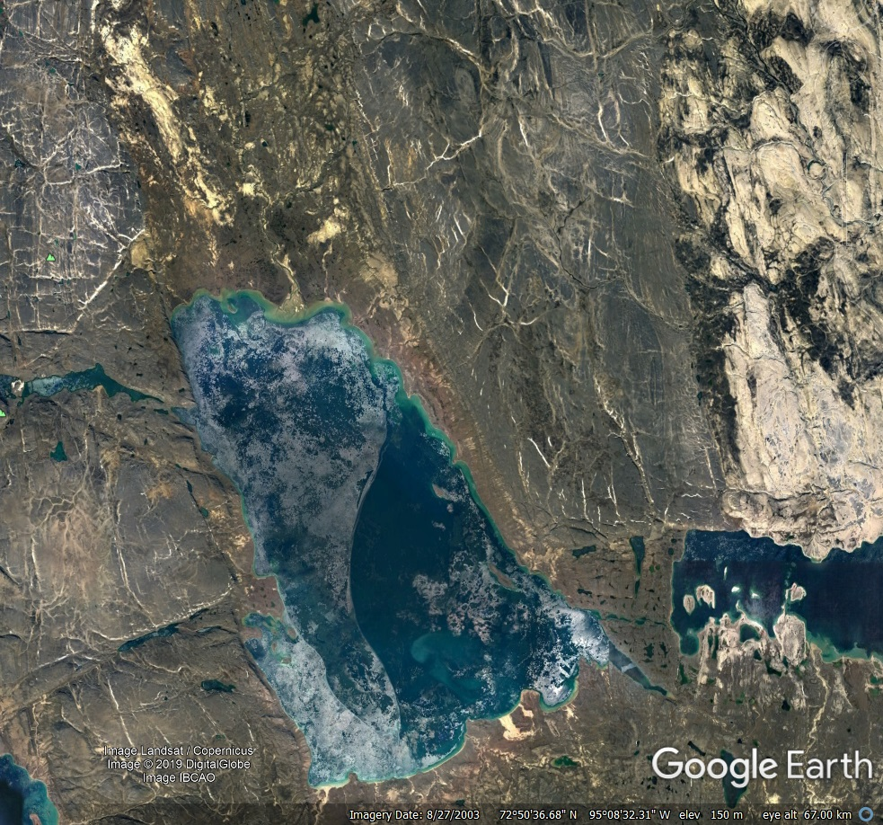
Introduction
Location :
Somerset Island, Northern Canada, Arctic Circle.
Size :
131 square miles.
Origin :
Formed by glacial scouring in Pleistocene Era
(2,500,000-11,000 years ago).

Slide 3
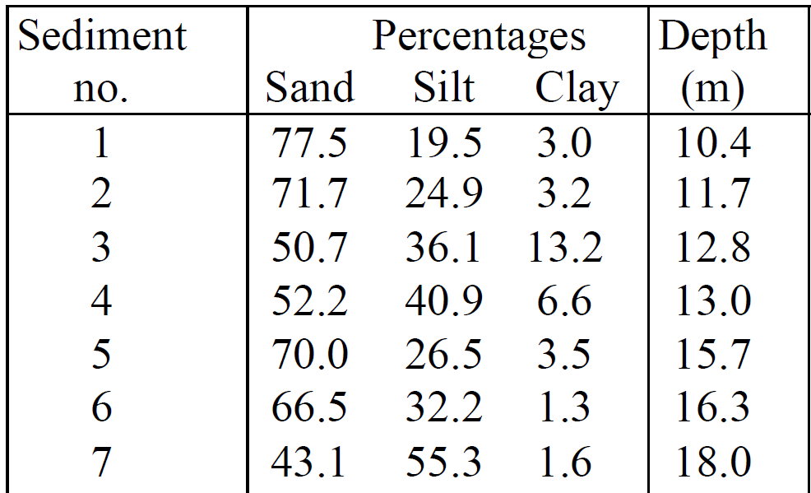
The data
39 samples taken from varying depths ~ (Coakley, J.P. & Rust, B.R. (1970))
Samples divided into 3 subsets, sand, silt, clay. (defined by particle size)

Slide 4
Sediment information
Sand has largest particle size, then silt, then clay
Sand takes most energy to transport, then silt, then clay.
Transported across the environment by wind and water.
Generally, the smaller the particle the further it has travelled.
Lakes act as sediment catchers.

Slide 5
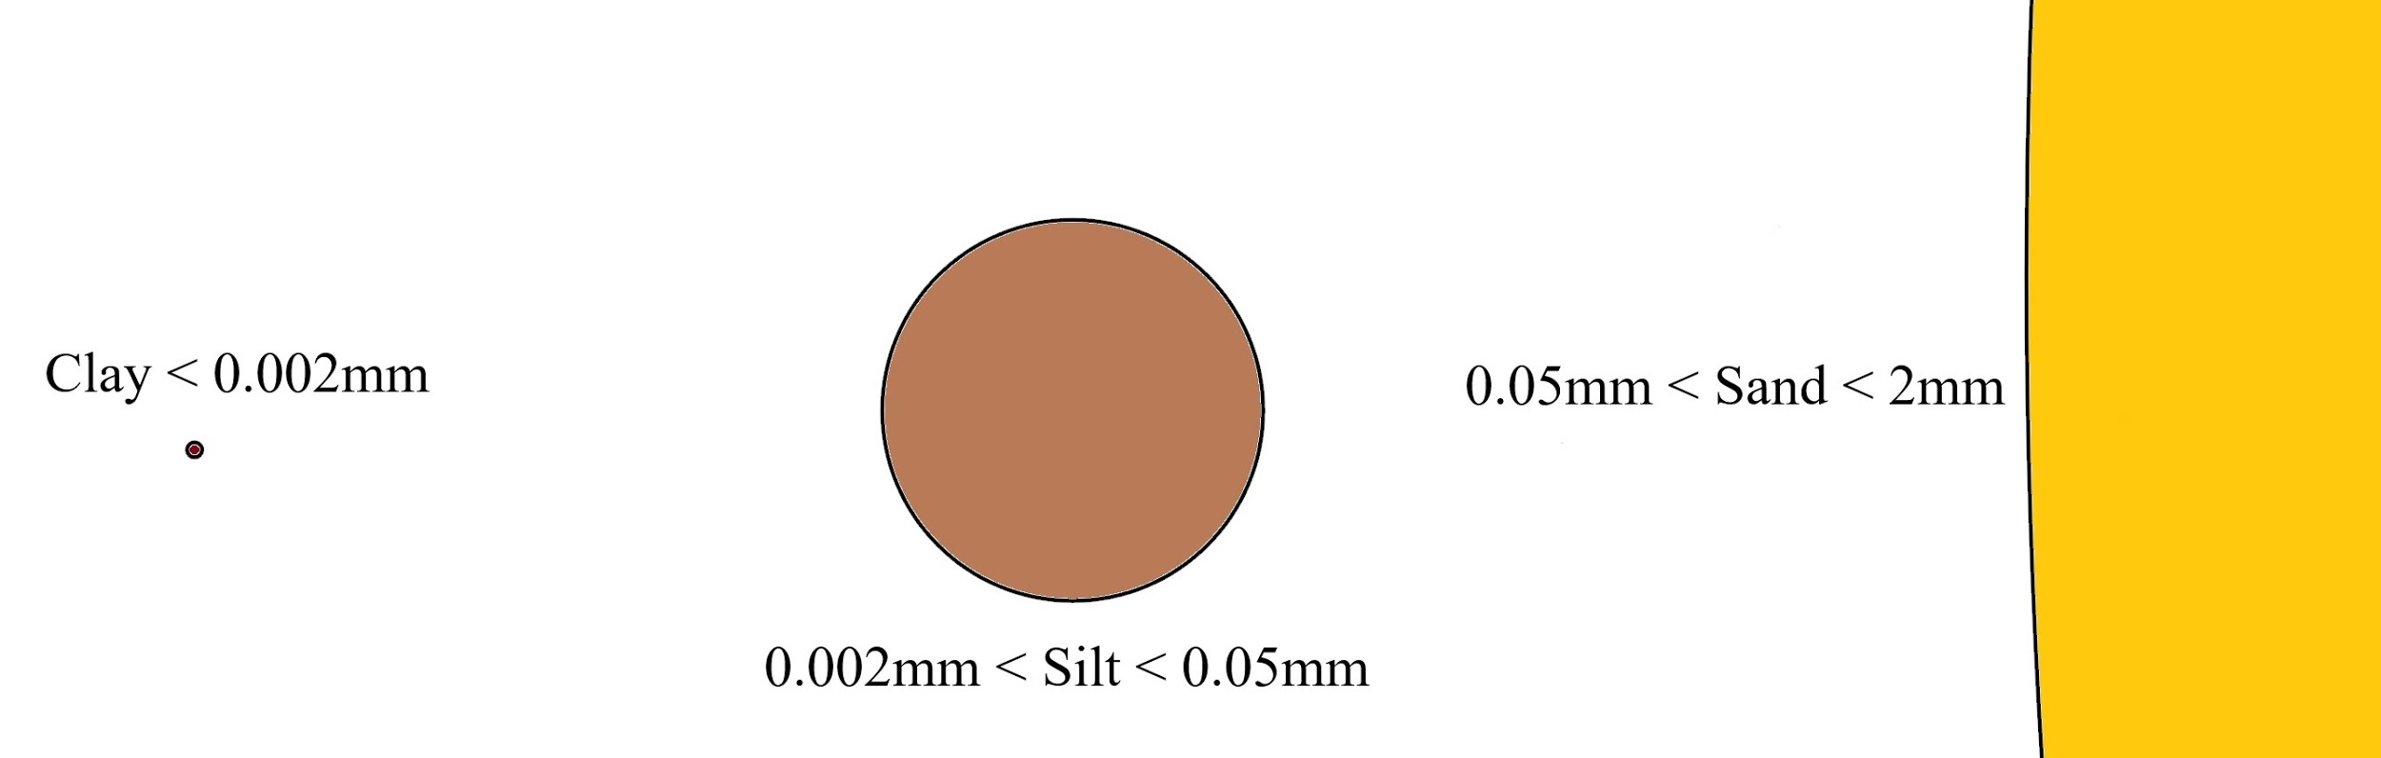
Sediment size comparison

Slide 6
Aims of the analysis
Is sediment composition dependent on water depth?
What else can we learn about the sediment from the data and other sources?

Slide 7
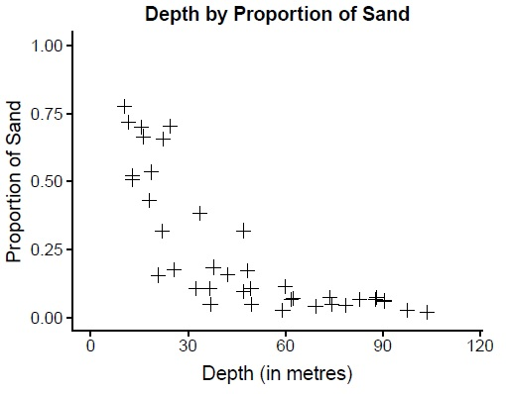
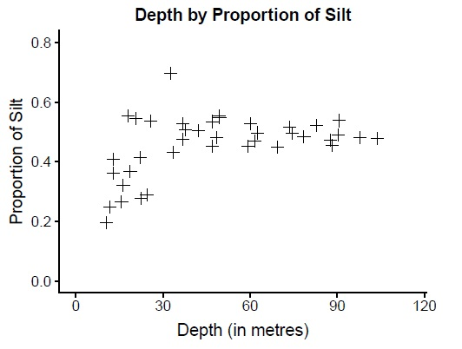
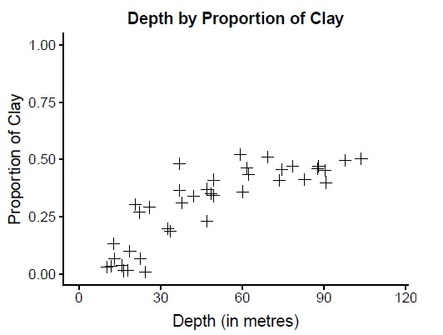
The data
Non-constant variance
Logarithmic relationships

Slide 8
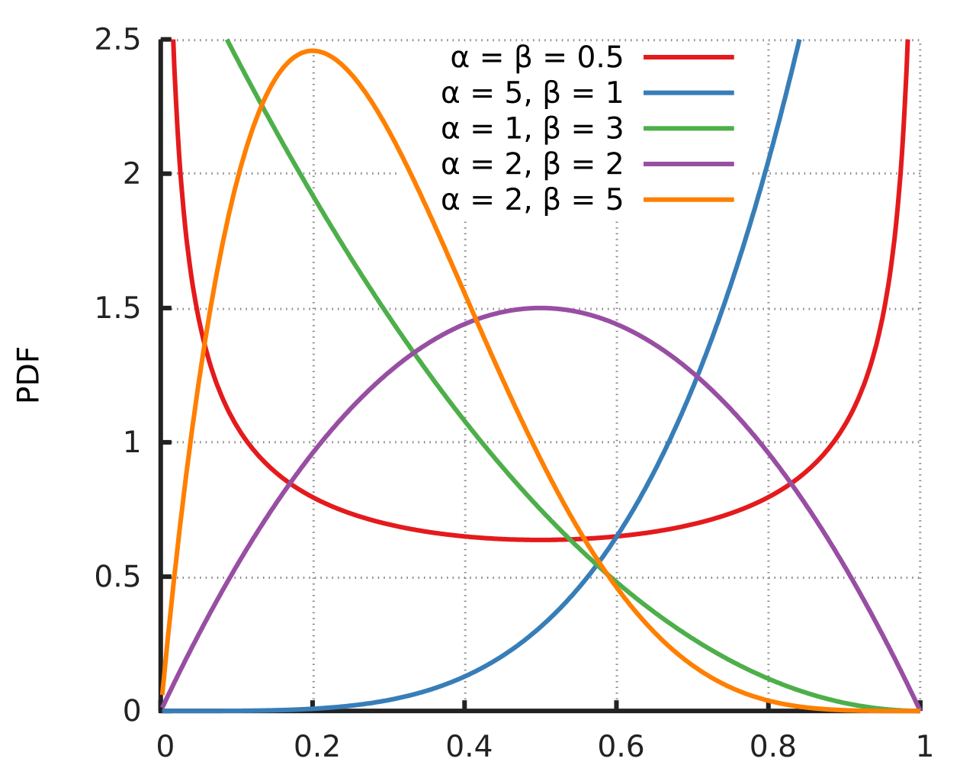
Modelling approach
Beta p.d.f distributions are defined on [0,1], as are proportions
Flexible : Deal with proportions which are heteroskedastic & asymmetrical / Can model variance separately
No need to transform the data
Model diagnostics are still an area of active research
By Horas based on the work of Krishnavedala - Own work, Public Domain, https://commons.wikimedia.org/w/index.php?curid=15404515

Slide 9
Modelling approach
Assume the proportion is beta distributed.
Knowing two proportions implies the 3rd since y1 + y2 + y3 = 1
Model constituents independently (Independent Models, eta)
Model 3rd proportion using the estimated values of the other two proportions (Implied Models, zeta)
Find the zeta model that closest matches it’s corresponding eta model

Slide 10
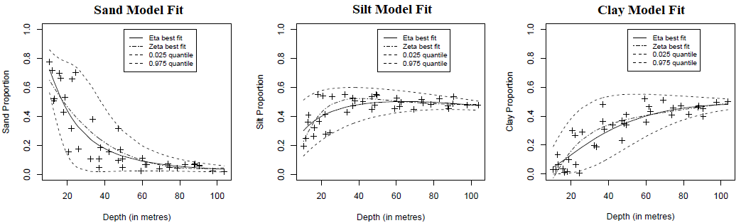
Model Fits
Clay model predicts negative proportions so not considered

Slide 11

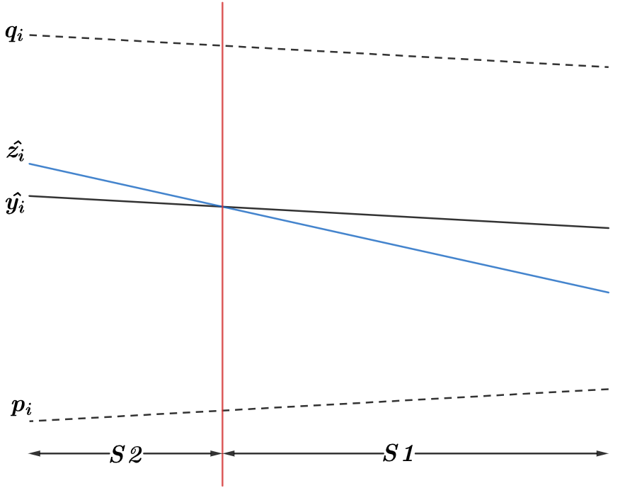
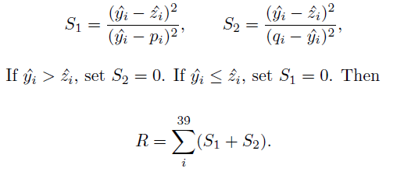
Model selection
Note :
Is symmetrical! So we cannot use this.

Slide 12
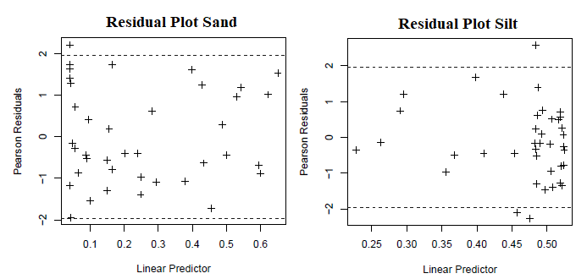
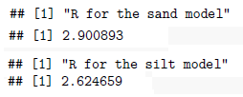
Model Selection
R values are close, sand average 7.4% “error”, silt average 6.7% “error” ~ (R/39)*100
Silt and Clay eta models were chosen to model the sand proportion

Slide 13
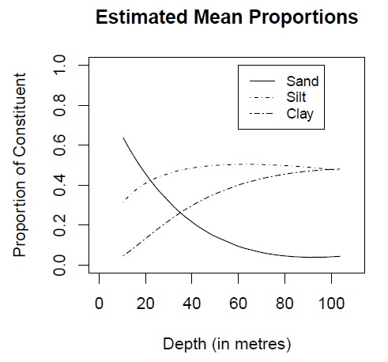
Conclusions
Sediment composition does depend on depth
Absence of sand and clay at the extremes of depth
Weak currents prevent transportation of sand into centre
Currents strong enough to transport the clay away from shore
Large silt particles behave like sand, small behave like clay
This is why silt is found quite evenly spread across the lake

Slide 14
What did we learn?
Is sediment composition dependent on water depth?
Yes
What else can we learn about the sediment from the data and other sources?
Sediment particle size decreases towards the centre
Dependent on the strength of the currents

Slide 15

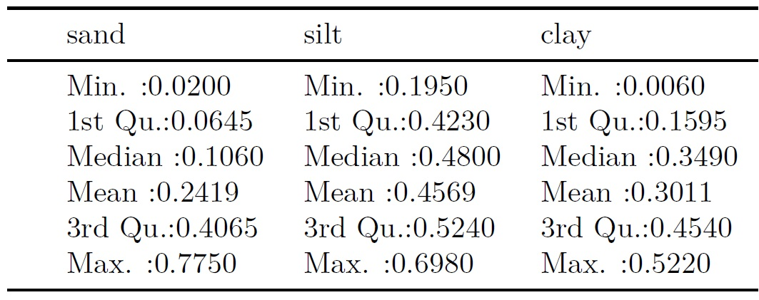


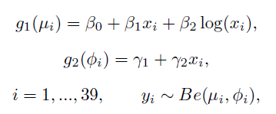
Extra (Not presented)

