Slide 1

DOWNLOAD LESSON CODE
OPEN (CODE) IN SUBLIME

Slide 2
Front-end web development
snacks & Design
MONDAY
FRANK
(Google sheet is pinned in slack)

Slide 3
FEWD
Q & A

Slide 4
*Wed Class + Office hours, how’s everyone doing?*

Slide 5
*Final Projects, focus on JS*

Slide 6
*Final Projects*

Slide 7
“Would it be possible to add the homework submission link a little earlier so we can upload our homework on Saturday?“

Slide 8
“What is something that is most commonly
attributed to Javascript when it shouldn't be?
(Like, should actually be done in CSS or HTML)”

Slide 9
“For our final projects,
would you recommend we use jQuery or Vanilla JS? “

Slide 10
“Convention for using spaces within functions and variables in JS...? (e.g. "( a * ( b + c )" vs. “(a*(b+c)")"
Notes:
Consistency.

Slide 11
*HOMEWORK*

Slide 12
JS - Variables and Conditionals
Eric Boyer

Slide 13
JS Basics
review

Slide 14
using jquery to manipulate the dom
1
2
Select an element/elements
Work with those elements

Slide 15
jquery — selecting elements
Selector
$('li')
.addClass('selected');
jQuery Function
jQuery Function:
Lets us find one or more elements in the page
Creates a jQuery object which holds references to those elements
We'll be using the shorthand in this class: $( )
$(selector) is the same as jQuery(selector)

Slide 16
using jquery to manipulate the dom
1
2
Select an element/elements
Work with those elements

Slide 17
jquery — working with those elements
Parameter(s)
$('li')
.addClass('selected');
Method

Slide 18
jquery methods — traversing the dom
traverse the dom
jQuery provides us with methods to find/select elements to work with & traverse the DOM
Some methods available to us:
What goes in the parentheses?
A css-style selector
.find( ) (finds all descendants)
.children( )
.parent( )
.siblings( )
Examples:
$('h1').find('a');
$('#box1').parent();
$('p').siblings('.important');
*Think of this as part of the selection process, must come directly after another selection
Notes:
Students will ask why we use these instead of just nested selectors. Example: this

Slide 19
jquery methods — Getting/setting content
get/set
content
Get/change content of elements, attributes, text nodes
Some methods available to us:
What goes in the parentheses?
The html, styles, classes you want to add/change
.html( )
.attr( )
.css( )
.addClass( )
.removeClass( )
.toggleClass( )
Examples of adding/changing content:
$('h1').html('Content to insert goes here');
$('img').attr('src', 'images/bike.png');
$('#box1').css('color', 'red');
$('p').addClass('success');
$('p').removeClass('my-class-here');

Slide 20
add class
$('h1').addClass('.fun')
Remember — no period!!
$('h1').addClass('fun')

Slide 21
jquery methods — effects/animation
add effects/animation
Add effects and animation to parts of the page
Some methods available to us:
What goes in the parenthesis?
An animation speed
.show( )
.hide( )
.fadeIn( )
.fadeOut( )
.slideUp( )
.slideDown( )
.slideToggle( )
Examples:
$('h1').fadeOut(200);
$('#box1').slideDown('slow');
$('h1').fadeIn();

Slide 22
jquery methods — events!
create
event
listeners
The .on() method is used to handle all events.
Syntax:
$('selector').on('event', code_that_should_run);
Example:
$('li').on('click', function() {
// your code here
});

Slide 23
jquery methods — events!
create
event
listeners
Some events that .on() deals with:
UI: focus, blur, change
Keyboard: keydown, keyup
Mouse: click, mouseup, mousedown, mouseover
Form: submit
Browser: resize, scroll
$('li').on('eventGoesHere', function() {
// your code here
});

Slide 24

jquery — review
key objective
Review jQuery selectors and events, get practice looking up new methods
EXERCISE
Type of exercise
Individual/paired
small group planning
8 min
Follow the instructions in lesson9_starter_code > [0] jquery_review > js/main.js

Slide 25
JS Basics
some new methods!

Slide 26


input and button elements
text input element
<input type="text" placeholder="Enter your name">
button element
<button type="button">Sign me up!</button>

Slide 27
some new methods!
get/set
content
Get/change content of elements, attributes, text nodes (part 2!)
What goes in the parentheses?
The html or content you want to add/change
Some new methods
.html( )
.append( )
.prepend( )
.val( )
Examples of adding/changing content:
$('h1').html('Summer in Chicago rocks!');
$('.box').html('<h1>Best box ever!</h1>');
$('ul').prepend('<li>First list item</li>');
$('ul').append('<li>Last list item</li>');
$('input').val();
Notes:
Draw a visual on the board

Slide 28
Learning objectives
JS Basics
Define variables and identify best cases to use them.
Differentiate between strings, integers and floats.
Apply conditionals to change the program's control flow

Slide 29

Agenda
Variables
Data Types
Conditionals
Lab — Temperature Converter

Slide 30
JS Basics
Variables

Slide 31
JS Basics
what are variables?

Slide 32
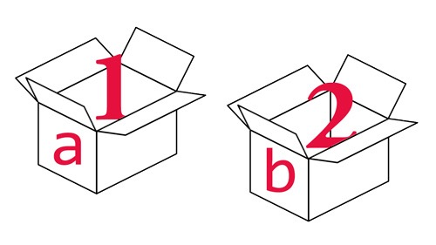
what are Variables?
We can tell our program to remember (store) values for us to use later on.
The 'container' we use to store the value is called a variable

Slide 33
JS Basics
syntax

Slide 34
javascript — variables
var age;
Declaring a variable
Keyword
Name
age = 29;
Assigning a variable
Name
Value
var age = 29;
Both in one step

Slide 35
javascript — variables
var age;
Declaring a variable
Keyword
Name
age = 29;
Assigning a variable
Name
Value
var age = 29;
Both in one step

Slide 36
javascript — variables
var age;
Declaring a variable
Keyword
Name
age = 29;
Assigning a variable
Name
Value
var age = 29;
Both in one step

Slide 37
javascript — variables
var age;
Declaring a variable
Semicolon!
age = 29;
Assigning a variable
Semicolon!
var age = 29;
Both in one step
Semicolon!

Slide 38
javascript — variable Re-assignment
var champion = “Eric”;
champion = “Ben”;

Slide 39
assignment operators
initial value:
Operator:
Example:
result:
assign value to variable
var num = 8
=
num = 6
6
add value to variable
var num = 8
+=
num += 6
14
subtract value from variable
var num = 8
-=
num -= 6
2

Slide 40
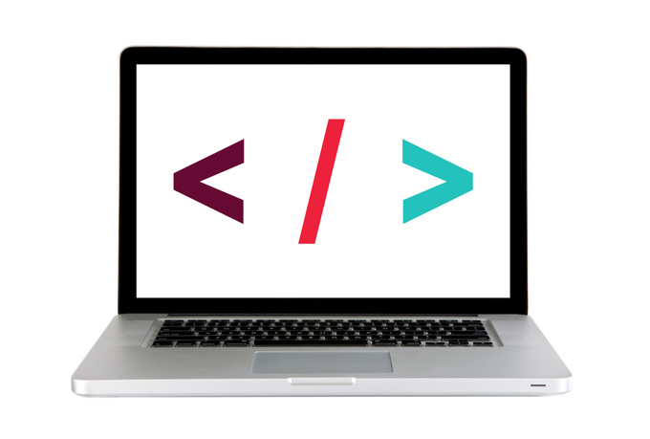
Code along — Score keeper
Score Keeper (Codepen)
Notes:
Get as far as explaining what’s going on with the code written, then fix in future slide.

Slide 41
JS Basics
rules

Slide 42

Variable conventions
Variables start with a lowercase letter
var numberOfStudents = 10;
var NumberOfStudents = 10;
2. If they contain multiple words, subsequent words start with an upper case letter.
var firstName = "Eric";
var firstname = "Eric";
var first name = "Eric";
3. Names can only contain: letters, numbers, $ and _ (no dashes - or periods . )
var number1 = 5.5;
var number-1 = 10;
var number.1 = 10;

Slide 43
Variable conventions
3. Variables cannot start with a number
var number1 = 10;
var 1number = 10;
4. Case sensitive - numberofstudents is not the same as numberOfStudents
5. Names should be descriptive
var lastName = "Boyer";
var x = "Boyer";

Slide 44
what can be stored in variables?
Data types:
Strings
numbers
booleans
"Today is Monday"
10
22.75
true
false
Letters and other characters enclosed in quotes
Positive numbers
Negative numbers
Decimals
Can have one of two values:
True
False
* Note: we'll meet some more data types later on down the road, too!
Notes:
Strings - single/double quotes: will explain later
Booleans - like a light switch

Slide 45
to summarize
A variable has both a “name” and a “value”
That value can change
A variable can be used multiple times throughout the code

Slide 46
order is important!!!
var name = “Matt”;
“Matt” = var name;
wrong!!!!!

Slide 47
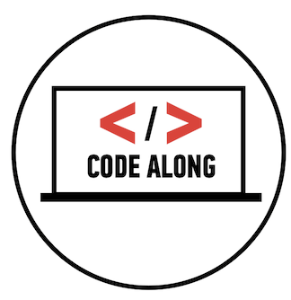
Code along — variables pt. 1
lesson9_starter_code > [1] variables

Slide 48
lab — VARIABLES — part 2
key objective
Practice declaring and assigning variables
Type of exercise
Individual/paired
EXERCISE
location
lesson9_starter_code > [1] variables
execution
6 min
Follow the instructions under Part 2

Slide 49
JS Basics
data types

Slide 50
data types
numbers

Slide 51
more about numbers
integers:
Integers are whole numbers
10
floats:
Number that uses a decimal to represent a fraction
22.75
*Can perform arithmetic on number data types

Slide 52
arithmetic operators
Operator:
Example:
Result:
Addition
+
2 + 4
6
Subtraction
-
8 - 1
7
Name:
Multiplication
*
2 * 3
6
division
/
4 / 2
2

Slide 53
data types
strings

Slide 54
more about strings
a string:
Stores textual information
Is surrounded by quotes
"How is the weather today?"
'Cold'

Slide 55
strings
double quotes vs. Single quotes
"It's a beautiful day"
'They "purchased" it'
escaping
'It\'s a beautiful day'
"They \"purchased\" it"

Slide 56
methods and properties of strings
MAKE STRING LOWERCASE:
LENGTH OF A STRING (PROPERTY):
var str = "Hello World";
var res = str.toLowerCase();
// the result of res will be:
// hello world!
var str = "Hello World";
var n = str.length;
// the result of n will be 11
MAKE STRING UPPERCASE:
var str = "Hello World";
var res = str.toUpperCase();
// the result of res will be:
// HELLO WORLD!
**Find a whole list of methods and properties for strings here

Slide 57
string Concatenation
To take two strings and stick them together, use the + operator.
This is called string concatenation.
var book = "Happy";
var summary = "Best book ever.";
var review = book + ": " + summary;
// Result will be: Happy: Best book ever.

Slide 58
data types
Booleans

Slide 59
booleans
Can have one of two values:
true
false

Slide 60
data types
converting data types

Slide 61
data type conversion
String to integer:
Number to string
var number = 4;
number.toString(); => "4";
var intString = "4";
var intNumber = parseInt(intString, 10);
String to float:
var floatString = "3.14159";
var floatNumber = parseFloat(floatString);
Notes:
Explain: Why would you need to convert data types?
String -> Integer in a form field. Taking a value that someone inputs as a text string and needing to do math with it.
Number -> String the reverse

Slide 62
Code along — Score keeper
Let's code! Score Keeper (Codepen)
Notes:
Let’s fix the broken buttons.

Slide 63
JS Basics
Conditionals

Slide 64
JS Basics
what are conditionals?

Slide 65
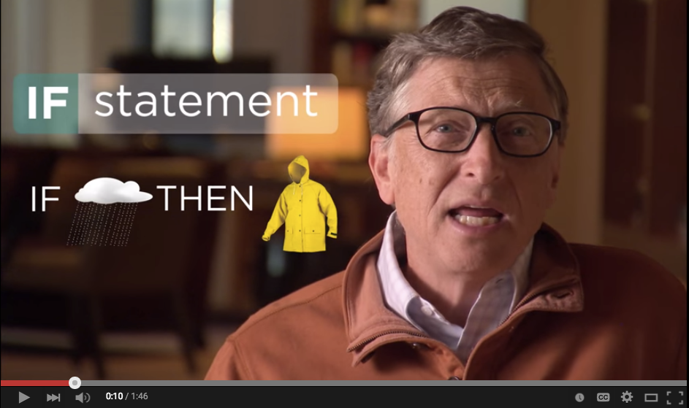
if statements
Notes:
Father Bill

Slide 66
conditional logic
If something is true, do one thing. If it is not, do something else. This type of logic or statement is a condition.
In JavaScript (and coding in general) you'll need to make comparisons all the time:
Is a user logged in?
Has the user chosen three or more colors?
Is the password correct?
Does a user have enough money in their bank account?
etc.

Slide 67
JS Basics
comparison operators

Slide 68
javascript — comparison operators
>=
===
Greater than or equal to
Equal to
<=
!==
Less than or equal to
Not equal to
>
Greater than
<
Less than

Slide 69
assignment vs. comparison — don't get them confused!
assignment
comparison
=
===
==
var number = 7;
or
if (number === 8) {
// Do something
}
Notes:
var check1 = '10',
check2 = 10;
check1 == check2 // true
check1 === check2 // false
== only compares values
=== compares values + type

Slide 70
JS Basics
if statements

Slide 71
javascript — if statement
Condition
if (answer === 38) {
// Do something if true
}

Slide 72
if statements
if (age > 65) {
$('h1').html("Senior Discount Applied");
}

Slide 73
javascript — if/else statement
if (answer === 38) {
// Do something if true
} else {
// Do something if false
}

Slide 74
if statements
if (age > 65) {
$('h1').html("Senior Discount Applied");
} else {
$('h1').html("Sorry, you do not qualify for a discount.");
}

Slide 75
javascript — if/else if/else
if (answer === 38) {
// Do something if first condition is true
} else if (answer === 30) {
// Do something second condition is true
} else {
// Do something if all above conditions are false
}

Slide 76
if statements
if (age > 65) {
$('h1').html("Senior Discount Applied");
} else if (age < 18) {
$('h1').html("Student Discount Applied");
} else {
$('h1').html("Sorry, you don't qualify for a discount");
}

Slide 77
Code along — Score keeper
Let's code! lesson9_starter_code > [2] conditionals

Slide 78
JS Basics
logical operators

Slide 79
javascript — logical operators
&&
and
||
or
!
not

Slide 80
multiple conditions
if (name === "GA" && password === "YellowPencil"){
//Allow access to internet
}

Slide 81
Exercise — blackout
key objective
Practice combining conditionals with jQuery to create a simple interaction.
EXERCISE
Type of exercise
Individual/Paired
execution
5 min
8 min
lesson9_starter_code > [3] blackout
Together: write pseudo code for the light/dark switcher.
In pairs, write code to complete the light/dark switcher.

Slide 82
Code along — compare two numbers
Let's code! Compare Two Numbers (Codepen)

Slide 83
JS Basics
lab

Slide 84

Lab — Temp converter

Slide 85
lab — Temp converter — part 1
key objective
Build an application using HTML/CSS and JS that converts a temperature from Fahrenheit to Celsius
EXERCISE
Type of exercise
Groups of 3-4
small group planning
Until 8:45
In groups of 3-4 test out the functional temperature converter and write pseudo code to convert a temperature from Fahrenheit to Celsius

Slide 86
lab — Temp converter — part 2 (Next class)
key objective
Build an application using HTML/CSS and JS that converts a temperature from Fahrenheit to Celsius
execution
EXERCISE
Until 8:50
Write .js to make the temperature converter functional.
Bonus #1: Change the background-color depending on what temperature the user enters
Bonus #2: Add error styles if the user doesn't enter a value in the form
Bonus #3: Add your own styles to the temperature converter
**For reference, see the Compare Two Numbers and Score Keeper

Slide 87
lab — Temp converter — Formulas
Formula to convert fahrenheit to celsius:
(fahrenheit - 32) / 1.8;
Formula to convert celsius to fahrenheit:
1.8 * celsius + 32;

Slide 88
jquery methods — events!
create
event
listeners
The .on() method is used to handle all events.
Syntax:
$('selector').on('event', code_that_should_run);
Example:
$('li').on('click', function() {
// your code here
});

Slide 89
Learning objectives
JS Basics
Define variables and identify best cases to use them.
Differentiate between strings, integers and floats.
Apply conditionals to change the program's control flow.

Slide 90
Front-end web development
snacks & Design
MONDAY
Eric
(Google sheet is pinned in slack)

Slide 91
JS - Variables and Conditionals
Exit Tickets

