Slide 1
Front-end web development
snacks & Design
TODAY
ERIC
(Google sheet is pinned in slack)

Slide 2
FEWD
Q & A

Slide 3
*Hardest Classes in Course*

Slide 4
Office hours: 2pm - 5pm, Sunday @ GA

Slide 5
“Can we do more practice if/then statements next class?”

Slide 6
“CAN WE DO ANOTHER LAB POR FAVOR”

Slide 7
“Can you review the importance of converting data types again? In what instances would you use these?”

Slide 8
“I didnt understand a single thing in today's lesson. I need to see actual applications on websites.”

Slide 9
“Is there an advantage to writing vanilla js? Is it just so you don't need to link the jquery and be connected to the internet.”

Slide 10
“I'll need to review. Brain shut off around 7:30”

Slide 11
"How do you only allow numbers or letters in an answer field?
Booleans?”

Slide 12
what can be stored in variables?
Data types:
Strings
numbers
booleans
"Today is Monday"
10
22.75
true
false
Letters and other characters enclosed in quotes
Positive numbers
Negative numbers
Decimals
Can have one of two values:
True
False
* Note: we'll meet some more data types later on down the road, too!
Notes:
Strings - single/double quotes: will explain later
Booleans - like a light switch

Slide 13
data type conversion
String to integer:
Number to string
var number = 4;
number.toString(); => "4";
var intString = "4";
var intNumber = parseInt(intString, 10);
String to float:
var floatString = "3.14159";
var floatNumber = parseFloat(floatString);
Notes:
Explain: Why would you need to convert data types?
String -> Integer in a form field. Taking a value that someone inputs as a text string and needing to do math with it.
Number -> String the reverse

Slide 14
*HTML Boilerplate*
lesson13_starter_code > [-] final_project_boilerplate

Slide 15
JS Basics
lab

Slide 16

Lab — Temp converter

Slide 17

lab — Temp converter — part 1
key objective
Build an application using HTML/CSS and JS that converts a temperature from Fahrenheit to Celsius
EXERCISE
Type of exercise
Groups of 3-4
small group planning
Until 8:45
In groups of 3-4 test out the functional temperature converter and write pseudo code to convert a temperature from Fahrenheit to Celsius

Slide 18
lab — Temp converter — part 2 (Next class)
key objective
Build an application using HTML/CSS and JS that converts a temperature from Fahrenheit to Celsius
execution
EXERCISE
Until 7:20
Write .js to make the temperature converter functional.
Bonus #1: Change the background-color depending on what temperature the user enters
Bonus #2: Add error styles if the user doesn't enter a value in the form
Bonus #3: Add your own styles to the temperature converter
**For reference, see the Compare Two Numbers and Score Keeper

Slide 19
lab — Temp converter — Formulas
Formula to convert fahrenheit to celsius:
(fahrenheit - 32) / 1.8;
Formula to convert celsius to fahrenheit:
1.8 * celsius + 32;

Slide 20
jquery methods — events!
create
event
listeners
The .on() method is used to handle all events.
Syntax:
$('selector').on('event', code_that_should_run);
Example:
$('li').on('click', function() {
// your code here
});

Slide 21
Functions
Eric Boyer

Slide 22
Learning objectives
Functions
Describe arguments as they relate to functions.
Predict values returned by a given function.
Notes:
End by revisiting the learning objectives. This lets students reflect on what they learned and determine if they have any outstanding questions.

Slide 23

Agenda
Review
Functions — What are functions?
Functions — Syntax
Functions — Return Values
Functions — Scope
Lab Time — Temperature Converter

Slide 24
FEWD
review

Slide 25
javascript — variables
var age;
Declaring a variable
Semicolon!
age = 29;
Assigning a variable
Semicolon!
var age = 29;
Both in one step
Semicolon!

Slide 26
javascript — variable Re-assignment
var name = “Matt”;
name = “Ana”;

Slide 27
what can be stored in variables?
Data types:
Strings
numbers
booleans
"Today is Monday"
10
22.75
true
false
Letters and other characters enclosed in quotes
Positive numbers
Negative numbers
Decimals
Can have one of two values:
True
False
* Note: we'll meet some more data types later on down the road, too!
Notes:
Strings - single/double quotes: will explain later
Booleans - like a light switch

Slide 28
javascript — comparison operators
==
>
Equal to
Greater than
===
<
Strict equal to
Less than
!=
>=
Not equal to
Greater than or equal to
!==
<=
Strict not equal to
Less than or equal to

Slide 29
javascript — if/else if/else
if (answer === 38) {
// Do something if first condition is true
} else if (answer === 30) {
// Do something second condition is true
} else {
// Do something if all above conditions are false
}

Slide 30
javascript — logical operators
&&
and
||
or
!
not

Slide 31
Review exercise — conditionals
key objective
Review and practice using variables and conditionals
Type of exercise
EXERCISE
Individual/paired
execution
12 min
Follow the instructions in lesson13_starter_code > [0] conditionals > main.js (Part 1)
If you finish early, work on the bonus section

Slide 32
Functions
Functions

Slide 33
Functions
what are functions?

Slide 34
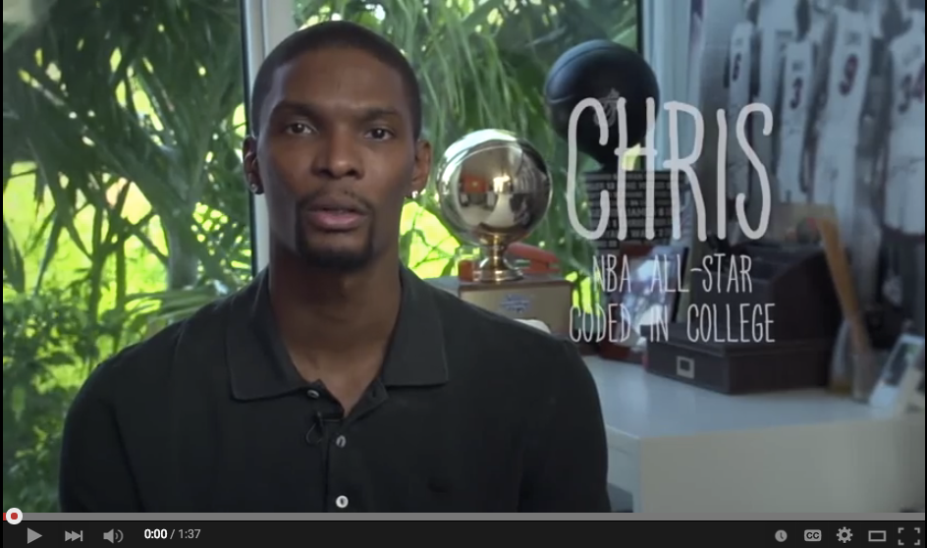
functions
Notes:
http://codepen.io/nevan/pen/BkdqI

Slide 35
Functions
Group steps
reusable
store steps
Allow us to group a series of statements together to perform a specific task
We can use the same function multiple times
Not always executed when a page loads. Provide us with a way to 'store' the steps needed to achieve a task.

Slide 36
dry
DRY — DON'T REPEAT YOURSELF

Slide 37

Let's take a closer look
jQuery Traffic Light
Notes:
Remember this ole boy? Change “clear” to not be DRY to explain

Slide 38
Functions
syntax

Slide 39
syntax — declaring a function
Keyword
Name
function pickADescriptiveName() {
// Series of statements to execute
}
Code block

Slide 40
syntax — calling a function
To run the code in a function, we 'call' the function by using the function name followed by parenthesis.
pickADescriptiveName();
Function name
Notes:
Note: order isn't important (declaration and calling)

Slide 41
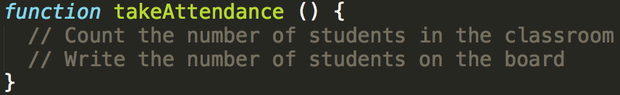
functions — taking attendance

Slide 42

functions — taking attendance

Slide 43

Code along — functions
Let's code! lesson13_starter_code > functions (part 1)

Slide 44
syntax — declaring a function (with parameters)
Parameters
function multiply(param1, param2) {
var result = param1 * param2;
$('h1').html(result);
}
We can use these parameters like variables from within our function

Slide 45
syntax — Calling a function (with arguments)
Arguments
multiply(350, 140)

Slide 46
Let's take a closer look
Multiply on CodePen

Slide 47
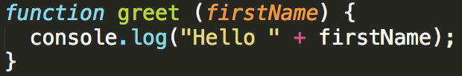
functions — Greet

Slide 48

functions — Greet

Slide 49
Code along — functions
Let's code! lesson13_starter_code > functions (part 2)
Notes:
Check for hands, who did/didn’t get this done?

Slide 50
Functions
return values

Slide 51
returning values from a function
To return a value from a function, we use the return keyword
From within a function, the return keyword 'hands' a value back to the code that called the function
We can then do something with that value, or store it in a variable for use later in the script
function convertToCurrency (entry) {
// Cut number to two decimal point
var currency = entry.toFixed(2);
// Prepend the dollar sign
currency = '$' + currency;
return currency;
}
var amountInDollars = convertToCurrency(entry);
$('ul').append('<li>' + amountInDollars + '</li>');
Notes:
Sometimes the point of a function is to give you something back

Slide 52
Functions
scope

Slide 53
variable scope
local variables
A local variable is a variable that is declared inside a function.
It can only be used in that function, and cannot be accessed outside of that function
global variables
A global variable is a variable that is declared outside of a function.
It can be used anywhere in the script.

Slide 54
Functions
Lab time!

Slide 55
Lab

Slide 56
lab — Temp converter — Formulas
Formula to convert fahrenheit to celsius:
(fahrenheit - 32) / 1.8;
Formula to convert celsius to fahrenheit:
1.8 * celsius + 32;

Slide 57
jquery methods — events!
create
event
listeners
The .on() method is used to handle all events.
Syntax:
$('selector').on('event', code_that_should_run);
Example:
$('li').on('click', function() {
// your code here
});

Slide 58
lab — Temp converter — part 1
key objective
Build an application using HTML/CSS and JS that converts a temperature from Fahrenheit to Celsius
EXERCISE
Type of exercise
Groups of 3-4
small group planning
In groups of 3-4 test out the functional temperature converter and write pseudo code to convert a temperature from Fahrenheit to Celsius

Slide 59
Code along — functions
Let's code! lesson13_starter_code > [2] temp_converter

Slide 60
lab — Temp converter — part 2
key objective
Build an application using HTML/CSS and JS that converts a temperature from Fahrenheit to Celsius
EXERCISE
execution
Until 8:50
Start with the functional temp converter
Create getCelsius() and getFahrenheit() functions
Bonus #1: Change the background-color depending on what temperature the user enters (example)
Bonus #2: Add error styles if the user doesn't enter a value in the form (example)
**For reference, see the Compare Two Numbers and Score Keeper

Slide 61
Learning objectives
Functions
Describe arguments as they relate to functions.
Predict values returned by a given function.
Notes:
End by revisiting the learning objectives. This lets students reflect on what they learned and determine if they have any outstanding questions.

Slide 62
lab
homework: “cash_register"

Slide 63
Front-end web development
snacks & Design
MONDAY
RYAN
(Google sheet is pinned in slack)

Slide 64
Functions
Exit Tickets

