Slide 1


Slide 2
Front-end web development
snacks & Design
TODAY!
LAURA
(Google sheet is pinned in slack)

Slide 3
FEWD
Q & A

Slide 4
“How is the code written after the pseudo is figured out?”

Slide 5
“Will we be going over jquery in more depth when we get to writting js?”

Slide 6
“I still need to see how jQuery is written into Javascript. Is it fair to say that scss::CSS is jQuery::Javascript?”

Slide 7

Agenda
Cont. Intro to Programming
Intro to jQuery
Using jQuery
Method Chaining
Debugging
jQuery Documentation
Lab

Slide 8
FEWD
intro to js

Slide 9
The three amigos: Structure, style, behavior
HTML = Noun
CSS = Adjective
Javascript = Verb
Structure
HTML
Style
CSS
Behavior
Javascript

Slide 10


java vs. javascript
Just a quick note! We're learning JavaScript in this class, not Java.
Java and JavaScript are actually two different languages.
!==
Notes:
End by revisiting the learning objectives. This lets students reflect on what they learned and determine if they have any outstanding questions.

Slide 11
What Javascript Can Do!
1
2
3
4
Access
Content
Modify
Content
Program
Rules
React to
Events

Slide 12
What Javascript Can Do!
1
2
3
4
Access
Content
Modify
Content
Program
Rules
React to
Events
You can use JS to select any element, attribute or text from an HTML page.
For example:
Select the text inside all the <p> elements on a page
Select the element that has the id attribute with a value of email
Find out what the user entered into a text input when they submit a form

Slide 13
What Javascript Can Do!
1
2
3
4
Access
Content
Modify
Content
Program
Rules
React to
Events
You can use JS to add elements, attributes and text to the page (or remove them)
For example:
Add an error message below a form
Change the size, position, color, or other styles for an element
Add or remove a class from elements to trigger new CSS rules for those elements

Slide 14
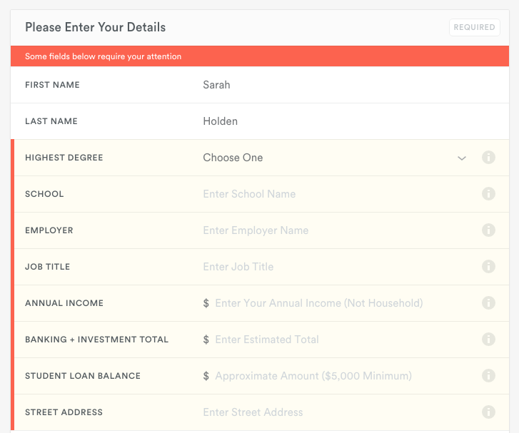
What Javascript Can Do - Modifying content
Add an error message (and styles) to a form
Notes:
Add an error message below a form

Slide 15
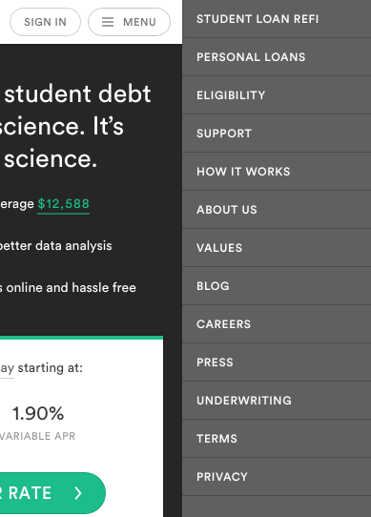
What Javascript Can Do - Modifying content
Change the size, position, color, or other styles for an element
Notes:
Change the size, position, color, or other styles for an element

Slide 16
What Javascript Can Do!
1
2
3
4
Access
Content
Modify
Content
Program
Rules
React to
Events
You can specify a set of steps (instructions) for the browser to follow.
For example:
Have images/text fade in as the user scrolls down the page
Check to make sure the user has entered a valid email address into a form and display an error message if not
Open a chat panel when the user clicks on a 'Chat with Us' button
Filter data when the user selects a filter

Slide 17
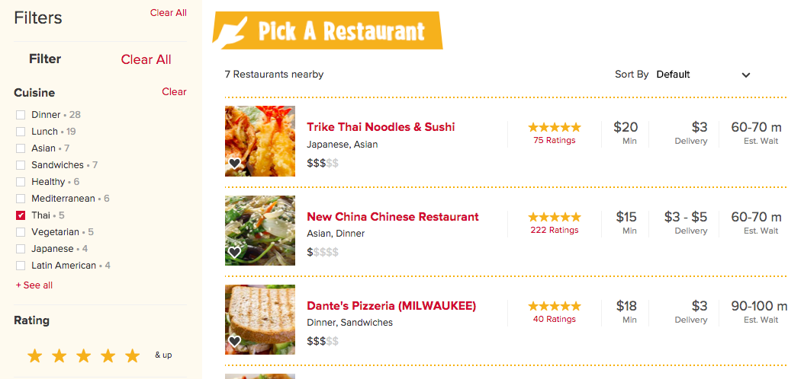
What Javascript Can Do - Program rules
Filter data when the user selects a filter
Notes:
Change the size, position, color, or other styles for an element

Slide 18

What Javascript Can Do!
1
2
3
4
Access
Content
Modify
Content
Program
Rules
React to
Events
You can specify that a script should run when an event occurs
For example:
When a button is clicked
When the cursor hovers over an element
When the user types information into a form
When a page has finished loading
When the user hits enter to submit a form

Slide 19
JQUERY
Eric Boyer

Slide 20
Learning objectives
JQuery
Differentiate between jQuery and JavaScript, describe benefits of using them.
Recognize jQuery syntax
Use selectors and jQuery functions to effectively manipulate the DOM.
Notes:
End by revisiting the learning objectives. This lets students reflect on what they learned and determine if they have any outstanding questions.

Slide 21
JQuery
intro to jquery

Slide 22
becoming a programmer
It isn't about the programming language!!!
It is about changing how you think.

Slide 23
your responsibilities
Don't feel like you have to sit down and memorize the syntax!
It's important that you:
Focus on understanding the key concepts
Are resourceful — we'll work on honing your Google-ing skills
Get as much practice in as possible

Slide 24
JQuery
the basics

Slide 25

intro to jquery — Your new best friend!
what is jQuery?
jQuery is a JavaScript file you include in your pages.
Makes it faster and easier to write cross-browser JavaScript
“Cross browser” - works the same in all* browsers.
Allows us to find elements using CSS-style selectors and then do something to them using jQuery methods
Your new best friend!
Notes:
Think about the “clearfix” hack. Re-using that class. It’s a utility that we’ve put in a place where we can re-use it.

Slide 26


jquery vs. javascript
jQuery allows us to use the CSS-style selectors that we know and love! Yay!
js:
jquery:
document.getElementsByTagName('body')[0]
$('body')
document.getElementById('about')
$('#about')

Slide 27
jquery vs. javascript
js:
document.getElementById('heading').innerHTML = "Your Name";
jquery:
$('#heading').html('Your Name');
**You could do everything jQuery does with plain-old vanilla Javascript**

Slide 28
JQuery
adding jquery to your project

Slide 29
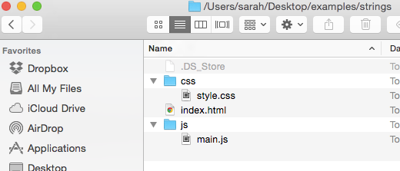

keep it on the up and up!
It is considered best practice to keep Javascript files organized in one folder.
Usually people name this folder 'scripts', 'js', or 'javascript'.
Use an underscore or dash between words in folder names instead of a space. And try to avoid characters/symbols in file names (really_cool_page.html or really-cool-page.html).
sample structure:

Slide 30
Step 1: add jQuery to your website
Download the jQuery script (version 2.x) and include it in your project. Keep things organized by placing it within your js folder.
Include jQuery in your HTML page before the closing </body> tag by adding a <script> element with a src that points to the jQuery file
Make sure to include jQuery before any other js files that use it!!!
<body>
<!-- HTML content here —>
<script src="js/jquery-1.11.2.min.js"></script>
<!-- Javascript file will go here —>
</body>

Slide 31
Step 2: Add a javascript file
Create a Javascript file. This process will be similar to creating an HTML or CSS file, but this time the file should have a .js extension (example: main.js)
Link to the Javascript file from your HTML page using the <script> element. We'll almost always want to add this script element right before the closing body tag.
<body>
<!-- HTML content here —>
<script src="js/jquery-1.11.2.min.js"></script>
<script src="js/main.js"></script>
</body>
order is important!!!!

Slide 32
pro tips
To make sure your js is hooked up properly:
Add an alert to the top of your JS file and load the page in the browser
alert('Hello from JS!');
If you don't see an alert pop up when you load the page, you know you have linked your files incorrectly.

Slide 33
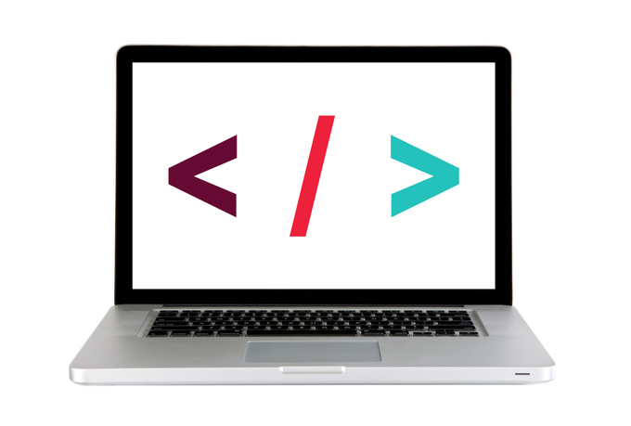
Let's take a closer look
Notes:
adding_jquery

Slide 34
JQuery
Using jquery

Slide 35
statements
Last class (and this) we are chatting about how scripts are a series of instructions that are executed one-by-one
Each individual step is called a statement
var today = new Date();
var hourNow = today.getHours()
var greeting;
if (hourNow > 18) {
greeting = 'Good evening';
} else {
greeting = 'Good afternoon';
}
document.write(greeting);
Begin on a new line
End with a semicolon

Slide 36
JS Syntax
Syntax: Spelling and grammar rules of a programming language.
Like any language, there are formal rules around how to write Javascript. This is the syntax.
;
{ }
( )
“ ”

Slide 37
comments
// this is a single line comment
/*
this
is
a
multiline comment
*/
Sublime shortcut: 1) Highlight what you want to comment 2) command + /

Slide 38
JQuery
Part 1 — select an element

Slide 39
using jquery to manipulate the dom
1
2
Select an element/elements
Work with those elements

Slide 40
jquery — selecting elements
Selector
$('li')
.addClass('selected');
jQuery Function
jQuery Function:
Lets us find one or more elements in the page
Creates a jQuery object which holds references to those elements
We'll be using the shorthand in this class: $( )
$(selector) is the same as jQuery(selector)

Slide 41
jquery objects — finding elements: some examples
You can use your CSS-style selectors!!!
css:
jquery:
class
.className
$('.className')
id
#idName
$('#idName')
Selector:
multiple
selectors
h1, h2, h3
$('h1, h2, h3')
DescendAnt
li a
$('li a')
& tons more!!!

Slide 42
JQuery
Part 2 — Add a method

Slide 43
using jquery to manipulate the dom
1
2
Select an element/elements
Work with those elements

Slide 44
jquery — working with those elements
Parameter(s)
$('li')
.addClass('selected');
Method

Slide 45

jquery methods
Be forewarned!
There are a lot of methods!
Do not feel like you need to sit down and memorize these. The important things is knowing that they're there and being able to look them up in the documentation.
See the jQuery docs for list!
Notes:
*In relation to CSS, where you are essentially learning and memorizing things, this should NOT be expected with JS/jQuery*

Slide 46
jquery methods — working with those elements
After we've selected elements, we can use jQuery methods to:
add effects/animation
create
event
listeners
finding
elements
get/set
content
See the jQuery docs for list!

Slide 47
traversing the dom?
Document
HTML
Body
attribute
h1
p
ul
attribute
li
li
li
Notes:
Remember nested selectors?

Slide 48
jquery methods — traversing the dom
traverse the dom
jQuery provides us with methods to find/select elements to work with & traverse the DOM
Some methods available to us:
What goes in the parentheses?
A css-style selector
.find( ) (finds all descendants)
.children( )
.parent( )
.siblings( )
Examples:
$('h1').find('a');
$('#box1').parent();
$('p').siblings('.important');
*Think of this as part of the selection process, must come directly after another selection
Notes:
Students will ask why we use these instead of just nested selectors. Example: this

Slide 49
jquery methods — working with those elements
After we've selected elements, we can use jQuery methods to:
add effects/animation
create
event
listeners
finding
elements
get/set
content
See the jQuery docs for list!

Slide 50
jquery methods — Getting/setting content
get/set
content
Get/change content of elements, attributes, text nodes
Some methods available to us:
What goes in the parentheses?
The html, styles, classes you want to add/change
.html( )
.attr( )
.css( )
.addClass( )
.removeClass( )
.toggleClass( )
Examples of adding/changing content:
$('h1').html('Content to insert goes here');
$('img').attr('src', 'images/bike.png');
$('#box1').css('color', 'red');
$('p').addClass('success');
$('p').removeClass('my-class-here');

Slide 51
Let's take a closer look
Notes:
jquery_code_along part 1

Slide 52
JQuery
separation of concerns

Slide 53
The three amigos: Structure, style, behavior
HTML = Noun
CSS = Adjective
Javascript = Verb
Structure
HTML
Style
CSS
Behavior
Javascript

Slide 54
css cascading
WINNER!
<li style=“color: red”></li>
#about .first h2 + li
Style
attribute
ID
Class,
attribute
Elements
Style
attribute
ID
Class
attribute
Elements
,
,
1
,
0
,
0
,
0
,
1
,
1
,
2
Most
specificity
value
Least
specificity
value
Most
specificity
value
Least
specificity
value

Slide 55
separation of concerns
Our JavaScript should focus on behavior and not on presentation (that's what our CSS is for!
How could we refactor our Color Switch from earlier to follow this guideline?
(Fork this codepen)
http://codepen.io/eboyer/pen/grPZay

Slide 56
Let's take a closer look
Notes:
color picker codepen refactor for classes

Slide 57
jquery methods — working with those elements
After we've selected elements, we can use jQuery methods to:
add effects/animation
create
event
listeners
finding
elements
get/set
content
See the jQuery docs for list!

Slide 58
jquery methods — effects/animation
add effects/animation
Add effects and animation to parts of the page
Some methods available to us:
What goes in the parenthesis?
An animation speed
.show( )
.hide( )
.fadeIn( )
.fadeOut( )
.slideUp( )
.slideDown( )
.slideToggle( )
Examples:
$('h1').fadeOut(200);
$('#box1').slideDown('slow');
$('h1').fadeIn();

Slide 59
jquery methods — working with those elements
After we've selected elements, we can use jQuery methods to:
add effects/animation
create
event
listeners
finding
elements
get/set
content
See the jQuery docs for list!

Slide 60
jquery methods — events!
create
event
listeners
The .on() method is used to handle all events.
Syntax:
$('selector').on('event', code_that_should_run);
Example:
$('li').on('click', function() {
// your code here
});

Slide 61
jquery methods — events!
create
event
listeners
Some events that .on() deals with:
UI: focus, blur, change
Keyboard: keydown, keyup
Mouse: click, mouseup, mousedown, mouseover
Form: submit
Browser: resize, scroll
$('li').on('eventGoesHere', function() {
// your code here
});

Slide 62
Let's take a closer look
Notes:
jquery_code_along part 2

Slide 63
JQuery
method chaining

Slide 64
jquery methods — method chaining
'.item'
'h2'
.find( )
.slideUp( )
$( )
300

Slide 65
jquery methods — method chaining
'#main'
'p'
$( )
.children( )
.fadeOut( )
'slow'

Slide 66
jquery methods — method chaining
'h3'
'p'
.show()
$( )
.siblings( )

Slide 67
JQuery
Debugging

Slide 68
debugging
WHY ISN’T IT WORKING?

Slide 69
debugging — where to start
Always start by defining the problem.
THE IMAGE IS NOT MOVING
NONE OF MY CODE WORKS

Slide 70
debugging — where to start
This will tell you where to start your hunt.
THE IMAGE IS NOT MOVING
NONE OF MY CODE WORKS
Find the code that makes the image move
* Syntax error, check console

Slide 71
debugging
To access debugging console:
Open the Chrome Inspector, click the Console tab

Slide 72
debugging — level 1
Check for errors in console
The location may not be correct but is a good place to start.
Ex: Unbalanced brackets or parentheses
x
Uncaught SyntaxError: Unexpected token )
main.js:13

Slide 73
debugging — level 2
console.log() can be used to display variable values in the console. This is useful for debugging.
console.log($('h2'));
This should print the element to the console.
If it doesn't, there's probably something wrong with your selector.
*Shortcut to access console: cmd + opt + j

Slide 74
debugging — level 3
Do some Googling!
Try Googling it
Be ready to clearly articulate the problem (Write out what your problem is)

Slide 75
debugging — level 4
Get help!
If you still can’t find a solution, ask your fellow classmates and instructors.
Help us help you!
Zip what you’re working on.
Post in Slack in the class channel.
Be descriptive about the problem.
Tell us what you've already done to try to figure it out.

Slide 76
JQuery
jquery documentation

Slide 77
jquery documentation - it's your friend!
Help! There's too much to learn! I feel overwhelmed!
A good developer is one that can look things up!!!
The jQuery Examples page has an example for almost every method!
jQuery documentation — Look things up

Slide 78

Dash - making your life easier one doc at a time
I highly recommend that you download Dash

Slide 79
JQuery
lab

Slide 80

Lab

Slide 81

ACTIVITY
key objective
Utilize jQuery tree traversal techniques to access and manipulate DOM elements.
Type of exercise
Partners/small groups
EXERCISE
As a class
Until 8:50
Lab is in lesson8_starter_code > [2] - select_fun
Follow the instructions in main.js
Use cheat sheet as a guide for syntax and look up any methods you're not familiar with in the jQuery documentation.
Bonus: Complete part 2 of the lab for more practice (lesson8_starter_code > [3] - select_fun_part_2)

Slide 82
Learning objectives
JQuery
Differentiate between jQuery and JavaScript, describe benefits of using them.
Recognize jQuery syntax
Use selectors and jQuery functions to effectively manipulate the DOM.
Notes:
End by revisiting the learning objectives. This lets students reflect on what they learned and determine if they have any outstanding questions.

Slide 83
lab
homework

Slide 84
HOMEWORK
IF YOU ARE STUCK…
1) Use the “Chrome Inspector” to look at your code, use the console, Google for answers.
2) Ask your question in the Slack channel and see if any fellow students might know the answer
3) Ask Eric
* When using your fellow students and instructors, pushing your code to Github is a great place to share where all of your code is currently at.

Slide 85
HOMEWORK
DUE 6pm, Sunday
Complete the “select_fun_part_2” lab assignment
Notes:
Talk about office hours, timing, etc.

Slide 86
Front-end web development
snacks & Design
MONDAY
Frank
(Google sheet is pinned in slack)

Slide 87
JQuery
Exit Tickets

