Slide 1
Intro to .net core
develop on the microsoft stack without paying a dime
Ryan Thompson
CEO, Kordata
Notes:
Introduce myself
How many C# devs out there? How many have never used .NET?
How many have heard about .NET core? Using it?
.NET has been around for a while
When Satya Nadella became CEO of Microsoft in 2014, things changed.
It was announced .NET would be open sourced.
Kordata adopted .NET core 1.0 beta in early 2016 and there were a lot of growing pains.
It gave us a technical and competitive advantage.

Slide 2
About .NET Core
Cross-platform
Consistent across architectures
Command-line tools
Flexible deployment (Docker!!)
Compatible
Open source
Supported by Microsoft
Free! (as in beer)
Notes:
Cross-platform: Runs on Windows, macOS and Linux
Consistent across architectures: Runs your code with the same behavior on multiple architectures, including x64, x86, and ARM.
Command-line tools: Command-line tools for local development and in CI scenarios. CI is a big deal.
Flexible deployment: Can be included in your app or installed side-by-side user- or machine-wide. Can be used with Docker containers.
Compatible: .NET Core is compatible with .NET Framework, Xamarin and Mono, via .NET Standard.
Open source: The .NET Core platform is open source, using MIT and Apache 2 licenses. .NET Core is a .NET Foundation project.
Supported by Microsoft: .NET Core is supported by Microsoft, per .NET Core Support.

Slide 3
Ecosystem overview
Roslyn Compiler
C#, F#, Visual Basic
Public API => Powerful Tooling
Kestrel Web Server
2x faster than nginx, 3x Java’s servlet, 4x IIS, 8x node.js cluster
Flexible middleware architecture
Visual Studio Code
Based on Electron => cross platform
Super lightweight / blazing fast
Huge library of extensions
NuGet Package Manager
Notes:
Roslyn complier is crazy fast, and built with the goal of turning the compiler into an API.
This enables some pretty incredible tooling to be built.
Kestrel was built from the ground up for speed and is the 3rd fastest web server out there.
VS Code is the new hotness. You can still use the old lumbering visual studio if you want, but VS Code is quick, agile and lightweight
Most of your favorite libraries now work on .NET core

Slide 4
Your first console app
dotnet new is your friend
Notes:
VS Code:
Totally free. Open source.
Folder based rather than project based. But you can also setup multi-folder workspaces.
Git integration
Tons of extensions for most languages
Docker integration is really cool
Settings offers so many configuration options.
Can define workspace and user settings. Handy for things like tab format, line spacing, etc.
Debugger has everything you would expect. Expression watchpoints.
Do a little live code demo to show some intellisense features
Show off some command line tools

Slide 5
Top nuget packages
Function | Package
JSON serialization / deserialization | Json.NET
Unit Testing | NUnit
Logging | Serilog, log4net, NLog
HTTP Client | System.Net.Http, RestSharp
Mocking Framework | Moq
IoC container | Autofac
Swagger API | Swashbuckle.AspNetCore
Fault tolerance | Polly
Fakes | Bogus
Date/Time handling | NodaTime
Text Formatting / Localization | Humanizer
Crypto | System.Security.Cryptography, PCLCrypto

Slide 6
Stuff You Should Know About C#
value types and reference types
int number = null; // Compiler error
Product myProduct = null; // No problem
accessors are a language construct
public class Product {
public string Name { get; set; }
public string Category { get; set; } = "General";
}
functions are first-class citizens
Func<int, int> addOne = (n) => n + 1;
Notes:
1. Value types copy the value when passed around.
2. Accessors are an important concept for encapsulation. These ones are automatically implemented but you can unwrap them and implement your own behavior
3. Very handy for lots of things / lets you package up functionality and pass it around.

Slide 7
Stuff You Should Know About C#
LINQ is your ticket to fluent / functional programming
List<int> evenSquares = Enumerable.Range(0, 10)
.Where(i => i % 2 == 0)
.Select(i => i * i)
.ToList();
type inference is awesome
var dontCareCauseIHaveAnIde = GetProducts()
.Where(p => p.Category == "Modern")
.Select(p => p.Name);
we have a real generic system
List<string> strings = new List<string>();
List<int> ints = new List<int>();
bool result = strings.GetType() == ints.GetType(); // False!
Notes:
1. Language-Integrated Query. FP language in disguise. Huge library of functionality. MoreLinq offers even more. Really great for working with any kind of list or collection.
1. All operations are streaming, so no repeated iterations.
2. In 2019 you don't need to declare the type of your variable. Any argument about needing to know the type by reading is void. Aside from being less to type, refactoring becomes less painful.
3. In Java, the statement would evaluate to true! C# keeps all the information about the runtime types in the bytecode.

Slide 8
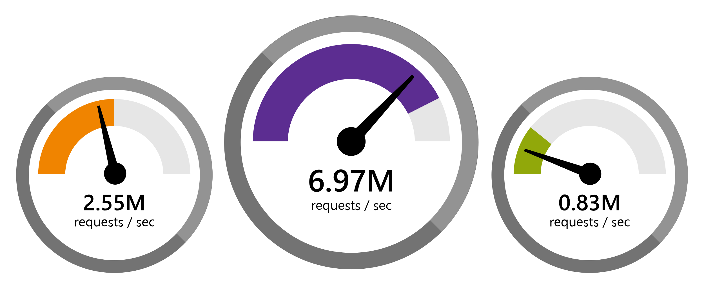
Asp.net core
java servlet
.net core
node.js
Notes:
From TechEmpower Round 16
Kestrel built for scale!

Slide 9

Asp.net core
razor pages
single-page apps
environment-based configuration
built-in dependency injection
Notes:
Can develop razor pages or SPA apps
Config system is awesome
DI is a core part of the platform

Slide 10
Asp.net core
demo

Slide 11
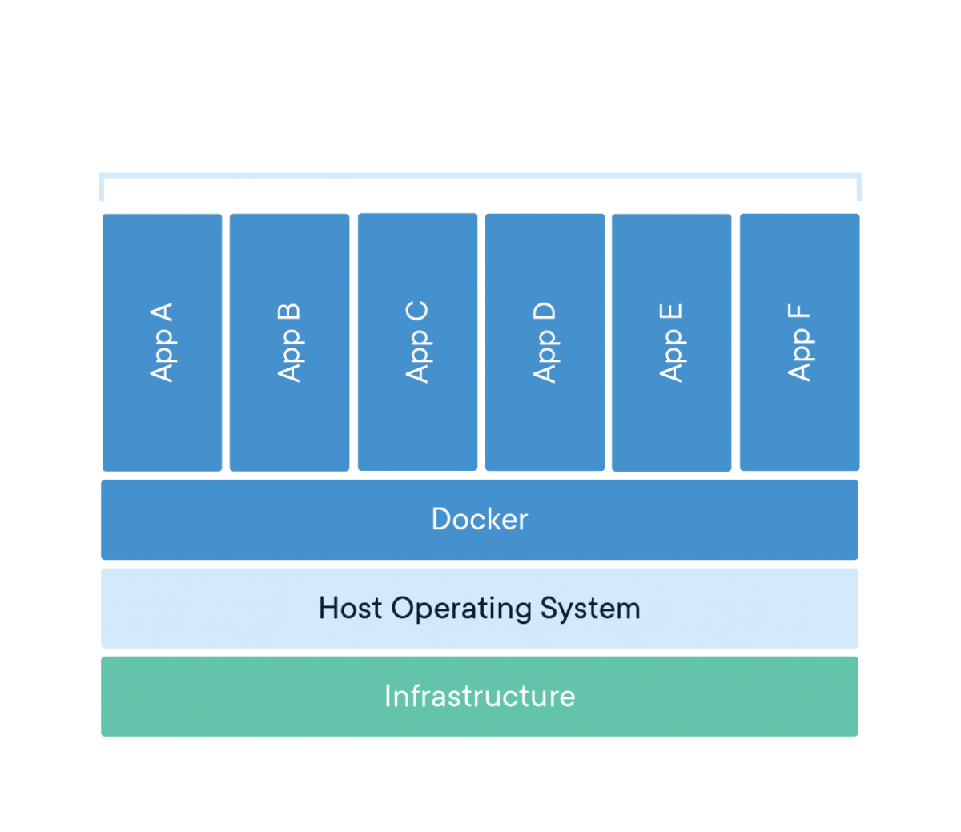
Docker
Notes:
Unit of software that packages up all code and dependencies.
Application runs quickly and reliably from one computing environment to another.
Different from VMs because they all share the same Host OS. VMs would require a new guest OS for each app.

Slide 12





Docker workflow
dockerfile
docker image
docker hub
docker container
your app
private repositories
Notes:
1. First you write your Dockerfile. It specifies what OS and software your app needs to run.
2. Dockerfile is built and bundled with your software into a docker image
3. You can publish your docker images to dockerhub repository, or your own private repos. We have a repo in AWS so autoscaling services can use the images.
4. Docker image is deployed into a container on a host OS.

Slide 13
Asp.net core
on docker

Slide 14
Safe type casting with the ‘is’ operator
old way
public static void HandleAircraft(Vehicle anObject)
{
var aircraft = anObject as Aircraft;
if (aircraft != null)
{
Console.WriteLine(aircraft.EngineCount);
}
}
new way
public static void HandleAircraft(Vehicle anObject)
{
if (anObject is Aircraft aircraft)
{
Console.WriteLine(aircraft.EngineCount);
}
}
Notes:
This was the idiomatic approach. Semantics are weird because a type check becomes a null check.
'Is' operator assigns the variable.

Slide 15
Safe type casting with the ‘is’ operator
old way
public static void HandleOnlyAircraft(Vehicle anObject)
{
var aircraft = anObject as Aircraft;
if (aircraft == null) return;
Console.WriteLine(aircraft.EngineCount);
}
new way
public static void HandleOnlyAircraft(Vehicle anObject)
{
if (!(anObject is Aircraft aircraft)) return;
Console.WriteLine(aircraft.EngineType);
}
Notes:
Negation version is also common. Problem now is that it's hard to differentiate 'anObject was null' vs 'we attempted to cast to Aircraft and got null'
Just abort if it's not the type. Cool thing is that 'is' still assigns the casted value to the variable within the enclosing scope, so you can access it outside.

Slide 16
Pattern Matching
old way
public static Certification GetRequiredCertification(Vehicle vehicle) {
var aircraft = vehicle as Aircraft;
if (aircraft != null) {
if (aircraft.EngineType == AircraftEngineType.Turbojet &&
aircraft.EngineCount == 4) {
return Certification.JumboJets;
}
return Certification.GeneralAircraft;
}
var watercraft = vehicle as Watercraft;
if (watercraft != null) {
return watercraft.Tonnage > 10000 ?
Certification.Ships : Certification.Boats;
}
etc.......
Notes:
I see stuff like this all the time and it's just difficult to parse what the business rules actually are. It gets buried in all the nesting and condition checking

Slide 17
Pattern Matching
new way
public static Certification GetRequiredCertification(Vehicle vehicle) {
switch (vehicle) {
case Aircraft a when a.EngineType == AircraftEngineType.Turbojet && a.EngineCount == 4:
return Certification.JumboJets;
case Aircraft a:
return Certification.GeneralAircraft;
case Watercraft w when w.Tonnage > 10000:
return Certification.Ships;
case Watercraft w:
return Certification.Boats;
case GroundVehicle g when g.WheelCount > 6 ||
g.GrossVehicleWeightRating > 10000:
return Certification.OversizeVehicles;
default:
return Certification.None;
}
}
Notes:
New pattern matching in C# 7 makes this awesome!
Note you can switch on type.
Then the casted value is available to do condition checking immediately. Awesome!

Slide 18
Expression bodies
property accessors
private string _name;
public string Name
{
get => _name;
set => SetProperty(ref _name, value);
}
methods
public bool IsSquare(Rectangle rect) => rect.Height == rect.Width;
constructors
public Vehicle(string name) => Name = name;
Notes:
1. You can new use expressions as bodies! Quick readable shorthand for stuff
2. Entire methods can be just an expression
3. Even constructors can be an expression

Slide 19
Expression Bodies
switch statements
public static int CertificationCostNew(Certification certification) =>
certification switch
{
Certification.JumboJets => 100000,
Certification.GeneralAircraft => 25000,
Certification.Ships => 20000,
Certification.Boats => 5000,
Certification.OversizeVehicles => 5000,
Certification.None => 0,
_ => throw new ArgumentException(message: "invalid enum value")
};
Notes:
New switch expressions
So concise and clear
Discard operator used for stuff you don't care about.

Slide 20
Tuples
dedicated class
public List<CategoryAndPrice> AvgPriceByCategory(List<Product> products)
old tuples
public List<Tuple<string, decimal>> AvgPriceByCategory2(List<Product> products)
c# 7 tuples
public List<(string Category, decimal Price)> AvgPriceByCategory3(List<Product> products)
Notes:
Often you want to return multiple values from a function
You could make a dedicated class
Or use the old tuples
Or use the new tuples

Slide 21
Tuples
dedicated class
foreach (var pair in prices)
{
Console.WriteLine($"Category: {pair.Category}, Price: {pair.Price}");
}
old tuples
foreach (var pair in prices)
{
Console.WriteLine($"Category: {pair.Item1}, Price: {pair.Item2}");
}
c# 7 tuples
foreach (var pair in prices)
{
Console.WriteLine($"Category: {pair.Category}, Price: {pair.Price}");
}
Notes:
Dedicate class is great - except you have to maintain that extra class
Old tuples have weird access syntax
New tuples give you benefits of the dedicated class without having to maintain the class

Slide 22
Tuples
deconstruction
foreach (var pair in prices)
{
(string Category, decimal Price) = pair;
Console.WriteLine($"Category: {Category}, Price: {Price}");
}
discards
foreach (var pair in prices)
{
(string Category, _) = pair;
Console.WriteLine($"Category: {Category}");
}
Notes:
We can deconstruct tuples
And we can use the discard operator

Slide 23
Tuples
switch statements
public string RockPaperScissors(string first, string second)
=> (first, second) switch
{
("rock", "paper") => "rock is covered by paper. Paper wins.",
("rock", "scissors") => "rock breaks scissors. Rock wins.",
("paper", "rock") => "paper covers rock. Paper wins.",
("paper", "scissors") => "paper is cut by scissors. Scissors wins.",
("scissors", "rock") => "scissors is broken by rock. Rock wins.",
("scissors", "paper") => "scissors cuts paper. Scissors wins.",
(_, _) => "tie"
};
Notes:
We can make switch expressions that switch on tuples.

Slide 24
Nullable reference types
Two types in .NET: value types and reference types
Value types can’t be null
By default, reference types can be assigned to null
Notes:
Value type is the actual value, reference type is a pointer to some data

Slide 25
Nullable reference types
Notes:
Sometimes called the billion dollar mistake

Slide 26
Nullable reference types
With C# 8, you can opt-in to non-nullable context
Notes:
You put a tag in your .csproj file

Slide 27
Nullable reference types
The compiler will now:
Track your usage of null with data-flow analysis
Assume that reference types cannot be null
Require you to explicitly declare when you want to use null
Signal inconsistent uses of null (which you will do)

Slide 28
Nullable Reference Types
public class Product
{
public string Name { get; set; }
public string Category { get; set; }
public string? Upc { get; set; }
public decimal Price { get; set; }
public double Rating { get; set; }
public Product(string name, string category)
=> (Name, Category) = (name, category);
}
Notes:
Decimal and double are value types, so they already can’t be null. They get initialized with default value 0.
We declared that Name and Category cannot be null, but we’re okay if Upc is null.
This is really handy and elegant because it lets you declare to the consumer what your intention is. Anyone who uses this can easily see that you have features that use Upc, but you don’t require it. The others are required.

Slide 29
Nullable Reference Types
error
public void MakeProduct()
{
var product = new Product("A product", "A category");
WriteLine(product.Upc);
}
ok
public void MakeProduct()
{
var product = new Product("A product", "A category");
if (product.Upc != null)
{
WriteLine(product.Upc);
}
}
Notes:
The compiler is going to give you an error if you try to do the thing on the top, because Upc is declared to be nullable. In this case, WriteLine doesn’t accept nulls, so this is an error.
If you check for null first, the compiler is smart enough to realize that and not complain.

Slide 30
Nullable Reference Types
public class Product
{
public string Name { get; set; }
public string Category { get; set; }
public string? Upc { get; set; }
public decimal Price { get; set; }
public double Rating { get; set; }
public Product(string name, string category)
=> (Name, Category) = (name, category);
}
Notes:
Take a look at the constructor – if you don’t initialize Name, and Category, you’ll get an error!!

Slide 31
Nullable Reference Types
public class Product
{
public string Name { get; set; } = string.Empty;
public string Category { get; set; } = string.Empty;
public Catalog Catalog { get; set; } = new Catalog();
public string? Upc { get; set; }
public decimal Price { get; set; }
public double Rating { get; set; }
}
I think we just invented a new kind of null…
Notes:
People will probably want to start doing this kind of thing. Now you don’t need a constructor.
But did you just invent a new kind of null? I don’t think there’s any way to avoid having to deal with ‘emptiness’ as a concept.

Slide 32
Questions?
(thank you!)

