Slide 1
eVAL
®
By Gem

Slide 2
Agenda
What is eVAL?
Overview
Devise
Database
Future features
Prototypes/Demo
Notes:
C

Slide 3
What is eVAL?
Simple web application for group peer evaluation
Notes:
C

Slide 4
Users
How does eVAL work?
Two types of users:
Admins have Classes which have Groups
Students just have Groups
Admins
Students
Classes
Groups
Groups
Notes:
C

Slide 5
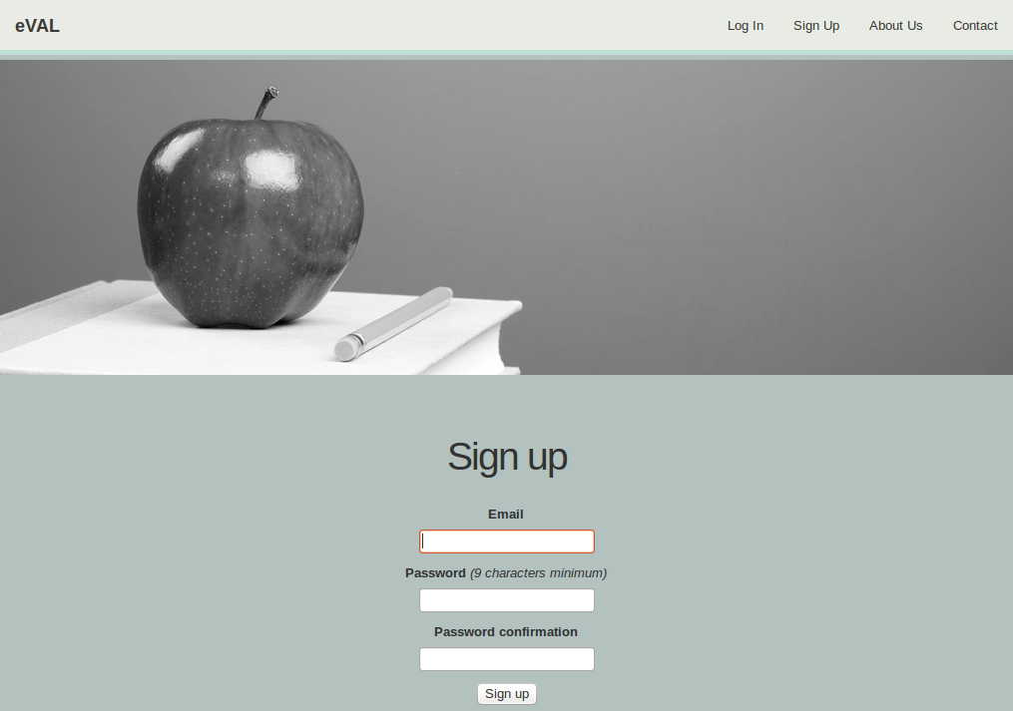
Current Features
Users
Sign-up
Log-in
Admin Status
Groups
Create new groups
Add/Remove members
General
Home
About
Contact
Notes:
C

Slide 6
Devise
Purpose:
Used for creating User scaffolds
Composed of 10 Modules
Features:
OmniAuth and Password hashing
Track users, e.g., signin count
User accounts locked after several failed log-ins
Provides timeout on inactive accounts
Personal secret keys
Ruby Gem
Notes:
R

Slide 7





Installation
Helpers
After sign in → root
current_user arbitrary
Notes:
R

Slide 8

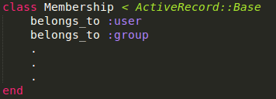
Memberships
Memberships consist of a group_id and a user_id
They belong to both users and groups
Notes:
R

Slide 9

Memberships Cont.
A user gets a “membership_id” when a new membership is created with the user’s id
Membership id’s are unique to users and groups
If a membership is deleted, the membership_ids are deleted from the user
Notes:
R

Slide 10

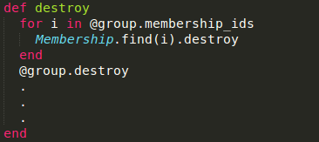

Classes and Groups
Classes have many groups
Groups have many users and belong to a class
Destroying a group destroys all the memberships in the group as well
Notes:
R

Slide 11
Groups
User 1
User 2
User 3
Group 1
Group 2
Group 3
[0, 1, 2]
[3]
[4, 5]
[1]
[0, 3, 4]
[2, 5]
Notes:
R

Slide 12
Groups
User 1
User 2
User 3
Group 2
Group 3
Group 1
[0, 1, 2]
[3]
[4, 5]
[1]
[0, 3, 4]
[2, 5]
Notes:
R

Slide 13
Groups
User 1
User 2
User 3
Group 2
Group 3
Group 1
[0, 1, 2]
[3]
[4, 5]
[1]
[0, 3, 4]
[2, 5]
Notes:
R

Slide 14
Groups
User 1
User 2
User 3
Group 2
Group 3
Group 1
[0, 1, 2]
[3]
[4, 5]
[1]
[0, 3, 4]
[2, 5]
Notes:
R

Slide 15
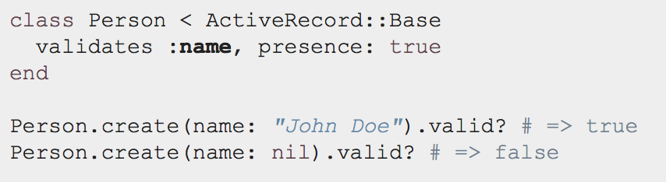
Validations
Used to ensure only valid information is stored in database
Built-in helpers
Custom validation methods
On SQL INSERT or SQL UPDATE from .new, .save or .update
Validations performed and will not change database if they are not passed
Notes:
Validations have built in helpers
But you can make your own validations as well if you need more customization
After calling .new, .save or .update, and before the SQL action is performed, the validations are performed and database only changes if they are all passed

Slide 16
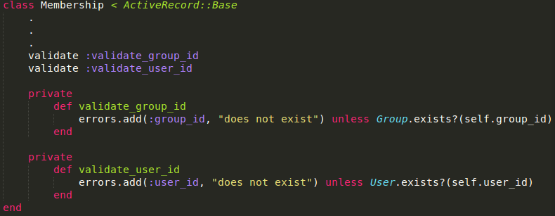
Custom Validations
Notes:
These are validations we made
First one checks to make sure that the group exists because you don’t want to make a membership if it doesn’t
Second one is the same but validates that the user exists

Slide 17
Database
Notes:
Z

Slide 18
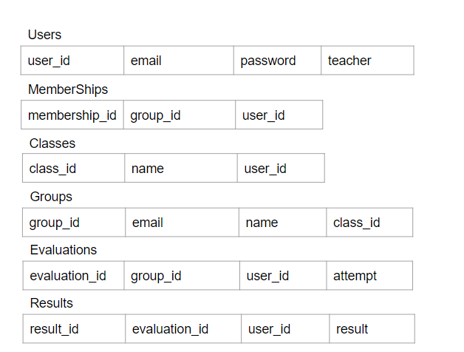
Database
Notes:
Z

Slide 19
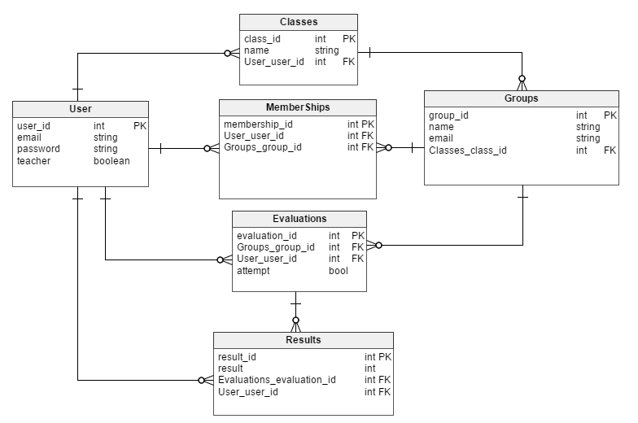
Database cont.
PK: Primary Key
FK: Foreign Key
Notes:
Z

Slide 20
Future Features - Classes
Currently administrators can:
Create/add groups
Add members
Goal: Allow administrator to do the following:
Edit classes and groups
Add members by email
List groups when viewing class
List members when viewing groups

Slide 21
Future Features - Evaluations
Currently students can:
Be assigned to groups
Fill out evaluation form
Goal: Have evaluations:
Know what group the student is in within a class
Know other group members
Submit

Slide 22
Future Features - URL Redirection
Currently users can type in a path and get to a page
Goal: Redirect if user is not logged in or not an admin
How: Create a session controller and keep track if the user logged in. If there is no user logged in, it will redirect to home page.

Slide 23
Demo

