Slide 1
Dynamics of Two-Level Quantum Systems
Ryan Toepfer
Carter Ronald
Notes:
1:00

Slide 2
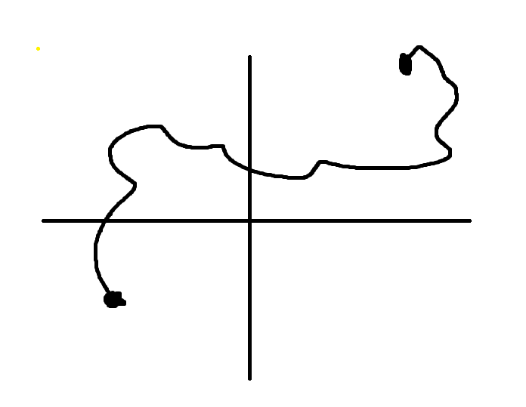
Problem Description
Describe the change of a quantum system over time, depending on its initial value, and a matrix that describes its motion
Notes:
2:30

Slide 3
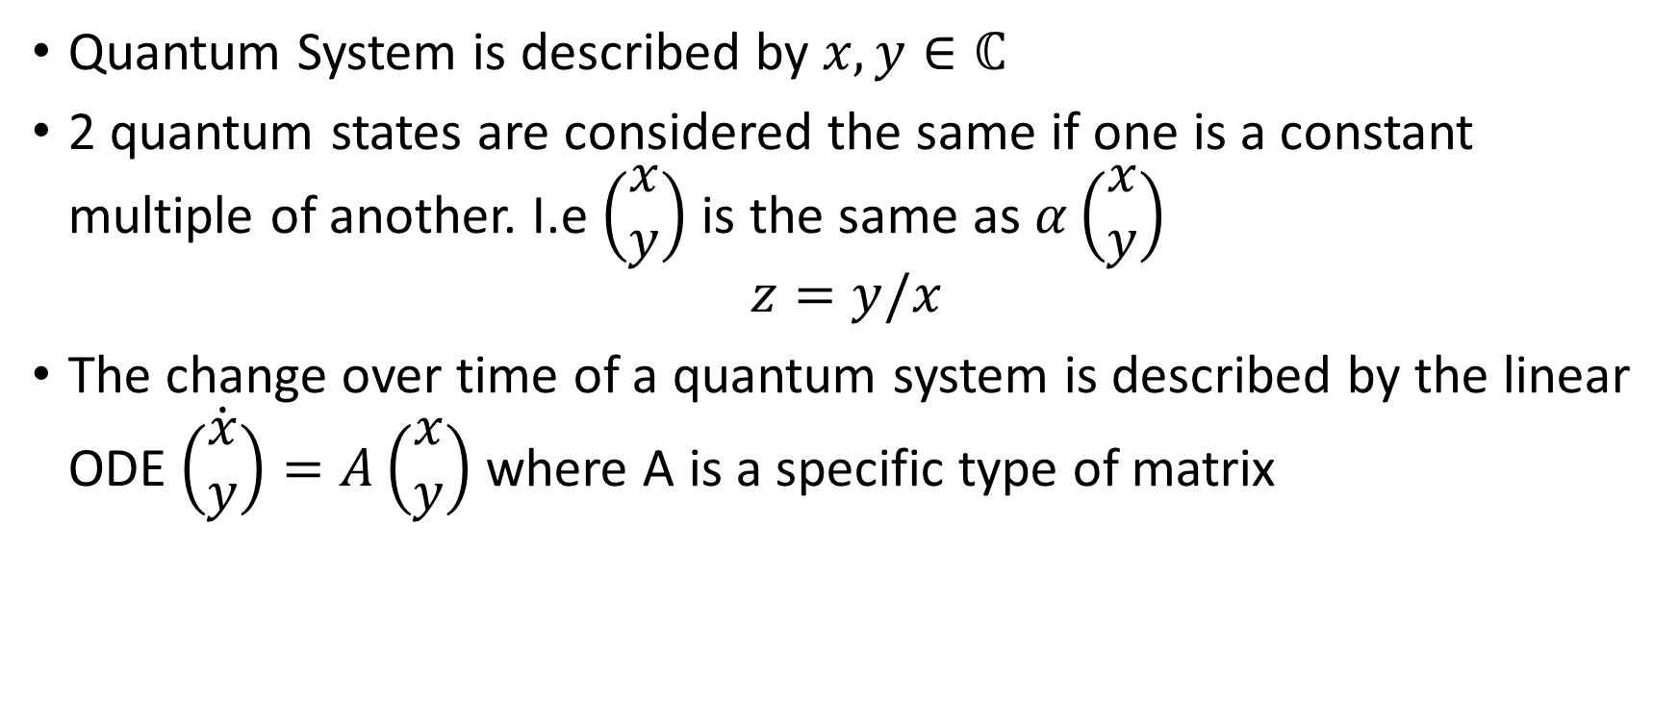
Problem Setup
Quantum System is described by $x,y∈ℂ$
2 quantum states are considered the same if one is a constant multiple of another. I.e $\left(\begin{aligned}x \\ y\end{aligned}\right)$ is the same as $α\left(\begin{aligned}x \\ y\end{aligned}\right)$
$$z=y/x$$
The change over time of a quantum system is described by the linear ODE $\dot{\left(\begin{aligned}x \\ y\end{aligned}\right)}=A\left(\begin{aligned}x \\ y\end{aligned}\right)$ where A is a specific type of matrix
Notes:
5:30 Talk about how z=y/x ignores a single class of solutions where x=0,

Slide 4
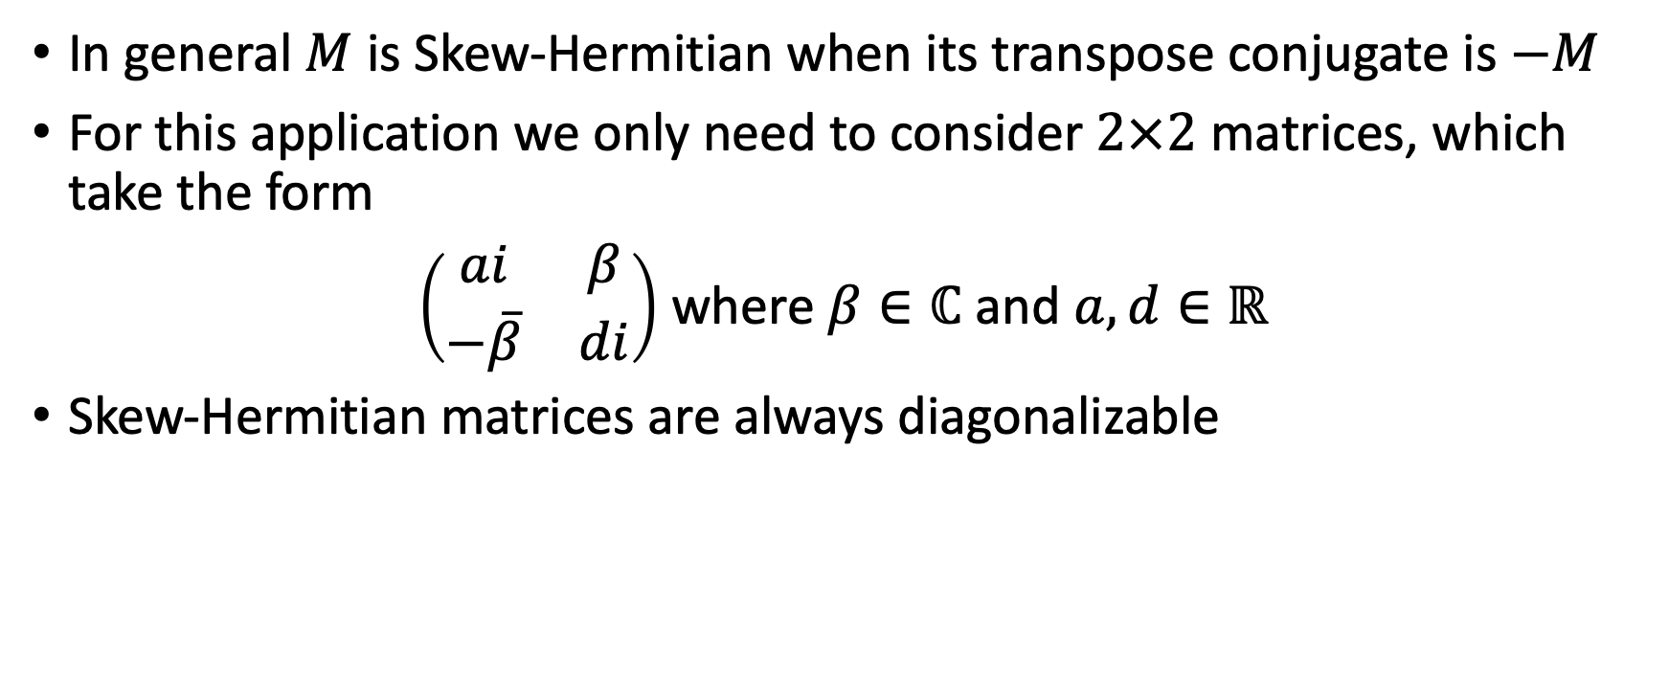
Skew-Hermitian Matrices
In general $M$ is Skew-Hermitian when its transpose conjugate is $−M$
For this application we only need to consider $2×2$ matrices, which take the form
$\left(\begin{matrix}ai & β \\ −\overline{β} & di\end{matrix}\right)$ where $β∈ℂ$ and $a,d∈ℝ$
Skew-Hermitian matrices are always diagonalizable
Notes:
6:30

Slide 5
What We Are looking For?
Why a direct solution is complicated
Notes:
7:30

Slide 6
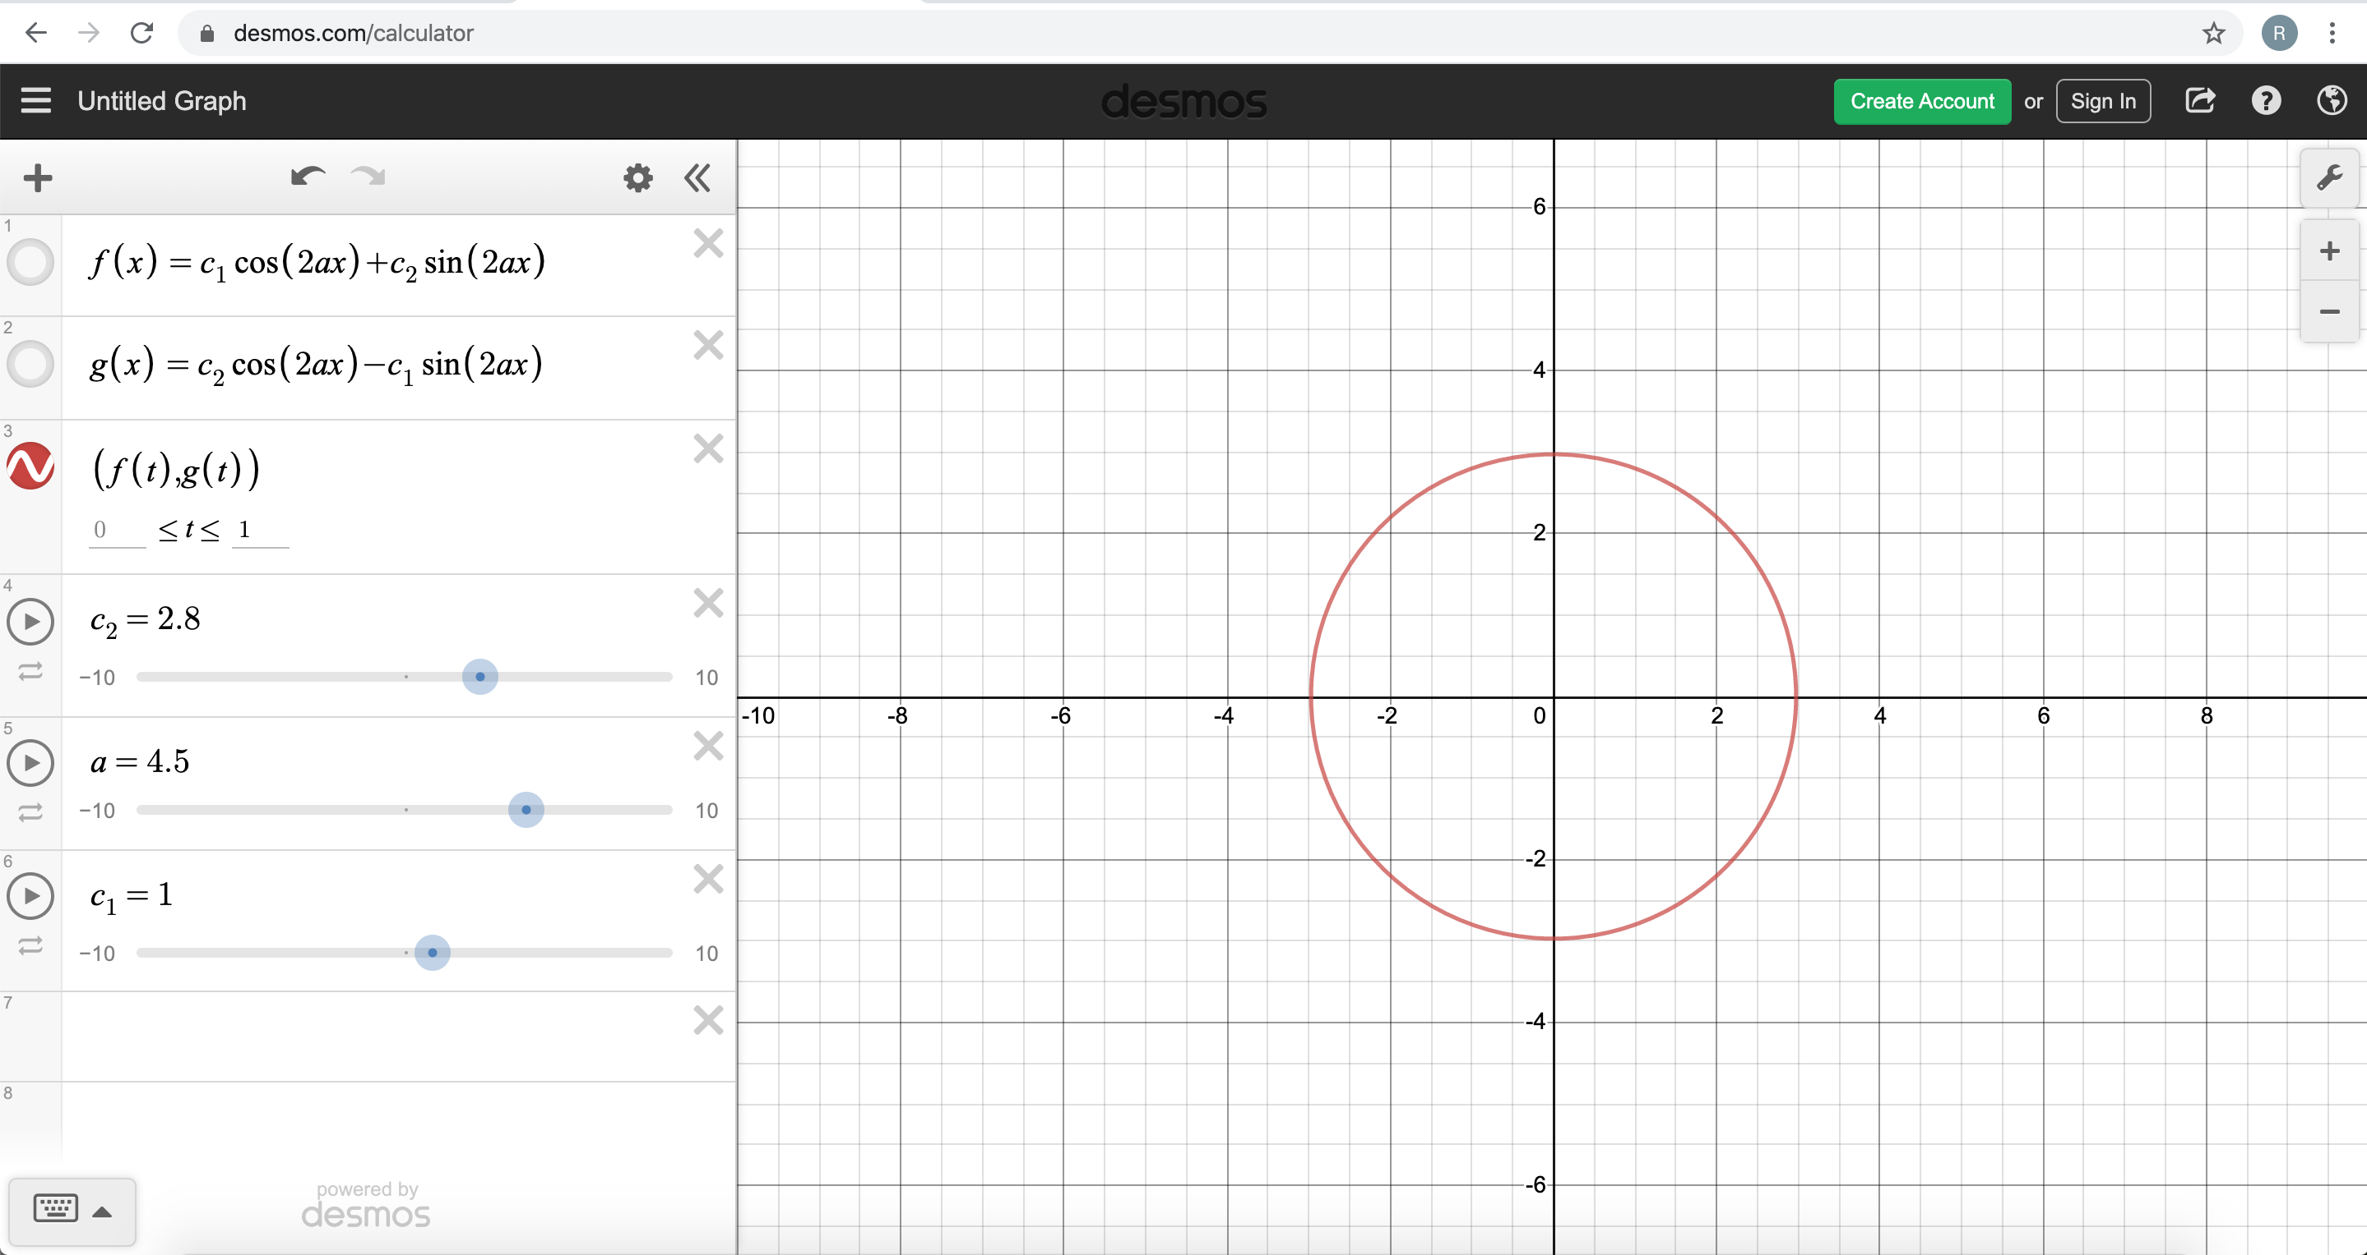


What If $β=0$ and $d=−a$
Then $A=\left(\begin{matrix}ai & 0 \\ 0 & ai\end{matrix}\right)$
Notes:
8:30

Slide 7
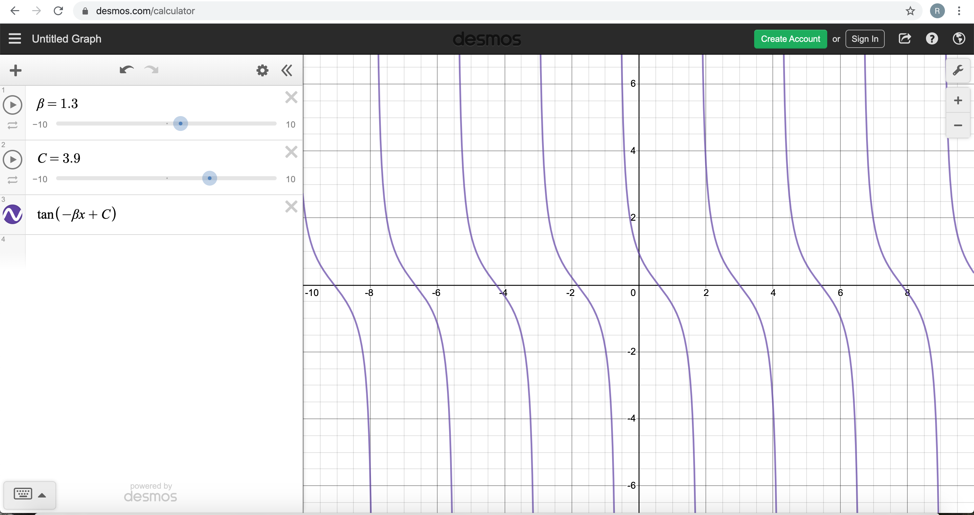


What If $β$ is real and $d=a=0$
Then $A=\left(\begin{matrix}0 & β \\ β & 0\end{matrix}\right)$
Notes:
9:00

Slide 8
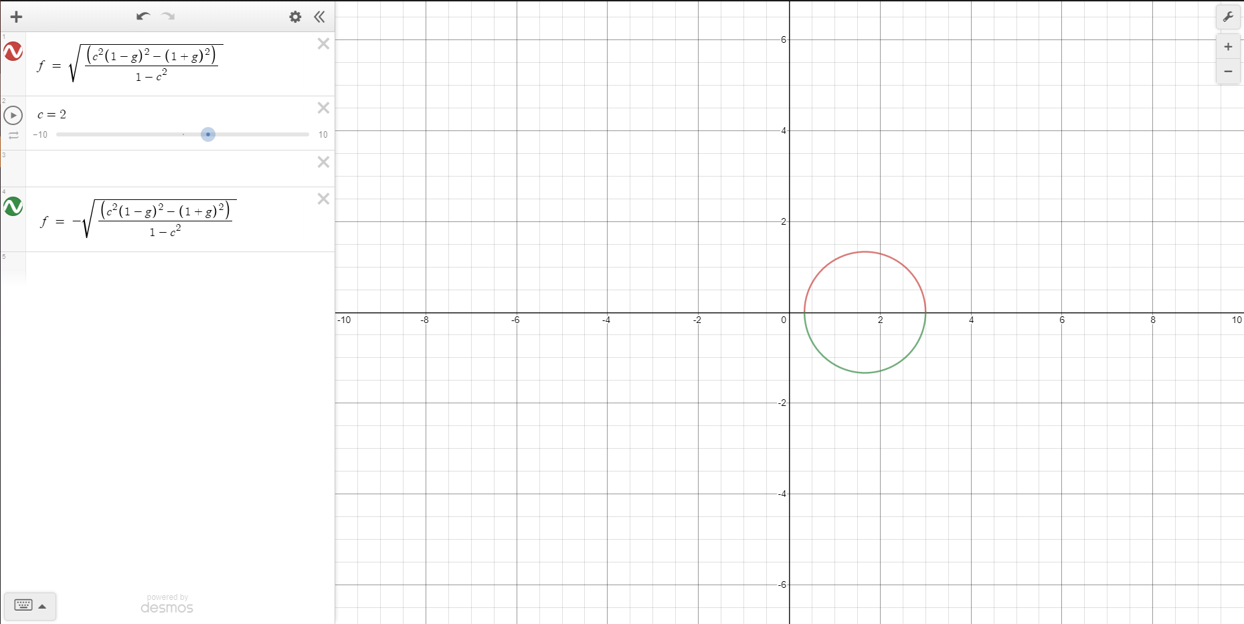

What If $β$ is real
Notes:
9:30

Slide 9

What if $β$ is purely imaginary
The shape of the graph changes depending on the parameters
Notes:
10:00

Slide 10
Solutions

Slide 11
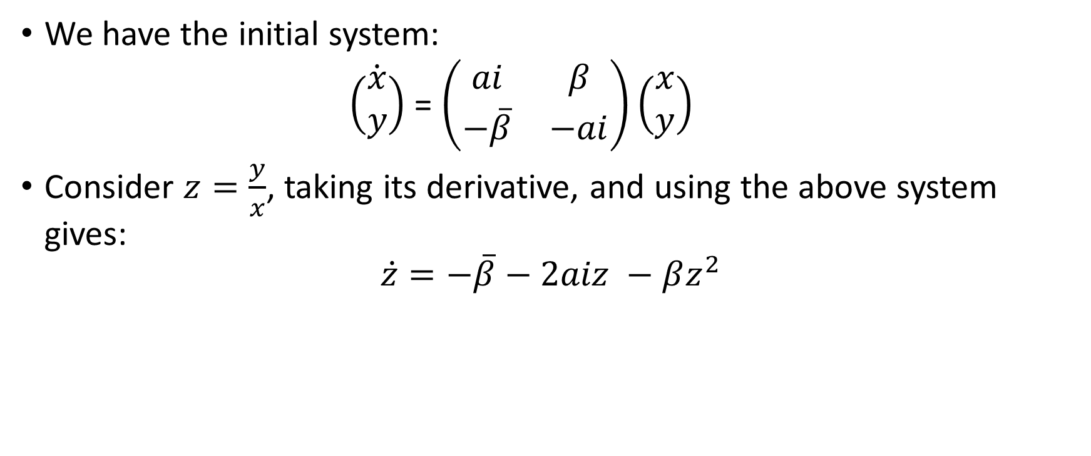

Getting an expression for $\dot{z}$ (Riccati Equation)
We have the initial system:
$\dot{\left(\begin{matrix}x \\ y\end{matrix}\right)}$ = $\left(\begin{matrix}ai & β \\ −\overline{β} & −ai\end{matrix}\right)\left(\begin{matrix}x \\ y\end{matrix}\right)$
Consider $z=\frac{y}{x}$, taking its derivative, and using the above system gives:
$$\dot{z}=−\overline{β}−2aiz −βz^{2}$$

Slide 12

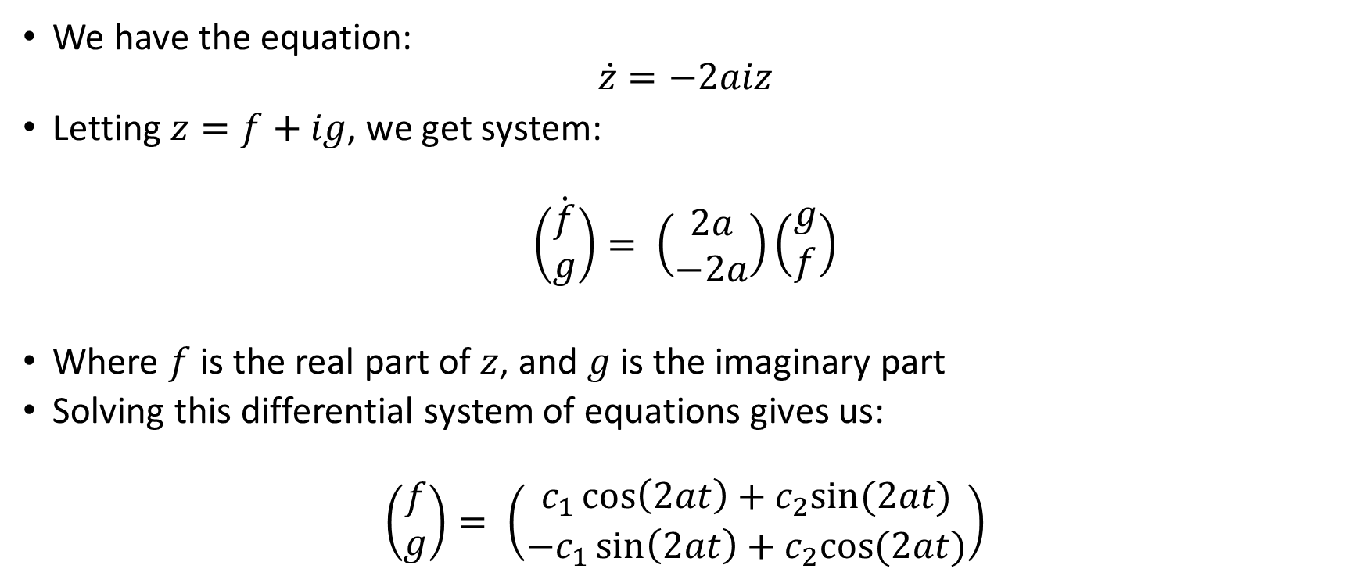
Solution for $β=0$
We have the equation:
$$\dot{z}=−2aiz$$
Letting $z=f+ig$, we get system:
$$\dot{\left(\begin{matrix}f \\ g\end{matrix}\right)}= \left(\begin{matrix}2a \\ −2a\end{matrix}\right)\left(\begin{matrix}g \\ f\end{matrix}\right)$$
Where $f$ is the real part of $z$, and $g$ is the imaginary part
Solving this differential system of equations gives us:
$$\left(\begin{matrix}f \\ g\end{matrix}\right)= \left(\begin{matrix}c_{1}\cos\left(2at\right)+c_{2}sin⁡(2at) \\ −c_{1}\sin\left(2at\right)+c_{2}cos⁡(2at)\end{matrix}\right)$$
Notes:
I will show the graphs after interactively.

Slide 13

Observation
When we had a matrix like:
$\dot{\left(\begin{matrix}x \\ y\end{matrix}\right)}$ = $\left(\begin{matrix}ai & 0 \\ 0 & −ai\end{matrix}\right)\left(\begin{matrix}x \\ y\end{matrix}\right)$
We got circles, thus when $\dot{z}=−2aiz$, we can see also that
$\frac{d}{dt}\left(\left|z\right|\right)=\frac{d}{dt}(z\overline{z}$) = $\dot{z}\overline{z}+z\dot{\overline{z}}$ = 0
Thus $\left|z\right|=\left|yx^{−1}\right|=constant$

Slide 14
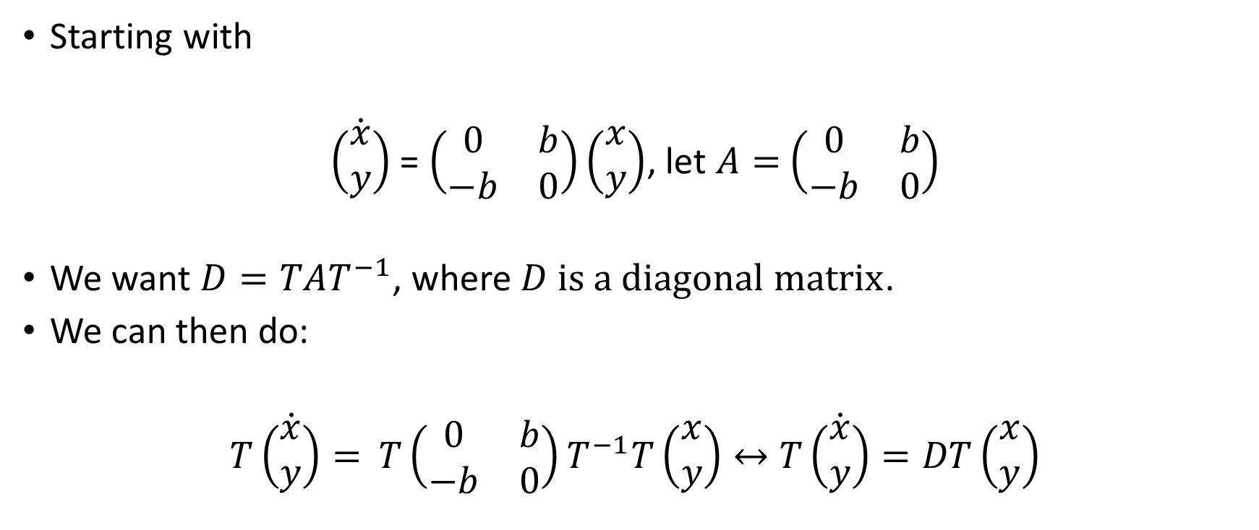
Generalized diagonalization
Starting with
$\dot{\left(\begin{matrix}x \\ y\end{matrix}\right)}$ = $\left(\begin{matrix}0 & b \\ −b & 0\end{matrix}\right)\left(\begin{matrix}x \\ y\end{matrix}\right)$, let $A=$ $\left(\begin{matrix}0 & b \\ −b & 0\end{matrix}\right)$
We want $D=TAT^{−1}$, where $D$ $is a diagonal matrix$.
We can then do:
$T\dot{\left(\begin{matrix}x \\ y\end{matrix}\right)}=$ $T\left(\begin{matrix}0 & b \\ −b & 0\end{matrix}\right)T^{−1}T\left(\begin{matrix}x \\ y\end{matrix}\right)↔$ $T\dot{\left(\begin{matrix}x \\ y\end{matrix}\right)}=DT\left(\begin{matrix}x \\ y\end{matrix}\right)$

Slide 15
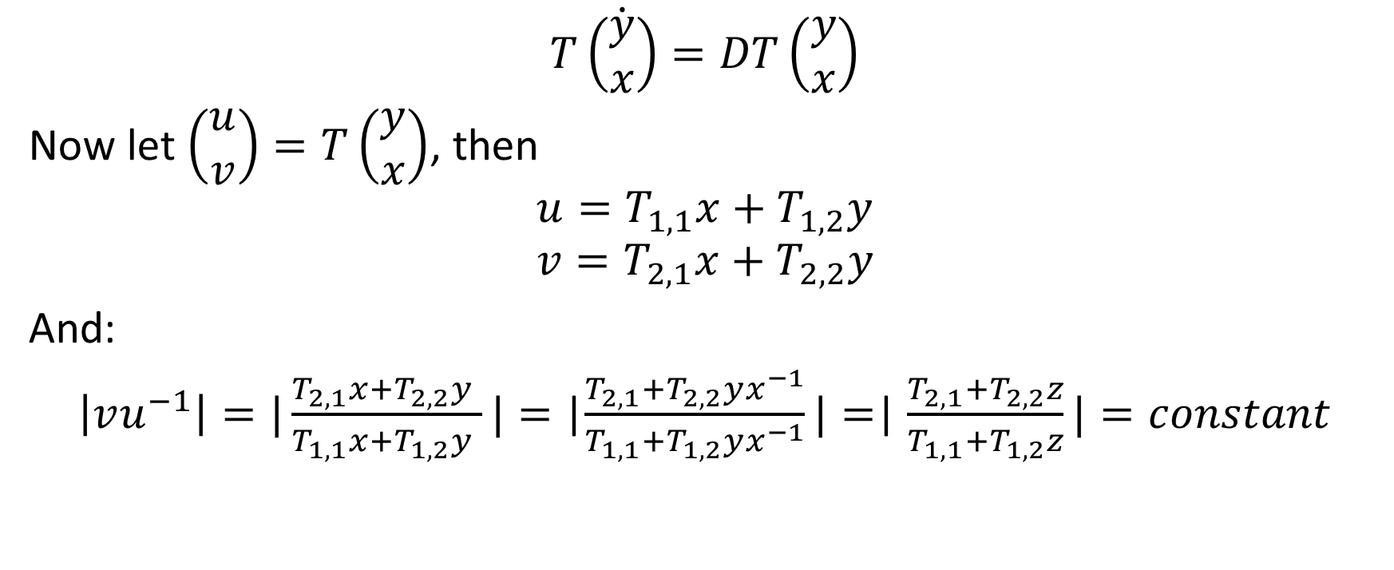
Generalize Diagonalization cont.
$$T\dot{\left(\begin{matrix}y \\ x\end{matrix}\right)}=DT\left(\begin{matrix}y \\ x\end{matrix}\right)$$
Now let $\left(\begin{matrix}u \\ v\end{matrix}\right)=T\left(\begin{matrix}y \\ x\end{matrix}\right)$, then
$$u=T_{1,1}x+T_{1,2}y$$
$$v=T_{2,1}x+T_{2,2}y$$
And:
$\left|vu^{−1}\right|=|\frac{T_{2,1}x+T_{2,2}y }{T_{1,1}x+T_{1,2}y }|=$ |$\frac{T_{2,1}+T_{2,2}yx^{−1}}{T_{1,1}+T_{1,2}yx^{−1}}|=$| $\frac{T_{2,1}+T_{2,2}z}{T_{1,1}+T_{1,2}z}|=constant$

Slide 16
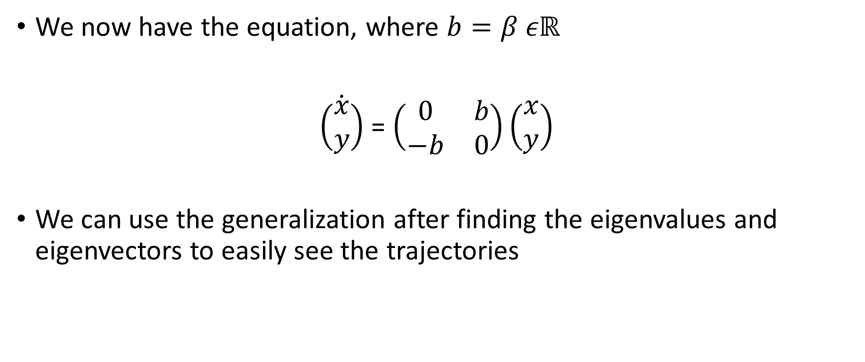

Solution for $β$ is real and $d=a=0$
We now have the equation, where $b=β εℝ$
$\dot{\left(\begin{matrix}x \\ y\end{matrix}\right)}$ = $\left(\begin{matrix}0 & b \\ −b & 0\end{matrix}\right)\left(\begin{matrix}x \\ y\end{matrix}\right)$
We can use the generalization after finding the eigenvalues and eigenvectors to easily see the trajectories

Slide 17

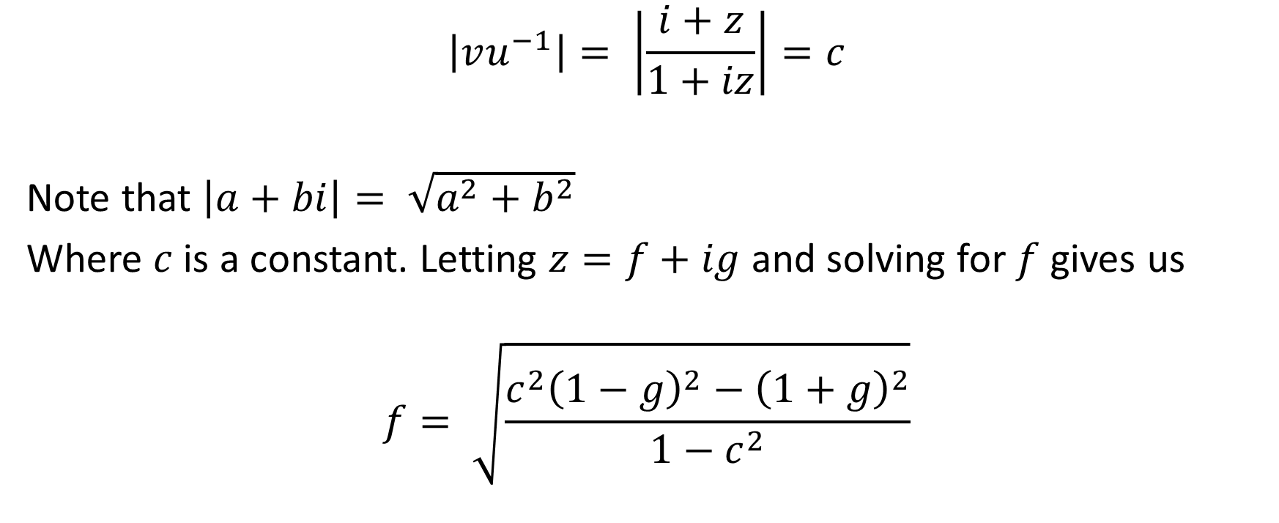
Solution for $β$ is real and $d=a=0$
$$\left|vu^{−1}\right|= \left|\frac{i+z}{1+iz}\right|=c$$
Note that $\left|a+bi\right|= \sqrt{a^{2}+b^{2}}$
Where $c$is a constant. Letting $z=f+ig$ and solving for $f$ gives us
$$f= \sqrt{\frac{c^{2}{\left(1−g\right)}^{2}−{\left(1+g\right)}^{2}}{1−c^{2}}}$$
Notes:
Show the graphs again interactively here as well.

Slide 18
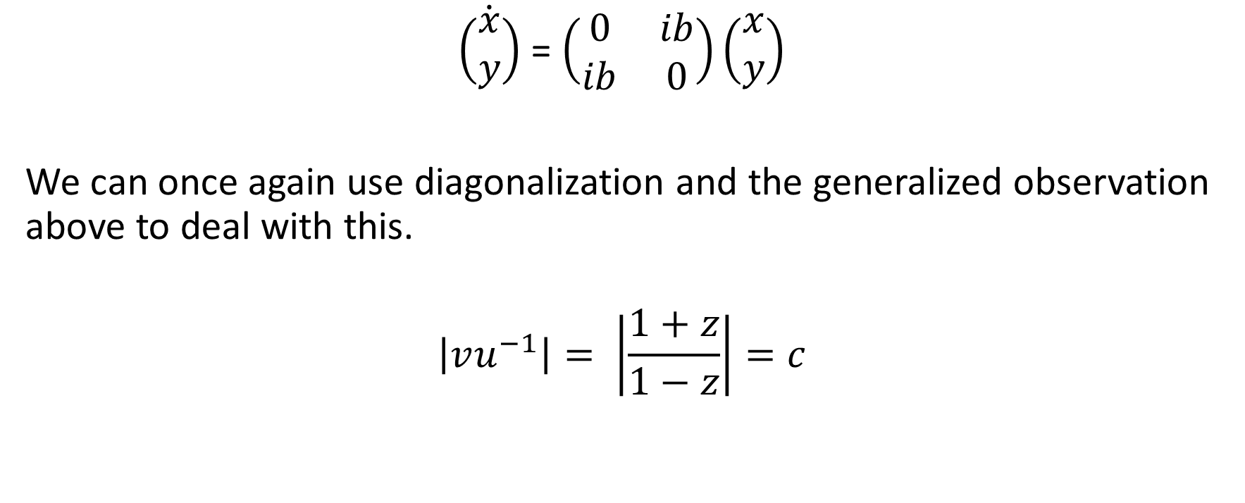

Solution for $β$ is purely imaginary
$\dot{\left(\begin{matrix}x \\ y\end{matrix}\right)}$ = $\left(\begin{matrix}0 & ib \\ ib & 0\end{matrix}\right)\left(\begin{matrix}x \\ y\end{matrix}\right)$
We can once again use diagonalization and the generalized observation above to deal with this.
$$\left|vu^{−1}\right|= \left|\frac{1+z}{1−z}\right|=c$$

Slide 19


Solution for $β$ is purely imaginary
$$\left|vu^{−1}\right|= \left|\frac{1+z}{1−z}\right|=c$$
Where $c$is a constant. Letting $z=f+ig$ and solving for $g$ here gives us:
$$g= \sqrt{\frac{c^{2}{\left(1−f\right)}^{2}−{\left(1+f\right)}^{2}}{1+c^{2}}}$$
Notes:
Once again show the graphs here interactively

Slide 20

Future
Consider solving when $β$ has real and imaginary part
Put all solutions together
Try a numerical simulation
Notes:
Can add anything here you think fits well.

Slide 21
References
Dr. D’Alessandro

