Slide 1
Math 492: Quantum Group
Ryan Toepfer
Carter Ronald
Notes:
1:00

Slide 2
Problem Description
Describe the change of a quantum system over time, depending on its initial value, and a matrix that describes its motion
Add picture to emphasize trajectory and ode
Notes:
2:30

Slide 3
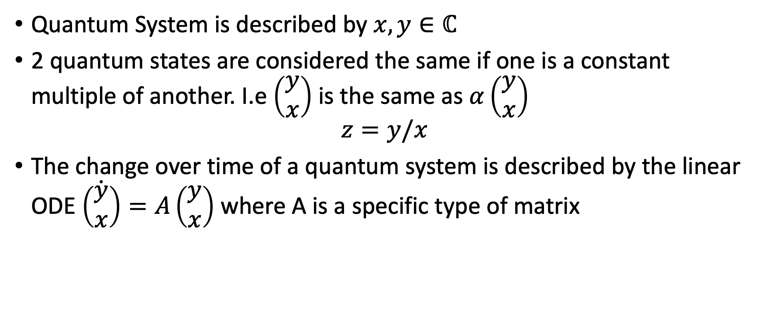
Problem Setup
Quantum System is described by $x,y∈ℂ$
2 quantum states are considered the same if one is a constant multiple of another. I.e $\left(\begin{aligned}y \\ x\end{aligned}\right)$ is the same as $α\left(\begin{aligned}y \\ x\end{aligned}\right)$
$$z=y/x$$
The change over time of a quantum system is described by the linear ODE $\dot{\left(\begin{aligned}y \\ x\end{aligned}\right)}=A\left(\begin{aligned}y \\ x\end{aligned}\right)$ where A is a specific type of matrix
Notes:
5:30 Talk about how z=y/x ignores a single class of solutions where x=0,

Slide 4
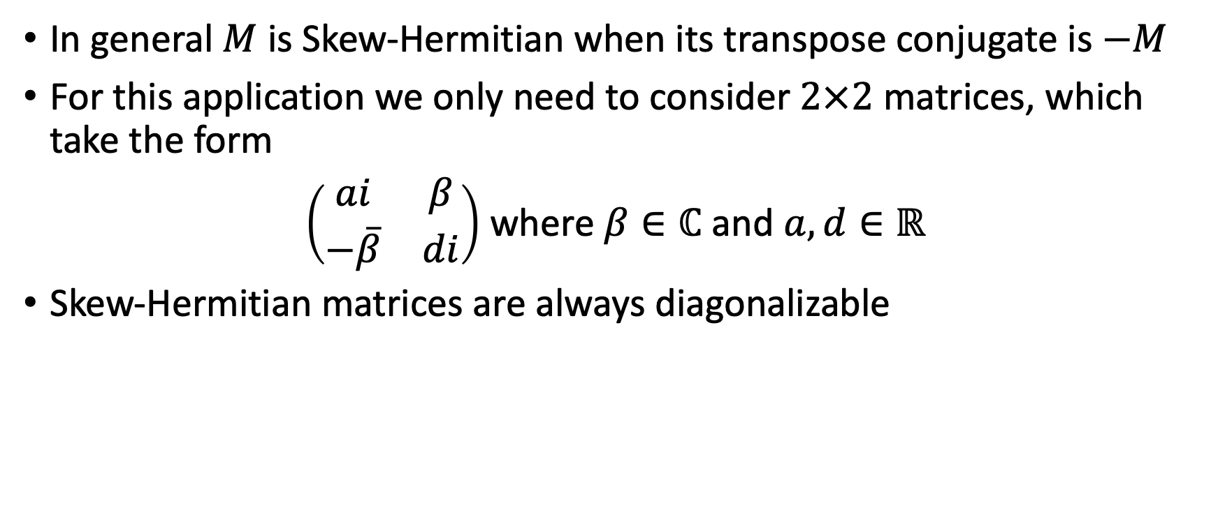
Skew-Hermitian Matrices
In general $M$ is Skew-Hermitian when its transpose conjugate is $−M$
For this application we only need to consider $2×2$ matrices, which take the form
$\left(\begin{matrix}ai & β \\ −\overline{β} & di\end{matrix}\right)$ where $β∈ℂ$ and $a,d∈ℝ$
Skew-Hermitian matrices are always diagonalizable
Notes:
6:30

Slide 5
What We Are looking For?
Why a direct solution is complicated
Notes:
7:30

Slide 6
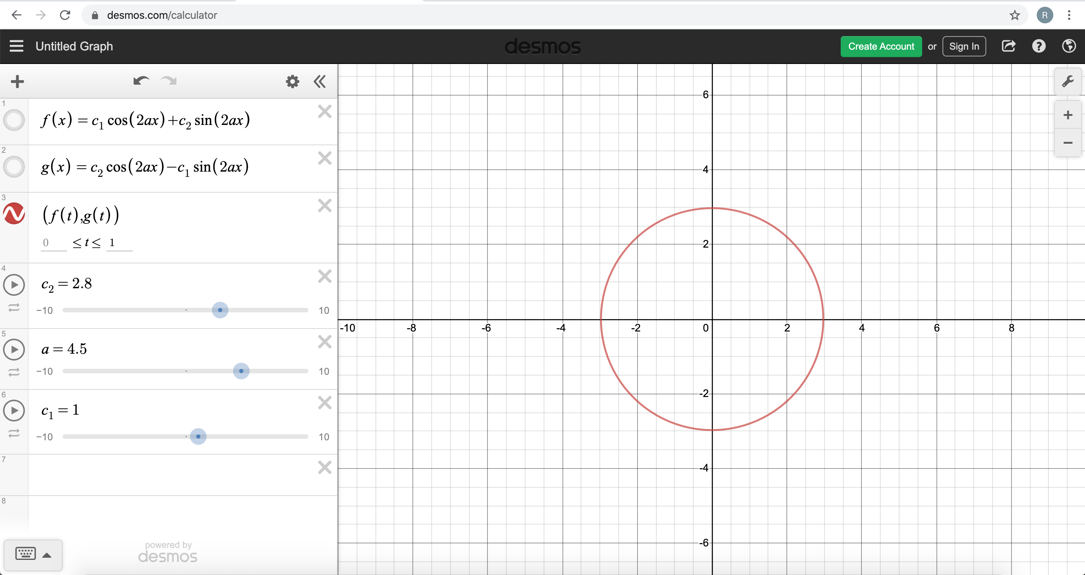


What If $β=0$ and $d=−a$
Then $A=\left(\begin{matrix}ai & 0 \\ 0 & ai\end{matrix}\right)$
Notes:
8:30

Slide 7
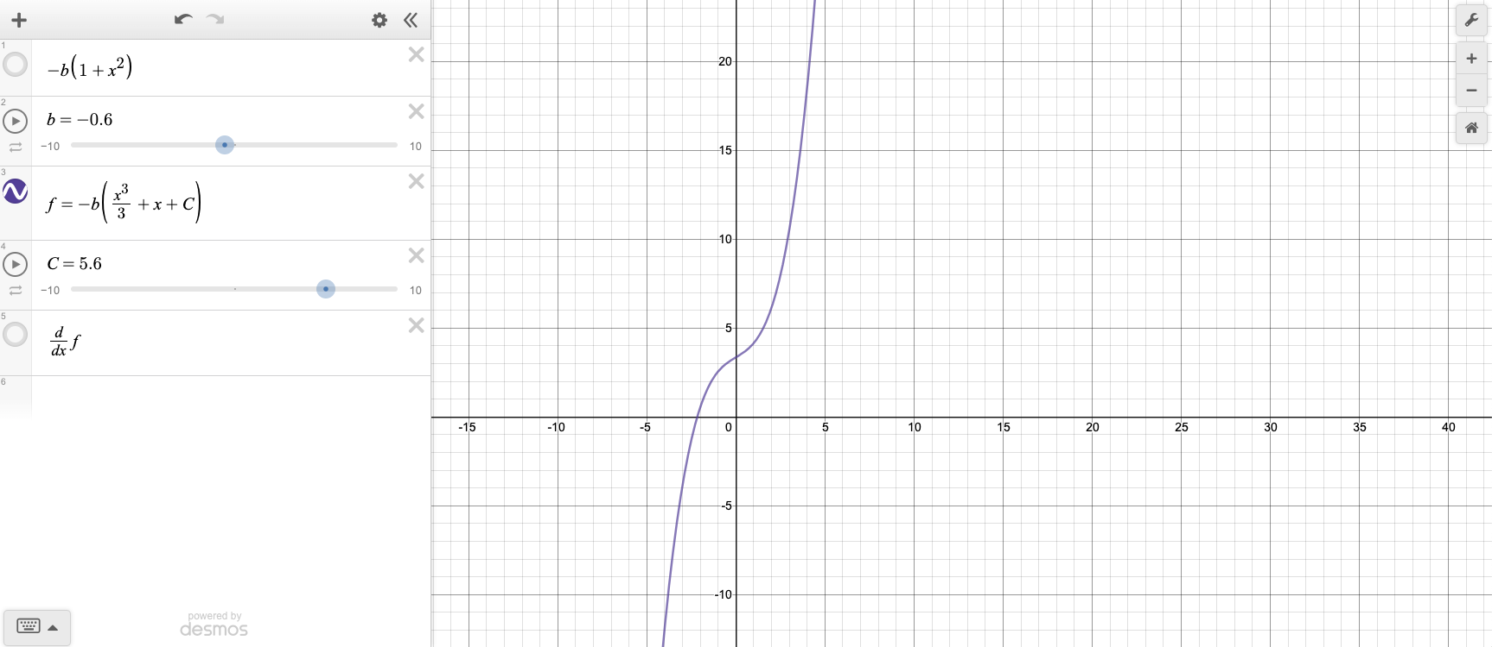


What If $β$ is real and $d=a=0$
Then $A=\left(\begin{matrix}0 & β \\ β & 0\end{matrix}\right)$
Notes:
9:00

Slide 8
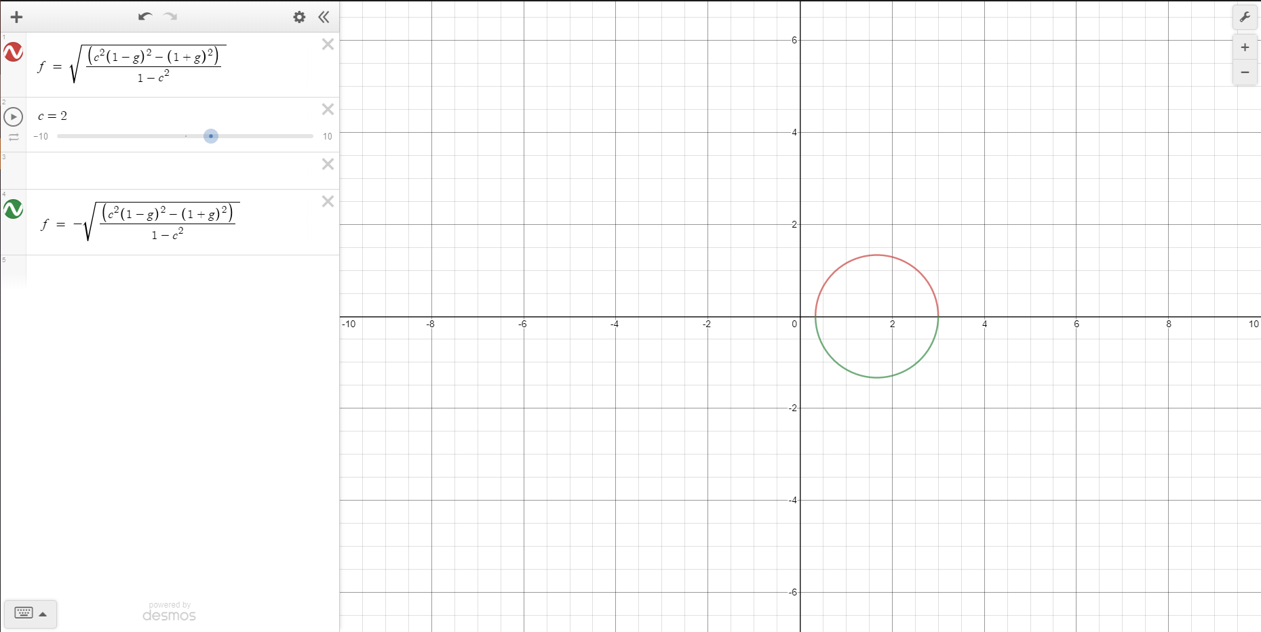

What If $β$ is real
Notes:
9:30

Slide 9

What if $β$ is purely imaginary
The shape of the graph changes depending on the parameters
Notes:
10:00

Slide 10
Solutions

Slide 11

Getting an expression for $\dot{z}$ (Riccati Equation)
TODO

Slide 12

Solution for $β=0$ and $d=−a$
Some intermediate steps
Look at plot interactively

Slide 13

Solution for $β$ is real and $d=a=0$
Some intermediate steps
Look at interactive plot

Slide 14

Solution for $β$ is real
Diagonalization
Eigenvalues

Slide 15

Solution for $β$ is real (continued)
Solution for |uv|
Interactive plot

Slide 16

Solution for $β$ is purely imaginary
Diagonalization
Eigenvalues

Slide 17

Solution for $β$ is purely imaginary.
Solution for |uv|
Interactive plot

