Slide 1
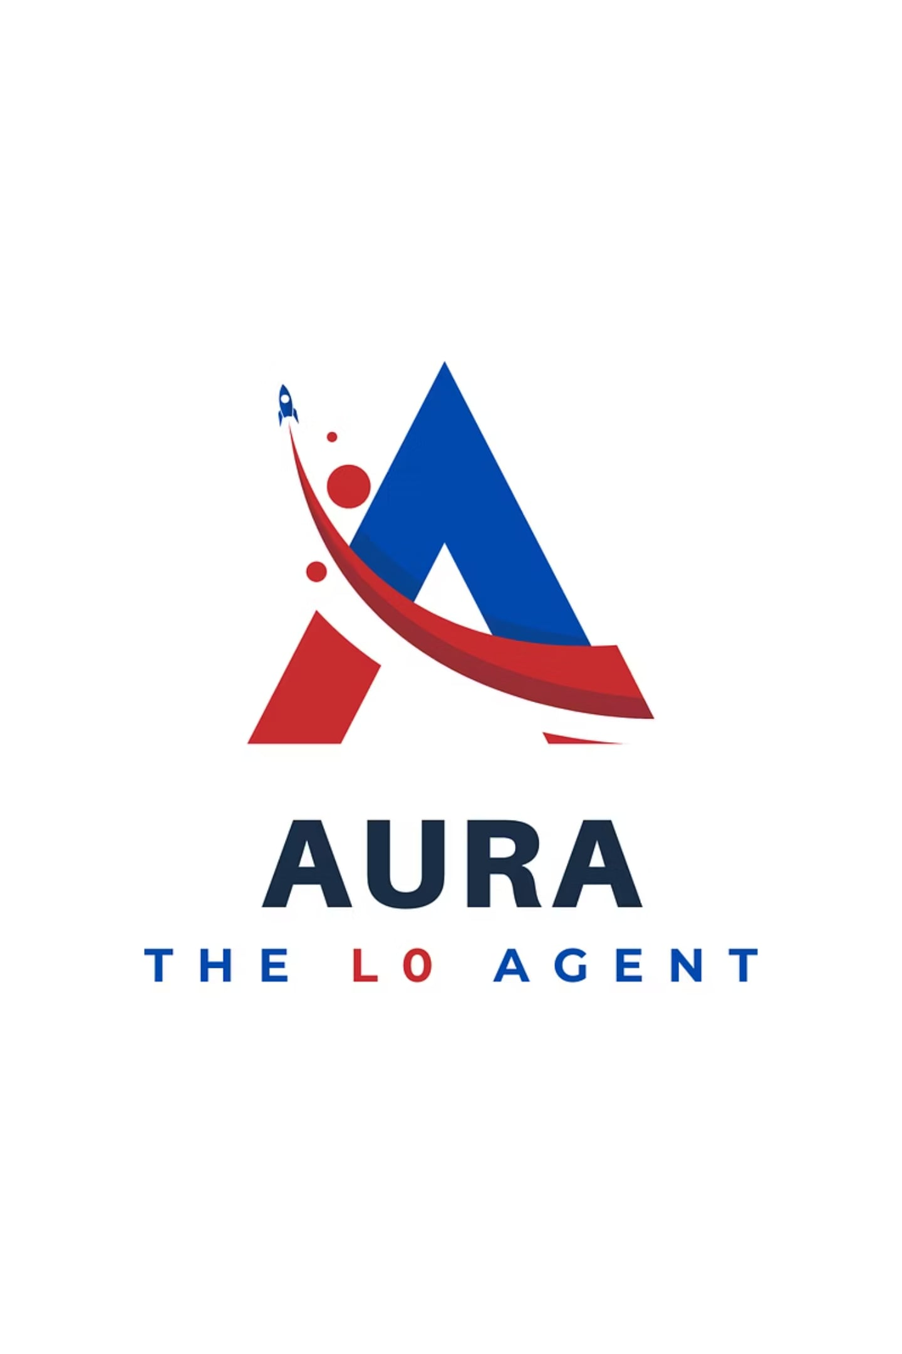

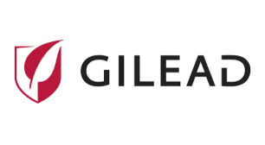
CIS GILEAD IDEATHON 2026 · AIOPS THEME
AURA - The L0 Agent
Agentic Unified Resolution & Assistance
An adaptive AIOps intelligence layer revolutionizing the Gilead Enterprise Service Desk and elevating L1/L2 support operations.
Ryan Ahmed Tusi · 2485906 Analyst Trainee
Gilead Sciences Inc · Cognizant Technology Solutions

Slide 2

"There has never been a tier before L1."
Enterprise IT support has remained fundamentally unchanged for decades. A user encounters an issue, L1, the human agent from contact center who answers first, and L2, the specialist who takes what L1 cannot solve. The two-tier model itself has never changed, no one has ever added a layer before L1.
What if Enterprise IT Support was designed around AI from the very beginning?

Slide 3

Meet AURA: The AI-Native L0 Support Layer
Redefining Enterprise IT Support by Introducing the Tier Before L1. Agentic Unified Resolution & Assistance (AURA)
Voice AI
Conversational user interactions
Agentic AI
Autonomous task execution
AURA: AI-Native L0
First point of contact for users
AIOps Automation
Automated operations and alerts
Endpoint Remediation
Fixes at the device level

Slide 4

How AURA Works
AURA transforms Enterprise IT Support by introducing L0, an intelligent, autonomous support layer that serves as the first point of engagement for every IT request. Unlike traditional chatbots, AURA is a new AI-first operating model that understands user needs, verifies identity, resolves routine issues autonomously, remediates endpoint problems, and coordinates specialized AI agents. For complex tasks, it escalates seamlessly with a fully documented, context-rich ServiceNow ticket, while continuously assisting throughout the support journey.
By operating as the AI-native front door, AURA shifts the model from reactive, ticket-driven service to a proactive, predictive, intelligent, and continuously learning operational capability, pioneering the industry's first true AI-native support tier, The L0 tier.

Slide 5
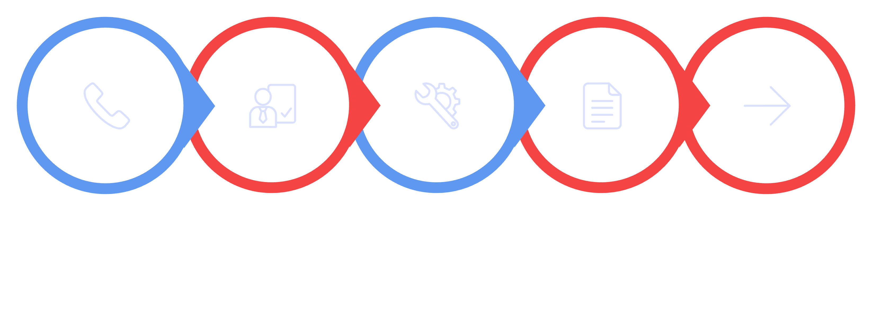
The Current L1 Call Lifecycle
Every call runs an identical, toil-heavy sequence and six data-backed pain points repeat inside it, every time.
Verification (5 min approx)
Troubleshooting
Documentation
Call Arrives
Transfer/Close
Red stages = toil overhead · Blue stage = real value

Slide 6






Six Gaps, One Loop
Six data-backed pain points repeat inside every call:
Same Issue, Daily
Verification Tax
Double Documentation
62% of tickets automatable
5 minutes approx. before troubleshooting starts
Retyped from memory after every call
Context Lost
Availability Routing
Reactive Spikes
~1 in 3 tickets escalate without a proper brief
Not skill-matched. Whoever is next in queue. Less productive.
Absorbed reactively, every week

Slide 7
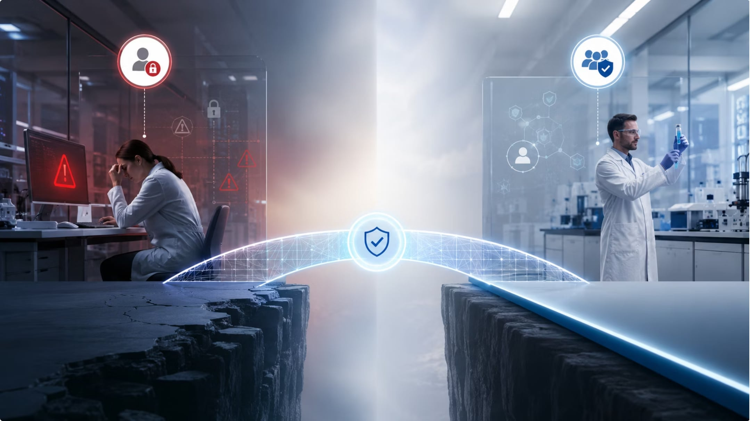
Why This Matters More at Gilead
A researcher locked out of a validated system can stall an experiment. A blocked analyst can delay a batch release. In a GxP environment, downtime is not a productivity question, it is a regulatory and patient-safety question.
This is one of the gap the L0 Support Layer is built to close.

Slide 8
The Evidence: A Habit That Became a Dataset
AURA was observed into existence by myself answering these calls every day. The data is real, structured, and sourced. Source: Ticket Analysis Master · AURA docx · Refer Excel Workbook & docx Attached ·
01
02
Week 1
Weeks 1–12
I joined as L1 Voice Analyst at Gilead Enterprise Service Desk
Logged every call to find patterns: formula-driven, structured excel sheet (automated analysis)
03
04
Month 3
CIS GIlead Ideathon 2026
200+ ticket dataset revealing a system-level problem
AURA: the structural answer, assembled from evidence

Slide 9
The Dataset in Numbers
The data collected over three months provides a clear quantitative overview of the service desk operations, highlighting critical areas for improvement and confirming the need for a solution like AURA.
200+
143
95
17.3
Tickets Logged
Resolved
KB-Driven
Min Avg. Resolution
3 months of structured data
~67 escalations recorded
Known-answer resolutions
Monday is peak volume day
"AURA was not ideated in a single session. It was observed into existence."
Source: Ticket Analysis Master ·

Slide 10
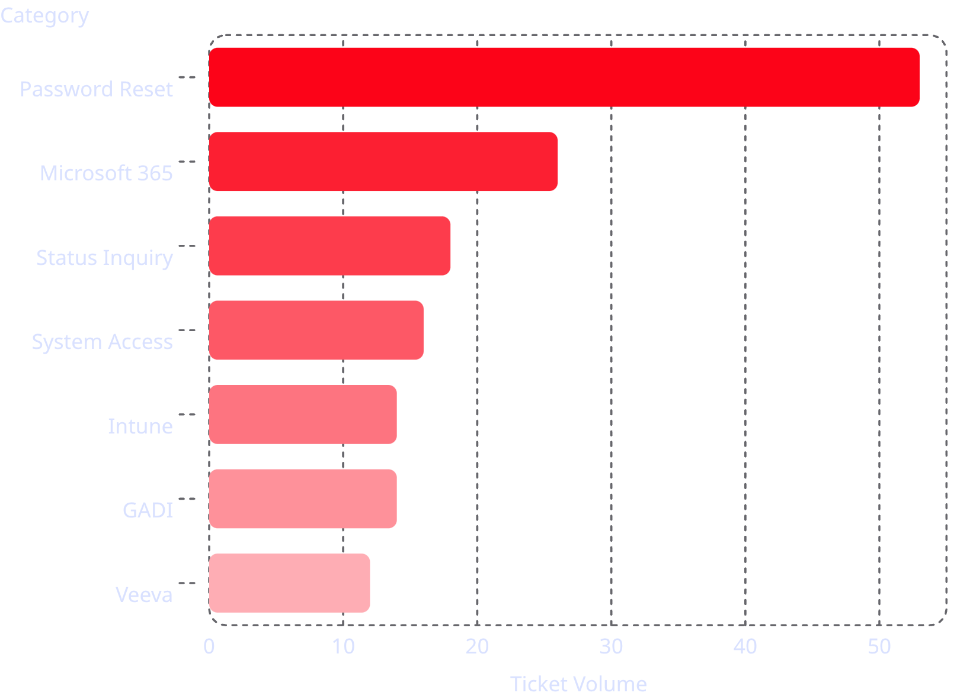
What Gilead Calls About and the ROI Map
131 / 212 ≈ 62%
Automation candidates — Password Reset alone is 94% automatable. KB-driven resolutions (95) vastly outnumber genuine manual troubleshooting (13).
Password Reset dominates volume and is the highest-confidence automation target. The pattern is unambiguous, automate from the top of this chart downward.
Source: Ticket Analysis Master ·

Slide 11
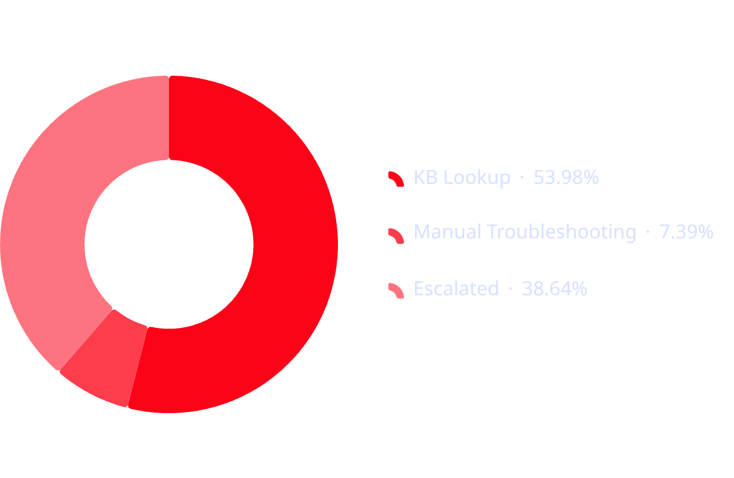
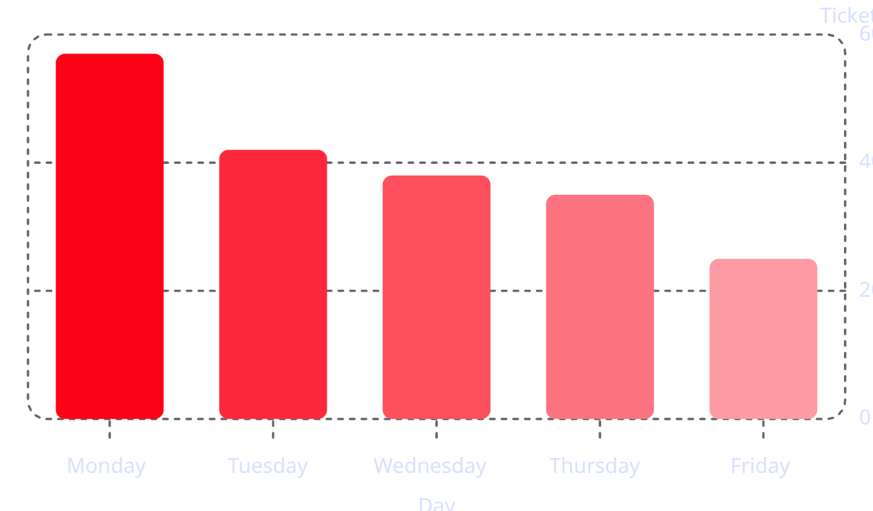
Where the Time Goes and the Monday Spike
Most "resolution" is known-answer lookup wrapped in overhead. The worst day of the week is entirely foreseeable, not noise, but the calendar. Source: Ticket Analysis Master ·
Resolution Type Breakdown
Volume by Day of Week
~88% resolve within 20-30 minutes, mostly verification and documentation, not troubleshooting.
Monday is 2.3× Friday's volume — entirely predictable, entirely addressable.

Slide 12

THE INSIGHT
What looked like a dozen automation ideas was one tier, waiting to be assembled.
Password reset bots. Lockout agents. KB recommenders. Sentiment tags. Each one a fragment. Together, a layer that sits before L1.

Slide 13

Introducing AURA: Two Faces, One System
Agentic Unified Resolution & Assistance: an AI-native platform introducing L0, a new autonomous layer before traditional L1 support. Structurally placed between users and agents. Two faces. Four modes. One system.
End User Contact
First touchpoint with user issue
Autonomous Resolution
L0 resolves common requests automatically
AURA L0 Platform
Agentic autonomous layer before L1 support
Co‑pilot Verification
L1/L2 checks and verifies actions
Summarize & Document
Auto summaries and ticket updates

Slide 14






The Six Pillars - Key Ideas
Six mechanisms, one loop: verification, remediation, escalation, documentation, prediction, and co-pilot support.
Conversational AI & Smart Verification
Autonomous Remediation
Intelligent Escalation
Sub-agents + Nexthink remote actions fix issues end-to-end.
Skill-matched routing with a complete brief before the human picks up.
Natural voice, protocol run exactly. Voice-recognition is an additive verification signal only.
Auto-Documentation
Predictive Operations
Active L0 Co-Pilot
Complete, timestamped, GxP-ready ServiceNow tickets generated automatically.
Recurring patterns acted on before the next wave arrives.
Live transcript listening, assists humans mid-call without being asked.

