Slide 1





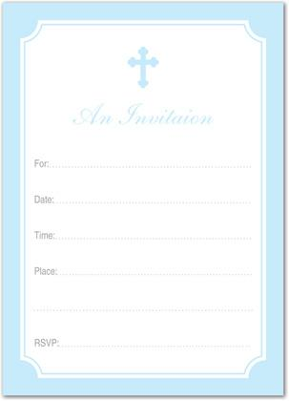
Hallmark Cards
Template Search
Login
Templates
$ 7.00
$ 6.50
$ 8.00
$ 4.45
$ 7.00
$ 5.55
Notes:
Main page

Slide 2
Login:
Username:
Password:
New Account?
Login

Slide 3
Login:
Username:
AdminLogin
Password:
P@ssword
New Account?
Login

Slide 4

Hallmark Cards
Track Order
Template Search
Welcome, AdminLogin!
Logout
Please pick a template below to begin.
Templates
$ 7.00
$ 6.50
$ 8.00
$ 4.45
$ 7.00
$ 5.55

Slide 5
Welcome, AdminLogin!
Logout
Undo
Redo
Font
Size
Insert Image
Save
Insert
Save
Heading:
Enter Text Here
Heading:
Greetings:
Line One:
Enter Text Here
Enter Text Here
Greeting:
Names:
Enter Text Here
Line Two:
Line Two:
Names:
Enter Text Here
Thanks:
Line Three:
Line Three:
Enter Text Here
Enter Text Here
Line Four:
Names:
Enter Text Here
Line Four:
Enter Text Here
Line Five:
Thanks:
Total Cost:
$x.xx
Line Five:
Names:
Enter Text Here
0
-
Quantity
+
Add New Text Box
Cancel
Continue

Slide 6
Welcome, AdminLogin!
Logout
Undo
Redo
Font
Size
Insert
Image
Save
Heading:
You’re Invited!
You’re Invited!
Greetings:
Line One:
Greetings to:
My Birthday Party
Greetings to:
Names:
Joe and Sam
Line Two:
My Birthday Party
Joe and Sam
October 1st, 5pm
Thanks:
Line Three:
October 1st, 5pm
Thanks,
The Gardens, SIUE
The Gardens, SIUE
Names:
YourName
Line Four:
Food will be provided!
Food will be provided!
Total Cost:
Thanks,
$ 700.00
Line Five:
YourName
100
-
Quantity
+
Add New Text Box
Cancel
Continue

Slide 7
Payment and Shipping
Cost: $700.00
Enter destination address:
Name:
Address:
Credit Card #:
City:
Security code:
State:
Expiration Date:
Zip code:
Cancel
Submit

Slide 8
Payment and Shipping
Cost: $700.00
Enter destination address:
Name:
Address:
YourName
1234 Street
Credit Card #:
1234567890123456
City:
Edwardsville
Security code:
1234
State:
Illinois
Expiration Date:
8/17
Zip code:
12345
Cancel
Submit

Slide 9
Order complete! Confirmation Numer: 2C46LS2
Hallmark Cards
Thanks!

