Slide 1
Age- and time-specific space-for-time mark recapture models using space4time
Record

Slide 2
Overview
Brief intro to mark-recapture models (~ 10 minutes)
The space4time model (~ 10 minutes)
Age data (~10 minutes)
Overview of space4time package (~10 minutes)
Example using fish captured at the East Fork Potlatch RST (1 hour)

Slide 3
Cormack-Jolly-Seber models

Slide 4







Cormack-Jolly-Seber model
Stochastic
Deterministic
t =1
t =2
t =3
t =4
t =5
t =6
State process
$$φ$$
$$φ$$
$$φ$$
Alive
$$(1−φ)$$
Dead
$$p$$
$$(1−p)$$
$$p$$
Observation process
Seen
Not seen
Notes:
Cormack-Jolly-Seber models are mark-recapture models. They involve two processes, a state and an observation process. Individuals are uniquely identified and are captured and recaptured over time.
In the state process, individuals can survive from one time period to the next (with probability $φ$). Once they die, they remain dead.
In the observation process, if individuals are alive they can be observed or recaptured (with probability p)
Assumptions of CJS models are:
Tags are not lost or misread
Capture and recaptures are random with respect to the population
Individuals with the same cohort (i.e. time at first capture, age, etc) have the same detection and survival probabilities
The survival or detection of individuals is independent from other individuals

Slide 5
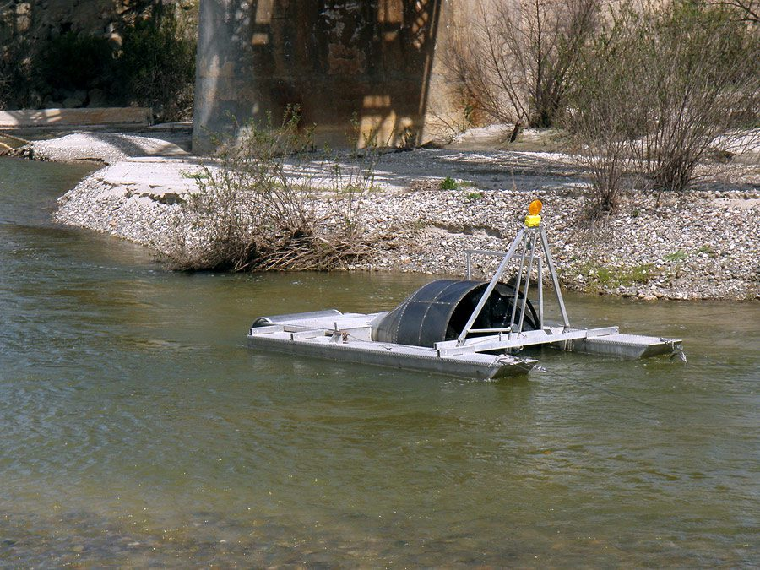
Space-for-time
Notes:
In space-for-time models, time is replaced with site. So instead of survival from one time period to the next, it is survival from one site to the next

Slide 6
The space4time model

Slide 7
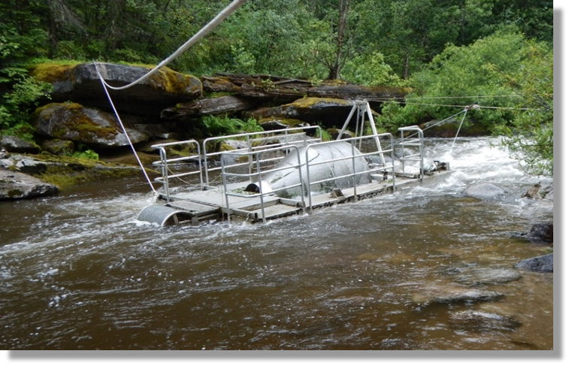
Objectives
Develop a mark-recapture model for juvenile steelhead
Estimate age-specific survival
Life history contributions to smolt abundance
Relate survival to environmental and biotic factors

Slide 8


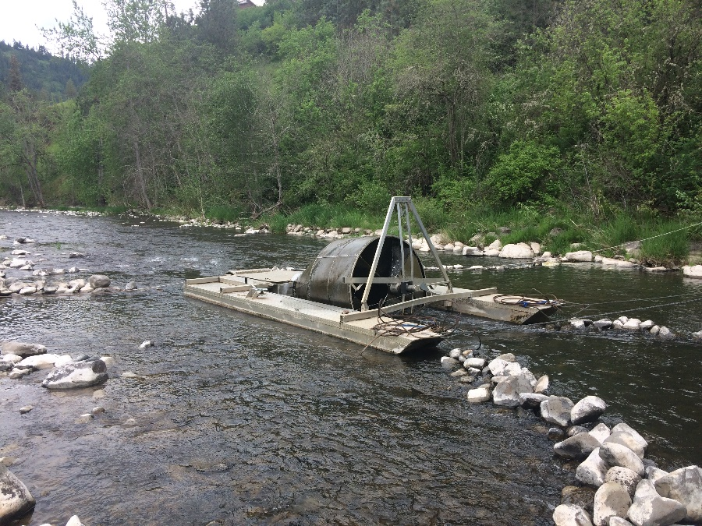

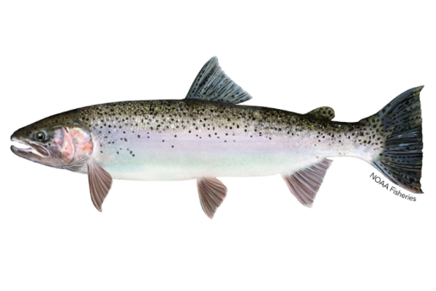



Age-1
Age-1
Age-2
Age-2
Age-3
Age-3
Age-4

Slide 9
Model details
Mark-recapture model
Observed data likelihood (Hance et al. 2020)
Incorporates uncertainty in age using an age sub-model
Includes covariates via GLM (generalized linear models)
Bayesian (Stan)
Flexible generalizability to other systems
Notes:
Space for time CJS model

Slide 10


RST 1st dam 2nd dam
1
1
1
Age
2
2
2
3
3
3
4
4

Slide 11










Age-1 survival = $θ_{1−1}$ + $θ_{1−2}$+ $θ_{1−3}$+ $θ_{1−4}$
Age-2 survival = $θ_{2−2}$ + $θ_{2−3}$ + $θ_{2−4}$
Age-3 survival = $θ_{3−3}$ + $θ_{3−4}$
RST 1st dam 2nd dam
$$θ_{1−1}$$
θ
1
1
1
$$θ_{1−2}$$
p
p
$$θ_{1−3}$$
Age
$$θ_{2−2}$$
$$θ_{1−4}$$
θ
2
2
2
$$θ_{2−3}$$
p
p
$$θ_{2−4}$$
$$θ_{3−3}$$
θ
3
3
3
$$θ_{3−4}$$
p
p
θ
4
4
p
p
Notes:
Cohort apparent survival

Slide 12
What do you need
Initial capture where fish are tagged (individually identifiable)
At least two downstream recapture sites (i.e. PIT array)
Auxiliary info on all fish (i.e. fork length)
Ages for some fish

Slide 13
Using space4time

Slide 14
= direct (used for…)
space4time workflow
= indirect (informs)
Define site configuration
linear_s4t_config()
simplebranch_s4t_config()
s4t_config()
Optional workflow
Fit ageclass only model
fit_ageclass()
Age data
id
ageclass
obs_time
obs_site
… optional variables
DART Basin TribPit Query Results
Capture history object
s4t_ch()
Use DART query
read_DART_file()
Capture history data
id
site
time
removed
Fit full mark-recapture model
fit_s4t_cjs_rstan()
fit_s4t_cjs_ml()
Clean capture history
clean_s4t_ch_obs()

Slide 15

Capture history
= direct transition
= direct or holdover
id | site | time | removed
1 | A | 2010 | FALSE
1 | C | 2011 | FALSE
1 | D | 2011 | FALSE
…
ID: 1
Released in 2010
Recaptured in 2011
Recaptured in 2011
Not observed again
A
C
D
E
B
Notes:
Example capture histories

Slide 16
Capture history
= direct transition
= direct or holdover
id | site | time | removed
…
2 | A | 2012 | FALSE
2 | C | 2012 | TRUE
…
Recaptured in 2012, removed and barged to ocean
ID: 2
Released in 2012
Not observed again
A
C
D
E
B
Notes:
Example capture histories

Slide 17
Capture history
= direct transition
= direct or holdover
id | site | time | removed
…
3 | A | 2010 | FALSE
3 | D | 2011 | FALSE
…
ID: 3
Released in 2010
Recaptured in 2011
Not observed again
A
Not observed
C
D
E
B
Notes:
Example capture histories

Slide 18
Site configuration
= direct transition
= direct or holdover
A
Age range: 0-3
C
D
E
Age range: 1-4
Age range: 1-4
Age range: 1-4
B
Age range: 1-4
simplebranch_s4t_config(site_names = c(“A”, “B”, “C”, “D”, ”E”),
branch_sites = c(“A”, “B”),
holdover_site = c(“A”, ”B”),
min_a = c(“A” = 0, “B” = 1, “C” = 1, “D” = 1, “E” = 1),
max_a = c(“A” = 3, “B” = 4, “C” = 4, “D” = 4, “E” = 4))
Notes:
Using the site configuration function

Slide 19
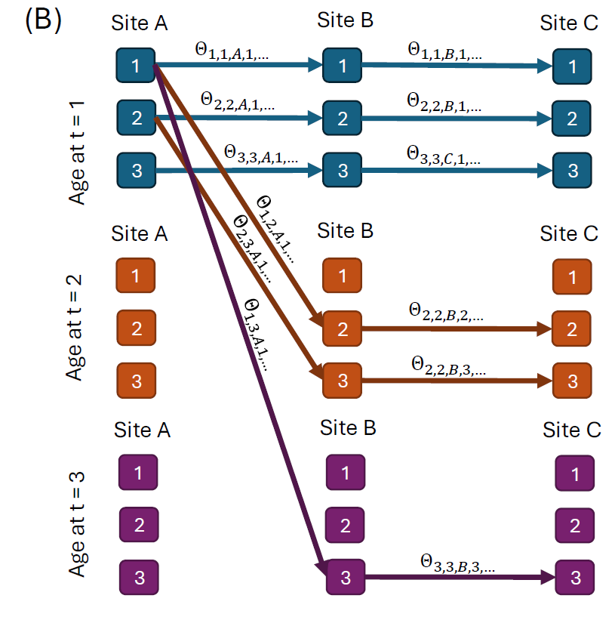
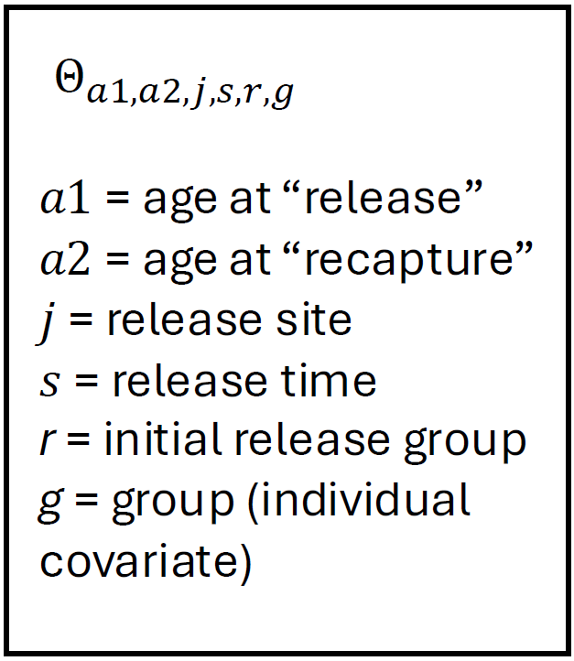
Parameterization of transitions
Notes:
The possible transitions for an individual released in time period 1. The associated probabilities are Theta, which are a function of theta parameters (next slide)

Slide 20
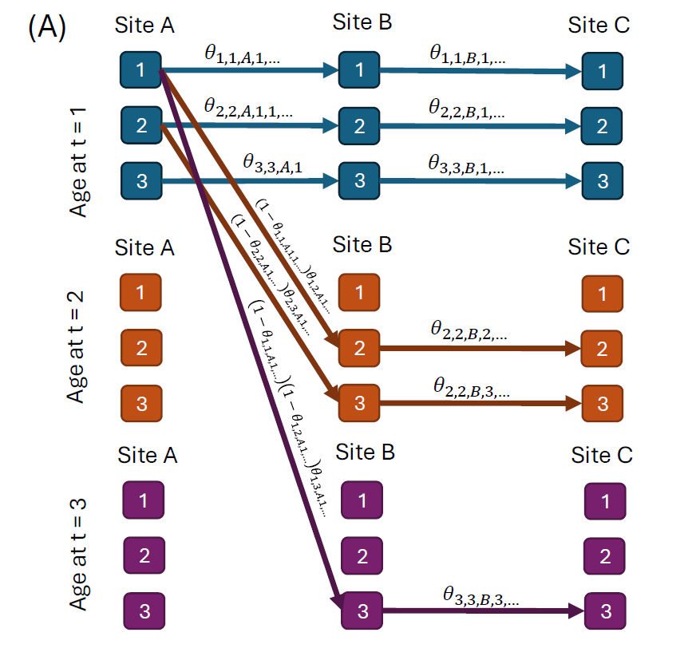
Parameterization of transitions
Notes:
The possible transitions for an individual released in time period 1. The associated probabilities are Theta (previous slide), which are a function of theta parameters.

