Slide 1

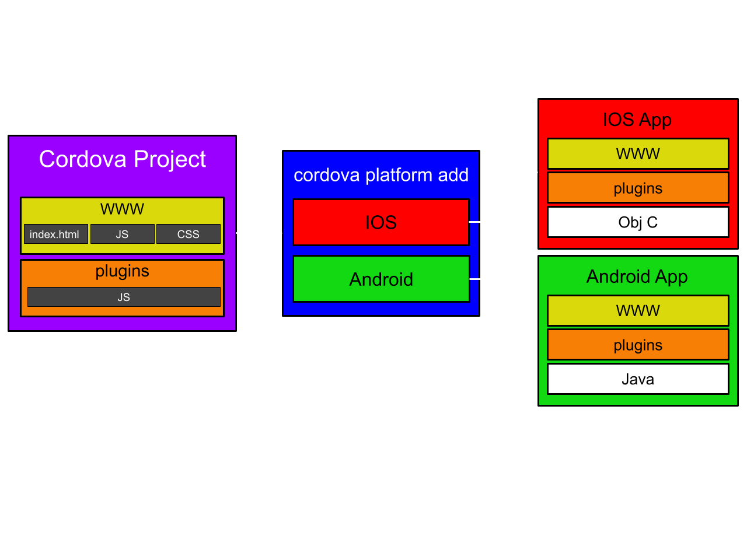
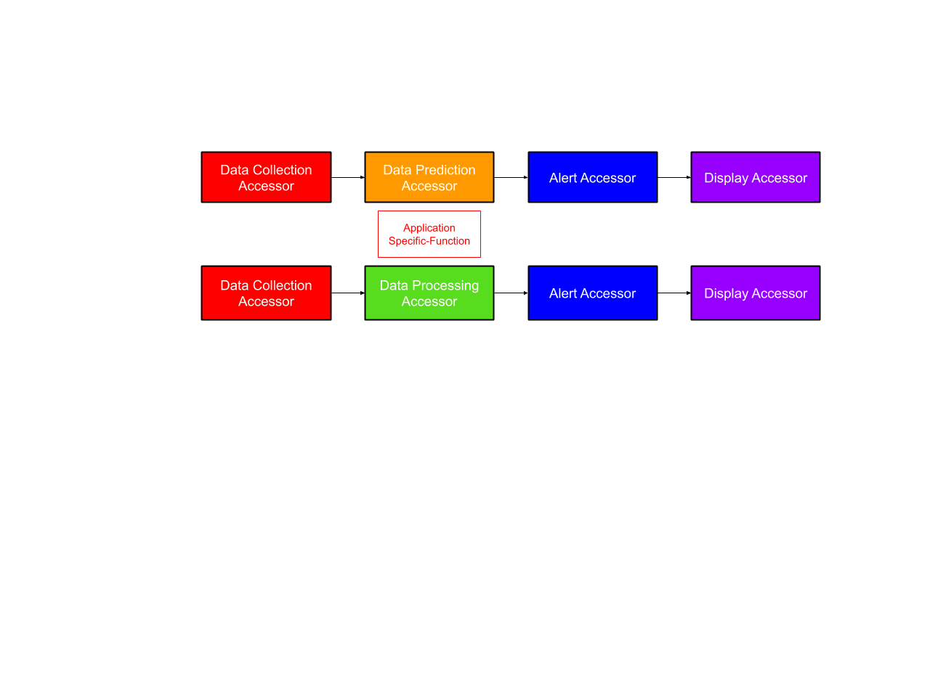

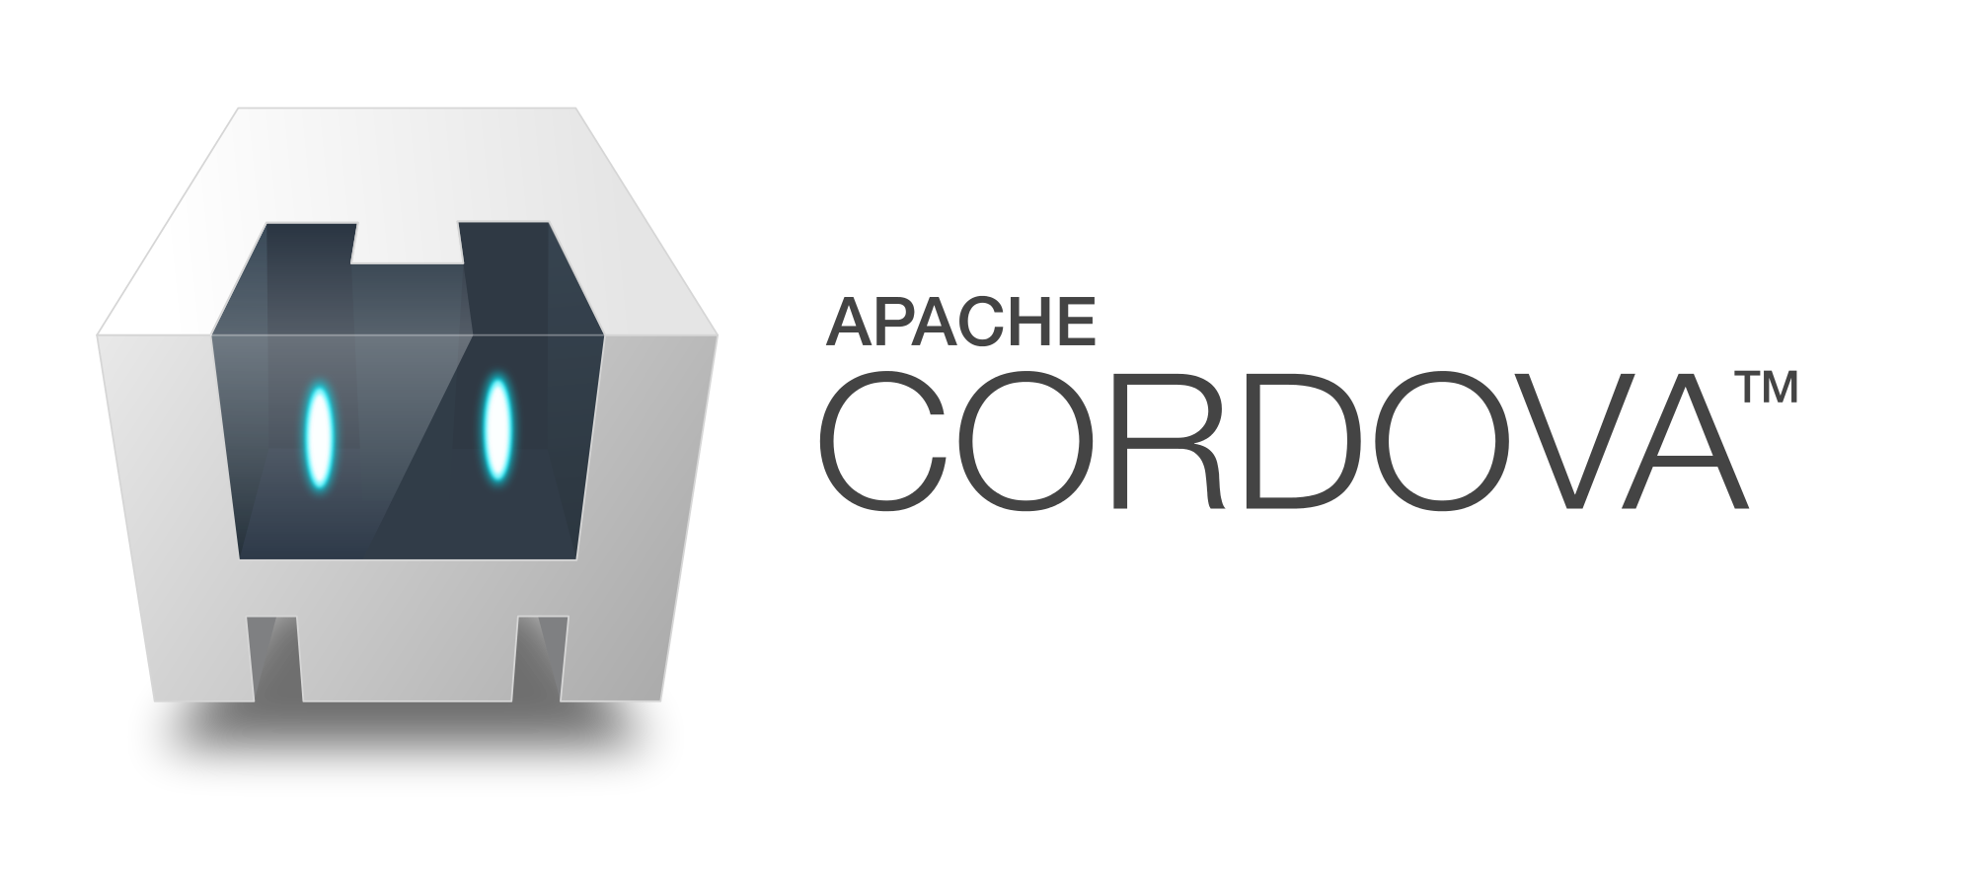
Experimentation with Cordova Accessor Host: An Edge-based IoT Middleware
Colin Campbell, Ryan Wakabayashi, Dr. Anne Ngu
Motivation
IoT application development is labor intensive
An edge-based IoT middleware should support:
Local processing
Reduce cloud dependency
Be secure and protect privacy
rapid development of applications
Result
Rapid development of IoT applications using Cordova Accessor Host:
Developed a BLE application for an Android smartphone that collects sensor data from Arduino
Deployed two simple Android applications to IOS by using Cordova’s CLI command for adding a platform
Deployed multiple smartphone applications developed with Cordova Host to Raspberry Pi without changing any code.
Experiment 1: Cordova Host for Arduino Devices
Utilizing a pre-existing Cordova Plugin API developed by EVOthings to communicate with Bluetooth low energy devices (BLE) on Android and IOS.
We replaced the BLE module, library, and successfully created two Android applications
Each app receives data from an Arduino MKR1010 Wi-Fi board with either an ultrasonic sensor or an Infrared temperature sensor.
Experiment 2: Cross-platform Deployment
IOS deployment was successful without any modification to the code.
Cordova Accessor Host
Apache Cordova is a light-weight accessor host that:
Runs on smaller edge-based
Supports local processing, adding security and lowering cloud dependency.
Utilizes web technologies like JavaScript, HTML, and CSS.
Is cross-platform
Future Research
Enable fall detection application to monitor multiple smartwatches concurrently
Further development of Cordova Accessor Host on Raspberry Pi
Evaluate the performance of Cordova Host with various IoT applications
Battery usage and memory consumption
Previous Research
An application has been developed for fall detection that features reusable accessors, software that has input and output ports.
Experiment 3: Cordova Host on Raspberry Pi
Initially our intentions were to use a Raspberry Pi as an IoT device to send sensor data to a smartphone. After installing the Raspbian OS, we realized that the BLE library only supports the Pi as a gateway device, not as a sensing device.
Since Raspberry Pi is a mini-computer we decided to deploy Cordova Host on Raspberry Pi by:
Installing Lineage OS – Android based OS
Access the Raspberry Pi via network connection to a computer
Build and Run within Android Studio
The Raspberry Pi successfully deployed and ran both simple applications. This shows that Cordova Host can be easily deployed to a different IoT device than a smartphone.
References
Pamboris, A., Kozis, C., & Herodotou, H. (2020). Cuttlefish: A Flexible and Lightweight Middleware for Combining Heterogeneous IoT Devices. 2020 IEEE 17th Annual Consumer Communications & Networking Conference (CCNC), Consumer Communications & Networking Conference (CCNC), 2020 IEEE 17th Annual, 1–6. Retrieved from https://bit.ly/3ff9OBa
Evothings. (n.d.). “Evothings/Cordova-Ble.” Github. Retrieved from github.com/evothings/cordova-ble
Goal
To make Cordova host run on microcontroller device to demonstrate the advantage of Cordova Host as an edge-based IoT middleware.
Acknowledgements
We thank the National Science Foundation for funding the research under the Research Experiences for Undergraduates Program.
We extend our gratitude to Jesuloluwa Eyitayo for his dedication, time, and application contributions.
A special recognition to our mentor Dr. Anne Ngu for guidance. Finally we would like to praise UC Berkeley for their contributions in The Ptolemy Project.
This material is based upon work supported by the National Science Foundation under REU grant #1757893. Any opinions, findings, and conclusions or recommendations expressed in this material are those of the authors and do not necessarily reflect the views of the National Science Foundation.

