Slide 1

Implementation of An Automatic Fingerprint Identification System
Peihao Huang, Chia-Yung Chang, Chaur-Chin Chen
Department of Computer Science
National Tsing Hua University
Hsinchu, Taiwan 30013
E-mail: cchen@cs.nthu.edu.tw

Slide 2

Outline
A Flowchart of Fingerprint Identification
♪ Type Classification
♪ Minutia Points Detection
♪ Minutiae Pattern Extraction
♪ Pattern Matching
♦ Rindex28, Lindex101 Databases
♦ Experimental Results

Slide 3
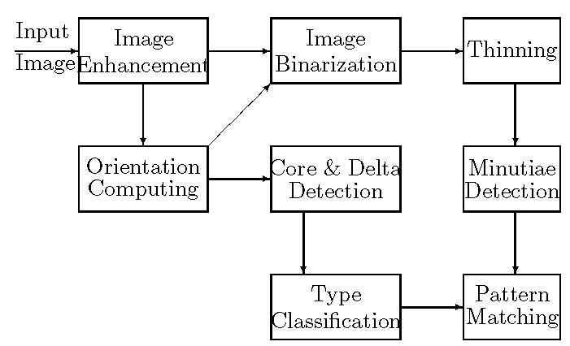
Flowchart of An AFIS

Slide 4
Image Enhancement
The moisture and scars of a finger as well as the pressure due to a fingerprint sensing could distort the quality of the acquired fingerprint image.
We adopt an ad hoc strategy to enhance the quality of a fingerprint image.
Support that A (i, j) is image gray level at pixel (i, j), μ and s² are the mean and variance of gray levels of input image, and α=150, γ=95, γ must satisfy γ>s.
The enhanced image B( i , j ) is given as follows.
B( i , j )← α + γ ＊ ([A ( i , j ) – μ]／s)

Slide 5
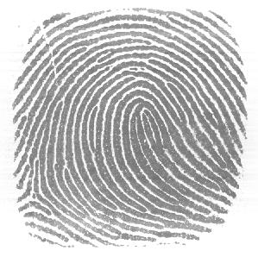
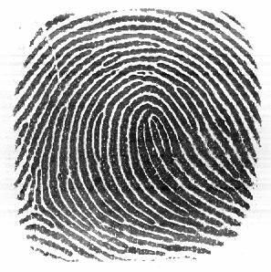
Result of Image Enhancement

Slide 6
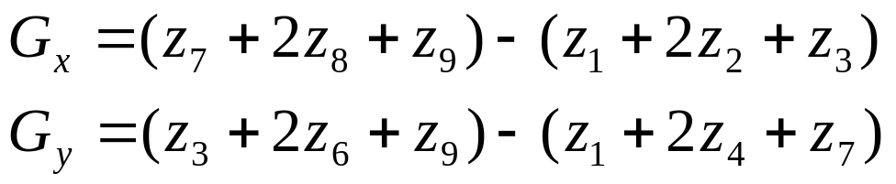
Orientation Computation(1)
First we apply a 5 by 5 median filtering on the image to avoid false gradient vectors generated by noise.
Then compute the gradient (G_{x},G_{y}) at each pixel by a Sobel operator.
mask Sobel Operation
z1 | z2 | z3
z4 | z5 | z6
z7 | z8 | z9

Slide 7
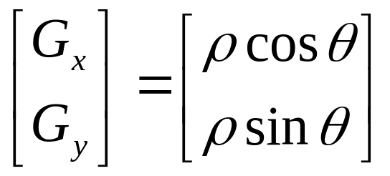
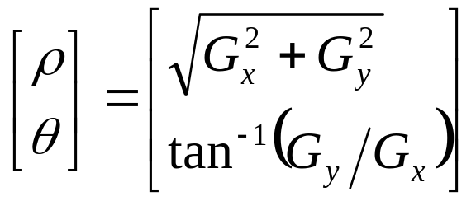
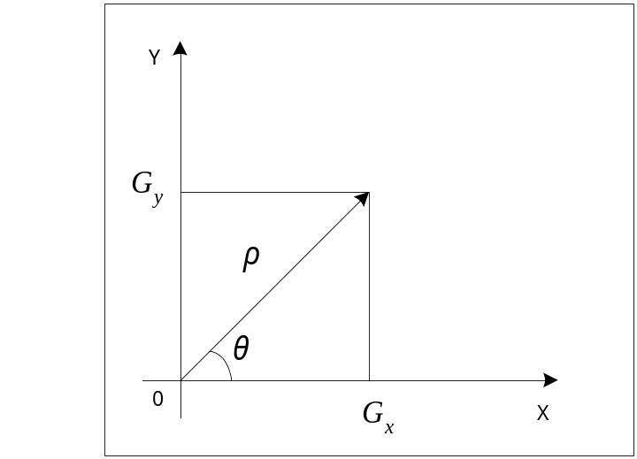
Orientation Computation(2)
The relationship between [G_{x}, G_{y}]^{T} and [ρ,θ]^{T}

Slide 8

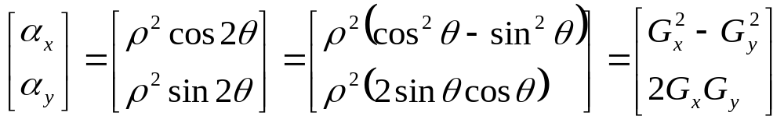

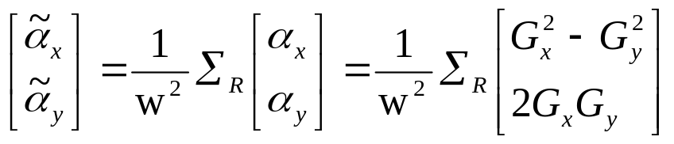
Orientation Computation(3)
Because of opposite gradient vectors might offset each other, we double the angles of the gradient vectors before averaging each block, and let the length of the gradient vectors be squared.
Let be represented by
The average gradient in each block R (w×w) is

Slide 9
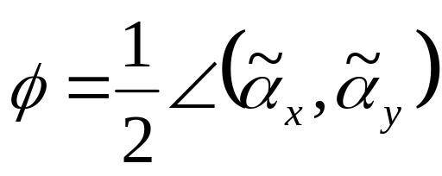

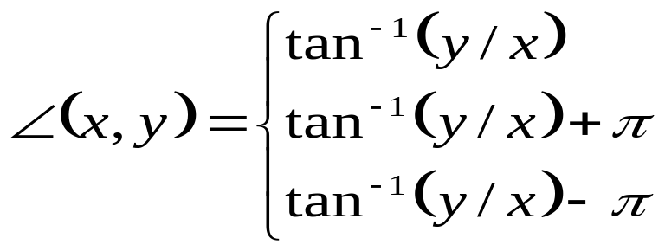
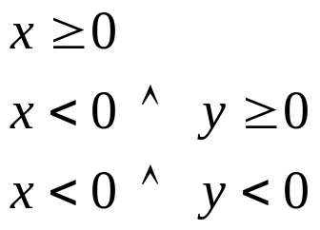
Orientation Computation(4)
The block gradient direction ψ is
where is defined as:
for

Slide 10
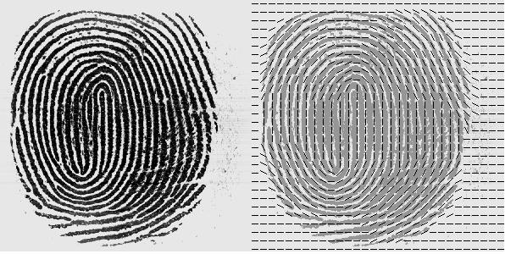
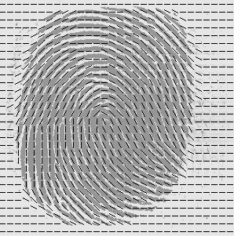
Orientation Computation(5)
Block orientation images

Slide 11
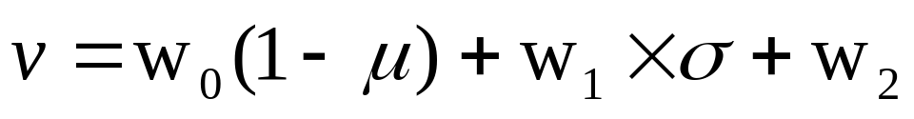
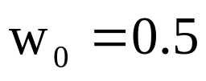


Region of Interest Detection(1)
To avoid obtaining false singular points or minutiae, we use mean and standard deviation in each block to determine if the block is “good” (not a marginal block) or not.
where , and is the ratio of distance to the center of the fingerprint image. μ and σ are normalized to be in [0,1].
If v > 0.8, the block is what we want.

Slide 12
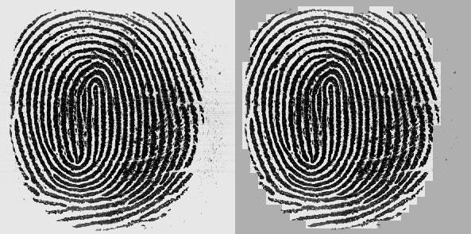
Region of Interest Detection(2)
Enhanced image Region of interest

Slide 13
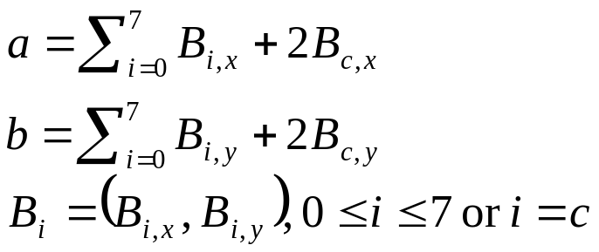
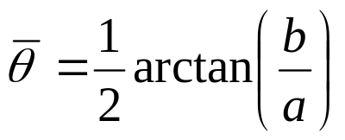
Singular Point Detection(1)
Because of noisy directions, we have to smooth the direction before computing the Poincaré index.
We regard the direction as a vector, double the angles and use a 3 by 3 averaging filter to smooth the direction.
The average direction of the block is
B₃
B₂
B₁
1
1
1
B₄
B_{c}
B₀
1
2
1
B₅
B₆
B₇
1
1
1

Slide 14
Singular Point Detection(2)
We compute Poincaré index by summing up the difference in the direction surrounding the block P. For each block P_{j}, we compute the angle difference from 8 neighboring blocks along counter-clockwise direction.
P₁
P₈
P₇
P_{1 →} P_{2 →} P_{3 →} P_{4 →} P_{5 →} P_{6 →} P_{7 →} P_{8 →} P₁
P₂
P
P₆
Core if the sum of difference is 180°
Delta if the sum of difference is -180°
P₃
P₄
P₅

Slide 15
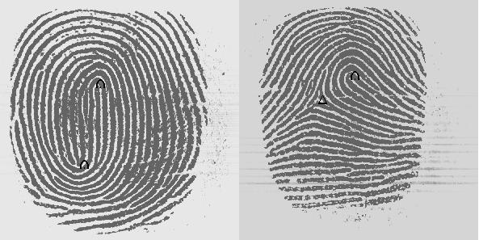
Singular Point Detection(3)
Singular points of Fingerprint Images

Slide 16
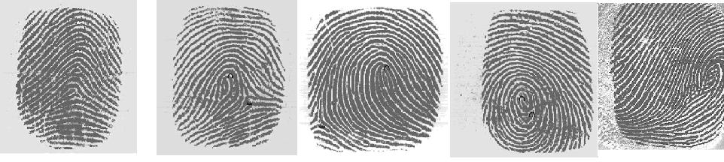
4+1 Fingerprint Type Classification
Arch Left Loop Right Loop Whorl undecided

Slide 17
Type Classification
Type | Arch (tented arch) | Left loop | Right loop | Whorl (twins loop) | Others
# of cores | 0 or 1 | 1 | 1 | 2 | 0 or >2
# of deltas | 0 or 1 (middle) | 1(right) | 1(left) | 0~2 | 0 or >2

Slide 18
Implementation of classification
All Fingerprint Images are collected by a Veridicom FP110 reader with resolution 500 dpi
Experiment on Rindex28: 4x28 Right Index Fingerprint Images collected from 28 students
  No classification error
Experiment on Lindex101
  17 classification errors
    Due to inappropriately pressing, too complex structure, or poor quality.

Slide 19
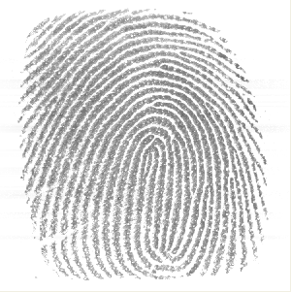
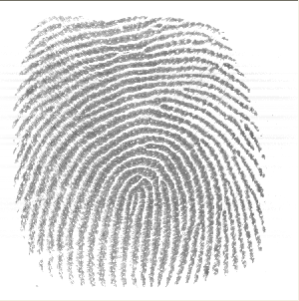
Inappropriately Pressing
Whorl Left Loop

Slide 20
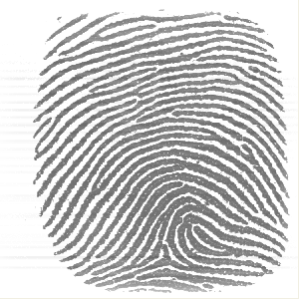
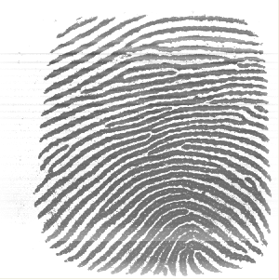
Inappropriately Pressing
Right Loop Arch

Slide 21
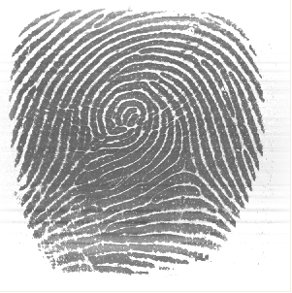
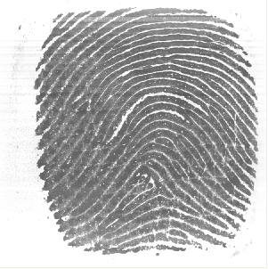
Too Complex Structure
Left or Whorl Left or Arch

Slide 22
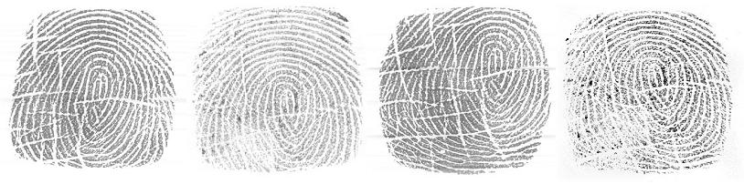
Fingerprint Images of Poor Quality
? X ? X

Slide 23
Flowchart of An AFIS

Slide 24
Image Binarization(1)
We have to distinguish valley and ridge of a fingerprint image before smoothing and thinning. So the gray value of pixels in the enhanced fingerprint image will be binarized to 0 or 255.
First we compute the gray value of P₂₅ and P₅₀ from the enhanced image, where P_{k} is the kth percentile of enhanced fingerprint image histogram.
Then we partition an enhanced fingerprint image into w by w blocks and compute the mean of each blocks. We define that M_{j} is the mean of the j-th block.

Slide 25
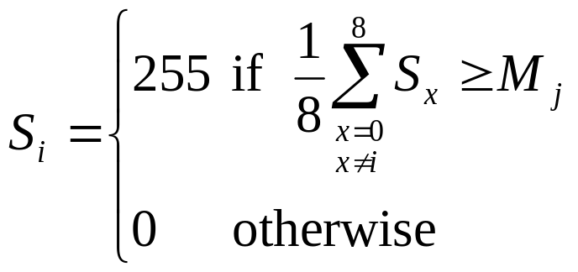
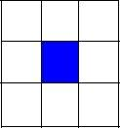
Image Binarization(2)
If the gray value of pixel S_{i} is less than P₂₅, we assign 0 to S_{i} . If the gray value of pixel S_{i} greater than P₅₀, we assign 255 to S_{i} . Otherwise, the pixel value is defined by the following rule:

Slide 26
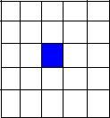
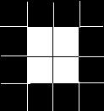
Smoothing
After binarization, we find that there is still much noise on ridge region. In order to make the result of thinning better, we have to smooth the fingerprint image first. A smooth stage uses neighboring pixels to remove noise.
First a 5 by 5 filter is used. The pixel p_{i} is assigned by:
p_{i} = { 255 if Σ_{5x5}N_{w}≧18
0 if Σ_{5x5}N_{b}≧18
p_{i} otherwise
Then a 3 by 3 filter is further proceed by:
p_{i} = { 255 if Σ_{3x3}N_{w}≧5
0 if Σ_{3x3}N_{b}≧5
p_{i} otherwise

Slide 27
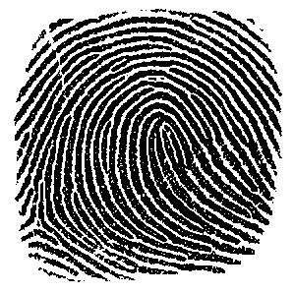
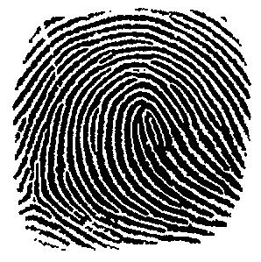
(a) Original image (b) Enhanced image
(c) Binarization image (d) Smoothed image

Slide 28
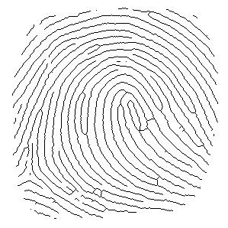
Thinning
The purpose of thinning stage is to gain the skeleton structure of fingerprint image.
It reduces a binary image consisting of ridges and valleys into a ridge map of unit width.
(d) Smoothed image (e) Thinned image

Slide 29
Minutiae Detection
From a thinned image, we can classify each ridge pixel into the following categories according to its 8-connected neighbors.
A ridge pixel is called :
an isolated point if it does not have any 8-connected neighbor.
an ending if it has exactly one 8-connected neighbor.
an edgepoint if it has two 8-connected.
a bifurcation if it has three 8-connected.
a crossing if it has four 8-connected.

Slide 30
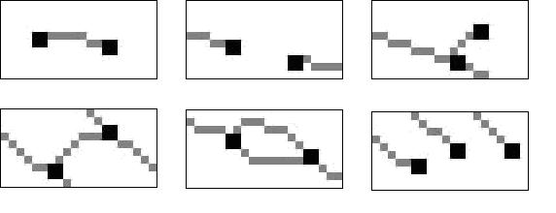
Minutiae Extraction
Due to broken ridges, fur effects, and ridge endings near the margins of an image, we have to remove the spurious minutiae as described below.
(1) Two endings are too close (within 8 pixels)
(2) An ending and a bifurcation are too close (< 8 pixels)
(3) Two bifurcations are too close (< 8 pixels)
(4) Minutiae are near the margins (< 8 pixels)

Slide 31
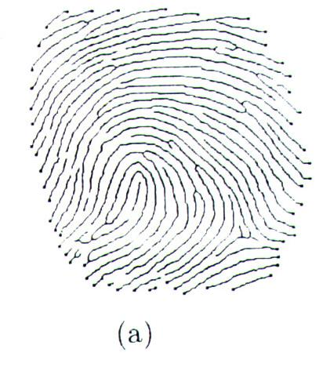
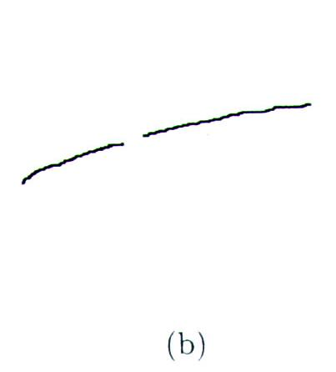
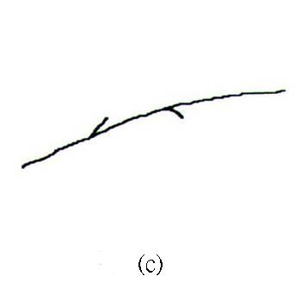
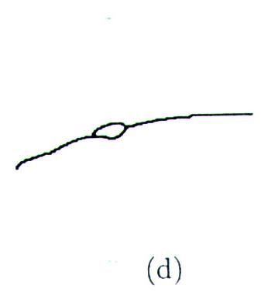
Minutiae Extraction
Spurious minutia pixels include :
(a) Ending that lie on the margins of the region of interest.
(b) Two nearest endings with the same ridge orientation.
(c) ending and bifurcation that are connected and close enough.
(d) two bifurcations that are too close.

Slide 32
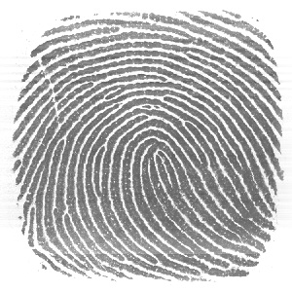
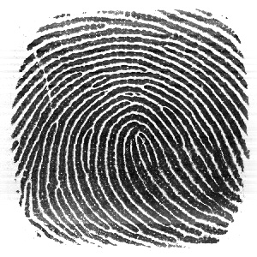
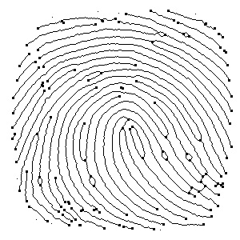
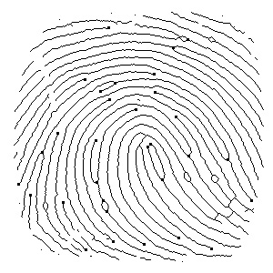
Example of Minutiae Extraction

Slide 33
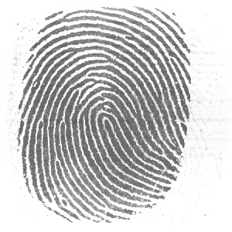
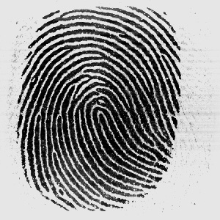
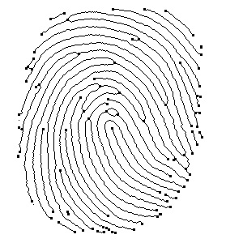
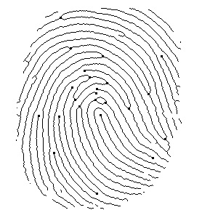
Example of Minutiae Extraction

Slide 34
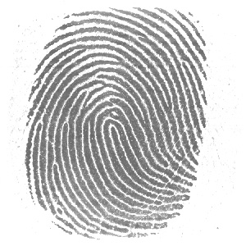
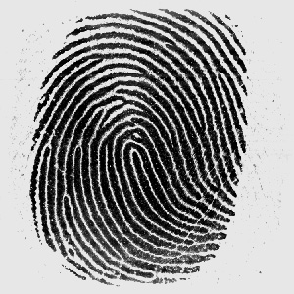


Example of Minutiae Extraction

Slide 35
Minutiae Extraction (10)
Fingerprint Template Data
The information format of fingerprint template data.
Type | #of cores | Core* | # of deltas | Delta* | # of minutiae | Minutiae*
4 bits | 2 bits | 24 bits | 2 bits | 24 bits | 7 bits | 26 bits
The information format of singular points, core or delta.
X Coordinate | Y Coordinate | Direction
10 bits | 10 bits | 4 bits
The information format of a minutia.
Kind of Minutiae | X Coordinate | Y Coordinate | Direction
2 bits | 10 bits | 10 bits | 4 bits

Slide 36

Minutiae Matching

Slide 37


Minutiae Pattern Matching

Slide 38

Minutiae Pattern Matching

Slide 39

Fingerprint Matching Score
The matching score of these two fingerprints is calculated by
where M is the number of potential type-matching minutiae within a disk of a certain user-specified radius, R (about 8~16 pixels). r measures the distance between a pair of potentially matched minutiae points.

Slide 40

Fingerprint Database (1)
Rindex28
Rindex28, is obtained from PRIP Lab at NTHU. It contains 112 images of size 300 by 300 contributed by 28 different individuals. Each contributed 4 times with the same right index finger scanned by a Veridicom FPS110 live scanner with 500 dpi

Slide 41
Fingerprint Database (2)
Lindex101
Lindex101, is obtained from PRIP Lab at NTHU. It contains 404 images of size 300 by 300 contributed by 101 different individuals. Each contributed 4 times with the same left index finger scanned by a Veridicom FPS110 live scanner with 500 dpi

Slide 42
Fingerprint Database (3)
FVC2000
 | Sensor Type | Image Size | Resolution
DB1 | Low-cost Optical Sensor | 300x300 | 500 dpi
DB2 | Low-cost Capacitive Sensor | 256x364 | 500 dpi
DB3 | Optical Sensor | 448x478 | 500 dpi
DB4 | Synthetic Generator | 240x320 | about500 dpi

Slide 43

Fingerprint Database (4)
Examples of fingerprint images from each database of FVC2000

Slide 44
Experimental Results
Rindex28
Lindex101
DB1
DB2
DB3
DB4
Recognition
rate
99.11%
111/112
82.67%
334/404
92.50%
74/80
90.00%
72/80
87.50%
70/80
92.50%
74/80
Enrolling time
for each fingerprint image
0.25 sec
0.25 sec
0.25 sec
0.25 sec
0.45 sec
0.17 sec
Matching
time
0.359 sec
3.14 sec
0.25 sec
0.218 sec
0.234 sec
0.156 sec
The experimental results of 6 databases

Slide 45


Mismatched Fingerprint Images

Slide 46
Conclusion
€ We reveal three problems, which affect the result of an AFIS
which merit further studies.
(1) Noise produces the poor binarization results
(2) Broken ridges result in the error orientation, which causes the
misclassification of a fingerprint type
(3) The shifted fingerprint image is difficult to match the minutiae
pattern well, for example, the type misclassification due to the
missing cores or deltas

Slide 47
Automatic Fingerprint Matching System
Hsing-Hua Yu and Chaur-Chin Chen
Department of Computer Science
National Tsing Hua University
    Hsinchu 30013, Taiwan

Slide 48
Outline
Introduction
Fingerprint Classification
Minutiae Extraction
Fingerprint Matching
Fingerprint Database
Experimental Results
Conclusion

Slide 49
Introduction
Fingerprint has been used as an individual identification for more than a century.
A perfect automatic fingerprint matching system has not been discovered yet.
We attempt to develop a sequence of algorithms to achieve an AFMS.

Slide 50

Introduction
Diagram of AFMS

Slide 51
Fingerprint Classification (1)
Image Enhancement
we adopt the following transformation to stretch the distribution of gray levels.
μ is the mean of gray levels of input image.
α=150, γ=100.
σ is the standard deviation of gray level of input image

Slide 52

Fingerprint Classification (2)
Original Image Enhanced Image

Slide 53



Fingerprint Classification (3)
Computing Block Orientation
We compute and at each pixel by Sobel operator.
then,

Slide 54
Fingerprint Classification (4)
Let be represented by
The average gradient in each block R of w by w can be computed by
The average gradient direction ψ is given by

Slide 55
Fingerprint Classification (5)
Enhanced Image Block Orientation of Image

Slide 56

Fingerprint Classification (6)
Region of Interest (RoI) Detection
In order to avoid detecting false singular points or minutiae We can use the mean and standard deviation in each block to decide if the block is of interest or not
We assign and . is the percentage of distance to the center of a fingerprint image.
The meanμand the standard deviationσare normalized to be in [0,1]
The block is of interest if v > 0.5.

Slide 57
Fingerprint Classification (7)
Enhanced image Region of interest

Slide 58
Fingerprint Classification (8)
Singular Point Detection
Due to the unavoidable noisy directions, we smooth the direction before computing the Poincaré index
We regard the direction as a vector, double the angles by using a 3 by 3 averaging box filter to smooth the direction.
The average direction of the block is defined as
B₃
B₂
B₁
1
1
1
B₄
B_{c}
B₀
1
2
1
B₅
B₆
B₇
1
1
1

Slide 59
Fingerprint Classification (9)
We compute the Poincaré index by summing up the changes along the direction surrounding the block P. For each block P_{j}, we compute the angle difference from 8 neighboring blocks along counter-clockwise direction.
P₁
P₈
P₇
P_{1 →} P_{2 →} P_{3 →} P_{4 →} P_{5 →} P_{6 →} P_{7 →} P_{8 →} P₁
P₂
P
P₆
Core if the sum of difference is 180°
Delta if the sum of difference is -180°
P₃
P₄
P₅

Slide 60
Fingerprint Classification (10)
The Detected Singular Points on Fingerprint Images

Slide 61
Fingerprint Classification (11)
type
arch
(tented arch)
left loop
right loop
Whorl
(twins loop)
others
# of cores
0 or 1
1
1
2
0 or >2
# of deltas
0 or 1 (middle)
1 (right)
1 (left)
0 ~ 2
0 or >2
Criteria for the types of fingerprints

Slide 62
Fingerprint Classification (12)
Arch Left Loop Right Loop Whorl undecided

Slide 63

Minutiae Extraction (1)
Binarization
Assign a pixel as valley (furrow),255, or ridge 0, from its gray value G(i,j) according to the following rule:

Slide 64

Minutiae Extraction (2)
Enhanced image Binarized image

Slide 65



Minutiae Extraction (3)
Smoothing
In order to make the result of thinning better, we might further smooth the fingerprint image by filtering.
First a 5 by 5 filter is used. The pixel is assigned by:
Then a 3 by 3 filter is further proceeded by:

Slide 66

Minutiae Extraction (4)
Binarized image Smoothed image

Slide 67
Minutiae Extraction (5)
Thinning
The purpose of thinning is to gain the skeleton structure of fingerprint image. The ridge is thinned to unit width for minutiae extraction. We use a thinning algorithm based on Hilditch (Suen+Wang, Pavalidis) to preserve the connectedness and shape of the fingerprint image.

Slide 68

Minutiae Extraction (6)
Smoothed image Thinning image.

Slide 69
Minutiae Extraction (7)
Minutiae Extraction
We classify a ridge pixel P from a thinned image into one of the five types according to the number of its 8-connected neighbors. The types can be defined as follows:
Ending and bifurcation points are called minutia points.
# of neighbors
0
1
2
3
4
Type
Isolated
Ending
Edge
Bifurcation
Crossing

Slide 70
Minutiae Extraction (8)
Due to broken ridges, fur effects, and ridge endings near the margins of an image, we have to remove the spurious minutiae as described below.
(1) Two endings are too close (within 8 pixels)
(2) An ending and a bifurcation are too close (< 8 pixels)
(3) Two bifurcations are too close (< 8 pixels)
(4) Minutiae are near the margins (< 8 pixels)

Slide 71

Minutiae Extraction (9)
Thinning image Minutiae points after removing
spurious minutiae

Slide 72
Minutiae Extraction (10)
Fingerprint Template Data
The information format of fingerprint template data.
Type | #of cores | Core* | # of deltas | Delta* | # of minutiae | Minutiae*
4 bits | 2 bits | 24 bits | 2 bits | 24 bits | 7 bits | 26 bits
The information format of singular points, core or delta.
X Coordinate | Y Coordinate | Direction
10 bits | 10 bits | 4 bits
The information format of a minutia.
Kind of Minutiae | X Coordinate | Y Coordinate | Direction
2 bits | 10 bits | 10 bits | 4 bits

Slide 73
Fingerprint Matching (1)
Registration Point
The registration point is regarded as the origin when processing minutiae matching.
  Left Loop and Right Loop: its core is employed
  Whorl: the coordinate of the upper-row core is utilized
  Arch: we apply the mask shown as follows
 | _
/ | _ | \

Slide 74
Fingerprint Matching (2)
Minutiae Matching
There are four steps involved in our matching process:
(1) Check the type of fingerprint
(2) Overlay by registration point
(3) Rotate and relocate
(4) Compute the matching score
(5) Comparison (the larger match score, the better match)

Slide 75
Fingerprint Matching (3)
The matching score of these two fingerprints is calculated by
where M is the number of potential type-matching minutiae within a disk of a certain user-specified radius, R (about 8~16 pixels). r measures the distance between a pair of potentially matched minutia points.

Slide 76
Fingerprint Database (1)
Rindex28
Rindex28, is obtained from PRIP Lab at NTHU. It contains 112 images of size 300 by 300 contributed by 28 different individuals. Each contributed 4 times with the same right index finger scanned by a Veridicom FPS110 live scanner with 500 dpi

Slide 77
Fingerprint Database (2)
Lindex101
Lindex101, is obtained from PRIP Lab at NTHU. It contains 404 images of size 300 by 300 contributed by 101 different individuals. Each contributed 4 times with the same left index finger scanned by a Veridicom FPS110 live scanner with 500 dpi

Slide 78
Fingerprint Database (3)
FVC2000
 | Sensor Type | Image Size | Resolution
DB1 | Low-cost Optical Sensor | 300x300 | 500 dpi
DB2 | Low-cost Capacitive Sensor | 256x364 | 500 dpi
DB3 | Optical Sensor | 448x478 | 500 dpi
DB4 | Synthetic Generator | 240x320 | about500 dpi

Slide 79
Fingerprint Database (4)
Examples of fingerprint images from each database of FVC2000

Slide 80
Experimental Results
Rindex28
Lindex101
DB1
DB2
DB3
DB4
Recognition
rate
99.11%
111/112
82.67%
334/404
92.50%
74/80
90.00%
72/80
87.50%
70/80
92.50%
74/80
Enrolling time
for each fingerprint image
0.25 sec
0.25 sec
0.25 sec
0.25 sec
0.45 sec
0.17 sec
Matching
time
0.359 sec
3.14 sec
0.25 sec
0.218 sec
0.234 sec
0.156 sec
The experimental results of 6 databases

Slide 81
Conclusion
€ We reveal three problems, which affect the result of an AFMS
which merit further studies.
(1) Noise produces the poor binarization results
(2) Broken ridges result in the error orientation, which causes the
misclassification of a fingerprint type
(3) The shifted fingerprint image is difficult to match the minutia
pattern well, for example, the type misclassification due to the
missing cores or deltas

