Slide 1


Find My Fit
People are not just searching for hotels or love anymore!

Slide 2
What Is the Problem?
Students tend to have an idea of where they want to go to school and what career path they would like to follow.
Research shows that these decisions tend to be based on some subset of the following:
Earning Potential et cetera.

Slide 3
What Are Prospective Students Missing?
The questions that could turn their dreams of a successful future into a nightmare.
A nightmare which leaves them with compromised beliefs and severely compromised wallets.
Time investments that do not provide sufficient returns.

Slide 4
How Do We Aim to Help Solve the Problem?
Our Mission Statement:
To provide guidance by asking the types of questions that are likely to assist prospective students in making informed decisions when selecting the school(s) they would like to attend, and then transform education-related data into student-relevant information.
Our Vision Statement:
To continually develop and facilitate this meta-service, to advance the efficiency of pursuing education.

Slide 5
Steps Involved in Solving the Problem
Research the problem and target audience
Identify the main problem
Identify the ideal solution
Derive an approximate to the ideal

Slide 6
Steps Involved Cont’d.
Identify/find data sources (e.g. APIs)
Transform data into information packets
Collect user data for information customization
Return customized information based on user inputs

Slide 7
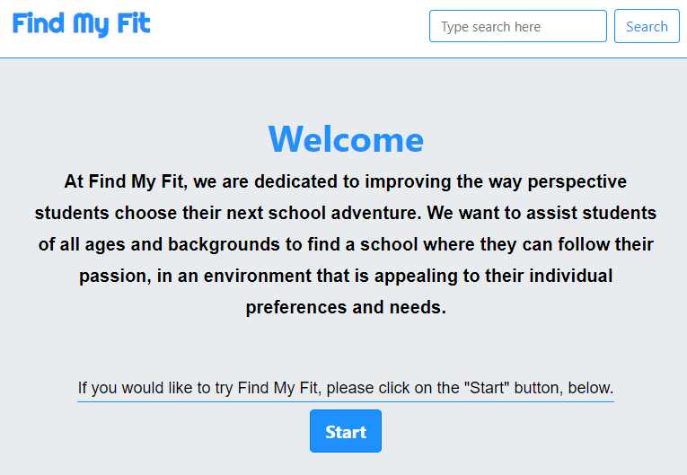
App Demo
https://ryanweingart.github.io/Group-Project-1/

Slide 8
To Infinity and Beyond
In keeping with our vision statement:
We aim to improve the Find My Fit user experience by keeping abreast with the issues that concern current and prospective students and the resources that we can use to assist them in their search.
During the next phase of development we intend to incorporate data pertaining to the cost of living, and lifestyle preferences of people living in the college town(s) where our students would like to attend. This should help students to determine the financial and social viability of prospective schools .
Eventually, we want to incorporate predictive analysis, aimed at advising students on trends and shifts in the employment marketplace, giving them a head start into these job markets.

Slide 9
Development Model:
Problem/Target Evolution
Ideal Solution Evolution
Develop Portfolio of Sources
Develop User Support
Improve Customization

Slide 10
Disclaimer
Find My Fit aims to show prospective students a sample of the school options that they have available to them, based on their responses to this beta phase quiz. Find My Fit encourages prospective students to follow up our recommendations with adequate research before making a decision on which school they ultimately attend.

Slide 11
Thank you for your time.
Any Questions?

