Slide 1
Team 18 Portfolio Manager
Ryan Wiwcharyk
Derin Yilmaz
Hannah Qu

Slide 2

Context, Requirements & Approach
Project Context: We decided to approach the project with a different perspective, which is that of a financial advisor in charge of managing several portfolios for their clients.
Role Division: Roles were divided equally with Derin on the UI features and functionality, Hannah on the backend architecture/resiliency and Ryan working on API design and business logic implementation.
Requirements:
Portfolio based CRUD operations
Portfolio dashboard
Purchasing/selling stocks
Viewing portfolio-wide value and P&L

Slide 3
Backend
Disclaimer:
Due to limitations with the Java YahooFinance package and API (ie. dead pacakge), we couldn’t use free APIs like yfinance or Alpha Vantage without significant rate limitations. Instead, we built and used our own SQL database (MySQL) to store and simulate real-time stock data.
Packages/Structure:
portfolio – CRUD for portfolios
stock – Buy/Sell stocks, update quantities & prices
transaction – Records history of trades
Controllers:
PortfolioController, StockController, TransactionController with /api/portfolios, /api/stocks, /api/transactions endpoints
Built REST APIs using @GetMapping, @PostMapping, @PutMapping, @DeleteMapping
Global Exception Handling:
PortfolioExceptionHandler.java: centralized exception handling with @ControllerAdvice
Custom Exceptions for Portfolio, Stock, and InsufficientCash
Database Design (MySQL):
Tables: portfolios, stocks, transactions, stockData
Generated by Spring JPA at runtime

Slide 4
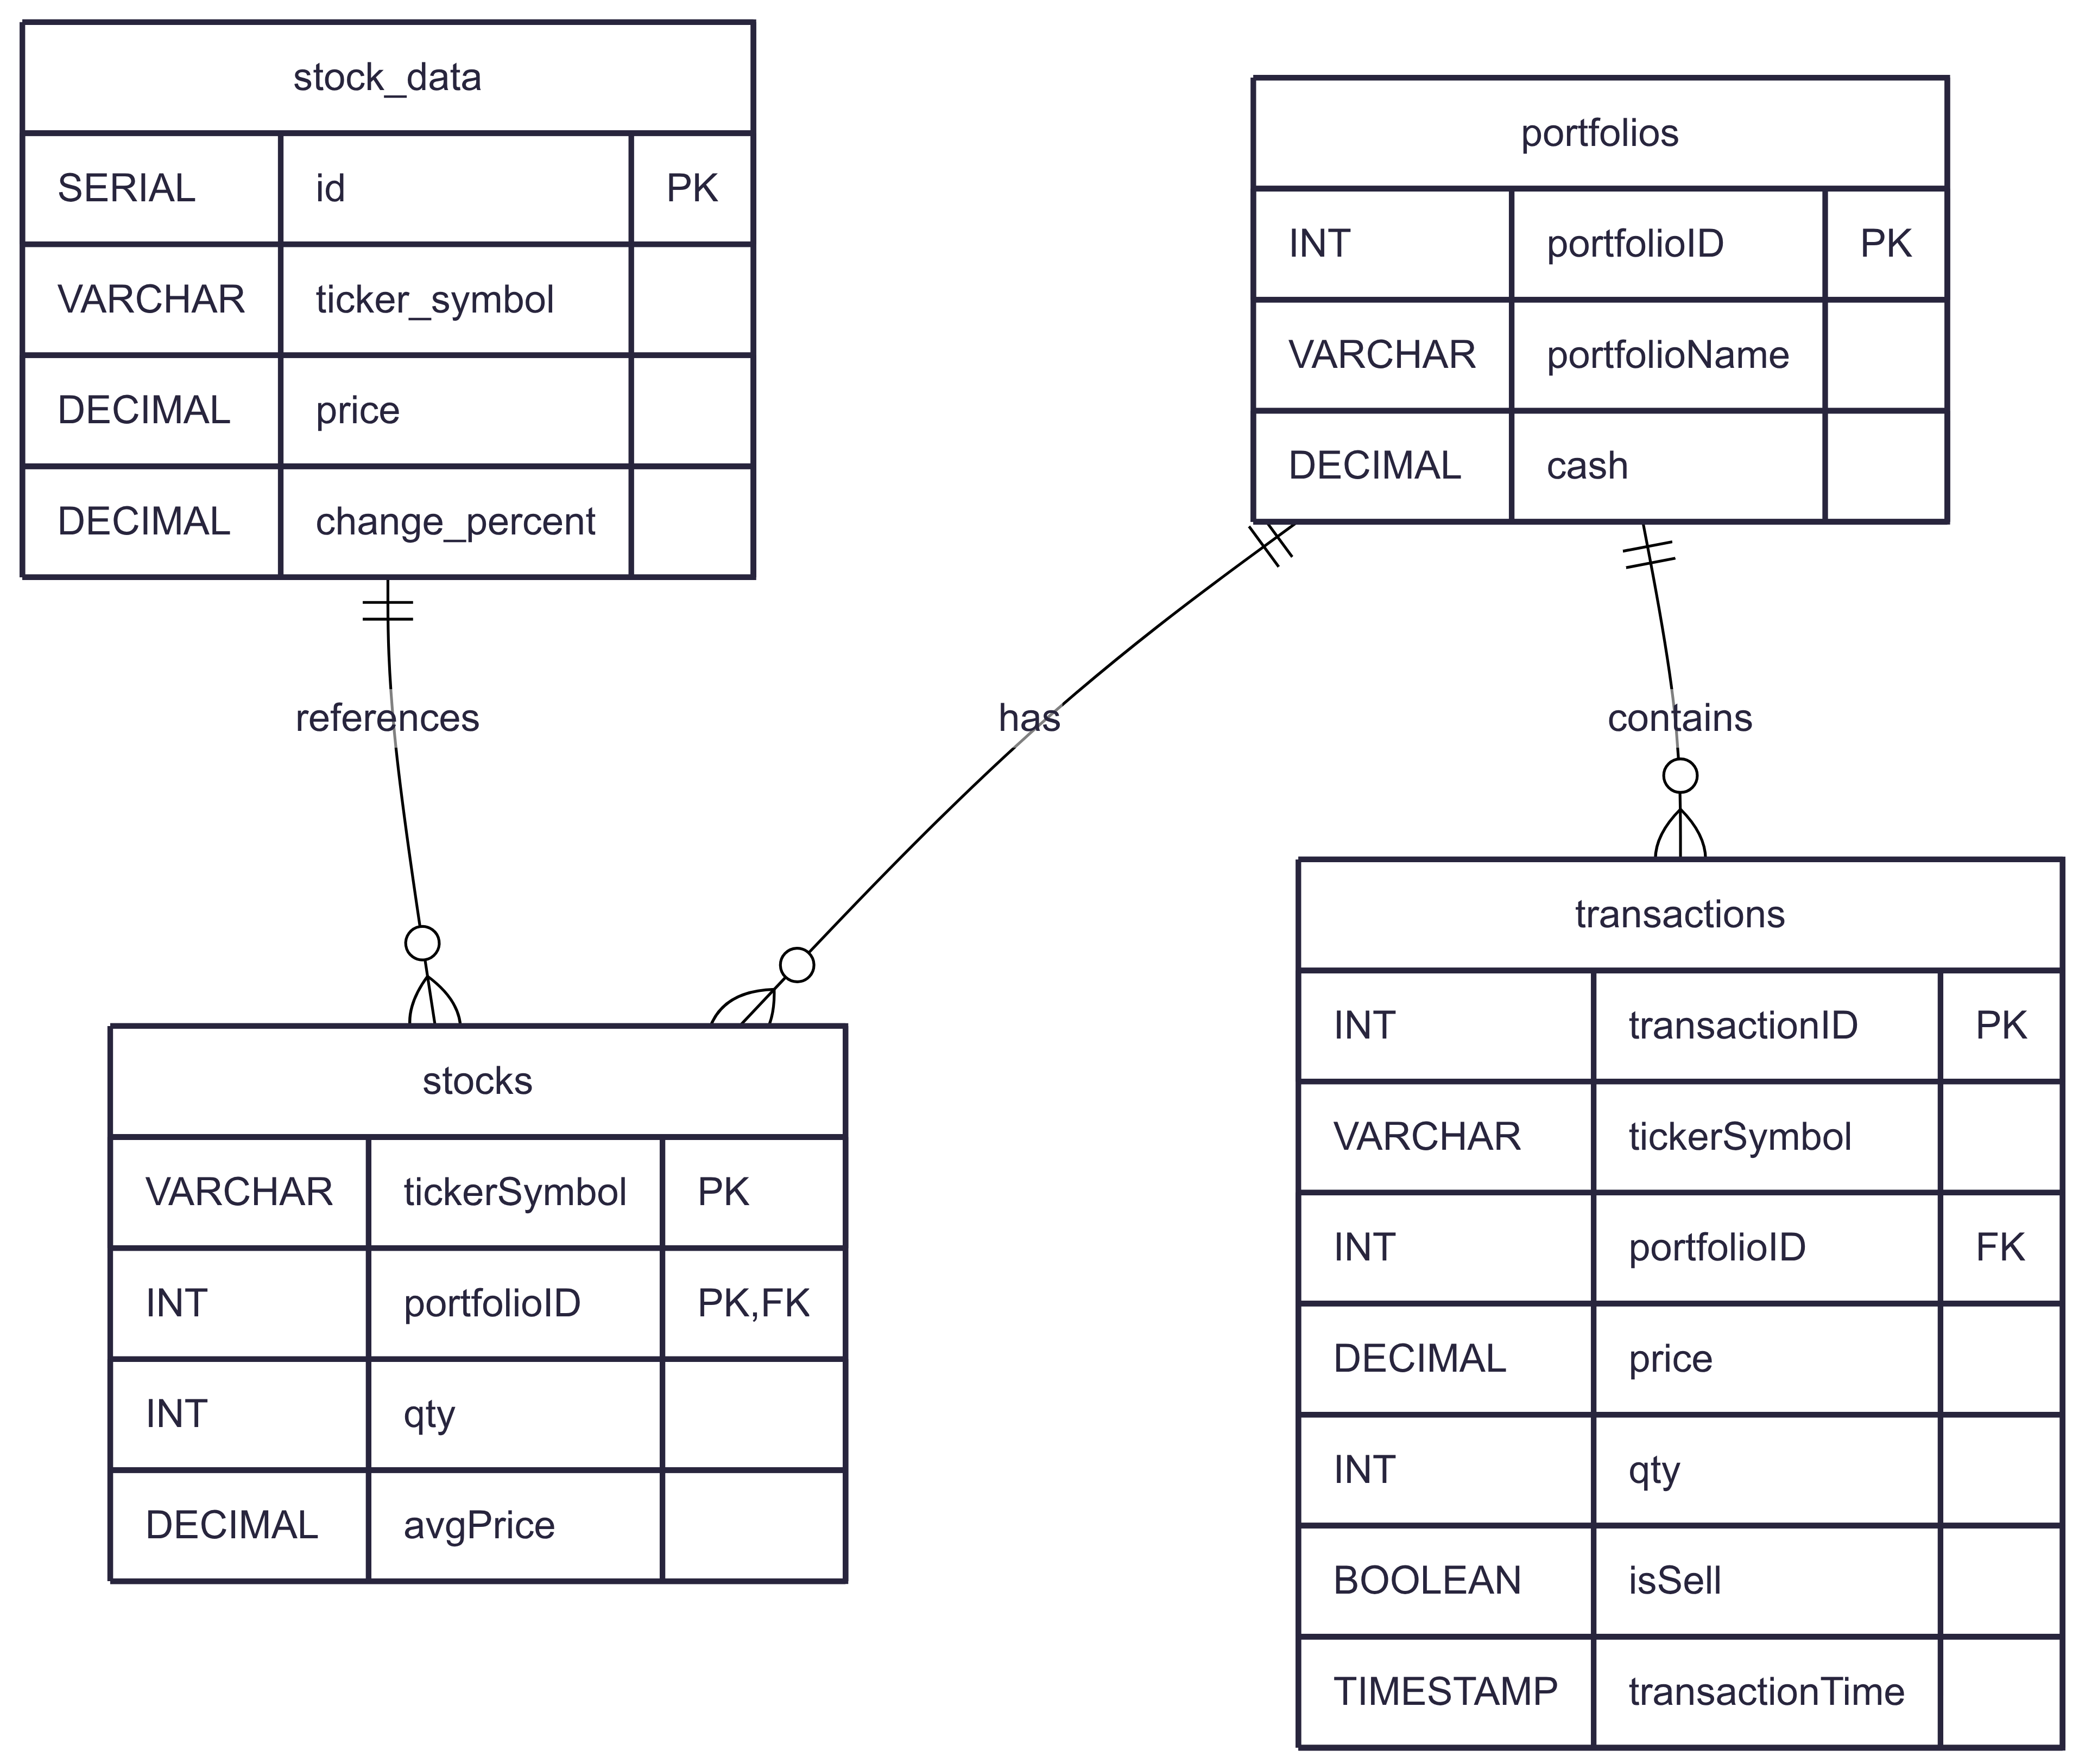
Data Model

Slide 5
Frontend
Components Edited:
Home.jsx – Welcome section, current portfolios (change name, description/ delete), add/search portfolios
Dashboard.jsx – Portfolio overview, bar, holdings table, buy/sell stocks, profit & loss, transaction historys
Styling:
Custom CSS for buttons, panels, responsive layout
animations: gradient headers, glowing hover effects

Slide 6
Demo
“add home and dashboard final screenshots here then do demo”

