Slide 1
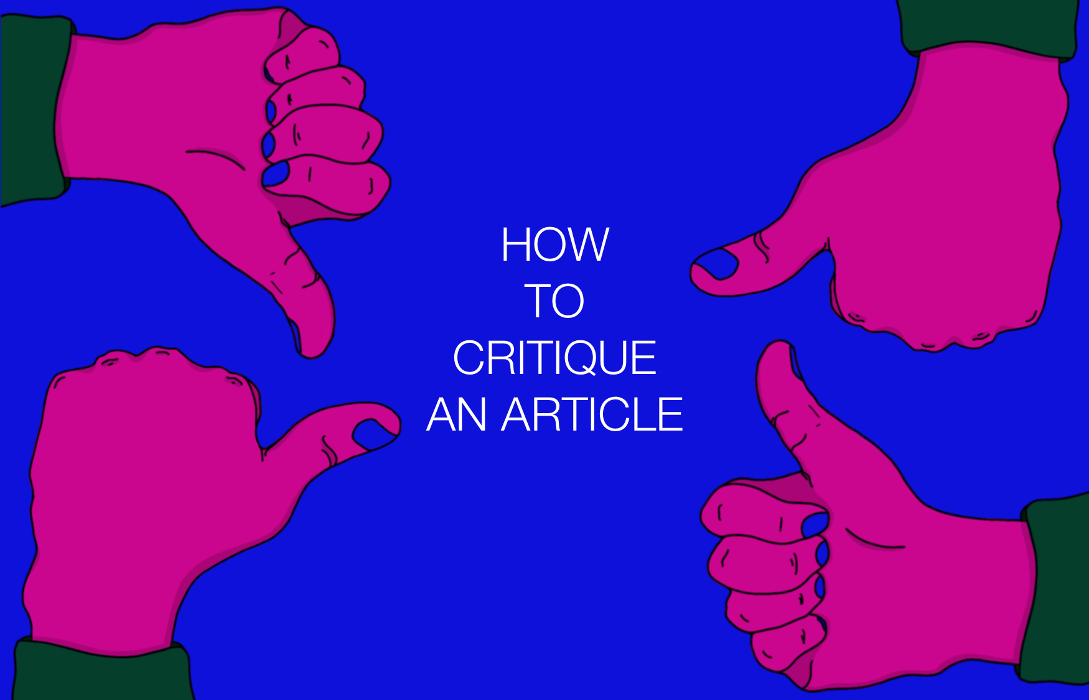
Critique
Fundamentals
Peer Feedback Session 1
Notes:
This week we will introduce the first in a series of interactive critique fundamentals workshops.
They are informed by the following sources, provided here for instructor and students who wish to dive into them in more details:
How to Crit: A small website by Mitch Goldstein http://howtocrit.com/
Draftsmen S2E29: How to Get Useful Feedback and Learning to Self Critique https://www.youtube.com/watch?v=dVT9kW916r8&t=1591s
“All in the Same Direction, All at the Same Time An Approach to Enhancing Creativity” by Annie Grove-White (Cardiff School of Art & Design, Wales, UK) https://eric.ed.gov/?id=EJ1058717
De Bono, Edward. 1999. Six thinking hats. Boston: Back Bay Books. https://tinyurl.com/y5u9ru9m (Sheridan only has a physical copy in the library)

Slide 2
What is ‘critique’?

Slide 3
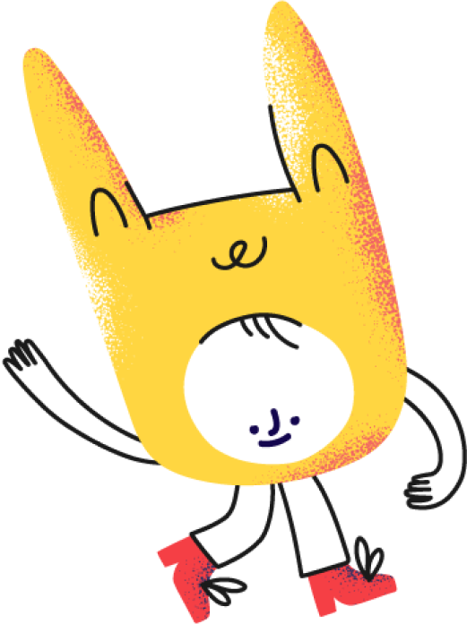
An overview of critique
Critique is a specific kind of feedback specific to the art and design industries.
May be one of the most valuable parts of a formal design education.
May also be one of the most difficult parts of design school, especially for new(er) students.
It requires time and practice to learn the skills needed to receive and give feedback during a critique.
You can learn and grow from both giving and receiving feedback during a critique.
Notes:
We begin by introducing the background info on critique.
Suggestion: intro this with a discussion with a crowdsourced definition of what critique is, to be generated with your students. Use any format that works best in your classroom.
Content adapted from www.howtocrit.com by Mitch Goldstein. / Image from designcritique.io

Slide 4
What is the purpose of critique?

Slide 5
The purpose of critique…
Is | Isn’t
To learn, to improve, and to strengthen a piece of design work | To comment on the talent of the designer (positive or negative)
 | A competition
 | A confidence boost
 | A personal attack
 | To show off
 | To punish someone
 | To act as ‘reality tv’ for others in the classroom
Notes:
We move on by clearly stating the purpose of crits.
Suggestion: intro this with a on student’s perceptions of the purpose of critique. It’s ok if this gets into the weeds a bit, especially when discussing their fears/horror stories.
Content heavily adapted from www.howtocrit.com by Mitch Goldstein.

Slide 6
The golden rule of a good critique
The goal for seeking feedback should always be made clear before a crit begins
Goals may include: exploring a concept, looking for errors details, as a celebration at the end of a project, etc.
The goal should NEVER be to tear apart the person who made the work. Your work ≠ your worth.
Notes:
We begin by introducing the background info on critique.
The number one cause of a bad critique is not stating a clear purpose for seeking feedback
Suggestion: can your students think of examples of crits they’ve had with and/or without clear goals? As a rule, which ones were more useful? Less painful?
Be sure to reiterate that making ‘bad’ work does not make you a bad person. All designers make bad work sometimes. Work ≠ worth.
Content adapted from www.howtocrit.com by Mitch Goldstein.

Slide 7
Responsibilities during critique…
The person receiving feedback | The person giving feedback
Ask specific, pointed questions about your work | Give useful feedback
Give the critique-er an area of focus | Ask the critique-ee what they want feedback on
Take notes or record (with consent) the session | Don’t give suggestions on how to ‘fix’ things unless you’re asked
Determine which feedback is and isn’t relevant | Be kind, not nice
Ask for more, if you’re not getting what you need
Do your best not to take it personally
Notes:
Critiques functionally optimally when there are clearly defined roles.
Kind = giving feedback that will make the work stronger
Nice = avoiding constructive criticism because you don’t want to hurt someone’s feelings
Content adapted from www.howtocrit.com by Mitch Goldstein.

Slide 8
Crits with ‘The Six Thinking Hats’
Blue Hat: Organization (the big picture, process) Explains the purpose of the critique and/or the work
White Hat: Neutrality (facts, information, objectivity) Gives facts/information to not run into the same issue(s) next time
Red Hat : Emotion (feelings, subjectivity) The emotional response to the work OR the feedback
Black Hat: Negativity (judgement, pessimistic view) Looks for weaknesses and negatives, assumes the worst outcome
Green Hat: Creativity (new ideas, innovation) Brainstorming and “what ifs”
Yellow Hat: Positivity (benefits, optimistic view) Looks for strengths and positives, assumes the best outcome
Notes:
The “Six Thinking Hats” is parallel thinking process developed by Edward de Bono
Process describes thinking into six clear functions and roles.
Content adapted from Edward de Bono’s ‘Six Thinking Hats’, as discussed by Marshall Vandruff (Draftsman, S02E29).

Slide 9
Example feedback from each hat
Blue Hat: “What are you looking for feedback on?”
White Hat: “Increased contrast will make the type more legible.”
Red Hat : “The colours you used are ugly.”
Black Hat: “This idea is ambitious given the due date.”
Green Hat: “What if you added an ‘Queen of Hearts’ motif?”
Yellow Hat: ”The overall mood helps reinforce the theme really well”.
You need feedback from each colour in order to improve your work!
Notes:
Examples of feedback for each hat. Challenge students to come up with more potential examples for each.
Content adapted from Edward de Bono’s ‘Six Thinking Hats’, as discussed by Marshall Vandruff (Draftsman, S02E29).

Slide 10
Today’s Peer Feedback
Will be live in breakout rooms
Will only take place if you have high fidelity wireframes to show for review
Will give feedback using the ‘6 thinking hats’
Have a goal of getting feedback on wireframes
1:1 crits with instructor will happen simultaneously

