Slide 1
Keridemlia: Discovery for KERI
Ryan W. West
ryan@ryanwwest.com
Notes:
Don’t explain, just go to second slide

Slide 2
The Insecure Internet
The Internet was not designed with security in mind
Today we have HTTPS and DNSSEC, but these are bolt-on solutions with constant new vulnerabilities being discovered.
To fully counteract these issues, the Internet should be designed with security from the ground up

Slide 3
KERI: Key Event Receipt Infrastructure
KERI is a fully decentralized, end-to-end identity system that uses Autonomic Identifiers (AIDs) which are embedded in their controller’s (owner’s) public keys
One can verify the authenticity of messages sent by controller with the AID
AIDs are bound to separately-stored key event logs (KELs) for verification even after keys are rotated (updated).
Key rotation, delegation, and revocation can be performed by appending signed events to this log
Always-available witness servers store these KELs for retrieval.
BXq5YqaL6L48pf0fu7IUhL0JRaU2_RxFP0AL43wYn148
Example AID; typically in Base64
Notes:
This is a simplification: some AIDs contain public keys (e.g. non-transferable) but some only contain public key commitments and you need the KEL for the key

Slide 4
Anatomy of an Autonomic Identifier (AID)
Controller
Publishes
Identifier
Key Event Log (KEL)
Generates
Publishes
Generates
Private Key
Public Key

Slide 5
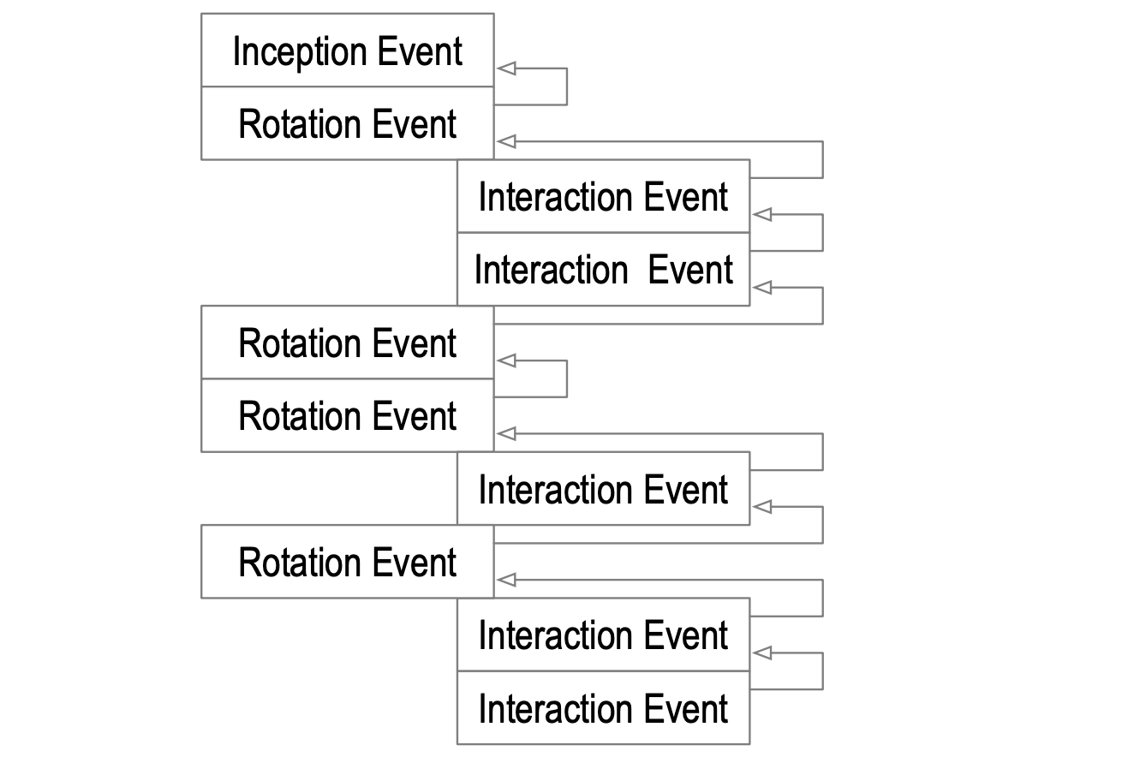
Anatomy of Key Event Log (KEL) and Key Event State (KES)
{
"vs": "KERI10JSON000155_",
"pre": "DvdCuGNS8hfFwsDPr_arwNfcS-XGJjriA_DJFVpvVa98",
"sn": "0",
"ilk": "icp",
"sith": "1",
"keys": [ "DvdCuGNS8hfFwsDPr_arwNfcS-XGJjriA_DJFVpvVa98" ],
"nxt": "E81dOYUE-rI5vSxlXyWWAnrChwJq_XRBndrIGD0YAZ0A",
"toad": "1",
"wits": [ "AA0Qupxej1c7f60oeEqlcWfGheabpg_V9IkEauaZzWuu-R3FNxxc0hyvnG8YyXT2iIV_1lUnw9k8Tqdw76wyNICg"
],
"cnfg": []
}
Produces
Key Event Log (KEL)
Key Event State (KES)

Slide 6
Modes of Running KERI
Direct Mode (Private Mode)
Controllers (users) wishing to communicate must establish an out-of-band connection
No public witness servers are necessary
A new AID can be made for every connection
Indirect Mode (Public Mode)
Any controllers with an AID can connect; the same AID can be used for many connections
Those wishing to verify an AID must get its corresponding key event log (with the latest public key) from the AID’s current witnesses (requiring their IP address)

Slide 7
Indirect Mode
Anyone with a controller’s public AID can use it to verify the signatures of messages published by the controller under the corresponding key pair
Users that wish to verify retrieve the key event log from witnesses to get the most recent public key from this log
This requires knowing a witness’s IP address

Slide 8
Keridemlia: Discovery for KERI
Keridemlia is a distributed database that stores mappings of AIDs to witness server IP addresses
Provides an API that allows for storage and retrieval
All data must be signed to be published, and all data retrieved is also signed
Enables controllers to use KERI in indirect mode
Uses a modified Kademlia Distributed Hash Table (DHT) for distribution

Slide 9
DNS and Keridemlia
Domain Name System (DNS) | Keridemlia
Maps identifiers, aka domain names (www.example.com), to IP Addresses | Maps AIDs to IP Addresses
Maps identifiers to identifiers (CNAME) | Maps controller AIDs to witness AIDs
Maps identifiers to IP addresses (A, AAAA) | Maps witness AIDs to IP addresses
Insecure by default; relies on bolt-on solutions like DNSSec for security | Uses KERI for built-in security with a cryptographic root-of-trust
Susceptible to network attacks | Fault tolerant; redundant data storage
Centralized | Decentralized
Similarities
Differences

Slide 10
Types of Distributed Systems
Hierarchy
Flooding
Distributed Hash Table (DHT)
Notes:
Also reviewed blockchain; there are more types that are not covered

Slide 11
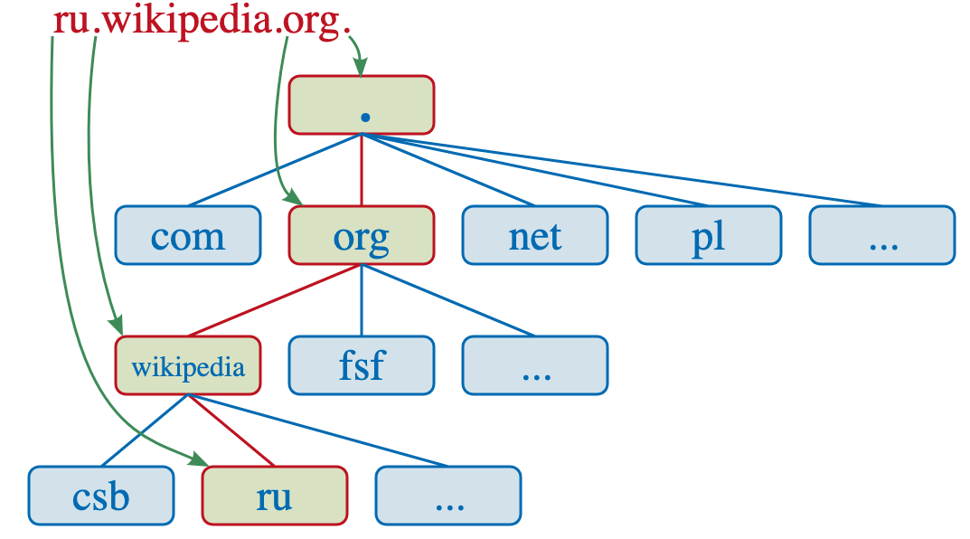
Types of Distributed Systems — Hierarchy
Hierarchical systems provide several levels of servers to provide scalable service
Example: Domain Name System (DNS)
Requests are forwarded from bottom-level servers to higher ones who have the answers
Previously fetched responses are cached by servers at each level
If a lower-level server has the response cached, it can return it rather than going up the levels, saving time and bandwidth
Performant, but centralized and impacted by network attacks
Notes:
because they are centralized and rely on few ‘root’ servers at the top of the hierarchy (such as DNS’s authoritative name servers), they are prone to network attacks and system outages if only a few servers are taken down.

Slide 12

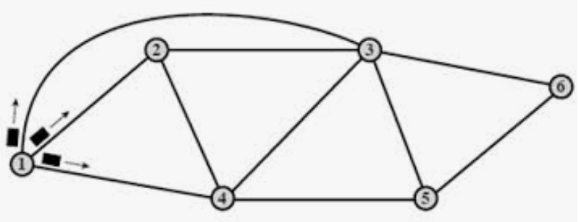
Types of Distributed Systems — Flooding
Flooding, or broadcast algorithms, send packets to every server they are connected to; repeat on recipient servers
Goal: eventually reach the target within n server hops
Stop replicating the message after n hops using a hop count sent with the packet
Leads to fast data location, but scales poorly with many servers
Polynomial increase in network traffic with each new server added
Napster and other flooding services attempted to scale better with flooding algorithms that contact fewer nodes, but performance is still subpar
Notes:
Hop count is sent with packet and decremented after it arrives at each server recipient

Slide 13

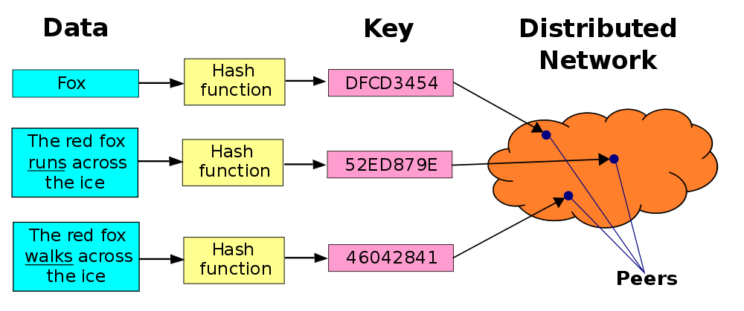
Types of Distributed Systems — DHT
Hash tables map keys to values
Keys provide constant-time lookup by running the provided key through a hash function (SHA-256)
The resulting hash points to the location of the value
Distributed hash tables expand key-value pair storage to multiple nodes
They use routing algorithms to store/retrieve data from specific nodes using the hash
Highly scalable — as nodes in network increase, time to locate a node only logarithmically increases
Decentralized and fault tolerant — can store data redundantly; freely joining/leaving network or attacking nodes doesn’t impact network

Slide 14
Keridemlia’s Distributed Database — DHT
DHTs provide high performance and scale with many nodes
Fault tolerant and completely decentralizable
Many tested, open-source implementations available
I chose to use Kademlia
This has a Python implementation on Github that I forked

Slide 15
Keridemlia Design
Design Steps:
Integrate KERI with Kademlia
Build an API
Verify Data is Authentic

Slide 16
Step 1: Integrate KERI with Kademlia
KERI’s Python library implements a special database class which keeps track of all events, keys, and other metadata needed to use KERI and AIDs
This class uses Lightning Memory-Mapped Database (LMDB), a high-performance key-value storage
Kademlia is also a key-value storage
I modified Kademlia’s backend to use the KERI database class
End result: a distributed KERI-specific database

Slide 17
Step 2: Build an API
Goal of KERI — map transferable controller AIDs to witness IP addresses
Why?
Transferable (rotatable) AIDs are bound to a corresponding Key Event Log (KEL)
The KEL records rotation events that update/revoke keys and interaction events that delegate control to other identifiers
The AID itself only includes the public key commitment created at inception — if the keys have been updated, must check KEL
AIDs designate witness servers to store KELs
If one wants to verify messages from an AID, they must get The KEL from the witness via its IP address
Example Key Event Log (KEL)
Notes:
Explain transferable vs non-transferable
Non-transferable AIDs cannot be rotated and thus do not need a KEL - the public key commitment in the AID is the only one there will ever be, so it can be instantly verified

Slide 18
Step 2: Build an API
A KEL starts with an inception event which defines the keys, the AID prefix, and non-transferable witness AIDs that controller designates
Future events can update the witness set
The KEL event does not contain the witness IP address
Keridemlia needs to map the controller AID to its current witness AIDs
Keridemlia also needs to map each witness AID to its current IP address
Notes:
Witness AIDs are non-transferable because they are less important and non-transferable AIDs can be instantly verified. If keys are compromised, no delegation was done; just make a new AID

Slide 19
Step 2: Build an API
HTTP Method | Endpoint | Description
POST | /id (requires json request body) | publish controller AID -> key event state (KES) mapping
GET | /id<aid> | get KES from controller AID
POST | /ip (requires json request body) | publish witness AID -> IP mapping
GET | /ip/<witness_id> | get witness IP from witness AID

Slide 20
Step 3. Verify Data is Authentic
KERI is based on the idea of end-verifiability — all events can be verified anytime by anyone
Keridemlia follows this idea:
All data must be verified before it is published to the DHT
All data fetched from the DHT is accompanied with a signature, allowing the client to verify its authenticity
This also saves storage space — no garbage data published to network

Slide 21
Step 3. Verify Data is Authentic
For controller AID -> AID’s key event state (KES) mappings:
Controller AIDs must be published using their latest key event state
Key event state (KES) - result of compounding all events in KEL to get the latest AID data
KES includes the AID prefix identifier, latest witness AID set, and latest public keys
The KES was created from signed events—if the caller does not trust the KES, they can request the full signed KEL from the witness and verify it
All signatures are stored in the DHT and returned on GET requests

Slide 22
Step 3. Verify Data is Authentic
For witness AID -> witness IP address mappings:
Witness AIDs are non-transferable — their keys cannot be rotated
No need for a KEL (key event log) or KES (key event state)
The AID prefix itself contains all information necessary to verify the controller of the AID
Witness IP addresses must be signed with the witness’s AID’s private key
All signatures are stored in the DHT and returned on GET requests
Notes:
Witness AIDs do not need to be individually signed for this mapping as they are present in signed KEL

Slide 23
Step 3. Verify Data is Authentic
Security Properties
Validating data to be published prevents Cache Poisoning (from DNS)
DNS does not validate mappings, so fake data can be published that falsely redirects users or blocks website access
While false data can still be published to Keridemlia, it is easily detectable
Providing signatures in GET responses prevents a client from ever using an invalid entry if it were somehow published to the DHT
It also limits attacks by malicious Keridemlia servers to only dropping data entries or denying service

Slide 24
Current State of Keridemlia
Prototype is being actively developed at https://github.com/ryanwwest/kademlia, which is a modified fork of the Kademlia repository
Design steps 1 and 2 are implemented; step 3 is in progress
Design paper available with more details available here: https://docs.google.com/document/d/1URYyPf5BaMEmTSEtdQiNrxjDUPz3qLUiOhW-w67sDM4/edit?usp=sharing
Notes:
For some audiences add this point:
Interested in contributing? Let me know!

Slide 25
Potential Optimizations
Return a witness IP address directly from a controller AID -> witness AID request
Today, two requests must be made for AID -> witness AID then witness AID -> witness IP
Saves time and bandwidth
Use local caching
Like DNS, a local cache could store recent GET responses
Before using the DHT, Keridemlia could check this cache for the response
Also saves time and bandwidth
Map AIDs to LIDs (Legitimized Human Meaningful Identifiers)

Slide 26
Questions or Feedback?

Slide 27

About Me
Senior Research Scientist at Crimson Vista, www.crimsonvista.com
Research for MS/PhD, cybersecurity litigation support, technical consulting
Finishing my Master’s in Computer Science at BYU
Keridemlia is my Master’s Project
Starting a PhD in Computer Science in 2021 at U of U
I enjoy piano, reading, racquetball and chips & salsa
www.ryanwwest.com ryanwest6@gmail.com

Slide 28
Picture Credits
DNS Hierarchy - https://commons.wikimedia.org/wiki/File:DNS_schema.svg
Flooding - https://www.slideshare.net/shefali84/11-routing-35115583
DHT - https://en.wikipedia.org/wiki/Distributed_hash_table
Key Event Log - KERI whitepaper https://github.com/SmithSamuelM/Papers/blob/master/whitepapers/KERI_WP_2.x.web.pdf

