Slide 1
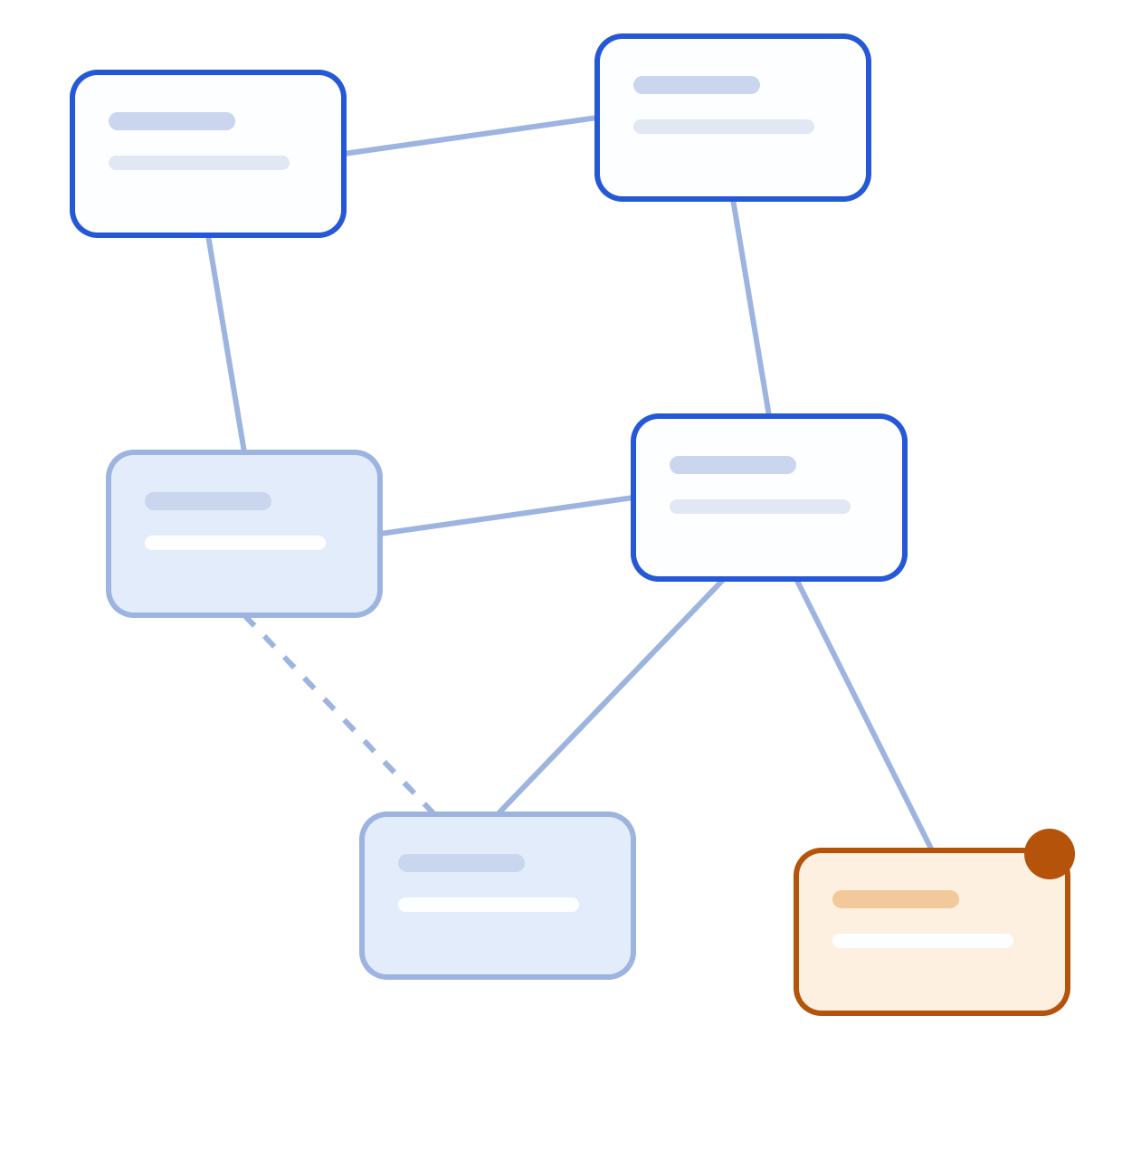
FlowLens
AI Native Practical Assessment
Prompt 1: Multi-Agent Collaboration
Ryan Yip Hui
Nanyang Technological University
Penultimate Computer Science Undergraduate
FlowLens · 01

Slide 2
What this talk covers
CONTENTS
01
Problem Statement and Solution
05
Architecture decisions
Who FlowLens serves, what it solves and how far it got
A code scheduler, and a verifier with executable checks
02
Project Architecture
06
Failure recovery
System Architecture and Tech Stack
Worker-stall recovery and a repaired model reply
03
Agents and handoffs
07
Single vs multi-agent
Collaboration, Agent Roles and Coordination
What collaboration found, and what it cost
04
End-to-end run
08
Design, limits and contribution
Demo run, from goal and requirements to replay evidence
Design iterations, Capability boundaries and Contributions
FlowLens · 02

Slide 3
Problem statement
PROBLEM
Website UI testing is often repetitive and requires human review. Reviewers must explore user journeys, try different inputs and collect evidence of problems. Doing this manually may lead to checks being missed.
Reviewers must discover the relevant pages and actions before they can test a journey.
For Team Leads and QA reviewers checking staging websites against written requirements.
A suspected problem needs reproducible evidence before it becomes a useful bug report.
FlowLens · 03

Slide 4
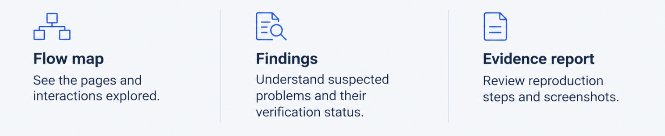
Introducing FlowLens
SOLUTION
FlowLens is a multi-agent website reviewer that explores user journeys, tests inputs and rechecks suspected problems against written requirements.
Start with a website URL, a review goal and expected behaviour
Scope: Authorised Chromium reviews within configured budgets. A completed run does not establish full coverage or that the website passed.
FlowLens · 04

Slide 5
Why another website-testing tool?
VALUE PROPOSITION
Approach | What it does well? | What FlowLens adds to it?
Manual testing | Flexible exploration and human judgment | Delegate repetitive exploration and evidence collection
Scripted browser tests | Repeatable checks for predefined journeys | Discover journeys and propose tests from a goal
Single agent testing | One agent explores and evaluates results | Separate responsibilities with traceable handoffs and fresh re-checks
FlowLens supports exploratory review; it complements manual testing and scripted regression tests.
FlowLens · 05

Slide 6
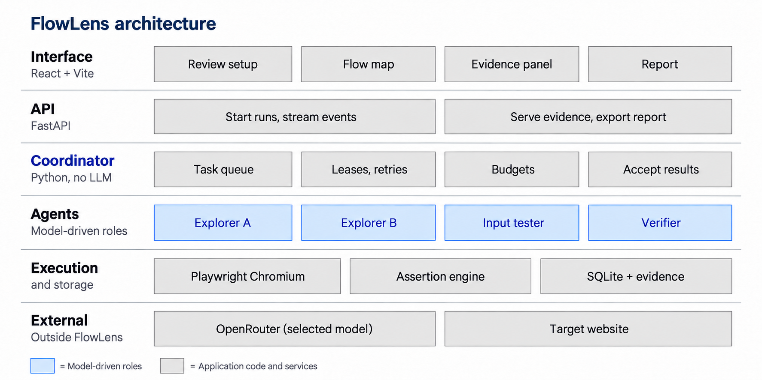

SYSTEM ARCHITECTURE
FlowLens Architecture
FlowLens · 06

Slide 7
Tech stack and engineering focus
TECHNOLOGY STACK
Layer | Technology | Why
Frontend | React, TypeScript, Vite, Tailwind CSS | Build the interactive review workspace
Flow map | React Flow + dagre | Display and arrange observed states and transitions
Backend | Python, FastAPI, Pydantic | Serve APIs and validate structured records
Coordination | Custom asyncio queue + SQLite | Manage dependencies, ownership, leases and retries
Browser automation | Playwright + Chromium | Execute actions and capture observations
Model access | OpenRouter + httpx | Access different LLMs through one adapter
Packaging | Docker Compose | Start the app and test fixtures reproducibly
FlowLens · 07

Slide 8

Four workers, one shared queue
COLLABORATION
Multi-Agent Shared Queue
Explorer A
Discovers pages and forms
Input Tester
Verifier
Designs and runs cases on discovered forms
Replays in fresh sessions with fresh data
Confirmed,
Not reproduced
Inconclusive
Explorer B
Discovers pages and forms
Separate browser contexts
Shared exploration memory
Arrows show Handoffs
Python Coordinator: Task claims, dependencies, leases, retries, deduplication and budgets. It is not another LLM.
Handoffs preserve context for the next specialist
Workers save controls, setup steps, requirements and evidence references.
The next specialist claims the task and rebuilds the scenario in its own browser.
Models decide
Code decides
Where to explore
Which tests to try
Which rules apply
Which check to use
Ownership, leases and limits
Control actions and refusals
Assertion evaluation
Acceptance of current results
FlowLens · 08

Slide 9
COLLABORATION
Coordinator: Code controlling the workflow
The model proposes actions. Queue ownership and execution rules determine what can run and which results count.
1) Claim eligible work
SIMPLIFIED PYTHON PSEUDOCODE
A claim assigns one current owner, an attempt ID and a renewable lease.
task = queue.claim(worker.role)
if task:
check_attempt(task) # ownership + renew lease
action = model.propose(task)
check_attempt(task) # before browser action
if action_allowed(action, task):
result = execute(action)
guard_publish(task) # reject expired attempt
publish(result)
else:
refuse_action()
2) Check before execution
Ownership checks run before model calls and browser actions. Form rules reject explorer-chosen fill and submit actions on recorded forms.
3) Guard publication
Check ownership again before saving results. Expired attempts cannot publish late results.
4) Restart after a stall
Expiry closes the old context and requeues the task. Another eligible worker restarts it from saved setup.
FlowLens · 09

Slide 10
AGENTS AND HANDOFFS
Explorer A: Browser exploration
Agent explores website journeys and hands discovered forms, setup steps and evidence to the tester.
Input
It receives the goal, requirements, current page controls and shared coverage: tried links, open work and the other explorer’s reservation.
Model decision
It chooses navigation, permitted clicks or reloads. Code refuses model-chosen fills and submits on recorded forms.
Code execution
Playwright executes allowed actions and records states and transitions. Automatic setup may fill forms to rebuild the starting page.
Output
It queues discovered forms for the tester with their controls, setup steps and evidence. Newly discovered pages can become exploration tasks.
Both explorers read shared coverage before planning. Setup replay is separate from a model-chosen action.
FlowLens · 10

Slide 11
AGENTS AND HANDOFFS
Explorer B: Another branch of the review
Explorer B uses the same logic in a separate task context. Before planning, shared reservations help the explorers choose distinct work.
Explorer A’s current work | Explorer B’s available work
A explores a ready page and reserves its next investigation. | B sees A’s reservation and can investigate different available work.
A’s discovery creates testing work with saved setup and evidence. | B can claim a new page found by A or by the tester.
Exploration reservations coordinate planned work. Task leases separately control ownership and stall recovery.
A and B have equal capabilities. Either can claim ready work or restart an expired task from saved setup.
FlowLens · 11

Slide 12
AGENTS AND HANDOFFS
Input tester: Tries inputs and checks the response
It tests normal and invalid inputs, then sends suspected requirement violations to the verifier.
Input
It receives a discovered form, its controls and setup steps, together with the requirements and evidence from an explorer.
Model decision
It proposes values to try, links relevant requirements and assesses observations after execution.
Code execution
Code rebuilds each case in a fresh context: fill text, select dropdown options and check tick boxes. Action-only forms are supported.
Output
The model compares the recorded response with the requirements. Suspected violations go to the verifier with steps and evidence.
An executed test is not a confirmed defect. Failed execution is reported separately from website behaviour.
FlowLens · 12

Slide 13
AGENTS AND HANDOFFS
Verifier: A requirement-based re-check
Checks whether the requirement applies and defines the expected behaviour before choosing a check for fresh browser replays.
Input
It receives the requirement, tested controls, inputs, steps and a fresh observation. Its prompt omits the tester’s verdict and outcome summary.
Model decision
It judges applicability to a tested control, quotes the rule and selects a supported assertion. Unclear expectations remain inconclusive.
Code execution
Code validates the fields, reference, quote and assertion. If the assessment permits verification, it evaluates the check in two fresh replays.
Confirmed: valid replays fail the expected-behaviour check.
Not reproduced: valid replays pass it.
Inconclusive: rule unclear or inapplicable, execution fails, or results conflict.
Output
Separate context gives partial independence. Applicability and assertion selection still depend on model judgment.
FlowLens · 13

Slide 14
AGENTS AND HANDOFFS
Handoffs: saved work the next role can use
Each handoff links the next task to the setup and evidence it needs to continue the review.
Handoff | What travels with it | What the recipient can do
Explorers to tester | Observed controls, setup recipe, requirements and evidence | Rebuild the form and design relevant test cases.
Tester to verifier | Test inputs, reproduction recipe, requirement and evidence references | Judge applicability and explicitness, then replay the case with a relevant check.
Tester to explorers | A newly observed page and its setup record | Explore a branch the tester discovered.
Verification result to coordinator | Typed assertion, replay outcomes and evidence references | Validate the result before updating the finding.
The queue records dependencies so verification waits for its prerequisite test task.
FlowLens · 14

Slide 15
AGENTS AND HANDOFFS
How a FlowLens review works
Step | What happens
1. Configure | Enter URL, goal, requirements and limits.
2. Start the review | Validate configuration, create the run and queue tasks.
3A. Begin exploration | One explorer claims the start task and discovers further work.
3B. Explore other branches | Another explorer claims ready work in its own browser.
4. Hand off forms | Pass forms to the tester with setup and evidence.
5. Test inputs | Execute bounded cases and record suspected violations.
6. Re-check suspicions | Check requirement relevance and replay an admitted candidate.
7. Record findings | Assign confirmed, not reproduced or inconclusive outcomes.
8. Finish the run | Record completion and explain unfinished work.
9. Review results | Inspect the map, findings and screenshots. Backend code formats the saved records into an HTML or Markdown report.
User Review Setup
Multi-Agent Work
Results and Reporting
FlowLens · 15

Slide 16
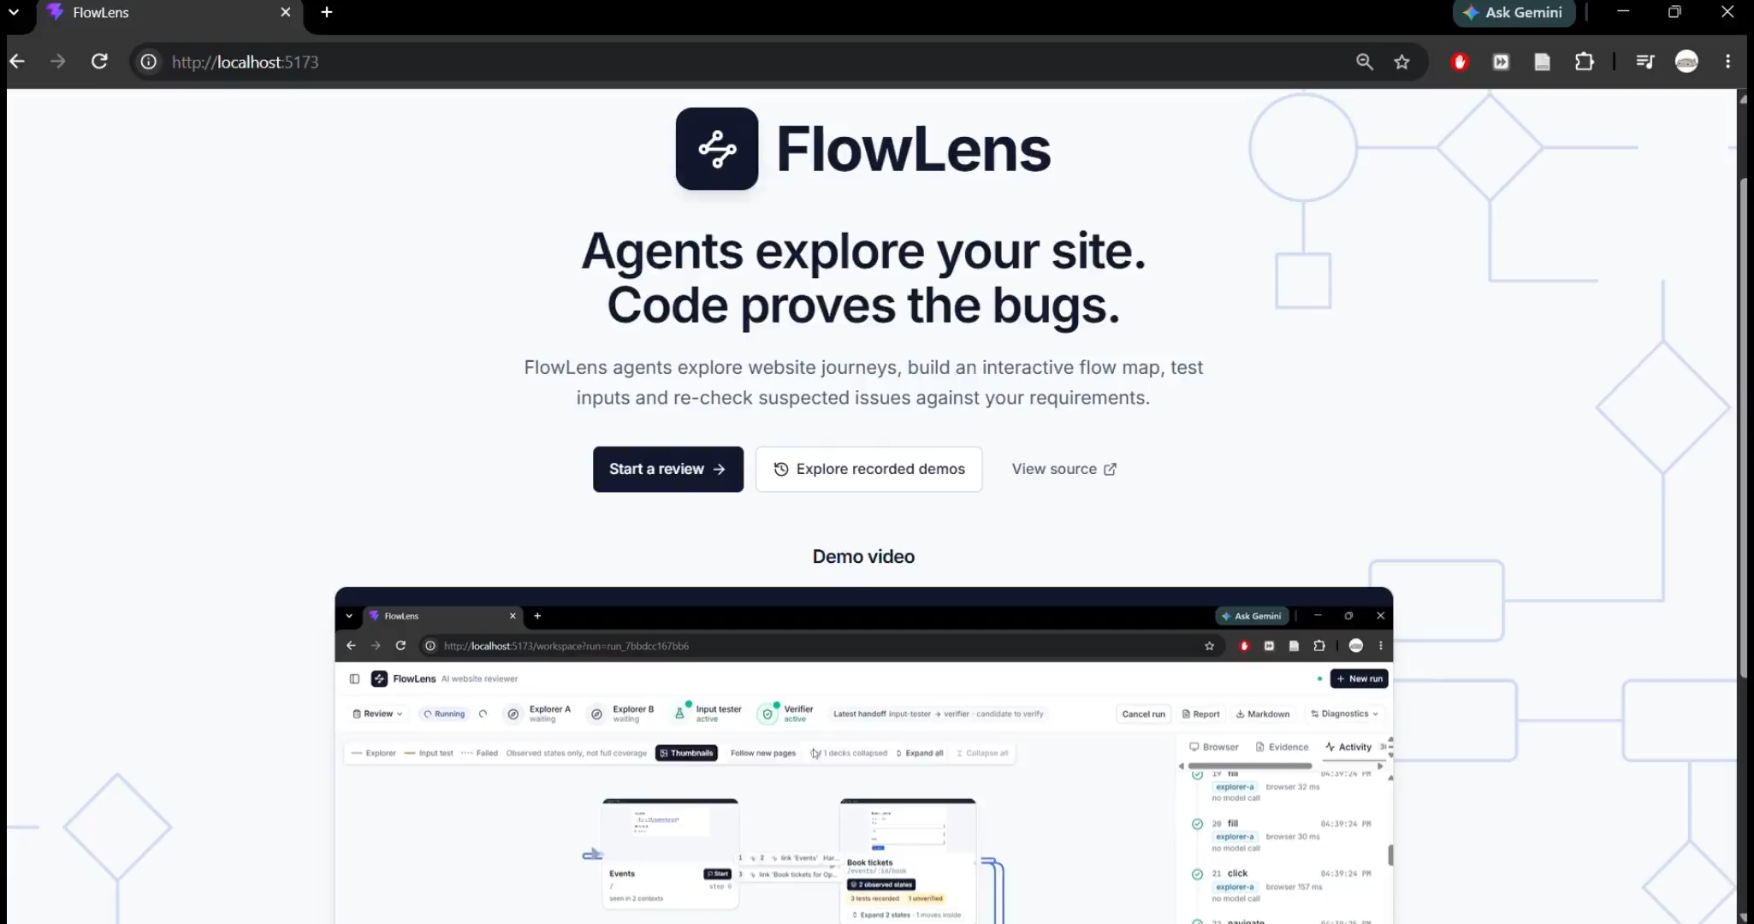

FlowLens in action
END-TO-END RUN
Recorded run · Backup demonstration
What the demo shows
Enter the website, review goal and requirements.
Watch four workers build the flow map and test forms.
Inspect two findings: excess tickets and failed cancellation.
Step through the original tests and verification replays.
Open the evidence-linked review report.
[ Live demonstration ]
Saved-run backup available
Ticket Desk · Deliberately broken test website
Saved run: run_7bbdcc167bb6
Completed · 13 model calls · Approximately US$0.017
FlowLens · 16

Slide 17
ARCHITECTURE DECISION 1
A code-controlled shared task queue
Workers share discoveries through a queue. Python code controls who works on each task and when.
Chosen approach | Four Python workers claim eligible tasks from a SQLite-backed queue. Claims record the owner, attempt and renewable lease.
Alternatives | Fixed pipeline: exploration → testing → verification. LLM Coordinator: a model assigns work, while code still enforces ownership and limits.
Why this choice | Testing can create new exploration work. Saved handoffs and explicit ownership make allocation and task restart inspectable.
Evidence | Sequential mode defers newly found states. In the live injected-stall run, B restarted A’s expired task; A’s follow-up-task write and late result were rejected.
Trade-offs | Extra coordination and repeated setup. A real Ticket fixed run used 4 explorer calls; Leave fixed still included 10 Dashboard clicks in 29 explorer calls.
Boundary: Recovery handles worker stalls within a running backend process; it does not demonstrate recovery after a backend crash.
FlowLens · 17

Slide 18
ARCHITECTURE DECISION 2
Fresh replays with code-evaluated checks
The tester raises a candidate. The verifier checks its requirement, chooses an assertion and hands execution to browser code.
Chosen approach | The verifier checks applicability and explicitness, then selects a typed assertion. Code evaluates it in two fresh browser replays.
Alternatives | Accept the tester’s verdict: cheaper, but no separate verification. Ask another model: provides a second opinion without demonstrating reproducibility.
Why this choice | Fresh replays expose reproducibility and preserve evidence. Ambiguous rules, execution failures or conflicting outcomes stay inconclusive.
Evidence | After a Caption false confirmation, the applicability gate rejected a date-in-Title candidate with real Gemini. Ticket Desk’s excess-ticket and failed-cancellation defects were each confirmed in two fresh replays
Trade-offs | Typically, one verifier model call plus two browser replays for an admitted candidate. The second replay reuses the check. Applicability and check selection can still be wrong.
Boundary: Code can evaluate a check correctly even when the model selected the wrong check.
FlowLens · 18

Slide 19
FAILURE RECOVERY 1
Worker-stall recovery
A worker stops responding while holding a task. The coordinator must release the task and prevent the expired attempt from submitting a late result.
Claim | A worker receives an attempt ID and a lease: time-limited permission to work.
Renew | The worker renews its lease before browser actions and during model calls.
Expire | If renewal stops and the lease expires, the coordinator revokes the attempt and closes its browser session.
Reassign | Another eligible worker can claim the task under a new attempt, if retries remain.
Reject late work | Ownership checks reject calls and results from the expired attempt.
Controlled test: Explorer A stalls for 75 s with an explicitly configured 45 s lease.
FlowLens · 19

Slide 20
FAILURE RECOVERY 1
A stalled explorer was replaced, and its late work was rejected
After stall | Event | Recorded transition
0 s | Stall injected | Explorer A pauses while holding the task.
45 s | Ownership expired | A’s attempt is revoked and its browser closes.
45 s | Task reassigned | Explorer B claims a new attempt.
54 s | Task completed | B completes the reassigned task.
75 s | Late work rejected | A resumes. Its follow-up-task write and late result are refused.
Outcome: Another worker can recover stalled work while code prevents the expired attempt from interfering.
Evidence: run_b77f96c4fdc7, code 7fdb5ac. Real model (Gemini 3 Flash), live, with an injected stall: 45 s lease, 75 s stall. Ticket Desk broken build, US$0.016.
Boundary: Recovery occurs within one running backend. The replacement restarts from saved setup; process-crash recovery is not implemented.
FlowLens · 20

Slide 21
FAILURE RECOVERY 2
Recovery from a Truncated Model Reply
In an earlier real-model run, the tester reached its output limit before returning a usable plan. The system detected the truncated reply.
Failure | Most output tokens went into reasoning, and the response ended with finish reason length.
Detection | The response ended with finish reason length, indicating that it reached the output limit.
Recovery | The system retried the planning request with minimal reasoning effort.
Outcome | The retry produced a valid plan. The run continued and confirmed the past-date scheduling defect.
Evidence: run_1e60d104e469, an earlier real-model run. The retry recovered and R5 was confirmed.
Limit: retries can still fail. A later Creator Studio plan contained invalid JSON, blocking draft tests while reporting incomplete coverage.
FlowLens · 21

Slide 22
SINGLE VERSUS MULTI-AGENT
Two workflows on the same targets
Two workflows reviewed development fixtures with matched configured caps. These results compare the whole workflow, not agent count alone.
Comparison | Single agent | Shared queue
Exploration | One continuous browser session | Separate session per exploration task
Who selects the check? | Same agent, with its prior verdicts | Separate verifier, without tester verdict
Who evaluates it? | Code evaluates the selected check | Code evaluates the selected check
Configured caps | 30 calls and US$0.15 per run | Same call and cost caps
Main batch: 64 runs, 4 models. MiniMax/GLM: 32 completed runs from a separate interrupted extension.
Two apps, broken/corrected builds, 2 repetitions per cell. Earlier code and unequal actual work.
FlowLens · 22

Slide 23
SINGLE VERSUS MULTI-AGENT · MODEL BENCHMARK
Supported detections by workflow
Model | Mode | Supported* | False conf. | Mean US$/run | Mean time | Mean calls
Gemini 3 Flash | Queue | 6/6 | 0 | 0.0284 | 76.1 s | 23.1
Gemini 3 Flash | Single | 3/6 | 0 | 0.0093 | 42.3 s | 8.5
MiniMax M2.7† | Queue | 5/6 | 0 | 0.0168 | 128.7 s | 24.2
MiniMax M2.7† | Single | 1/6 | 0 | 0.0062 | 84.5 s | 8.0
GLM 4.7† | Queue | 4/6 | 0 | 0.0326 | 249.1 s | 20.0
GLM 4.7† | Single | 4/6 | 0 | 0.0128 | 191.3 s | 8.6
Haiku 5.5 | Queue | 1/6 | 0 | 0.0064 | 68.5 s | 20.9
Haiku 5.5 | Single | 2/6 | 0 | 0.0024 | 39.9 s | 7.4
GPT-5 Nano | Queue | 1/6 | 2 | 0.0035 | 62.7 s | 20.9
GPT-5 Nano | Single | 1/6 | 1 | 0.0030 | 60.8 s | 15.5
DeepSeek V4 | Queue | 1/6 | 0 | 0.0028 | 109.0 s | 22.4
DeepSeek V4 | Single | 2/6 | 0 | 0.0012 | 67.6 s | 8.0
*Supported: broken fails, corrected passes. †Separate extension; MiniMax/GLM cells completed.
Earlier code, small sample. Queue 18/36; single 13/36. Benefits varied; queue cost more and took longer.
FlowLens · 23

Slide 24
SINGLE VERSUS MULTI-AGENT
Single or multi-agent?
My decision: The Multi-agent Shared Queue fits FlowLens’s branching review workflow and recovery needs. For a short, straightforward review, a single agent may be sufficient.
Discoveries create further work
Testing can reveal new pages. The shared queue lets either explorer pick up that work during the same review.
Suspicions receive a separate check
The verifier checks without seeing the tester’s verdict. This reduces influence from the original conclusion, although it still shares the tester’s steps and model.
Task ownership supports recovery
Another explorer restarts an expired task from saved setup. Code rejects the old attempt’s late result.
Trade-offs
More model calls, repeated setup and some duplicated exploration.
Higher cost and longer runtime in these benchmark runs.
A separate verifier can still choose the wrong check.
FlowLens · 24

Slide 25
DESIGN ITERATION 1
Reducing repeated exploration
Before:
Workers owned different tasks but repeatedly followed familiar links. Shared context listed known pages, not completed investigations. Each new task began with little local action history.
Change Implemented
Shared memory now records tried links, open work and sampled records. Explorers reserve distinct work before planning. Repeat refusals and no-progress stops bound loops.
Why | Task ownership prevents duplicate claims. Shared coverage helps different tasks build on completed investigations.
Observed | Real Ticket run: 4 routes, 2 forms, 6 explorer calls. Leave Desk completed but included 10 Dashboard clicks. Different inputs prevent a measured savings claim.
Trade-off | Tracking adds prompt context and can skip useful states: one scripted Ticket test lost a page structure. Return navigation remains necessary.
FlowLens · 25

Slide 26
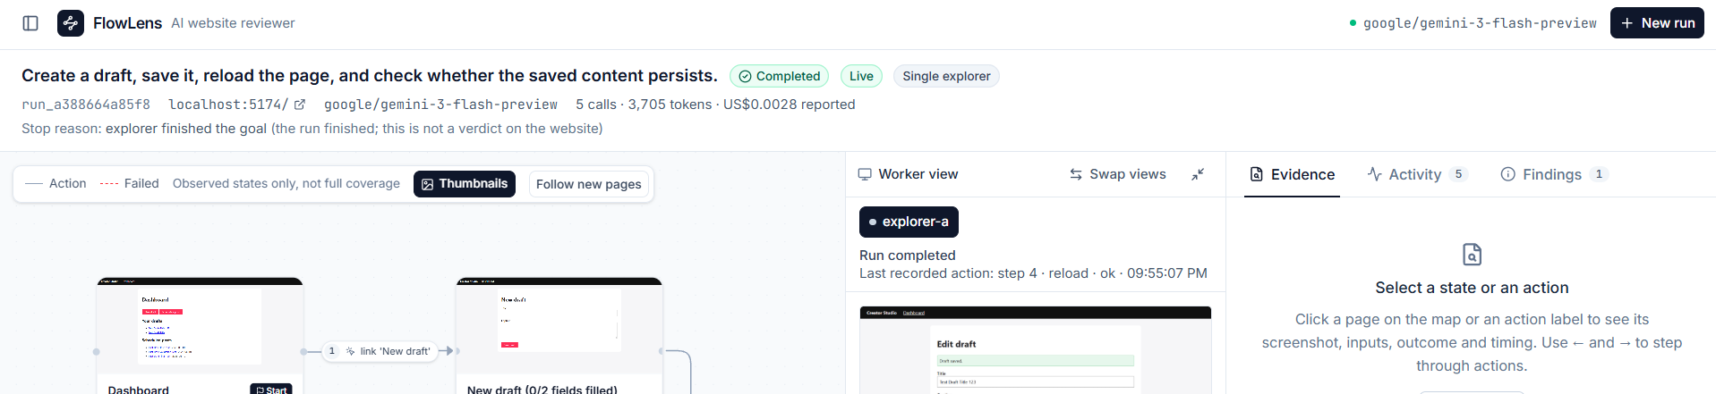
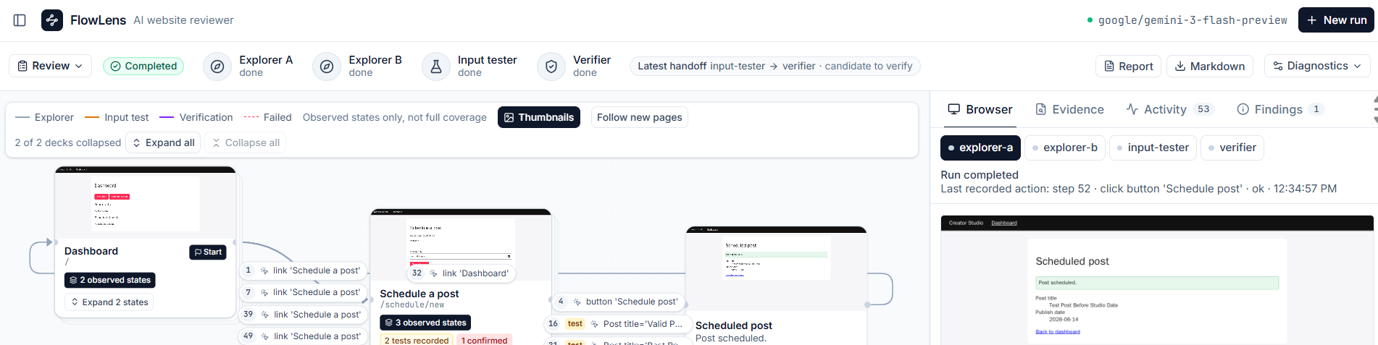
DESIGN ITERATION 2
UI iteration: More map space, visible agents
Earlier: Map squeezed between panels
More map space
Compressed the top bar and moved secondary details into Diagnostics.
Visible agent activity
Worker status updates through 1.5 s polling.
Less map clutter
Grouped related page states into collapsible stacks.
Later: Compact controls, agent activity and a larger map
FlowLens · 26

Slide 27
CAPABILITY BOUNDARY
What FlowLens delivers and its limits
Capability | Demonstrated | Remaining boundary
Collaboration | Explorer, tester and verifier handoffs | Coverage is bounded.
Verification | Relevant checks and fresh browser replays | Models can still misread rules or choose the wrong check.
Execution | Dropdown, checkbox and failure handling | Radio/file controls are unsupported. Invalid plans can block tasks.
Recovery | Stalled tasks can restart under another worker | Within one backend process. No crash resume or rollback.
Isolation and reports | Fixture data isolation; reports from saved records | External server data may be shared. Evidence links need the local server.
Performance | Queue helped some models in the benchmark | Benefits vary by model; queue costs more and takes longer.
Next validation: Compare QA reviews with and without FlowLens: review time, real defects found and time spent checking false alarms.
FlowLens · 27

Slide 28
What was reused, assisted and directed
CONTRIBUTION
Reused foundations/libraries
AI Assistance
My decisions and validation
Playwright
Browser execution
FastAPI and Pydantic
APIs and structured records
React Flow with Dagre
Interactive flow map
Automatic node layout
Radix UI and Tailwind CSS
Tabs, screenshot dialog and tooltips, with custom styling
Claude code Opus 5.5
Assisted code implementation and debugging
Running benchmarks
ChatGPT-6.1 Sol
Planning and review
Presentation preparation
FlowLens-specific work
Queue, workflows, checks, fixtures and reports built with AI assistance
Defined the scope
bounded website reviews with evidence
Chose the workflow
shared tasks, specialist roles and verification.
Directed the interface
map space, agent activity and evidence.
Challenged results
reviewed false confirmations and required broken/corrected checks.
Directed corrections
investigated repeated exploration, failed test execution and misleading verification.
Set acceptance criteria
judged changes by execution evidence and preserved coverage.
My most valuable contribution was directing the product and evaluation, then manually testing and challenging plausible AI-generated results against actual execution evidence.
FlowLens · 28
Notes:
The prompt asks me to separate what I reused, what was changed, and what I did myself, so here it is plainly. Reused as libraries: Playwright for browser automation, FastAPI for the backend, React Flow and Dagre for drawing and laying out the map, and Radix UI for interface components. AI assistance: Claude helped heavily with implementation. GPT supported planning and design review. I’m stating that directly because this is an AI-native assessment and pretending otherwise wouldn’t be credible. What I owned: the product scope, the user experience, the acceptance gates that decided whether a feature was done, how the evaluation was designed, and correcting the AI when it went wrong. [Add one or two concrete correction examples here from your development notes, for example a time generated code claimed a check passed that didn’t, or an assertion that didn’t cover a requirement.] The most valuable contribution, in my view, is the coordination layer: bounded exploration, testing and verification connected by handoffs that can recover from failure, with every accepted result linked to evidence. Likely question: “How much of the code did you write by hand?” Answer honestly. The point I’d make is that the design decisions, the gates and the evaluation are mine, and I can explain any part of the coordinator.

Slide 29
APPENDIX A1 · MODEL CONFIGURATION
Four models, the same agent roles
OPENROUTER_MODEL selects one model for all roles in a run.
LIVE DEMO CHOICE
ALSO BENCHMARKED
Gemini 3 Flash Preview
Claude Haiku 5.5
anthropic/claude-haiku-5.5
google/gemini-3-flash-preview
GPT-5 Nano
Queue mode found 6/6 known defect opportunities with zero false confirmations in the fixture benchmark.
openai/gpt-5-nano
DeepSeek V4 Flash
deepseek/deepseek-v4-flash
Explorers, tester and verifier share the selected model. Report export is code that formats saved records.
FlowLens · A1

Slide 30
Same result, higher cost
APPENDIX A2 · EARLIER CREATOR STUDIO BATCH
Condition | Past date found | False confirms | Mean time | Model calls | Cost per run
Single agent | 3 / 3 | 0 | 59 s | 9–10 | US$0.009–0.012
Shared queue | 3 / 3 | 0 | 85 s | 24–26 | US$0.030–0.038
What matched
What multi-agent cost
Both found the defect in every run: a past publish date was accepted, violating the past-date rule (R5). Corrected builds produced no confirmations.
On this fixture, the shared queue was slower and more expensive, with no gain in what it found.
3 runs per condition on one small fixture. Descriptive results only.
FlowLens · A2

Slide 31
Broader exploration reached one more defect
APPENDIX A3 · EARLIER TICKET DESK BATCH
Known defect, broken build | Single agent | Shared queue
DT2: accepts more than six tickets | 2 / 2 | 2 / 2
DT5: cancelled booking still listed | 0 / 2 | 2 / 2
False confirmations, both builds | 0 | 0
Why DT5 was missed
Read with care
The single agent never reached the cancellation dialog. That is an exploration gap, not evidence the defect was absent.
Known regression fixture, not held-out
8 of 12 planned runs: spend guard stopped the rest
Batch cost US$0.145
Earlier failed batches kept, not hidden
FlowLens · A3

Slide 32
Agents versus models, and the four run modes
APPENDIX A4 · AGENTS AND MODES
An agent here is a role with its own task context and responsibilities. All workers may call the same underlying model.
Mode | Who works | Use it for
Explorer only | One explorer | Quick map; observations stay unverified
Sequential | Explorer → tester → verifier | Simple handoff; deferred exploration not followed
Shared queue | Explorer A, B, tester, verifier | Main multi-agent mode
Single-agent baseline | One agent, all roles | Comparison; checks labelled self-checks
FlowLens · A4

Slide 33
Task and evidence contracts
APPENDIX A5 · TASK AND EVIDENCE CONTRACTS
What each handoff carries
Reliability rules in the queue
Explorer → Tester
Atomic task claims and dependencies
Deduplication of repeated work
Bounded retries
Leases, renewed while a model call is in flight
Bounded timeouts for hung calls
Stale attempts rejected on return
Model-call capacity reserved before each call
Budget share kept for testing and verification
Observed controls, setup recipe, requirements, evidence
Tester → Verifier
Suspected violation, reproduction recipe, requirement. Not the tester’s verdict.
Verifier → Coordinator
Typed assertion and two replay results; code decides the outcome
Tester → Explorers
Newly discovered pages, as exploration tasks
FlowLens · A5

Slide 34
Reproducibility, CI and public websites
APPENDIX A6 · REPRODUCIBILITY AND CI
Run it
Public websites
docker compose up -d
Origin approval required; navigation outside permitted origins is blocked
TodoMVC demo, explorer only: added todos, toggled completion, filtered, reloaded. 10 model calls, US$0.0069
That run was unverified exploration; checkbox persistence is marked “not evaluated”
Fresh browser contexts, but server data is not isolated
Starts FlowLens and four fixture builds: Creator Studio and Ticket Desk, broken and corrected
Clean-checkout smoke checks passed on native Windows and Docker
Saved demo runs are labelled recorded and open without an API key
CI: backend tests with locked dependencies and Chromium; frontend lint and build
Not every browser, UI or live test runs in CI. Repo: github.com/ryanyipp/ai-native-assessment
FlowLens · A6

Slide 35
Likely questions
APPENDIX A7 · LIKELY QUESTIONS
Question | Short answer
Why not one agent? | Gemini queue found 6/6 versus 4/6 for single in this small fixture benchmark, at higher time and cost.
Same model, so same agent? | Separate roles, contexts and duties; independence is partial, and code judges.
What if the assertion is wrong? | Possible. The report shows the exact assertion and replay screenshots.
Was the stall real? | Injected on purpose. Expiry and reassignment ran through the real coordinator.
Any website? | No. Authorised origins only; no login automation; some controls unsupported.
Why no coverage %? | The full set of states is unknown, so a percentage would be invented.
How was AI used? | Claude for implementation, GPT for planning; I set gates and evaluated.
FlowLens · A7

Slide 36
APPENDIX A9 · LOCAL DEPLOYMENT
Local deployment: six containers
Port | Service | Purpose
5173 | frontend | FlowLens workspace
8000 | backend | FastAPI, agents and Chromium
5174 | creator-studio-broken | Creator fixture with known defects
5175 | creator-studio-corrected | Creator fixture with fixes
5176 | ticket-desk-broken | Ticket fixture with known defects
5177 | ticket-desk-corrected | Ticket fixture with fixes
docker compose up --build -d
Open http://localhost:5173. The backend publishes all service ports.
Shared network namespace: workers and your browser reach the fixtures through localhost.
flowlens-data at /data keeps records, evidence and fixture data between restarts.
FlowLens · A9

