Slide 1
CSE 3400 - Introduction to Cyber Security (aka: Computer and Information Security) Topic 1: Cryptology, Encryption and Pseudo-randomness
© Prof. Amir Herzberg
Dept. of Computer Science & Engineering
University of Connecticut
Last updated: 8/18/2018

Slide 2
Cryptology
Literally: `Science of secret information`
Protecting secrets: encryption
Using secrets: keys
Using limitations of adversary to…
Prevent damage – e.g. encrypt for privacy
Punish (deter) corruption – e.g. signed proofs and reviews
Which limitations? computational + knowledge
Main tool for cyber security
Earliest, most known function: encryption

Slide 3



Encryption
Prevention of exposure of secret information
Earliest and `basic’ tool of cryptology
Related terms:
Cryptography: `secret writing’
Cryptanalysis: `breaking’ encryption
Encryption scheme = Cryptosystem = Cipher
Encrypt
Decrypt

Slide 4
The Encryption World: basic terms
Goal: encrypt plaintext into ciphertext
Only legit-recipient can decrypt ciphertext to plaintext
Adversary cannot learn anything from ciphertext
Idea: decryption uses secret algorithm and/or key
Variants:
Keyed or unkeyed?
Same key (symmetric) or different keys (asymmetric)?
Stateful / stateless ? Randomized ? Input size?
key
key
plaintext
ciphertext
plaintext
Encrypt
Decrypt
Notes:
4
10/30/11
Asymmetric = public key

Slide 5
Encryption, Decryption, Correctness
Key k
Plaintext
m
Encrypt E
Ciphertext c=E_{k}(m)
Key k
Ciphertext c
Decrypt D
Plaintext m=D_{k}(c)
Key k
Key k
Plaintext
m
Encrypt E
Ciphertext c=E_{k}(m)
Decrypt D
Plaintext m=D_{k}(E_{k}(m))

Slide 6
Ancient, Keyless Ciphers
Ancient ciphers were simple, naive
No key: secrecy is in the algorithm
Monoalphabetic: encrypt/decrypt one character at a time
A set {<E,D>} of permutation + inverse: m=D(E(m))
At-BaSh: most ancient documented cipher
Used three times in the book of Jeremiah
A simple monoalphabetic keyless cipher for Hebrew letters
Plaintext, ciphertext are both single Hebrew letters
substitute first letter of alphabet by last… and so on:
At-Bash
אתבש
א | ב | ג | . | . | . | . | ר | ש | ת
ת | ש | ר | . | . | . | . | ג | ב | א

Slide 7
Most ancient: At-BaSh and AzBy
At-Bash: maps letters in Hebrew alphabet:
First letter (Aleph) to last (Taf): At
Second (Bat) to one-before-last (Shin): BaSh
Hence name: At-Bash, or in Hebrew letters: אתבש
AzBy: same idea, for Latin alphabet
A→z, B→y, …
For 26-char alphabet, letters mapped to 0,1...25: E(m)=25-m
Hebrew:
אתבש At-BaSh
א | ב | ג | . | . | . | . | ר | ש | ת
ת | ש | ר | . | . | . | . | ג | ב | א
Latin:
AzBy
A | B | C | . | . | . | . | X | Y | Z
Z | Y | X | . | . | . | . | C | B | A

Slide 8
(Unkeyed) Caesar Cipher
Used by Julius Caesar
Rotate the 26 letters of the alphabet by 3:
a b c d e f g h i j k l m n o p q …
A B C D E F G H I J K L M N O P Q …
As formula:
c = E(p) = p+3 (mod 26)
p = D(c) = c-3 (mod 26)
Ceasar and AtBash are trivial to cryptanalyze
No key – algorithm itself is `secret`
‘Security by obscurity’
+3

Slide 9
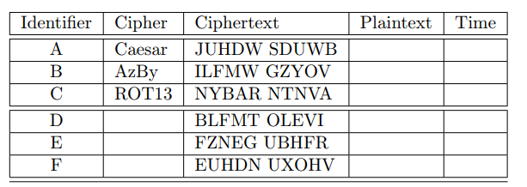
Exercise 2.2: manual cryptanalysis
Table contains encryptions of pairs of simple 5-letter words.
For one cipher from {ABC}, and one from {DEF}: find plaintext words – and write time.
Write your name!!

Slide 10
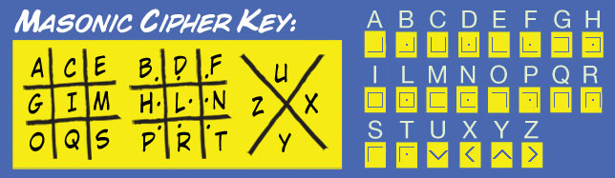
The Masonic Cipher [18th century]
Another example of ancient, keyless cipher
Maps each Latin letter to a simple geometric shape
Exercise: write your name in English – and encrypted by Masonic cipher

Slide 11
Shift Cipher: Keyed variant of Caesar
(character-key) Shift / Caesar Cipher:
k← {0,1,…25}; c = E(p) = p+k (mod 26)
Find key by trying all 26 keys (exhaustive search)
(l-bits block) Shift / Caesar Cipher:
Select random key k← {0,1}^{l}
Break plaintext into l-bits blocks p₁, p₂,…
c_{i} = E_{k}(p_{i}) = p_{i}+k (+ may be xor or addition mod 2^{l} )
2^{l} keys… exhaustive search can be impractical
But still weak…
Exercise: suppose attacker can get encryption E_{k}(p_{i}) of one known block p_{i} . Decrypt all blocks!
keyed variants of Ceasar
a
Notes:
11
10/30/11

Slide 12
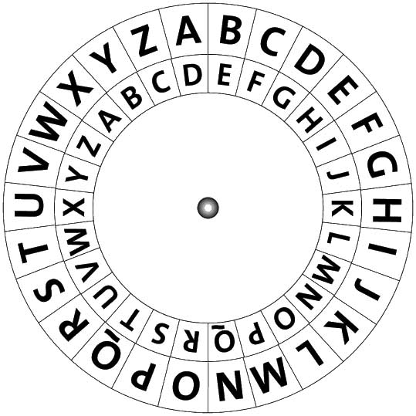
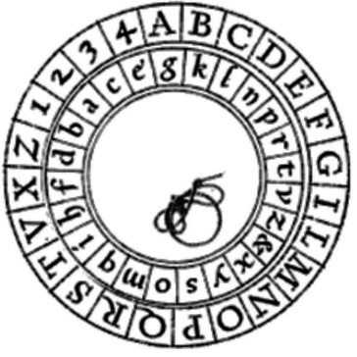
Monoalphabetic Substitution Ciphers
Generalize, improve Caesar, AtBash:
Other permutations of letters
To letters or to other symbols (no real difference)
Keyed: Given key k, cipher E_{k} is a permutation
Or: the ‘key’ is simply the permutation (table)
Classical, `elementary school’ cryptosystem
Examples:
Vulnerable to letter-frequency cryptanalysis

Slide 13
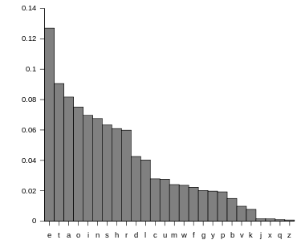
Letter frequencies (in English)
Other useful statistic:
Bigrams, Trigrams…
First/Last letter in words, sentences
Etc…
Principle: limit amount of usage of each key

Slide 14
Example: Frequency Cryptanalysis
Given ciphertext:
UZQSOVUOHXMOPVGPOZPEVSGZWSZOPFPESXUDBMETSXAIZ
VUEPHZHMDZSHZOWSFPAPPDTSVPQUZWYMXUZUHSX
EPYEPOPDZSZUFPOMBZWPFUPZHMDJUDTMOHMQ
Count relative letter frequencies:
A | B | C | D | E | F | G | H | I | J | K | L | M
2 | 2 | 0 | 6 | 6 | 4 | 2 | 7 | 1 | 1 | 0 | 0 | 8
N | O | P | Q | R | S | T | U | V | W | X | Y | Z
0 | 9 | 16 | 3 | 0 | 10 | 3 | 10 | 5 | 4 | 5 | 2 | 14

Slide 15
Example: Frequency Cryptanalysis
Given ciphertext:
UZQSOVUOHXMOPVGPOZPEVSGZWSZOPFPESXUDBMETSXAIZ
VUEPHZHMDZSHZOWSFPAPPDTSVPQUZWYMXUZUHSX
EPYEPOPDZSZUFPOMBZWPFUPZHMDJUDTMOHMQ
Sorted:
P | Z | S | U | O | M | H | D | E | V | X | F | W
16 | 14 | 10 | 10 | 9 | 8 | 7 | 6 | 6 | 5 | 5 | 4 | 4
e | t
Q | T | A | B | G | Y | I | J | C | K | L | N | R
3 | 3 | 2 | 2 | 2 | 2 | 1 | 1 | 0 | 0 | 0 | 0 | 0
Most frequent is e, followed by t… let’s replace…

Slide 16
Example: Frequency Cryptanalysis
Given ciphertext:
UtQSOVUOHXMOeVGeOteEVSGtWStOeFeESXUDBMETSXAIt
VUEeHtHMDtSHtOWSFeAeeDTSVeQUtWYMXUtUHSX
EeYEeOeDtStUFeOMBtWeFUetHMDJUDTMOHMQ
Sorted:
P | Z | S | U | O | M | H | D | E | V | X | F | W
16 | 14 | 10 | 10 | 9 | 8 | 7 | 6 | 6 | 5 | 5 | 4 | 4
e | t
Q | T | A | B | G | Y | I | J | C | K | L | N | R
3 | 3 | 2 | 2 | 2 | 2 | 1 | 1 | 0 | 0 | 0 | 0 | 0
In English texts, `t` is often followed by `h`. Count chars following Z (t):
Twice: W, H, U and O; once: QVDS. Pick W, since this gives `the’…

Slide 17
Example: Frequency Cryptanalysis
Given ciphertext:
UtQSOVUOHXMOeVGeOteEVSGthStOeFeESXUDBMETSXAIt
VUEeHtHMDtSHtOWSFeAeeDTSVeQUthYMXUtUHSX
EeYEeOeDtStUFeOMBtheFUetHMDJUDTMOHMQ
Sorted:
P | Z | S | U | O | M | H | D | E | V | X | F | W
16 | 14 | 10 | 10 | 9 | 8 | 7 | 6 | 6 | 5 | 5 | 4 | 4
e | t |  |  |  |  |  |  |  |  |  |  | h
Q | T | A | B | G | Y | I | J | C | K | L | N | R
3 | 3 | 2 | 2 | 2 | 2 | 1 | 1 | 0 | 0 | 0 | 0 | 0
In English texts, `t` is often followed by `h`. Count chars following Z (t):
Twice: W, H, U and O; once: QVDS. Pick W, since this gives `the’…

Slide 18
Example: Frequency Cryptanalysis
Given ciphertext:
UtQSOVUOHXMOeVGeOteEVSGthStOeFeESXUDBMETSXAIt
VUEeHtHMDtSHtOWSFeAeeDTSVeQUthYMXUtUHSX
EeYEeOeDtStUFeOMBtheFUetHMDJUDTMOHMQ
Sorted:
P | Z | S | U | O | M | H | D | E | V | X | F | W
16 | 14 | 10 | 10 | 9 | 8 | 7 | 6 | 6 | 5 | 5 | 4 | 4
e | t | a |  |  |  |  |  |  |  |  |  | h
Q | T | A | B | G | Y | I | J | C | K | L | N | R
3 | 3 | 2 | 2 | 2 | 2 | 1 | 1 | 0 | 0 | 0 | 0 | 0
We have thSt with S being third-most common. After e and t, most common letters are: aoinshr (in this order). Only `a` fits, so…

Slide 19
Example: Frequency Cryptanalysis
Given ciphertext:
UtQaOVUOHXMOeVGeOteEVaGthatOeFeEaXUDBMETaXAIt
VUEeHtHMDtaHtOWaFeAeeDTaVeQUthYMXUtUHaX
EeYEeOeDtatUFeOMBtheFUetHMDJUDTMOHMQ
Sorted:
P | Z | S | U | O | M | H | D | E | V | X | F | W
16 | 14 | 10 | 10 | 9 | 8 | 7 | 6 | 6 | 5 | 5 | 4 | 4
e | t | a |  |  |  |  |  |  |  |  |  | h
Q | T | A | B | G | Y | I | J | C | K | L | N | R
3 | 3 | 2 | 2 | 2 | 2 | 1 | 1 | 0 | 0 | 0 | 0 | 0
Next common in ciphertext is U and in English are oinsr (in this order). Only few, rare words begin with `ot’ (and not `oth’), but `it` is common, so…

Slide 20
Example: Frequency Cryptanalysis
Given ciphertext:
itQaOViOHXMOeVGeOteEVaGthatOeFeEaXiDBMETaXAIt
ViEeHtHMDtaHtOWaFeAeeDTaVeQithYMXitiHaX
EeYEeOeDtatiFeOMBtheFietHMDJiDTMOHMQ
Sorted:
P | Z | S | U | O | M | H | D | E | V | X | F | W
16 | 14 | 10 | 10 | 9 | 8 | 7 | 6 | 6 | 5 | 5 | 4 | 4
e | t | a | i |  |  |  |  |  |  |  |  | h
Q | T | A | B | G | Y | I | J | C | K | L | N | R
3 | 3 | 2 | 2 | 2 | 2 | 1 | 1 | 0 | 0 | 0 | 0 | 0
Next common in ciphertext are OMH and in English are onsr (in this order). ‘O’=E(‘o’) is unlikely since it gives `that oeFeEa…` ➔ try ‘M’=E(‘o’)…

Slide 21
Example: Frequency Cryptanalysis
Given ciphertext:
itQaOViOHXoOeVGeOteEVaGthatOeFeEaXiDBoETaXAIt
ViEeHtHoDtaHtOWaFPAeeDTaVeQithYoXitiHaX
EeYEeOeDtatiFeOoBtheFietHoDJiDToOHoQ
Sorted:
P | Z | S | U | O | M | H | D | E | V | X | F | W
16 | 14 | 10 | 10 | 9 | 8 | 7 | 6 | 6 | 5 | 5 | 4 | 4
e | t | a | i |  | o |  |  |  |  |  |  | h
Q | T | A | B | G | Y | I | J | C | K | L | N | R
3 | 3 | 2 | 2 | 2 | 2 | 1 | 1 | 0 | 0 | 0 | 0 | 0
Next common in ciphertext are OMH and in English are onsr (in this order). ‘O’=E(‘o’) is unlikely since it gives `that oeFeEa…` ➔ try ‘M’=E(‘o’)…

Slide 22
Example: Frequency Cryptanalysis
Given ciphertext:
itQaOViOHXoOeVGeOteEVaGthatOeFeEaXiDBoETaXAIt
ViEeHtHoDtaHtOWaFeAeeDTaVeQithYoXitiHaX
EeYEeOeDtatiFeOoBtheFietHoDJiDToOHoQ
Sorted:
P | Z | S | U | O | M | H | D | E | V | X | F | W
16 | 14 | 10 | 10 | 9 | 8 | 7 | 6 | 6 | 5 | 5 | 4 | 4
e | t | a | i |  | o |  |  |  |  |  |  | h
Q | T | A | B | G | Y | I | J | C | K | L | N | R
3 | 3 | 2 | 2 | 2 | 2 | 1 | 1 | 0 | 0 | 0 | 0 | 0
Hey, we have `the FietHoDJ`… most likely: `the Vietcong` !!

Slide 23
Example: Frequency Cryptanalysis
Given ciphertext:
itQaOViOcXoOeVGeOteEVaGthatOeFeEaXiDBoETaXAIt
ViEectcoDtactOhaFeAeeDTaVeQithYoXiticaX
EeYEeOeDtatiFeOoB the vietcong iDToOcoQ
Sorted:
P | Z | S | U | O | M | H | D | E | V | X | F | W
16 | 14 | 10 | 10 | 9 | 8 | 7 | 6 | 6 | 5 | 5 | 4 | 4
e | t | a | i |  | o | c | n |  |  |  | v | h
Q | T | A | B | G | Y | I | J | C | K | L | N | R
3 | 3 | 2 | 2 | 2 | 2 | 1 | 1 | 0 | 0 | 0 | 0 | 0
 |  |  |  |  |  |  | g
Next common in ciphertext is O and in English is s… go for it!

Slide 24
Example: Frequency Cryptanalysis
Given ciphertext:
itQasViscXoseVGesteEVaGthatseFeEaXinBoETaXAIt
ViEectcoDtactshaFeAeenTadeQithYoXiticaX
EeYEesentatiFesoB the vietcong inToscoQ
Sorted:
P | Z | S | U | O | M | H | D | E | V | X | F | W
16 | 14 | 10 | 10 | 9 | 8 | 7 | 6 | 6 | 5 | 5 | 4 | 4
e | t | a | i | s | o | c | n |  |  |  | v | h
Q | T | A | B | G | Y | I | J | C | K | L | N | R
3 | 3 | 2 | 2 | 2 | 2 | 1 | 1 | 0 | 0 | 0 | 0 | 0
 |  |  |  |  |  |  | g
Next common in ciphertext is O and in English is s… go for it!
And then, EVX and rdl… and `GesterEVG’ fits `yesterday’, so..

Slide 25
Example: Frequency Cryptanalysis
Given ciphertext:
itQas disclosed yesterday that several inBorTalAIt
directcontactshaveAeenTadeQithYolitical
reYresentativesoB the vietcong inToscoQ
Sorted:
P | Z | S | U | O | M | H | D | E | V | X | F | W
16 | 14 | 10 | 10 | 9 | 8 | 7 | 6 | 6 | 5 | 5 | 4 | 4
e | t | a | i | s | o | c | n | r | d | l | v | h
Q | T | A | B | G | Y | I | J | C | K | L | N | R
3 | 3 | 2 | 2 | 2 | 2 | 1 | 1 | 0 | 0 | 0 | 0 | 0
 |  |  |  | y |  |  | g
Next common are `X’ and ‘l’, which fits text very well –
Esp. noticing that Y must be P (representatives, political…)…

Slide 26
Example: Frequency Cryptanalysis
Given ciphertext:
itQas disclosed yesterday that several inBorTalAIt
direct contacts have AeenTadeQith political
representativesoB the vietcong inToscoQ
Sorted:
P | Z | S | U | O | M | H | D | E | V | X | F | W
16 | 14 | 10 | 10 | 9 | 8 | 7 | 6 | 6 | 5 | 5 | 4 | 4
e | t | a | i | s | o | c | n | r | d | l | v | h
Q | T | A | B | G | Y | I | J | C | K | L | N | R
3 | 3 | 2 | 2 | 2 | 2 | 1 | 1 | 0 | 0 | 0 | 0 | 0
 |  |  |  | y | p |  | g
Next common are `QT’ and ‘umw’; so sentence must begin with `it was`…
Also, `oB` must be `of`, and so `inBorTal` must be `informal`, so…

Slide 27
Example: Frequency Cryptanalysis
Given ciphertext:
it was disclosed yesterday that several informal AIt
direct contacts have Aeenmade with political
Representatives of the vietcong in moscow
Sorted:
P | Z | S | U | O | M | H | D | E | V | X | F | W
16 | 14 | 10 | 10 | 9 | 8 | 7 | 6 | 6 | 5 | 5 | 4 | 4
e | t | a | i | s | o | c | n | r | d | l | v | h
Q | T | A | B | G | Y | I | J | C | K | L | N | R
3 | 3 | 2 | 2 | 2 | 2 | 1 | 1 | 0 | 0 | 0 | 0 | 0
w | m |  | f | y | p |  | g
Oh this already makes sense… and this `Aeenmade` must be `been made`…
So we’re essentially done !

Slide 28
Example: Frequency Cryptanalysis
Given ciphertext:
it was disclosed yesterday that several informal AIt
direct contacts have Aeenmade with political
Representatives of the vietcong in moscow
Sorted:
P | Z | S | U | O | M | H | D | E | V | X | F | W
16 | 14 | 10 | 10 | 9 | 8 | 7 | 6 | 6 | 5 | 5 | 4 | 4
e | t | a | i | s | o | c | n | r | d | l | v | h
Q | T | A | B | G | Y | I | J | C | K | L | N | R
3 | 3 | 2 | 2 | 2 | 2 | 1 | 1 | 0 | 0 | 0 | 0 | 0
w | m | b | f | y | p |  | g
Oh this already makes sense… and this `Aeenmade` must be `been made`…
So we’re essentially done, as `bIt’ must be `but`…

Slide 29
Example: Frequency Cryptanalysis
Given ciphertext:
UZQSOVUOHXMOPVGPOZPEVSGZWSZOPFPESXUDBMETSXAIZ
VUEPHZHMDZSHZOWSFPAPPDTSVPQUZWYMXUZUHSX
EPYEPOPDZSZUFPOMBZWPFUPZHMDJUDTMOHMQ
Found plaintext:
it was disclosed yesterday that several informal but
direct contacts have beenmade with political
Representatives of the vietcong in moscow

Slide 30
Example: Frequency Cryptanalysis
Given ciphertext:
UZQSOVUOHXMOPVGPOZPEVSGZWSZOPFPESXUDBMETSXAIZ
VUEPHZHMDZSHZOWSFPAPPDTSVPQUZWYMXUZUHSX
EPYEPOPDZSZUFPOMBZWPFUPZHMDJUDTMOHMQ
Count relative letter frequencies
Guess P & Z are e and t
Guess ZW is th and hence ZWP is the
Proceeding with trial and error finally get:
it was disclosed yesterday that several informal but
direct contacts have been made with political
representatives of the vietcong in moscow

Slide 31
Example: Frequency Cryptanalysis
Given ciphertext:
UZQSOVUOHXMOPVGPOZPEVSGZWSZOPFPESXUDBMETSXAIZ
VUEPHZHMDZSHZOWSFPAPPDTSVPQUZWYMXUZUHSX
EPYEPOPDZSZUFPOMBZWPFUPZHMDJUDTMOHMQ
Count relative letter frequencies
Guess P & Z are e and t
Guess ZW is th and hence ZWP is the
Proceeding with trial and error finally get:
it was disclosed yesterday that several informal but
direct contacts have been made with political
representatives of the vietcong in moscow

Slide 32
Example: Frequency Cryptanalysis
Given ciphertext:
UZQSOVUOHXMOPVGPOZPEVSGZWSZOPFPESXUDBMETSXAIZ
VUEPHZHMDZSHZOWSFPAPPDTSVPQUZWYMXUZUHSX
EPYEPOPDZSZUFPOMBZWPFUPZHMDJUDTMOHMQ
Count relative letter frequencies
Guess P & Z are e and t
Guess ZW is th and hence ZWP is the
Proceeding with trial and error finally get:
it was disclosed yesterday that several informal but
direct contacts have been made with political
representatives of the vietcong in moscow

Slide 33
Security-by-Obscurity Ciphers
Other ‘naïve’ ciphers
Security relied on obscurity
I.e., hope attacker does not know cipher
Used extensively in 19th century
… but usually cryptanalyzed
… esp. after encryption devices were captured

Slide 34
Vigenére’s cipher
Multiple shift ciphers
Shift the i^{th} letter by key[i] : c[i] = p[i] + key[i mod |key|] (mod 26)
Prevents simple statistical attack
Prob(c[i]=x) does not depend (only) on p[i]
But what about more advanced attacks?
Plaintext: | T | E | L | L | H | I | M | A | B | O | U | T | M | E
Key: | C | A | F | E | C | A | F | E | C | A | F | E | C | A
Ciphertext: | W | F | R | Q | K | J | S | F | E | P | A | Y | P | F
Notes:
34
10/30/11

Slide 35
Attacking Vigenére’s cipher
Vigenére’s cipher: C_{i}=K[i+P_{i}]
Stronger statistical (cipher-text only) attacks:
Easy: if length of key is known
If not… try lengths [or use Kasiski’s method]
Principle: limit amount of usage of each key
What if adversary also knows/chooses some plaintext?
Known plaintext:
Common prefixes, e.g. `Dear`, `Hail`, `Date:`, `<html>`
Exposed/non-confidential messages, …
Chosen plaintext: `the message we intercepted was: …`
Easy exercise: known-plaintext attack on Vigenére
Notes:
35
10/30/11

Slide 36
Kerckhoffs’ Known Design Principle [1883]
Assume adversary knows the design – everything except the secret keys
No `security by obscurity’
Although attacking obscure design is harder
Why assume/use public design ?
No need to replace system once design is exposed
Usually stronger
Establish standards for multiple applications:
Efficiency of production and of test attacks / cryptanalysis
Secrecy is based only on secrecy of key
a
Notes:
36
10/30/11

Slide 37
Exhaustive Key Search
Kerckhoffs: Secrecy ≤ secrecy of key
Exhaustive Key Search Attack: try all keys
How to identify correct key??
Depends on attacker capability (model)
Known-Plaintext attack: test key against known plaintext, ciphertext pair (‘crib’): (p, E_{k}(p))
Ciphertext-only exhaustive search attack: use ciphertexts and predicate identifying plaintexts
For every plaintext p holds Pred(p)=1
k≠k’ ➔ for random plaintext p, holds Pred(D_{k’}(E_{k}(p)))=0
Predicates: ‘sensible’ text in English; known format; or error-detection/correction code (in plaintext)
a
Notes:
37
10/30/11

Slide 38
Sufficient Effective Key Length
Sufficient Effective Key Length Principle:
Ciphers should have sufficient effective key length, with a safety margin, to make attacks infeasible, for best adversary resources (HW, cryptanalysis) expected, during `sensitivity period` of data
Effective key length: key length for exhaustive search, which is as efficient as best targeted attack with real key space/length
Targeted attack: exploit properties of cryptosystem
Large key-space is necessary, not sufficient
Monoalphabetic substitution cipher, with permutation as key: 26! = 4 x 1026 keys… yet insecure!

Slide 39
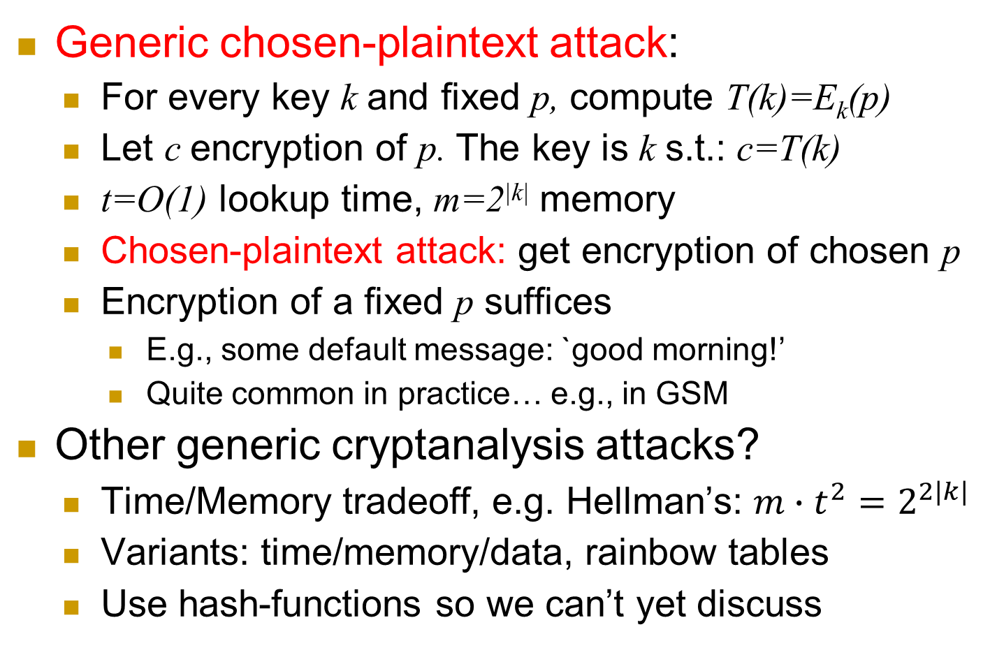
Table-Lookup: a Generic CPA
Generic chosen-plaintext attack:
For every key k and fixed p, compute T(k)=E_{k}(p)
Let c encryption of p. The key is k s.t.: c=T(k)
t=O(1) lookup time, m=2^{|k|} memory
Chosen-plaintext attack: get encryption of chosen p
Encryption of a fixed p suffices
E.g., some default message: `good morning!’
Quite common in practice… e.g., in GSM
Other generic cryptanalysis attacks?
Time/Memory tradeoff, e.g. Hellman’s: $m∙t^{2}=2^{2|k|}$
Variants: time/memory/data, rainbow tables
Use hash-functions so we can’t yet discuss
a
Notes:
39
10/30/11

Slide 40
We can apply generic attacks to every cryptosystem. So, is breaking just a question of resources? Can encryption be secure unconditionally – even against attacker with unbounded time and storage?
Yes we can!
hmm, but this requires keys as long as plaintext
(the smaller-font comment ☺ )
➔ Rarely practical

Slide 41
One-Time-Pad (OTP)
[Frank Miller, 1882] and
[Vernham (and Mauborgne?), 1919]
To encrypt message m, compute the bitwise XOR of the key with the message:
E_{k}(m)=c where c[i] = k[i] ⊕ m[i]
To decrypt ciphertext c, compute the bitwise XOR of the key with the ciphertext:
D_{k}(c)=m’ where m’[i] = k[i] ⊕ c[i]
0 | 1 | 1 | 1 | 0 | 0 | 0 | 1 | 0
Key k (pad)
Plaintext m
+
Ciphertext c
1 | 0 | 0 | 0 | 1 | 0 | 0 | 1 | 1
 |  |  |  | 1 | 0 | 0 | 0 | 1

Slide 42
One-Time-Pad: Example, Properties
k = 11001
m = 10011
C = 01010
k = 11001
c = 01010
m’ = 10011
m’= k ⊕ c = k ⊕ (k ⊕ m) = (k ⊕ k) ⊕ m = 0 ⊕ m = m
Very simple, efficient… except |k|=|m|
Shannon [1949; simplified]: OTP is Unconditionally secure, and for every unconditionally-secure cipher, |k|≥|m|
Proofs of these claims? See crypto course / books ☺
Attackers are computationally limited (if not stated otherwise)
Can we do computationally-secure |k|<<|m| variant of OTP?

Slide 43
Announcement: Homeworks
First homework (math problems): submit by next lecture
Type it – unless you can handwrite beautifully and clearly
Next homework should be published around weekend and due following lecture

Slide 44
News!!! ConCrypt Announcement
ConCrypt Inc. announced a new encryption scheme, the CES, which is features 500 bit key, yet is five time more efficient than AES, with only 128 bit key!!!
`CES was proved by leading experts to be more secure than AES’
Possible conclusions:
This class may not be necessary anymore
Or another?

Slide 45
The Attack Models Championship
Which attack models did we discuss?
CTO, KPA, CPA, CCA
Model A is stronger than model B, if a cipher secure against A is also secure against B
Notation: A > B
Example: KPA > CTO [why?]
KPA vs. CPA ? KPA vs. CCA?
CPA vs. CCA ?

Slide 46
Unconditional vs. Computational Security
Unconditional security
No matter how much computer power is available, the cipher cannot be broken
Computational security
The cost of breaking the cipher exceeds the value of the encrypted info
The time required to break the cipher exceeds the useful lifetime of the info
Or: a Probabilistic Polynomial Time (PPT) attacker has sub-polynomial success probability
Notes:
Unconditional security would be nice, but the only known such cipher is the one-time pad (later). For all reasonable encryption algorithms, have to assume computational security where it either takes too long, or is too expensive, to bother breaking the cipher.

Slide 47
Pseudo-Random Generator Stream Cipher
Idea: `similar’ to OTP, but with bounded-length seed s
How? With a pseudorandom generator PRG(s)
PRG(s) outputs a long stream of bits (longer than |s|)
Which is `indistinguishable from random’ bit-stream
Seed s
PRG
0 | 1 | 1 | 1 | 0 | 0 | 0 | 1 | 0
Bit i of PRG(s)
m_{i} : bit i of m
c_{i}
Plaintext m
+
Ciphertext c
1 | 0 | 0 | 0 | 1 | 0 | 0 | 1 | 1
 |  |  |  | 1 | 0 | 0 | 0 | 1

Slide 48
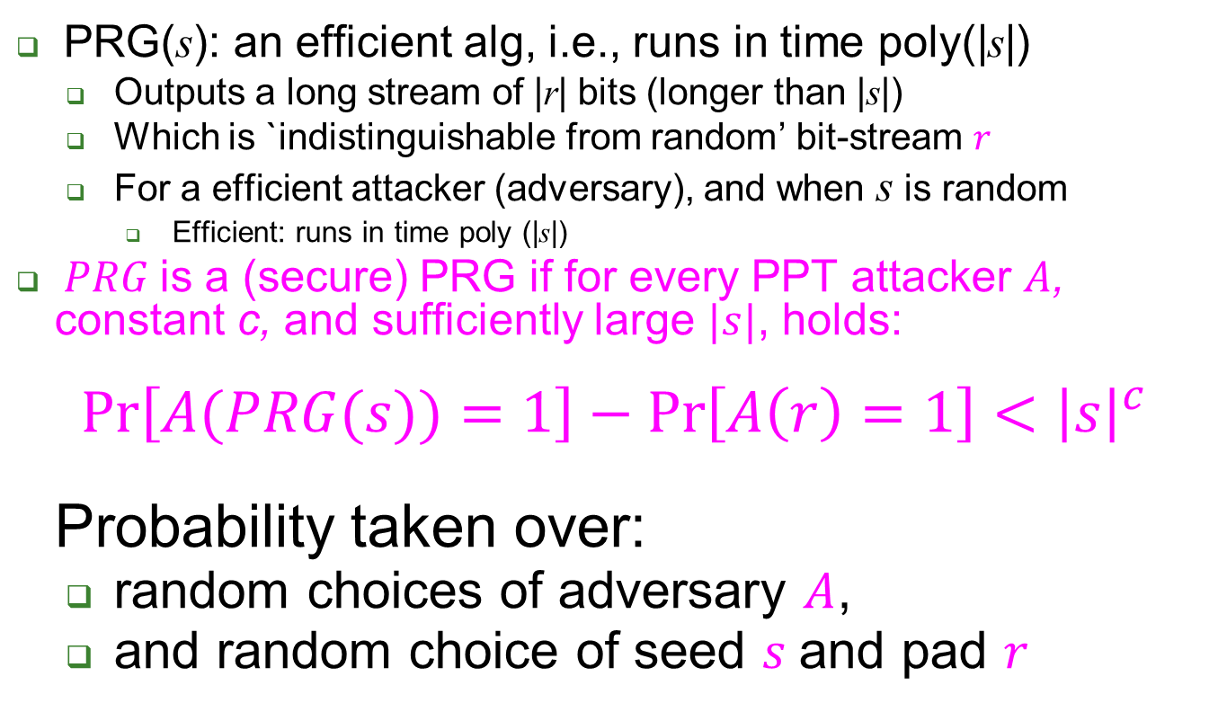
Pseudo-Random Generator
PRG(s): an efficient alg, i.e., runs in time poly(|s|)
Outputs a long stream of |r| bits (longer than |s|)
Which is `indistinguishable from random’ bit-stream $r$
For a efficient attacker (adversary), and when s is random
Efficient: runs in time poly (|s|)
$PRG$is a (secure) PRG if for every PPT attacker $A$, constant c, and sufficiently large $|s|$, holds: $\operatorname{Pr}\left[A(PRG(s))=1\right]−\operatorname{Pr}\left[A\left(r\right)=1\right]<{\left|s\right|}^{c}$ Probability taken over:
random choices of adversary $A$,
and random choice of seed $s$and pad $r$

Slide 49
Many PRG proposals…
Often based on Feedback Shift Register(s)
Easy for efficient HW
Linear feedback (LFSR) - or not
LFSR is easily predictable (not secure PRG)
More complex (mult-regs, etc.), e.g. in GSM
GSM’s original stream-ciphers (A5/1, A5/2): broken
And attacker can cause GSM to use weakest cipher ☹

Slide 50
Many PRG proposals…
Often based on Feedback Shift Register(s)
Easy for efficient HW
Linear feedback (LFSR) - or not
LFSR is easily predictable (not secure PRG)
More complex (mult-regs, etc.), e.g. in GSM
GSM’s original stream-ciphers (A5/1, A5/2): broken
And attacker can cause GSM to use weakest cipher ☹
Others, e.g., RC4
Byte-based designed, efficient in SW and HW
Known attacks, e.g., using first output bytes

Slide 51
Add on GSM’s A5/1, A5/2
Design, explain why these are actually PRFs
Vulnerabilities:
KPA
CTO
System-provided known plaintext
Does this mean attack is CTO? Cryptosystem vs. system security notions.

Slide 52
Example: RC4 Stream Cipher
Byte-based designed, efficient in SW (and HW)
Key schedule alg: output pseudo-random byte permutation S[i] (over [0,...255]).
Pseudo-random Generation alg:
i := 0, j := 0
while GeneratingOutput:
i := (i + 1) mod 256, j := (j + S[i]) mod 256
swap values of S[i] and S[j]
output S[(S[i] + S[j]) mod 256]
Known attacks: for related keys, using first output bytes (➔use RC4-drop[n], e.g., n=3000)

Slide 53
Example: Misusing Stream-Ciphers
MS-Word 2002 uses RC4 to encrypt:
PAD=RC4(password)
Save PAD xor Document (bitwise)
Problem?
Write answer on paper, with name; first to submit and present to class gets a bonus late-submission day – if correct !
(No penalty for incorrect answer)

Slide 54
Example: Misusing Stream-Cipher
MS-Word 2002 uses RC4 to encrypt:
PAD=RC4(password)
Save PAD xor Document (bitwise)
Problem: same pad used when document is modified [‘two times pad’]
Attacker gets: c1=PAD xor d1, c2=PAD xor d2
Enough redundancy in English to decrypt!
[Mason et al., CCS'06]
Cryptography is bypassed more often than broken !!

Slide 55
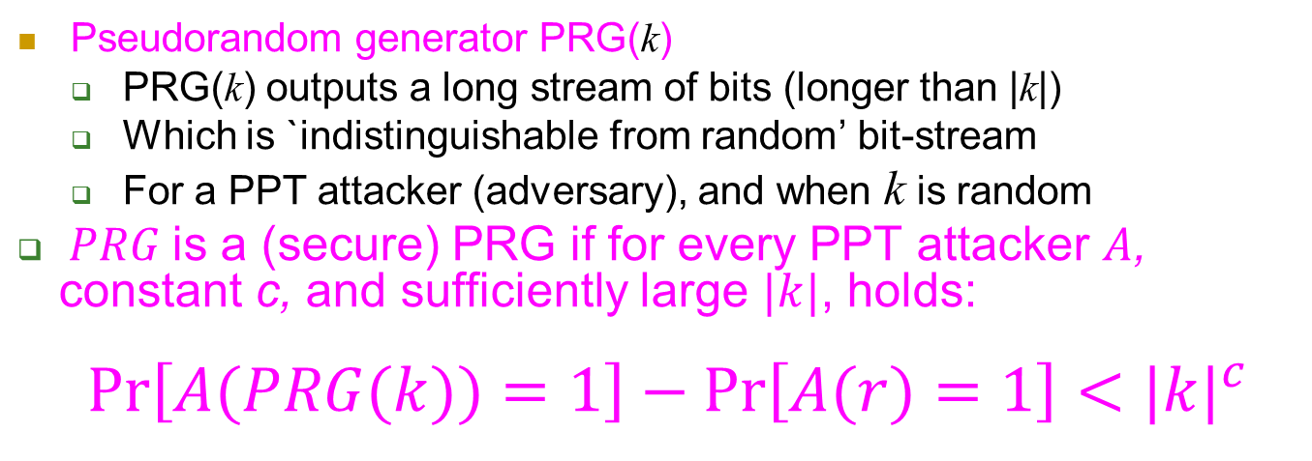
Recall: PRG Stream Cipher (1)
Pseudorandom generator PRG(k)
PRG(k) outputs a long stream of bits (longer than |k|)
Which is `indistinguishable from random’ bit-stream
For a PPT attacker (adversary), and when k is random
$PRG$is a (secure) PRG if for every PPT attacker $A$, constant c, and sufficiently large $|k|$, holds: $\operatorname{Pr}\left[A(PRG(k))=1\right]−\operatorname{Pr}\left[A(r)=1\right]<{|k|}^{c}$
Key/seed k
PRG
0 | 1 | 1 | 1 | 0 | 0 | 0 | 1 | 0
Plaintext m
+
Ciphertext c
1 | 0 | 0 | 0 | 1 | 0 | 0 | 1 | 1
 |  |  |  | 1 | 0 | 0 | 0 | 1

Slide 56
Recall: PRG Stream Cipher (2)
Let:
p(i) be i-th bit of plaintext
c(i) be i-th bit of ciphertext
PRG_{k}(i) be the i-th output bit of the PRG (with input seed/key k)
PRG stream cipher : c(i)=p(i) ⊕ PRG (i)
Problem: requires keeping synchronized state
Counter i
Table of (future) bits: PRG(i)
Can we reduce or eliminate this synchronized state?
Key/seed k
PRG
0 | 1 | 1 | 1 | 0 | 0 | 0 | 1 | 0
Plaintext m
+
Ciphertext c
1 | 0 | 0 | 0 | 1 | 0 | 0 | 1 | 1
 |  |  |  | 1 | 0 | 0 | 0 | 1

Slide 57
A Stateless Stream Cipher?
PRG-based stream ciphers are stateful : remember how many bits (or bytes) were already output, and bit values PRG(i)
Can we avoid or minimize this long-term state?
The answer is…
Yes we can!
In three steps:
Use less state
No state Both: random function
No state, and pseudo-random function
Key k
PRG
0 | 1 | 1 | 1 | 0 | 0 | 0 | 1 | 0
Plaintext m
+
Ciphertext c
1 | 0 | 0 | 0 | 1 | 0 | 0 | 1 | 1
 |  |  |  | 1 | 0 | 0 | 0 | 1

Slide 58


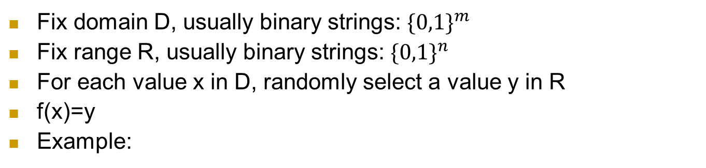
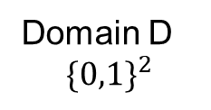
What’s a (‘truly’) random function f?
Fix domain D, usually binary strings: ${\{0,1\}}^{m}$
Fix range R, usually binary strings: ${\{0,1\}}^{n}$
For each value x in D, randomly select a value y in R
f(x)=y
Example:
 | f( )
00
01
10
11
Range R ${\{0,1\}}^{5}$
Domain D
$${\{0,1\}}^{2}$$

Slide 59
What’s a (‘truly’) random function?
Fix domain D, usually binary strings: ${\{0,1\}}^{m}$
Fix range R, usually binary strings: ${\{0,1\}}^{n}$
For each value x in D, randomly select a value y in R
f(x)=y
Example:
 | f( )
00 | 01101
01 | 11010
10 | 01101
11 | 11101
Range R ${\{0,1\}}^{5}$
Domain D
$${\{0,1\}}^{2}$$

Slide 60
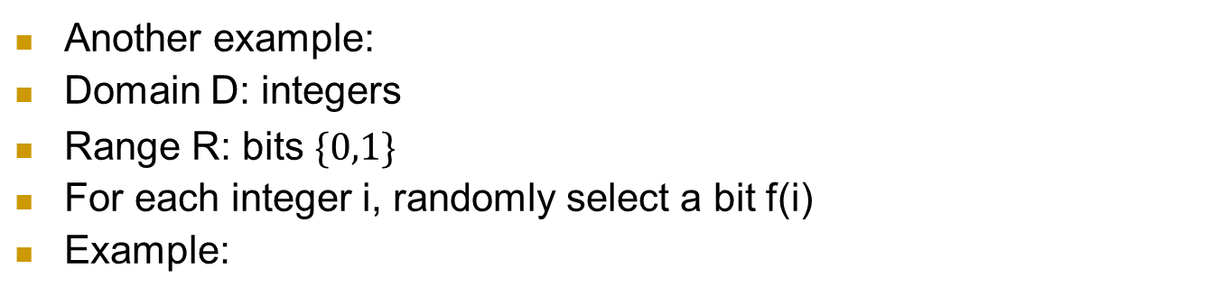

What’s a (‘truly’) random function?
Another example:
Domain D: integers
Range R: bits ${\{0,1\}}^{}$
For each integer i, randomly select a bit f(i)
Example:
i | f(i)
1
2
3
4
5
6
… | …
Range: bits ${\{0,1\}}^{}$
Domain:
integers

Slide 61
What’s a (‘truly’) random function?
Another example:
Domain D: integers
Range R: bits ${\{0,1\}}^{}$
For each integer i, randomly select a bit f(i)
Example:
i | f(i)
1 | 0
2 | 0
3 | 1
4 | 1
5 | 1
6 | 0
… | …
Range: bits ${\{0,1\}}^{}$
Domain:
integers

Slide 62
Exercise: Random Function Stateful Stream Cipher
Let:
p(i) be i-th bit of plaintext
c(i) be i-th bit of ciphertext
f be random function from integers to bits; f(i) is the output bit for input integer i
Exercise: design a stream cipher using f...
Which requires only to maintain synchronized state i (number of bit)
Present as formula and as diagram, write your name
0 | 1 | 1 | 1 | 0 | 0 | 0 | 1 | 0
Plaintext m
+
Ciphertext c
1 | 0 | 0 | 0 | 1 | 0 | 0 | 1 | 1
 |  |  |  | 1 | 0 | 0 | 0 | 1

Slide 63
Exercise: Random Function Stateful Stream Cipher
Let:
p(i) be i-th bit of plaintext
c(i) be i-th bit of ciphertext
f be random function from integers to bits; f(i) is the output bit for input integer i
Exercise: design a stream cipher using f...
Which requires only to maintain synchronized state i (number of bit)
c(i)= p(i) ⊕ f (i)
Next: can we entirely avoid sync state??
Bit number i
f(i)
0 | 1 | 1 | 1 | 0 | 0 | 0 | 1 | 0
Plaintext m
+
Ciphertext c
1 | 0 | 0 | 0 | 1 | 0 | 0 | 1 | 1
 |  |  |  | 1 | 0 | 0 | 0 | 1

Slide 64
Random Function Stateless Stream Cipher
Choose some large number n
Let:
p(i) be i-th bit of plaintext
c(i) be i-th bit of ciphertext
f be random function from n-bits string x to bits; f(x) is the output bit
For each bit (say number i):
Select random n-bit string x_{i}
Let c(i)=( p(i)+f(x_{i}) , x_{i} ) [yes, send x_{i} `in the clear’ !!]
Next: optimization??

Slide 65
Random Function Stateless Stream Cipher
Idea: operate in blocks (say of n bits)
Choose some large number n
Let:
f be random function from n-bits `block’ x to n-bits `block’
p(i) be i-th block of n-bits of plaintext
c(i) be i-th block of n-bits of ciphertext
For each block (say number i):
Select random n-bit string x_{i}
Let c(i)=( p(i)+f(x_{i}) , x_{i} ) [yes, send x_{i} `in the clear’ !!]
Same overhead per block, i.e., only 1 bit overhead per bit !!
Challenge: sharing such random function !!
Size of table? 2^n entries of n bits each…
Next: use pseudo-random function instead !

Slide 66
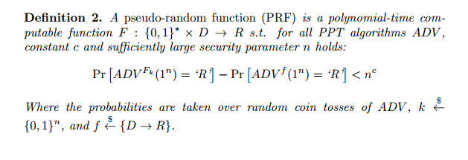
Avoiding State: Pseudo-Random Function
Idea: use Pseudo-Random Function (PRF) instead of random
Feasible: efficient to compute functions
What’s a Pseudo-Random Function (PRF)?
f← PRF_{k}(.) [for random k]
or f← random function
x
f(x)

Slide 67
Constructing a PRF
[GGM84] showed how to construct PRF from PRG
But the construction uses many PRG calls for each PRF computation
➔ Not deployed in practice
Instead, efficient constructions of PRFs from:
A block cipher [later]
Construction is trivial: a block cipher is a PRF !
Crypto hash functions [even later]
Applications of PRF

Slide 68
PRF Applications (1)
Given a PRF, construct a PRG: exercise
Given a PRF, construct a `stateless’ stream cipher:
Solution 1: use instead of random function as shown before
But: must send random input for each `block’ – x2 overhead…
Can we do better? [yes – solutions 2 and 3…]
Solution 2: use PRF to seed a PRG
Select random init-value IV, let s←PRF_{k}(IV)
Use s as seed of PRG, i.e., use PRG(s)
Solution 3: Do it all with PRF (i.e., implement PRG too)
Select random `initial pad block` p₀
Often referred to as Initialization Vector IV
Becomes part of ciphertext – required for decryption
Use to generate pseudo-random pad: p₁ , p₂ , …
p_{i}=PRF_{k}(p_{i-1})
Ciphertext is bitwise XOR of plaintext with pad: c_{i}=m_{i}+p_{i}

Slide 69
‘Stateless stream cipher’ using PRF
p₀
p₁=F_{k}(p₀)
PRF F_{k}
Key k
PRF F_{k}
Key k
`pad` p_{i}=F_{k}(p_{i-1})
0 | 1 | 1 | 1 | 0 | 0 | 0 | 1 | 0
m₂
0 | 0 | 1 | 0 | 0 | 0 | 1 | 1 | 0
m₁
1 | 0 | 0 | 0 | 1 | 0 | 0 | 1 | 1
+
1 | 1 | 0 | 1 | 1 | 0 | 0 | 0 | 1
+
c_{i} =m_{I}⊕F_{k}(p_{i})
c₁
c₂
1 | 1 | 1 | 1 | 1 | 0 | 0 | 0 | 1
1 | 1 | 1 | 1 | 1 | 0 | 0 | 0 | 1
Plaintext: m=m₁||m₂||…
Ciphertext : (p₀ , [c₁ || c₂ ||…] )
p₀ can be random (stateless) or counter
This is called Output Feedback Mode when using a block cipher (later)

Slide 70
PRF Applications (2)
PRFs have many applications: encryption, authentication, key management…
E.g.: given PRF, construct encryption scheme (soon)
Example: derive independent key for each day d
Easy, with PRF and single shared key k
Key for day d is k_{d}=F_{k}(d)
Exposure of keys of Monday and Wednesday does not expose key for Tuesday
Similarly: separate keys for different goals, e.g., encryption and authentication
How?
d
Key k
PRF F_{k}
F_{k}(d)

Slide 71
We defined security for PRG and PRF. But… what about security of encryption??
A bit tricky, in fact.

Slide 72
Exercise: define secure encryption
Alice’s
encryption
key
Bob’s
decryption
key
K
K
K
B
plaintext
encryption
algorithm
ciphertext
decryption
algorithm
plaintext
Define a secure symmetric cryptosystem
Refer to (1) Attacker model and (2) success criteria
Be as precise as possible, take five minutes
Write down; one good proposal gets late submission day!

Slide 73
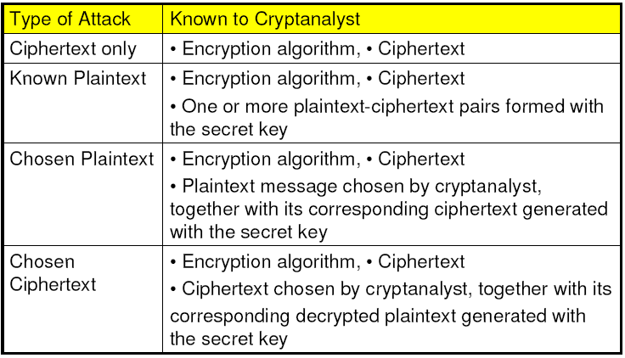
Attacker Capabilities / Model
C
(KPA)
(CPA)
(CCA)
And… Probabilistic Polynomial Time (PPT) !
Notes:
note def of attacker model and precise security defs in general is crucial for any security system , not just crypto!

Slide 74
Cryptanalysis Success Criteria
Key recovery ? -- meaningless
(Full) Message recovery? – may be an overkill. E.g., when m∈{“Advance”, “Retreat”}
Can’t learn anything at all about plaintext – how to define? Can we achieve it ?
Well-defined notion: ‘semantic security’ [crypto course]
Indistinguishability: Eve ‘wins’ if she distinguishes between encryptions of two messages
We focus on indistinguishability:
In crypto course: equivalent to semantic security

Slide 75
Indistinguishability: Encryption is like disguise…
With a good disguise, adversary…
Can’t even tell the most pretty from the most ugly
Can’t even identify the same disguised person
Talk to masked Rachel
She disappears for few minutes
Who returned? Rachel or Leah?
As long as they are roughly same size
A giant can never disguise as a dwarf
With good encryption, adversary can’t find m_{0,} m₁ s.t. |m₀|=|m₁|, yet she can identify E(m₀) vs. E(m₁)
➔ Encryption must be randomized – or stateful
Notes:
75
10/30/11

Slide 76
Defining Secure Encryption
Attacker capabilities:
Computational limitations? ➔ PPT
Data: ciphertext only (CTO)? Known/chosen plaintext (KPA/CPA)? Chosen ciphertext (CCA)?
What’s a successful attack?
Indistinguishability: Eve ‘wins’ if she distinguishes between encryptions of two messages
Stateful or stateless?

Slide 77
Conservative Design Principle
When designing, evaluating a scheme…
Consider most powerful attacker (CTO< KPA< CPA)
Be as general as possible – cover many applications
‘Easy’ success criteria
Indistinguishability, not message/key recovery
Make it easy to use it securely, hard to be wrong!
When designing, evaluating a system
Which use some crypto scheme(s)…
Restrict attacker’s capabilities (e.g., avoid known/chosen plaintext)

Slide 78
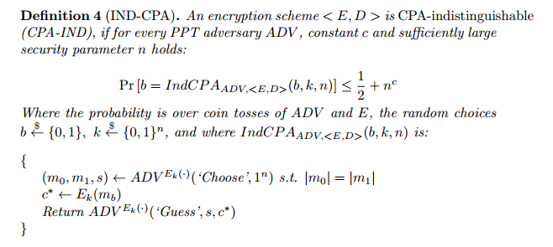
Note: this def uses randomization, and only CPA; for non-CPA and stateful, deterministic definitions, see crypto course.

Slide 79
What’s next? Present a secure cryptosystem? … how can we know it’s secure? Proof of security ➔ P ≠ NP

Slide 80

Crypto Building-Blocks Principle
Design and focus cryptanalysis efforts on few basic functions: simple, easy to test, replaceable
Construct schemes from basic functions
Provably secure constructions: attack on scheme ➔ attack on function
Allows replacing broken/suspect functions
Allows upgrading to more secure/efficient function
E.g., build encryption from PRG/PRF
PRG/PRF: deterministic, stateless, FIL (Fixed-Input-Length), single function
Encryption: randomized/stateful, VIL (Variable-Input-Length), few functions
Notes:
Another advantage is that robust combiner for function usually gives robust combiner for scheme (and usually, it is simpler than direct combiner for scheme)

Slide 81
Why standardize block ciphers, not encryption?
Crypto building blocks principle, rephrased: design, cryptanalyze simple function F, use F to construct more complex scheme S
Reduction: attack on S ➔ attack on F
Design (FIL, deterministic, stateless) block cipher/PRF, construct (VIL, randomized/stateful) cryptosystem
Given two PRFs F, F’, let F’’_{k,k’}(x)=F_{k}(x)⊕F_{k’}(x)
If either F or F’ is a secure PRF ➔ F’’ is secure PRF
This is a robust combiner for PRFs
Different `modes` have different properties…

Slide 82

Block Ciphers and PRPs
Block Cipher: a basic crypto building block
E_{k} , D_{k} : m=D_{k} (E_{k} (m))
Data Encryption Standard (DES): US NIST, 1977-2001, 64-bit blocks, 56 bit keys ➔ exhaustive search
Advanced Encryption Standard (AES): NIST 2002-?, 128-bit blocks, 128 bit keys
Cf.: (invertible) Pseudo-Random Permutation (PRP)
64 bit block
128 bit block
DES
128/192/256 bit key
AES
DES
1977-
2001
56b key
64 bit block
128 bit block

Slide 83
PRP: (Invertible) Pseudo-Random Permutation
Aka Block Cipher
Pseudo-Random Permutation (PRP): similar to PRF, but limited to permutations – and invertible
A pair of (keyed) functions, s.t.: m=D_{k}(E_{k}(m))
Often referred to as ‘block cipher’
Note: deterministic → not secure encryption !
But used to construct encryption, see next
f← E_{k}(.) or D_{k}(.) [for random k]
or f← random permutation or its inverse
x
f(x)
Can’t tell if f is a random permutation or just E / D with a random key!

Slide 84
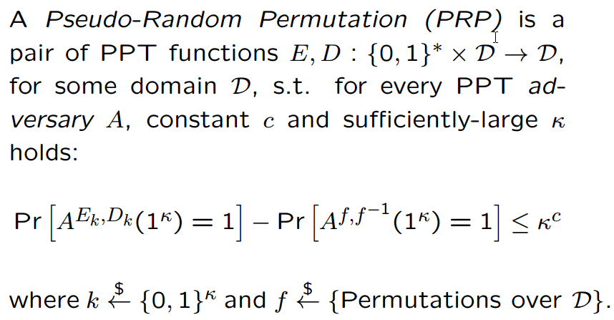
Block Cipher / Pseudo-Random Permutation
Often referred to as ‘strong PRP’ (since D queries are allowed, too)

Slide 85
The Feistel Block-cipher Construction
Idea: use randomness in data!
Used in Data Encryption Standard (DES)
Reversible!
With >2 rounds: PRF → PRP
Used in DES (but not in AES)
Why? Try to directly design a reversible PRP!
F_{k}()
X
F_{k}()
X
F_{k}()
X

Slide 86
PRP→Encryption: Modes of Operation
`Modes of operation’ define how to use block ciphers, to...
Encrypt long (Variable Input Length, VIL) messages
Randomize/add state for security
Often: use random/stateful Initialization Vector (IV)
Use longer or shorter keys
Longer key (e.g., Triple-DES): better security (at least against exhaustive search)
Shorter key: intentionally-weakened version, e.g. to meet export regulations
Other tasks (e.g., message authentication)

Slide 87
‘Classical’ Modes of Operation
For encryption
Later: modes for message authentication
Assume plaintext is m₀||m₁||…
Electronic Code Book mode (ECB): encryption c_{i}=E_{k}(m_{i}), decryption m_{i}=D_{k}(c_{i})
Per-Block Random (PBR): r_{i}←$, c_{i} = (r_{i} , m_{i}⊕ E_{k}(r_{i}))
Output Feedback (OFB) mode:
Encryption: p₀←$, p_{i} = E_{k}(p_{i-1} ), c₀=p_{0,} c_{i}= p_{i}⊕ m_{i}
Cipher Feedback (CFB): c₀←$, c_{i} = m_{i}⊕ E_{k}(c_{i-1} ), m_{i} = c_{i}⊕ E_{k}(c_{i-1} )
Cipher-block-chaining (CBC): c₀←$, c_{i} =E_{k}(m_{i}⊕ c_{i-1} ), m_{i} =D_{k}(c_{i} )⊕ c_{i-1}

Slide 88



ECB Insecurity Example (Wikipedia)
Electronic Code Book mode (ECB): c=E_{k}(m), m=D_{k}(c)
`Encrypt` E_{k}
`Decrypt` D_{k}
m
c
Which of these is ECB encryption? Why?

Slide 89
Per-Block Random (PBR) mode
A simple way to construct secure encryption from PRP/PRF
Not a standard mode – presented just for teaching
Enc_{k}(m;r)=(r , m_{i}⊕ E_{k}(r))
Enc_{k}(m;r) notation means r is random coin tosses
Dec_{k}((r , c) )=E_{k}(r)⊕ c
Wasteful: random block per plaintext block
Confidentiality ? Yes!
Theorem: If (E, D) is a PRP, then (Enc, Dec) is a CPA-indistinguishable symmetric encryption.
Integrity? No: flip ciphertext bit ➔ flip corresponding plaintext bit

Slide 90

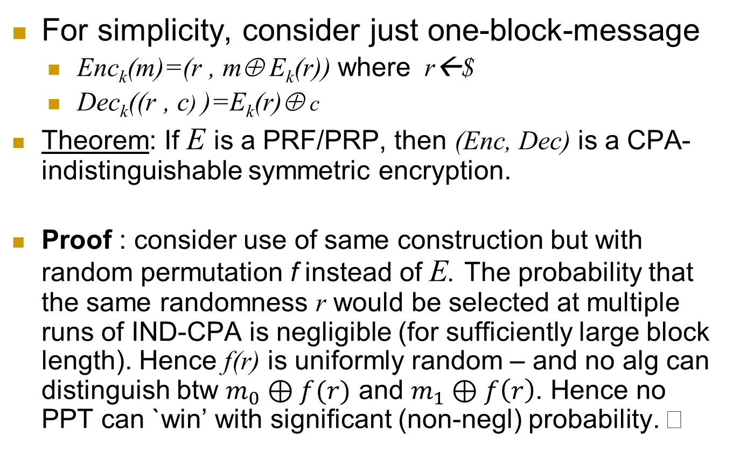
Per-block random mode is IND-CPA
For simplicity, consider just one-block-message
Enc_{k}(m)=(r , m⊕ E_{k}(r)) where r←$
Dec_{k}((r , c) )=E_{k}(r)⊕ c
Theorem: If E is a PRF/PRP, then (Enc, Dec) is a CPA-indistinguishable symmetric encryption.
Proof : consider use of same construction but with random permutation f instead of E. The probability that the same randomness r would be selected at multiple runs of IND-CPA is negligible (for sufficiently large block length). Hence f(r) is uniformly random – and no alg can distinguish btw $m_{0}⊕f(r)$ and $m_{1}⊕f\left(r\right)$. Hence no PPT can `win’ with significant (non-negl) probability.

Slide 91
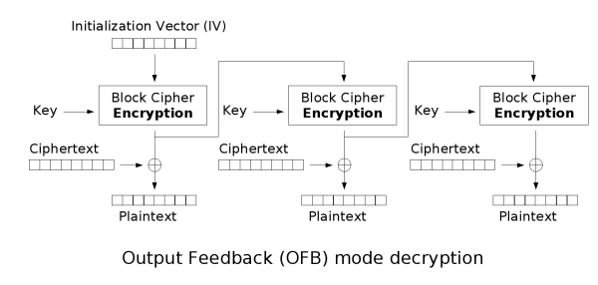
Output-Feedback (OFB) Mode
Goal: encrypt long (multi-block) messages, with less random bits
Generate and send less random bits
How? Use random bits only for first block (`initialization vector’)
To encrypt next blocks of message, use output of previous block
Namely, a block-by-block stream cipher
Encryption: p₀←$, p_{i} = E_{k}(p_{i-1} ), c₀=p_{0,} c_{i}= p_{i}⊕ m_{i}
Decryption: p₀=c_{0,} p_{i} = E_{k}(p_{i-1} ), m_{i} = p_{i}⊕ c_{i}

Slide 92
Output-Feedback (OFB) Mode
Goal: encrypt long (multi-block) messages, with less random bits
Generate and send less random bits
How? Use random bits only for first block (`initialization vector’)
Use this to generate a long sequence of pseudo-random blocks (bits)
Then do bitwise XOR with the corresponding plaintext blocks (bits)
Namely, a block-by-block stream cipher
Encryption: p₀←$, p_{i} = E_{k}(p_{i-1} ), c₀=p_{0,} c_{i}= p_{i}⊕ m_{i}
Decryption: p₀=c_{0,} p_{i} = E_{k}(p_{i-1} ), m_{i} = p_{i}⊕ c_{i}
Offline pad pre-computation: compute pad in advance
Real time: only XOR !
Bit errors are localized (corrupt only one bit)
No integrity: Flip ciphertext bit ➔ flip corresponding decrypted plaintext bit
Can we protect integrity?

Slide 93
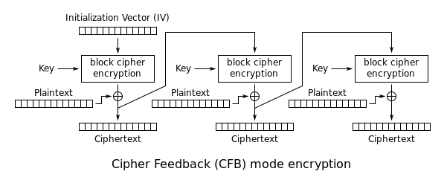
Cipher-Feedback Block (CFB) Encryption
Again use random first block (`initialization vector’, IV)
Use IV to generate first pseudo-random pad p₁ =E_{k}(IV)
XOR with plaintext to obtain c₁ = m₁⊕ E_{k}(IV)
Repeat… with c_{i} = m_{i}⊕ E_{k}(c_{i-1})

Slide 94
Cipher-Feedback Block (CFB) Encryption
Again use random first block (`initialization vector’, IV)
Use the IV to generate first pseudo-random pad p₁ =E_{k}(IV)
XOR with plaintext to obtain c₁ = m₁⊕ E_{k}(IV)
Repeat… with c_{i} = m_{i}⊕ E_{k}(c_{i-1})
Ciphertext: IV, c₁ = m₁⊕ E_{k}(IV), … , c_{i} = m_{i}⊕ E_{k}(c_{i-1})
Decryption: m_{i} = c_{i}⊕ E_{k}(c_{i-1} )
Parallelizable
Bit/block errors are localized (corrupt only 2 blocks)
Integrity?
I.e., can attacker cause change in decrypted plaintext?
Flip ciphertext bit ➔ flip corresponding decrypted plaintext bit
But also corrupt next plaintext block
Except for last block: no `next block’
Can we protect integrity (even) better?

Slide 95
Cipher Block Chaining (CBC) Mode
Popular mode for VIL (Variable Input Length) encryption
Operation:
c[0] =IV∈_{R}{0,1}^{l}
i>0: c[i] = E_{k}(c[i-1] ⊕ m[i])
Parallel decryption
But no offline precomputing
Integrity: flip bit in c[i] ➔ flip bit in m[i+1] … But also corrupt m[i]
May suffice to ensure integrity for many applications
But not all!
Split plaintext m to l bit blocks m[1],…
m[1] | m[2] | … | m[n]
IV
E
E
E
k
c[0] | c[1] | … | c[n]
Ciphertext c[0],c[1]…
Notes:
95
10/30/11

Slide 96
Security of CBC mode
Thm: If block-cipher E is a (strong) pseudo-random permutation ➔CBC#E is IND-CPA-secure encryption
Proof: omitted (crypto course ☺ )
Not secure against Chosen-Ciphertext Attack (CCA)
Intuitively: attacker can choose ciphertext and get its decryption, except for the `challenge ciphertext’
Definition, details: beyond scope of this course
We briefly describe Feedback-CCA: practical variant

Slide 97
Security of CBC mode (2)
Thm: If block-cipher E is a (strong) pseudo-random permutation ➔CBC#E is IND-CPA-secure encryption
Proof: omitted (crypto course ☺ )
Observation: CBC is Not IND-CCA-Secure
CCA (Chosen ciphertext attack), intuitively: attacker can choose ciphertext and get its decryption, except for the `challenge ciphertext’
Definition, details: crypto course
Exercise: show observation is true
i.e., show that CBC is Not IND-CCA-Secure
Feedback-CCA: very practical attack model !
Just returns <ERROR, OK> for any ciphertext
Error – for incorrectly padded decryption (next)

Slide 98
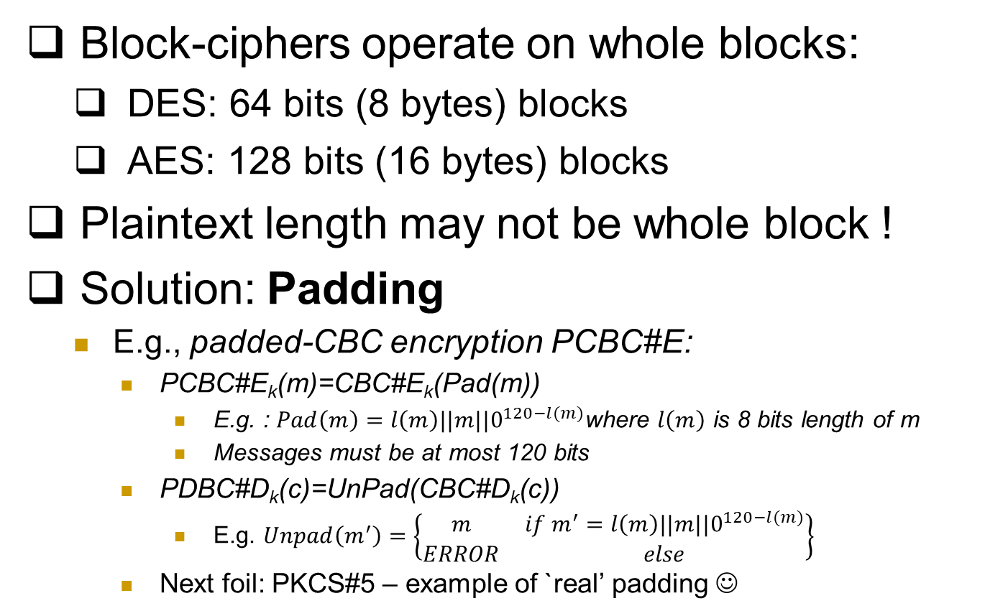
Note: Padding Encryption
Block-ciphers operate on whole blocks:
DES: 64 bits (8 bytes) blocks
AES: 128 bits (16 bytes) blocks
Plaintext length may not be whole block !
Solution: Padding
E.g., padded-CBC encryption PCBC#E:
PCBC#E_{k}(m)=CBC#E_{k}(Pad(m))
E.g. : $Pad\left(m\right)=l\left(m\right)||m||0^{120−l(m)}$where $l\left(m\right)$ is 8 bits length of m
Messages must be at most 120 bits
PDBC#D_{k}(c)=UnPad(CBC#D_{k}(c))
E.g. $Unpad\left(m^{′}\right)=\left\{\begin{matrix}m & if m^{′}=l\left(m\right)||m||0^{120−l(m)} \\ ERROR & else\end{matrix}\right\}$
Next foil: PKCS#5 – example of `real’ padding ☺

Slide 99
PKCS#5* padding (e.g.: 8 byte block)
If |m| mod 8 = 7 (one byte short of block): Pad(m)=m || ’1’
If |m| mod 8 = 6: Pad(m)=m || ’22’
….
If |m| mod 8 = 1: Pad(m)=m || ’7777777’
If |m| mod 8 = 0 (string end on complete block): Pad(m)=m || ’8…8’
Unpad(m): {
If |m| mod 8 = 0 then
{if m[1]=’1’ then return UnPad(m)=m[|m|…2]
if m[1..2]=‘22’ then return UnPad(m)=m[|m|…3]
…}
Unpad(m)=ERROR }
Examples: 1. pad(‘abcde’)=‘abcde22’, pad(‘stranger’)=‘stranger88888888’
2. unpad(‘5/5/2021’)=‘5/5/202’; unpad(‘UnPad `test’ and ‘bug 2001’
3. Show how padding facilitates exhaustive search
Notes:
* I think I’ve simplified a bit, if I’m not wrong, PKCS actually concatenates the corresponding binary strings (01x, etc.), but this is simpler and attack is essentially the same

Slide 100
Feedback-CCA attack on PKCS#5...
c=F_{k}(p): 8-byte ciphertext to-be-decrypted
To find least-significant byte p[1]:
Select seven random bytes c’[8]… c’[2]
Find c’[1] s.t. PCBC#D_{k}(c’||c) is OK (not ERROR)
Most likely: c’[1] ⊕ p[1] =‘1’ [Why?]
Confirm: repeat with different c’[8]… c’[2]
Exercise:
1. Why most likely c’[1] ⊕ p[1] =‘1’ ?
2. If so, p[1] = __________
3. How to find also p[2] (and other bytes) ???

Slide 101
Ensuring CCA Security
Give no feedback on failure? Harder to resolve problems ☹
Possible with minor changes to PKCS#5 unpad, e.g.:
Check only last byte (other added bytes randomized)
If last byte is not valid (‘1’ to ‘8’): return entire message (no pad)
Decryption never returns ERROR ➔ foils padding attack!
Better: `Prevent` decryption queries!
How?
Use secret key (also) to `sign/authenticate` ciphertext…
And decrypt only properly authenticated ciphertext
Output `failure` if given unauthenticated ciphertext
How to authenticate? We’ll see in next lecture…
Instead we see how not to authenticate - and encrypt…
Another real-life example… WEP

Slide 102
Use Case: WEP (In)Security
WEP: Wired Equivalent Privacy
Known insecure (2001!), still widely used
Between mobile and access point
Often same key is shared to all mobiles
Confidentiality: RC4 encryption (PRG)
Seed: 24-bit per-packet `IV' and 40/104 bit key
WEP_k(m)=[IV,RC4(IV||k)+(m||crc(m)]
Integrity and authenticity: CRC [next]
And optional (init) authentication exchange

Slide 103
WEP Integrity
Integrity: 32-bit CRC
Linear: CRC(m+m')=CRC(m)+CRC(m')
+ is XOR
WEP(m)=RC4+[m||CRC(m)]
Insecure: WEP(m')=RC4+[m'||CRC(m')] =WEP(m)+[m‘+m||CRC(m‘+m)]

Slide 104
WEP Authentication… & Encryption
`Authentication`:
Shared-Key Authentication:
Access point sends random R
Mobile sends WEP(R;IV)
Open-System Authentication [=no authentication]
A known-plaintext oracle
Deadly for 40-bit cipher ☹
Known R ➔ known RC4(k,IV)
~ 2^24 req’ ➔ known RC4(k,IV) for most IVs
Attacker can decrypt most messages!

Slide 105
WEP Encryption
24-bit IV-reuse: WEP_k(m)=[IV,RC4(IV,k)+(m||crc(m)]
Shared-key authentication gives R,WEP(R)
Easy decryption on IV reuse!
Hence: use open-system (i.e., no) authentication
Even w/o auth: same-pad `encryption’ for messages using same IV...
Exploit insecure integrity
Change dest IP to attacker → get plaintext!
Exploit WEP use of `plain' RC4 (not RC4-drop)

Slide 106
Encryption: Final Words
Basic goal of cryptography
Focus: computationally-limited adversaries
Principles:
Kerckhoff’s: Known Design
Sufficient Key Space
Crypto Building Block: build schemes from simple, standard functions
Constructions & reductions: PRG→PRF→PRP→Enc
Secure system design: easy to use securely, hard to use incorrectly!

Slide 107
Encryption: Final Words...
Many variants…
One important example is Homomorphic encryption: E(m₁+m₂)=EncAdd(E(m₁),E(m₂))
Where EncAdd is an efficient algorithm
Fully-homomorphic : also E(m1*m2)=EncMult(E(m1), E(m2))
Very inefficient designs, huge keys… but lots of research!

Slide 108
Thank You!
Amir Herzberg

Slide 109
Common mistakes -
See eg An Empirical Study of Cryptographic Misuse in Android Applications (CCS’13)

Slide 110
Deployment Issues
– PK-crypto is slow; how to encrypt long msgs?
– Encryption and compression ?
– Dealing with errors (and corruptions)
-- Versions: downgrade attacks

Slide 111
Hybrid Encryption (`enveloping`)
Public key cryptosystems (PKG,PKE,PKD) are slow
Also: most (e.g. RSA) have fixed block size (FIL)
Using a long block size is veeeery slooow
Using CBC etc. is also too wasteful
Use VIL secret key cryptosystem (SKG,SKE,SKD) (e.g. CBC,OTP); encrypt shared key and use it to encrypt plaintext
e
Encryption
Decryption
k ←SKG(1^{k})
ck
ck← PKE_{e}(k)
k← PKD_{d}(ck)
Plaintext p
c
c←SKE_{k}(p)
SKD_{k}(c)
Notes:
111
10/30/11

Slide 112
Encryption: at what phase?
Related goals:
Compression
Error-detection code
Integrity, authentication
Can’t compress ciphertext
Redundancy in plaintext may help attacker
➔ Compress then Encrypt
Message
Compress
Plaintext
Encrypt
Ciphertext
But: compress-then-encrypt is not IND-CPA-Secure! Why?? Challenge: define, solve…

Slide 113
Exploiting Length-Exposure
Side-channel attacks on TLS sites
CRIME and TIME attacks
Web 2.0: auto-suggest/complete, preload…
Script sends keystrokes, server responds
Size of response may reveal keystrokes, choices
See: Chen et al, `Side channel Leaks in Web Applications’, S&P 2010 (and follow-ups)

Slide 114
Encryption: at what phase?
Plaintext redundancy
☺ Authenticates ?
☹ May help attacker
E.g.: turn KPA into COA ! [GSM]
So: compressing plaintext is good!
Can’t compress ciphertext
➔ Compress then Encrypt
Message
Compress
Plaintext
Encrypt
Ciphertext
Compress-then-encrypt is not IND-CPA-Secure! Why?? Challenge: define, solve…

Slide 115
Error Detection / Correction
EDC/ECC on plaintext?
Motivation: detect fake ciphertext (integrity)
But may help attacker
Adds (much) redundancy to plaintext
Validate key guess
Turn KPA into COA [GSM]
And: error in ciphertext invalidates EDC/ECC !
➔ Better: Encrypt before Error Detection
Message
Compress
Plaintext
Code
Plaintext
EDC
Encrypt
Ciphertext

Slide 116
Encryption and Error Detection (2)
Does Encrypt-then-Add-EDC protect integrity?
No…
Example: WEP (next)
Integrity / authenticity: next topic
Message
Compress
Plaintext
Encrypt
Ciphertext
Code
Ciphertext
EDC

Slide 117
CTR mode

