Slide 1
Encryption, Decryption, Correctness
Key k
Plaintext
m
Encrypt E
Ciphertext c=E_{k}(m)
Key k
Ciphertext c
Decrypt D
Plaintext m=D_{k}(c)
Key k
Key k
Plaintext
m
Encrypt E
Ciphertext c=E_{k}(m)
Decrypt D
Plaintext m=D_{k}(E_{k}(m))

Slide 2
What are Public Key Signatures?
Key length l,
Random tap
KeyGen KG
Private signing key s
(s,v)
Public verification
key v
s
v
Message
m
Sign S
m, σ=S_{s}(m)
Verify V
m if V_{v}(m, σ)=OK
Error otherwise
Assuming limitations:
Knowledge limitations: key s is secret (unknown to attacker)
Resource limitations: can’t find key s by trying all keys
Then attacker cannot forge signature
I.e., find `signature’ σ for unsigned-message m s.t. V_{v}(m, σ)=OK

Slide 3
Kerckhoffs’ Known Design Principle [1883]
Assume adversary knows the design – everything except the secret keys
No `security by obscurity’
Although attacking obscure design is harder
Why assume/use public design ?
No need to replace system once design is exposed
Usually stronger
Establish standards for multiple applications:
Efficiency of production and of test attacks / cryptanalysis
Secrecy is based only on secrecy of key
a
Notes:
3
10/30/11

Slide 4
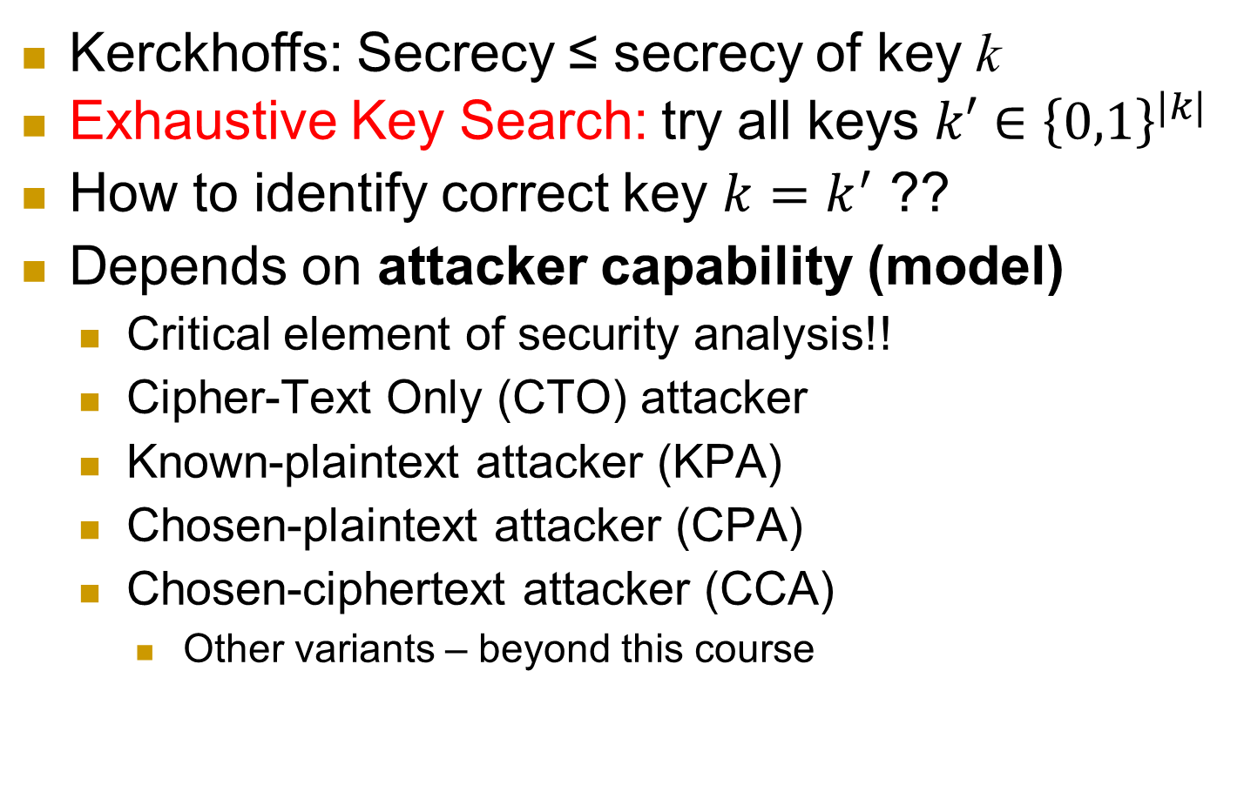
Exhaustive Key Search
Kerckhoffs: Secrecy ≤ secrecy of key k
Exhaustive Key Search: try all keys $k′∈{\left\{0,1\right\}}^{|k|}$
How to identify correct key $k=k^{′}$ ??
Depends on attacker capability (model)
Critical element of security analysis!!
Cipher-Text Only (CTO) attacker
Known-plaintext attacker (KPA)
Chosen-plaintext attacker (CPA)
Chosen-ciphertext attacker (CCA)
Other variants – beyond this course
Notes:
4
10/30/11

Slide 5



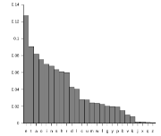
Encryption attacker models
Cipher-Text Only (CTO) attacker
Adversary learns something about random plaintext
Given only ciphertext – and plaintext distribution
Known-plaintext attacker (KPA)
Chosen-plaintext attacker (CPA)
Chosen-ciphertext attacker (CCA)
E_{k}
D_{k}
m*
c₁=E_{k}(m₁), c₂=E_{k}(m₂), … , c*=E_{k}(m*)
m1, m2,…
m_{1,} m_{2,}…
m*
Info about m* (beyond distribution)
a
Notes:
5
10/30/11

Slide 6
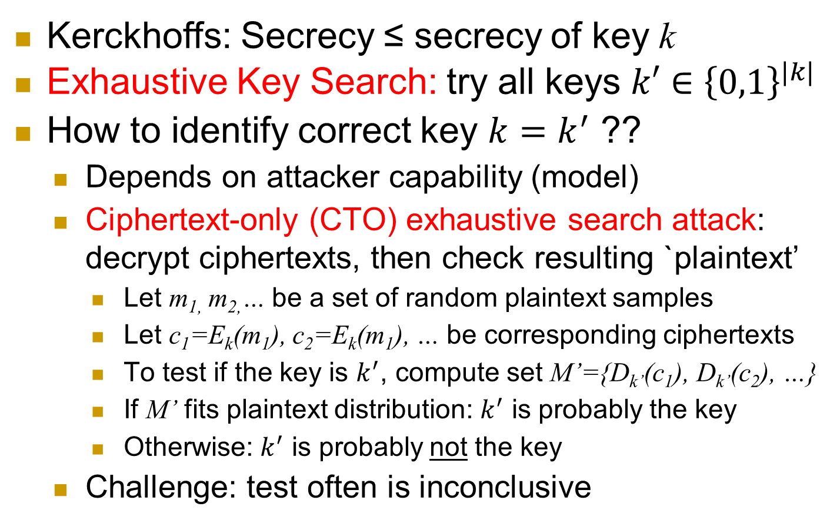
Exhaustive Key Search
Kerckhoffs: Secrecy ≤ secrecy of key k
Exhaustive Key Search: try all keys $k′∈{\left\{0,1\right\}}^{|k|}$
How to identify correct key $k=k^{′}$ ??
Depends on attacker capability (model)
Ciphertext-only (CTO) exhaustive search attack: decrypt ciphertexts, then check resulting `plaintext’
Let m_{1,} m_{2,}… be a set of random plaintext samples
Let c₁=E_{k}(m₁), c₂=E_{k}(m₁), … be corresponding ciphertexts
To test if the key is $k^{′}$, compute set M’={D_{k’}(c₁), D_{k’}(c₂), …}
If M’ fits plaintext distribution: $k^{′}$ is probably the key
Otherwise: $k^{′}$ is probably not the key
Challenge: test often is inconclusive
Notes:
6
10/30/11

Slide 7
Encryption attacker models
Cipher-Text Only (CTO) attacker
Known-plaintext attacker (KPA)
Sample messages M={m₁, m₂,…}
Give M and ciphertexts c₁=E(m₁), c₂, … to attacker
Chosen-plaintext attacker (CPA)
Chosen-ciphertext attacker (CCA)
E
D
m_{1,} m_{2,}…
c₁=E(m₁), c₂=E(m₂), … , c*=E(m*)
m*
Info about m* (beyond distribution)
a
Notes:
7
10/30/11

Slide 8
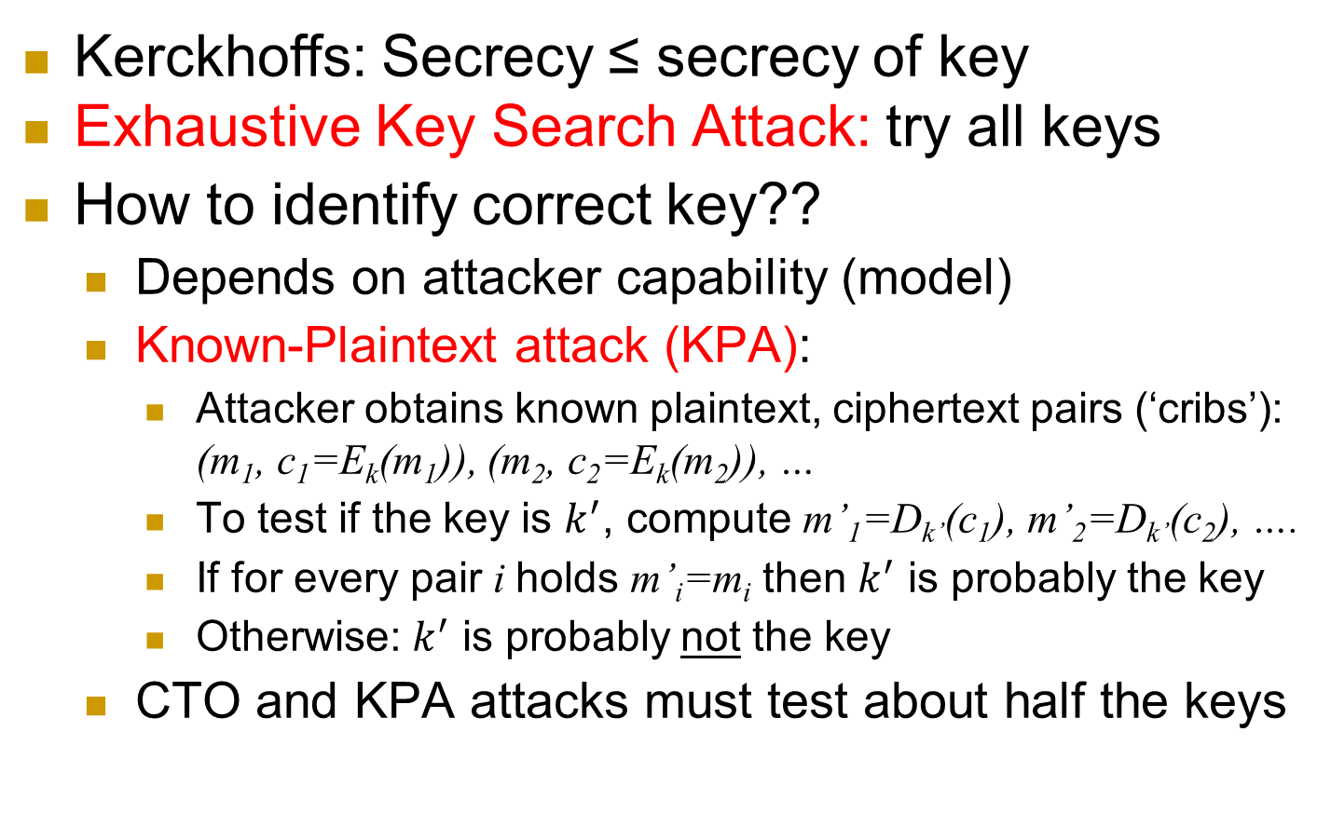
Exhaustive Key Search
Kerckhoffs: Secrecy ≤ secrecy of key
Exhaustive Key Search Attack: try all keys
How to identify correct key??
Depends on attacker capability (model)
Known-Plaintext attack (KPA):
Attacker obtains known plaintext, ciphertext pairs (‘cribs’): (m₁, c₁=E_{k}(m₁)), (m₂, c₂=E_{k}(m₂)), …
To test if the key is $k^{′}$, compute m’₁=D_{k’}(c₁), m’₂=D_{k’}(c₂), ….
If for every pair i holds m’_{i}=m_{i} then $k^{′}$ is probably the key
Otherwise: $k^{′}$ is probably not the key
CTO and KPA attacks must test about half the keys
a
Notes:
8
10/30/11

Slide 9
Encryption attacker models
Cipher-Text Only (CTO) attacker
Known-plaintext attacker (KPA)
Chosen-plaintext attacker (CPA)
Attacker can choose messages m₁, m₂,…
Chosen-ciphertext attacker (CCA)
E
D
m_{1,} m_{2,}…
c₁=E(m₁), c₂=E(m₂), … , c*=E(m*)
m*
Info about m* (beyond distribution)
a
Notes:
9
10/30/11

Slide 10
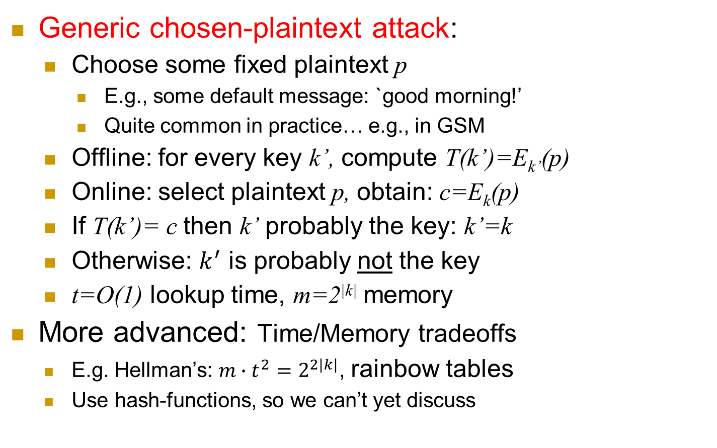
Table-Lookup: a Generic CPA
Generic chosen-plaintext attack:
Choose some fixed plaintext p
E.g., some default message: `good morning!’
Quite common in practice… e.g., in GSM
Offline: for every key k’, compute T(k’)=E_{k’}(p)
Online: select plaintext p, obtain: c=E_{k}(p)
If T(k’)= c then k’ probably the key: k’=k
Otherwise: $k^{′}$ is probably not the key
t=O(1) lookup time, m=2^{|k|} memory
More advanced: Time/Memory tradeoffs
E.g. Hellman’s: $m∙t^{2}=2^{2|k|}$, rainbow tables
Use hash-functions, so we can’t yet discuss
a
Notes:
10
10/30/11

Slide 11
Encryption attacker models
Cipher-Text Only (CTO) attacker
Known-plaintext attacker (KPA)
Chosen-plaintext attacker (CPA)
Chosen-ciphertext attacker (CCA)
Attacker can select ciphertexts c₁, c₂,…
And receive decryptions:
E
D
m*
c*=E(m*)
c₁, c₂ ,…
m₁=D(c₁), m₂=D(c₂), …
Info about m* (beyond distribution)
a
Notes:
11
10/30/11

Slide 12
The Attack Models Championship
we discuss several attack models:
CTO, KPA, CPA, CCA
Model A is stronger than model B, if a cipher secure against A is also secure against B
Notation: A > B
Example: KPA > CTO [why?]
KPA vs. CPA ?
KPA vs. CCA?
CPA vs. CCA ?

Slide 13
Attack Models: Crypto vs. NetSec
Attack models are central to cybersecurity
And differ – even for different crypto functions
Exercise: map CTO, KPA, CPA to NetSec:
Eavesdropping attacker
Ditto, and also with `cross-site capabilities’
Can cause client to send arbitrary request to server
Eavesdropper, and knows that the server sends encryption of a known `homepage’ to client

Slide 14
Sufficient Effective Key Length
Sufficient Effective Key Length Principle:
Ciphers should have sufficient effective key length, with a safety margin, to make attacks infeasible, for best adversary resources (HW, cryptanalysis) expected, during `sensitivity period` of data
Effective key length: key length for exhaustive search, which is as efficient as best targeted attack with real key space/length
Targeted attack: exploit properties of cryptosystem
Large key-space is necessary, not sufficient
Monoalphabetic substitution cipher, with permutation as key: 26! = 4 x 1026 keys… yet insecure!

Slide 15
Sufficient Effective Key Length
Sufficient Effective Key Length Principle:
Keys should be long enough to make attacks infeasible, for best adversary resources expected, during `sensitivity period` of data
Exhaustive search – or other attacks
Large key-space is necessary, not sufficient
Monoalphabetic substitution cipher, with permutation as key: 26! = 4 x 1026 keys… yet insecure!
Effective key length: log of number of trials by the most effective attack
Same as number of bits for exhaustive search
Defined for specific attack models

Slide 16
One-Time-Pad (OTP)
[Frank Miller, 1882] and
[Vernham (and Mauborgne?), 1919]
To encrypt message m, compute the bitwise XOR of the key k with the message m:
E_{k}(m)=c where c[i] = k[i] ⊕ m[i]
To decrypt ciphertext c, compute the bitwise XOR of the key with the ciphertext:
D_{k}(c)=m’ where m’[i] = k[i] ⊕ c[i]
1 2 3 4 5 6 7 8
... | 1 | 1 | 1 | 0 | 0 | 0 | 1 | 0
Key k (pad)
Plaintext m
+
Ciphertext c
1 2 3 4 5 6 7 8
1 2 3 4 5 6 7 8
... | 0 | 0 | 0 | 1 | 0 | 0 | 1 | 1
 |  |  |  | 1 | 0 | 0 | 0 | 1

Slide 17
One-Time-Pad: Example, Properties
k = 11001
m = 10011
C = 01010
k = 11001
c = 01010
m’ = 10011
m’= k ⊕ c = k ⊕ (k ⊕ m) = (k ⊕ k) ⊕ m = 0 ⊕ m = m
Very simple, efficient… but stateful and: |k|=|m|
Shannon [1949; simplified]: OTP is Unconditionally secure, and for every unconditionally-secure cipher, |k|≥|m|
Proofs of these claims? See crypto course / books ☺
So: assume attackers are computationally limited

Slide 18
Unconditional vs. Computational Security
Unconditional security
No matter how much computer power is available, the cipher cannot be broken
Computational security
The cost of breaking the cipher exceeds the value of the encrypted info
The time required to break the cipher exceeds the useful lifetime of the info
Or: a Probabilistic Polynomial Time (PPT) attacker has sub-polynomial success probability
Notes:
Unconditional security would be nice, but the only known such cipher is the one-time pad (later). For all reasonable encryption algorithms, have to assume computational security where it either takes too long, or is too expensive, to bother breaking the cipher.

Slide 19
Can we do computationally-secure |k|<<|m| variant of OTP?

Slide 20
Pseudo-Random Generator Stream Cipher
Idea: `similar’ to OTP, but with bounded-length seed s
How? With a pseudorandom generator PRG(s)
PRG(s) outputs a long stream of bits (longer than |s|)
Which is `indistinguishable from random’ bit-stream
Seed s
(as key)
PRG
1 2 3 4 5 6 7 8
... | 1 | 1 | 1 | 0 | 0 | 0 | 1 | 0
Bit i of PRG(s)
Bit i of m
c_{i}
Ciphertext c
Plaintext m
+
1 2 3 4 5 6 7 8
1 2 3 4 5 6 7 8
... | 0 | 0 | 0 | 1 | 0 | 0 | 1 | 1
 |  |  |  | 1 | 0 | 0 | 0 | 1

Slide 21
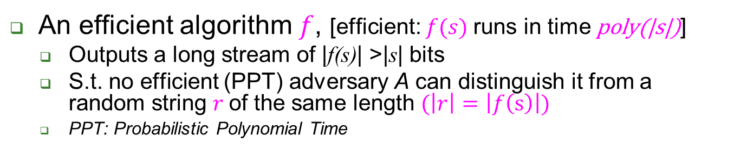
Pseudo-Random Generator (PRG)
An efficient algorithm $f$, [efficient: $f(s)$runs in time poly(|s|)]
Outputs a long stream of |f(s)| >|s| bits
S.t. no efficient (PPT) adversary A can distinguish it from a random string $r$of the same length $(\left|r\right|=\left|f\left(s\right)\right|)$
PPT: Probabilistic Polynomial Time
Which of these strings is random and which is pseudo-random?
Random string r
Random
(but short)
Seed s
I think upper string is random
PRG(s)
PPT adversary A
PRG
PRG is secure if any PPT adversary A succeeds with probability<½ + negl(|s|),
where negl() is a negligible function (<any polynomial in |s|).
Probability is over coins of A and the random strings r, s.

Slide 22
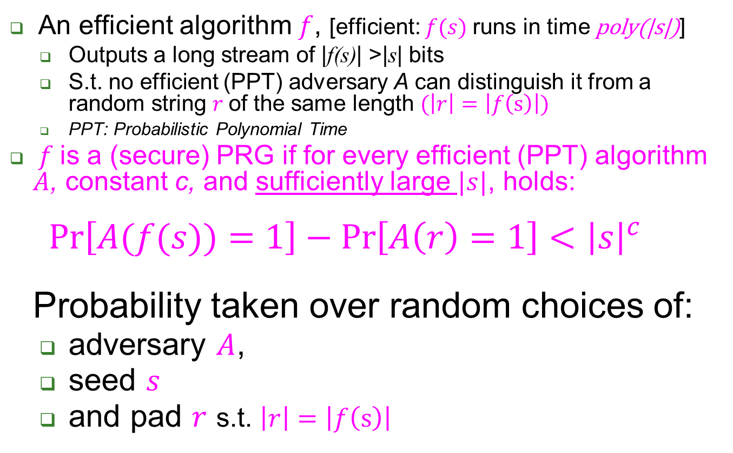
Pseudo-Random Generator (PRG)
An efficient algorithm $f$, [efficient: $f(s)$runs in time poly(|s|)]
Outputs a long stream of |f(s)| >|s| bits
S.t. no efficient (PPT) adversary A can distinguish it from a random string $r$of the same length $(\left|r\right|=\left|f\left(s\right)\right|)$
PPT: Probabilistic Polynomial Time
$f$is a (secure) PRG if for every efficient (PPT) algorithm $A$, constant c, and sufficiently large $|s|$, holds: $\operatorname{Pr}\left[A(f(s))=1\right]−\operatorname{Pr}\left[A\left(r\right)=1\right]<{\left|s\right|}^{c}$ Probability taken over random choices of:
adversary $A$,
seed $s$
and pad $r$ s.t. $\left|r\right|=\left|f\left(s\right)\right|$

Slide 23
Many PRG proposals…
Often based on Feedback Shift Register(s)
Easy for efficient HW
Linear feedback (LFSR) - or not
LFSR is easily predictable (not secure PRG)
More complex (mult-regs, etc.), e.g. in GSM
GSM’s original stream-ciphers (A5/1, A5/2): broken
And attacker can cause GSM to use weakest cipher ☹

Slide 24
Many PRG proposals…
Often based on Feedback Shift Register(s)
Easy for efficient HW
Linear feedback (LFSR) - or not
LFSR is easily predictable (not secure PRG)
More complex (mult-regs, etc.), e.g. in GSM
GSM’s original stream-ciphers (A5/1, A5/2): broken
And attacker can cause GSM to use weakest cipher ☹
Others, e.g., RC4
Byte-based designed, efficient in SW and HW
Known attacks, e.g., using first output bytes

Slide 25
Add on GSM’s A5/1, A5/2
Design, explain why these are actually PRFs
Vulnerabilities:
KPA
CTO
System-provided known plaintext
Does this mean attack is CTO? Cryptosystem vs. system security notions.

Slide 26
Example: RC4 Stream Cipher
Byte-based designed, efficient in SW (and HW)
Key schedule alg: output pseudo-random byte permutation S[i] (over [0,...255]).
Pseudo-random Generation alg:
i := 0, j := 0
while GeneratingOutput:
i := (i + 1) mod 256, j := (j + S[i]) mod 256
swap values of S[i] and S[j]
output S[(S[i] + S[j]) mod 256]
Known attacks: for related keys, using first output bytes (➔use RC4-drop[n], e.g., n=3000)

Slide 27
Example: Misusing Stream-Ciphers
MS-Word 2002 uses RC4 to encrypt:
PAD=RC4(password)
Save PAD xor Document (bitwise)
Why is this insecure ?
Write answer on paper, with name

Slide 28
Example: Misusing Stream-Cipher
MS-Word 2002 uses RC4 to encrypt:
PAD=RC4(password)
Save PAD xor Document (bitwise)
Problem: same pad used when document is modified [‘two times pad’]
Attacker gets: c1=PAD xor d1, c2=PAD xor d2
Enough redundancy in English to decrypt!
[Mason et al., CCS'06]
Cryptography is bypassed more often than broken !!

Slide 29
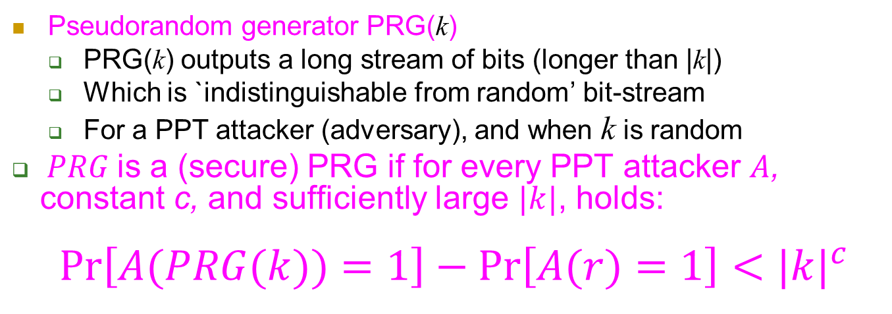
Recall: PRG Stream Cipher (1)
Pseudorandom generator PRG(k)
PRG(k) outputs a long stream of bits (longer than |k|)
Which is `indistinguishable from random’ bit-stream
For a PPT attacker (adversary), and when k is random
$PRG$is a (secure) PRG if for every PPT attacker $A$, constant c, and sufficiently large $|k|$, holds: $\operatorname{Pr}\left[A(PRG(k))=1\right]−\operatorname{Pr}\left[A(r)=1\right]<{|k|}^{c}$
Key/seed k
PRG
0 | 1 | 1 | 1 | 0 | 0 | 0 | 1 | 0
Plaintext m
+
Ciphertext c
1 | 0 | 0 | 0 | 1 | 0 | 0 | 1 | 1
 |  |  |  | 1 | 0 | 0 | 0 | 1

Slide 30
Recall: PRG Stream Cipher (2)
Let:
p[i] be i-th bit of plaintext
c[i] be i-th bit of ciphertext
PRG(k)[i] be the i-th output bit of the PRG (with input seed/key k)
PRG stream cipher : c[i]=p[i] ⊕ PRG[k](i)
Problem: requires keeping synchronized state:
counter i
the entire output of the PRG
Can we reduce or eliminate this synchronized state?
Key/seed k
PRG
0 | 1 | 1 | 1 | 0 | 0 | 0 | 1 | 0
Plaintext m
+
Ciphertext c
1 | 0 | 0 | 0 | 1 | 0 | 0 | 1 | 1
 |  |  |  | 1 | 0 | 0 | 0 | 1

Slide 31
A Stateless Stream Cipher?
PRG-based stream ciphers are stateful : remember how many bits (or bytes) were already output, and bit values PRG(i)
Can we avoid or minimize this long-term state?
The answer is…
Yes we can!
In three steps (versions):
Use less state
Use no state Both: random function
…same, but with pseudo-random function
Key k
PRG
0 | 1 | 1 | 1 | 0 | 0 | 0 | 1 | 0
Plaintext m
+
Ciphertext c
1 | 0 | 0 | 0 | 1 | 0 | 0 | 1 | 1
 |  |  |  | 1 | 0 | 0 | 0 | 1

Slide 32


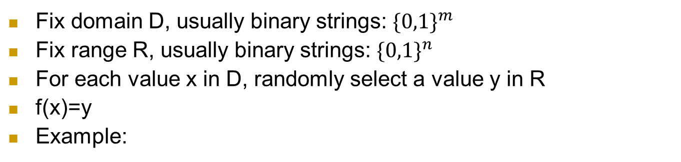
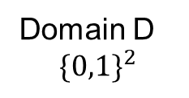
First, what’s a (‘truly’) random function f?
Fix domain D, usually binary strings: ${\{0,1\}}^{m}$
Fix range R, usually binary strings: ${\{0,1\}}^{n}$
For each value x in D, randomly select a value y in R
f(x)=y
Example:
 | f( )
00
01
10
11
Range R ${\{0,1\}}^{5}$
Domain D
$${\{0,1\}}^{2}$$

Slide 33
What’s a (‘truly’) random function?
Fix domain D, usually binary strings: ${\{0,1\}}^{m}$
Fix range R, usually binary strings: ${\{0,1\}}^{n}$
For each value x in D, randomly select a value y in R
f(x)=y
Example:
 | f( )
00 | 01101
01 | 11010
10 | 01101
11 | 11101
Range R ${\{0,1\}}^{5}$
Domain D
$${\{0,1\}}^{2}$$

Slide 34
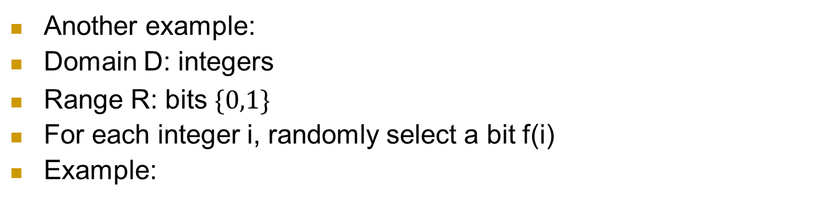

What’s a (‘truly’) random function?
Another example:
Domain D: integers
Range R: bits ${\{0,1\}}^{}$
For each integer i, randomly select a bit f(i)
Example:
i | f(i)
1 | 0
2 | 0
3 | 1
4 | 1
5 | 1
6 | 0
… | …
Range: bits ${\{0,1\}}^{}$
Domain:
integers

Slide 35
Exercise: Random Function Stateful Stream Cipher
Let:
p(i) be i-th bit of plaintext
c(i) be i-th bit of ciphertext
f be random function from integers to bits; f(i) is the output bit for input integer i
Exercise: design a stream cipher using f...
Keeping as state only the bit-location i
Present as formula and/or by adding to this diagram
write your name
0 | 1 | 1 | 1 | 0 | 0 | 0 | 1 | 0
Plaintext m
+
Ciphertext c
1 | 0 | 0 | 0 | 1 | 0 | 0 | 1 | 1
 |  |  |  | 1 | 0 | 0 | 0 | 1

Slide 36
Exercise: Random Function Stateful Stream Cipher
Let:
p(i) be i-th bit of plaintext
c(i) be i-th bit of ciphertext
f be random function from integers to bits; f(i) is the output bit for input integer i
Exercise: design a stream cipher using f...
Keeping as state only the bit-location i
c(i)= p(i) ⊕ f (i)
Next: can we entirely avoid sync state, i.e., not to `remember’ i??
Bit number i
f(i)
0 | 1 | 1 | 1 | 0 | 0 | 0 | 1 | 0
Plaintext m
+
Ciphertext c
1 | 0 | 0 | 0 | 1 | 0 | 0 | 1 | 1
 |  |  |  | 1 | 0 | 0 | 0 | 1

Slide 37
Random Function Stateless Stream Cipher
Choose some large number n
Let:
p(i) be i-th bit of plaintext
c(i) be i-th bit of ciphertext
f be random function from n-bits string r to bits; f(r) is the output bit
For each bit (say number i):
Select random n-bit string r_{i}
Let c(i)=( p(i)+f(r_{i}) , r_{i} ) [yes, send r_{i} `in the clear’ !!]
Q: why do we need to output, send r_{i}?
Overhead: per-bot communication, computation… optimization??
random n-bit string r_{i}
f(r_{i})
0 | 1 | 1 | 1 | 0 | 0 | 0 | 1 | 0
Ciphertext c:
f(r_{i})+m[i], r_{i}
Plaintext m
+
1 | 0 | 0 | 0 | 1 | 0 | 0 | 1 | 1
 |  |  |  | 1 | 0 | 0 | 0 | 1

Slide 38
Random Function Stateless Encryption
Optimization: operate in blocks (say of n bits)
f be random function from n-bits strings (`blocks’) to n-bits strings (`blocks’)
p(i) be i-th block of n-bits of plaintext
c(i) be i-th block of n-bits of ciphertext
For each block (say number i):
Select random n-bit string r_{i}
Let c(i)=( p(i)+f(r_{i}) , r_{i} ) [yes, send r_{i} `in the clear’ !!]
Same overhead per block, i.e., only 1 bit overhead per bit !!
Challenge: sharing such random function f !!
Size of table? 2^n entries of n bits each…
Next: use pseudo-random function instead !
random n-bit string r_{i}
f(r_{i})
Pseudo-random n-bit pad f(r_{i})
Plaintext n-bit block m_{i}
+
Ciphertext n-bit block c_{i}=m_{i}+f(r_{i})

Slide 39
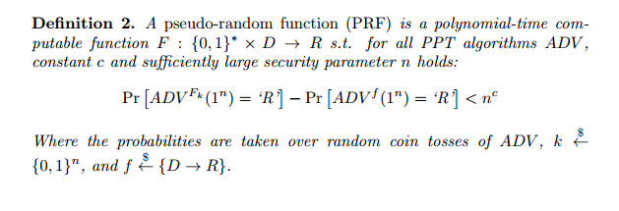
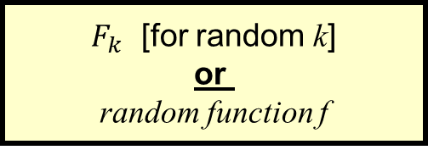
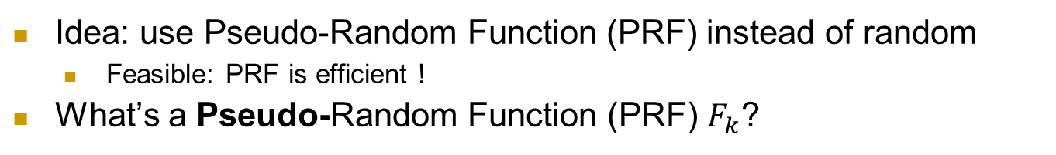
Avoiding State: Pseudo-Random Function
Idea: use Pseudo-Random Function (PRF) instead of random
Feasible: PRF is efficient !
What’s a Pseudo-Random Function (PRF) $F_{k}$?
$F_{k}$ [for random k]
or random function f
x

Slide 40
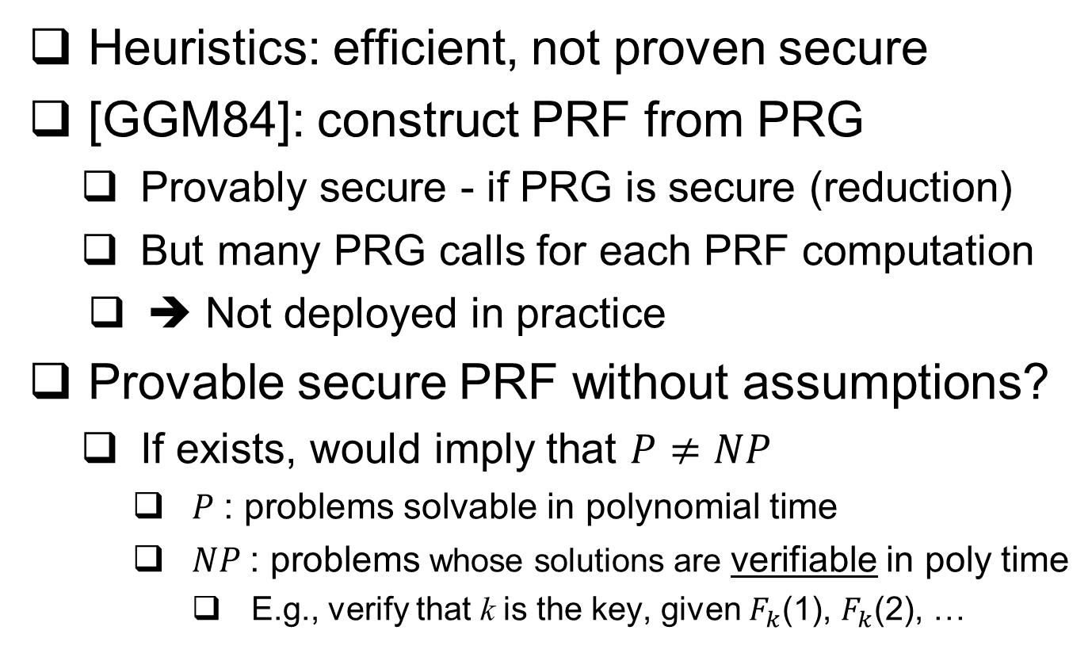
Constructing a PRF
Heuristics: efficient, not proven secure
[GGM84]: construct PRF from PRG
Provably secure - if PRG is secure (reduction)
But many PRG calls for each PRF computation
➔ Not deployed in practice
Provable secure PRF without assumptions?
If exists, would imply that $P≠NP$
$P$: problems solvable in polynomial time
$NP$: problems whose solutions are verifiable in poly time
E.g., verify that k is the key, given $F_{k}$(1), $F_{k}$(2), …

Slide 41
Avoiding State: Pseudo-Random Function
Idea: use Pseudo-Random Function (PRF) instead of random
Feasible: PRF is efficient !
What’s a Pseudo-Random Function (PRF) $F_{k}$?
$F_{k}$ [for random k]
or random function f
x

Slide 42
PRF Applications (1)
Given a PRF, construct a PRG: exercise
Given a PRF, construct stateless encryption
Solution 1:
Security: same argument as OTP, if random r not used yet
Probability of repeating r = ?
Security is implied by security of random function (why?)
Overhead: random input for each `block’ !
Can we use and send less bits?
$$E_{k}\left(m\right)=\left\{r←\$;\text{Ciphertext}\text{=}\left(\text{m}⊕f_{k}\left(r\right),r\right)\right\}$$

Slide 43
PRF Applications (2)
Given a PRF, construct a PRG: exercise
Given a PRF, construct stateless encryption
Solution 1:
Solution 2: use PRF to seed a PRG
Solution 3: same, but implement PRG with PRF, too
No need in two cryptographic assumptions
Use to generate pseudo-random pad: p₁ , p₂ , …
p_{i}=f_{k}(p_{i-1})
$$E_{k}\left(m\right)=\left\{r←\$;\text{Ciphertext}\text{=}\left(\text{m}⊕f_{k}\left(r\right),r\right)\right\}$$
$$E_{k}\left(m\right)=\left\{r←\$;\text{Ciphertext}\text{=}\left(\text{m}⊕PRG\left(f_{k}\left(r\right)\right),r\right)\right\}$$

Slide 44
‘Stateless stream cipher’ using PRF
p₀
p₁=F_{k}(p₀)
PRF F_{k}
Key k
PRF F_{k}
Key k
`pad` p_{i}=F_{k}(p_{i-1})
0 | 1 | 1 | 1 | 0 | 0 | 0 | 1 | 0
m₂
0 | 0 | 1 | 0 | 0 | 0 | 1 | 1 | 0
m₁
1 | 0 | 0 | 0 | 1 | 0 | 0 | 1 | 1
+
1 | 1 | 0 | 1 | 1 | 0 | 0 | 0 | 1
+
c_{i} =m_{I}⊕F_{k}(p_{i})
c₁
c₂
1 | 1 | 1 | 1 | 1 | 0 | 0 | 0 | 1
1 | 1 | 1 | 1 | 1 | 0 | 0 | 0 | 1
Plaintext: m=m₁||m₂||…
Ciphertext : (p₀ , [c₁ || c₂ ||…] )
p₀ can be random (stateless) or counter
This is called Output Feedback Mode when using a block cipher (later)

Slide 45
PRF Applications
PRFs have many more applications: encryption, authentication, key management…
Example: derive independent key for each day d
Easy, with PRF and single shared key k
Key for day d is k_{d}=F_{k}(d)
Exposure of keys of Monday and Wednesday does not expose key for Tuesday
Similarly: separate keys for different goals, e.g., encryption and authentication
How?
d
Key k
PRF F_{k}
F_{k}(d)

Slide 46
We defined security for PRG and PRF. But… what about security of encryption??
A bit tricky, in fact.

Slide 47
Exercise: define secure encryption
Alice’s
encryption
key
Bob’s
decryption
key
K
K
K
B
plaintext
encryption
algorithm
ciphertext
decryption
algorithm
plaintext
Define a secure symmetric cryptosystem
Refer to (1) Attacker model and (2) success criteria
Be as precise as possible, take five minutes
Write down; one good proposal gets late submission day!

Slide 48
Defining Secure Encryption
Attacker capabilities:
Computational limitations? ➔ PPT
Ciphertext only (CTO), Known / chosen plaintext attack (KPA/CPA), Chosen ciphertext (CCA)?
What’s a successful attack?
Key recovery ?
May be impossible yet weak cipher…
(Full) Message recovery?
What of partial exposure, e.g., m∈{“Advance”, “Retreat”}
Prudent: attacker ‘wins’ for any info on plaintext

Slide 49
Conservative Design Principle
When designing, evaluating a cryptosystem…
Consider most powerful attacker (CTO< KPA< CPA)
Be as general as possible – cover many applications
And `easiest’ attacker-success criteria
Not message/key recovery!
Make it easy to use securely, hard to use insecurely!
When designing, evaluating a system
Which use some cryptosystem
Restrict attacker’s capabilities (e.g., avoid known/chosen plaintext)

Slide 50
Cryptanalysis Success Criteria
Key recovery ? -- meaningless
(Full) Message recovery? – may be an overkill. E.g., when m∈{“Advance”, “Retreat”}
Can’t learn anything at all about plaintext – how to define? Can we achieve it ?
Well-defined notion: ‘semantic security’ [crypto course]
Indistinguishability: Eve ‘wins’ if she distinguishes between encryptions of (any) two messages
We focus on indistinguishability:
In crypto course: equivalent to semantic security

Slide 51
Defining Secure Encryption
Attacker capabilities:
Computational limitations? ➔ PPT
Ciphertext only (CTO), Known / chosen plaintext attack (KPA/CPA), Chosen ciphertext (CCA)?
What’s a successful attack?
`Attacker learns something about the plaintext’
Aka semantic security
Indistinguishability: Eve ‘wins’ if she distinguishes btw encryptions of two messages
Equivalent definitions, actually! [Crypto course]

Slide 52
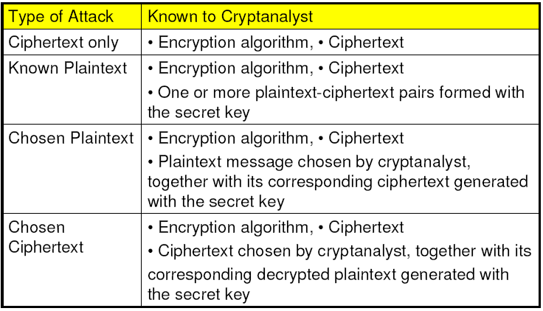
Attacker Capabilities / Model
C
(KPA)
(CPA)
(CCA)
And… Probabilistic Polynomial Time (PPT) !
Notes:
note def of attacker model and precise security defs in general is crucial for any security system , not just crypto!

Slide 53
Indistinguishability: Encryption is like disguise…
With a good disguise, adversary…
Can’t even tell the most pretty from the most ugly
Can’t even identify the same disguised person
Talk to masked Rachel
She disappears for few minutes
Who returned? Rachel or Leah?
As long as they are roughly same size
A giant can never disguise as a dwarf
With good encryption, adversary can’t distinguish E(m₀) vs. E(m₁)
Even when adversary selects m_{0,} m₁ (s.t. |m₀|=|m₁|)
Even when comparing to known encryption E(m₀)
➔ Encryption must be randomized (or stateful)
Notes:
53
10/30/11

Slide 54
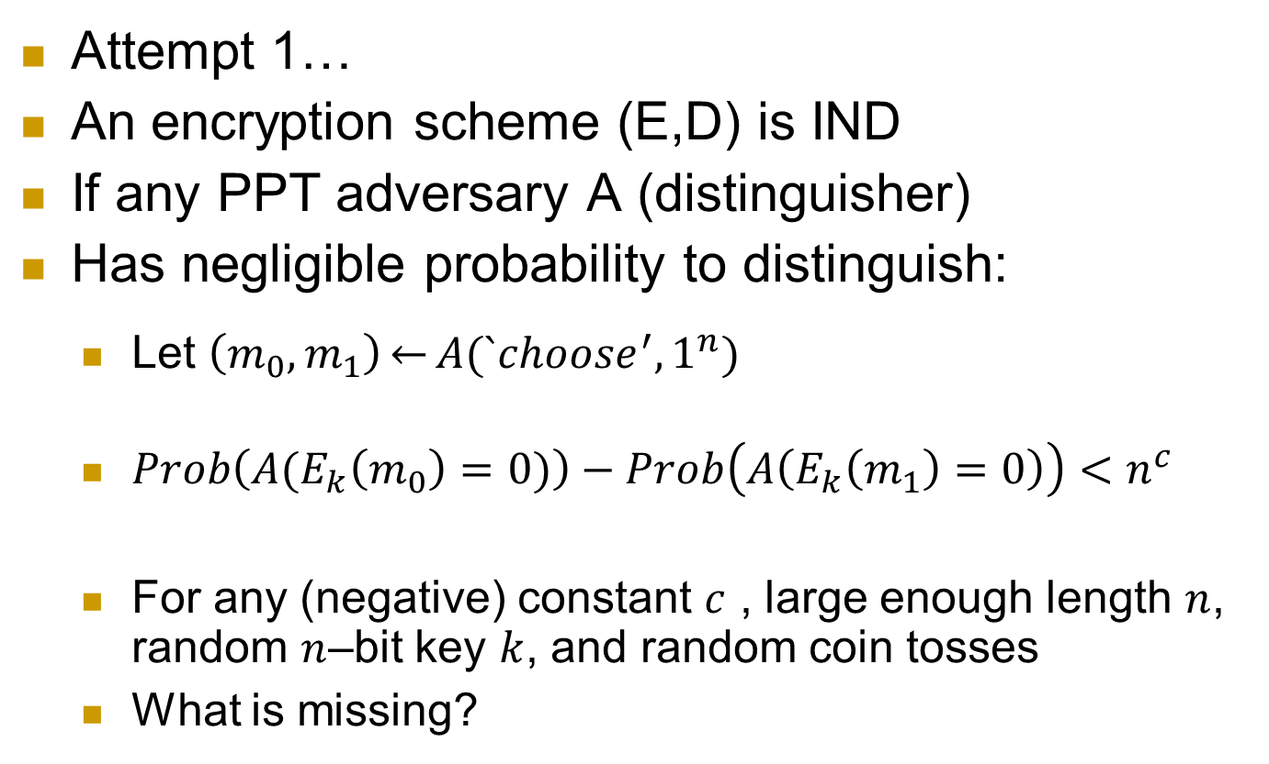
Defining Indistinguishable Encryption
Attempt 1…
An encryption scheme (E,D) is IND
If any PPT adversary A (distinguisher)
Has negligible probability to distinguish:
Let $\left(m_{0},m_{1}\right)\underset{←}{}A(`choose^{′},1^{n})$
$Prob\left(A(E_{k}\left(m_{0}\right)=0)\right)−Prob\left(A\left(E_{k}\left(m_{1}\right)=0\right)\right)<n^{c}$
For any (negative) constant $c$ , large enough length $n$, random $n$–bit key $k$, and random coin tosses
What is missing?
Adversary capabilities – e.g., CPA
Notes:
54
10/30/11

Slide 55
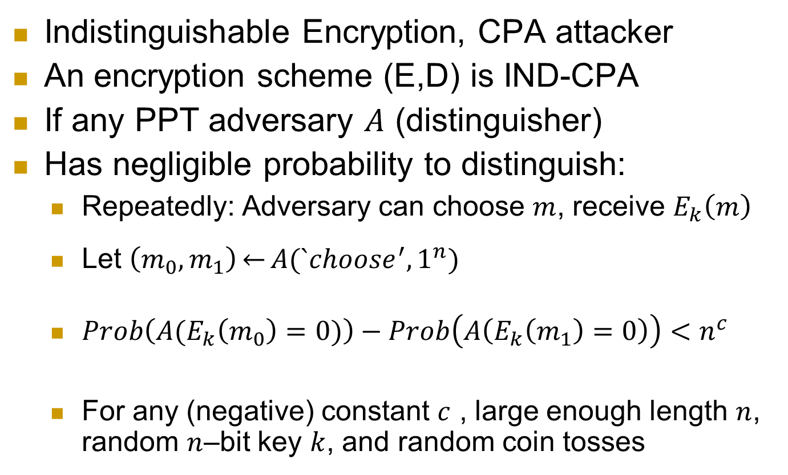
Defining: IND-CPA Encryption
Indistinguishable Encryption, CPA attacker
An encryption scheme (E,D) is IND-CPA
If any PPT adversary $A$ (distinguisher)
Has negligible probability to distinguish:
Repeatedly: Adversary can choose $m$, receive $E_{k}\left(m\right)$
Let $\left(m_{0},m_{1}\right)\underset{←}{}A(`choose^{′},1^{n})$
$Prob\left(A(E_{k}\left(m_{0}\right)=0)\right)−Prob\left(A\left(E_{k}\left(m_{1}\right)=0\right)\right)<n^{c}$
For any (negative) constant $c$ , large enough length $n$, random $n$–bit key $k$, and random coin tosses
Notes:
55
10/30/11

Slide 56
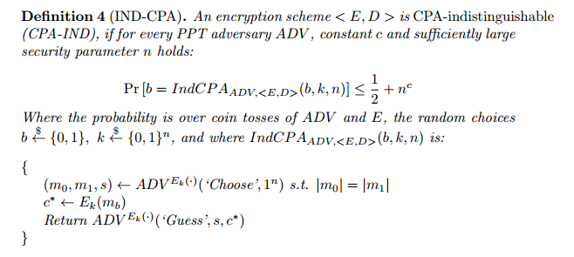
Hidden foil: definition of IND-CPA secure encryption

Slide 57
What’s next? Present a secure cryptosystem? … provably secure w/o assumptions ? Unlikely: Proof of security ➔ P ≠ NP (similar argument to PRF) Instead, let’s build secure encryption from PRF ! (I.e., IND-CPA – if PRF is secure) Actually, we’ll use block cipher (and build it)

Slide 58

Block Ciphers
Block Cipher: a basic crypto building block
E_{k} , D_{k} : m=D_{k} (E_{k} (m))
Data Encryption Standard (DES): US NIST, 1977-2001, 64-bit blocks, 56 bit keys ➔ exhaustive search
Advanced Encryption Standard (AES): NIST 2002-?, 128-bit blocks, 128 bit keys
64 bit block
128 bit block
DES
128/192/256 bit key
AES
DES
1977-
2001
56b key
64 bit block
128 bit block
Definition: a Pseudo-Random Permutation (PRP)…

Slide 59
News!!! ConCrypt Announcement
ConCrypt Inc. announced a new encryption scheme, the CES, which is features 500 bit key, yet is four time more efficient than AES, with only 128 bit key!!!
`CES was proven by leading experts to be more secure than AES’
Possible conclusions:
This class may not be necessary anymore
Or another?

Slide 60
PRP: (Invertible) Pseudo-Random Permutation
Common definition for block cipher
Pseudo-Random Permutation (PRP): similar to PRF, but limited to permutations – and invertible
A pair of (keyed) functions, s.t.: m=D_{k}(E_{k}(m))
Note: deterministic, stateless → not secure encryption !
But used to construct encryption, see next
f← E_{k}(.) or D_{k}(.) [for random k]
or f← random n-bit permutation or its inverse
x
f(x)
Can’t tell if f is a random permutation or just E / D with a random key!

Slide 61
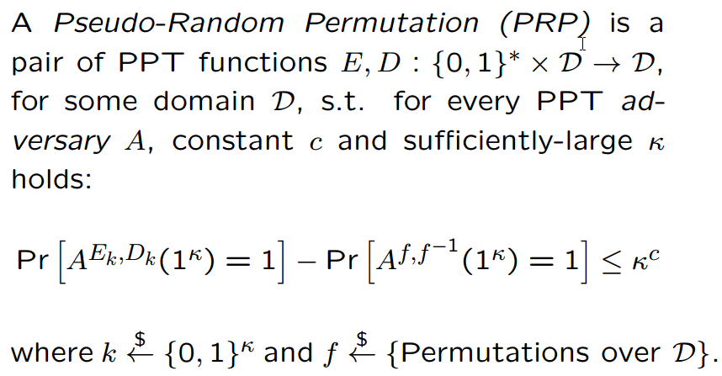
Block Cipher / Pseudo-Random Permutation
Often referred to as ‘strong PRP’ (since D queries are allowed, too)

Slide 62

Crypto Building-Blocks Principle
Design and focus cryptanalysis efforts on few basic functions: simple, easy to test, replaceable
Construct schemes from basic functions
Provably secure constructions: attack on scheme ➔ attack on function
Allows replacing broken/suspect functions
Allows upgrading to more secure/efficient function
E.g., build encryption from PRG/PRF/PRP
PRG,PRF,PRP: deterministic, stateless, FIL (Fixed-Input-Length)
Encryption: randomized, stateful, VIL (Variable-Input-Length)
Notes:
Another advantage is that robust combiner for function usually gives robust combiner for scheme (and usually, it is simpler than direct combiner for scheme)

Slide 63
Why standardize block ciphers, and not encryption?
Crypto building blocks principle, rephrased: design, cryptanalyze simple function, use function to construct more complex scheme
Design, cryptanalyze PRF; use it to build block cipher; and block cipher to construct cryptosystem
Attack on cryptosystem ➔ attack on block cipher, PRF
Design (FIL, deterministic, stateless) PRF, construct (VIL, randomized/stateful) cryptosystem
PRFs are easier to design and to combine:
Given two PRFs F, F’, let F’’_{k,k’}(x)=F_{k}(x)⊕F’_{k’}(x)
If either F or F’ is a secure PRF ➔ F’’ is secure PRF
This is a robust combiner for PRFs
Next: Feistel construction of a PRP from PRF!

Slide 64
The Feistel Block-cipher Construction
Turn PRF F_{k} into invertible PRP (block cipher)
Used in DES (but not in AES)
Idea: use randomness in data!
Used in Data Encryption Standard (DES)
Reversible!
With >2 rounds: PRF → PRP
Why? Try to directly design a reversible PRP!
F_{k}()
X
F_{k}()
X
F_{k}()
X

Slide 65
PRP→Encryption: Modes of Operation
`Modes of operation’: use block cipher (PRP), to...
Encrypt long (Variable Input Length, VIL) messages
Randomize/add state for security
Often: use random/stateful Initialization Vector (IV)
Use longer or shorter keys
Longer key (e.g., Triple-DES): better security (at least against exhaustive search)
Shorter key: intentionally-weakened version, e.g. to meet export regulations
Other tasks (e.g., message authentication)

Slide 66



Block Cipher Modes of Operation
For encryption
Later: modes for message authentication
Assume plaintext is in blocks: m₀||m₁||…
Electronic Code Book mode (ECB): encryption c_{i}=E_{k}(m_{i}), decryption m_{i}=D_{k}(c_{i})
`Encrypt` E_{k}
`Decrypt` D_{k}
m_{i}
c_{i}
m_{i}
Which of these is ECB encryption? Why?

Slide 67
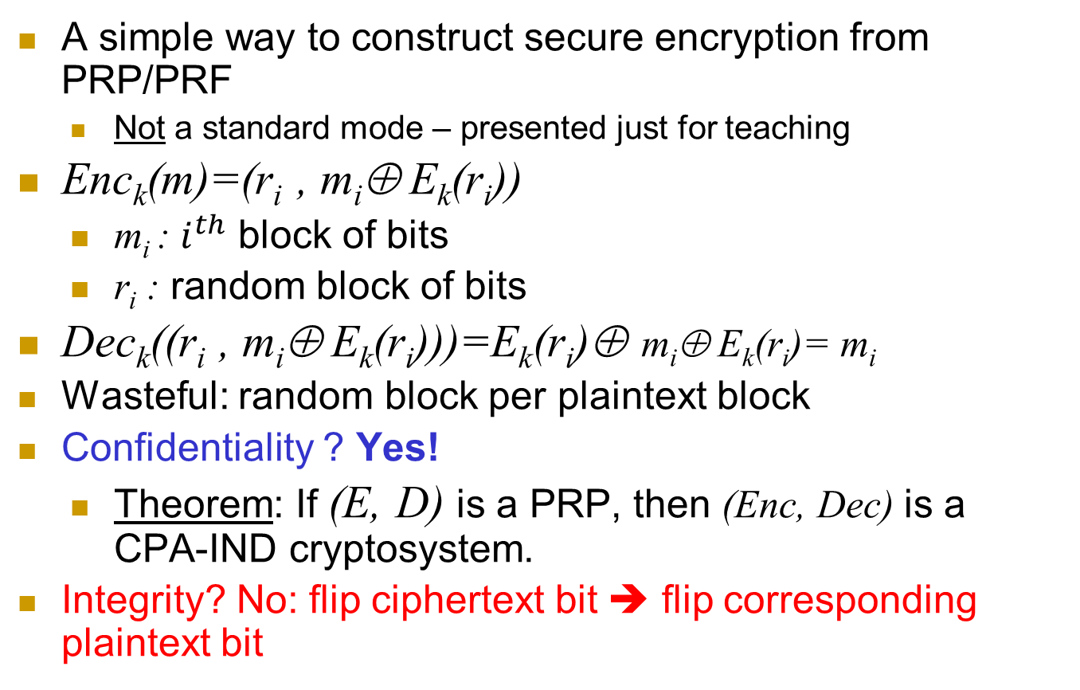
Per-Block Random (PBR) mode
A simple way to construct secure encryption from PRP/PRF
Not a standard mode – presented just for teaching
Enc_{k}(m)=(r_{i} , m_{i}⊕ E_{k}(r_{i}))
m_{i} : $i^{th}$ block of bits
r_{i} : random block of bits
Dec_{k}((r_{i} , m_{i}⊕ E_{k}(r_{i})))=E_{k}(r_{i})⊕ m_{i}⊕ E_{k}(r_{i})= m_{i}
Wasteful: random block per plaintext block
Confidentiality ? Yes!
Theorem: If (E, D) is a PRP, then (Enc, Dec) is a CPA-IND cryptosystem.
Integrity? No: flip ciphertext bit ➔ flip corresponding plaintext bit

Slide 68

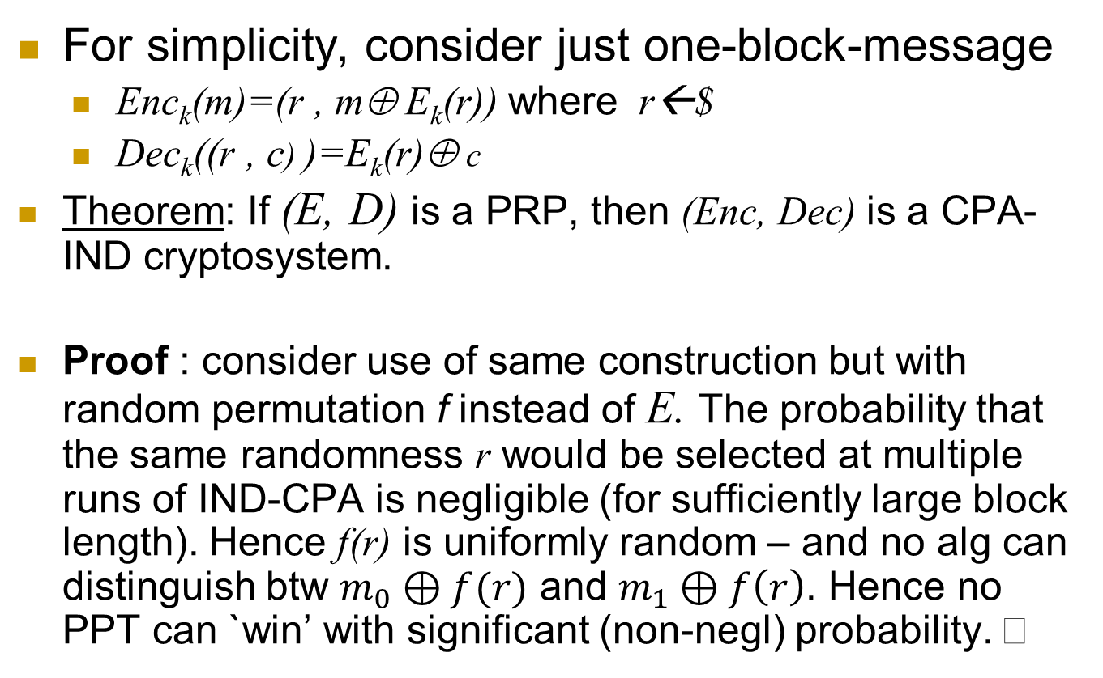
Per-block random mode is IND-CPA
For simplicity, consider just one-block-message
Enc_{k}(m)=(r , m⊕ E_{k}(r)) where r←$
Dec_{k}((r , c) )=E_{k}(r)⊕ c
Theorem: If (E, D) is a PRP, then (Enc, Dec) is a CPA-IND cryptosystem.
Proof : consider use of same construction but with random permutation f instead of E. The probability that the same randomness r would be selected at multiple runs of IND-CPA is negligible (for sufficiently large block length). Hence f(r) is uniformly random – and no alg can distinguish btw $m_{0}⊕f(r)$ and $m_{1}⊕f\left(r\right)$. Hence no PPT can `win’ with significant (non-negl) probability.

Slide 69
Encryption Modes of Operation
We saw two...
ECB (insecure!): c_{i}=E_{k}(m_{i})
Per-Block Random (PBR): r_{i}←$, c_{i} = (r_{i} , m_{i}⊕ E_{k}(r_{i}))
We’ll see three more…
Output Feedback (OFB)
Cipher Feedback (CFB)
Cipher-block-chaining (CBC)
Others exist (for encryption – and other tasks)
All operate on blocks (e.g., 128 bits = 16 bytes)

Slide 70
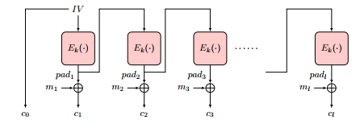
Output-Feedback (OFB) Mode
Goal: encrypt long (multi-block) messages, with less random bits
Generate and send less random bits – cf. to per-block random
How? Use random bits only for first block (`initialization vector’)
To encrypt next blocks of message, use output of previous block
Namely, a block-by-block stream cipher
Encryption: pad₀←IV, pad_{i} ← E_{k}(pad_{i-1} ), c₀ ← pad_{0,} c_{i} ← pad_{i}⊕ m_{i}
Decryption: ?

Slide 71
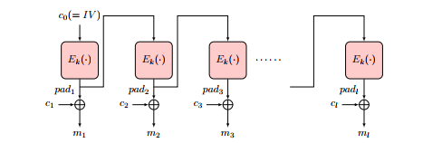
Output-Feedback (OFB) Mode
Goal: encrypt long (multi-block) messages, with less random bits
Generate and send less random bits – cf. to per-block random
How? Use random bits only for first block (`initialization vector’)
To encrypt next blocks of message, use output of previous block
Namely, a block-by-block stream cipher
Encryption: pad₀←IV, pad_{i} ← E_{k}(pad_{i-1} ), c₀ ← pad_{0,} c_{i} ← pad_{i}⊕ m_{i}
Decryption: pad₀ ← c_{0,} pad_{i} ← E_{k}(p_{i-1} ), m_{i} ← pad_{i}⊕ c_{i}

Slide 72
Output-Feedback (OFB) Mode
Encryption: pad₀←IV, pad_{i} ← E_{k}(pad_{i-1} ), c₀ ← pad_{0,} c_{i} ← pad_{i}⊕ m_{i}
Decryption: pad₀ ← c_{0,} pad_{i} ← E_{k}(p_{i-1} ), m_{i} ← pad_{i}⊕ c_{i}
Offline pad computation: compute pad in advance
Online computation: only (parallelizable) XOR !
Bit errors are bitwise localized (corrupt only one bit)
No integrity: Flip ciphertext bit ➔ flip corresponding decrypted plaintext bit
Can we protect integrity?

Slide 73
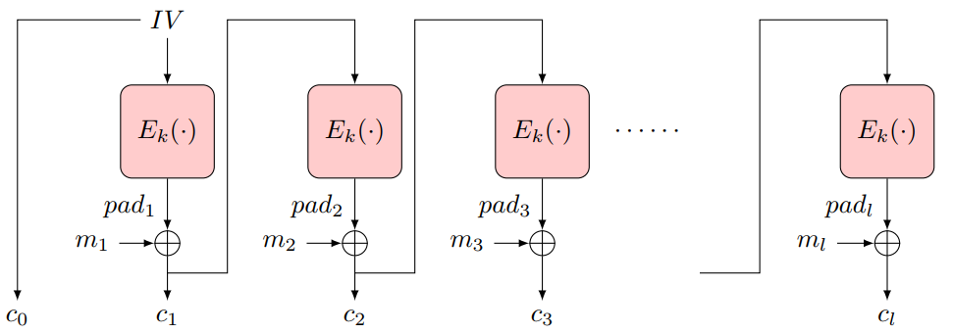
Cipher-Feedback Block (CFB) Encryption
Random first block c₀ (`initialization vector’, IV)
XOR ‘pad’ E_{k}(c₀) with plaintext to obtain: c₁ = m₁⊕ E_{k}(c₀)
Repeat: c_{i} = m_{i}⊕ E_{k}(c_{i-1})

Slide 74
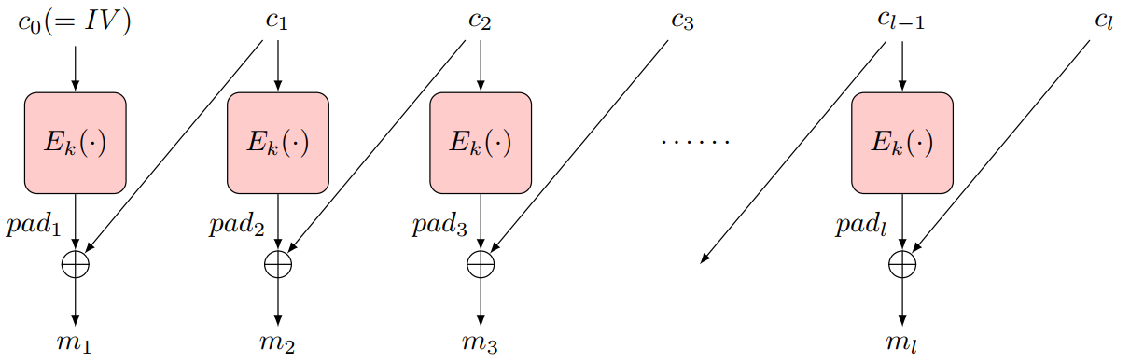
Cipher-Feedback Block (CFB) Encryption
Random first block c₀ (`initialization vector’, IV)
XOR ‘pad’ E_{k}(c₀) with plaintext to obtain: c₁ = m₁⊕ E_{k}(c₀)
Repeat: c_{i} = m_{i}⊕ E_{k}(c_{i-1})
CFB Encryption
CFB Decryption

Slide 75
Cipher-Feedback Block (CFB) Encryption
Random first block c₀ (`initialization vector’, IV)
XOR ‘pad’ E_{k}(c₀) with plaintext to obtain: c₁ = m₁⊕ E_{k}(c₀)
Repeat: c_{i} = m_{i}⊕ E_{k}(c_{i-1})
Ciphertext: c₀, c₁ = m₁⊕ E_{k}(c₀), … , c_{i} = m_{i}⊕ E_{k}(c_{i-1})
Can’t pre-compute `pad’ offline ☹
Decryption: c_{i}⊕ E_{k}(c_{i-1})= m_{i}⊕ E_{k}(c_{i-1}) ⊕ E_{k}(c_{i-1})= m_{i}
Parallelizable
Bit/block errors are 2-block localized (corrupt only 2 blocks)
Integrity? A bit…
Flip ciphertext bit ➔ flip corresponding decrypted plaintext bit
But also corrupt next plaintext block
Except for last block: no `next block’
Can we protect integrity (even) better?

Slide 76
Cipher Block Chaining (CBC) Mode
Random first block c₀ (`initialization vector’, IV)
i>0: c_{i} = E_{k}(c_{i-1} ⊕ m_{i})
Parallel decryption
But no offline precomputing
Integrity: flip bit in c[i] ➔ flip bit in m[i+1] … But also corrupt m[i]
May suffice to ensure integrity for many applications
But not all!
Split plaintext m to l bit blocks m[1],…
m[1] | m[2] | … | m[n]
IV
E
E
E
k
c[0] | c[1] | … | c[n]
Ciphertext c[0],c[1]…
Notes:
76
10/30/11

Slide 77
Security of CBC mode
Thm: If block-cipher E is a (strong) pseudo-random permutation ➔CBC#E is IND-CPA-secure encryption
Proof: omitted (crypto course ☺ )
Not secure against Chosen-Ciphertext Attack (CCA)
Intuitively: attacker can choose ciphertext and get its decryption, except for the `challenge ciphertext’
Definition, details: beyond scope of this course
We briefly describe Feedback-CCA: practical variant

Slide 78
Security of CBC mode (2)
Thm: If block-cipher E is a (strong) pseudo-random permutation ➔CBC#E is IND-CPA-secure encryption
Proof: omitted (crypto course ☺ )
Observation: CBC is Not IND-CCA-Secure
CCA (Chosen ciphertext attack), intuitively: attacker can choose ciphertext and get its decryption, except for the `challenge ciphertext’
Definition, details: crypto course
Exercise: show CBC is Not IND-CCA-Secure
Feedback-CCA: practical variant of CCA
Just returns <ERROR, OK> for any ciphertext
Error – for incorrectly padded decryption (next)

Slide 79
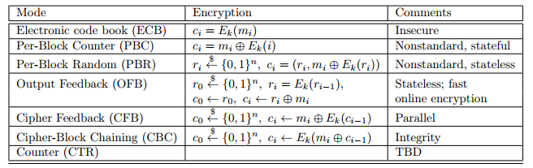
Encryption Modes of Operation

Slide 80
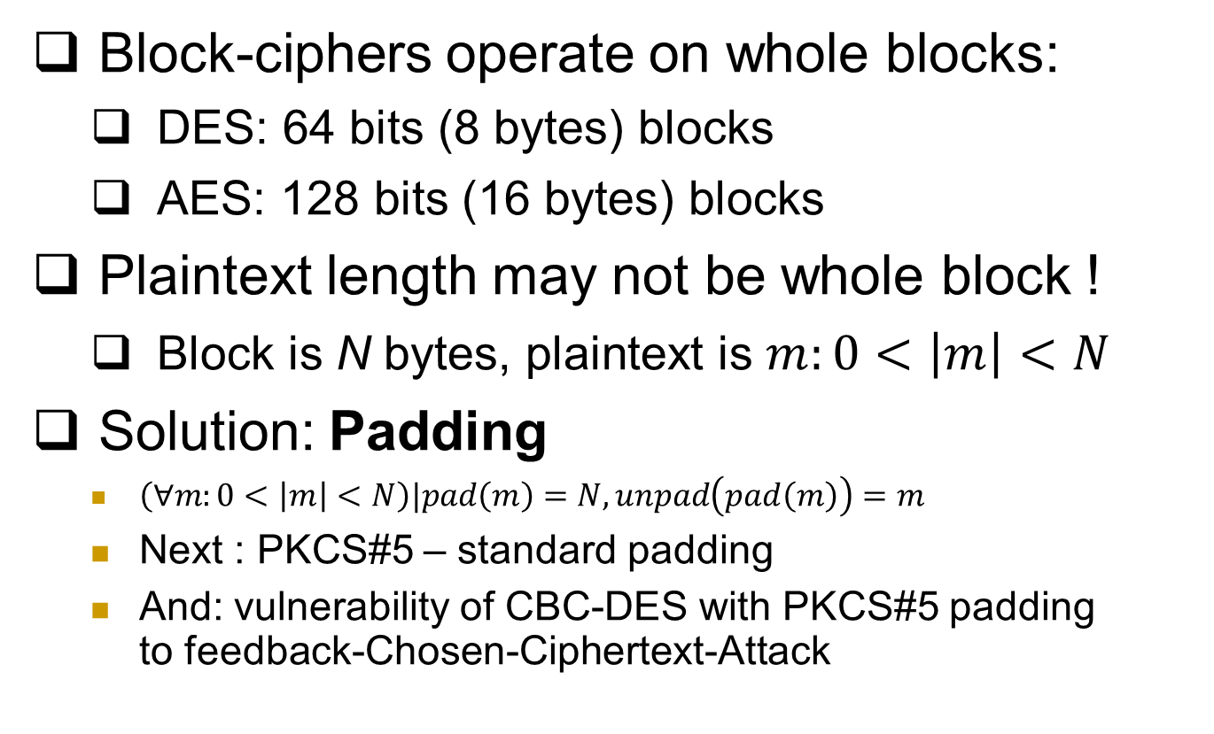
Note: Padding Encryption
Block-ciphers operate on whole blocks:
DES: 64 bits (8 bytes) blocks
AES: 128 bits (16 bytes) blocks
Plaintext length may not be whole block !
Block is N bytes, plaintext is $m:0<\left|m\right|<N$
Solution: Padding
$\left(∀m:0<\left|m\right|<N\right)|pad\left(m\right)=N, unpad\left(pad\left(m\right)\right)=m$
Next : PKCS#5 – standard padding
And: vulnerability of CBC-DES with PKCS#5 padding to feedback-Chosen-Ciphertext-Attack
skip

Slide 81
PKCS#5* padding (e.g.: 8 byte block)
If |m| mod 8 = 7 (one byte short of block): Pad(m)=m || ’1’
If |m| mod 8 = 6: Pad(m)=m || ’22’
….
If |m| mod 8 = 1: Pad(m)=m || ’7777777’
If |m| mod 8 = 0 (string end on complete block): Pad(m)=m || ’8…8’
Unpad(m): {
If |m| mod 8 = 0 then
{if m[1]=’1’ then return UnPad(m)=m[|m|…2]
if m[1..2]=‘22’ then return UnPad(m)=m[|m|…3]
…}
Unpad(m)=ERROR }
Examples: 1. pad(‘abcde’)=‘abcde22’, pad(‘stranger’)=‘stranger88888888’ [padding of longer strings]
2. unpad(‘5/5/2021’)=‘5/5/202’;
3. unpad(‘UnPad’) = ?
3. Show how padding facilitates exhaustive search
Notes:
* I think I’ve simplified a bit, if I’m not wrong, PKCS actually concatenates the corresponding binary strings (01x, etc.), but this is simpler and attack is essentially the same

Slide 82
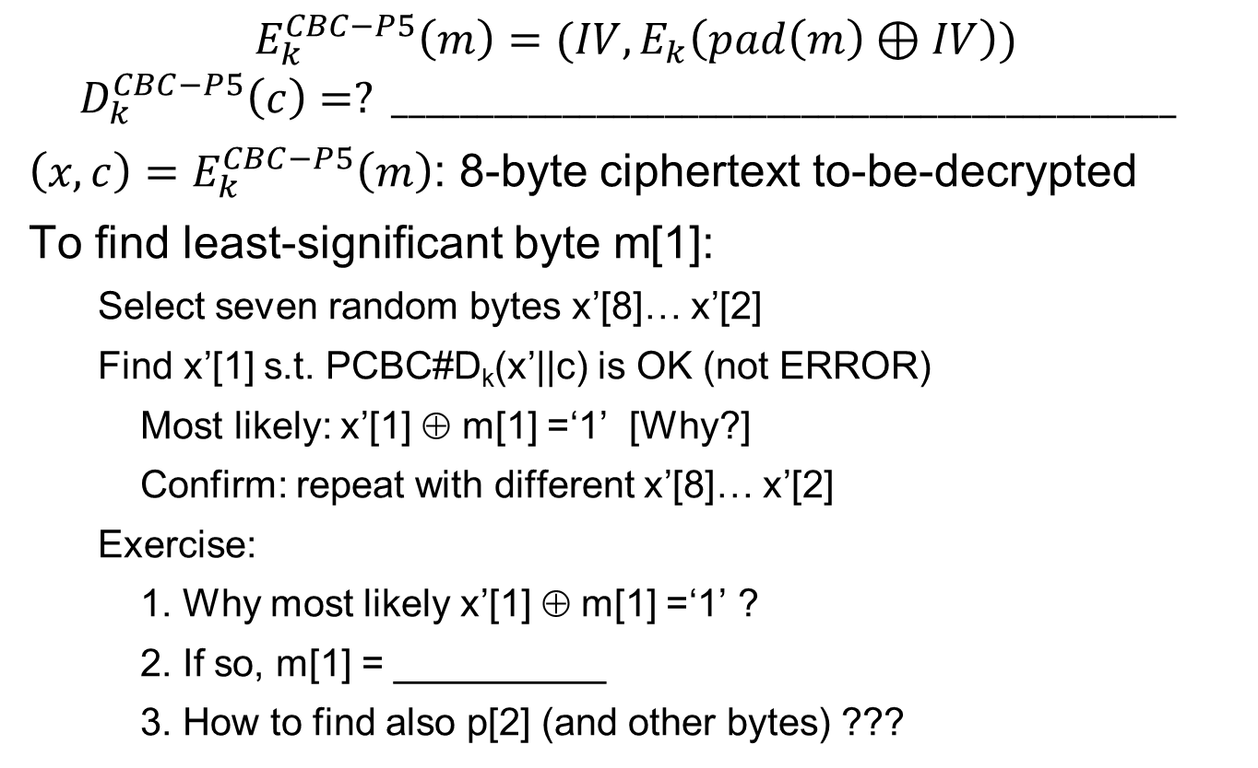
Feedback-CCA attack on CBC with PKCS#5
$$E_{k}^{CBC−P5}\left(m\right)=(IV,E_{k}\left(pad\left(m\right)⊕IV\right))$$
$$D_{k}^{CBC−P5}\left(c\right)=? ______________________________________________$$
${\left(x,c\right)=E}_{k}^{CBC−P5}\left(m\right)$: 8-byte ciphertext to-be-decrypted
To find least-significant byte m[1]:
Select seven random bytes x’[8]… x’[2]
Find x’[1] s.t. PCBC#D_{k}(x’||c) is OK (not ERROR)
Most likely: x’[1] ⊕ m[1] =‘1’ [Why?]
Confirm: repeat with different x’[8]… x’[2]
Exercise:
1. Why most likely x’[1] ⊕ m[1] =‘1’ ?
2. If so, m[1] = __________
3. How to find also p[2] (and other bytes) ???

Slide 83
Ensuring CCA Security
Give no feedback on failure? Harder to resolve problems ☹
Possible with minor changes to PKCS#5 unpad, e.g.:
Check only last byte (other added bytes randomized)
If last byte is not valid (‘1’ to ‘8’): return entire message (no pad)
Decryption never returns ERROR ➔ foils padding attack!
Better: `prevent` decryption queries!
How?
Use secret key (also) to `sign/authenticate` ciphertext…
And decrypt only properly authenticated ciphertext
Output `failure` if given unauthenticated ciphertext
How to authenticate? We’ll see in next lecture…
Instead we see how not to authenticate - and encrypt…
Another real-life example… WEP

Slide 84
Use Case: WEP (In)Security
WEP: Wired Equivalent Privacy
Known insecure (2001!), still widely used
Between mobile and access point
Often same key is shared to all mobiles
Confidentiality: RC4 encryption (PRG)
Seed: 24-bit per-packet `IV' and 40/104 bit key
WEP_k(m)=[IV,RC4(IV||k)+(m||crc(m)]
Integrity and authenticity: CRC [next]
And optional (init) authentication exchange

Slide 85
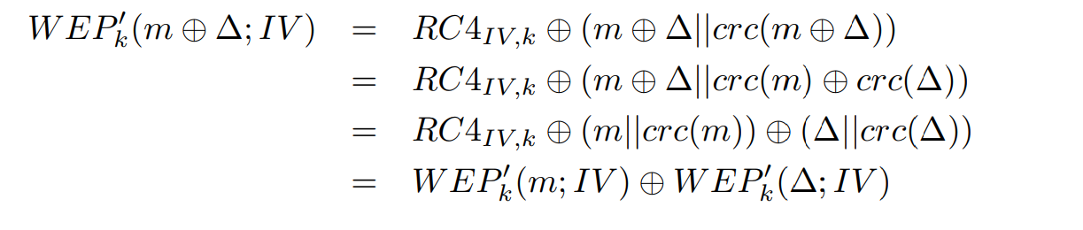
WEP Integrity
Integrity: 32-bit CRC
Linear: CRC(m+m')=CRC(m)+CRC(m')
+ is XOR
WEP(m)=RC4+[m||CRC(m)]
Insecure:

Slide 86
WEP Authentication… & Encryption
`Authentication`:
Shared-Key Authentication:
Access point sends random R
Mobile sends WEP(R;IV)
Open-System Authentication [=no authentication]
A known-plaintext oracle
Deadly for 40-bit cipher ☹
Known R ➔ known RC4(k,IV)
~ 2^24 req’ ➔ known RC4(k,IV) for most IVs
Attacker can decrypt most messages!

Slide 87
WEP Encryption
24-bit IV-reuse: WEP_k(m)=[IV,RC4(IV,k)+(m||crc(m)]
Shared-key authentication gives R,WEP(R)
Easy decryption on IV reuse!
Hence: use open-system (i.e., no) authentication
Even w/o auth: same-pad `encryption’ for messages using same IV...
Exploit insecure integrity
Change dest IP to attacker → get plaintext!
Exploit WEP use of `plain' RC4 (not RC4-drop)

Slide 88
Hybrid Encryption (`enveloping`)
Public key cryptosystems (PKG,PKE,PKD) are slow
Also: most (e.g. RSA) have fixed block size (FIL)
Using a long block size is veeeery slooow
Using CBC etc. is also too wasteful
Use VIL secret key cryptosystem (SKG,SKE,SKD) (e.g. CBC,OTP); encrypt shared key and use it to encrypt plaintext
e
Encryption
Decryption
k ←SKG(1^{k})
ck
ck← PKE_{e}(k)
k← PKD_{d}(ck)
Plaintext p
c
c←SKE_{k}(p)
SKD_{k}(c)
Notes:
88
10/30/11

Slide 89
Encryption: at what phase?
Related goals:
Compression
Error-detection code
Integrity, authentication
Can’t compress ciphertext
Redundancy in plaintext may help attacker
➔ Compress then Encrypt
Message
Compress
Plaintext
Encrypt
Ciphertext
But: compress-then-encrypt is not IND-CPA-Secure! Why?? Challenge: define, solve…

Slide 90
Exploiting Length-Exposure
Side-channel attacks on TLS sites
CRIME and TIME attacks
Web 2.0: auto-suggest/complete, preload…
Script sends keystrokes, server responds
Size of response may reveal keystrokes, choices
See: Chen et al, `Side channel Leaks in Web Applications’, S&P 2010 (and follow-ups)

Slide 91
Encryption: at what phase?
Plaintext redundancy
☺ Authenticates ?
☹ May help attacker
E.g.: turn KPA into COA ! [GSM]
So: compressing plaintext is good!
Can’t compress ciphertext
➔ Compress then Encrypt
Message
Compress
Plaintext
Encrypt
Ciphertext
Compress-then-encrypt is not IND-CPA-Secure! Why?? Challenge: define, solve…

Slide 92
Error Detection / Correction
EDC/ECC on plaintext?
Motivation: detect fake ciphertext (integrity)
But may help attacker
Adds (much) redundancy to plaintext
Validate key guess
Turn KPA into COA [GSM]
And: error in ciphertext invalidates EDC/ECC !
➔ Better: Encrypt before Error Detection
Message
Compress
Plaintext
Code
Plaintext
EDC
Encrypt
Ciphertext

Slide 93
Encryption and Error Detection (2)
Does Encrypt-then-Add-EDC protect integrity?
No…
Example: WEP (next)
Integrity / authenticity: next topic
Message
Compress
Plaintext
Encrypt
Ciphertext
Code
Ciphertext
EDC

Slide 94
Encryption: Final Words
Basic goal of cryptography
Focus: computationally-limited adversaries
Principles:
Kerckhoff’s: Known Design
Sufficient Key Space
Crypto Building Block: build schemes from simple, standard functions
Constructions & reductions: PRG→PRF→PRP→Enc
Secure system design: easy to use securely, hard to use incorrectly!

Slide 95
Encryption: Final Words...
Many variants…
One important example is Homomorphic encryption: E(m₁+m₂)=EncAdd(E(m₁),E(m₂))
Where EncAdd is an efficient algorithm
Fully-homomorphic : also E(m1*m2)=EncMult(E(m1), E(m2))
Very inefficient designs, huge keys… but lots of research!

Slide 96
Thank You!
Amir Herzberg

Slide 97
Common mistakes -
See eg An Empirical Study of Cryptographic Misuse in Android Applications (CCS’13)

Slide 98
Deployment Issues
– PK-crypto is slow; how to encrypt long msgs?
– Encryption and compression ?
– Dealing with errors (and corruptions)
-- Versions: downgrade attacks

Slide 99
CTR mode

