Slide 1
Indoor Monitoring
Rasjaad, Marcel, Diego, Sebastiaan, Faustino and Ryan

Slide 2
Contents
Introduction
Setup Project
Hardware and sensor setup/explanation
Bluetooth low-energy setup/explanation
Android Application
Demo

Slide 3
Introduction
Problem: Sensor to measure conditions in room
Fitted into small box
Meant to be kept in a plug
Data sent to an app made for Android
Completely independent

Slide 4
Setup project
Agile development
Physical sprint board
Team split in 3 groups

Slide 5
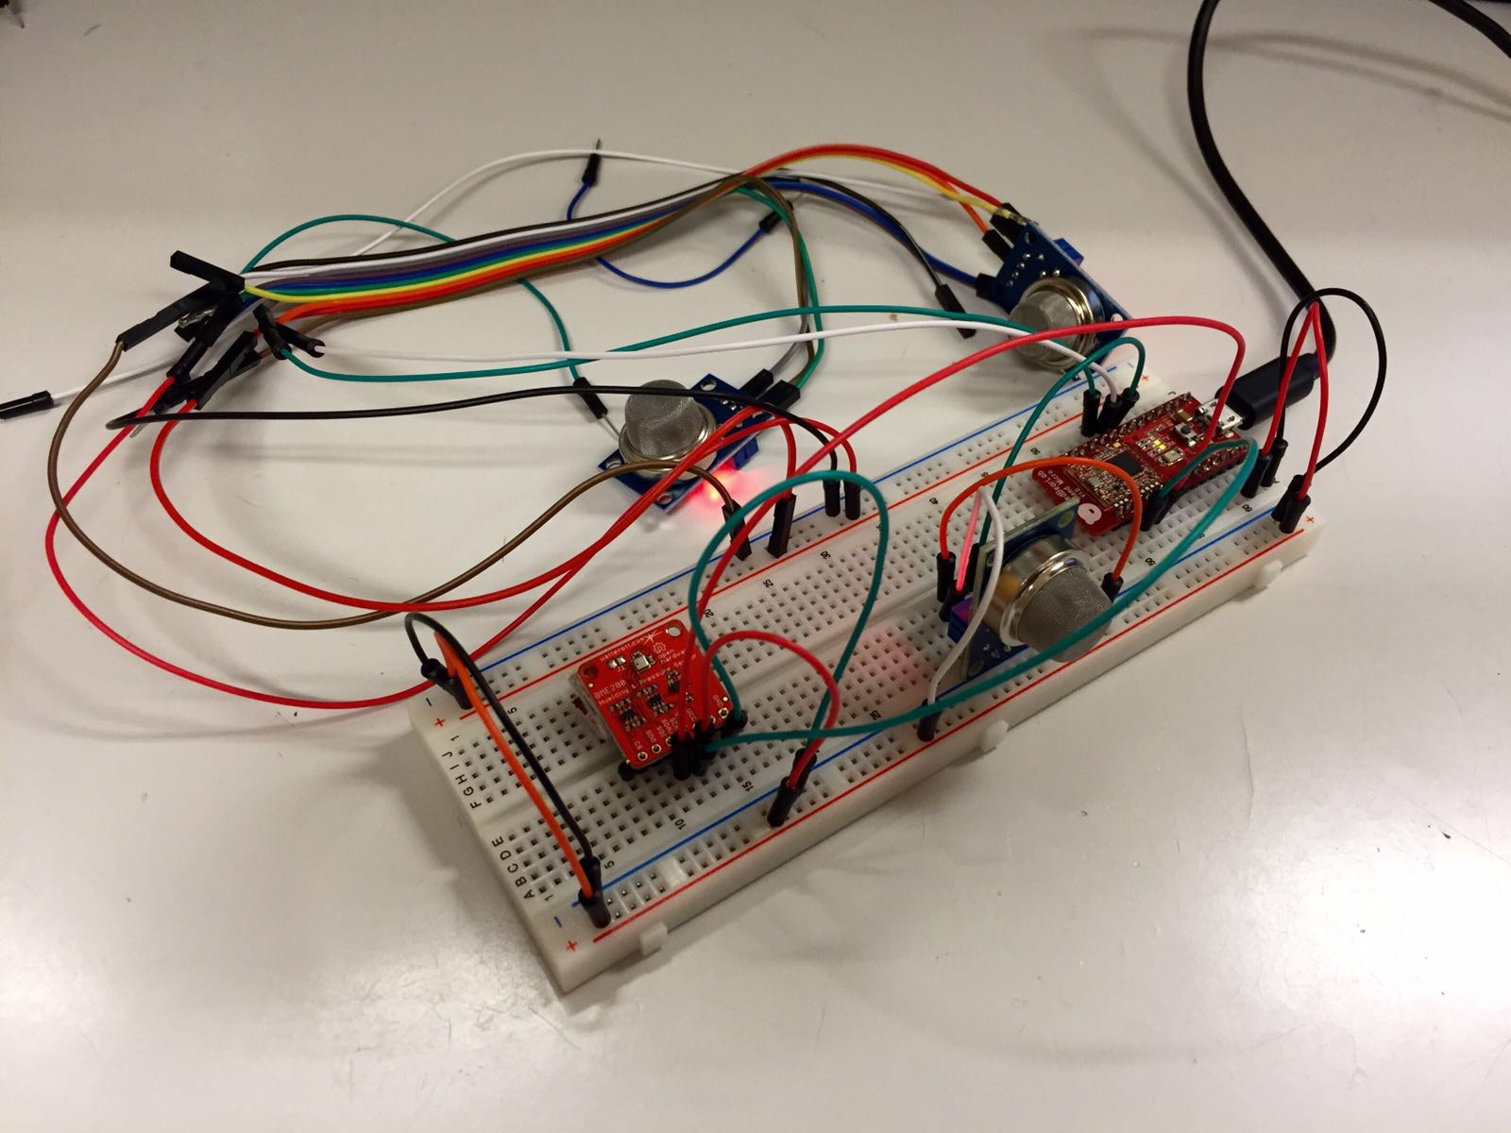
Hardware
6 sensors
Connected with microcontroller
I2C & analog
Board programmed with C++
Gas-sensors don’t give useful values
Notes:
We have 6 different sensors:
Temperature
Humidity
Pressure
Air Quality (Could be used to control windows automatically)
Smoke Sensor (Particle)
LPG, Methan, Alcohol
All are connected to the microcontroller / arduino. They are also powered from the arduino.
They are using different communication methods:
I2C
Analog
Programmed with C++
We can’t use the GAS Sensor values.
Would need to do a calibration
Define a Threshold

Slide 6

Bluetooth connection
Board has Bluetooth adapter on-board
Acts as beacon
Capable of transmitting JSON to several devices
19 bytes per transmission

Slide 7
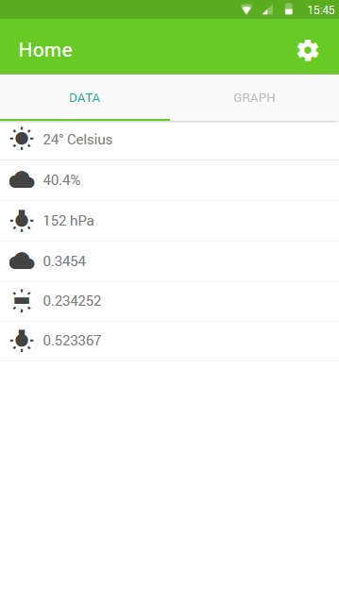
Android application
Collect bytes sent from Bluetooth to JSON
Decodes the JSON string back to an object with values
Shows the values in a simple UI
Graph is for future development

Slide 8
ADD GOOGLE PLAY STORE LINK

