Slide 1

A Measurement of Boltzmann’s Constant using Video Microscopy of Brownian Motion
Ryan Z. Nie
In collaboration with Zack Klappenbach
Advanced Laboratory, Physics Department, Boston University, 02215
Advanced Laboratory Seminar Series

Slide 2
Table of Contents
Theory
Experimental Setup
Data Extraction
Results
Q+A
Advanced Laboratory Seminar Series

Slide 3




Theory
Assuming particles are perfect spheres
𝜇 : linear drag coefficient
𝜂 : coefficient of viscosity
a : radius of particles
T : temp. (K) of particles
k : Boltzmann’s constant
Experiment:
Measure mean squared displacements of particles
s : <R^2>/t
Theory, Experiment Setup, Data Extraction, Results, Q+A

Slide 4
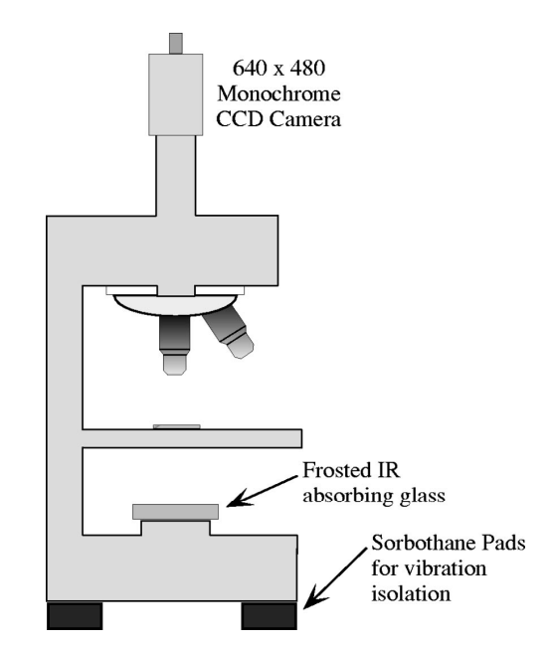
Experiment Setup
Carboxylate 3μm micron microspheres on slide
Swift Sw380t 40x-2500x magnification microscope
Raspberry Pi to project videos of moving particles onto linux computer
Saved videos for further analysis
Theory, Experiment Setup, Data Extraction, Results, Q+A
Notes:
Vibration

Slide 5
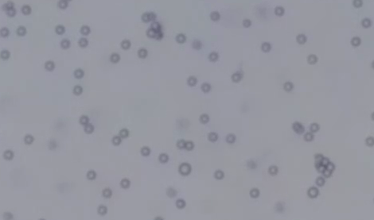
Data Extraction
Using recorded videos
Tracker used to extract X-Y coordinates
Export data for further analysis and linear model on Python
Theory, Experiment Setup, Data Extraction, Results, Q+A
Notes:
Coordinates

Slide 6
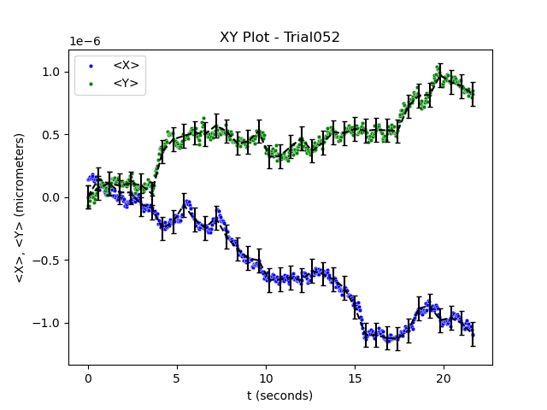
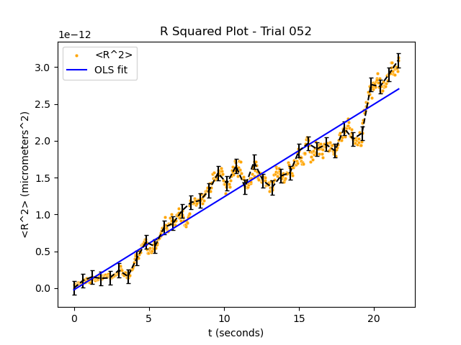
Results
Pitre’s value: 1.38 × 10^−23 J/K *
Average experimental value: (5.01 ± 0.87) × 10^−24 J/K over 3 trials
*Pitre, L. New measurement of the boltzmann constant k by acoustic thermometry of helium-4 gas. Metrologia 54, 6 (2017).
Theory, Experiment Setup, Data Extraction, Results, Q+A
Notes:
Errors with positions and pixels on Tracker
Shaking of apparatus
Uncertainty with temperature, radius of spheres,viscosity and positions

Slide 7
Thank you! Q+A?
Theory, Experiment Setup, Data Extraction, Results, Q+A

Slide 8
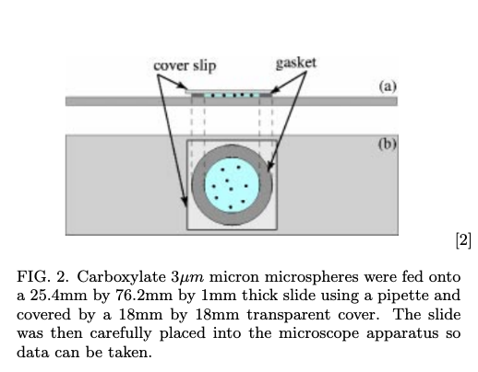

Slide 9
