Slide 1
PI OVEN
Edge LLM optimization
on Raspberry Pi
Qwen2.5 1.5B Q4_K_M | llama.cpp | CPU-only ARM64
Notes:
[Sources]
- Repository README.md
- results/benchmark_results.jsonl
[/Sources]

Slide 2
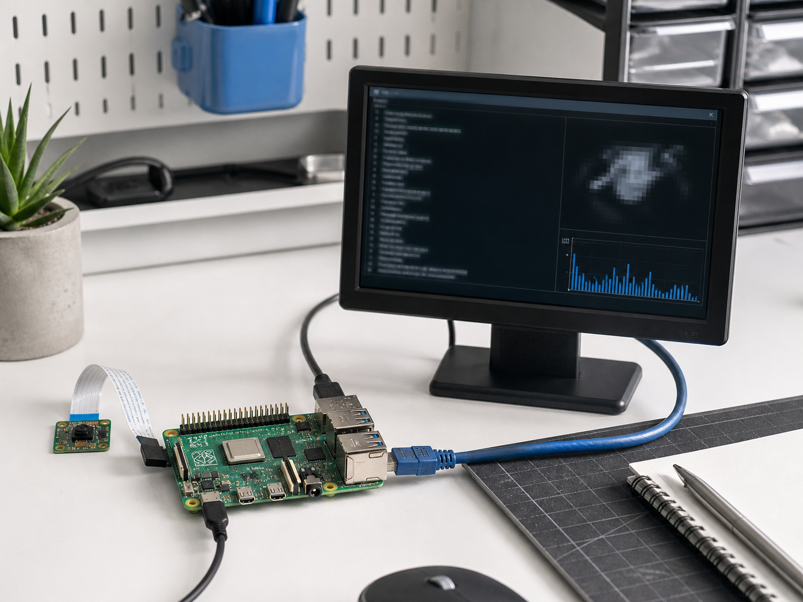
Edge inference turns optimization into a systems problem
CPU-only
Small devices expose every bottleneck
Limited RAM
Token latency
Model weights and KV cache
compete for memory
Each generated token needs
another forward pass
2
Notes:
[Sources]
- Generated edge-inference motivation image (built-in image generation tool)
- Repository README.md
[/Sources]

Slide 3
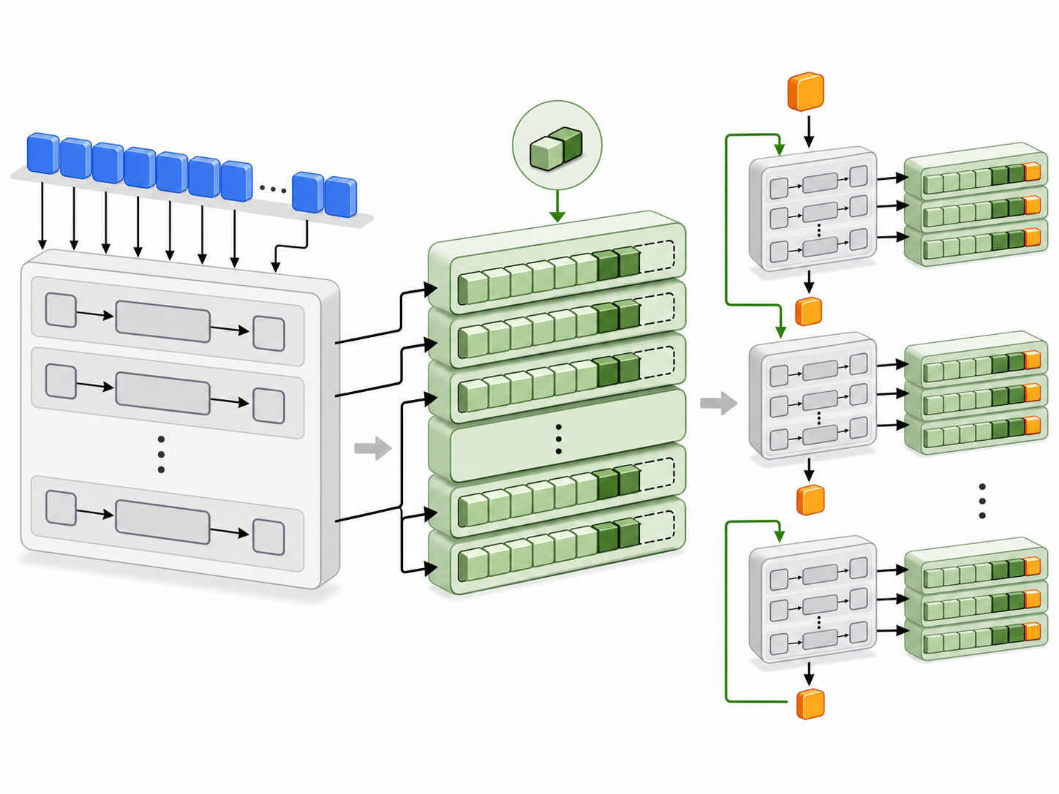
Prefill builds context; decode reuses it one token at a time
No cache
repeats the whole sequence
Prefill processes all prompt tokens in parallel and creates key/value tensors at every layer. The KV cache stores that context. Decode then evaluates only the newest token, attends to cached history, and appends the next key/value pair.
3
Notes:
[Sources]
- Generated KV-cache flow image (built-in image generation tool)
- tinyserve/naive.py
- tinyserve/README.md
[/Sources]

Slide 4
The completed run establishes a usable CPU baseline
Nine successful runs cover KV-cache precision, thread scaling, speculative decoding, llama-bench throughput, and Linux perf counters.
3.080
7.112
3.628
tokens/s
tokens/s
cores
Best measured generation
Best measured prefill
Average CPU utilization
4
Notes:
[Sources]
- results/benchmark_results.jsonl
- results/perf_stat.txt
[/Sources]

Slide 5
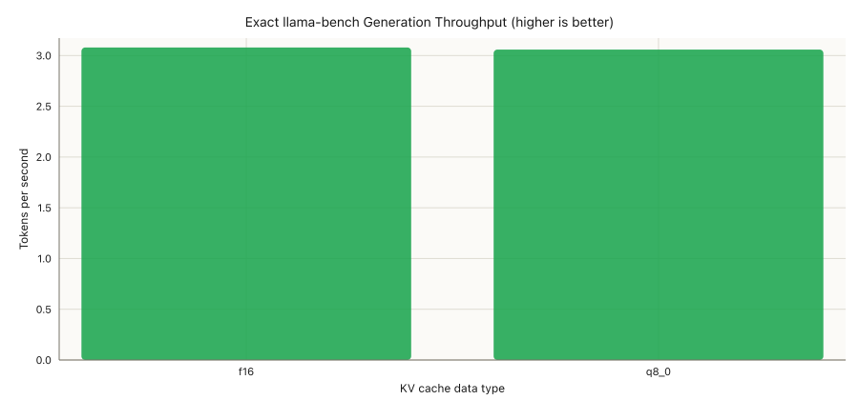
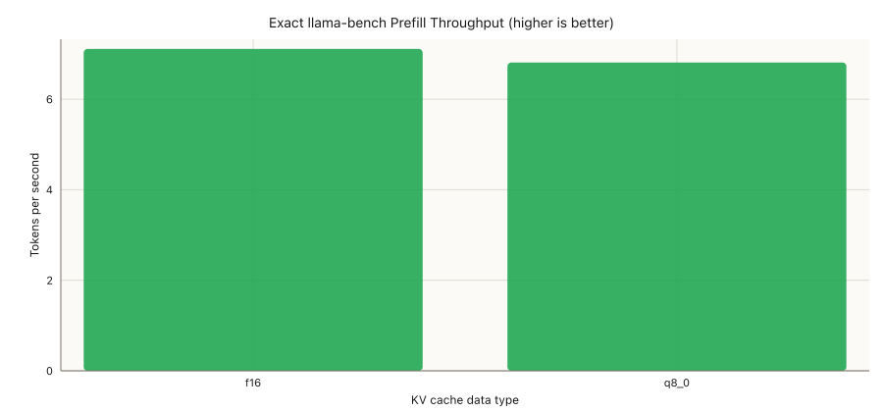
F16 and Q8 KV caches are effectively tied for generation
Generation: F16 leads Q8 by only 0.67%
Prefill: F16 leads Q8 by 4.23%
One sample per condition: treat small differences as directional, not conclusive.
5
Notes:
[Sources]
- results/plots/llama_bench_generation_throughput.png
- results/plots/llama_bench_prefill_throughput.png
[/Sources]

Slide 6
Two threads capture almost all available scaling
1.80x
speedup from 1 to 2 threads
98.422s
96.317s
2 threads
Best efficiency
4 threads
Fastest overall
6
Notes:
[Sources]
- results/plots/thread_scaling_wall_time.png
- results/benchmark_results.jsonl
[/Sources]

Slide 7
Speculative decoding is slower on this configuration
2.17x
longer wall time
The 0.5B draft model adds more work than it saves. Acceptance rate was not captured, so the run shows the outcome but not the exact cause.
7
Notes:
[Sources]
- results/plots/speculative_wall_time.png
- results/benchmark_results.jsonl
[/Sources]

Slide 8
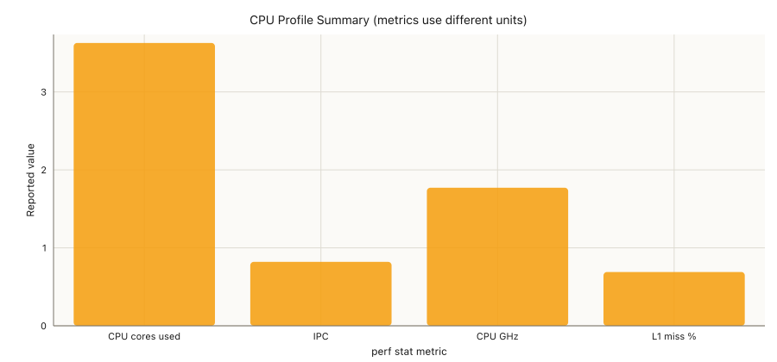
The CPU is well utilized, but pipeline efficiency is modest
3.628 cores
90.7% of the four-core budget
0.82 IPC
Substantial execution stalls remain
0.69% L1 miss
L1 cache is not the obvious bottleneck
8
Notes:
[Sources]
- results/plots/perf_summary.png
- results/perf_stat.txt
[/Sources]

Slide 9
The best method depends on whether speed or efficiency matters
Use the winner within each comparable category; do not compare normalized scores across different metrics.
Decision | Winner | Measured result | Confidence | Recommendation
Generation speed | F16 KV | 3.080 tok/s | Low | Tie in practice with Q8
Prefill speed | F16 KV | 7.112 tok/s | Low | Retest with repetitions
Lowest latency | 4 threads | 96.317 s | Medium | Use for fastest response
CPU efficiency | 2 threads | 98.422 s | Medium | Only 2.2% behind four
Decode method | Standard Q8 | 2.17x faster | Medium | Skip speculative for now
Lowest memory | Unknown | RAM not captured | None | Measure RSS before deciding
9
Notes:
[Sources]
- results/analytics/summary.csv
- results/analytics/report.md
[/Sources]

Slide 10
NEXT
Make the next run
comparison-grade
3+ repetitions with warmup
Actual token count and TTFT
Peak RAM, temperature, and speculative acceptance rate
Notes:
[Sources]
- results/analytics/report.md
[/Sources]

