Slide 1
PI OVEN
Edge LLM optimization
on Raspberry Pi
Qwen2.5 1.5B Q4_K_M | llama.cpp | CPU-only ARM64
Notes:
[Sources]
- Repository README.md
- results/benchmark_results.jsonl
[/Sources]

Slide 2
The completed run establishes a usable CPU baseline
Nine successful runs cover KV-cache precision, thread scaling, speculative decoding, llama-bench throughput, and Linux perf counters.
3.080
7.112
3.628
tokens/s
tokens/s
cores
Best measured generation
Best measured prefill
Average CPU utilization
2
Notes:
[Sources]
- results/benchmark_results.jsonl
- results/perf_stat.txt
[/Sources]

Slide 3
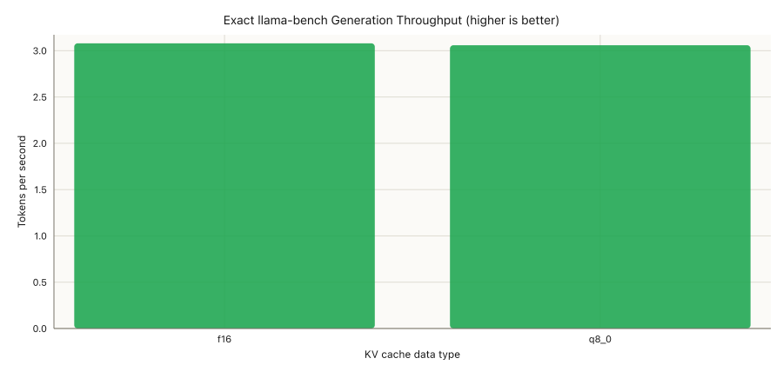
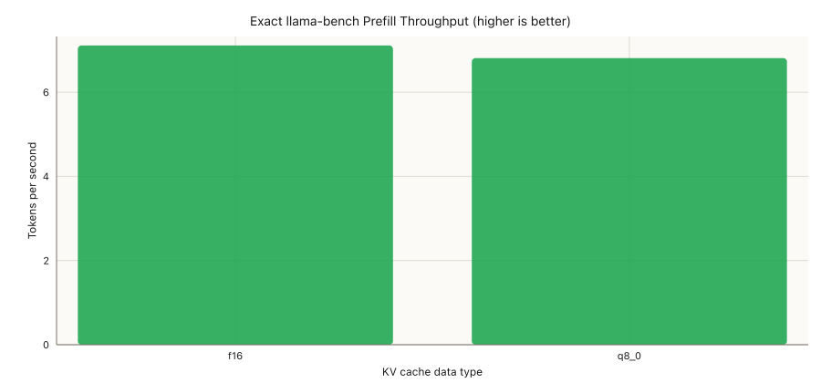
F16 and Q8 KV caches are effectively tied for generation
Generation: F16 leads Q8 by only 0.67%
Prefill: F16 leads Q8 by 4.23%
One sample per condition: treat small differences as directional, not conclusive.
3
Notes:
[Sources]
- results/plots/llama_bench_generation_throughput.png
- results/plots/llama_bench_prefill_throughput.png
[/Sources]

Slide 4
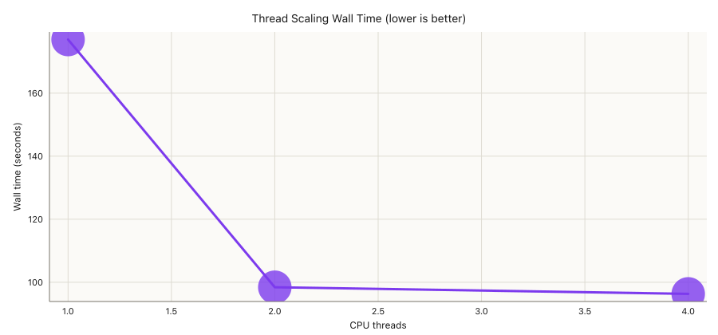
Two threads capture almost all available scaling
1.80x
speedup from 1 to 2 threads
98.422s
96.317s
2 threads
Best efficiency
4 threads
Fastest overall
4
Notes:
[Sources]
- results/plots/thread_scaling_wall_time.png
- results/benchmark_results.jsonl
[/Sources]

Slide 5
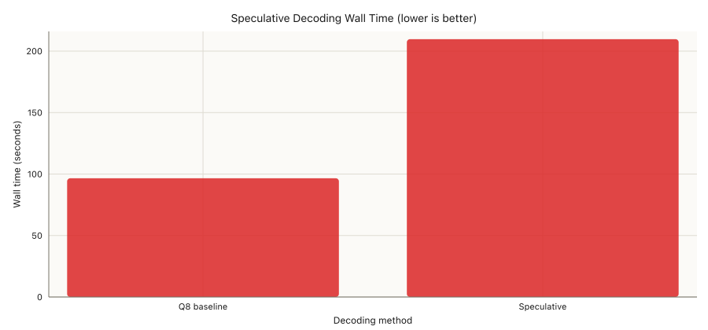
Speculative decoding is slower on this configuration
2.17x
longer wall time
The 0.5B draft model adds more work than it saves. Acceptance rate was not captured, so the run shows the outcome but not the exact cause.
5
Notes:
[Sources]
- results/plots/speculative_wall_time.png
- results/benchmark_results.jsonl
[/Sources]

Slide 6
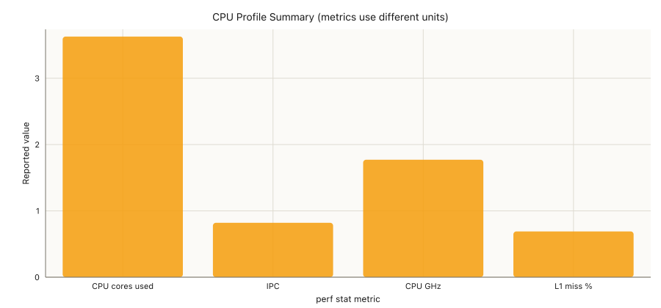
The CPU is well utilized, but pipeline efficiency is modest
3.628 cores
90.7% of the four-core budget
0.82 IPC
Substantial execution stalls remain
0.69% L1 miss
L1 cache is not the obvious bottleneck
6
Notes:
[Sources]
- results/plots/perf_summary.png
- results/perf_stat.txt
[/Sources]

Slide 7
The best method depends on whether speed or efficiency matters
Use the winner within each comparable category; do not compare normalized scores across different metrics.
Decision | Winner | Measured result | Confidence | Recommendation
Generation speed | F16 KV | 3.080 tok/s | Low | Tie in practice with Q8
Prefill speed | F16 KV | 7.112 tok/s | Low | Retest with repetitions
Lowest latency | 4 threads | 96.317 s | Medium | Use for fastest response
CPU efficiency | 2 threads | 98.422 s | Medium | Only 2.2% behind four
Decode method | Standard Q8 | 2.17x faster | Medium | Skip speculative for now
Lowest memory | Unknown | RAM not captured | None | Measure RSS before deciding
7
Notes:
[Sources]
- results/analytics/summary.csv
- results/analytics/report.md
[/Sources]

Slide 8
NEXT
Make the next run
comparison-grade
3+ repetitions with warmup
Actual token count and TTFT
Peak RAM, temperature, and speculative acceptance rate
Notes:
[Sources]
- results/analytics/report.md
[/Sources]

