Slide 1
Fractional Oxidational States
Group work done by:
Yash
Ayush
Atharv

Slide 2
What are Fractional Oxidational Numbers?
Fractional oxidation numbers, also known as non-integer or non-whole number oxidation numbers, are a concept in chemistry that arises when an atom in a chemical compound does not have a clear integer oxidation number. This situation typically occurs in covalent compounds where electrons are shared between atoms.
Fractional oxidation numbers are a way to represent this unequal sharing of electrons, even though oxidation numbers are typically assigned as whole numbers. They provide a simplified and approximate way to describe the electron distribution in covalent compounds.

Slide 3
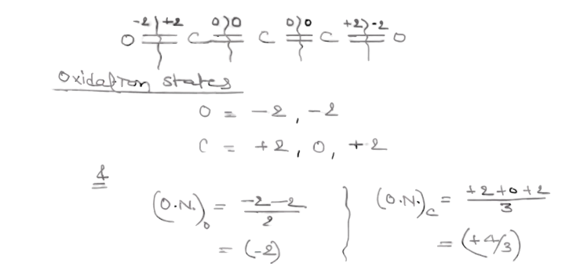
C₃O₂

Slide 4
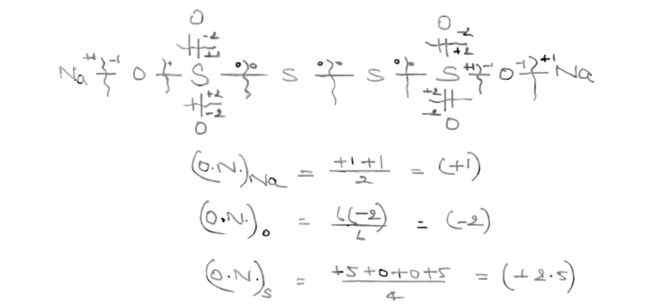
Na₂S₄O₆

Slide 5
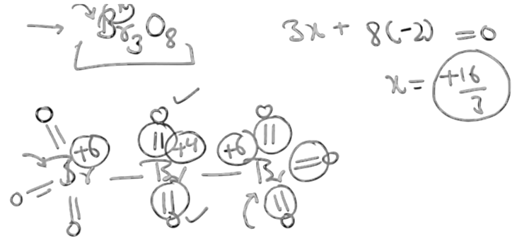
Br₃O₈

Slide 6
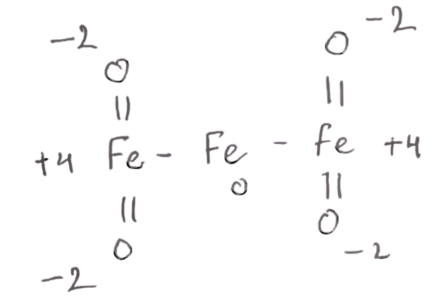
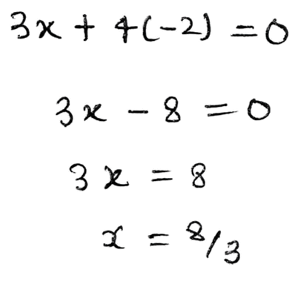
Fe₃O₄

Slide 7
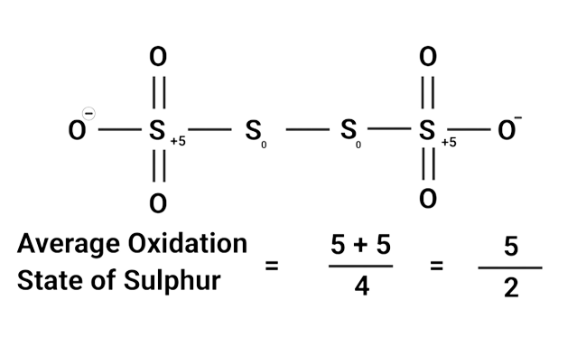
S₂O₆²⁻

Slide 8
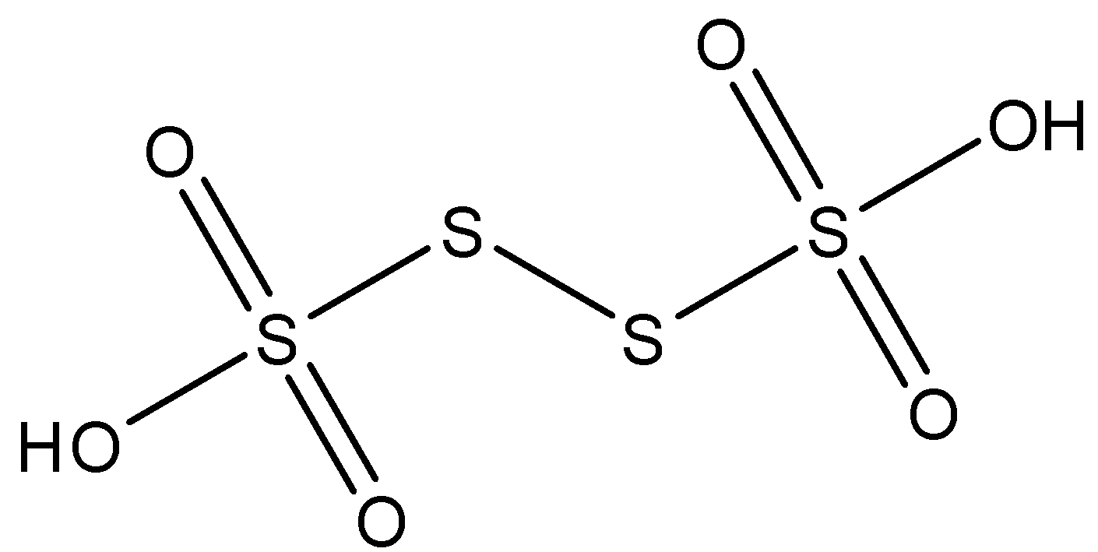
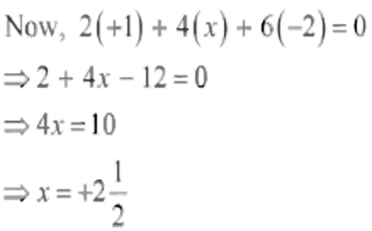
H₂S₄O₆

Slide 9


