Slide 1
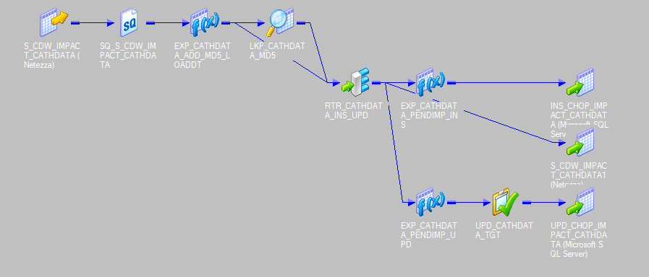
Cardiac Registry Data Load Overview
1
2
3
4a
SQL query called
4b
1
2
MD5 Hash added
6
3
MD5 Lookup and comparison done on staging table to determine if “load flag” should be set to 1 or 0
5
4
Inserts into staging tables (CardioAccess and CDW)
5
Updates into staging table
6
Staging table loads CardioAccess table using triggers that fire upon INSERT or UPDATE of staging table loading records where “load flag” is set to 1 (new and updated records).

