Slide 1
Sts registry automation for anesthesia
Douglas Ryba
Cardiac Center Data Engineer

Slide 2
Background
Goal: To eliminate as much manual data entry as possible for Anesthesiologists for the STS Registry in CardioAccess.
Approach: Through collaboration between clinical experts and data engineering, we can properly define each measure of the registry and update vendor database with appropriate values from EMR.
Clinical Validation: Dr. Manrique and I worked through many iterations to refine the data generated vs. the clinically correct data.
Notes:
How long does this take to do, per case, on average?
Goal: Eliminates unneeded, repetitive work, reduces errors, makes for more timely filing.

Slide 3
Overview
Scope – STS Registry – Anesthesia
122 fields will automatically be entered for you in CardioAccess
Accounts for roughly >80% of all potentially entered fields.
Upon Go-Live, Anesthesiologists will only enter the Surgical case number in CardioAccess to trigger the automation. Working towards full automation in the near future (Phase II)
Time spent in CardioAccess should only be a few minutes per case
Will need to add Medications and skim each case to validate and “sign off”
Notes:
Validation/Sign off – Definition change vs. Program error

Slide 4
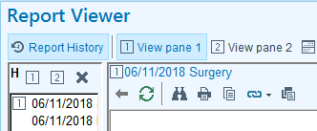

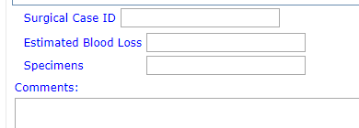
Workflow walk-through
Will need to manually add the Surgical Case ID to the Operative Tab
Data Elements will be added to STS Registry the following day
Project is underway to auto-create an encounter ID upon Surgical scheduling which would eliminate this step (Phase II)

Slide 5
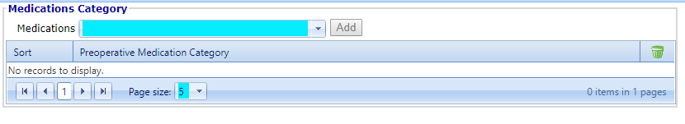
Data elements out of scope
Anesthesia Preop – Medications

Slide 6
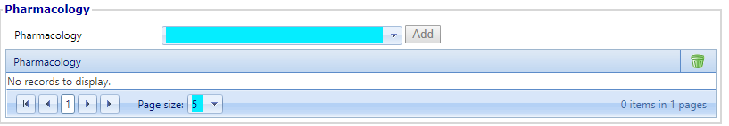
Data elements out of scope
Anesthesia Intraop – Pharmacology

Slide 7

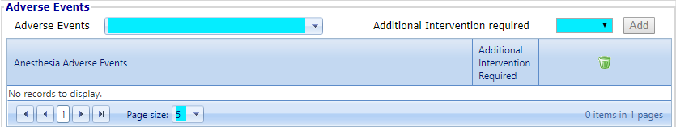
Data elements out of scope
Anesthesia ICU/PACU – Pharmacology
Anesthesia ICU/PACU – Adverse Events
Pacemaker Needed upon Arrival – Site/Type
Peri-Anesthesia Demise

Slide 8
Next steps
Broader Data Validation
Data Automation Go-Live (Oct. 1)
Tighter QA during initial phase
On-going QA on a regular basis
Ongoing Maintenance
Upgrades (Epic / CardioAccess)
Break-fix
Enhancements – Additions
Feedback/Questions

