Slide 1
Ranking pages in a whole user journey
Douglas Adams & Jakub Rybak
Notes:
Douglas

Slide 2
Outline
Overview: Existing vs proposed solution
Context-based approaches
Content-based approaches
Context + content based approaches
Notes:
Douglas

Slide 3
Overview
Notes:
Jakub

Slide 4
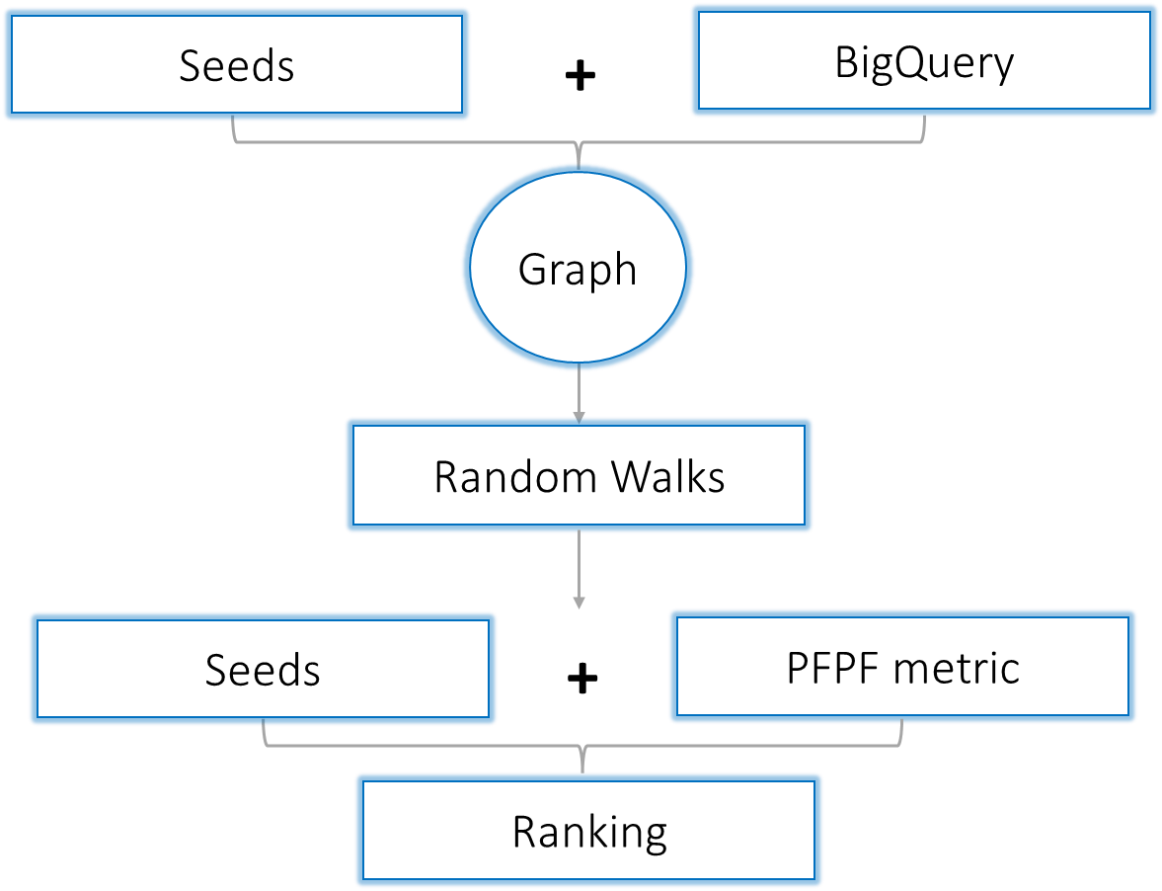
Current approach
Notes:
Jakub

Slide 5
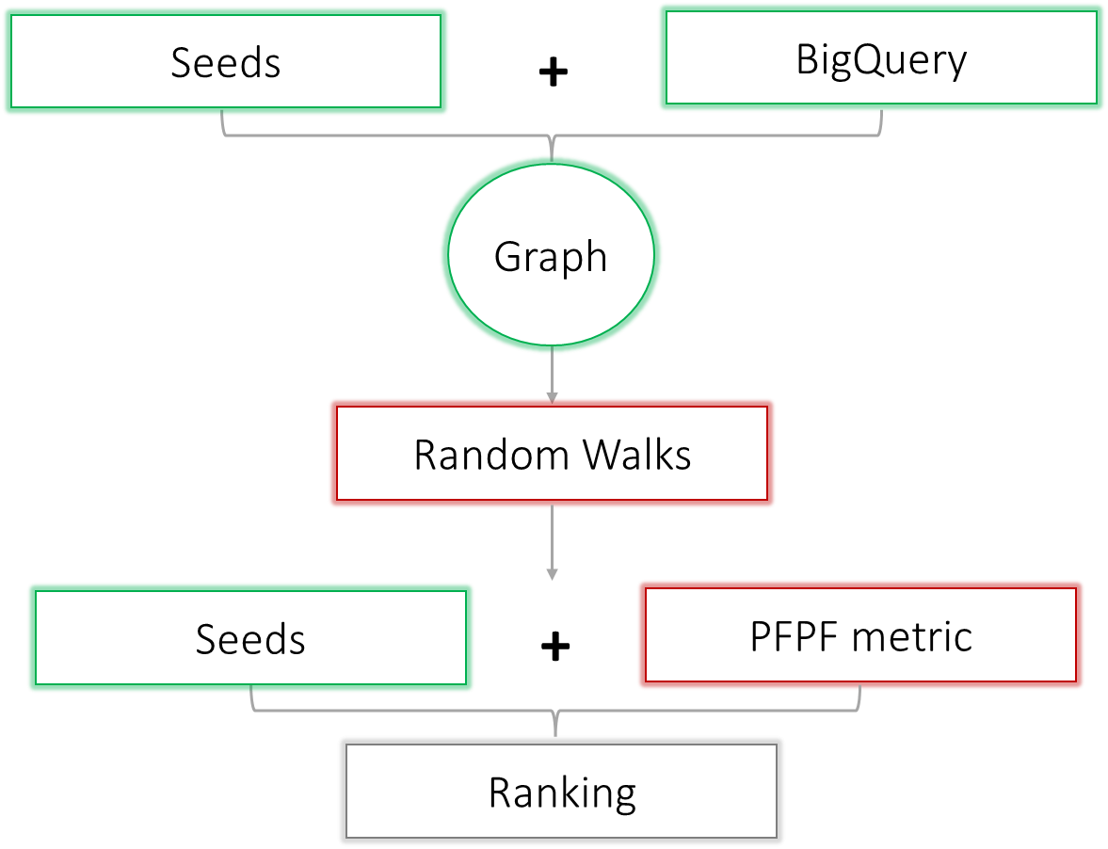
Our modifications
Notes:
Jakub

Slide 6
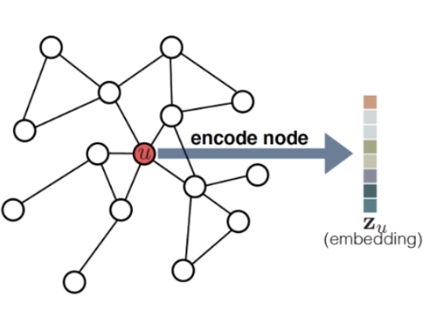
Key points
Second-order random walks (Node2vec)
Embedding graphs into vector spaces
NER data as “features”
Notes:
Jakub

Slide 7
Hypotheses
What makes pages / nodes similar?
Context: pages with a similar context tend to be similar
Content: pages with similar content tend to be similar
Notes:
Jakub

Slide 8
Context-based approaches
Random walks
Notes:
Jakub

Slide 9
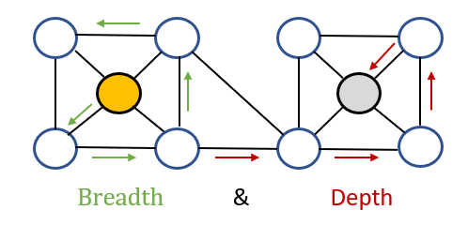
Context similarity: sampling
Similarity hypothesis:
nodes in a similar context tend to be similar
How to sample from graphs: random walks (one option)
Second-order r. w.
Notes:
Jakub

Slide 10
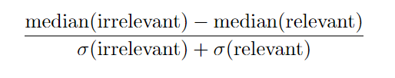
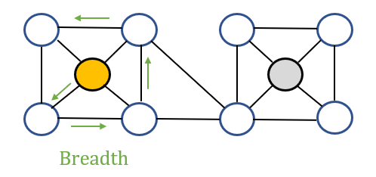
Context similarity: results
Label top 100 pages from original algorithm (relevant / irrelevant).
Original method ≃ 0
Second-order random walks ≃ 0.22
Second-order random walks & cosine similarity (node2vec) ≃ 0.24
Notes:
Jakub

Slide 11
Some issues
Directly optimises embeddings
→ No parameter sharing
→ Not applicable to unseen nodes
Does not consider content of nodes
Notes:
Jakub

Slide 12
Content-based approaches
Named-entity recognition
Notes:
Douglas

Slide 13
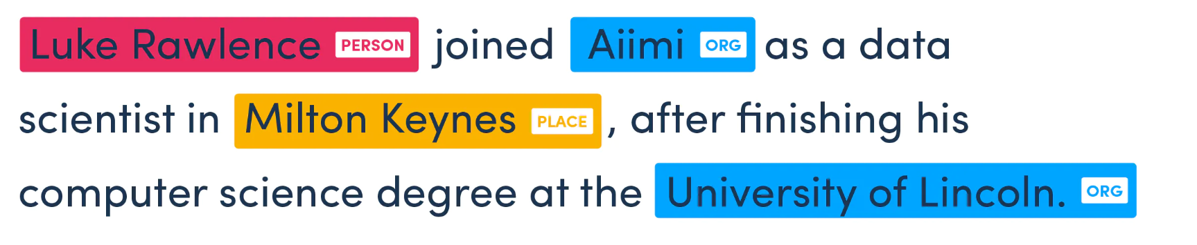
Named-entity recognition
Notes:
Douglas

Slide 14
Named-entity recognition
Used a pre-trained transformer which had been fine tuned to extract entities on gov.uk in a previous GDS project
Extracted >150,000 entities from the 10,614 pages in the ER subgraph
After removing entities with a frequency < 5 and those which had been misidentified, this reduced to just over 100,000
This list of 100,000 entities contained 1555 unique identities
Notes:
Douglas

Slide 15
Combining page context and content
Geometric deep learning
Notes:
Douglas

Slide 16
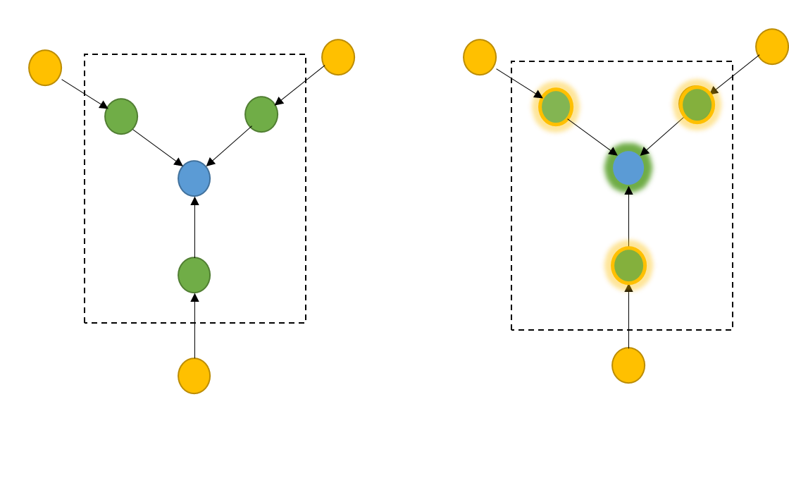
Graph neural networks
First layer
Second layer
Notes:
Douglas

Slide 17
Semi-supervised GNNs
x = nodes & features (10,614 pages,1555 features)
y = node labels (500 webpages; 1 = relevant, 0 = not relevant)
edge_index = links between pages (71,781 links)
edge_attr = weight of each link (1-10,786, higher = stronger)
Notes:
Douglas

Slide 18
Semi-supervised GNNs
Label a small set of nodes (500 nodes ~ 5%) and use these to train the model in a supervised fashion
Then use this trained model to make a small prediction about a small set of unlabelled nodes and add this to the training dataset and re-train
Notes:
Douglas

Slide 19
Semi-supervised GNNs
Graph Convolutional Network (GCN) model achieves up to 76% validation accuracy after training on 450 labelled nodes
This is comparable to a node classification accuracy of 81% on the standard Cora citation dataset with the same architecture
Other models such as the Graph Attention Network (GAT) achieved lower prediction accuracy
Notes:
Douglas

Slide 20
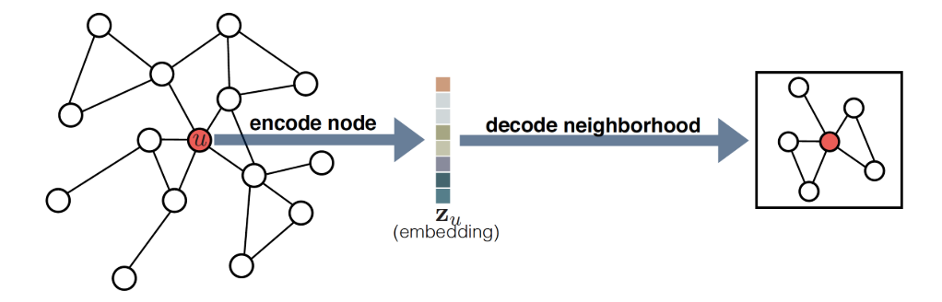
Unsupervised GNNs
GNN as an encoder-decoder model
Notes:
Jakub

Slide 21
Unsupervised GNNs
Statistic: probability of observing a neighborhood.
⇾ Node2vec, Word2vec
⇾ Negative sampling: samples from second-order RWs.
Two convolutional layers
Validation set: 10% randomly selected nodes
Ranking: cosine distances to seed nodes.
Notes:
Jakub

Slide 22
Comparing methods
Notes:
Jakub

Slide 23
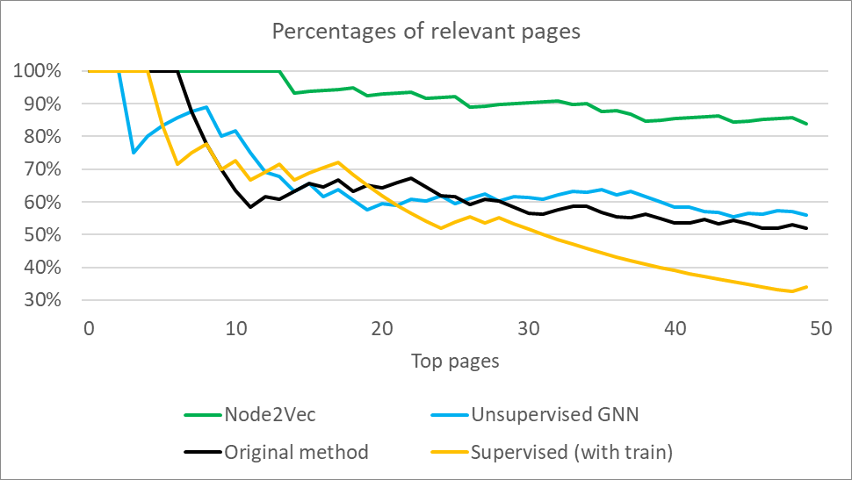
Comparison
For top k pages (x-axis), plot % of relevant pages (y-axis)
Two sets of labels
Notes:
Jakub

Slide 24
Outlook
Semi-supervised:
More representative training set
Different architectures etc
Node2vec: Combine different walk types
Unsupervised GNN: Optimise model architecture
Notes:
Jakub

Slide 25
Thank you!
Notes:
Jakub

