Slide 1

Java
Java Concurrency
Александр Помосов

Slide 2
Reminder
Отметьтесь на портале
‹#›

Slide 3
Reminder
Обновите репозиторий
‹#›

Slide 4
Agenda
Multithreading basics
Concurrency challenges
java.util.concurrent
Thread-safety recipes
‹#›
Notes:
‹#›

Slide 5
Agenda
Multithreading basics
Concurrency challenges
java.util.concurrent
Thread-safety recipes
‹#›
Notes:
‹#›

Slide 6
Threads revisited
main thread
t1.start()
t1
t1.run()
t2
t2.start()
t2.run()
‹#›

Slide 7
Operating System role
Creates threads (clone syscall)
Schedules threads (context switch)
Provides api for Thread management
Behaviour of multithreaded program is (inter alia) dependent on OS scheduling
‹#›

Slide 8
Threads start example
main thread
The order in which threads start
is not defined
and is dependent on
OS scheduling
@see races.RandomRunExample
t1
t2
‹#›

Slide 9
Agenda
Multithreading basics
Concurrency challenges
java.util.concurrent
Thread-safety recipes
‹#›
Notes:
‹#›

Slide 10
Challenge 1. Race condition
Race condition (состояние гони, гонка)
program behaviour where the output is dependent on the sequence or timing of other uncontrollable events
Parallel programs are racy by nature, some races may be errors.
@see races
deadly race: https://ru.wikipedia.org/wiki/Therac-25
‹#›

Slide 11
Challenge 2. Data races
Data race
two or more threads in a single process access the same memory location concurrently, and
at least one of the accesses is for writing
@see data_races
Solution - allow only one thread to access data at a time
‹#›

Slide 12
Concurrency visualization
Java concurrent visualization
cd lecture9/
java -jar javaConcurrentAnimated.jar
‹#›

Slide 13
Mutex
Mutex (mutual exclusion)/lock
mechanism that allow only one thread to enter ‘critical section’ (block of code that must be executed only by one thread at a time). That thread acquires lock
Reentrant lock
lock, that can be acquired by single thread multiple times
@see javaConcurrentAnimated.jar (ReentrantLock)
‹#›

Slide 14
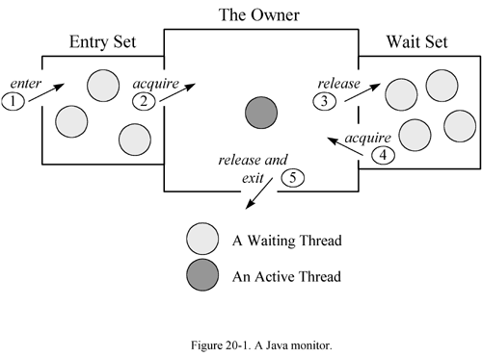
Monitor
Monitor
(mutex + entry set)
Only one thread at a time may own a monitor. Any other threads attempting to lock that monitor are blocked until they can obtain a lock on that monitor.
‹#›

Slide 15
Java Object internal monitors
In java every Object has internal monitor.
That is, every Object can act as a lock.
@see javaConcurrentAnimated.jar (synchronized)
@see synchronized_example
Let’s fix data_races example - make increment a critical section
@see data_races (2 balls)
‹#›

Slide 16
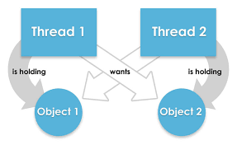
Challenge 3. Deadlock
Deadlock
a state in which each member of a group of actions, is waiting for some other member to release a lock
(Do not forget starvation and livelock)
@see deadlock
‹#›

Slide 17
jstack - detect deadlock
jstack prints Java stack traces of Java threads for a given Java process or core file or a remote debug server.
http://docs.oracle.com/javase/7/docs/technotes/tools/share/jstack.html
jstack <pid>
‹#›

Slide 18
Java Object internal monitors
What if I want to control monitor - to control internal monitor from program?
Internal Object monitor have ‘wait set’ and methods for controlling waiting threads:
Object.wait(), Object.wait(timeout) - current thread releases the monitor and enters wait set
Object.notify(), Object.notifyAll() - removes random (all) threads from wait set into blocking set
@see java.lang.Object
‹#›

Slide 19
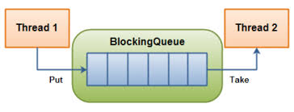
Blocking queue example
Blocking queue blocks reading thread, when there is nothing to read. And blocks writing thread, when it is full
@see javaConcurrentAnimated.jar (BlockingQueue)
@see blocking_queue
‹#›

Slide 20
Inter-thread communication
Threads (unlike processes) can communicate via
shared memory (shared variables/shared mutable state)
If we have reads and writes to shared mutable variables, that affect each other, we call it concurrent access
Oracle guide to concurrency in Java
https://docs.oracle.com/javase/tutorial/essential/concurrency/index.html
‹#›

Slide 21
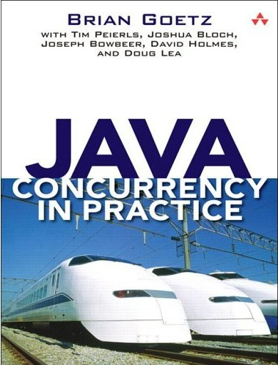
Thread-safety
A class is thread-safe if it behaves correctly when accessed from multiple threads, regardless of the scheduling or interleaving of the execution of those threads by the runtime environment, and with no additional synchronization or other coordination on the part of the calling code
(from JCiP)
https://www.amazon.com/Java-Concurrency-Practice-Brian-Goetz/dp/0321349601
‹#›

Slide 22
No state - no problem
It is data that must be protected from concurrent access. Even thought ‘synchronized’ about code.
Every access to protected data must be synchronized (every read and write), else program is not properly synchronized.
So let’s avoid state! (no, impossible in practice)
Stateless objects are always thread-safe
‹#›

Slide 23
Shared mutable state
Concurrency appear when shared mutable state is accessed from several threads
Let’s avoid concurrency!
(really good idea!)
@see shared_mutable_state
Immutable and unshared objects are always thread-safe
‹#›

Slide 24
Use immutable state (final)
‘final’ guarantees that after construction reference will be always read properly
final only guarantees immutability for single reference to make object fully-immutable you must mark every reference final, not only root object
if you change final fields via reflection - you lose guarantees
Make final as much shared variables as possible
‹#›

Slide 25
Unshared state (ThreadLocal)
ThreadLocal<Object> locals = new ThreadLocal<Object>();
As with final - ThreadLocal only guarantees, that the reference, that is accessed via ThreadLocal variable (‘locals’ in example) is thread local, no in-depth thread locality.
@see thread_local
‹#›

Slide 26
What happen when we have SMS?
This is defined by Java Memory Model (JMM)
Java Language Specification (JLS)
Chapter 17. Threads and locks
https://docs.oracle.com/javase/specs/jls/se7/html/jls-17.html
(do not read! first look at https://shipilev.net/#jmm )
JMM is tricky to understand and is hard to use directly.
‹#›

Slide 27
Java Memory Model (JMM)
JMM specifies what can be read by particular read action in program.
More precisely it defines guarantees on read/write atomicity, write visibility and instruction ordering.
‹#›

Slide 28
JMM. Why so complex?
JVM is highly optimized. It is possible because of relatively weak guarantees of JMM.
JMM was created as a trade-off between performance, complexity of JVM and abilities of hardware.
JMM considered to be one of the most successful memory models.
Recently Introduced C++ Memory Model is highly based on JMM.
‹#›

Slide 29
Challenge 4. Atomicity
Some operations that are expected to be atomic - are not:
i++;
double/long reads and writes on 32 bit systems
check then act actions:
@see data_races
if (!map.containsKey(key)) { map.put(key, value); }
‹#›
Notes:
mic

Slide 30
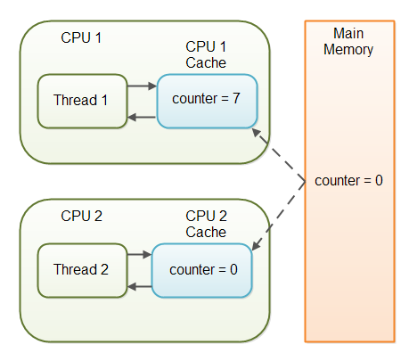
Challenge 5. Visibility
Modern processors have multi-level caches. Thus threads running on different processors may not see changes made by other threads.
It actually depends on cache coherence protocol.
https://en.wikipedia.org/wiki/Cache_coherence
Most modern processors provide coherent caches, so visibility problems are rare
But WORA! @see visibility
‹#›

Slide 31
Challenge 6. Ordering
In sake of performance javac, jit and JVM may change your code whenever it is accepted by Java Memory Model, that is reorder instructions.
After all, processor reorders instructions by himself.
JMM restrict some reorderings.
‹#›

Slide 32
Challenge 7. Performance
Reasoning about performance of concurrent programs is tricky
@see https://shipilev.net/
‹#›

Slide 33
Solution - volatile
‘volatile’ means:
atomic reads and writes to reference (not all operations on object)
reads to volatile variables always return right value
reads and writes of volatile variables can not be reordered
‘happens-before’ relation
(If you make all references in your program ‘volatile’, there will be no data races)
@see volatile_example
‹#›

Slide 34


7 challenges of concurrency
“Я прочитал вашу лекцию
все систематизировал и нарисовал”
Иероним Босх
‹#›

Slide 35
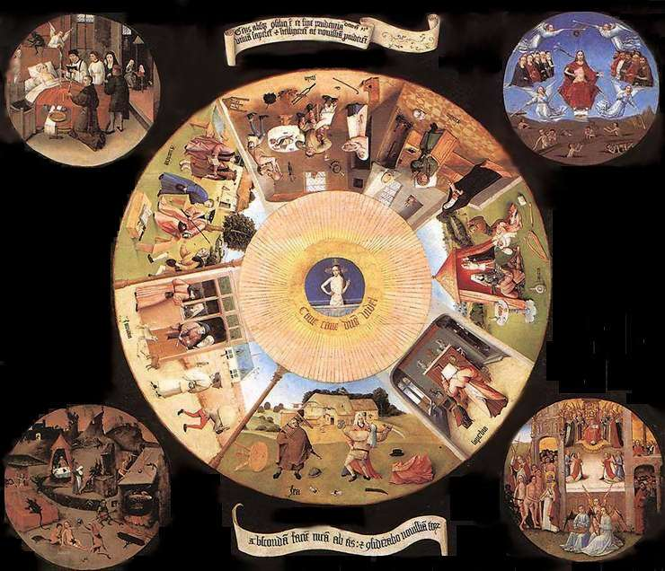
‹#›

Slide 36
Agenda
Multithreading basics
Concurrency challenges
java.util.concurrent
Thread-safety recipes
‹#›
Notes:
‹#›

Slide 37
java.util.concurrent
It is hard to reason low-level JMM categories, but there are a number of high-level constructions in JDK
‹#›

Slide 38
Atomics
Atomics provide non-blocking operations on common objects. Also provides methods for atomic ‘check then act’ operations
(compareAndSet, incrementAndGet)
@see data_races/Stopper.java
@see javaConcurrentAnimated.jar (AtomicInteger)
‹#›

Slide 39
Concurrent Collections
ConcurrentHashMap
BlockingQueue
@see javaConcurrentAnimated.jar (ConcurrentHashMap, BlockingQueue)
‹#›

Slide 40
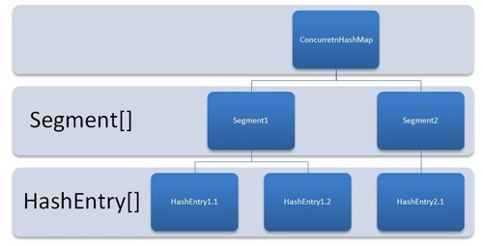
ConcurrentHashMap
A hash table supporting
full concurrency
of retrievals
and high expected
concurrency for updates.
Iteration over copy
of collection at some point
https://habrahabr.ru/post/132884/
https://docs.oracle.com/javase/8/docs/api/java/util/concurrent/ConcurrentHashMap.html
‹#›

Slide 41
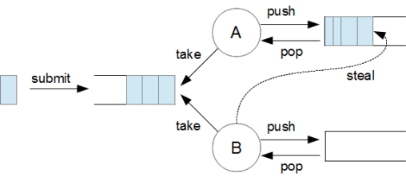
ForkJoinPool
@see javaConcurrentAnimated.jar
‹#›

Slide 42
Futures
Future is implementation of ‘promises’.
A Future represents the result of an asynchronous computation
We can block on get() until the result is ready.
@see javaConcurrentAnimated.jar (Future)
‹#›

Slide 43
Synchronizers
It is hard to reason low-level JMM categories, but there are a number of high-level constructions in JDK
@see javaConcurrentAnimated.jar
(CyclicBarrier, Phaser)
Good manual with visualization
https://habrahabr.ru/post/277669/
‹#›

Slide 44
Agenda
Multithreading basics
Concurrency challenges
java.util.concurrent
Thread-safety recipes
‹#›
Notes:
‹#›

Slide 45
Recipe 1. Unshared immutable state
Don't share the state variable across threads
Make the state variable immutable
Use synchronization whenever accessing the state variable
‹#›

Slide 46
Recipe 2. Safe initialization
Do not share ‘this’
from constructor
Bad example --------------->
@see initialization
public class SomeClass{
private Object v1;
private final Object v2;
SomeClass(Object v1, Object v2){
//’this’ leaks
//initalization is not completed
StaticRegistry.register(this);
this.v1 = v1;
this.v2 = v2;
}
}
‹#›

Slide 47
Recipe 3. Safe publication
To publish an object safely, both the reference to the object and the object's state must be made visible to other threads at the same time. A properly constructed object can be safely published by:
Initializing an object reference from a static initializer
Storing a reference to it into a volatile field or AtomicReference
Storing a reference to it into a final field of a properly constructed object
Storing a reference to it into a field that is properly guarded by a lock
‹#›

Slide 48
Recipe 4. Use JDK constructions
That to use in real life situations (by priority)
concurrent collections/synchronizers/ForkJoinPool
synchronized/volatile for reference reads/writes
atomics
wait/notify
volatile ‘happens-before’ magic
(If you are doing 4 or 5 for simple task, maybe you are doing something wrong)
‹#›

Slide 49
References
java concurrency in practice (signature book for Java Developer)
https://www.amazon.com/Java-Concurrency-Practice-Brian-Goetz/dp/0321349601
Shipilev blog (JMM, concurrency, performance, benchmarks for people, JDK contributor)
https://shipilev.net/
Doug Lea-s home page (java.util.concurrent father and famous spec in concurrency and allocators)
http://g.oswego.edu/
Java Memory Model Pragmatics (best explanation of JMM - available in russian)
https://shipilev.net/#jmm
JMM Under the hood (deep explanation of JMM)
http://gvsmirnov.ru/blog/tech/2014/02/10/jmm-under-the-hood.html
What Every Dev Must Know About Multithreaded Apps (Common knowledge)
https://lyle.smu.edu/~coyle/cse8313/handouts.fall06/s04.msdn.multithreading.pdf
Most active russian community on java, concurrency and related topics
http://razbor-poletov.com/ (podcast)
https://gitter.im/razbor-poletov/razbor-poletov.github.com (chat)
‹#›

Slide 50
Reasoning about concurrent program
Bugs in concurrent programs are hard to reproduce
Hopefully we have toolchain for analysis of multithreaded programs
jcstress
http://openjdk.java.net/projects/code-tools/jcstress/
(requires JDK9)
‹#›

Slide 51

Вот теперь понятно, cпасибо!
‹#›

Slide 52

Спасибо
за внимание!
Александр Помосов
alpieex@gmail.com

