Slide 1

Java
ORM
Сергей Рыбалкин

Slide 2

ORM
Отметьтесь на портале
2

Slide 3
JDBC
+ + + | - - -
Clean and simple SQL processing | Complex in large projects
Good performance with large data | Large programming overhead
Very good for small applications | Query is DBMS specific
Simple syntax
3

Slide 4
Data
RDBMS – row in table
Java – instance of class
4

Slide 5
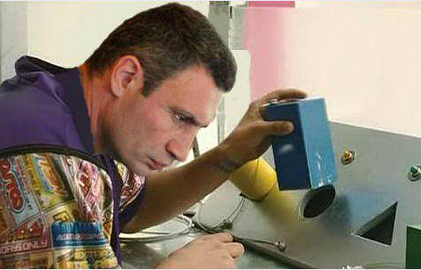
Data. Mismatch
RDBMS – row in table
Java – instance of class
5

Slide 6
Data. Convert
RDBMS
JAVA
6

Slide 7
Data. Convert
mapping
RDBMS
mapping
JAVA
mapping
mapping
mapping
mapping
7

Slide 8

Data. Convert
mapping
RDBMS
mapping
JAVA
mapping
mapping
mapping
mapping
8

Slide 9

Data. Convert
What about?
inheritance
identity
access
…
9

Slide 10

We need a hero
To convert all the data
To hide sql details
To reduce boilerplate code
Based on JDBC ‘under the hood’
10

Slide 11

ORM / JPA
Object – Relational Mapping
CRUD API
object-specific query language
mapping customization
11

Slide 12
ORM. Frameworks
Enterprise JavaBeans Entity Beans
Java Data Objects
Castor
TopLink
Spring DAO
Hibernate
…
12

Slide 13

ORM. Hibernate
13

Slide 14
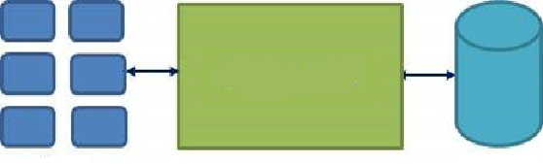



ORM. Hibernate
14

Slide 15
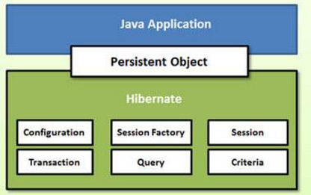
ORM. Hibernate
15

Slide 16
Hibernate. Configuration
Database connection
Mapping
hibernate.properties
hibernate.cfg.xml
16

Slide 17
Hibernate. Session
SessionFactory – factory based on config
Session – factory product to get a physical connection with a database
17

Slide 18
Hibernate. Query
Query – SQL or Hibernate Query Language (HQL)
from Person person where name = ‘Sasha’
from Match match
where match.a is not null
and match.a != match.b
18

Slide 19
Hibernate. Transaction
Transaction – unit of work
(underlying JDBC or JTA)
19

Slide 20
Hibernate. Transaction
Transaction idiom
@see ru.atom.model.dao.Database
20

Slide 21

Hibernate
Implement class
Annotate class
Add mapping
Create table*
…
Profit
21

Slide 22
Hibernate. Reference
https://www.tutorialspoint.com/hibernate/index.htm
https://habrahabr.ru/post/265061/
http://www.slideshare.net/vinayhulgar/manning-hibernate-quickly
22

Slide 23
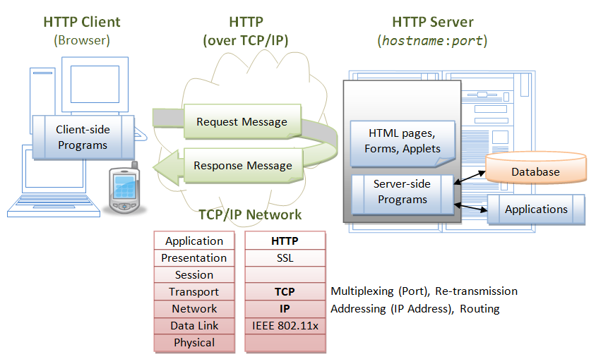
Tinder Server
23

Slide 24
Tinder Server
JDBC → ORM migration
24

Slide 25

ORM
25

Slide 26

Спасибо
за внимание!
Сергей Рыбалкин
s.rybalkin@corp.mail.ru

