Slide 1
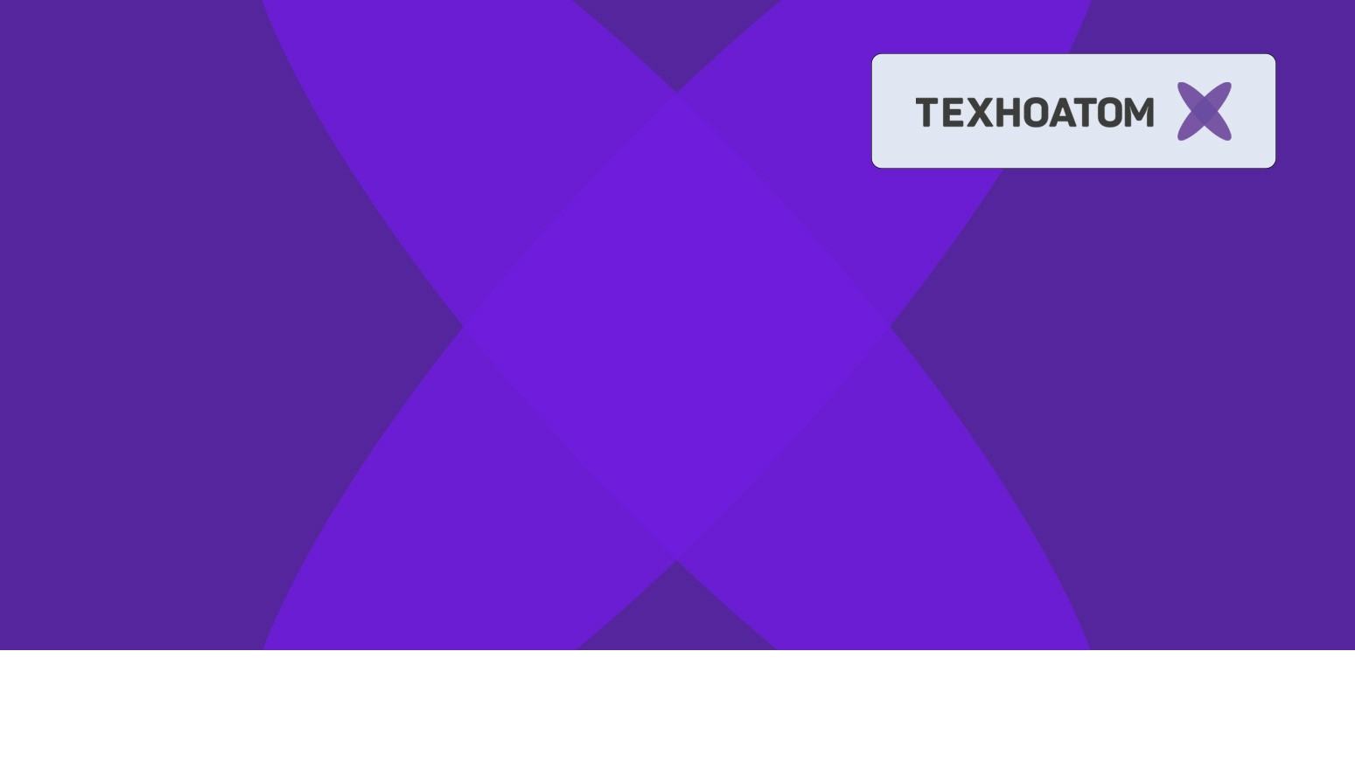
Java
Client-server communication. WebSockets
Александр Помосов

Slide 2
Reminder
Отметьтесь на портале
‹#›

Slide 3
Reminder
Обновите репозиторий
‹#›

Slide 4
Agenda
IO/NIO
Game server architecture
Web sockets
Client-server communication
‹#›
Notes:
‹#›

Slide 5
Agenda
IO/NIO
Game server architecture
Web sockets
Client-server communication
‹#›
Notes:
‹#›

Slide 6
IO
http://docs.oracle.com/javase/tutorial/essential/io/
API for input and output to
files
network streams
internal memory buffers
…
Blocking
‹#›

Slide 7
IO. Byte streams
InputStream
OutputStream
@see ru.atom.io.ByteStreams.java
look at System.out / System.err
‹#›

Slide 8
IO. Character streams
Reader
Writer
Scanner
@see ru.atom.io.CharacterStreams.java
‹#›

Slide 9
NIO
Non-blocking IO
‹#›

Slide 10
IO. File operations
java.nio.file
Modern file API
@see ru.atom.nio.Files.java
‹#›

Slide 11
Agenda
IO/NIO
Game server architecture
Web sockets
Client-server communication
‹#›
Notes:
‹#›

Slide 12
Game server architecture
@see project server
‹#›

Slide 13

Services overview
AccountServer
Registers and authenticates users
HTTP
Client
8080
WebSocket
ClientConnectionServer
Handles packets received from client
Threads
7000
Ticker
Synchronizes other services ticks
DB
Mechanics
Where all the game happen
Entry point
MasterServer
Orchestrator for other services
‹#›

Slide 14
ApplicationContext
How do we manage dependencies in complex project?
spaghetti-style
public static fields and Singletons
Dependency Injection
contexts (instance containers)
@see ApplicationContext
‹#›

Slide 15
What to do?
ready
HTTP
ready
AccountServer
Registers and authenticates users
Client
8080
WebSocket
ClientConnectionServer
Handles packets received from client
today
Threads
7000
ready
Ticker
Synchronizes other services ticks
РК2
DB
later
Mechanics
Where all the game happen
Entry point
MasterServer
Orchestrator for other services
ready
‹#›

Slide 16
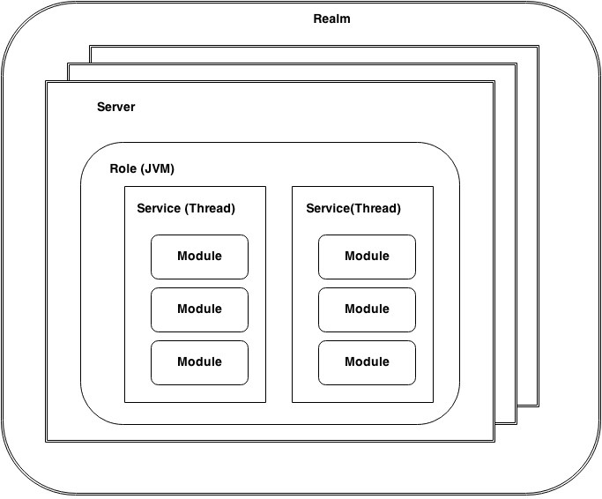
Real Game
Does monolitic mean bad?
https://habrahabr.ru/company/mailru/blog/220359/

Slide 17
Agenda
IO/NIO
Game server architecture
Web sockets
Client-server communication
‹#›
Notes:
‹#›

Slide 18
WebSocket
client-server
application-layer
over single TCP connection
full-duplex
protocol (ws:// wss://)
Standardized in 2011
https://tools.ietf.org/html/rfc6455
Supported by most modern browsers
but can be used for any extensive client-server communication
‹#›

Slide 19
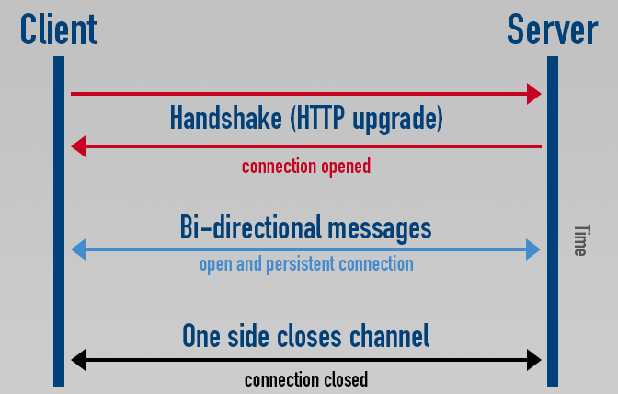
WebSocket
Client-server
client is session initiator
Full-duplex
exchange data
in both directions
Good for games!
‹#›

Slide 20
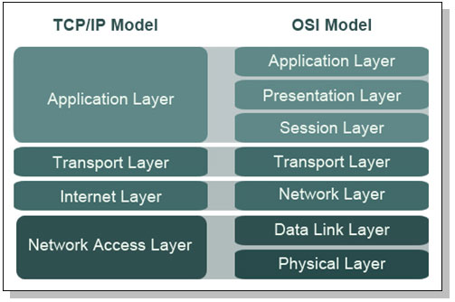
WebSocket
Application layer
handshake like HTTP
Over single
tcp connection
but then no handshakes
or headers required
only raw data
Web
Socket
TCP
IP
Network Access Layer
‹#›

Slide 21
WebSockets dependencies
We use jetty implementation of WebSocket
<dependency>
<groupId>org.eclipse.jetty.websocket</groupId>
<artifactId>websocket-api</artifactId>
<version>9.3.7.v20160115</version>
</dependency>
<!-- To run websockets in embedded server -->
<dependency>
<groupId>org.eclipse.jetty.websocket</groupId>
<artifactId>websocket-server</artifactId>
<version>9.3.7.v20160115</version>
</dependency>
‹#›

Slide 22
tcpflow
tcp traffic sniffer in human-readable format
https://github.com/simsong/tcpflow
слушать loopback интерфейс (-i) на портах 8080 и 7000 и выводить в консоль (-с)
sudo tcpflow -c -i lo port 8080 or port 7000
‹#›

Slide 23
WebSocket. Examples
@see websocket
‹#›

Slide 24
Agenda
IO/NIO
Game server architecture
Web sockets
Client-server communication
‹#›
Notes:
‹#›

Slide 25
Many ways to IPC
real time game
client-server communication
How?
‹#›

Slide 26
Full client authorization
Client
HTTP
Server
login, password
AuthClient
(REST client)
Account server
(REST Server)
token
WebSocket
network service
CommandAuth
(login, token)
network service
CommandAuthOk
associate session with player
CommandAuthFail
drop session
session
Commands
other services
other services
‹#›

Slide 27
Client-server protocol
Client
Server
POJO
Plain Old
Java Object
GSON
JSON
(String)
JSON
(String)
GSON
POJO
Plain Old
Java Object
WebSocket
So protocol POJO are shared between client and server
How can we achieve this?

Slide 28
Protocol project
ZagarClientServerProtocol - project containing protocol Commands as POJO
It is included as dependency in both client and server (shared)
<dependency>
<groupId>MIFIGame</groupId>
<artifactId>ZagarClientServerProtocol</artifactId>
<version>${clientServerProtocol.version}</version>
</dependency>
‹#›

Slide 29
Protocol project contents
Command - base class declaring that every command have a name (command field)
Client -> Server commands:
CommandAuth
CommandEjectMass
CommandMove
CommandSplit
Server -> Client commands:
CommandAuthFail
CommandAuthOk
CommandLeaderBoard
CommandReplicate
‹#›

Slide 30
Protocol changing
Changing protocol affects both client and server
If you change protocol you normally:
Change <version> in ZagarClientServerProtocol project
maven clean in ZagarClientServerProtocol
maven install in ZagarClientServerProtocol (put new version into local maven repository)
To update to new protocol change
clientServerProtocol.version in both server and client
‹#›

Slide 31
Connection handling
@see package network
network.packets contains all packets that can be sent from anywhere in server
network.handlers contains handlers for all accepted packets
ClientConnectionHandler decides which handler will service packet (based on command name)
‹#›

Slide 32
Example - client auth
@see ZagarClientServerProtocol.protocol.CommandAuth
@see client/zagar.network.packets.PacketAuth
@see server/zagar.network.handlers.PacketHandlerAuth
‹#›

Slide 33
Practice - say thank you
@see client/zagar.network.handlers.PacketHadlerAuthOk
Reply on CommandAuthOk with CommandThankYou(your name)
‹#›

Slide 34
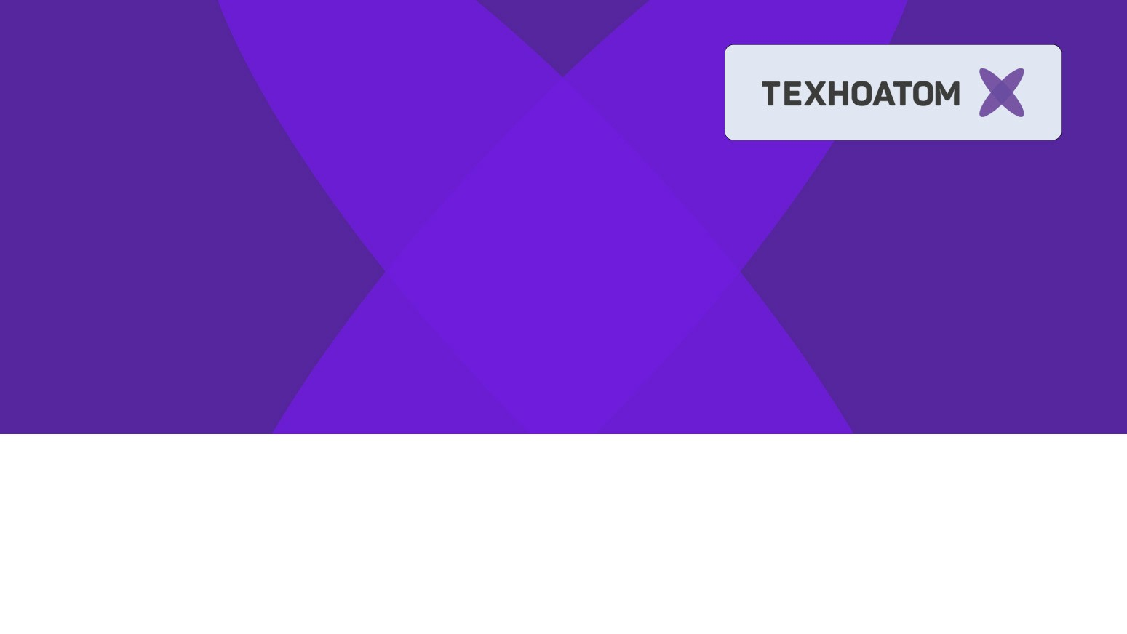
Спасибо
за внимание!
Александр Помосов
alpieex@gmail.com

