Slide 1
Predicting Revolution
The Relationship Between Protests, Government Types, and Regime Change

Slide 2
TABLE OF CONTENTS
1.
4.
2.
5.
3.
6.
Analysis Objective
Findings
The “why”
What it all means
Data Sources & Approach
Summary
The “who, what and where”
What we learned
Modeling
Next Steps
The “how”
Where to go from here

Slide 3
DATA SOURCES
1. Historical Protest Data
17k protests from 1990 to 2020 in 167 countries
Features include: protest size, location, and objectives
Source: Mass Mobilization Project by Political Instability Task Force
2. Government Characterizations
Nearly every government globally from 1975 to 2020
Features include: autocracy vs. democracy, tenure of leader, etc.
Source: The Database of Political Institutions by Inter-American Development Bank (IDB)
3. Regime Transitions
1700 government transitions between 1776 and 2020 globally
Features include: country leadership transition dates, exec. constraints
Source: Polity Project by the Center for Systemic Peace

Slide 4
APPROACH
Protests
Snapshot of government at time of protest
Government
characterizations
Regime
changes
Time from protest to next government transition
Protests leading up to government transition

Slide 5
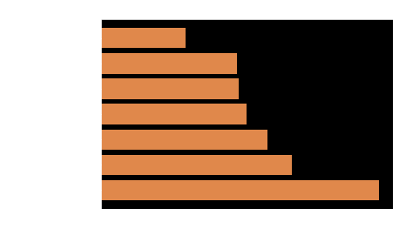
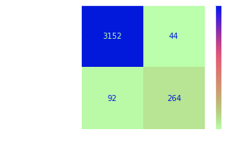
MODELING
Tested 7 different model types with 55 configurations
XG Boost identified as highest performer
Accuracy: 96%
F1 score: 0.80

Slide 6
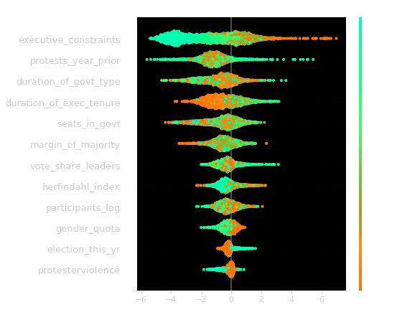
FINDINGS
Generalizations
Lower likelihood of regime change | Higher likelihood of regime change
New leadership | Low executive constraints
Gender diversity in leadership | Large protester turnout

Slide 7
SUMMARY
Regime transitions can be accurately predicted based on data about protests and government characteristics
The strongest predictor is the amount of government authority.
Protests in highly authoritarian regimes tend to be more strongly correlated with regime change than protests in strongly democratic countries

Slide 8
LIMITATIONS & NEXT STEPS
Limitations
Only valid if the protests are known (less valid with little media representation or protest suppression)
Correlation not causation
Next step: time series analysis
How past protests affect future protests
How inputs change over time

Slide 9
CONTACT INFO
Seth Schober
Data Scientist
seth.schober@gmail.com
linkedin.com/in/sethschober
github.com/sethschober/Predicting-Political-Revolutions

