Slide 1

Achieving sustainable growth
Will new Europe fly or crawl in the 21st century global knowledge economy
Symposium: „The Future of Europe.
Sustainable Development and Economic Growth?”
Vienna
September 12-13, 2007
Dr Krzysztof Rybiński*
National Bank of Poland
Deputy Governor
Email: krzysztof.rybinski@nbp.pl
Blog: www.rybinski.eu
* Views presented here are my own and they do not necessarily represent the official position of the National Bank of Poland or the Financial Services Authority. Presentation based on paper Radzikowski, Rybiński (2007)

Slide 2
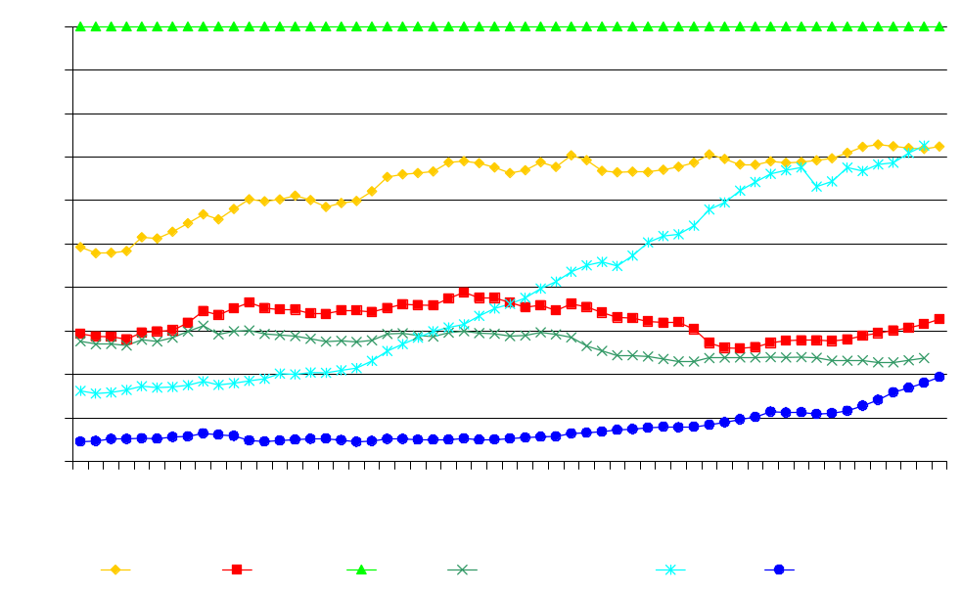
Economic growth in the long run…
GDP per capita in 1990 US$ (converted at Geary Khamis PPPs, US=100)
From the middle of the 70’s there has not been much convergence of Western Europe towards the U.S.
NIEs recorded an enormous acceleration from the end of the 60’s.
China woke up in the 80’s.
After an initial decline in the beginning of the 90’s, CEE-4 had to start their convergence actually from scratch.
Source: Groningen Growth and Development Centre and the Conference Board, Total Economy Database, January 2007, http://www.ggdc.net.

Slide 3
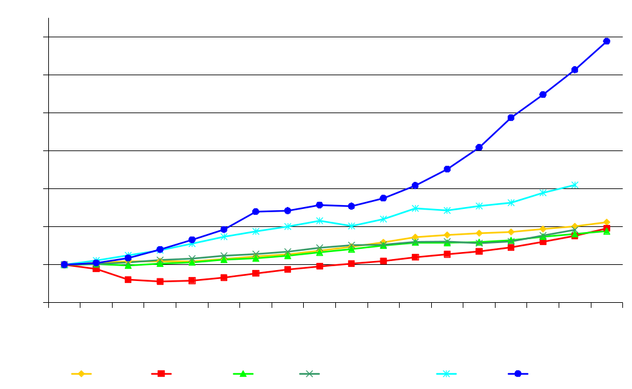
…and in the medium run
GDP per capita in 1990 US$ (converted at Geary Khamis PPPs, 1989=100)
Although CEE-4 are the most successful group among the post-communist countries, their growth since 1989 has been negligible when compared to NIEs and China.
Source: Groningen Growth and Development Centre and the Conference Board, Total Economy Database, January 2007, http://www.ggdc.net.

Slide 4
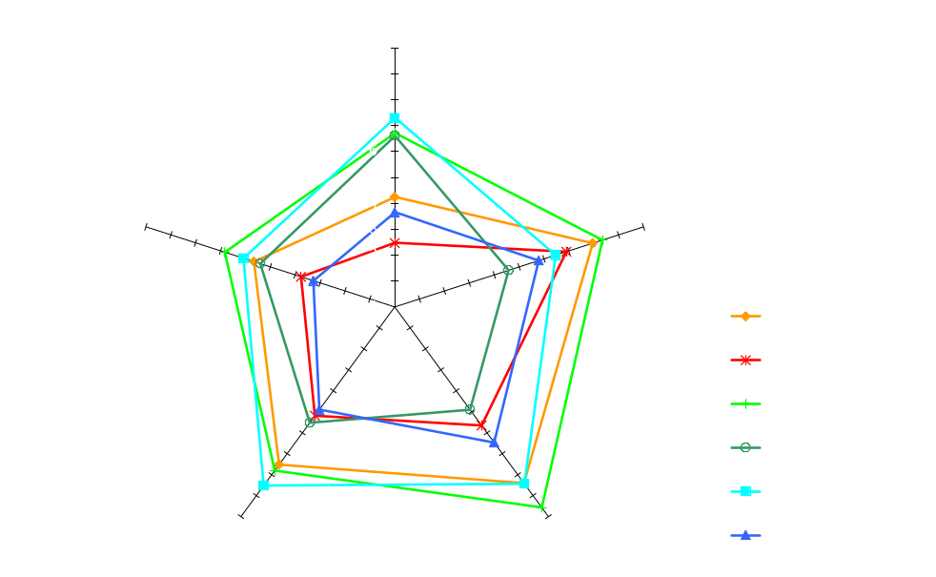
Institutional factors and policy-mix
Index of economic freedom in 1990
In the beginning of the transition most institutions in CEE-4 were yet fledgling.
Policies were being transformed from centrally planned into market oriented.
Source: Fraser Institute.

Slide 5
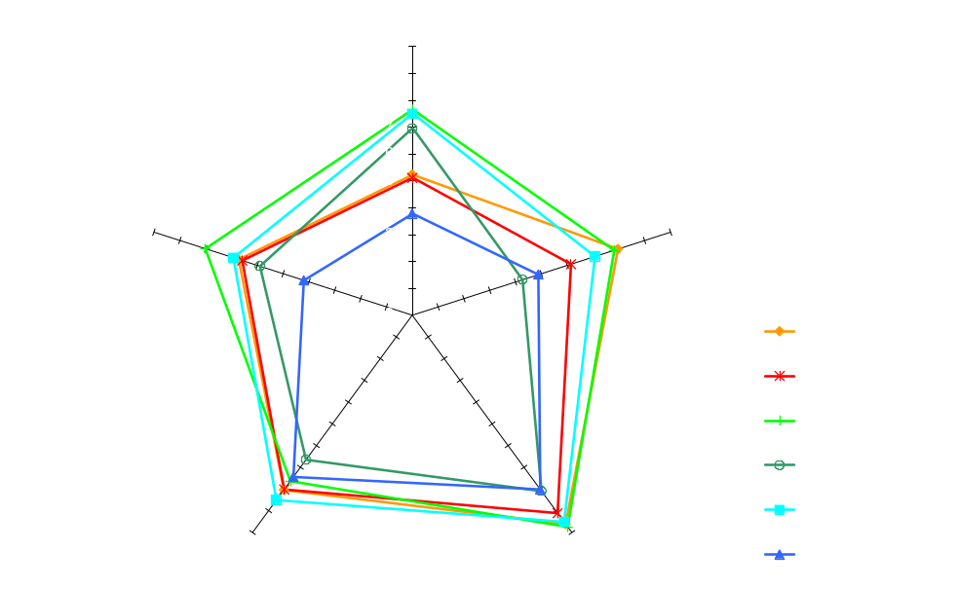
Institutional factors and policy-mix
Index of economic freedom in 2004
Since then many institutions have been founded and policies improved but…
Some maintained weak.
Others converged to the EU’s welfare state model.
Source: Fraser Institute.

Slide 6
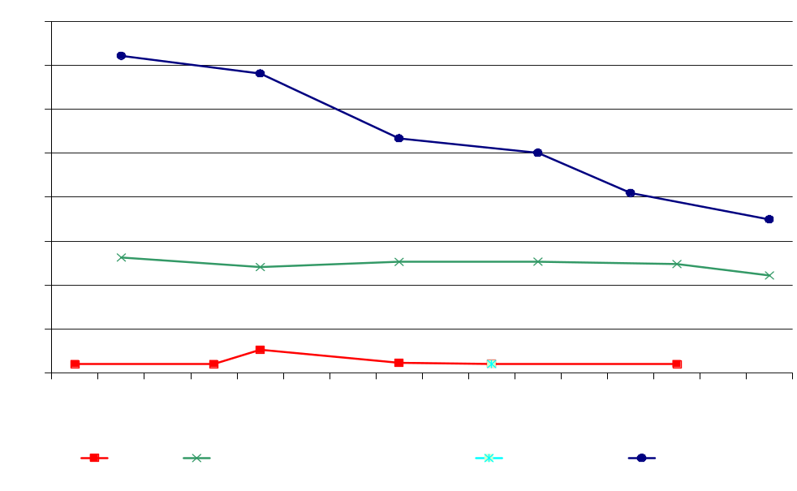
Social development
“The key to solving the problem of crisis-induced poverty lies in guaranteeing stable economic growth and creating new jobs (Górniak 2001).”
The UN’s goal of halving the world’s poverty by 2015 from its 1990 level is likely to be reached mainly due to a spectacular and sustained growth recorded by East Asia and the Pacific and South Asia.
Poverty headcount ratio at $2 a day (PPP)
(% of population)
Source: World Development Indicators 2007.

Slide 7
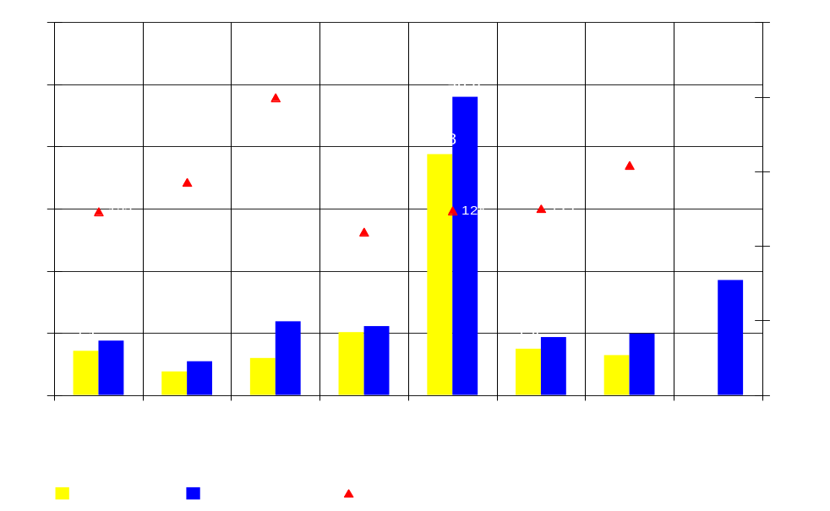
Income inequality
Decile dispersion ratio (10th income decile/1st income decile)
It is important to stress that globalization reduces inequality, as documented in Sala-i-Martin (2006).
However, while globalization allows poor countries to catch up, which reduces international income inequality, at the same time there is a trend of rising intra-country inequalities.
Source: WIDER World Income Inequality Database; World Development Indicators 2007; U.S. Census Bureau; Korean Statistical Information Service; Report on The Survey of Family Income and Expenditure in Taiwan Area, National Statistics Republic of China (Taiwan).

Slide 8
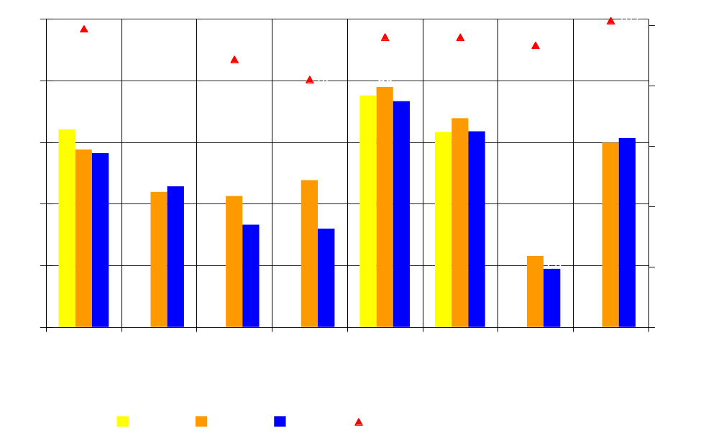
Income distribution
Compensation of employees (in % of GDP)
In many countries compensation of employees as a share of GDP declined.
It suggests, that globalization of the labor market was accompanied by the rising bargaining power of corporations.
* Data on Singapore refer to earnings and exclude employer social contributions.
Source: Ecowin Databases: Ecowin Economic and OECD QNA.

Slide 9
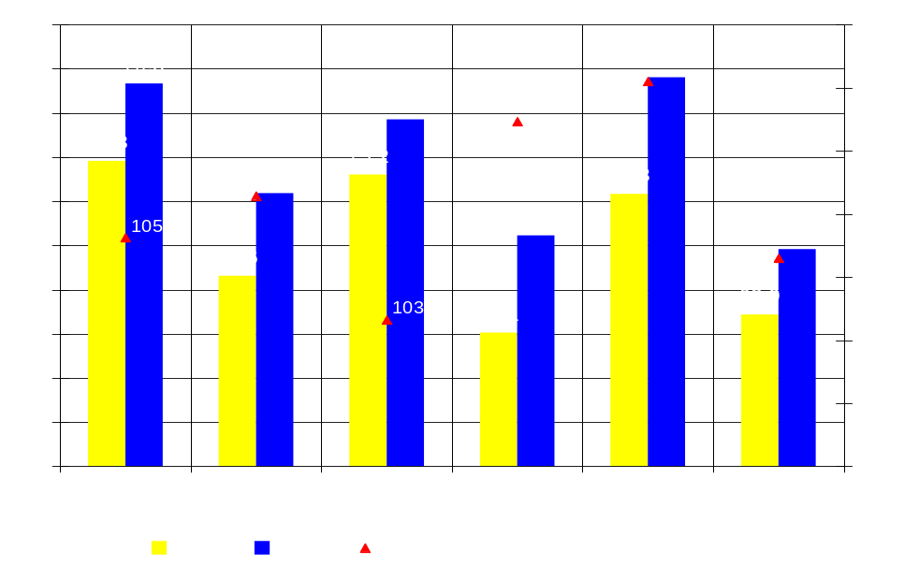
Health
The 70’s saw a major deterioration in health trends in all CEE-4.
It reflected an overall negative situation of health in communist states.
Although many common health problems in CEE-4 still remain more prevalent than in the EU, overall health conditions have improved dramatically.
Life expectancy at birth, total (years)
Source: World Development Indicators 2007.

Slide 10
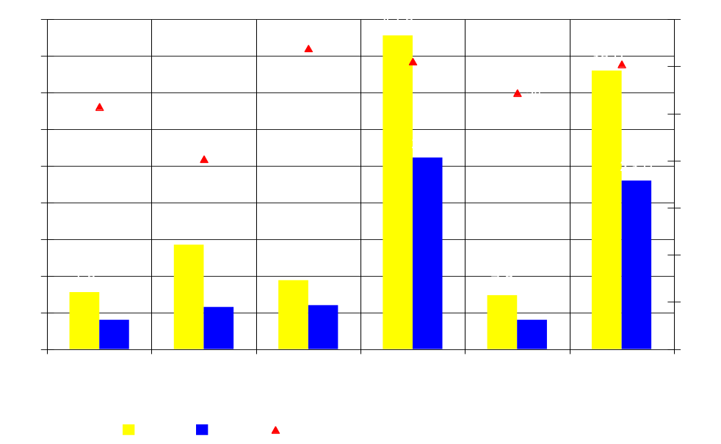
Health
While these trends in
CEE-4 are highly positive the superior performance of NIEs in this area is also meaningful.
Infant mortality rate (per 1,000 live births)
Source: World Development Indicators 2007.

Slide 11
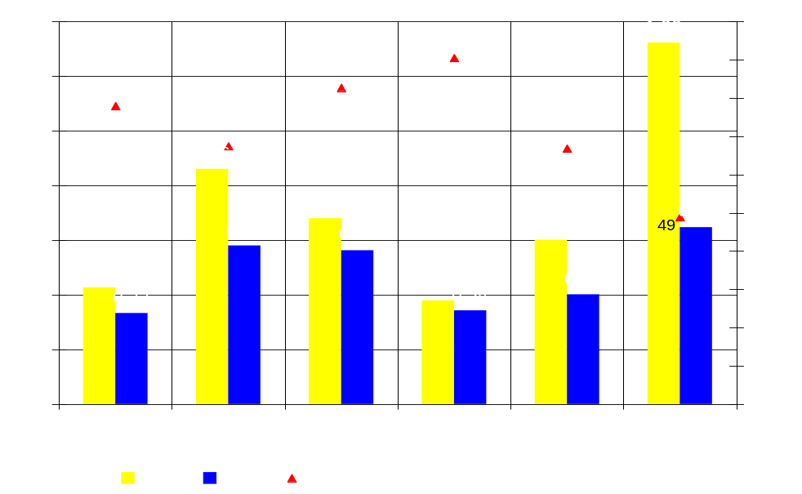
Environmental protection
CO2 emissions (kg per 2000 PPP $ of GDP)
The communist economies led to an intensive and excessive use of natural resources.
Source: World Development Indicators 2007.

Slide 12
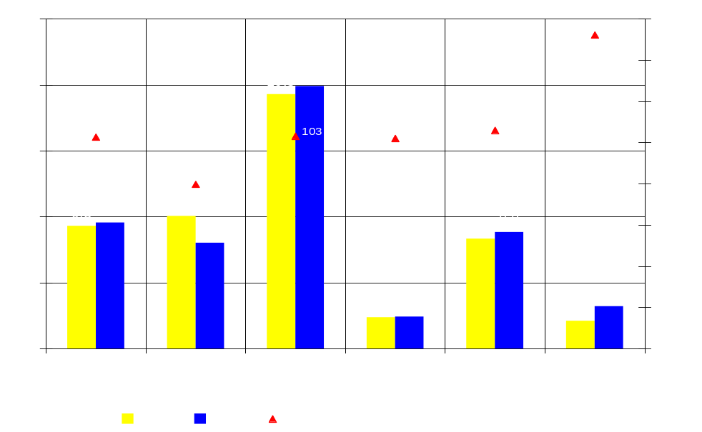
Environmental protection
CO2 emissions (metric tons per capita)
The transition process itself as well as the mixture of pressure and incentives from the West brought about a number of significant changes (e.g. a switch to less share of heavy industry in the economy).
Source: World Development Indicators 2007.

Slide 13
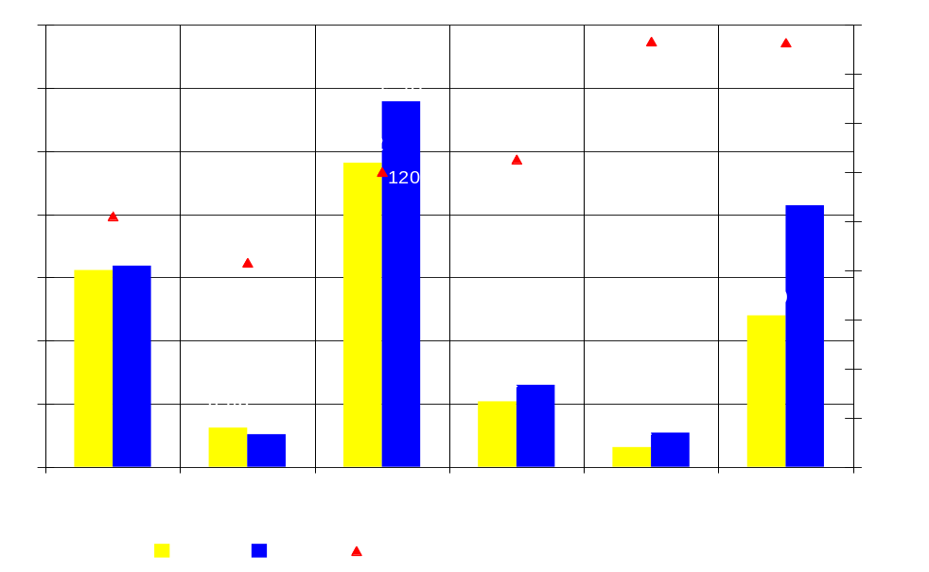
Environmental protection
CO2 emissions (million kt)
As a consequence CO₂ emissions slumped.
CEE-4 was the only group of countries that managed to reduce the absolute amount of CO₂ emissions.
Source: World Development Indicators 2007.

Slide 14
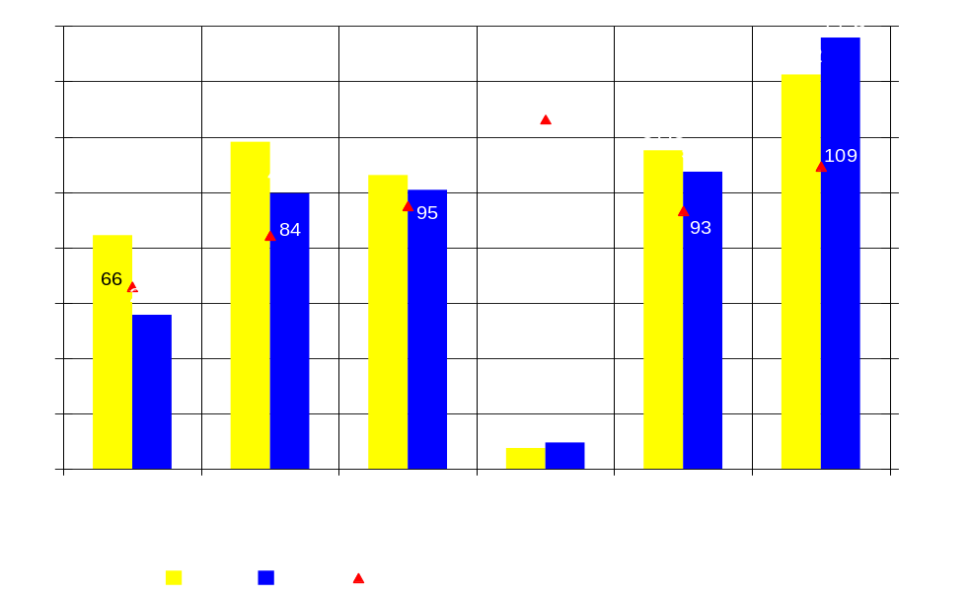
Environmental protection
Electricity production from coal sources (% of total)
Market energy prices broke the tradition of excessive coal consumption in favor of, less harmful to the environment, energy sources such as oil and gas.
Source: World Development Indicators 2007.

Slide 15
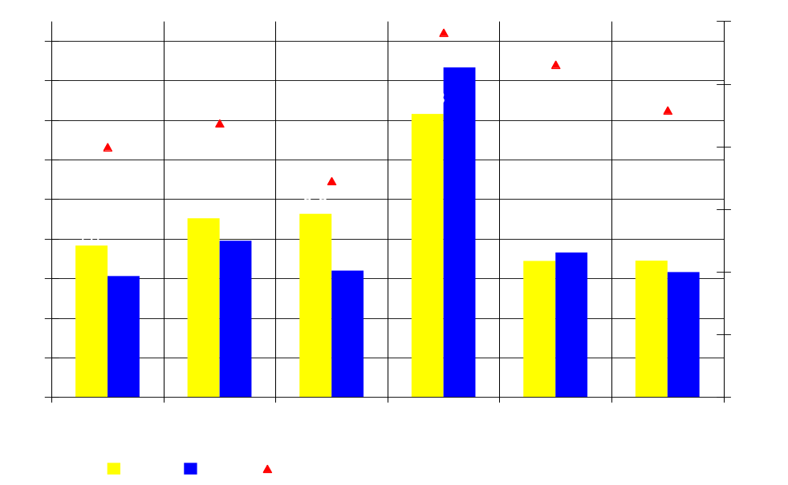
Environmental protection
Electric power transmission and distribution losses (% of output)
Exposure of companies transmitting and distributing energy to market competition as well as liberalization and partial privatization reduced wasteful practices.
Source: World Development Indicators 2007.

Slide 16
What matters?
Romer (1986) argued that one of key factors of economic progress are innovations, ideas or more broadly knowledge.
His second observation was non-rivalry of ideas, which has a number of important consequences.
Knowledge, however, is only one of the three components of intellectual capital. Structural and relationship capital are the other two.
The ability to source knowledge globally has become a key advantage that can be exploited by small countries with excellent knowledge infrastructure (such as Finland or Ireland).
It can be used to leverage growth by large corporations or small companies.
Thus knowledge economy seems to be the growth engine in the 21st century.

Slide 17
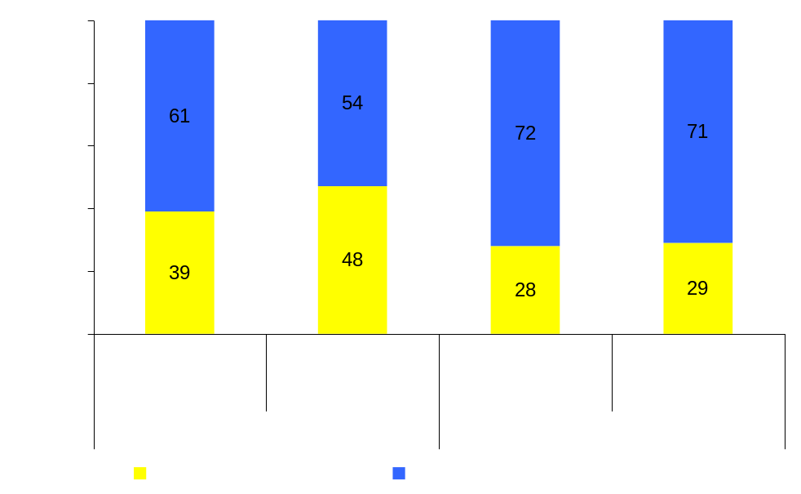
Large corporations did better …
In 10 years the share of largest firms in employment remained unchanged while their share in profits rose.
What contributed to this massive increase of profit per employee?
Is this question valid for entire countries or regions?
Employment and profit share of the 150 largest corporations listed in the U.S., 1994 and 2004.
Source: Bryan, Zanini (2005).

Slide 18
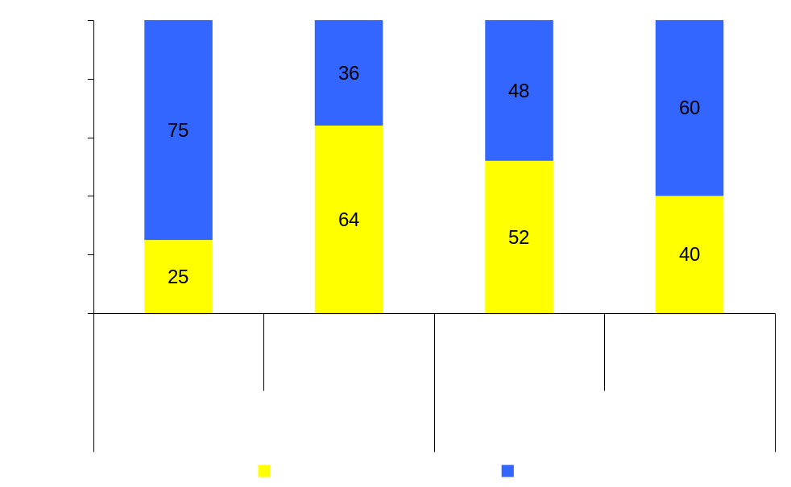
… amid development of IC
The share of intellectual capital in the market value of corporations listed in the U.S. (in US$ trillion)
Partial answer to this question is that in the case of largest corporations the value of intangibles rose at a very fast pace.
Although there could be several explanations, the most plausible one is that the level of intellectual capital in large corporations exceeds that in the medium ones, which is adequately priced by the financial markets.
Source: Bryan, Zanini (2005).

Slide 19
Globalization strategies adopted by new global challengers
Model 1: Taking RDE brands global
Model 2: Turning RDE engineering into global innovation
Model 3: Assuming global category leadership
Model 4: Monetizing RDE natural resources
Model 5: Rolling out new business models to multiple markets
Model 6: Acquiring natural resources
Source: Aguiar et al. (2006), The Boston Consulting Group.

Slide 20
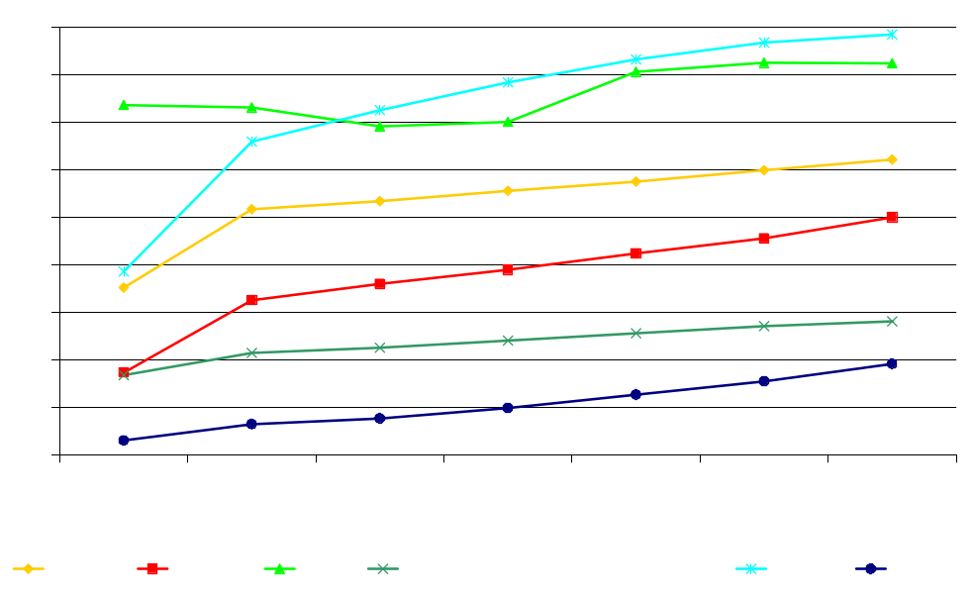
Higher education important for knowledge potential
School enrollment, tertiary (% gross)
Tertiary enrollment is an important indicator of future knowledge potential.
The gap between U.S. and other regions has narrowed.
Interestingly, South Korea has become the leader.
China is closing its gap with the Latin America.
CEE countries last year reached 50% ratio.
Source: World Development Indicators 2007.

Slide 21
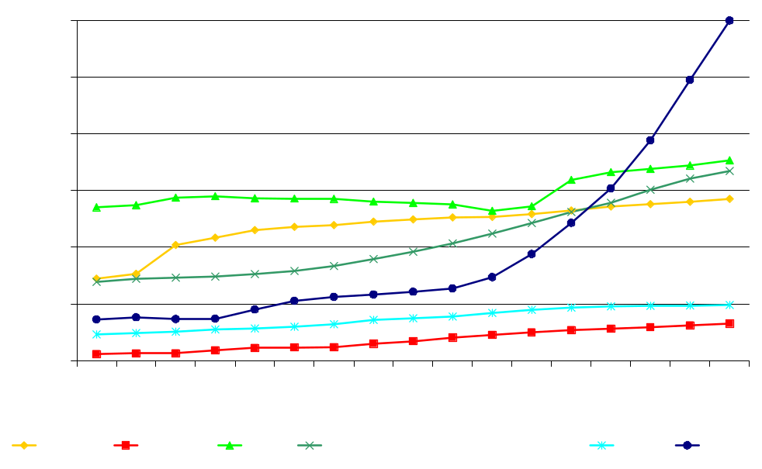
Higher education – absolute values are important too
Higher education students (incl. universities) in thousands
Bearing in mind that the quality of education is not similar in all regions it is also worth to look at the absolute numbers as it may be a good proxy for the future number of domestic researchers.
Recent years have witnessed an important shift in this area.
* Data for Germany are available from 1992 and for the Czech Republic and Slovakia from 1993.
Source: Euromonitor International from national statistics/UNESCO.

Slide 22
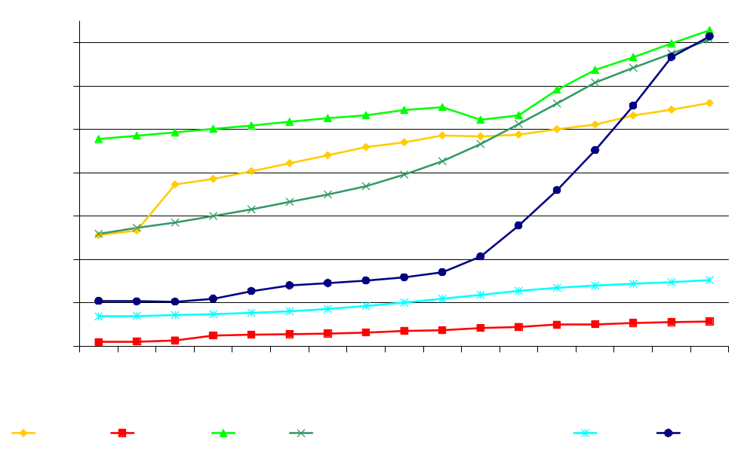
Higher education – absolute values are important too
University students in thousands
We can safely predict that the number of students will increase further in China.
The absolute number of students in CEE-4 has also increased significantly, but the gap with NIEs remained.
It is also worth noticing that LAC countries make steady progress.
* Data for Germany are available from 1992, for Luxembourg from 1999 and for the Czech Republic and Slovakia from 1993.
Source: Euromonitor International from national statistics/UNESCO.

Slide 23
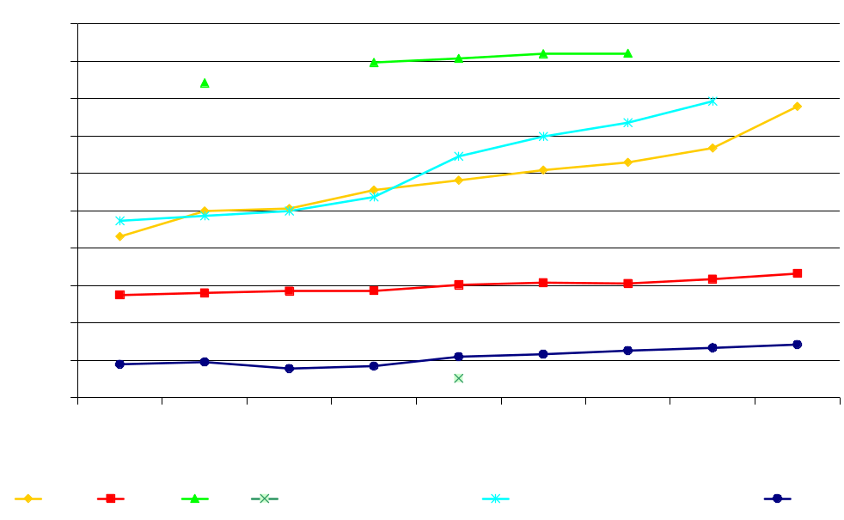
Current ability to innovate
Researchers in R&D (per million people)
The current ability to innovate can be assessed by the number of researchers.
The U.S. continues to dominate the world both in terms of researchers intensity and absolute number of researchers in R&D.
However in terms of researchers’ intensity both the EU-15 and the NIEs are closing the gap.
Source: World Development Indicators 2007.

Slide 24
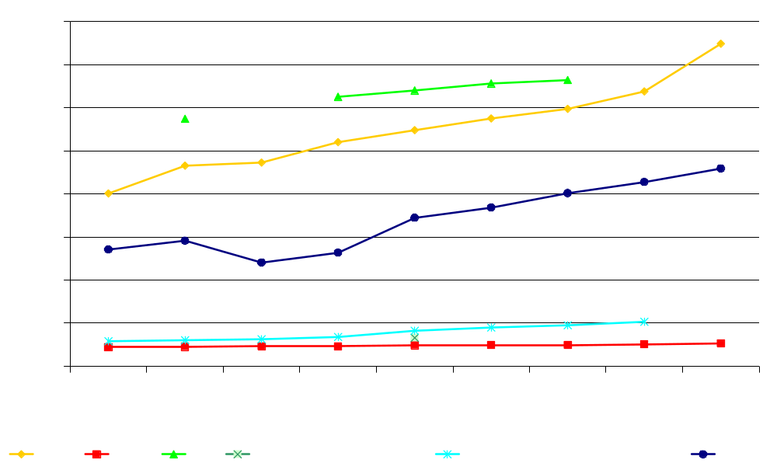
Current ability to innovate
Researchers in R&D in thousands
In absolute number of researchers China is the third biggest in the world, although the quality of researchers there may not be as good as in the U.S. or the EU.
It is evident that in the last ten years the research gap between the NIEs and the CEE-4 has been growing.
Source: World Development Indicators 2007.

Slide 25
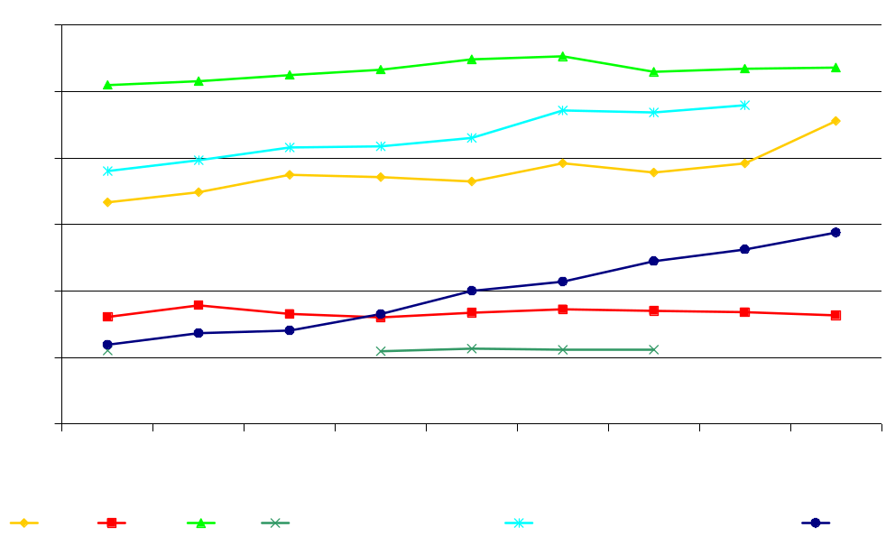
How much on R&D and ICT
Research and development expenditure (% of GDP)
R&D expenditure measures funding available to people with great ideas.
The EU has been closing the gap with the U.S. in terms of R&D spending as a ratio of GDP.
In the last ten years there was no improvement in R&D spending in CEE-4 countries; it lags badly behind China.
Source: World Development Indicators 2007.

Slide 26
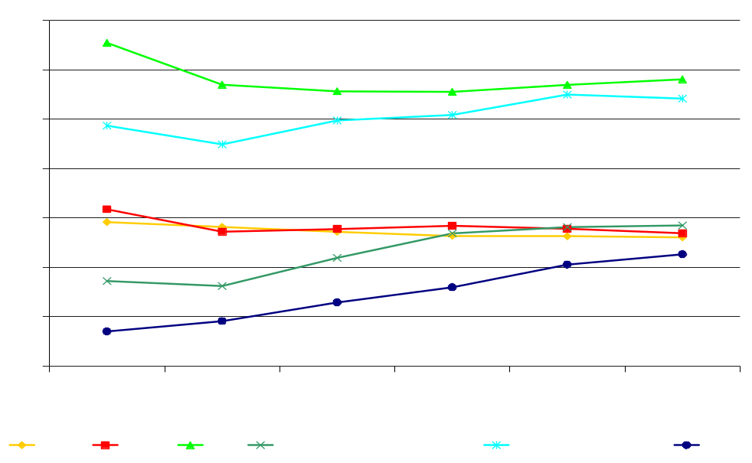
How much on R&D and ICT
Information and communication technology expenditure (% of GDP)
ICT expenditure is a proxy for country ability to source knowledge globally.
ICT is likely to facilitate factors that are important in achieving technical progress.
The EU lags badly behind the U.S. in terms of ICT expenditures. With growing importance of ICT using industries for productivity growth it may signal the Europe’s troubles lying ahead, despite its improvement in R&D spending.
Source: World Development Indicators 2007.

Slide 27
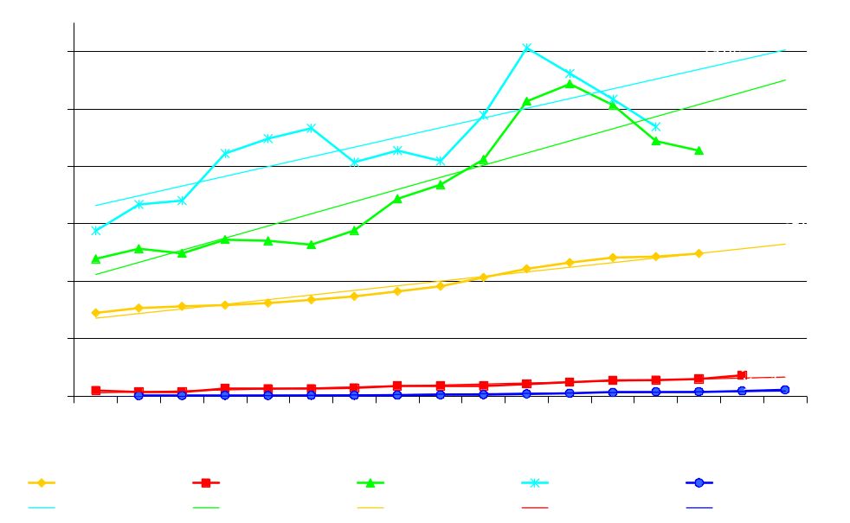
How much on R&D and ICT
Total R&D spending per capita (in ECU/euro)
In terms of absolute levels of spending per capita U.S. and Japan still top the league and exhibit similar volatility pattern.
Source: Eurostat, CEIC Data ISI Securities China Premium Database.

Slide 28
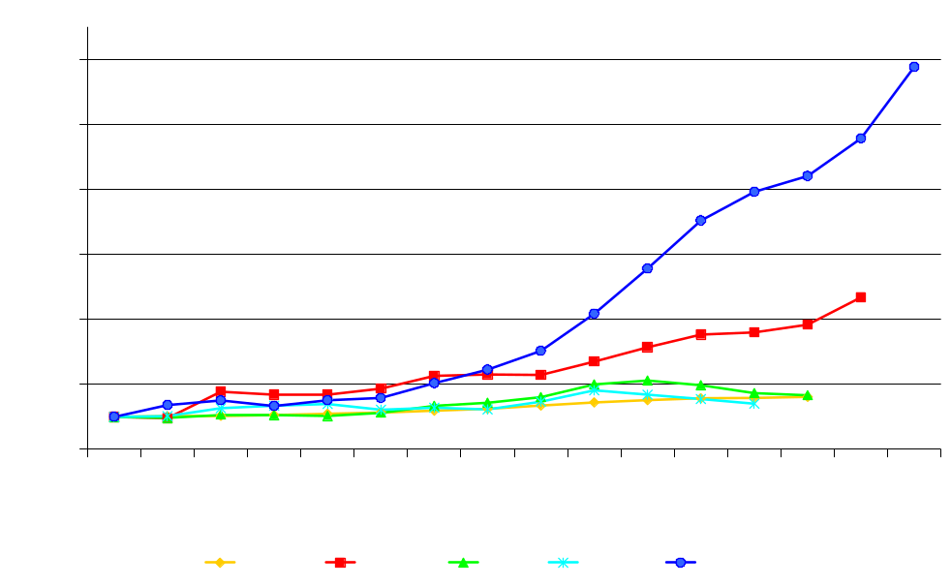
How much on R&D and ICT
Total R&D spending per capita (in ECU/euro, 1991=100)
While U.S. and NIEs are world leaders in terms of R&D and ICT spending, China has made an enormous progress, raising R&D spending per capita 12 times over the last 15 years.
Source: Eurostat, CEIC Data ISI Securities China Premium Database.

Slide 29
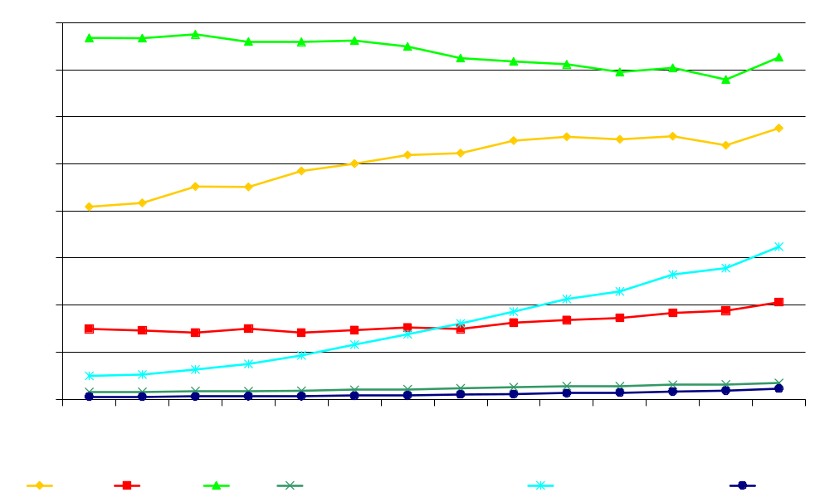
Now the outcomes
Scientific and technical journal articles per million people
Similar picture emerges when one looks at the outcomes, e.g. number of scientific and technical journal publications.
The U.S. and EU-15 dominate the world in terms of publication intensity.
In early 1990s CEE-4 published twice as many papers per million of citizens than NIEs, but in recent years these proportions have changed dramatically.
* From 2000 data for NIEs exclude Hong Kong
Source: World Development Indicators 2007.

Slide 30
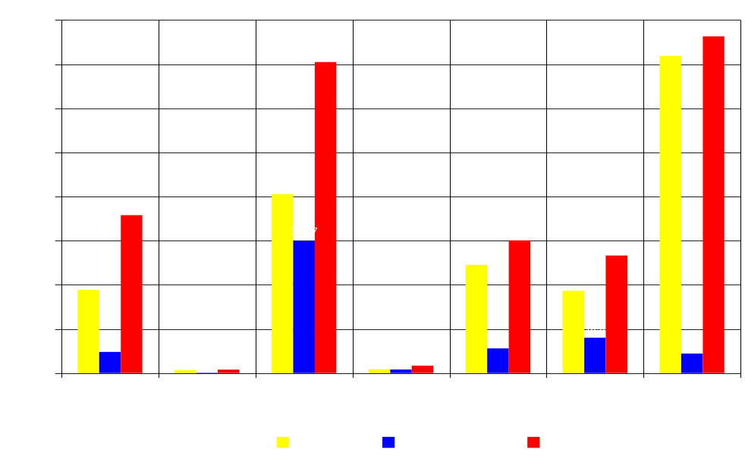
Now the outcomes
Patent filings by office in 2005 in thousands
The statistics showing patent filing do paint an interesting picture.
Japan and the U.S. are the leaders, while China, NIEs and EU-15 are high in rank.
CEE-4 does not exist on the world patent map.
Instead of focusing on generating more innovations companies, regions and countries should find and analyze their weakest links in the innovation value chain, and take corrective actions.
* Data for EU-15 are the sum of patent filings from national patent offices and the European Patent Office. According to WIPO, EPO patent filings in 2005 amounted to 60.8 thousands. The total number of patent filings for EU-15 may be overstated as the EPO grants patents on behalf of the member states of the European Patent Convention (EPC), the membership of which is larger than that of the European Union because some EPC member states are not members of the European Union. Furthermore many European patent applicants seek patent protection in multiple EPC member States, therefore, non-resident patent filings by Europeans in other EPC member State offices and at the EPO have become common. For the same reasons the total number of patent filings for CEE-4 may be underrated. Data for Italy are not available. Latin America-6 includes: Brazil, Chile, Colombia, Cuba, Ecuador and Peru.
Source: World Intellectual Property Organization.

Slide 31

Now the outcomes
The U.S. has only marginally higher number of researchers than EU-15, but records twice as many patent filings.
NIEs are much more effective that China, but smaller number of researchers produces almost as many patents as EU-15.
It does indicate many weak links in the innovation generation process in Europe.
Researchers in R&D and total number of patents filed
* Data for EU-15 are the sum of patent filings from national patent offices and the European Patent Office. According to WIPO, EPO patent filings in 2005 amounted to 60.8 thousands. The total number of patent filings for EU-15 may be overstated as the EPO grants patents on behalf of the member states of the European Patent Convention (EPC), the membership of which is larger than that of the European Union because some EPC member states are not members of the European Union. Furthermore many European patent applicants seek patent protection in multiple EPC member States, therefore, non-resident patent filings by Europeans in other EPC member State offices and at the EPO have become common. For the same reasons the total number of patent filings for CEE-4 may be underrated. Data for Italy are not available. Latin America-6 includes: Brazil, Chile, Colombia, Cuba, Ecuador and Peru.
Source: World Intellectual Property Organization.

Slide 32

Now the outcomes
When the effectiveness of money spent on R&D is taken into account we see that the U.S. holds a supreme position.
China files almost as many patents as EU-15 with half of the EU-15’s level of R&D expenditure as a share of GDP.
CEE-4 spend much more on R&D than LAC countries, and produce fewer patents. Both regions hardly exist on the world R&D map.
R&D spending and total number of patents filed
* Data for EU-15 are the sum of patent filings from national patent offices and the European Patent Office. According to WIPO, EPO patent filings in 2005 amounted to 60.8 thousands. The total number of patent filings for EU-15 may be overstated as the EPO grants patents on behalf of the member states of the European Patent Convention (EPC), the membership of which is larger than that of the European Union because some EPC member states are not members of the European Union. Furthermore many European patent applicants seek patent protection in multiple EPC member States, therefore, non-resident patent filings by Europeans in other EPC member State offices and at the EPO have become common. For the same reasons the total number of patent filings for CEE-4 may be underrated. Data for Italy are not available. Latin America-6 includes: Brazil, Chile, Colombia, Cuba, Ecuador and Peru.
Source: World Intellectual Property Organization.

Slide 33
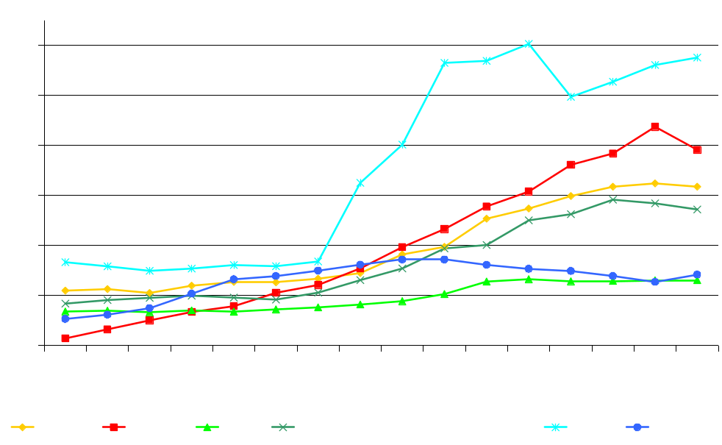
FDI may help…
Inward FDI stock (in % of GDP)
As documented above CEE-4 countries lack ability to generate great ideas and to transform them into new products or services.
Therefore it appears that foreign direct investments become the most important modernization channel.
Indeed CEE-4 became a very large recipient of FDI.
Source: UNCTAD, World Economic Outlook.

Slide 34
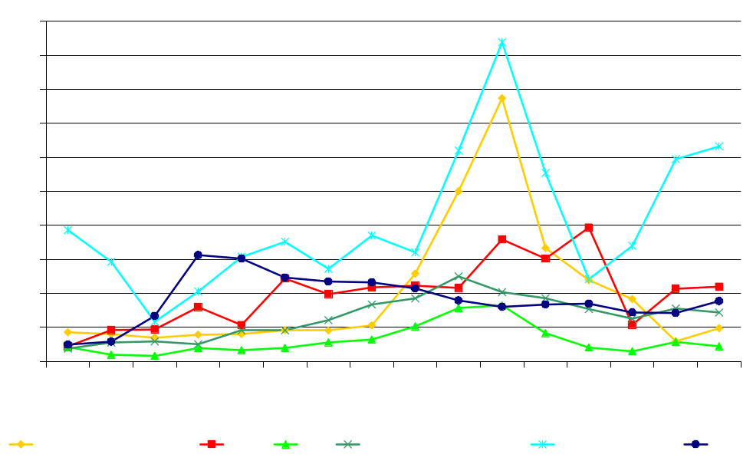
FDI may help…
FDI, net inflows (% of GDP)
Only NIEs economies managed to attract higher FDI stock in relation to GDP and enjoy higher FDI annual inflows.
Source: World Development Indicators 2007.

Slide 35
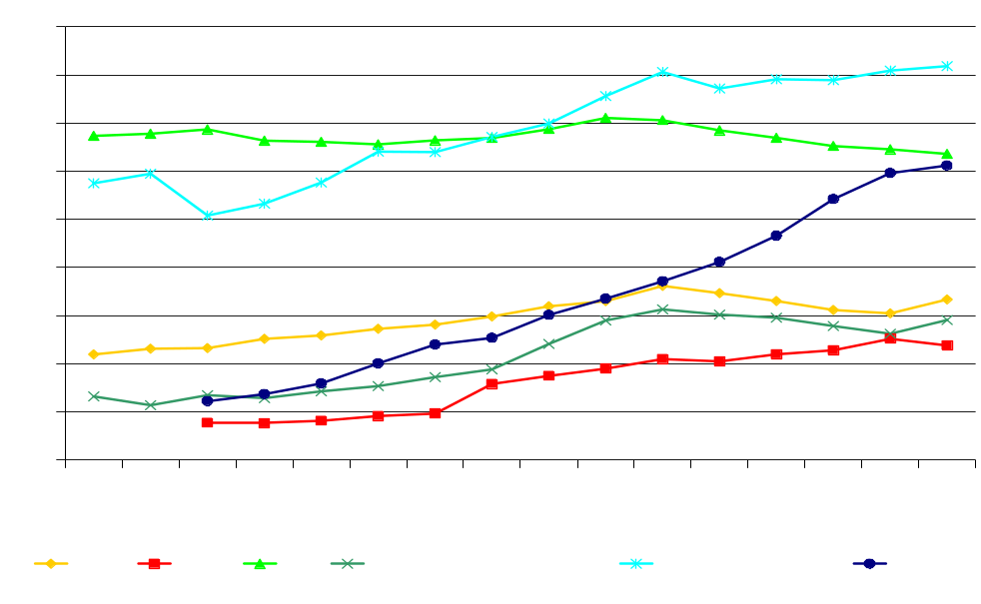
…if well-targeted
High-technology* exports (% of manufactured exports)
However, in the global knowledge economy it is important to attract high foreign direct investments to sectors that can become globally competitive.
While CEE-4 significantly improved the structure of exports, the high-tech goods account for only 12 percent of manufactured exports, which is the world’s worst result.
* High-technology exports are products with high R&D intensity, such as in aerospace, computers, pharmaceuticals, scientific instruments, and electrical machinery. Data for Hong Kong are included from 1992.
Source: World Development Indicators 2007.

Slide 36
Who will be thought, innovation and idea leaders?
The 21st century will see a new paradigm. Data shown above suggest that China and NIEs will become thought, innovation and idea leaders.
A very fine summary of this line of thought was offered by Hexter, Woetzel (2007):
“In such a competitive hothouse, adapted practices will evolve quickly, and as China merges into the world economy best practice there will become best practice globally. More products developed in China will become global products; more industrial processes developed in China will become global processes. The ability to develop a Chinese talent pool will therefore be critical across all functions. Learning how to execute in China – the world’s most competitive market – will teach companies how to compete more aggressively elsewhere”.

Slide 37
Why not us?
The last few years were very good for CEE-4 countries. However, the analysis presented in this section identified important structural deficiencies of CEE-4 knowledge economies. In particular they lack the ability to generate innovations. Although they have attracted large pool of FDI it seems to have been located in relatively low value added industries. It suggests that, after a period of EU-accession positive output shock, CEE-4 may find it difficult to maintain fast and sustainable growth path.
Another major deficiency of Europe, which was inherited by new Europe as well, is the lack of ability to create shared and ambitious vision, strategic goals and successful implementation of strategic plans.
Last but not least, new Europe is struggling with massive emigration to Western Europe which has become a significant „brain drain”. No action has been taken so far to convert it to „intellectual capital gain”.

Slide 38
Conclusions
Data presented in this paper suggest that the ability to retain technological leadership by the U.S. and especially by the EU is rapidly vanishing because:
Population of present and future innovators in Asia (China and NIEs) is rapidly enlarging;
Environment is much more competitive in many Asian markets than in Europe or the U.S., and tough competition breeds success;
Sharply increasing return to education (white-collar wages) will lead to even faster closing of the technology and innovation gap between the U.S. and China or NIEs;
Biggest developed world democracies, the EU and the U.S. lack clear vision and strategy;
Western world has failed to understand the importance of intellectual capital to future prosperity.

Slide 39
Recommendations
Abolish present “destructive creation”.
Create long-term vision reaching out to 2050.
This vision has to be universally shared by citizens and politicians, based on this vision strategic action plans have to be developed.
Analyze what assets are needed to fulfill that vision, invest to create these assets.
Conduct a careful analysis of strategies developed and implemented by most successful global corporations, especially those from emerging markets.
There will be no success in the 21st century without courage or luck. Do not bet your future on being lucky!
Innovation cannot emerge without reaching an adequate level of intellectual capital. The quest for intellectual capital of the 21st century has already begun. Both the old and the new Europe have to wake up and join the race.

Slide 40
Thank you
Comments and questions most welcome!!!
Dr Krzysztof Rybiński
National Bank of Poland
Deputy Governor
Email: krzysztof.rybinski@nbp.pl
Blog: www.rybinski.eu

