Slide 1




ALY 6060 - Final Project Presentation
(CRN :20472 Winter 2024)
Professor: Michael Carvallo
Date: 03/26/2024

Slide 2





Carbon Emissions
Presented by Shaikh Rahheb

Slide 3



Introduction
Carbon emissions are at the forefront of global environmental discussions, with profound implications for climate change and sustainability.
In this presentation, we'll dive into the wealth of data available on carbon emissions, exploring trends, disparities, and potential solutions.
Through our analysis, we aim to shed light on the complex dynamics of carbon emissions, empowering us to make informed decisions for a more sustainable future.

Slide 4


Data Set
Our analysis is based on a comprehensive dataset sourced from reputable organizations such as the World Bank and the European Environment Agency.
The dataset covers carbon emissions data from various countries and regions spanning multiple decades.
Key variables include carbon emissions in metric tons per capita, allowing for a detailed examination of emissions trends over time.
With this rich dataset, we have the opportunity to explore the intricate patterns and dynamics of carbon emissions on a global scale.

Slide 5
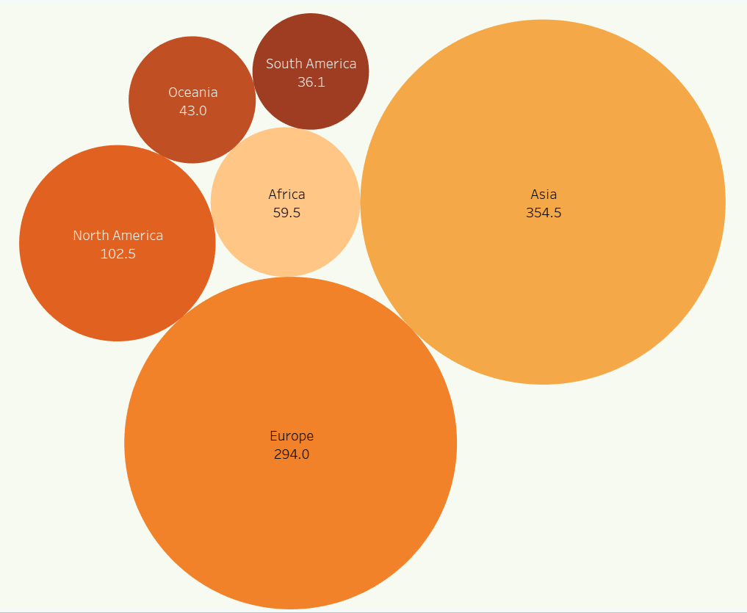
Descriptive Analytics:
Each bubble represents a continent, with the size of the bubble indicating the magnitude of carbon emissions.
From the visualization, we observe that Asia emerges as the largest emitter, followed by Europe and North America.
Asia emerges as the largest emitter, driven by its population size, industrialization, and reliance on fossil fuels for energy.
Europe and North America follow closely behind, reflecting their historical industrial development and extensive energy consumption.
By analyzing this bubble chart, we gain valuable insights into the relative contributions of different continents to global carbon emissions.

Slide 6
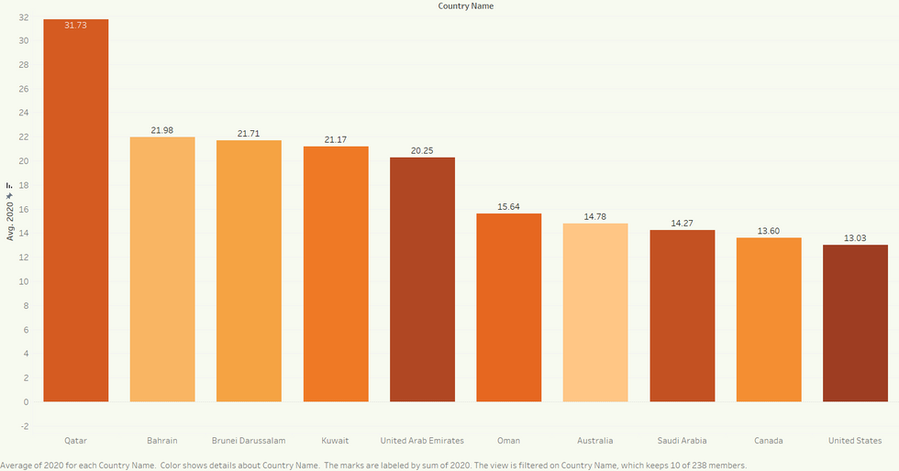
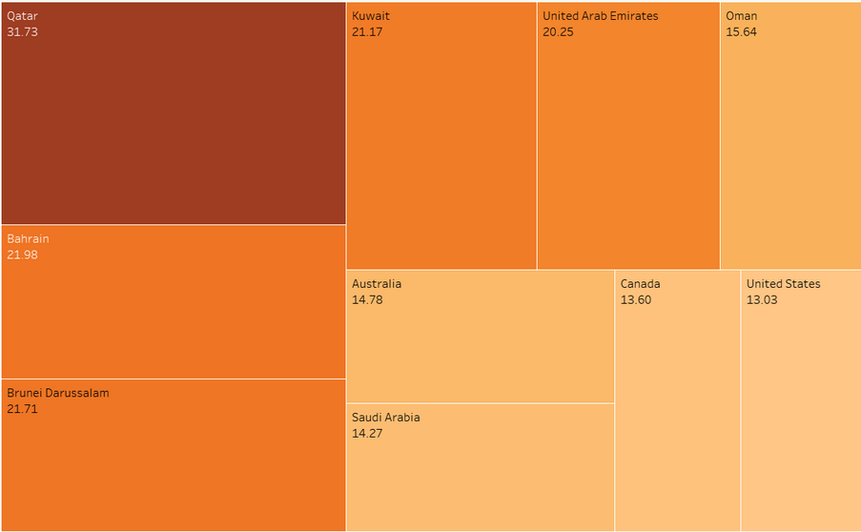
Analysis :
Top 10 countries with the highest carbon emissions in the year 2020, showcasing Qatar, Bahrain, Kuwait, Brunei Darussalam, Australia, UAE, Saudi Arabia, Canada, and the USA.
These countries exhibit varying levels of industrialization, economic development, and reliance on fossil fuels, contributing to their significant carbon emissions.
Nations like Qatar, Bahrain, Kuwait, and Brunei Darussalam, known for their oil and gas reserves, have high per capita emissions due to their reliance on fossil fuel industries.
Australia's emissions are driven by its energy-intensive industries and coal-fired power plants, while the UAE and Saudi Arabia's emissions stem from their oil and gas extraction and processing activities.
Canada and the USA, as large industrialized nations, have substantial emissions from their transportation, manufacturing, and energy sectors.

Slide 7
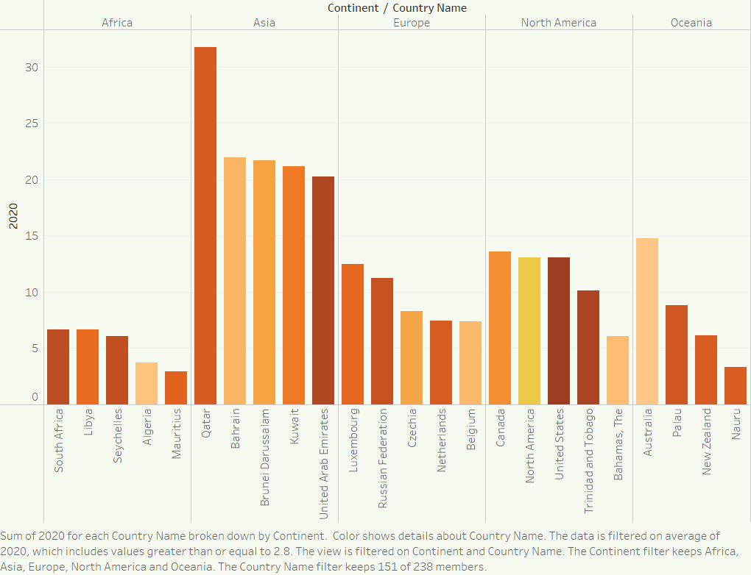
Analysis:
Top 5 Countries Across Continents for Emissions:
Africa:
South Africa
Libya
Seychelles
Algeria
Mauritius
Asia:
Qatar
Brunei
Bahrain
Kuwait
UAE
Europe:
Luxembourg
Russian Federation
Czechia
Netherlands
Belgium
North America:
USA
Canada
Bahamas
Trinidad and Tobago
Oceania:
Australia
Palau
New Zealand
Nauru
(Note: The ranking is based on carbon emissions data for the year 2020.)

Slide 8
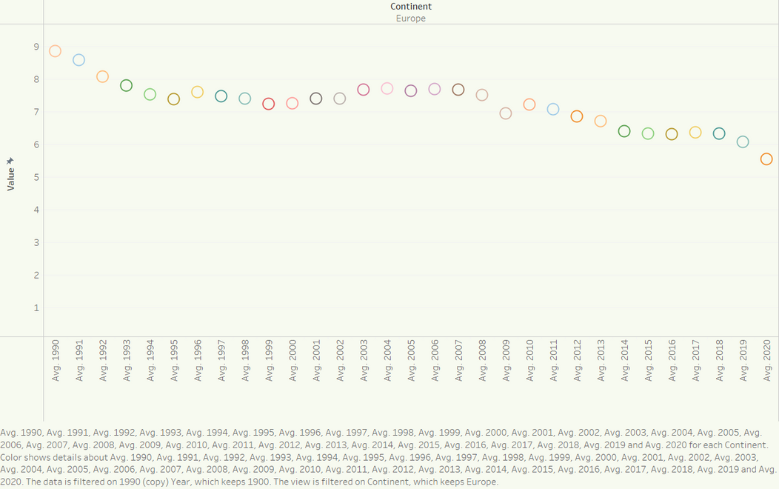
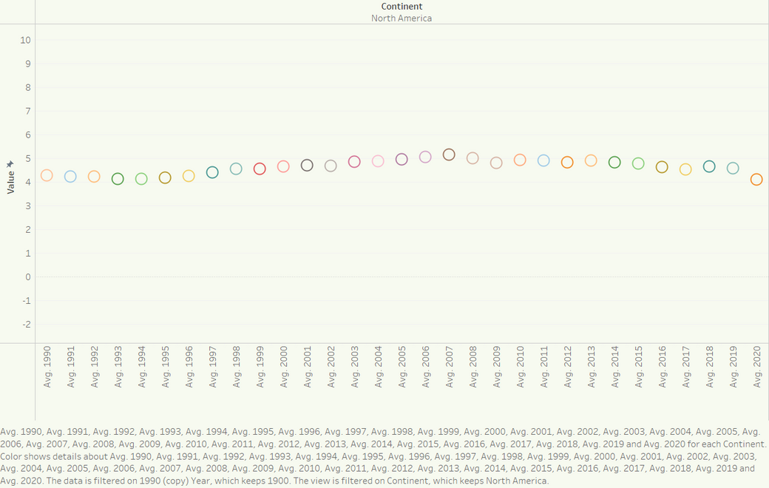
Analysis Across Years(Europe and NA):
A comparison of carbon emissions trends over time between Europe and North America reveals distinct trajectories.
Europe showcases a gradual decline in emissions, reflecting advancements in technology, increased focus on renewable energy, and stringent environmental regulations.
North America's emissions trends are characterized by fluctuations, influenced by factors such as economic cycles, energy policy changes, and shifts in industrial activity.
Despite these differences, both regions have made strides in reducing emissions per capita in recent decades, demonstrating a commitment to sustainability and environmental stewardship.
These trends underscore the importance of region-specific approaches to emissions reduction and highlight the need for continued collaboration and innovation to address climate change on a global scale.

Slide 9
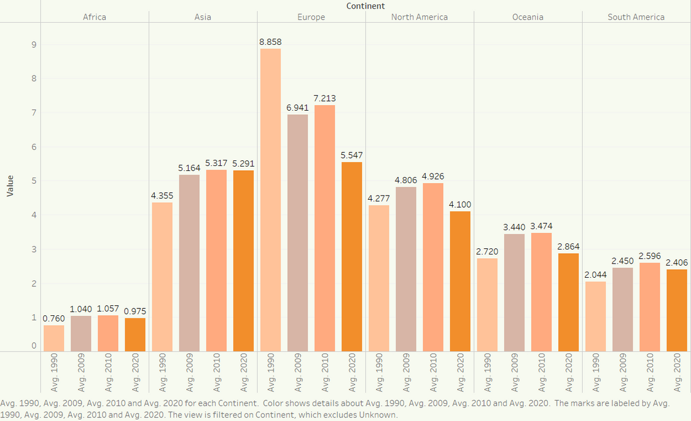
Decade Analysis:
An overview of carbon emissions trends by decade, with a special focus on the impact of the 2009 market crash.
Each bar represents emissions levels for a specific decade, allowing for a comparison of emissions trends over time.
The inclusion of the year 2009 highlights a notable downturn in emissions, particularly pronounced in Europe compared to other regions.
The market crash disproportionately affected Europe due to its heavy reliance on export-oriented industries and interconnected financial markets.
This visualization underscores the significance of external events in shaping emissions trends and emphasizes the need for resilience and sustainability in economic systems.

Slide 10







Carbon emission problems
Rising Temperatures: Increased carbon emissions contribute to global warming, resulting in rising temperatures worldwide.
Threats to Human Health: Air pollution associated with carbon emissions poses risks to human health, contributing to respiratory diseases, cardiovascular problems, and other health issues.
Impact on Ecosystems: Elevated carbon emissions have adverse effects on ecosystems, including disruptions to habitats, loss of biodiversity, and shifts in species distributions.
Altered Weather Patterns: Climate change driven by carbon emissions leads to changes in weather patterns, including more frequent and severe extreme weather events such as heatwaves, droughts, storms, and floods.

Slide 11

Conclusion
For this analysis with limited data, we can conclude that while emissions growth has slowed in recent years(covid pandemic), we have yet to reach the peak.However, when searching the internet, we found that our analysis only scratches the surface of the complex issue of carbon emissions.
In conclusion, our analysis highlights the evolution of carbon emissions over time and the urgent need for action to address the challenges posed by climate change.
We observe that before the Industrial Revolution, emissions were minimal, but the pace of growth accelerated significantly in the mid-20th century.
By 1950, the world emitted 6 billion tonnes of CO2, a figure that nearly quadrupled to over 20 billion tonnes by 1990.
Today, emissions exceed 35 billion tonnes annually, underscoring the magnitude of the challenge we face.

Slide 12
References
[1] European Environment Agency. (2010, June 3). Recession and renewables cut greenhouse gas emissions in 2009. European Environment Agency. https://www.eea.europa.eu/media/newsreleases/recession-and-renewables-cut-greenhouse#:~:text=The%20economic%20recession%20and%20the,fall%20in%20emissions%20in%202009.
[2] World Bank. (n.d.). CO2 emissions (metric tons per capita). World Bank Data. https://data.worldbank.org/indicator/EN.ATM.CO2E.PC
[3] Intergovernmental Panel on Climate Change. (n.d.). Home. https://www.ipcc.ch/
[4] Environmental Protection Agency. (n.d.). Climate change indicators: Greenhouse gases. https://www.epa.gov/climate-indicators/greenhouse-gases
[5] United Nations Framework Convention on Climate Change. (n.d.). Home. https://unfccc.int/
[6] Global Carbon Project. (n.d.). Home. https://www.globalcarbonproject.org/
[7] Carbon Disclosure Project. (n.d.). Home. https://www.cdp.net/

Slide 13

Thank
You

