Slide 1
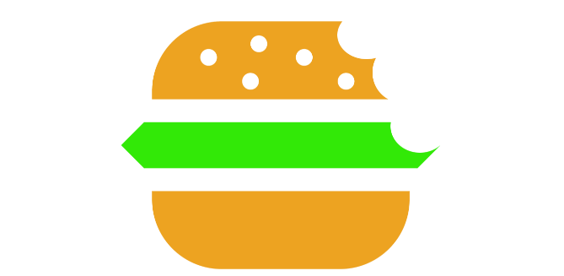
GrabABite©
DBMS Project

Slide 2
Group Members
Pushkar Jain IIT2014039
Abhinav Prakash IIT2014046
Rydel D’costa IIT2014047
Sudhanshu Monga IIT2014081

Slide 3
What Is GrabABite?
Everyone living in a college hostel dreads MESS FOOD. While studying for the exams and burning the midnight oil students usually find themselves hungry way past midnight and are left with very limited options to eat but don’t have any proper information about them.
This project aims to put an end to all these struggles by compiling all these information in one place (through an app) accessible to everyone. The project will maintain a database of all nearby restaurants and eateries. What’s more it will also show where someone can GrabABite anytime on a 24 hour clock.

Slide 4
Overview
So the facilities our app will provide are :
Location of nearby restaurant and eateries on real time basis, their contact details and complete menu
Given a budget the filtered list of items a user can eat
Users can provide reviews and feedback about a particular eatery
Direct calling facility to the eatery

Slide 5
Technologies Used
Design Phase: ER-Diagram
App Development: Java, Android Studio, XML, Google API
Database Development: SQL, MySQL on XAMPP Server
Database Connectivity: PHP, phpMyAdmin
Some of the latest Material Design features like Recycler View, Navigation View, Collapsing Toolbar, Card View, FAB Button

Slide 6
Database Tables – 3NF
User (Id, Username)
Register (Id , Name, Email, Password)
Restaurant (Rid, Rname, Rtablename, Contact, Xlocation, Ylocation, Delivery)
Review (Id, Rid, Review)
Malikdhaba (DishName, DishPrice, Recommended)

Slide 7
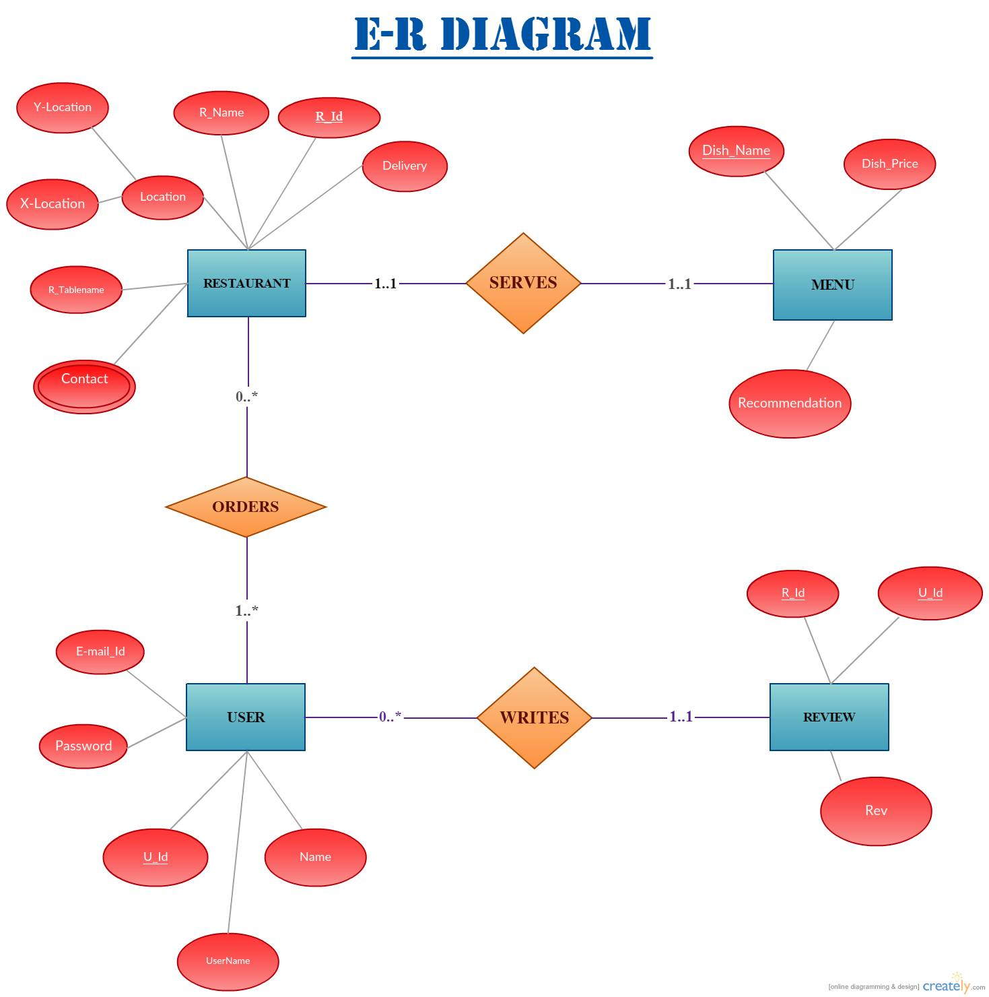

Slide 8
Connectivity using PHP

Slide 9

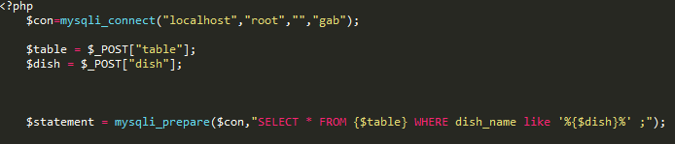

Slide 10
IN APP EXPERIENCE

Slide 11
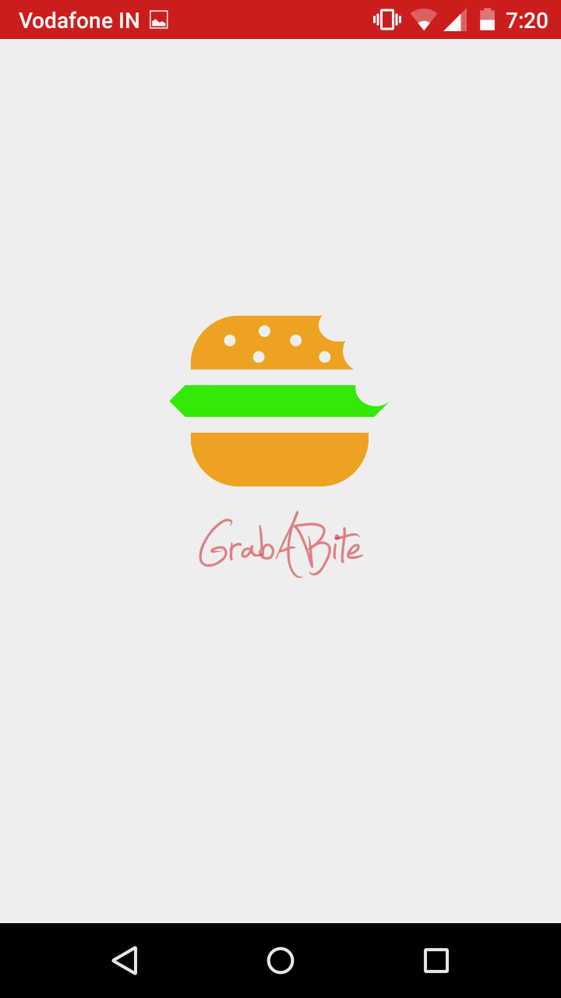
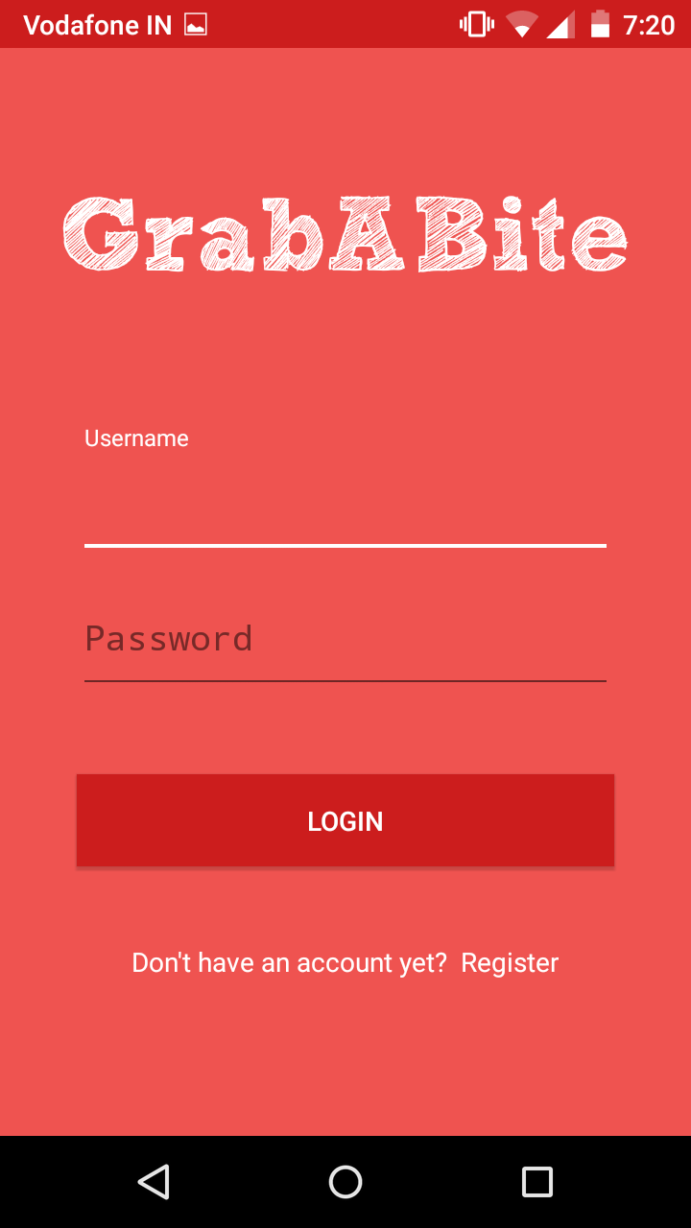
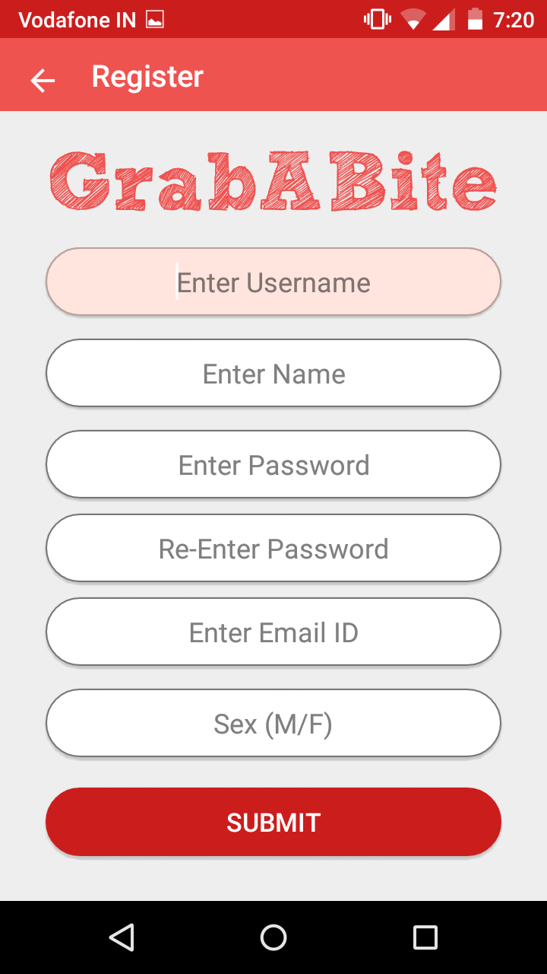

Slide 12
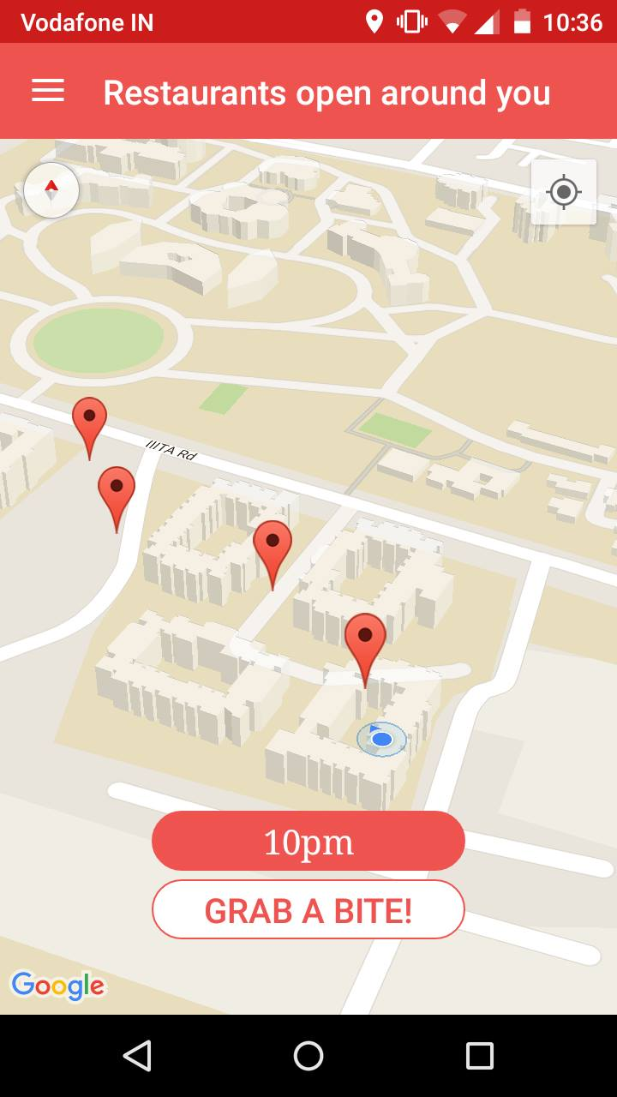
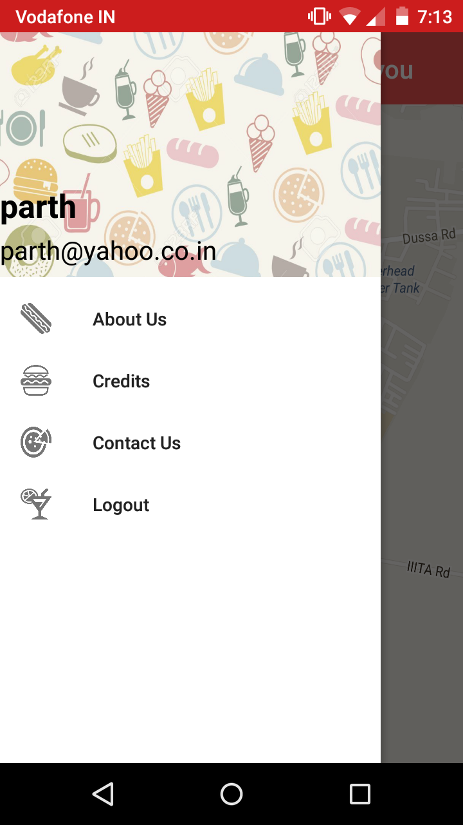
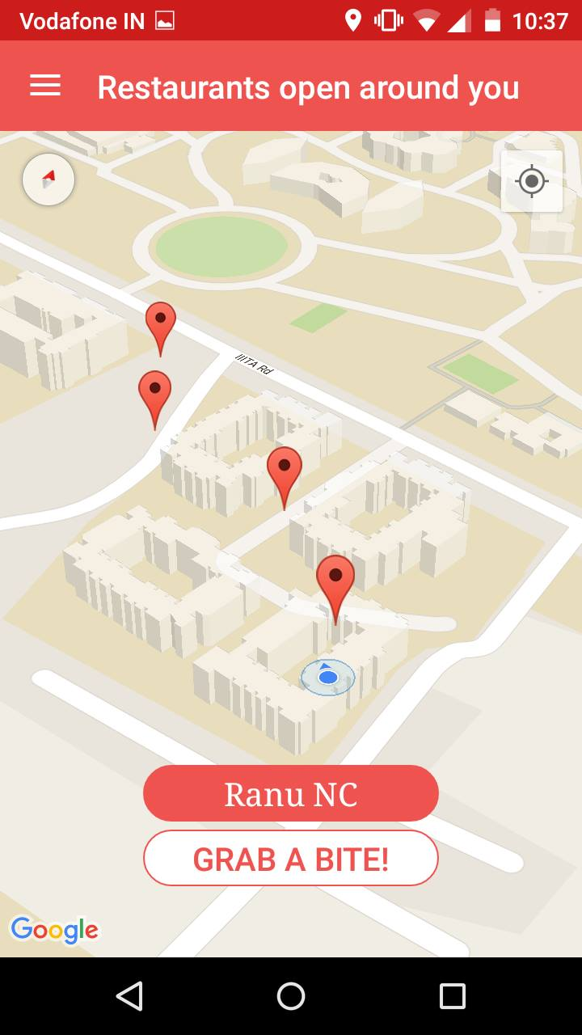

Slide 13
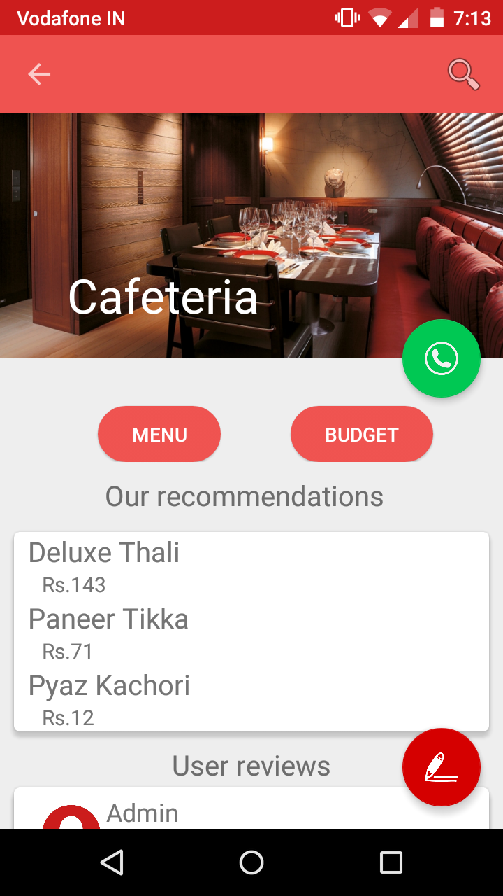
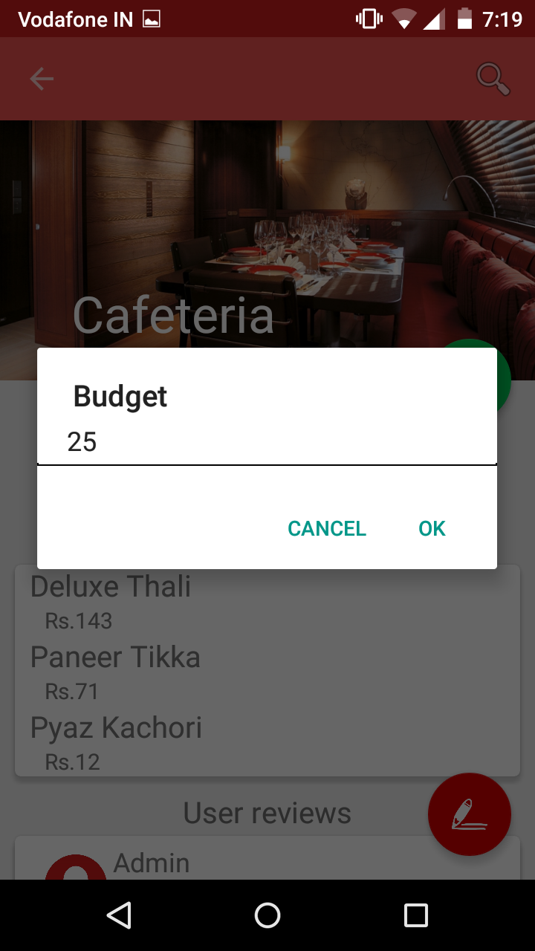
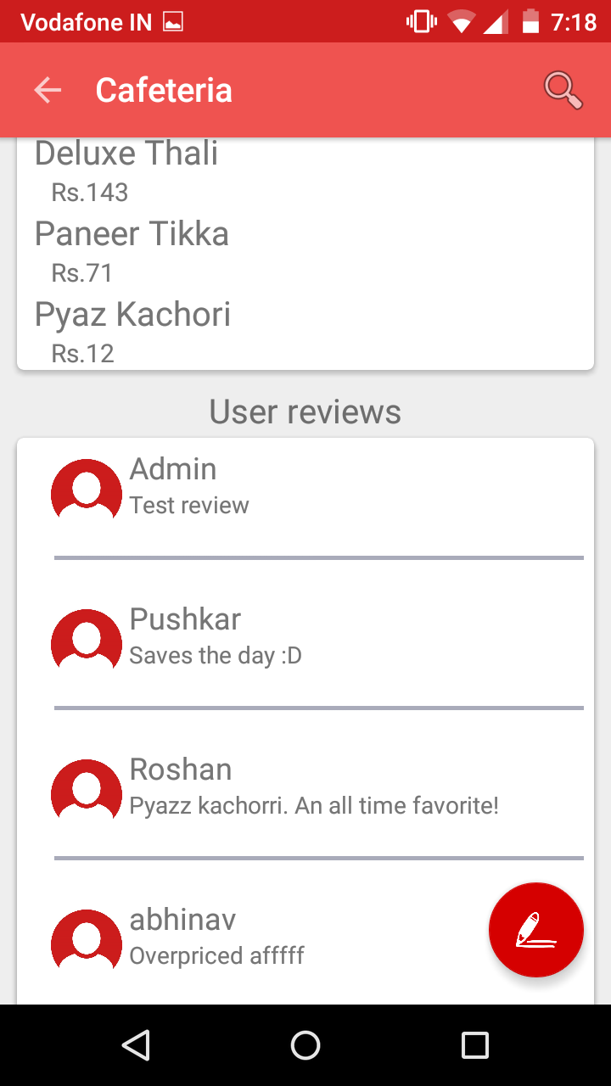

Slide 14
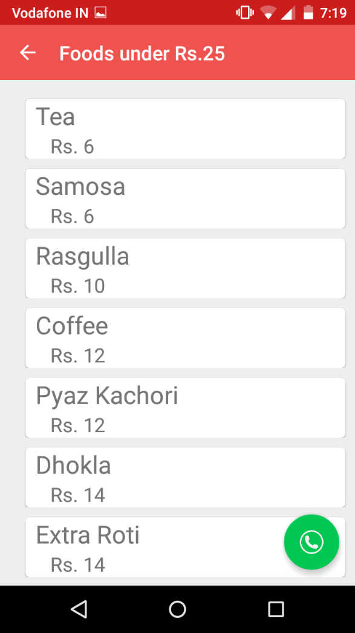
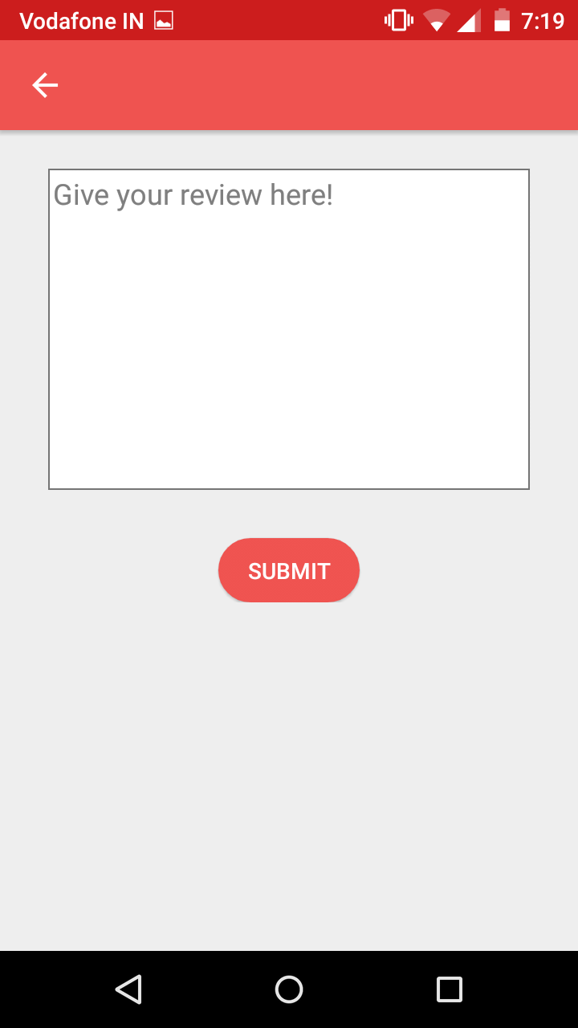
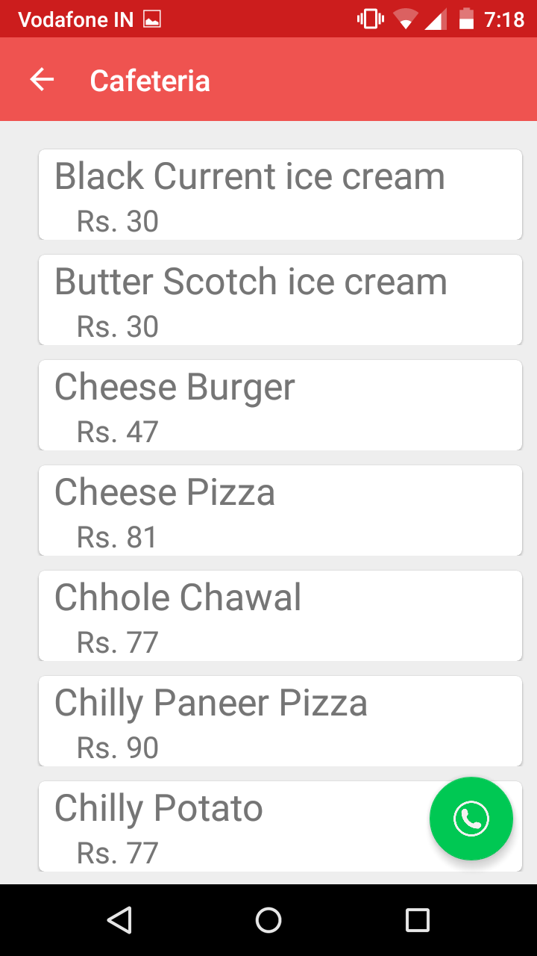
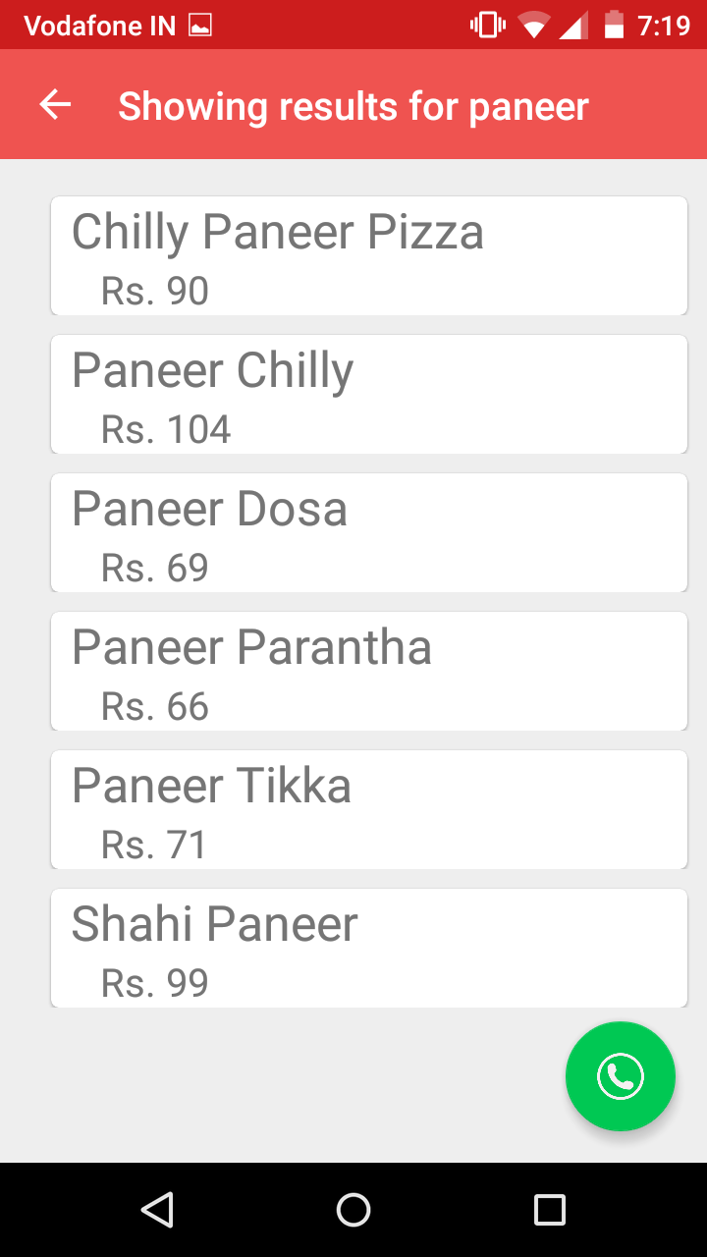

Slide 15
Android Codes

Slide 16
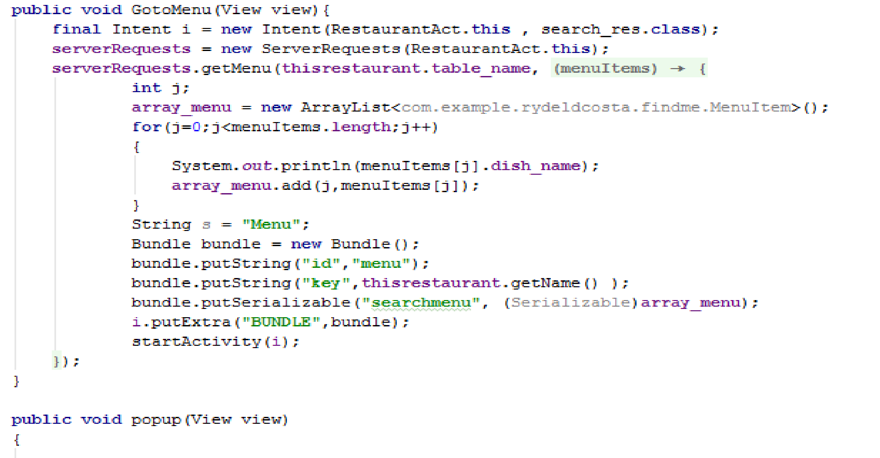

Slide 17
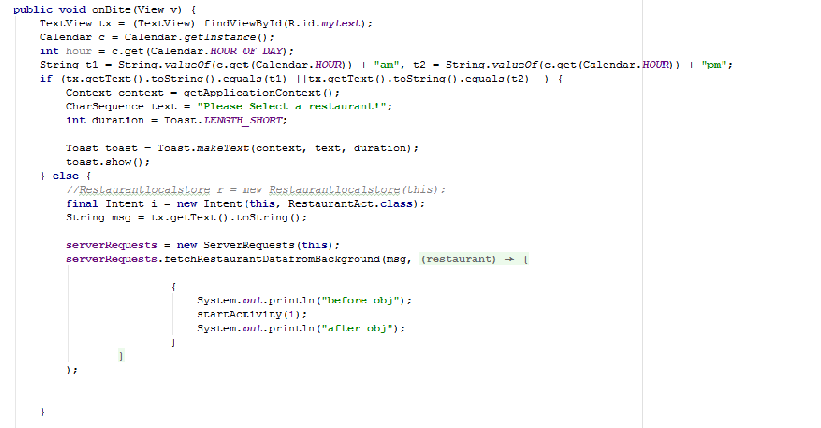

Slide 18
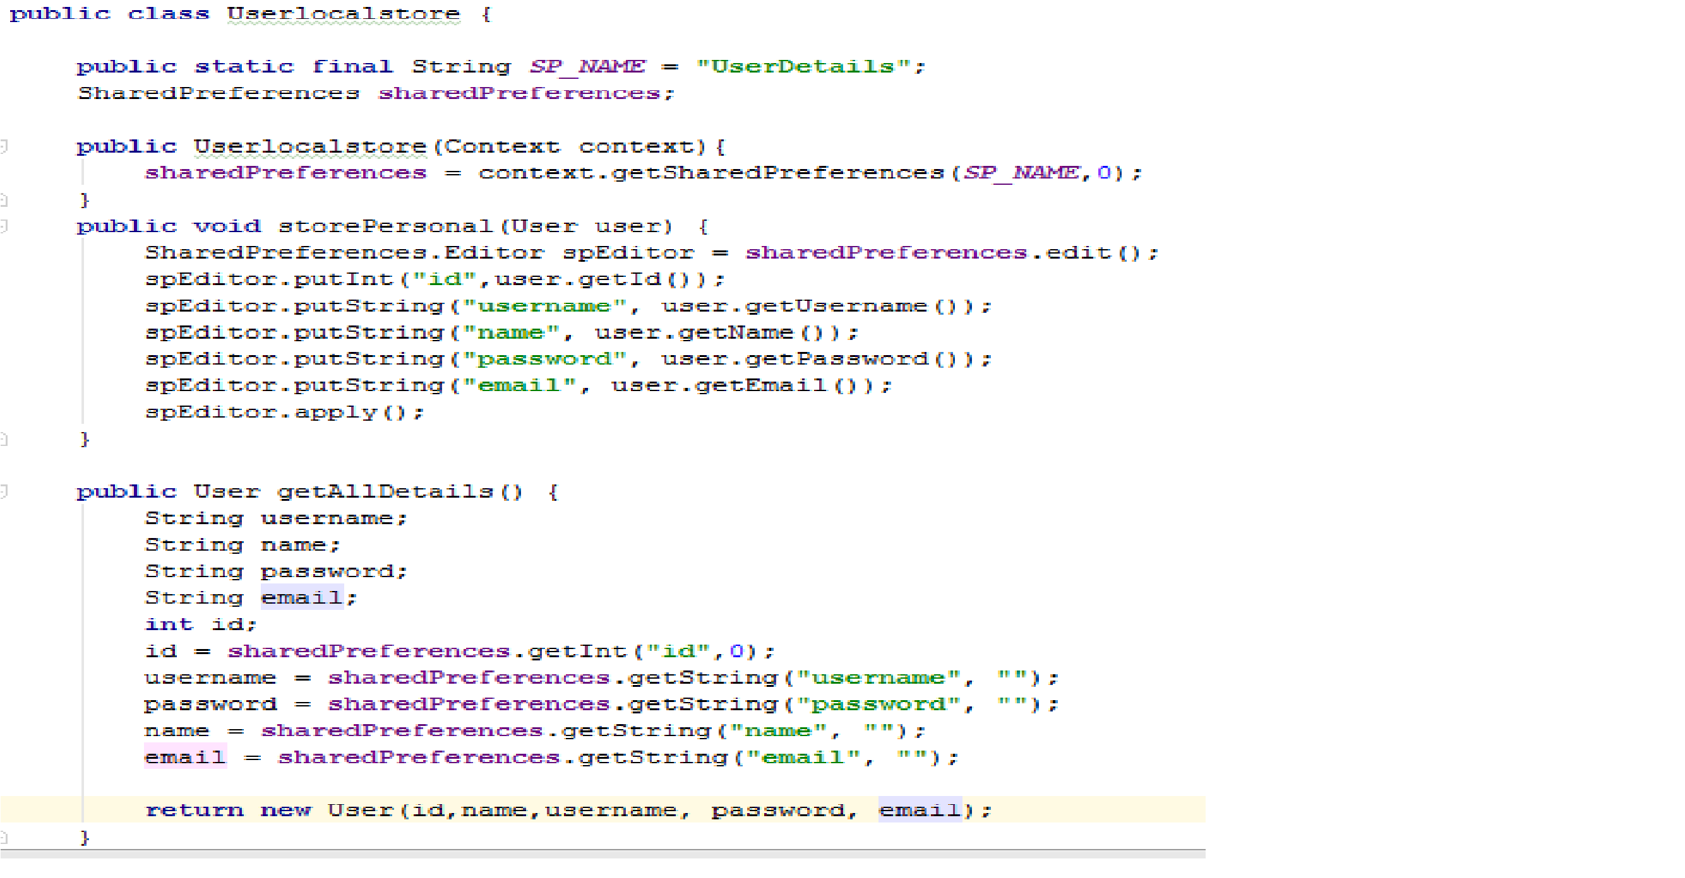

Slide 19
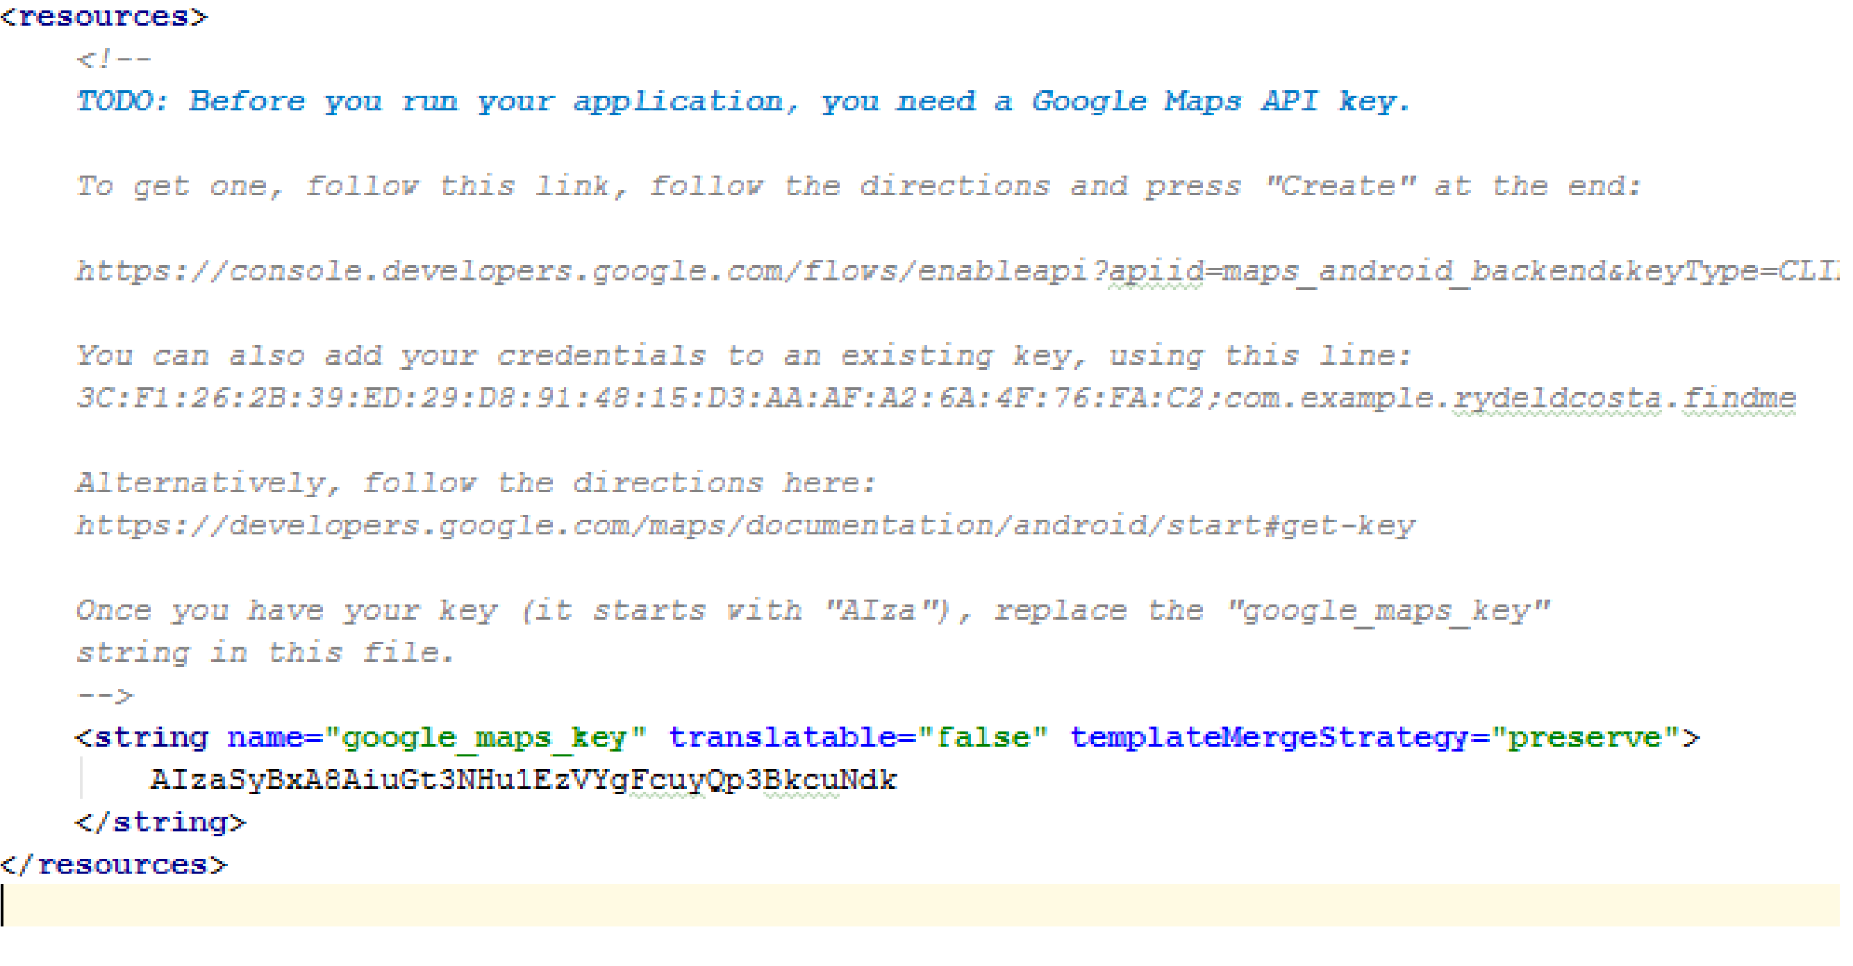

Slide 20
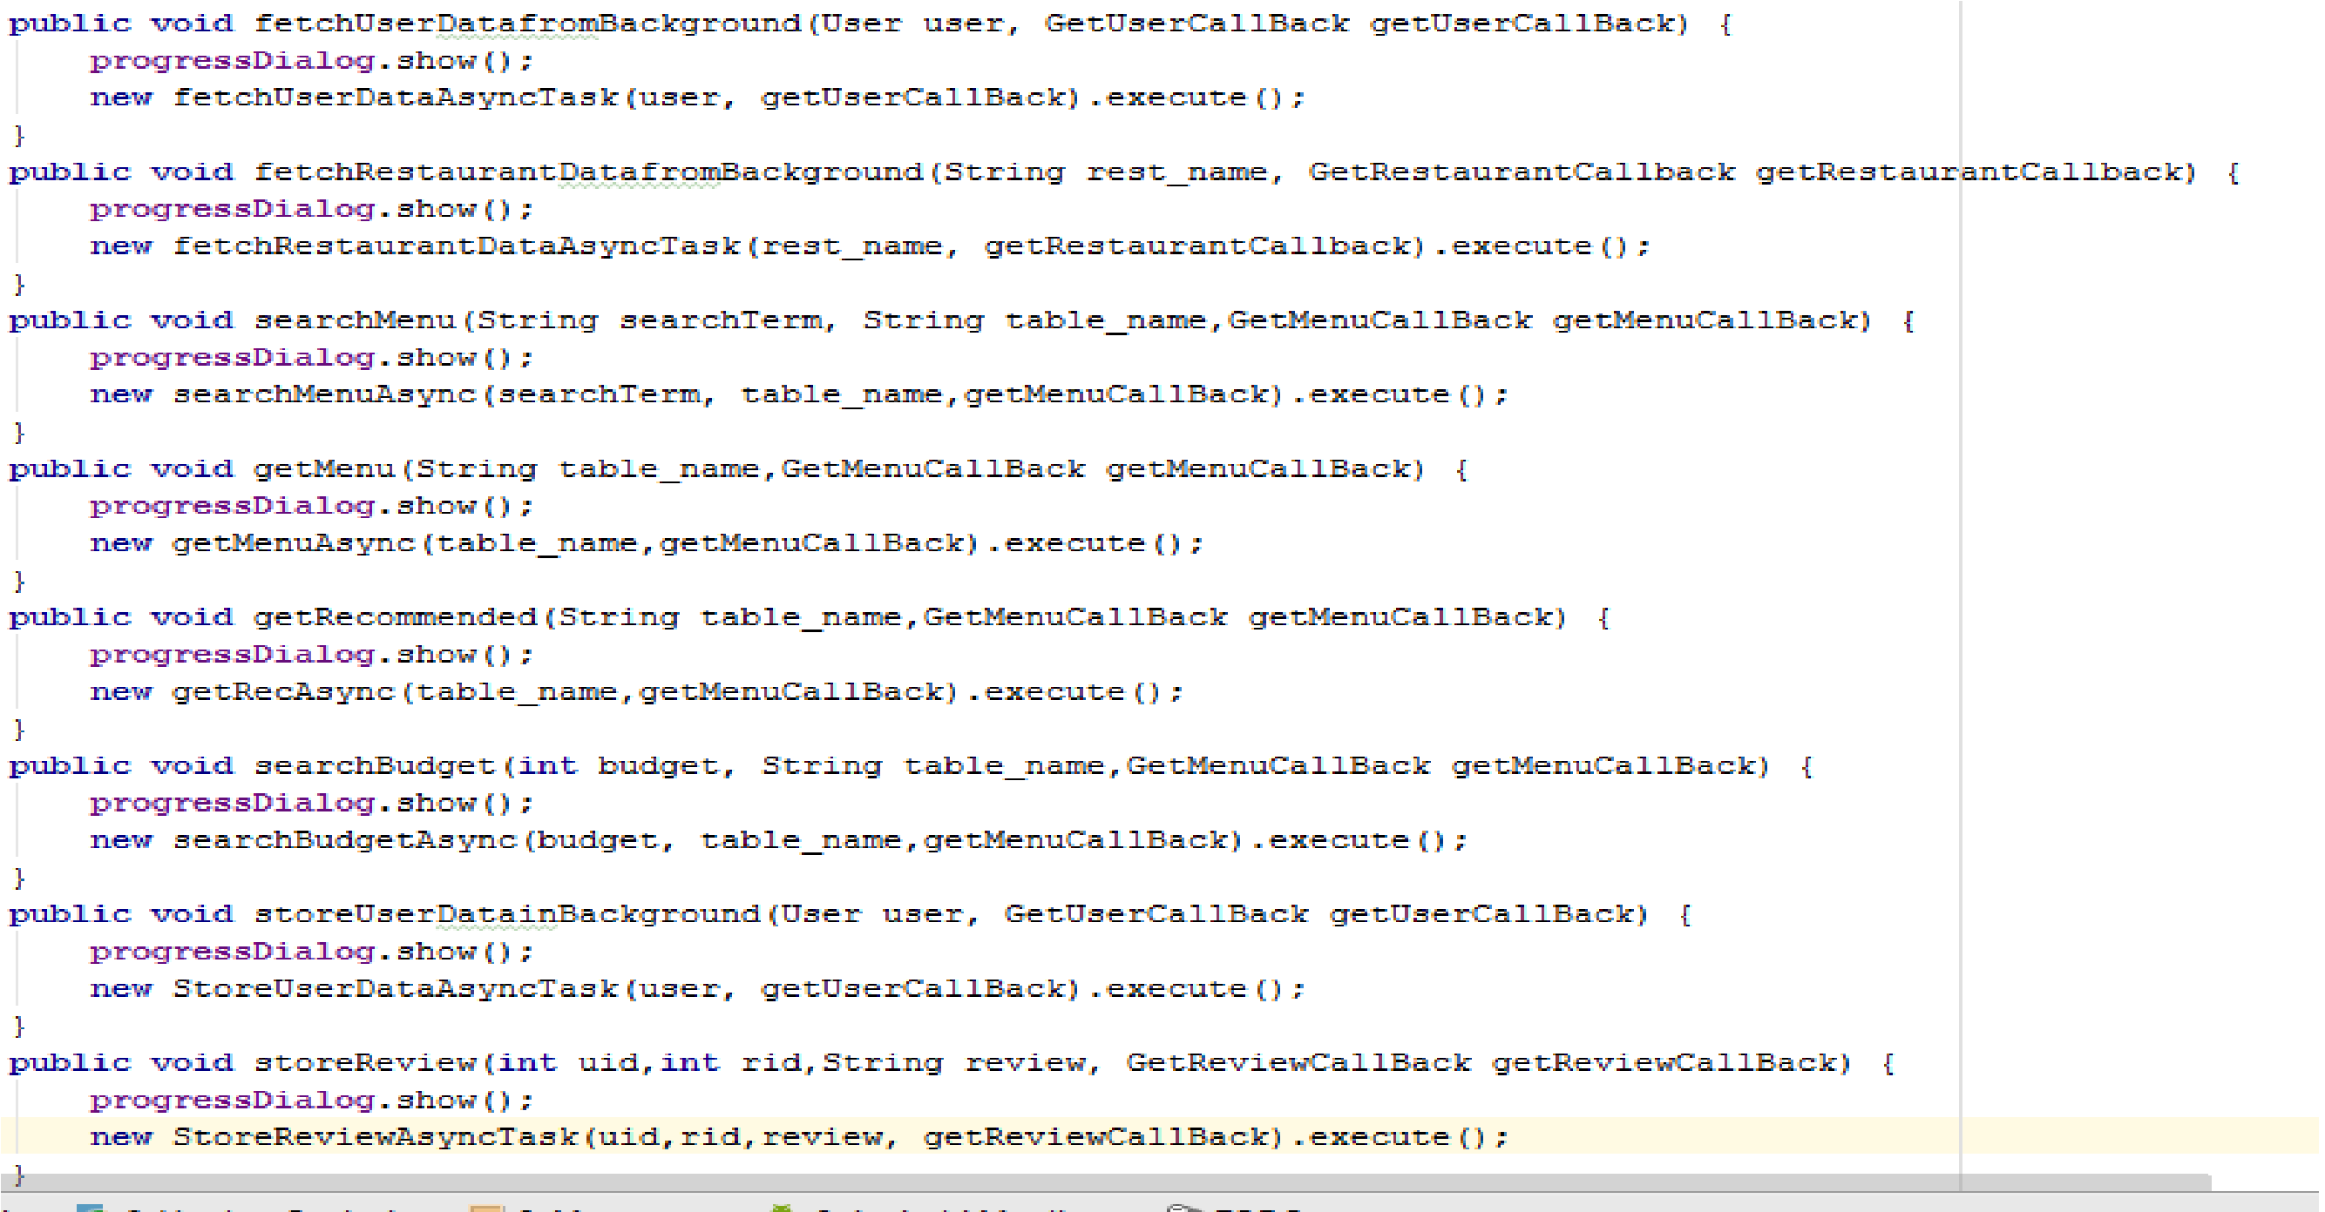

Slide 21
THANK YOU

