Slide 1
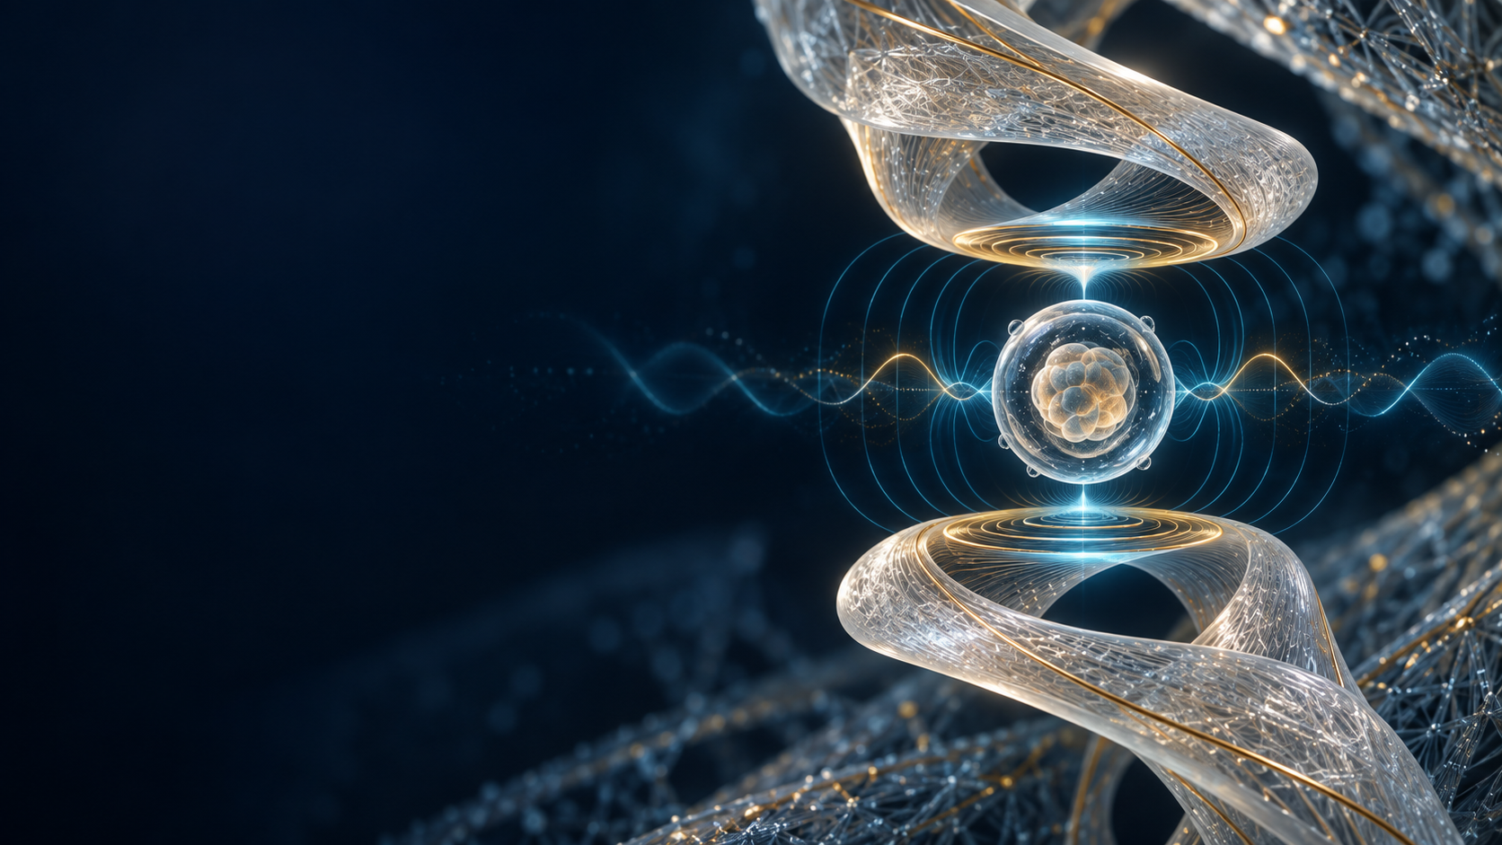
Adaptive Chiral
Bio-Resonance Platform
Non-invasive developmental metrology built from computationally manufactured resonators, multimodal sensing and temporal AI.
RESEARCH & PARTNERSHIP DECK
ScanIQ LLC
September 2026
Notes:
Concept rendering created for this deck. Proposed device architecture; not a clinical product.

Slide 2
Embryo assessment still sees only part of the biology
Morphology and timing matter, but they do not directly measure dielectric, mechanical or magnetic change.
01
02
03
IMAGE-LED
SPARSE SIGNAL
MISSING LAYER
Time-lapse systems infer competence from appearance and division timing.
Metabolic and genetic assays add information but can be episodic, invasive or expensive.
Continuous physical-property sensing could reveal deviations before morphology becomes obvious.
Opportunity
Add a passive, continuous electromechanical phenotype to the embryo-development record.
SCANIQ / CONFIDENTIAL CONCEPT
02
Notes:
Framing only. Clinical utility requires prospective validation and regulatory review.

Slide 3
The scientific building blocks already exist
Published work supports stage-dependent electrical changes, time-lapse AI and chiral THz materials.
1.49 MHz
13 stages
0.92
≈510 MPa
Bovine embryo EIS anchor
Medaka stages modeled
Metabolic + morphology AUC
Fused silk flexural strength
Embryo impedance
Differential spectra change with cell mass, viability and development.
AI morphokinetics
Time-lapse models provide independent stage and outcome labels.
Chiral materials
Fused silk and asymmetric microstructures can rotate THz polarization.
SCANIQ / CONFIDENTIAL CONCEPT
03
Notes:
Sources: IEEE/biomedical literature on bovine embryo impedance spectroscopy (PMID 40039530); Measurement papers on medaka differential EIS; Nature Communications 2026 spent-medium metabolites plus morphology; Nature Sustainability 2026 fused silk and THz optical activity. Values are study-specific and do not establish clinical performance for the proposed platform.

Slide 4
The invention links fabrication, sensing and learning in one closed loop
A sample perturbs the resonator. The model learns the trajectory. The manufacturing kernel tunes the next design.
1
2
3
4
5
SDF + material field
Field-oriented printing
Differential sensing
Temporal AI
Measured redesign
›
›
›
›
Geometry, density, fiber direction and chirality
Aperture deposition with controlled alignment and cure
Impedance, resonance, phase, Q and near-field channels
Stage estimate, deviation score and outcome probability
Update local material orientation toward the target transfer function
Design intent
Maximize developmental-state information per unit exposure, rather than maximize Q alone.
SCANIQ / CONFIDENTIAL CONCEPT
04
Notes:
Proposed architecture and optimization objective.

Slide 5
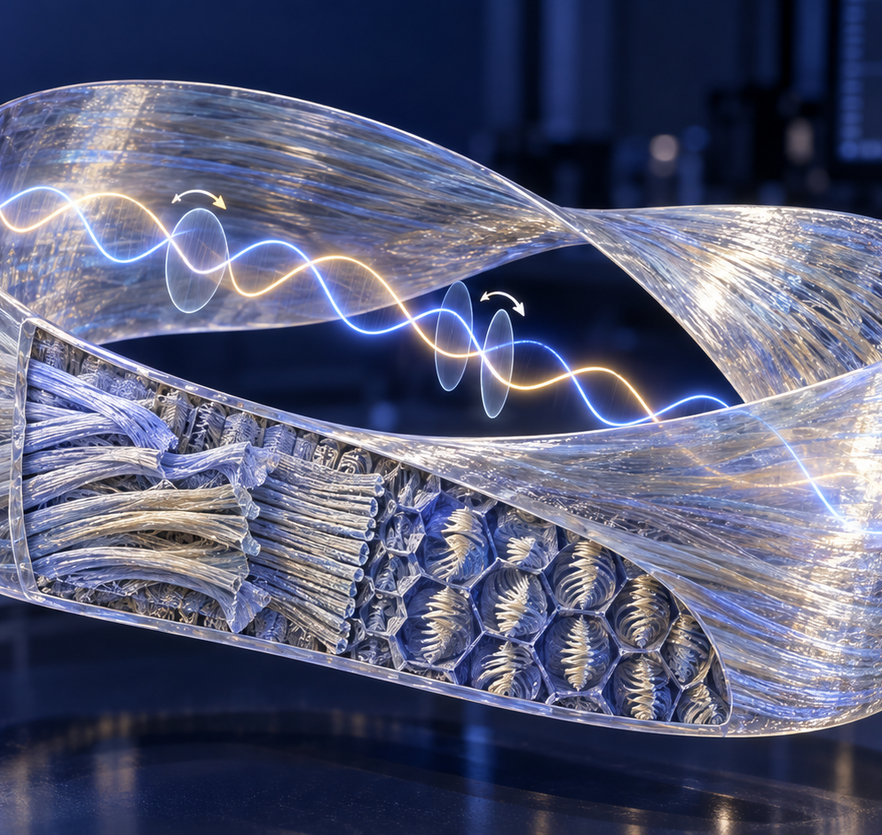
A resonator with encoded internal structure
The Möbius form supplies topology. The material field programs local fiber orientation, crystal alignment, handedness and dielectric loss.
MACRO
Twist, width, thickness, coupling gap
MESO
Fiber direction, porosity, conductive traces
MICRO
Chiral domains, crystalline order, additives
Output: a target electromagnetic transfer function
SCANIQ / CONFIDENTIAL CONCEPT
05
Notes:
Concept rendering. Relevant foundation: hierarchical fused silk with terahertz optical activity and chiral microstructures with THz polarization response.

Slide 6
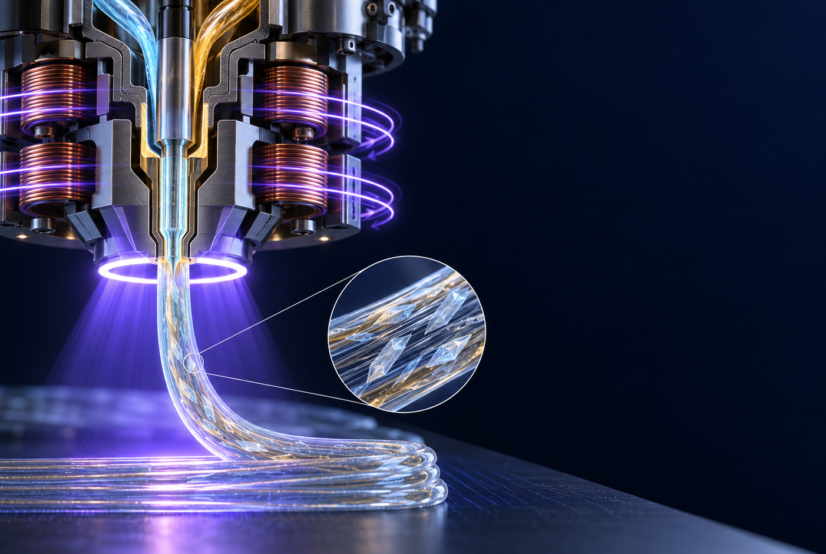
The printhead turns a material field into physical anisotropy
A coaxial aperture deposits the feedstock while a rotating field controls orientation before cure.
A
Feedstock
Silk or polymer composite with alignable fibers or particles
B
Orientation zone
Programmed electric or magnetic field follows the voxel vector
C
Fixation
Optical, thermal or chemical cure locks the local structure
SCANIQ / CONFIDENTIAL CONCEPT
06
Notes:
Concept rendering. Magnetic-field-assisted direct ink writing and silk-fibroin printing each have prior art; proposed novelty lies in closed-loop SDF/material-field control and resonant-response feedback.

Slide 7
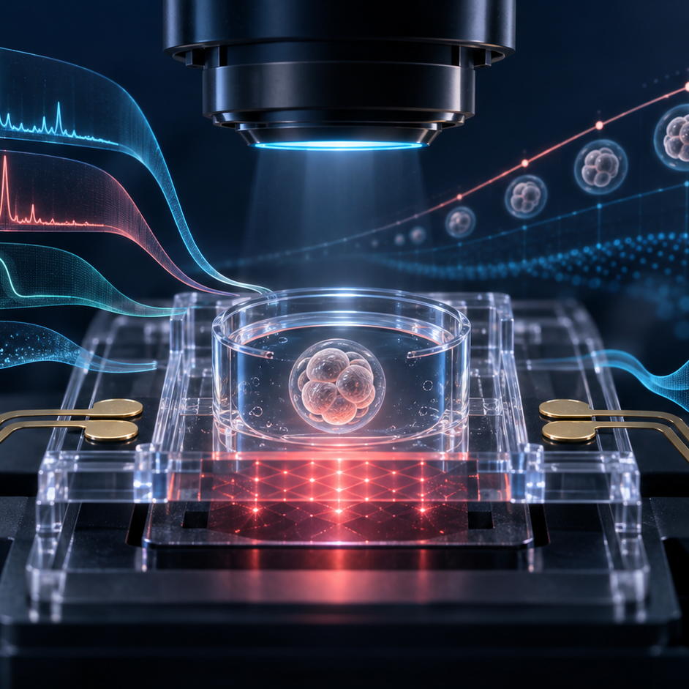
Four synchronized views of development
RF / impedance
Δf, ΔQ, S11, phase, complex impedance
Optical
Morphology, cleavage timing, motion
Environmental reference
Temperature, vibration, geomagnetic and laboratory EMI
Optional quantum channel
Near-field NV diamond measurements at realistic stand-off
THz role
Interrogate the resonator through near-field or evanescent coupling. Avoid high-loss bulk transmission through culture medium.
SCANIQ / CONFIDENTIAL CONCEPT
07
Notes:
Concept rendering. Water strongly absorbs THz radiation, so the proposed early embodiment uses evanescent or resonator-mediated coupling. NV sensing remains an optional research channel, not a required clinical claim.

Slide 8
AI learns a trajectory through spectral space
The core output is a time-dependent developmental phenotype, not a single “good frequency.”
Zygote
· · ·
4-cell
· · ·
Morula
· · ·
2-cell
· · ·
8-cell
· · ·
Blastocyst
MODEL INPUT
Z(f,t) • fᵣ(t) • Q(t) • phase • image sequence • environment • optional metabolism
MODEL OUTPUT
stage probability • trajectory deviation • arrest risk • confidence and uncertainty
Training principle
Use blinded outcomes and external validation. Separate discovery models from clinical claims.
SCANIQ / CONFIDENTIAL CONCEPT
08
Notes:
Model architecture is proposed. Performance claims must come from prospective datasets; published embryo AI results only establish feasibility of time-lapse prediction as an independent labeling channel.

Slide 9
A staged program lowers technical and biological risk
Each phase answers one question before the next layer adds complexity.
01
Bench phantom
Can the resonator resolve controlled dielectric and geometric perturbations?
02
Non-living models
Do microspheres, cells and organoids produce repeatable spectral signatures?
03
Animal embryos
Do spectra track stage, viability and arrest under blinded conditions?
04
Multimodal model
Does fusion outperform imaging alone on held-out sites?
05
Regulated translation
Can the system meet safety, reproducibility and clinical-study requirements?
SCANIQ / CONFIDENTIAL CONCEPT
09
Notes:
Human embryo work requires formal ethics, reproductive-medicine collaboration and applicable regulatory oversight. No stimulation or growth-acceleration claims should enter the first validation program.

Slide 10
The strongest IP sits in the closed-loop combination
Individual components have prior art. The defensible claim strategy connects how the device is designed, made, measured and updated.
FABRICATION
RESONATOR
MEASUREMENT
SDF plus spatial material field controls local anisotropy and chirality
Topologically chiral hierarchical composite positioned near a biological sample
Differential, broadband, time-resolved perturbation of the resonator-sample system
LEARNING
REDESIGN
Temporal multimodal model maps spectra to developmental-state trajectories
Measured response updates the material field until the target transfer function is reached
SCANIQ / CONFIDENTIAL CONCEPT
10
Notes:
Patent strategy concept only, not legal advice. A formal prior-art search and claim drafting by patent counsel are required before filing. Keep MagIQ/ASW embodiments outside this biological patent family.

Slide 11
The next milestone is a measurable bench prototype
A 12-week feasibility sprint can test whether a manufactured chiral resonator adds useful signal beyond standard impedance electrodes.
MATERIALS
FABRICATION
Silk/polymer formulation and microstructure characterization
Field-assisted printhead, coupon library and metrology
BIOLOGY
RF / DATA
Embryology partner, model selection and blinded endpoints
VNA/impedance acquisition, controls and temporal modeling
PARTNERSHIP ASK
University lab + embryology collaborator + RF/materials fabrication support
SCANIQ / CONFIDENTIAL CONCEPT
11
Notes:
Proposed partnership and research plan. Initial work should remain non-clinical and passive-sensing only.

