Slide 1
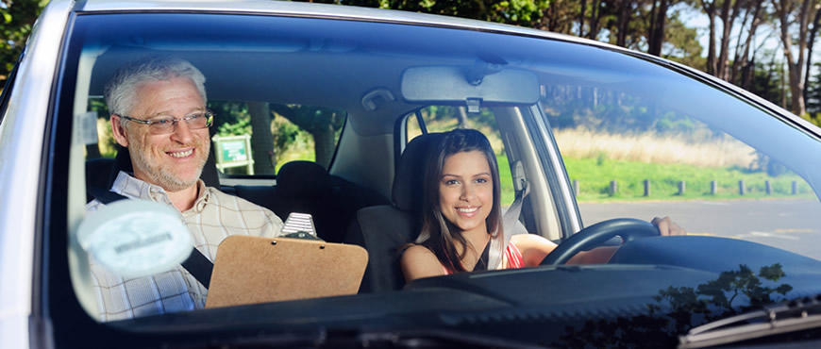
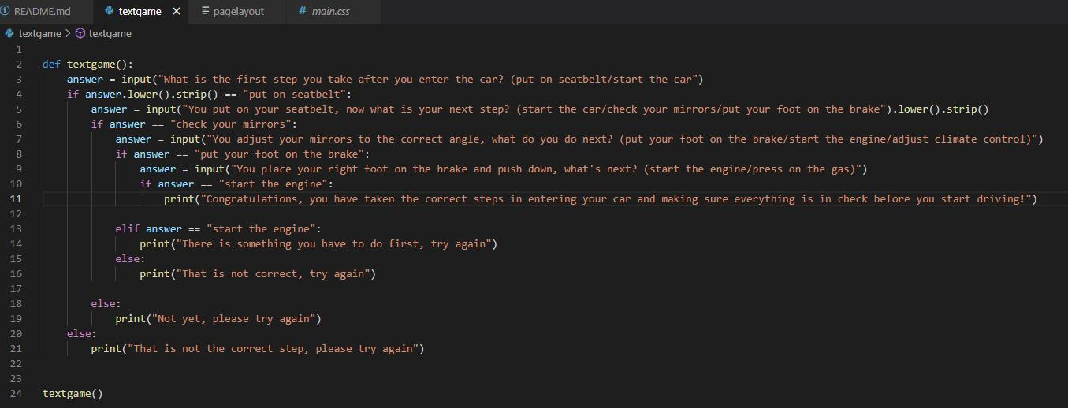
Driver’s Ed Training Program
The program should provide the basic information needed for the Driver’s Ed test and will ensure that your teenager is prepared to be on their own on the road.
By: Rylan Heisser
This program is intended to deliver experience behind the wheel, without being behind the wheel.
Link to origin of program: https://github.com/orgs/ksu-is/repositories
As shown in the code above, this program is meant to be short and simple to avoid confusion but will still provide adequate knowledge to the user.

