Slide 2
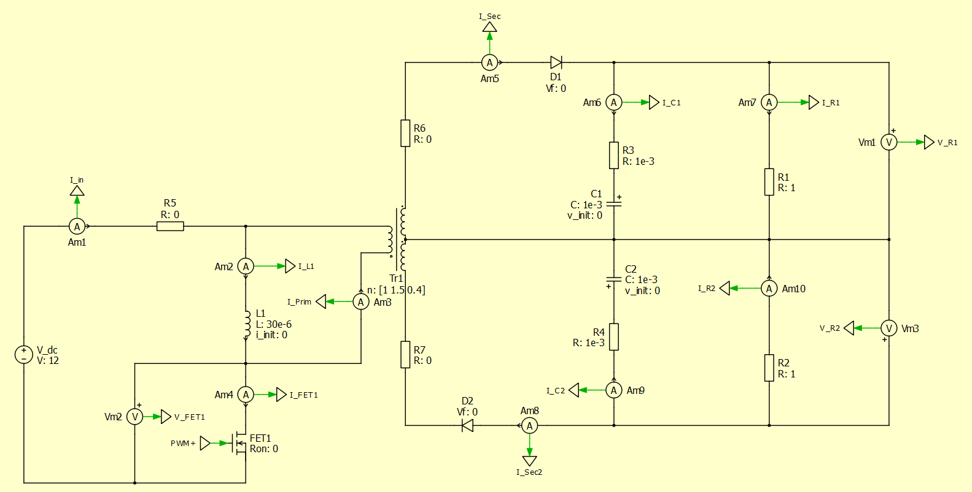
Ideal Flyback for Gate Drive VDD/VEE
Specifications
V_in = 12V
V_out = 15V/-4V

Slide 3
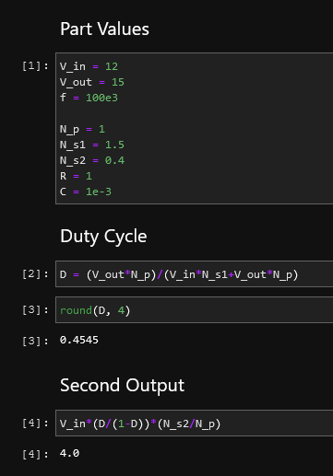
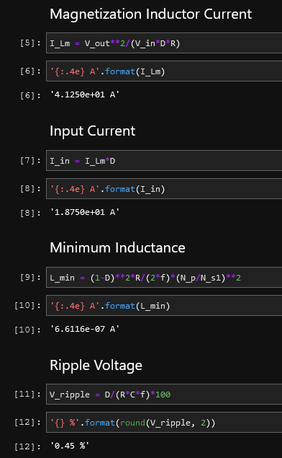
Ideal Flyback Calculations

Slide 4
Ideal Flyback Transient, D=0.4545

Slide 5
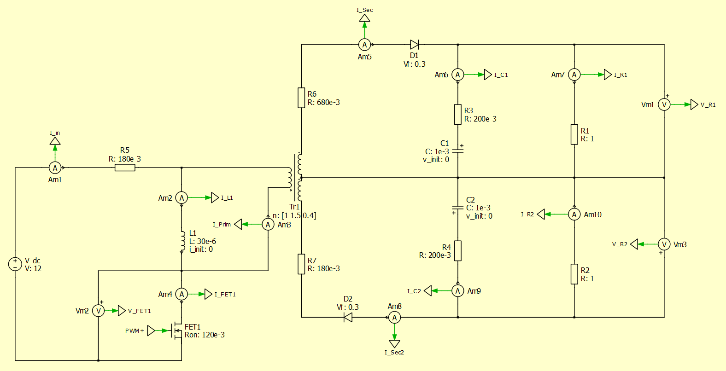
Nonideal Flyback

Slide 6
Nonideal Flyback Transient, D=0.4545

Slide 7
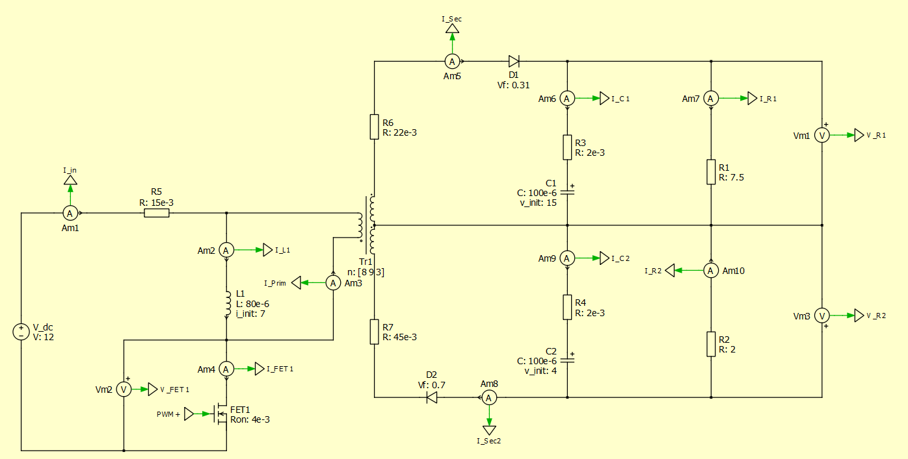
Nonideal Flyback w/ Different Turns Ratio
Losses obtained from quick look at Digikey

Slide 8
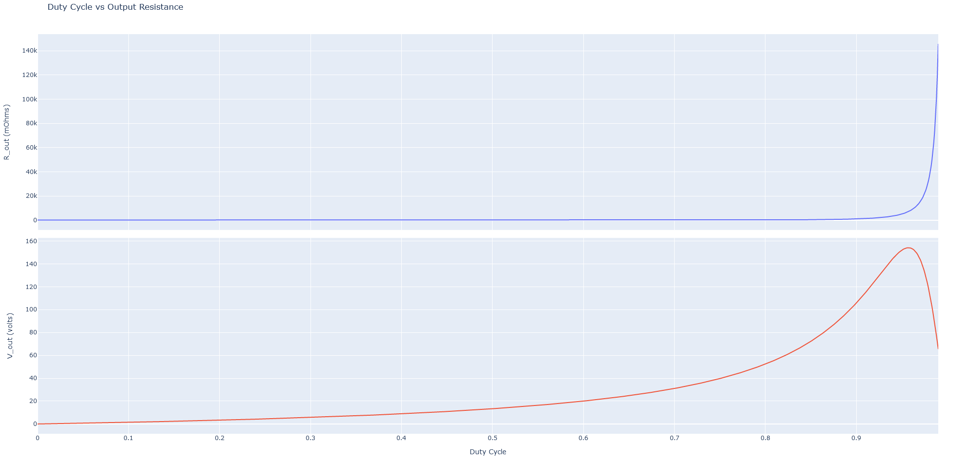
Power Loss Model

Slide 9
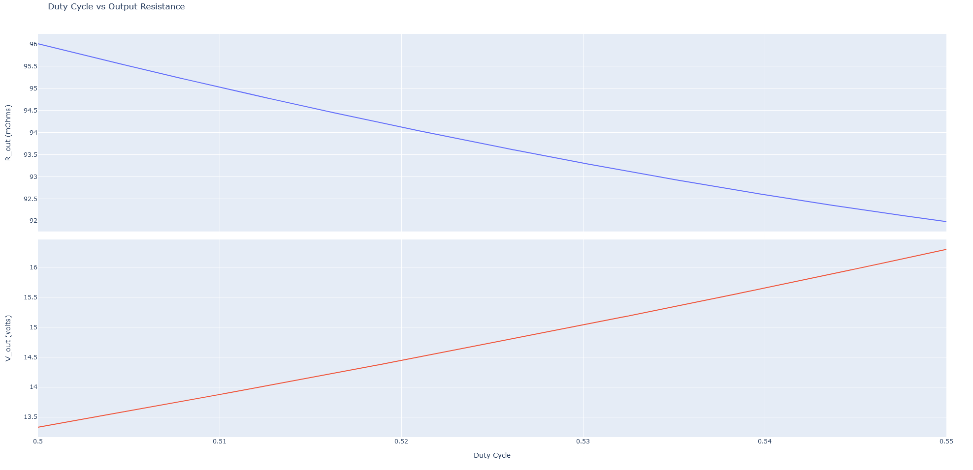
Power Loss Model

Slide 10
Nonideal Flyback Diff Turns Ratio, Transient, D=0.5355

Slide 11
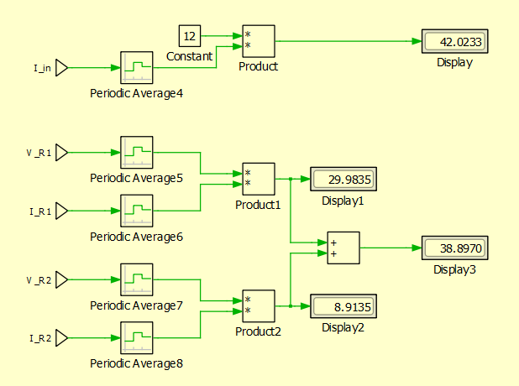
Nonideal Flyback Diff Turns Ratio, Efficiency
Efficiency = 0.926

