Slide 1


Dashboard 311 Service Requests Miami-Dade County 2019
Ravi yernena
NYCDSA

Slide 2

Dashboard for Executives and Internal Staff
Measure KPIs
Identify problem areas
Improve process efficiency
Resource Allocation-
Monitor effectiveness of IT tools/channels

Slide 3

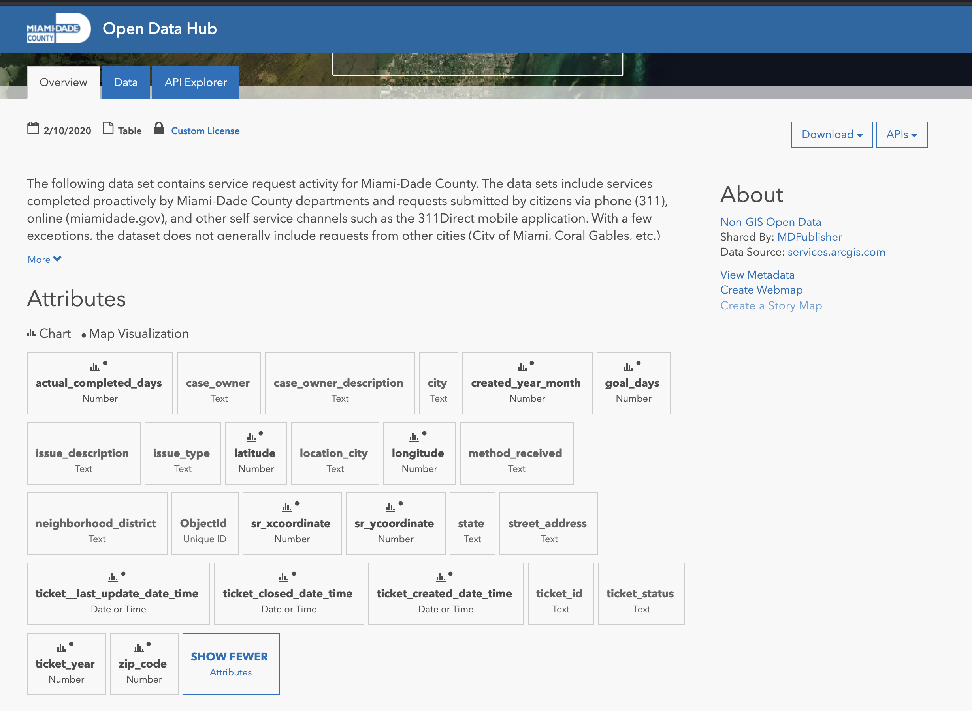
2019’s Data of 311 Service Requests (https://gis-mdc.opendata.arcgis.com/datasets/5f7d05e0fd0a4a52b1514b7d8f35ea9c_0)
Captured by multiple channels
Approximately 320,000 observations and 25 features
Reduced to top10 request types
R, Shiny, gvisCharts, Plotly and Leaflet

Slide 4

Which Department is performing well?
How many requests logged each day during 2019?
How many requests for each month and what types are they?
Counts of method of request received?
Want to see locations of these events on the map?
Want to know the count of each request type per City?
Want to explore the underlying data?

Slide 5

Top 10 Request Types
Top 5 performing Departments
Isssue Type | Total
1 BULKY TRASH REQUEST | 95384
2 GREEN WASTE CART REQUEST | 50262
3 RECYCLING BLUE CART ISSUES | 14398
4 ILLEGAL DUMPING - WM | 13253
5 GARBAGE COMPLAINT | 11101
6 MOSQUITO INSPECTION REQUEST | 10777
7 PET ACCOUNT UPDATE | 10614
8 POTHOLE | 7181
9 JUNK AND TRASH / OVERGROWTH | 6587
10 STRAY / DOG-AT-LARGE | 6462
Owner | On-time(%)
1 Citations_and_Tags | 100
2 Regulatory_and_Economic_Resources | 79
3 Solid_Waste_Management | 73
4 Enforcement_Section-3-36 | 71
5 Public_Works_Road_And_Bridges-16-60 | 14
Requests per month
Month | Count
1 Jul | 21352
2 Aug | 21279
3 May | 19928
4 Oct | 19366
5 Jun | 18964
6 Apr | 18938
7 Sep | 18063
8 Jan | 18005
9 Dec | 17745
10 Mar | 17575
11 Nov | 17109
12 Feb | 16214
Top 10 Cities
City | Count
1 Miami Dade County | 169774
2 City of Miami Gardens | 19076
3 Town of Cutler Bay | 6931
4 City of Pinecrest | 4240
5 City of Miami | 4035
6 City of Palmetto Bay | 3840
7 City of Doral | 3813
8 City of Miami Lakes | 3458
9 City of Opa-Locka | 2067
10 Village of Palmetto Bay | 1741

Slide 6

What’s next
Insights are endless and depending on the question
Can be improved by including more filtering controls to drilldown on the information.
Can be targeted for citizens by including insensitive data and different kind of measures
More interaction can be built between the map and charts.

Slide 7

?

